Slide 1



KOHLER Enterprise Intelligence Agent
Track 3: Unified Enterprise Conversational AI Agent Prototype — KOHLER‑MITWPU AI Research Lab case study. High‑impact executive summary of a permission‑aware copilot for enterprise governance.

Slide 2
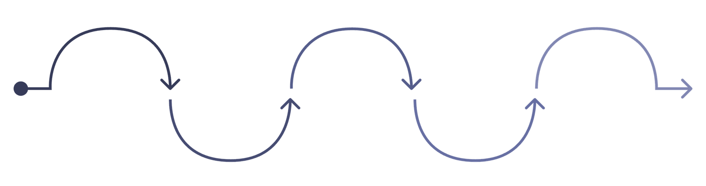
Core Approach
The KOHLER Enterprise Intelligence Agent runs every query through a 10-step governed loop, splitting work between deterministic code and the LLM:
  Detect intent & format – classify what's being asked and what output is needed (chat, JSON, Excel, email)
  Route domain – map the query to HR / Finance / Support / Privacy / Legal
  RBAC pre-filter (deterministic) – drop any policy chunk the user's role isn't cleared for, before it ever reaches a prompt
  Hybrid retrieval – pull the most relevant, temporally-active policy chunks (token-overlap + recency scoring)
  Tool execution (deterministic) – run any needed lookups (employee directory, expense audit, Excel builder)
  Conflict check (deterministic) – detect if the query touches a superseded policy version and resolve to the active one
  Synthesize answer – LLM writes the grounded response, citing only retrieved chunks
  Verify & score confidence (deterministic) – check that every number in the answer actually exists in the source text; compute a weighted confidence score
  HITL gate (deterministic) – if the action is high-risk (e.g. outbound email), pause for human approval
  Audit log (deterministic) – record the query, decision, and latency
The one-line version: deterministic code guards security, dates, numbers, and approvals — the LLM only ever reasons over text it's already been cleared to see.
Route Domain
Hybrid Retrieval
Detect Intent
RBAC Pre-filter
Tool Execution
Classify request and desired output
Map query to HR, Finance, Support, Privacy, Legal
Fetch relevant, recent policy chunks
Drop policy chunks user can't access
Run deterministic lookups and tasks

Slide 3
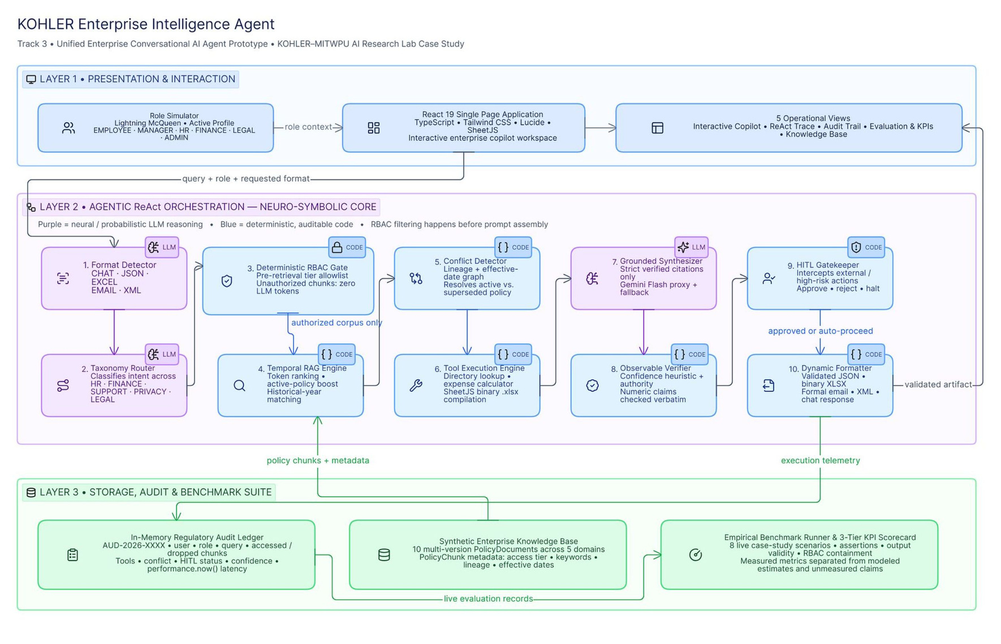
System Architecture

Slide 4
Six-tier access control, evaluated before retrieval
Role | Access Tier | Accessible | Restricted
EMPLOYEE | Standard Associate | Standard HR, travel, warranty terms | Executive severance, entertainment caps, legal logs
MANAGER | Dept. Manager | + team approval thresholds, budgets | Executive compensation, CPO assessments
HR | HR Specialist | Full HR repository, severance formulas | Finance exception caps, legal records
FINANCE | Finance Auditor | Full travel/procurement, entertainment caps | HR health records, litigation files
LEGAL | Legal & Compliance | DPAs, whistleblower hotlines, risk | Unmasked compensation matrices
ADMIN | Enterprise Superuser | Full access — all 5 domains | None
FUNCTIONALITY

Slide 5
INNOVATION
The system is a hybrid neuro-symbolic agent (often called an Agentic RAG system with a deterministic governance layer).
Capability | Pure LLM / Naive RAG | Pure Expert System | This Hybrid Agent
Facts & grounding | Model weights — high hallucination risk | Hardcoded rules — brittle, rigid | RAG: retrieved from authoritative chunks
Access control (RBAC) | Prompt instructions only | Deterministic permission matrix | Deterministic — evaluated before retrieval
Supersession / conflicts | May blend 2024 and 2026 numbers | Explicit version graph | Deterministic metadata graph
Language & synthesis | Fluent, creative, flexible | Cannot handle unscripted language | LLM: cross-domain synthesis and drafts
Deterministic code guards the enterprise perimeter (security, dates, numbers, audit). The LLM provides fluent reasoning over grounded text. Neither side does the other's job.

Slide 6
TECHNICAL MOAT
Rather than presenting an ungrounded LLM probability percentage, the system computes an observable composite score:
  (Retrieval Relevance): Percentage relevance of top retrieved chunks.
  (Authority Level): Document authority tier (Board = 100%, Corporate/Legal = 90%, Departmental = 75%).
  (Temporal Validity): Freshness relative to effective date and active status.
  (Conflict Freedom): 100% if no unresolved supersession conflicts exist, 70% if resolved.
  (Claim Grounding): Verification pass rate of extracted numerical clauses.
Users can click the Confidence badge in the UI to inspect the exact mathematical contributions of each factor.

Slide 7


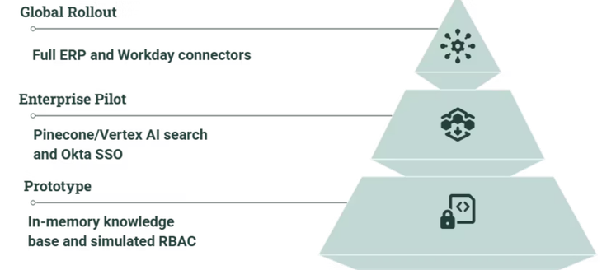

Business Impact & Production Roadmap
1
2
Decision Velocity
Audit & Compliance
Replaces 1.5–2 hours of manual policy hunting with sub‑second verified answers.
Eliminates reliance on superseded policies and provides centralized audit logs of automated lookups.
3
Workflow Automation
Auto‑generates audit spreadsheets and procurement emails to reduce manager friction.
The KOHLER agent pairs foundation models with deterministic security, temporal reasoning, and human‑in‑the‑loop governance for a production‑ready enterprise AI.
Takeaway: A mature vision for enterprise AI — deterministic access, temporal policy reasoning, and artifact synthesis enable secure, auditable, high‑value automation.

