Slide 1
OOPS | SYCSE Mini Project
class Student {
private:
string name;
int rollNo;
public:
string getName();
void setName(string);
};
// auto-generated
UML Class Diagram
Code Generator
in C++
Mahek Shukla • Rohan Upadhye • Chirayu Agrawal • Yatharth Agrawal
Roll No: 7, 10, 12, 20 resp.
Github Repository : https://github.com/Mahek-Technophile/OOP-Class-Diagram-to-CPP-file-converter-.git

Slide 2
What Are We Building?
INPUT
OUTPUT
CLASS Student
ATTR private string name
ATTR private int rollNo
METHOD public string getName()
METHOD public void setName(string)
END
class Student {
private:
string name;
int rollNo;
public:
string getName();
void setName(string);
};
→
Generator
diagram.txt
Student.h (auto-generated)

Slide 3
System Architecture
1
2
3
4
Input Parser
UML Model Classes
Code Generator
File Writer
›
›
›
Reads diagram.txt
line by line
UMLAttribute
UMLMethod
UMLClass
Abstract base class
CPPCodeGenerator
Writes compilable
.h files to output/

Slide 4
UML Model Classes — The OOP Backbone
UMLAttribute
UMLMethod
UMLClass
Fields / Methods:
Fields / Methods:
Fields / Methods:
string access
string type
string name
string access
string returnType
string name
vector<string> params
string className
vector<UMLAttribute> attrs
vector<UMLMethod> methods
void addAttribute()
void addMethod()
e.g. "private string name"
e.g. "public void setName(string)"
Main container — most important!

Slide 5
OOP Pillars Applied
Constructors
File Operations
UMLAttribute, UMLMethod & UMLClass each define a constructor
Takes access, type/returnType & name as parameters
Uses this-> to assign values to member variables
Called automatically when an object is instantiated
CPPCodeGenerator opens an ofstream to output/<ClassName>.h
Checks is_open() before writing to catch missing folders
Writes class skeleton — private fields then public members
Closes the stream with outFile.close() after generation
Operator Overloading
Function Overloading
operator+ defined twice inside UMLClass
Right-hand type (UMLAttribute vs UMLMethod) decides the branch
Returns *this so calls can be chained with =
Example: cls = cls + UMLAttribute(...) / cls + UMLMethod(...)
operator+ is overloaded twice-once taking a UMLAttribute, once taking a UMLMethod
The Compiler distinguishes between the two purely by the type of right hand operand.
Both versions return *this, allowing the result to be assigned or chained

Slide 6
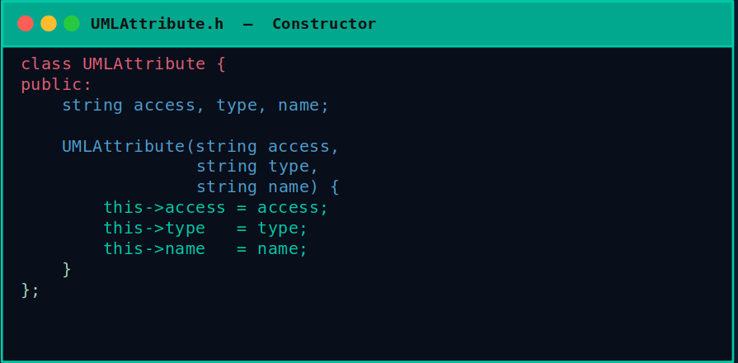
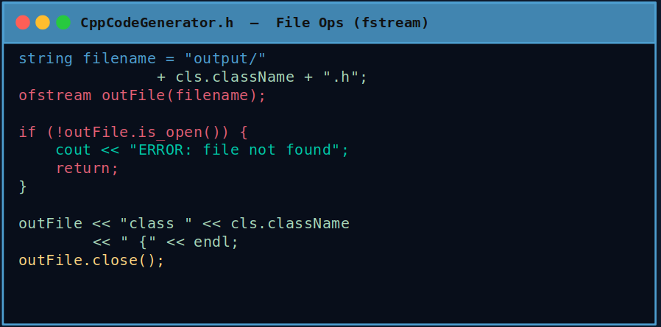
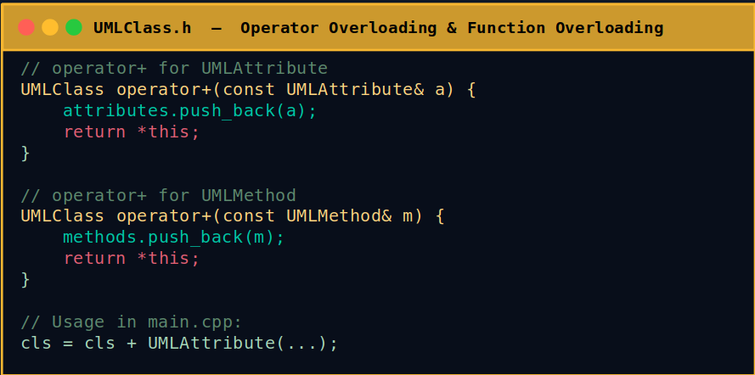
Code in Action

Slide 7
Step 3 — The Input Parser
How it works:
UMLParser.cpp (pseudocode)
open file("diagram.txt");
while (getline(file, line)) {
if line starts "CLASS"
→ new UMLClass(name)
if line starts "ATTR"
→ new UMLAttribute(...)
if line starts "METHOD"
→ new UMLMethod(...)
if line == "END"
→ save class to vector
}
return vector<UMLClass>;
1
Open file
ifstream reads diagram.txt
2
Read line by line
getline() processes each row
3
Parse keyword
Detects "CLASS", "ATTR", "METHOD", "END"
4
Build objects
Creates UMLClass / UMLAttribute / UMLMethod
5
Store in vector
vector<UMLClass> holds all classes

Slide 8
Step 4 — The Code Generator
CodeGenerator (abstract base)
↓ inherits
CPPCodeGenerator
→ Future: JavaCodeGenerator | PythonCodeGenerator
What CPPCodeGenerator writes:
write: "class Student {" → write private attributes
write: "public:" → write public methods
write: "};" → close and save as Student.h

Slide 9
Project File Structure
/UML-Code-Generator
Key Files Explained
├── main.cpp
├── UMLParser.h
├── UMLParser.cpp
├── UMLClass.h
│ ├── Attribute.h
│ └── Method.h
├── CodeGenerator.h
├── CPPCodeGenerator.cpp
├── diagram.txt
└── output/
└── Student.h
main.cpp
Entry point — wires parser + generator together
UMLParser.cpp
Reads diagram.txt, builds UMLClass objects
UMLClass.h
Main container with attribute & method vectors
CodeGenerator.h
Abstract base enabling polymorphism
CPPCodeGenerator.cpp
Implements generate() → writes .h files
diagram.txt
Your UML input text file

Slide 10
Demo Output — What It Produces
diagram.txt (INPUT)
Student.h (OUTPUT)
CLASS Student
ATTR private string name
ATTR private int rollNo
ATTR private float marks
METHOD public string getName()
METHOD public void setName(string)
METHOD public int getRollNo()
END
#ifndef STUDENT_H
#define STUDENT_H
#include <string>
using namespace std;
class Student {
private:
string name;
int rollNo;
float marks;
public:
string getName();
void setName(string);
int getRollNo();
};
#endif
→

Slide 11
The Team
Mahek Shukla
Rohan Upadhye
07
10
PRN: 1262241984
PRN: 1262241998
SYCSE | OOPS Mini Project
SYCSE | OOPS Mini Project
Chirayu Agrawal
Yatharth Agrawal
12
20
PRN: 1262242010
PRN: 1262242058
SYCSE | OOPS Mini Project
SYCSE | OOPS Mini Project

