Slide 1
Student Learning Activity and Course Relationship Tracker
Graduate NoSQL Database Project • October 2026
Neo4j • Python • Flask • HTML/CSS/JavaScript
Mahek Patel | Yashvi Patel | Rishikesh Pathak
1

Slide 2
Project Introduction
Purpose
Track students, courses, enrollments, and completed learning activities.
Core idea
Use a graph database to represent how learning entities are connected.
Outcome
A working web application for managing and exploring learning records.
2

Slide 3
Problem Statement & Objectives
Problem
Student and course information is often stored separately, making relationships harder to explore.
Objective 1
Manage student profiles, courses, and enrollment records.
Objective 2
Record learning activities and view individual learning history.
Objective 3
Use Neo4j relationships to retrieve connected information efficiently.
3

Slide 4
Technology Stack
Database — Neo4j
Stores Student, Course, and LearningActivity nodes and their relationships.
Backend — Python + Flask
Handles routes, form validation, and Neo4j database queries.
Frontend — HTML, CSS, JavaScript
Provides dashboards, forms, tables, and interactive controls.
Query Language — Cypher
Creates, matches, updates, and deletes graph data.
4

Slide 5
Why Neo4j?
Relationship-focused model
Enrollment and activity connections are first-class graph relationships.
Readable queries
Cypher expresses paths such as Student → Course and Student → Activity.
Flexible exploration
Traverse connected records without manually combining many tables.
5

Slide 6
Graph Database Design
Three node labels and three relationship types
Student
Course
LearningActivity
student_id, name, email
course_id, course_name, credits
activity_id, title, type, date, duration, description
Student ── ENROLLED_IN ──> Course
Student ── COMPLETED ──> LearningActivity
LearningActivity ── FOR_COURSE ──> Course
6

Slide 7
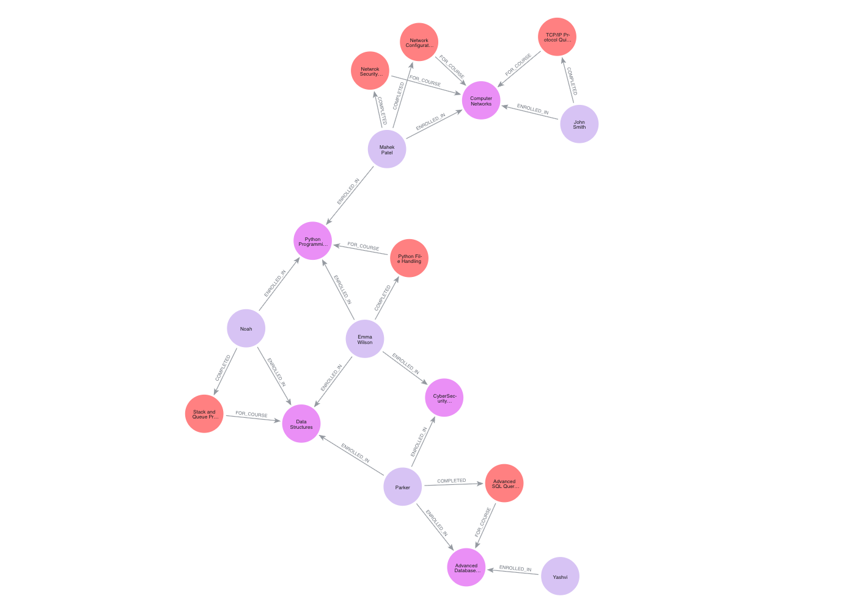
Neo4j Graph: Complete Database
Actual project database • 17 nodes • 24 relationships
6 Students
5 Courses
6 Learning Activities
12 ENROLLED_IN
6 COMPLETED
6 FOR_COURSE
7

Slide 8
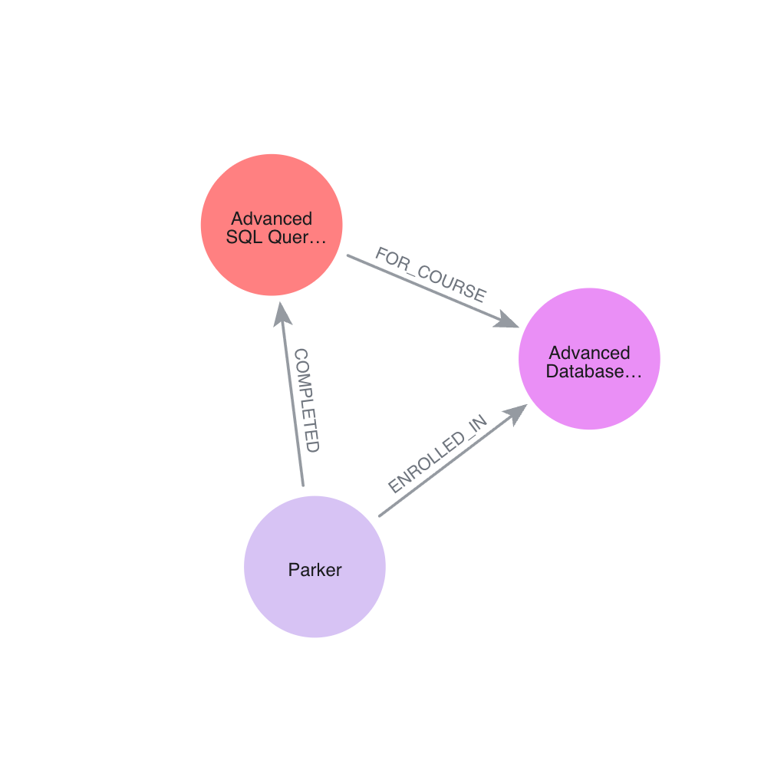
Neo4j Graph: Relationship Example
A real connected record from the project database
Parker → enrolled in → Advanced Database Systems
Parker → completed → Advanced SQL Query Practice
Activity → for course → Advanced Database Systems
8

Slide 9
System Features
Student & course management
Add, view, edit, and delete records with validation.
Enrollment management
Connect students to courses; restrict activities to enrolled courses.
Learning activity management
Track activity type, date, duration, description, and course.
Dashboard & learning history
View counts, completed activities, total minutes, and course history.
9

Slide 10
Cypher Operations & Integration
Flask uses the Neo4j Python driver to execute parameterized Cypher queries
CREATE / MERGE Add graph records and relationships
MATCH Retrieve connected nodes
SET Update node properties
DELETE / DETACH DELETE Remove relationships or records
COUNT Summarize dashboard statistics
Example: MATCH (s:Student)-[:ENROLLED_IN]->(c:Course) RETURN s, c
10

Slide 11
Validation & Testing
Input validation
Reject blank required fields, invalid names/emails, and nonpositive durations or credits.
Duplicate prevention
Check student IDs, course IDs, and student email uniqueness.
Relationship validation
Only allow a learning activity for a course in which its student is enrolled.
Functional testing
Verify CRUD flows, graph links, learning history, and dashboard counts.
11

Slide 12
Live Demonstration & Conclusion
Demonstrate the working Flask application alongside Neo4j
1. Open the dashboard and show student/course/activity totals.
2. View enrollments and add a learning activity.
3. Show student learning history.
4. Run a Cypher query to visualize linked nodes.
5. Highlight input validation and relationship checks.
Conclusion: Neo4j provides a clear model for tracking connected student learning records.
GitHub: github.com/Mahek1101/Student-Learning-Activity-Tracker
12

