Slide 1
California State University, Northridge Lemonade Inventory Management System
Presented By:
Umar Nasir
Rigoberto Juarez
Jasnoor Chawla
Mahek Donga

Slide 2
Contents
Introduction
Motivation
System and Process Overview
Results
Conclusion
Future Work

Slide 3
Introduction
Purpose:
Produce a working inventory and order management system for mid-sized retailer
Have multi-faceted systems that connect to each other
Save order and customer records
Provide efficient and fast search/lookup functionality
Scope:
MVC Model
Database integration
Java and GUI using Swing

Slide 4
Why this project?
New Frameworks and Tech
Swing (and ActionListeners)
mySQL databases via phpMyAdmin and mySQL Workbench
SQL code and syntax
The Familiar
Java and OOP
Lots of classes ---> Imports and Packages
Attainability and Practicality
Usefulness as a tool
Scope vs. Timeframe

Slide 5
An Overview on Swing
Implements component sets to build GUIs (JTextField, JButton,etc.)
Written in/for Java → Platform Dependent
Makes heavy use of MVC Design Pattern
ActionListener objects used for button clicks

Slide 6
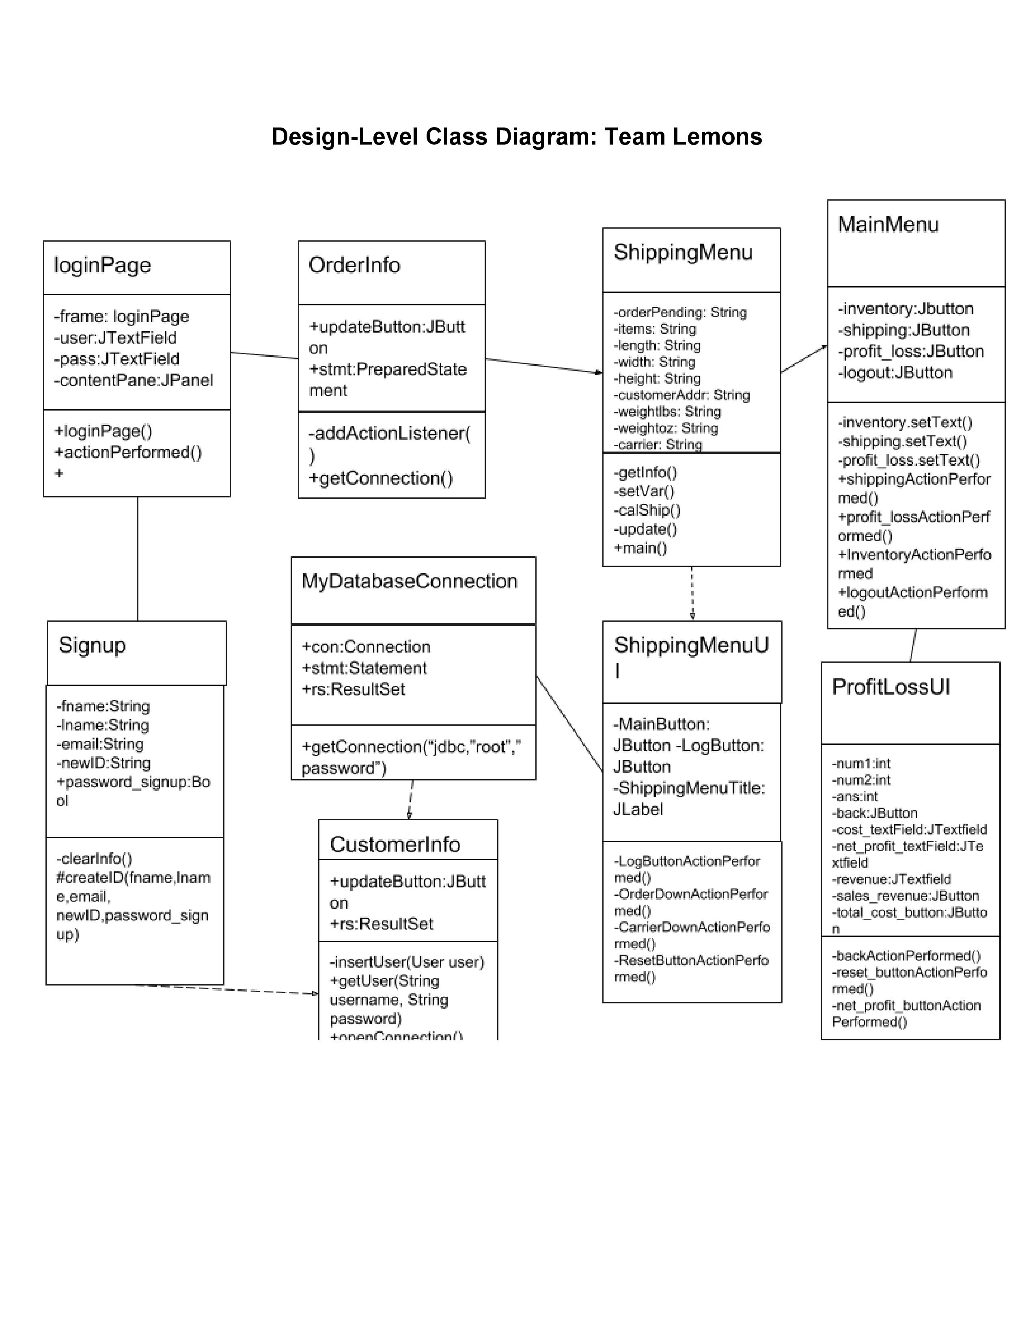

Slide 7
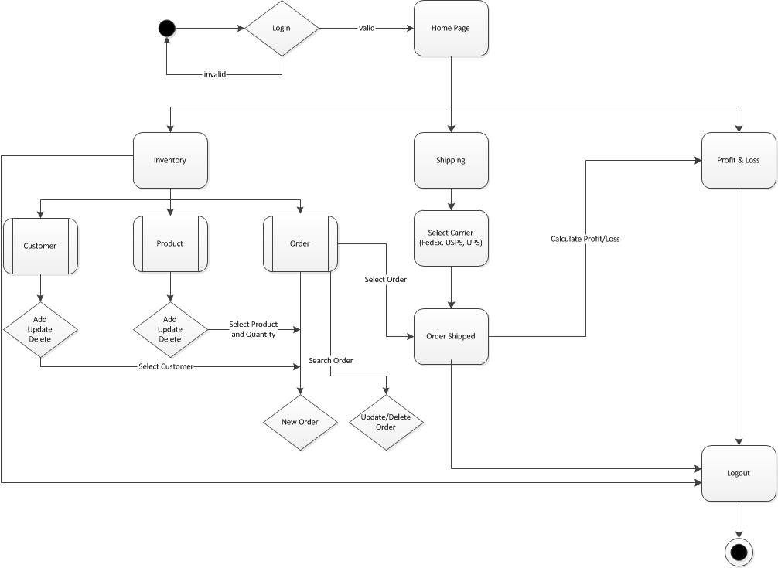
Process Overview
System layout
Language-java
Database-Mysql
Connector-JDBC
Process Flow

Slide 8
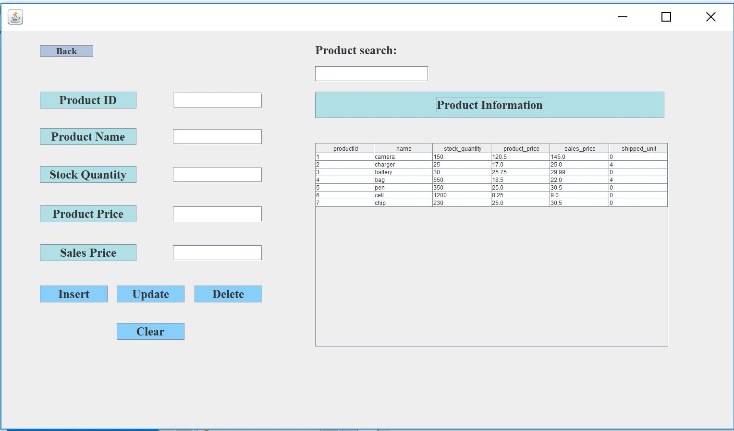
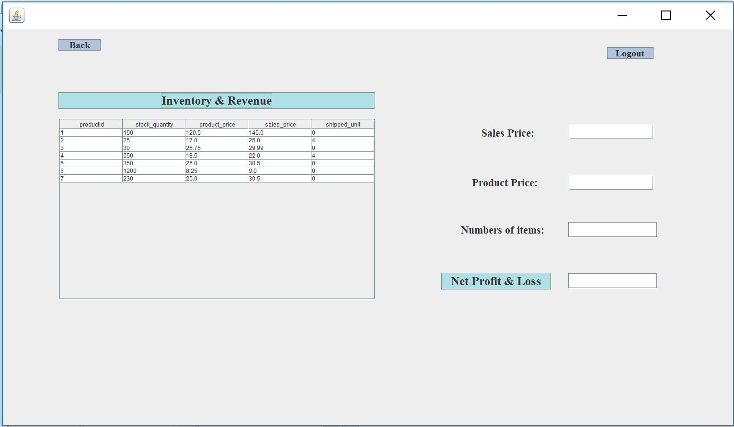
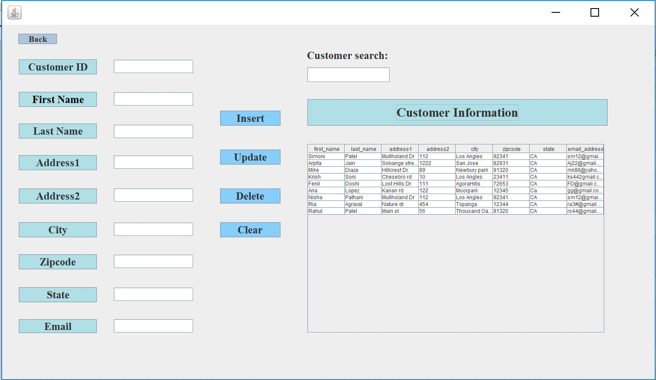
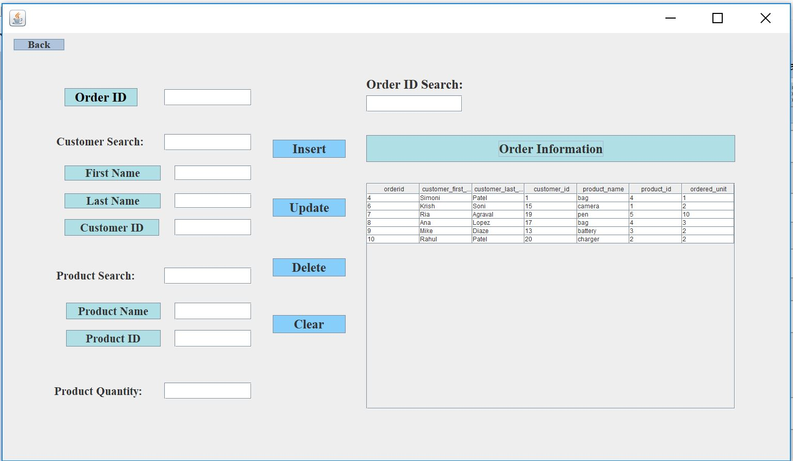
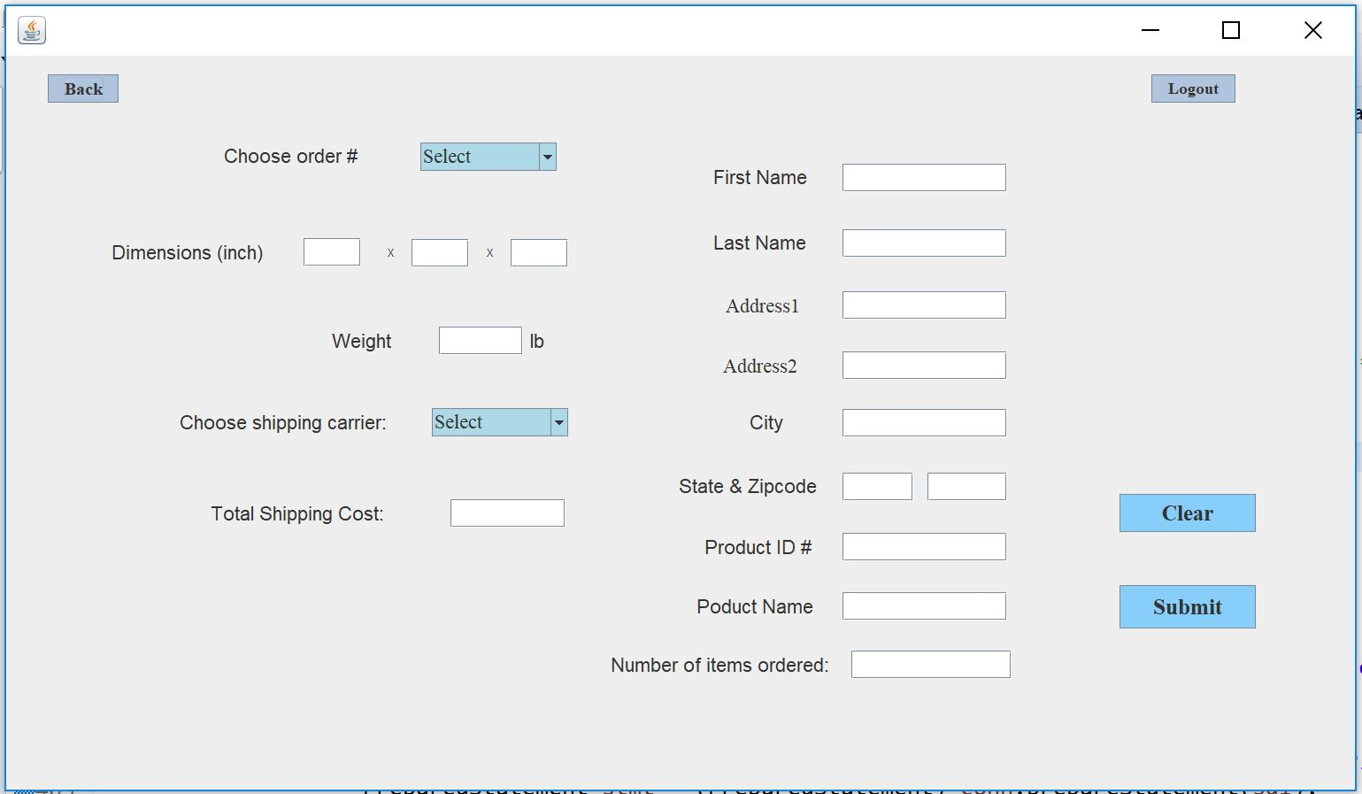
Process Overview
Three Modules
Inventory
Customer Information
Product Information
Order Information
Shipping
Profit & Loss

Slide 9
Result
Original Purpose: “Produce a working inventory and order management system”
Intended Functionalities:
Inventory for the products
A repository of customers
A display of the company’s total expenditures and profit
The ability to generate an order and apply different shipping values/ costs to it
Missing
Browser feature

Slide 10
Experience
Difficult to come up with the best data structure for database system
Attempted
AVL trees
Linked list
Importing and exporting data from Excel
Final Choice
MySQLWorkbench

Slide 11
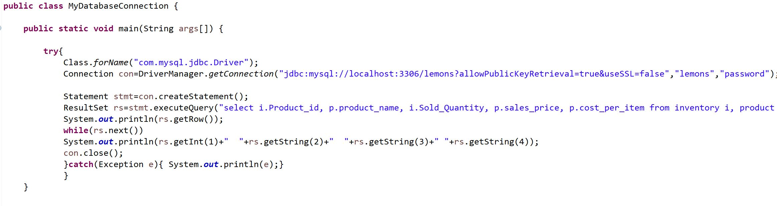

Slide 12
Conclusion
Lemonade helps small to mid sized relators…
Control
Manage
Protect
Runs on java
Quality ensured
Lemonade allows system to system communication

Slide 13
Future Work
Update layout
Do not allow to delete an order, if it is shipped already
Create web based system
Lemonade will support new outputs and hardware

Slide 14
Thank You!
Questions?

