Slide 1

E-COMMERCE
ANALYSIS AND PREDICTION

Slide 2
Problem statement:
Objective: Analyze customer churn patterns and segment the customer base to inform targeted marketing and retention strategies.
Tasks:
Customer Churn Analysis:
Identify factors contributing to customer churn using customer demographics, order history, complaints, and coupon usage data.
Customer Segmentation:
Segment the customer base based on relevant features such as purchase behavior, demographics, and engagement metrics.
Provide insights into the characteristics and behaviors of each segment.
Outcome:
Develop targeted marketing and retention strategies tailored to each customer segment to reduce churn and enhance customer loyalty.

Slide 3
GOAL:
Identify customer churn patterns:
• Perform exploratory data analysis to understand the relationships between customer
demographics, purchase behavior, and churn.
• Apply clustering techniques to segment the customer base into distinct groups.
• Consider features such as purchase frequency, purchase amount, and customer demographics
for segmentation.
• Analyze the characteristics of each segment and provide descriptive insights about their
behavior.
Predictive Modeling:
• Build a predictive model to forecast customer churn using machine learning algorithms (e.g.,
logistic regression, random forest, or gradient boosting).
• Evaluate the model's performance using appropriate metrics.
Implementation Plan:
• Based on the insights from customer churn and segmentation analyses, propose customer
retention strategies tailored to each segment.
• Develop an implementation plan for the suggested retention strategies, including a timeline and
key performance indicators to measure their success.

Slide 4
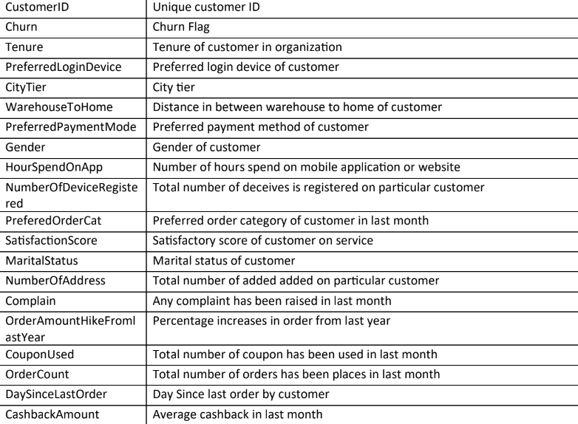
Data summarization:

Slide 5
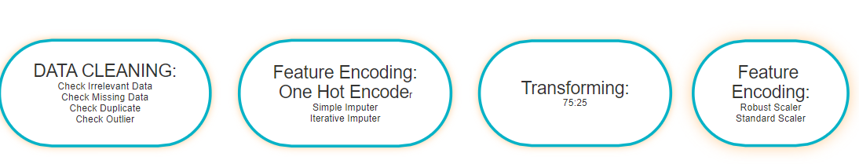

DATA PREPROCESSING STEPS:

Slide 6
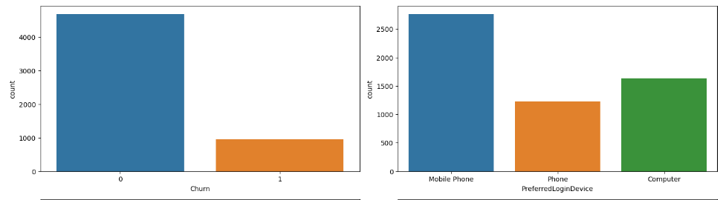
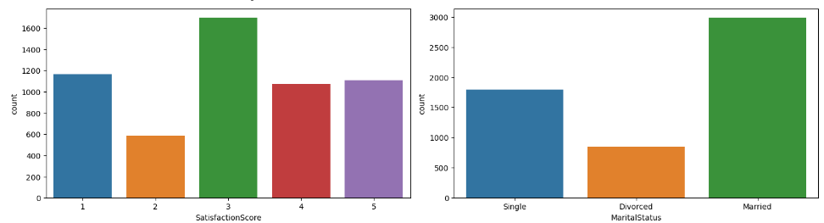
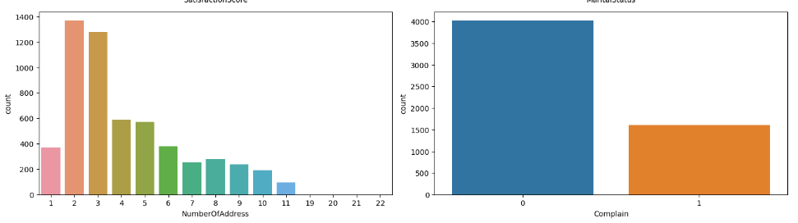
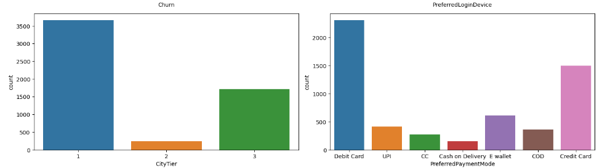
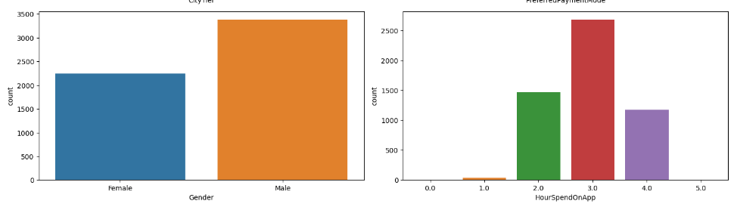
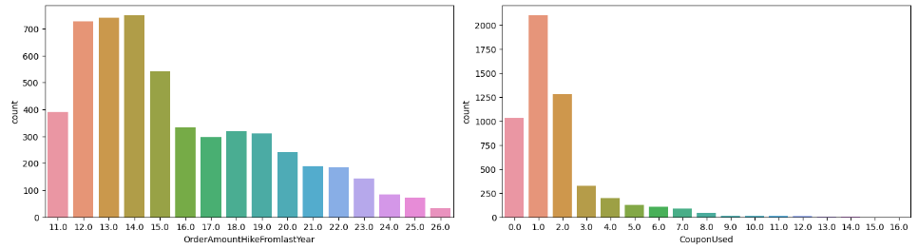
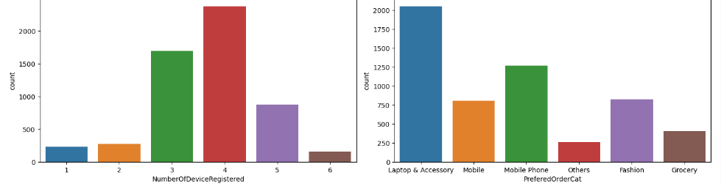
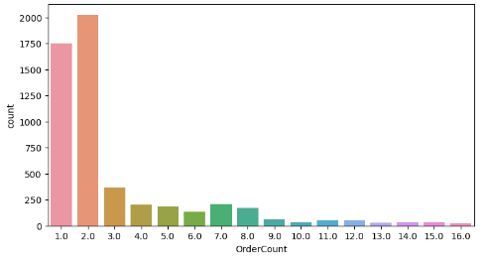

Slide 7
Feature analysis of numeric data:
Tenure: Customers with longer tenure are less likely to churn. A longer tenure indicates customer satisfaction and loyalty, suggesting these customers are happy with the services and thus stay longer.
CityTier: Churn rates are similar across different city tiers. City tier doesn't significantly impact churn, implying that customers from various city tiers have comparable satisfaction levels.
WarehouseToHome: Shorter distances between warehouse and home correlate with lower churn. Faster delivery times improve customer satisfaction, making them more likely to continue using the service.
HourSpendOnApp: More time spent on the app correlates with lower churn. Higher app engagement indicates that customers find value in the app, leading to increased retention.
NumberOfDeviceregistered: Customers with more registered devices are less likely to churn. Acess to the service across multiple devices increases convenience and satisfaction, reducing the likelihood of churn.
SatisfactionScore: Higher satisfaction leads to lower churn
NumberOfAddress: Customers with multiple addresses indicate higher engagement and loyalty to the service.
Complain: If there are more complaints, the churn rate increases, They are negative impact on customer satisfaction.
OrderAmountHikeFromLastYear: Customers who spent more in the past are valuable and likely to stay, highlighting the importance of retaining high-value customers.
CouponUsed: Coupons enhance loyalty by providing additional value, making customers more likely to continue using the service.
OrderCount: Higher order counts are associated with lower churn. Frequent usage builds loyalty and habit.
DaySinceLastOrder: Recency is a good predictor of churn; customers who haven't ordered recently are more likely to leave.

Slide 8
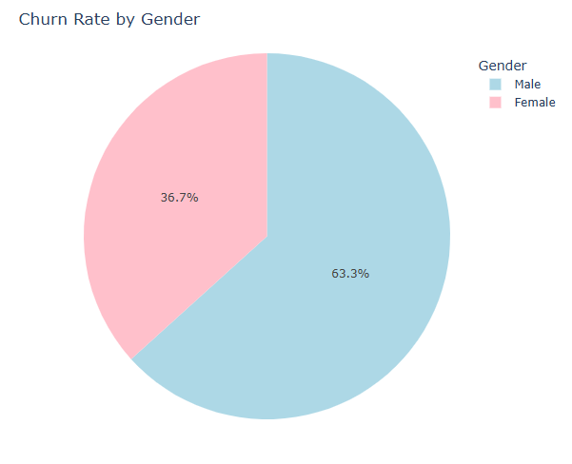
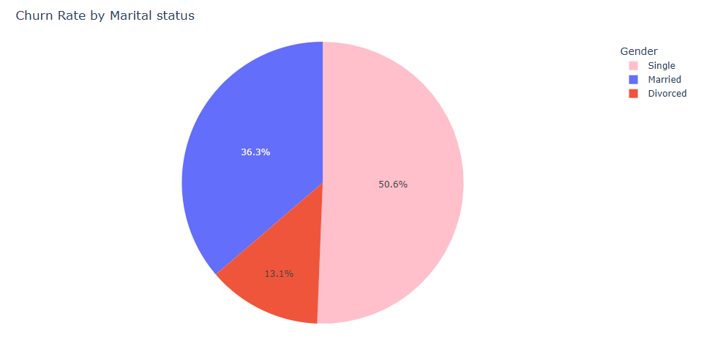
Feature analysis for categorical data: Gender: Marital Status:
SINGLE PEOPLE ARE MORE LIKELY TO CHURN AS COMPARED TO MARRIED, WITH DIVORCED PEOPLE LEAST LIKELY TO CHURN
IT IS EVIDENT THAT MALE ARE MORE LIKELY TO CHURN AS COMPARED TO FEMALE

Slide 9
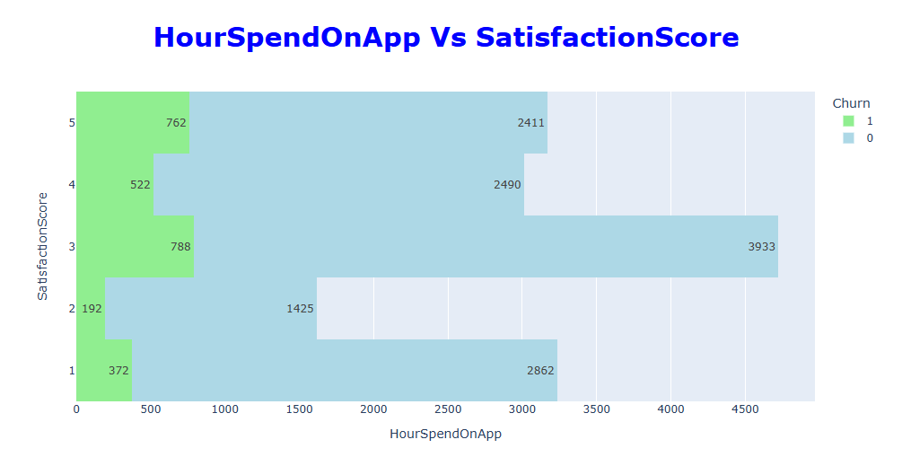
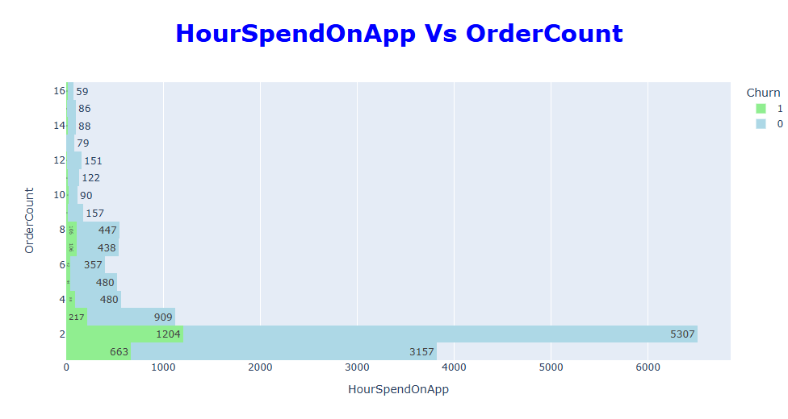
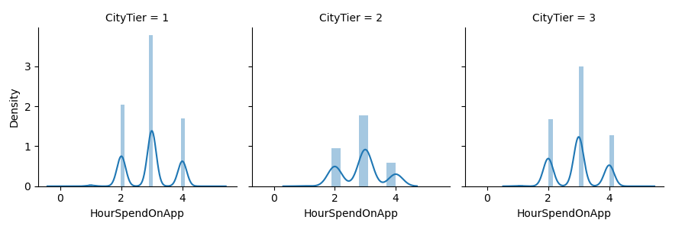

Slide 10
GIST OF OVERVIEW OF DIFFERENT FEATURES:
The average churn rate among e-commerce customers is approximately 16.84%. This indicates that out of all customers, around 16.84% discontinue their usage over a given period.
A significant majority, about 71% of customers, prefer using their mobile devices to log into the e-commerce platform. This highlights the importance of optimizing the mobile user experience.
Approximately 71.5% of customers have not lodged any complaints. However, those who do file complaints have a significantly higher churn rate, around 31.7%. This suggests that complaints are a strong indicator of customer dissatisfaction leading to churn.
Customers from City Tiers 1 and 2 show no preference for using E-wallets as a payment method. This could be due to a lack of trust or availability of other preferred payment options in these areas.
Gender-specific preferences indicate that the most popular order category for males is MOBILE PHONES, whereas females show a preference for LAPTOPS & ACCESSORIES. Additionally, customers who primarily order groceries exhibit the lowest churn rate when compared to other categories.
Paradoxically, customers who award a satisfaction score of 5 out of 5 tend to have the highest churn rate relative to other satisfaction scores. This counterintuitive finding suggests that even highly satisfied customers might leave the platform, possibly due to unmet expectations beyond the shopping experience.
In churn prediction models, TENURE emerges as the most critical feature according to the Decision Tree Classifier. This signifies that the length of time a customer has been with the company is a strong predictor of whether they will continue using the service or not.

Slide 11
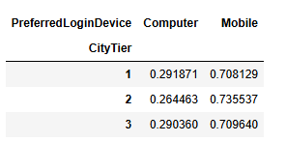
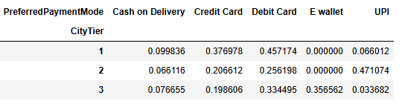
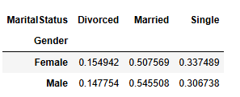
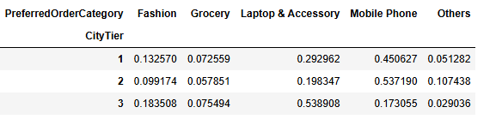
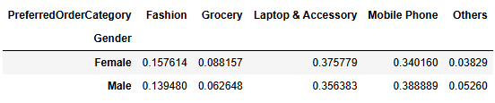
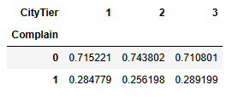
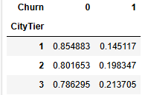
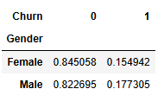
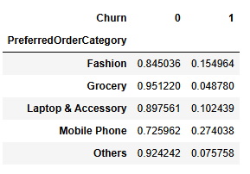
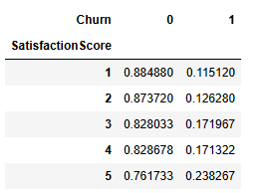
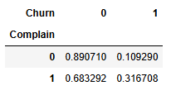
MULTIVARIATE ANALYSIS:

Slide 12
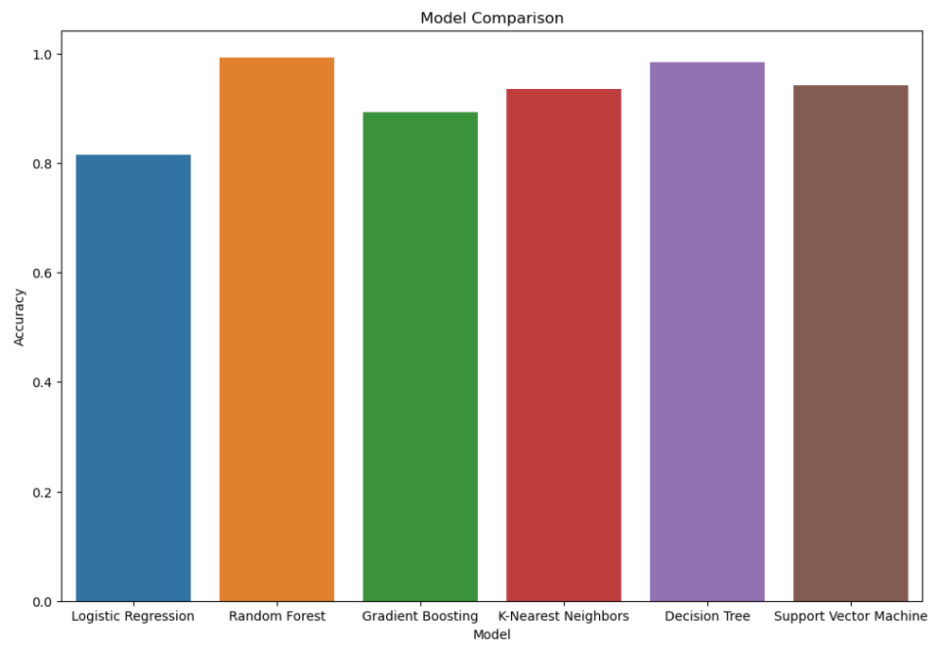
MODEL ACCURACY COMPARISION:

Slide 13
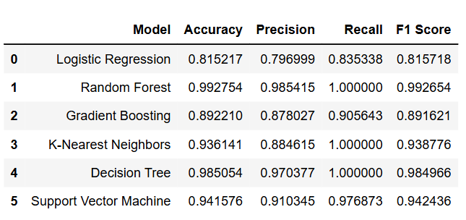

Slide 14
PREDICTION ANALYSIS:
From the analysis it is evident that Random forest performs the best, followed by Decision Trees.
RANDOM FOREST:
Random Forest is an ensemble learning technique that leverages a group of decision trees to generate predictions. This algorithm is a type of supervised learning method. In our project, the Random Forest Classifier emerged as the most effective model. The following steps outline the functioning of the Random Forest Classifier:
Model Creation and Training: Initially, the model is created and trained using the provided training data. The Random Forest Classifier then builds multiple decision trees, each constructed from a different random subset of the training data, which includes both samples and features.
Prediction Voting: Once all decision trees are constructed, the model uses a majority voting mechanism to combine their individual predictions and produce a final, collective prediction.
Additionally, this model does not require hyper-parameter tuning in this instance, as it already demonstrates excellent performance with accuracy, recall, and precision all ranging between 98% and 100%.

Slide 15
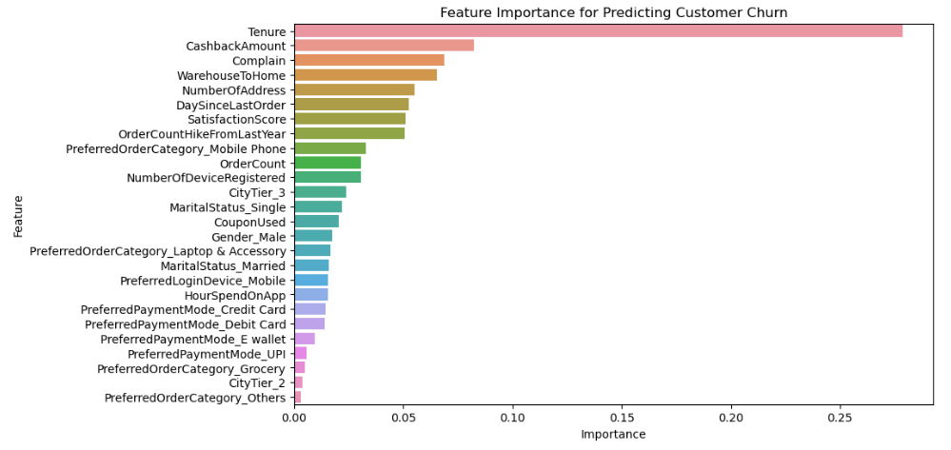
Feature Importance:

Slide 16
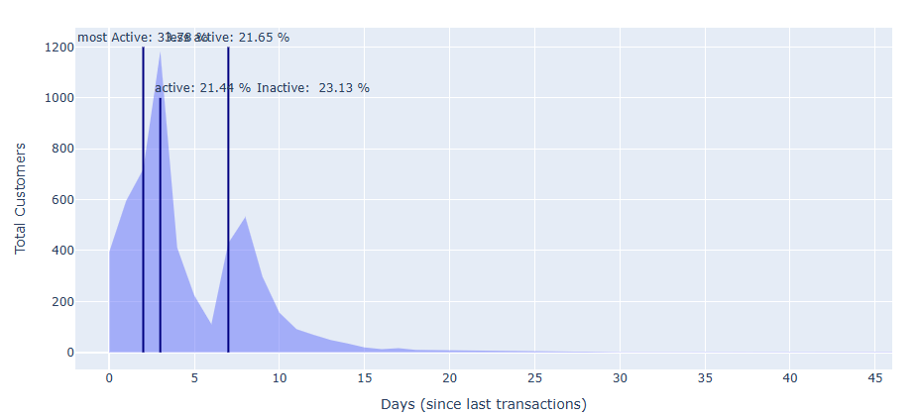
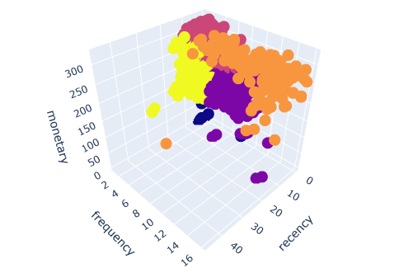
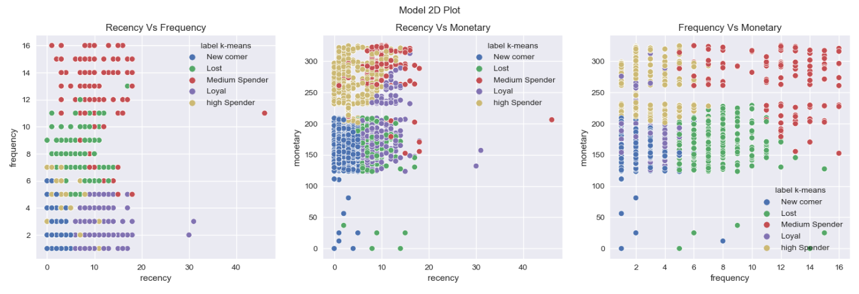

Slide 17
Recommendations to improve the retention:
Reward System: Provide points for every transaction that can be redeemed for gifts, coupons, or special offers to incentivize continuous transactions. Eg: Coupons and Cashback on certain amount of purchase or reaching certain numbr of visits on app.
Promotional Offers: Offer discounts or cashbacks strategically to retain customers, analyzing the impact on business.
User Segmentation: Segment users based on gender, tenure, etc., to provide targeted ads and promotions, rewarding milestones.
Enhanced Initial Services: Focus on the crucial initial two months by offering additional services like excellent UX, first purchase rewards, or exclusive discounts.
Enhanced Customer Support: Offer comprehensive support via various channels like phone, text, video tutorials, in-app service, or blogs to prevent customer churn.
Competitor Analysis: Continuously analyze competitors to identify areas for service improvement.
Feedback Monitoring: Pay attention to both positive and negative feedback from customers. Eg: Analyzing using NLP
Mobile Promotions: Utilize mobile promotions as most customers engage via mobile, reducing churn.
Community Building: Build a community, especially for mobile phone buyers, on social media to foster connections, encourage testimonials, share updates, and reduce customer isolation. Membership can be a part of this community-building efforts. Eg: Instagram Groups, WhatsApp communities
Exclusive Memberships: Establish tiered memberships like silver, gold, platinum to reward loyal customers with points and exclusive privileges. Eg: Myntra, Zomato

Slide 18


