Slide 1
CLEARVIEW
P2P Invoice Reconciliation
Intelligent AI-Powered Procure-to-Pay Automation
Multi-Modal AI
RAG Architecture
Neo4j Graph
LangChain Agents
FastAPI + React
Demo Presentation │ Internal Architecture Walkthrough

Slide 2
Problem Statement
Invoice processing in many organizations is slow and manual, with data coming from different formats and systems. Matching invoices with purchase orders and receipts often leads to errors, delays, and extra work. There is also limited visibility and tracking, making it hard to manage payments and audits efficiently.
Project Objectives
Create a simple, automated system that collects invoices from all sources and processes them in one place. Use intelligent automation to match, validate, and approve invoices with minimal manual effort. Provide clear tracking, faster processing, and better visibility for teams.

Slide 3
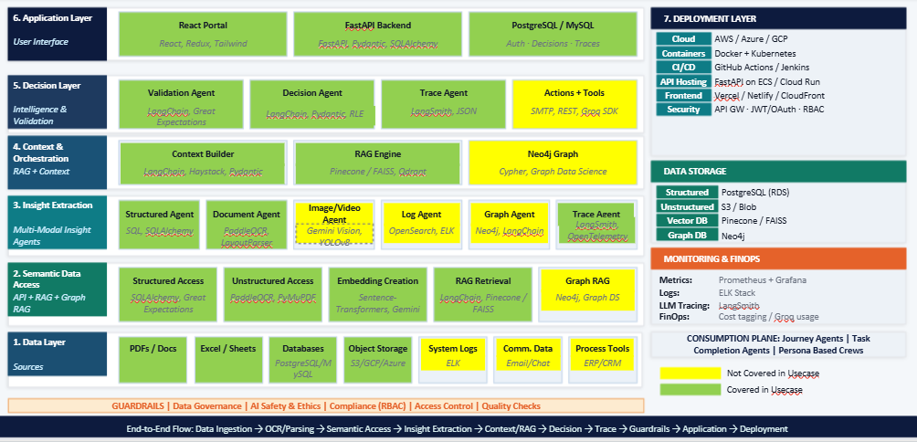
P2P Architecture

Slide 4
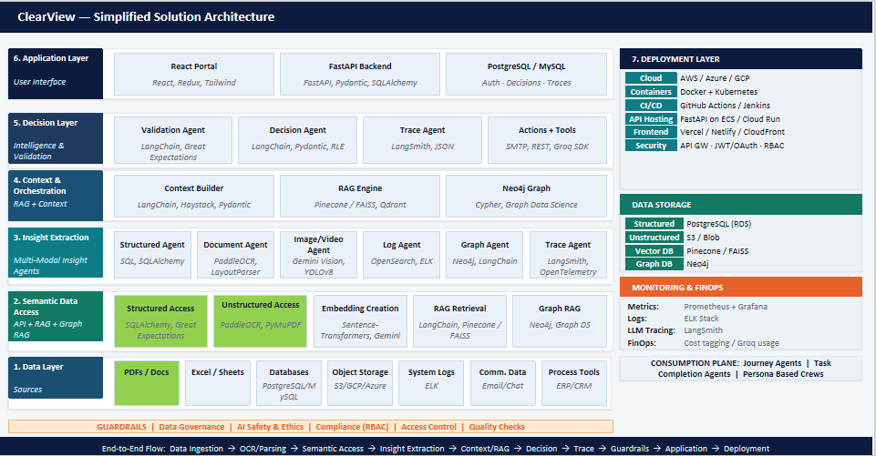
P2P Architecture : Modules Covered

Slide 5
Data Layer — Sources
The foundation of the ClearView platform. All invoice-related raw data sources are ingested here before any AI processing begins.
📄
PDFs / Docs
OUTCOME: Unified, traceable raw data pipeline across all P2P document types. Eliminating manual data gathering.

Slide 6
End-to-End P2P Invoice Reconciliation Flow
1
2
3
4
5
Data
Ingestion
OCR /
Parsing
Semantic
Access
Insight
Extraction
Context /
RAG
PDFs, Excel, ERP, Email → Raw pipeline
Gemini Vision
Embedding + Vector Index + Graph
6 Specialized AI Agents process data
Context Builder + RAG Engine + Neo4j
6
7
8
9
Decision
Trace &
Guardrails
Application
Deployment
Validation + 3-Way Match + Approve/Reject
LangSmith audit + RBAC compliance
React UI + FastAPI + Notifications
K8s + Cloud + CI/CD
Invoice Approved → Payment Triggered → Vendor Notified → Audit Log Created → Dashboard Updated — all AUTOMATICALLY

