Slide 1
E-Commerce Purchase Intention Prediction
Predicting purchase vs. no-purchase on two independent datasets, using five machine learning models
Dataset 1: Clickstream purchase propensity (455K sessions) Dataset 2: UCI Online Shoppers Intention (12K sessions)
Models: Logistic Regression • SVM • Random Forest • Gradient Boosting • XGBoost

Slide 2
PROBLEM STATEMENT
Can we predict purchase from session behaviour?
Binary classification: purchase vs. no-purchase, across two datasets
The problem
Only a small share of online sessions end in a purchase (4.2% and 15.6% in our datasets)
Businesses cannot tell in real time which visitors are likely buyers, so offers and reminders are missed
Manually reviewing hundreds of thousands of sessions does not scale
The objective
Predict purchase (1) vs no purchase (0) from session behaviour
Build, tune and compare 5 models (Logistic Regression, SVM, Random Forest, Gradient Boosting, XGBoost) per dataset
Judge with Precision, Recall, F1, and ROC-AUC not accuracy alone
Find which behaviours signal purchase
Scope of the study
Datasets: Clickstream (455K sessions) and UCI Online Shoppers (12K sessions)
Models: Logistic Regression, SVM, Random Forest, Gradient Boosting, XGBoost
Metrics: Accuracy, Precision, Recall, F1, ROC-AUC, PR-AUC
Split: stratified 60 / 20 / 20 into train, validation and test
4.2%
15.6%
purchase rate
purchase rate
2

Slide 3
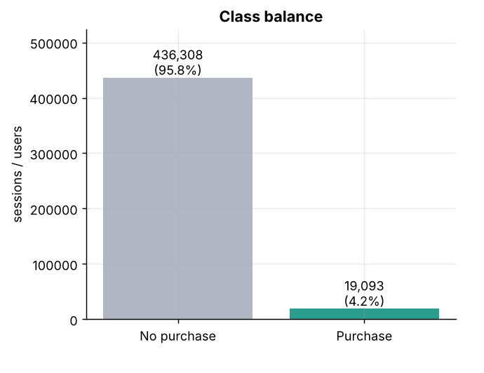
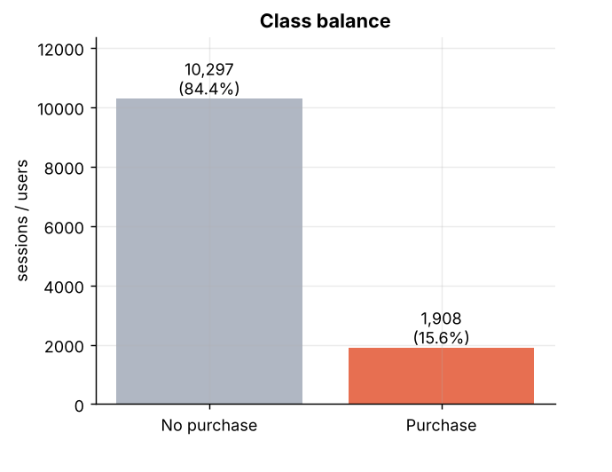
Datasets: Clickstream vs UCI Online Shoppers
Class balance of both datasets: purchase is the minority class
Dataset 1: Clickstream (target = ordered)
Dataset 2: UCI Online Shoppers (target = Revenue)
455,401
24
4.2%
12,330
18
15.6%
raw sessions
behavioural flags
purchase rate
raw sessions
attributes
purchase rate
Target: ordered (1 = purchase) • Split: stratified 60 / 20 / 20
Target: Revenue (True = purchase) • 125 duplicate rows removed • Split: 60 / 20 / 20
3

Slide 4
DATA UNDERSTANDING & PREPROCESSING
From raw sessions to a tested model
Train set (60%)
Fits scaler, encoder and models
Model training
LR, SVM, Random Forest, Gradient Boosting, XGBoost
Raw data
Dataset 1: 455,401 sessions
Dataset 2: 12,330 sessions
Clean + features
Remove duplicates
Check missing values
Add engineered features
Stratified split
60 / 20 / 20
same purchase ratio in every part
Validation set (20%)
Used to tune the threshold
Threshold tuning
Best F1 on validation; pick final model
Test set (20%)
Untouched until the end
Final evaluation
Accuracy, Precision, Recall, F1, ROC-AUC, PR-AUC
4

Slide 5
DATA UNDERSTANDING & PREPROCESSING
Preprocessing and feature engineering
Methods are chosen according to the type and role of each feature
TRANSFORMATIONS
ENGINEERED BEHAVIOURAL FEATURES
Dataset 1
StandardScaler
Centres and scales numeric features so units do not dominate (used for Logistic Regression).
total_clicks
sum of 10 click / action counts
info_checks
delivery, returns and size-chart views
Dataset 2
One-hot encoding
Dataset 2 categories (month, visitor type, operating system, browser, region, traffic type) become indicator columns.
TotalPages
combined page count
TotalDuration
combined browsing time
AvgTimePerPage
time relative to pages viewed
Class weights
class_weight = "balanced" makes the models pay more attention to the rare purchase class, without changing the real data.
ExitBounceDiff
ExitRates minus BounceRates
PageValuePerProductPage
PageValues relative to product pages
5

Slide 6
PREDICTIVE MODELLING APPROACH
Five models, chosen for different strengths
Linear, kernel and tree-based families compared fairly on both datasets
Logistic Regression
Linear model
Fast, interpretable baseline. Coefficients show which behaviours push toward a purchase.
1
SVM (Support Vector Machine)
Kernel model
Max-margin boundary that captures non-linear patterns the linear model misses.
2
Random Forest
Tree ensemble (bagging)
Bags many decision trees; robust to noise and needs little tuning, a strong and reliable middle ground.
3
Gradient Boosting
Tree ensemble (boosting)
Each new tree corrects the previous tree’s errors, which suits tabular behaviour data.
4
XGBoost
Tree ensemble (boosting)
Regularised boosting (L1/L2) curbs overfitting
5
6

Slide 7
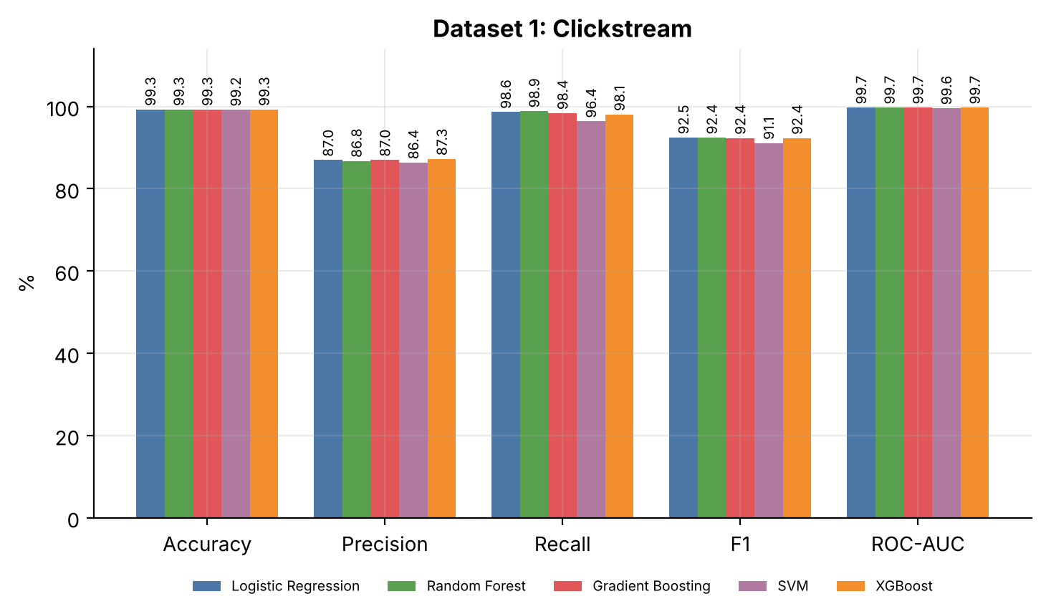
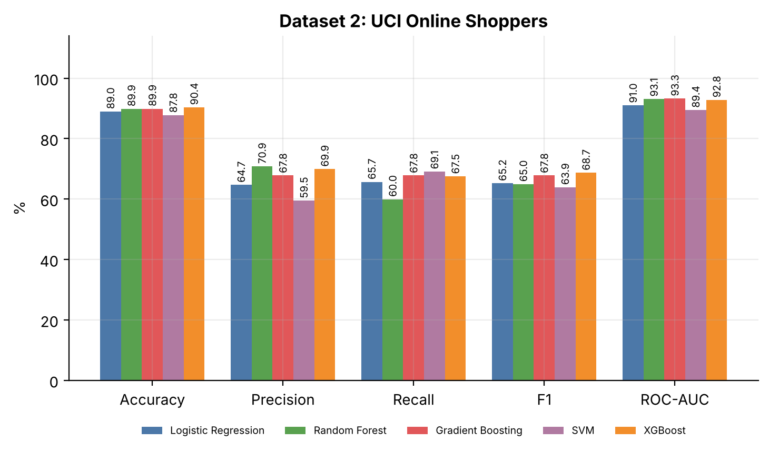
EVALUATION OF THE MODEL
Model evaluation — accuracy metrics, both datasets
What the graphs show
Dataset 1: all 5 models score almost the same (F1 91.12–92.5%, ROC-AUC 99.59–99.74%); precision (about 86–87%) is the lowest bar.
Dataset 2: XGBoost leads F1 (68.71%); Random Forest has the top precision (70.90%) but the lowest recall (59.95%); Gradient Boosting has the top ROC-AUC (93.29%).
Final models (best validation F1): Gradient Boosting on Dataset 1 (F1 92.36%) and XGBoost on Dataset 2 (F1 68.71%).
8

Slide 8
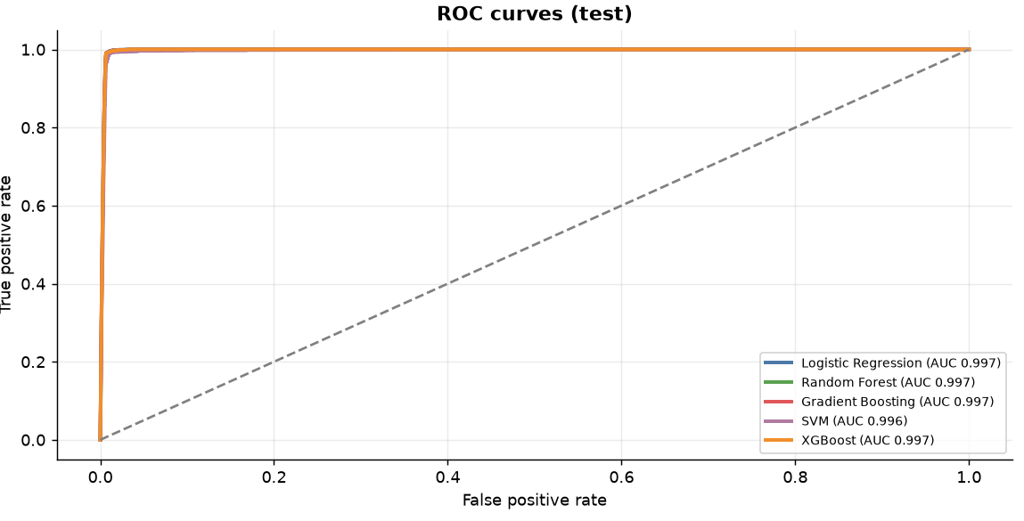
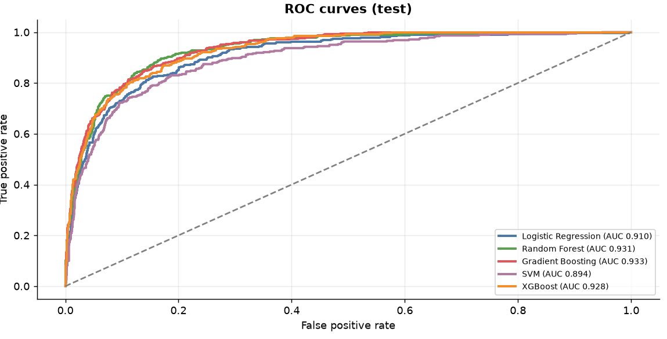
EVALUATION OF THE MODEL
Model evaluation — ROC curves, both datasets
Dataset 1
Dataset 2
What the graphs show
Dataset 1: all 5 curves hug the top-left corner, far above the random-guess diagonal (AUC 0.996–0.997).
Dataset 2: Logistic Regression (AUC 0.910) and SVM (0.894) trail the tree models (AUC 0.928–0.933).
Final models: Gradient Boosting on Dataset 1 (ROC-AUC 99.74%) and XGBoost on Dataset 2 (ROC-AUC 92.82%), chosen on validation F1.
9

Slide 9
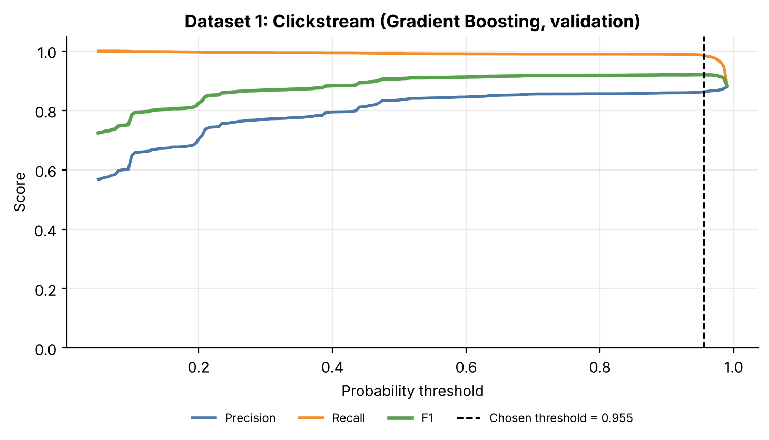
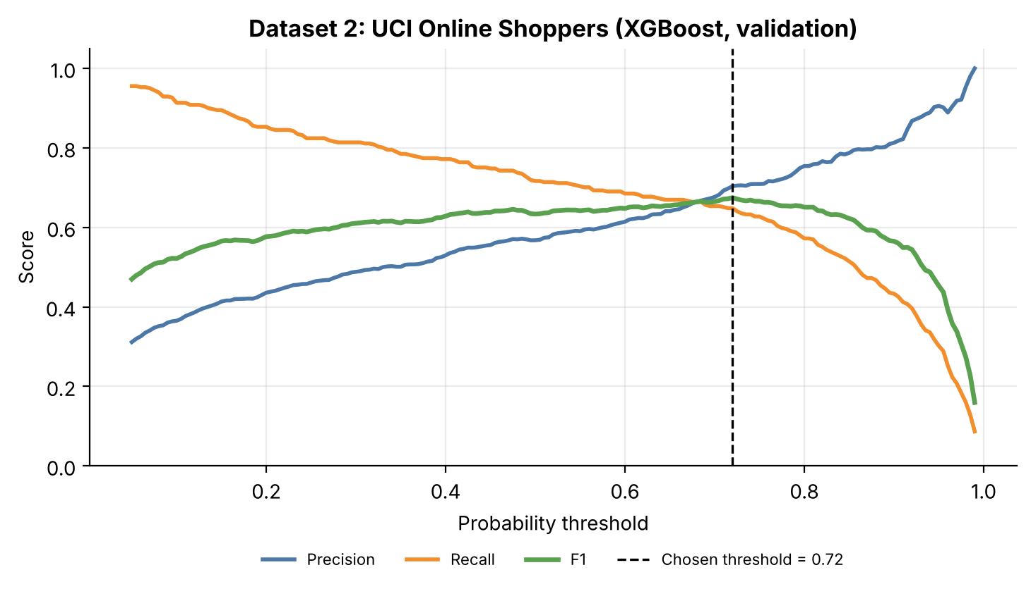
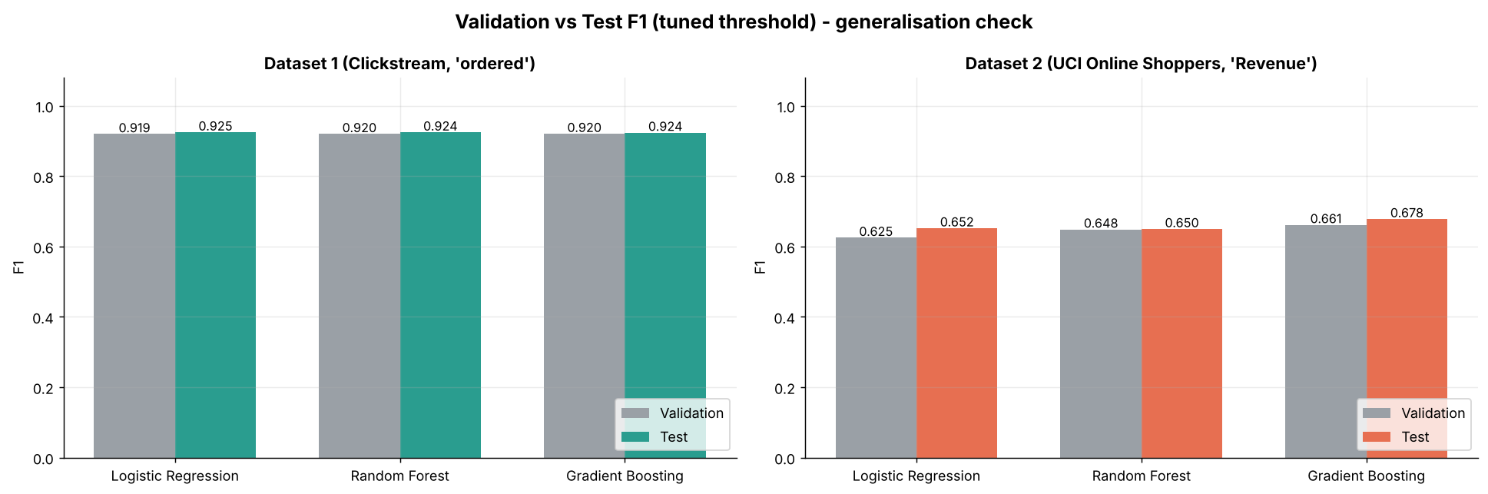
MODEL DEVELOPMENT
Training, tuning, and threshold selection
Threshold tuning
The default 0.50 cut-off is rarely the best one: the best threshold is picked on validation F1 and applied once to the untouched test set. This means the tuning did not overfit to the validation set.
Dataset 1: Precision and F1 rise with the threshold while Recall stays high; chosen threshold 0.955 (test F1 92.4%, Recall 98.4%).
Dataset 2: Precision rises as Recall falls; chosen threshold 0.72, where they balance (test F1 68.7%).
7

Slide 10
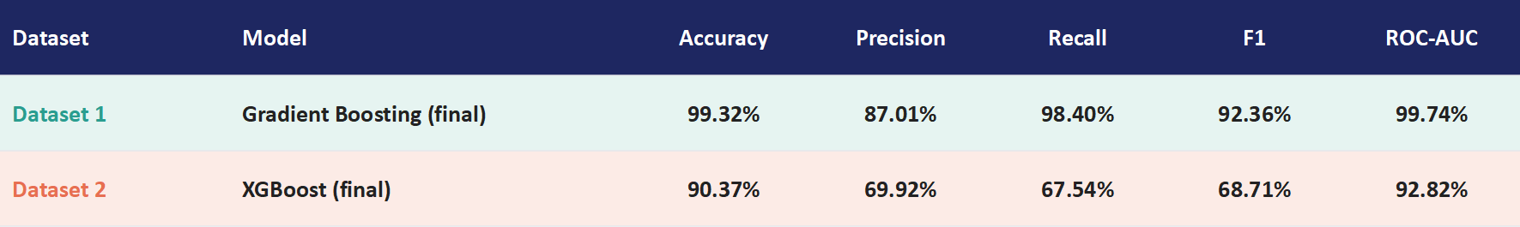
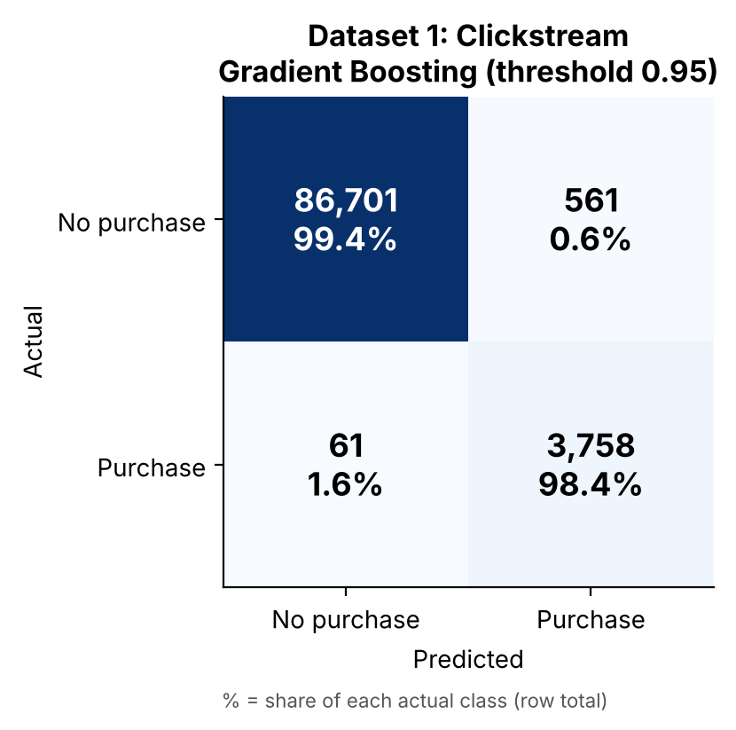
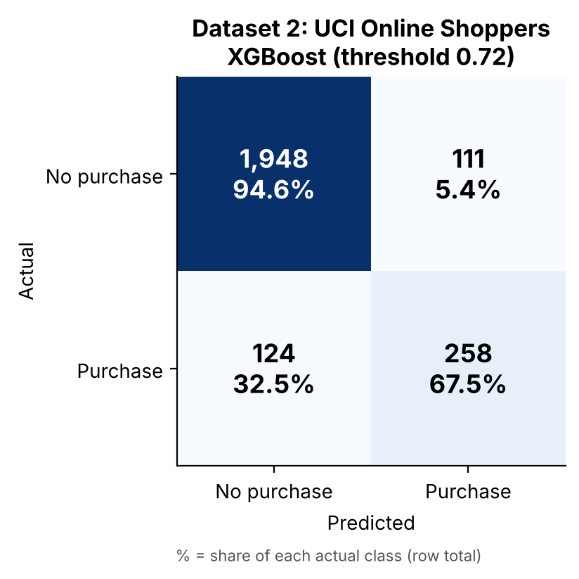
EVALUATION OF THE MODEL
Evaluation: metrics and confusion matrices
Final model per dataset (Gradient Boosting — Dataset 1, XGBoost — Dataset 2); held-out test set, tuned threshold
Final model = best F1 on the validation set: Gradient Boosting (Dataset 1) and XGBoost (Dataset 2).
Dataset 1: Gradient Boosting identified 98.4% of buyers (3,758 of 3,819); it missed 61 buyers (FN, 1.6% of buyers) and wrongly flagged 561 non-buyers (FP, 0.6% of non-buyers).
Dataset 2: XGBoost identified 67.5% of buyers (258 of 382); it missed 124 buyers (FN, 32.5% of buyers) and wrongly flagged 111 non-buyers (FP, 5.4% of non-buyers).
10

Slide 11
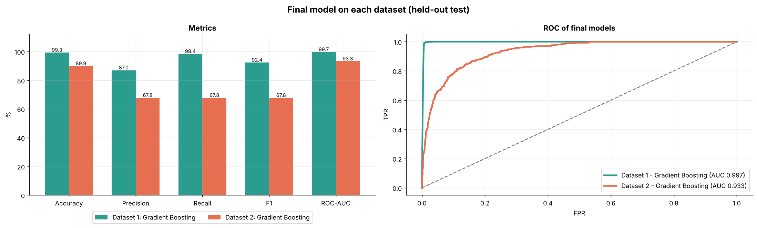
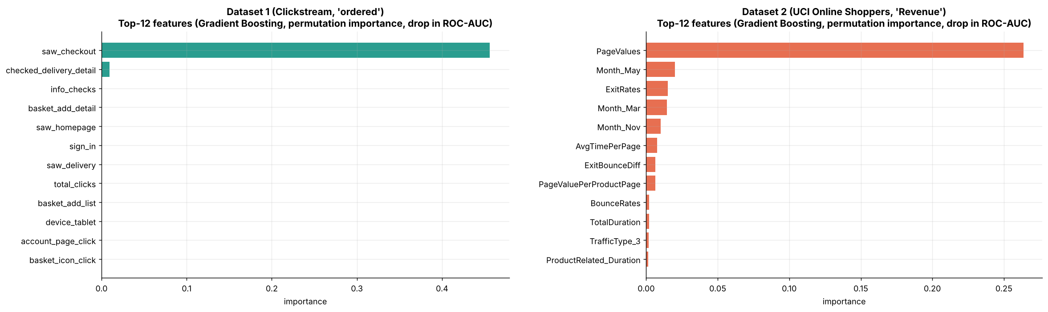
RESULTS & INTERPRETATION
Final model results, and what drove predictions
Interpretation
Dataset 1 performs better than Dataset 2: F1 92.36% vs 68.71%, ROC-AUC 99.74% vs 92.82%.
Dataset 1: saw_checkout was the strongest predictor, contributing to high performance.
Dataset 2: PageValues was the most influential feature, followed by ExitRates and month-related features.
Key insight: Checkout and basket actions are strong purchase signals.
Business use: Target high-intent visitors with relevant offers or reminders.
11

Slide 12
CONCLUSION
Conclusion
Final models: Gradient Boosting on Dataset 1 (F1 92.4%, ROC-AUC 99.7%) and XGBoost on Dataset 2 (F1 68.7%, ROC-AUC 92.8%).
One pipeline (cleaning, feature engineering, class weights, tuning, threshold selection) worked on two very different datasets.
Checkout and basket-stage actions are the strongest purchase signal: the clearest, most actionable finding.
Model quality still depends on how much data is available and how separable the classes are.
Practical use: score live sessions and trigger nudges for high-intent visitors.
Thank you

