Slide 1


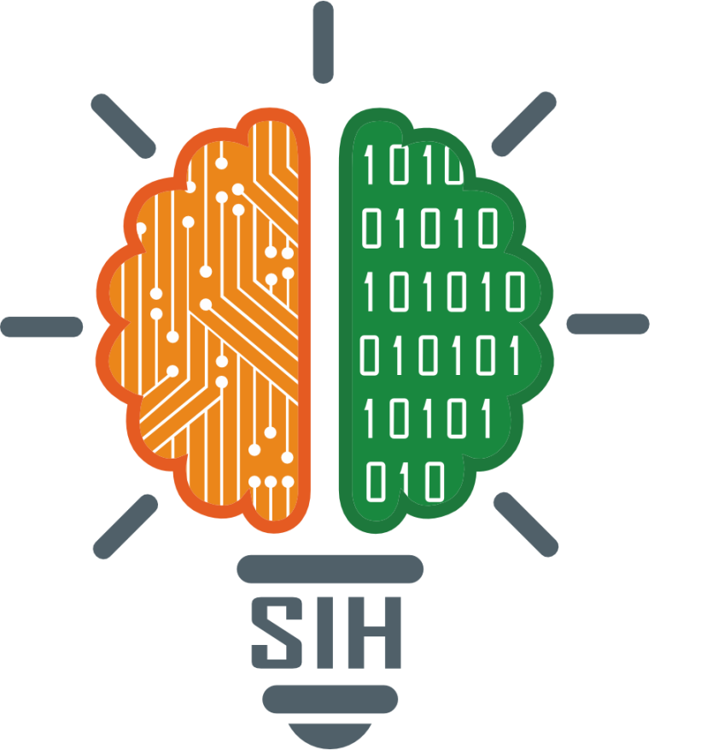
SMART INDIA HACKATHON 2025
TITLE PAGE
Problem Statement ID - SIH25032​
Problem Statement Title - Development of a Smart Digital Platform to Promote Eco & Cultural in Jharkhand. ​
Theme - Travel and Tourism​
PS Category - Software​
Team ID - ​84067
Team Name (Registered on portal) : AtlasCrew

Slide 2
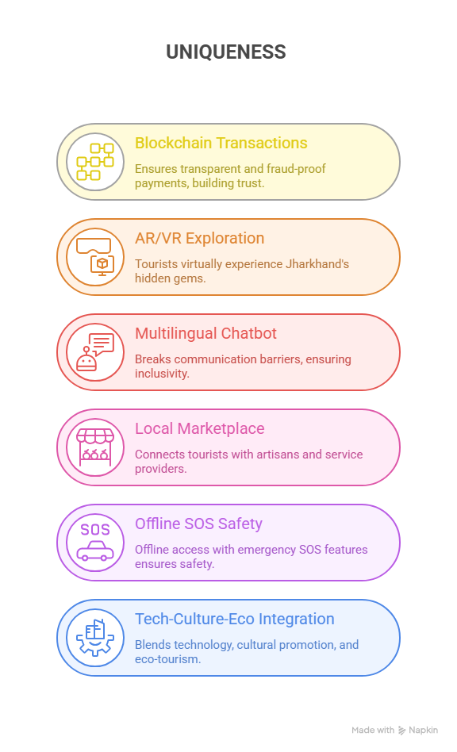

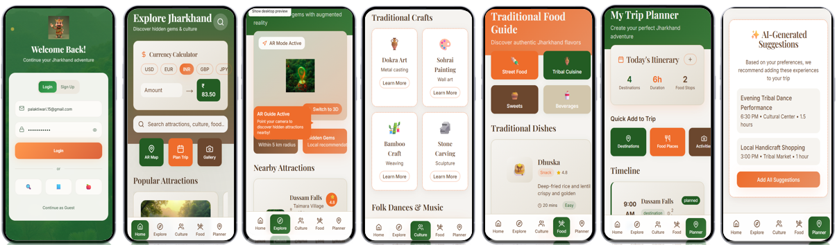
IDEA TITLE
Proposed Solution :-
A web-based and mobile solution for Jharkhand tourism that combines local marketplace integration, secure bookings, cultural promotion, and trip planning in one location.
Travelers can enjoy inclusive, interesting, and customized travel experiences with features like AR/VR interactive maps, multilingual AI chatbots, and customized itineraries.
Featuring a marketplace for homestays and artisans, blockchain-secured payments, offline navigation, and SOS emergency support, it guarantees visitor safety, trust, and local economic development.
Uniqueness of Solution :-
**Visual Prototype Interface of DurgamPath App**

Slide 3
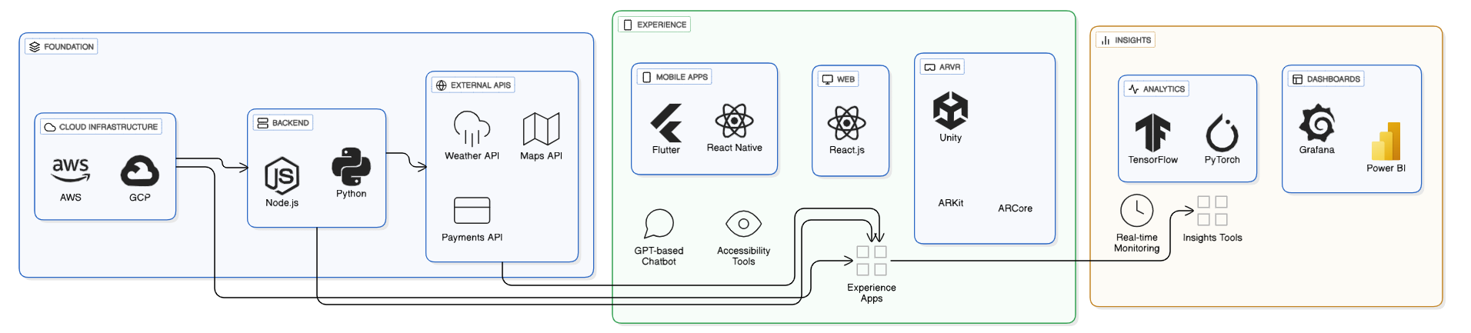
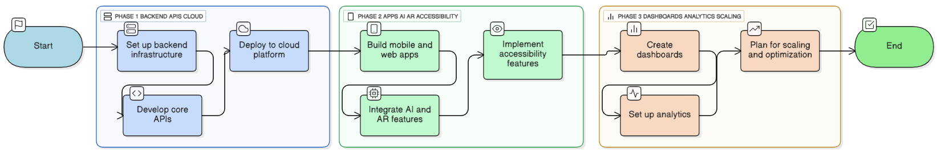
TECHNICAL APPROACH
Technology Implementation :-
Interface
Insights
Foundation
Flow of Implementation :-

Slide 4
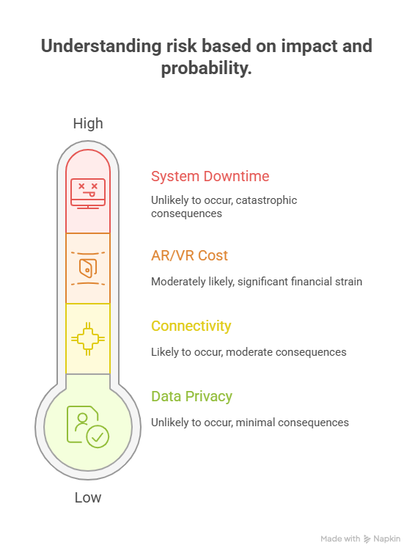
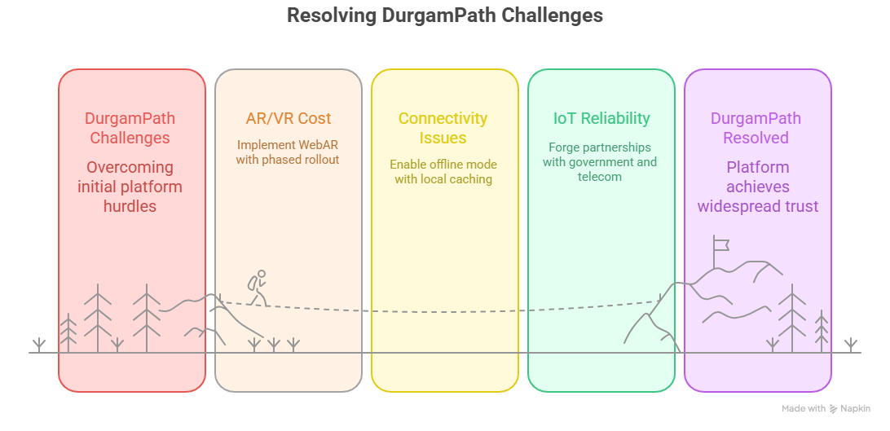
FEASIBILITY AND VIABILITY
Feasibility Breakdown :-
The solution is technically feasible with AI, Blockchain, AR/VR, and Cloud scalability, ensuring reliability.
It is operationally strong through partnerships with tourism boards, guides, and artisans for smooth execution.
Its economic viability comes from multiple revenue streams backed by government and sponsor support.
With rising market demand for digital, authentic, eco-friendly tourism and a focus on community empowerment, the model ensures sustainability and long-term growth.
Potential Challenges & Risks :- ​
Strategies for Resolving Challenges :-​

Slide 5
IMPACT AND BENEFITS
Potential Impact on Jharkhand Tourism
Boost in Tourist Footfall – Digital discovery of unexplored destinations attracts more domestic and international travelers.
Cultural Revitalization – AR/VR storytelling preserves and promotes tribal culture, heritage, and local festivals.
Decentralized Tourism Growth – Balanced promotion of both popular and hidden spots reduces overcrowding and distributes economic benefits.
Policy & Planning Support – Real-time dashboards empower the government with insights for infrastructure, safety, and tourism development.
Global Branding – Positions Jharkhand as a tech-enabled, smart tourism hub on national and international platforms.
Sustainable Ecosystem – Encourages eco-tourism, responsible travel and community-led participation
Benefits of the Solution
Seamless Tourist Experience – Personalized itineraries, multilingual chatbot, blockchain-secured payments, offline navigation, and SOS safety.
Community Empowerment – Local guides, artisans, and homestays get direct market access.
Government Enablement – Data-driven decisions with real-time visitor heatmaps, spending insights, and adoption metrics.
Economic Upliftment – Increased tourism spending contributes to Jharkhand’s GDP while nurturing small businesses.
Inclusive Tourism – WCAG-compliant design, voice-first navigation, and regional language support ensure accessibility for all.
Global Outreach – AR/VR showcases Jharkhand at global expos, schools, and online platforms, attracting worldwide attention.

Slide 6
RESEARCH AND REFERENCES
Jharkhand Tourism Policy (2021). Department of Tourism, Art, Culture, Sports & Youth Affairs, Government of Jharkhand .https://www.nsws.gov.in/s3fs/2022-10/Jharkhand%20Tourism%20Policy%202021.pdf
PIB report 2017-18. Government of India, Press Information Bureau. PM launches development projects in Jharkhand https://www.pib.gov.in/PressReleseDetail.aspx?PRID=1514130
Tussyadiah, I. P., Wang, D., Jung, T. H., & tom Dieck, M. C. (2018). Virtual reality, presence, and attitude change: Empirical evidence from tourism https://www.sciencedirect.com/science/article/abs/pii/S0261517717302662?via%3Dihub
Guttentag, D. A. (2010). Virtual reality: Applications and implications for tourism. Tourism Management, 31(5), 637-651 Virtual reality: Applications and implications for tourism – ScienceDirect
Nam, K., Dutt, C. S., Chathoth, P., & Khan, M. S. (2019). Blockchain technology for smart city and smart tourism: latest trends and challengeshttps://www.researchgate.net/publication/331385130_Blockchain_technology_for_smart_city_and_smart_tourism_Latest_trends_and_challenges
Dey, P., & Mandal, S. (2020). Challenges and Prospects of Tribal Tourism: A Case Study on the Santhal Tribe in West Bengal and Jharkhandhttps://www.researchgate.net/publication/367129068_Tribal_History_A_Study_of_its_Problems_and_Prospects

