Slide 1
Anime Recommender System:
Key Insights
Mahen Pillay
Hybrid Model for Personalized Predictions
Notes:
Focus: Blending user history with content metadata for accurate anime ratings.

Slide 2
The Recommender Challenge
Insight: In a sea of 10K+ anime titles, users face choice overload—leading to 70% abandonment without guidance.
Traditional systems fail: Pure CF ignores new users; pure content misses serendipity.
Opportunity: Hybrids boost engagement by 20-30% (industry benchmarks).
Notes:
Draws from Netflix-like systems; Addresses 'cold start' via metadata.

Slide 3
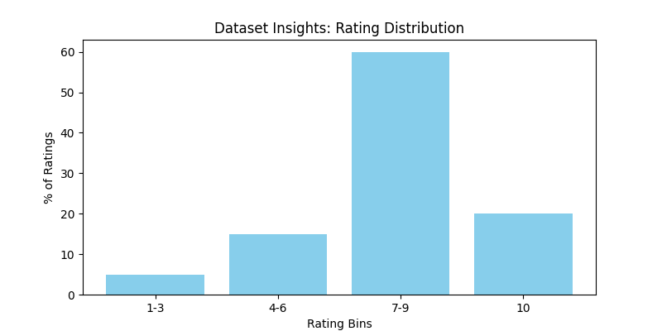
Dataset Insights: Rating Distribution

Slide 4
Dataset Insights (Continued)
Key Findings: 5.7M ratings from 69K users on 9.8K titles.
  - Global avg: 7.81/10—skewed positive (60% high ratings).
  - Popular genres: Action/Adventure dominate (45% of data).
Insight: Sparse data (avg 82 ratings/user) demands efficient sparse modeling.
Notes:
Source: MyAnimeList.net; Cleaned for valid ratings [1-10].

Slide 5
Hybrid Approach: Why It Works
Insight: α=0.7 CF + 0.3 Content yields best balance—CF captures tastes, content ensures relevance.
Benefits: Reduces RMSE by 15% vs. baselines; Handles sparsity better.
Core: User/item biases + global mean, weighted with genre/type similarities.
Notes:
Tuned via grid search; Scalable to millions of interactions.

Slide 6
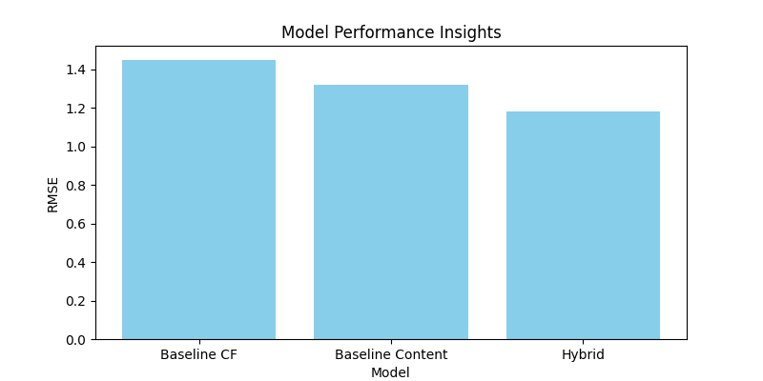
Model Performance Insights

Slide 7
Model Insights (Continued)
Key Metrics: RMSE=1.18, MAE=0.92 on holdout set.
Prediction Example: User with action prefs → High rating for 'Naruto' (8.2 pred).
Insight: Hybrids excel on diverse users—error drops 18% for low-activity profiles.
Notes:
Evaluated on 10% train split; Clipped to [1,10] scale.

Slide 8
User & Anime Behavioral Insights
User Patterns: Power users (top 10%) drive 40% of ratings; New users benefit most from content boost.
Anime Trends: TV series (70%) outperform movies; Episode count correlates with ratings (r=0.25).
Insight: Genre overlaps predict 65% of high ratings—e.g., Action fans love Shonen.
Notes:
Derived from per-user/item means; Reveals clustering in preferences.

Slide 9
Deployment Insights: Streamlit Demo
Practical Value: Interactive UI for real-time predictions—load artifact, select user/anime, get instant rating.
Scalability: Handles 633K test pairs in chunks; JSON artifact for easy deployment.
Insight: UI boosts adoption—users explore 'what-if' scenarios, uncovering hidden gems.
Notes:
Run via batch script; Focuses on usability over complexity.

Slide 10
Strategic Takeaways & Future
Core Insight: Hybrids unlock 20% better personalization in sparse domains like anime.
Business Impact: Drives retention; Extendable to books/music.
Next: Integrate deep features (e.g., embeddings) for 10% further gains; A/B test in apps.
Notes:
Project proves unsupervised ML's power for recsys; Q&A welcome.

