Slide 1

Campus Canteen
Ordering System
A Data Structures & Algorithms CCP Project
Built with: Java • JavaFX • Maven
Core Structures: Array • Queue • Linked List • BST • HashMap
Faculty of Engineering Sciences and Technology

Slide 2
Problem Statement
Manual canteen ordering during rush hours leads to long queues, lost order records, and no visibility into order status for students or staff.
1
Digitize Ordering
2
Fair Processing
Students browse a live menu and place orders from any device.
Orders are served strictly in the order they were placed (FIFO).
3
Fast Lookup
4
Live Inventory
Menu and order history retrieval must be efficient, not linear scans.
Stock updates the moment an order is placed.
Campus Canteen Ordering System | DSA CCP Project
2

Slide 3
System Architecture
JavaFX front-end talks to a single static data-holder class that owns every data structure.
MainApplication
DataStore
Model Classes
JavaFX UI
(Login / Student / Admin views)
Static class
Owns all data structures
User • MenuItem • Order
• BSTNode
Each data structure is mapped to one core operation:
Array (List<User>)
Login credential storage & lookup
Queue (LinkedList)
FIFO order processing
Linked List
Live inventory management
Binary Search Tree
Menu items sorted by itemId
HashMap
O(1) order history lookup per user
Campus Canteen Ordering System | DSA CCP Project
3

Slide 4
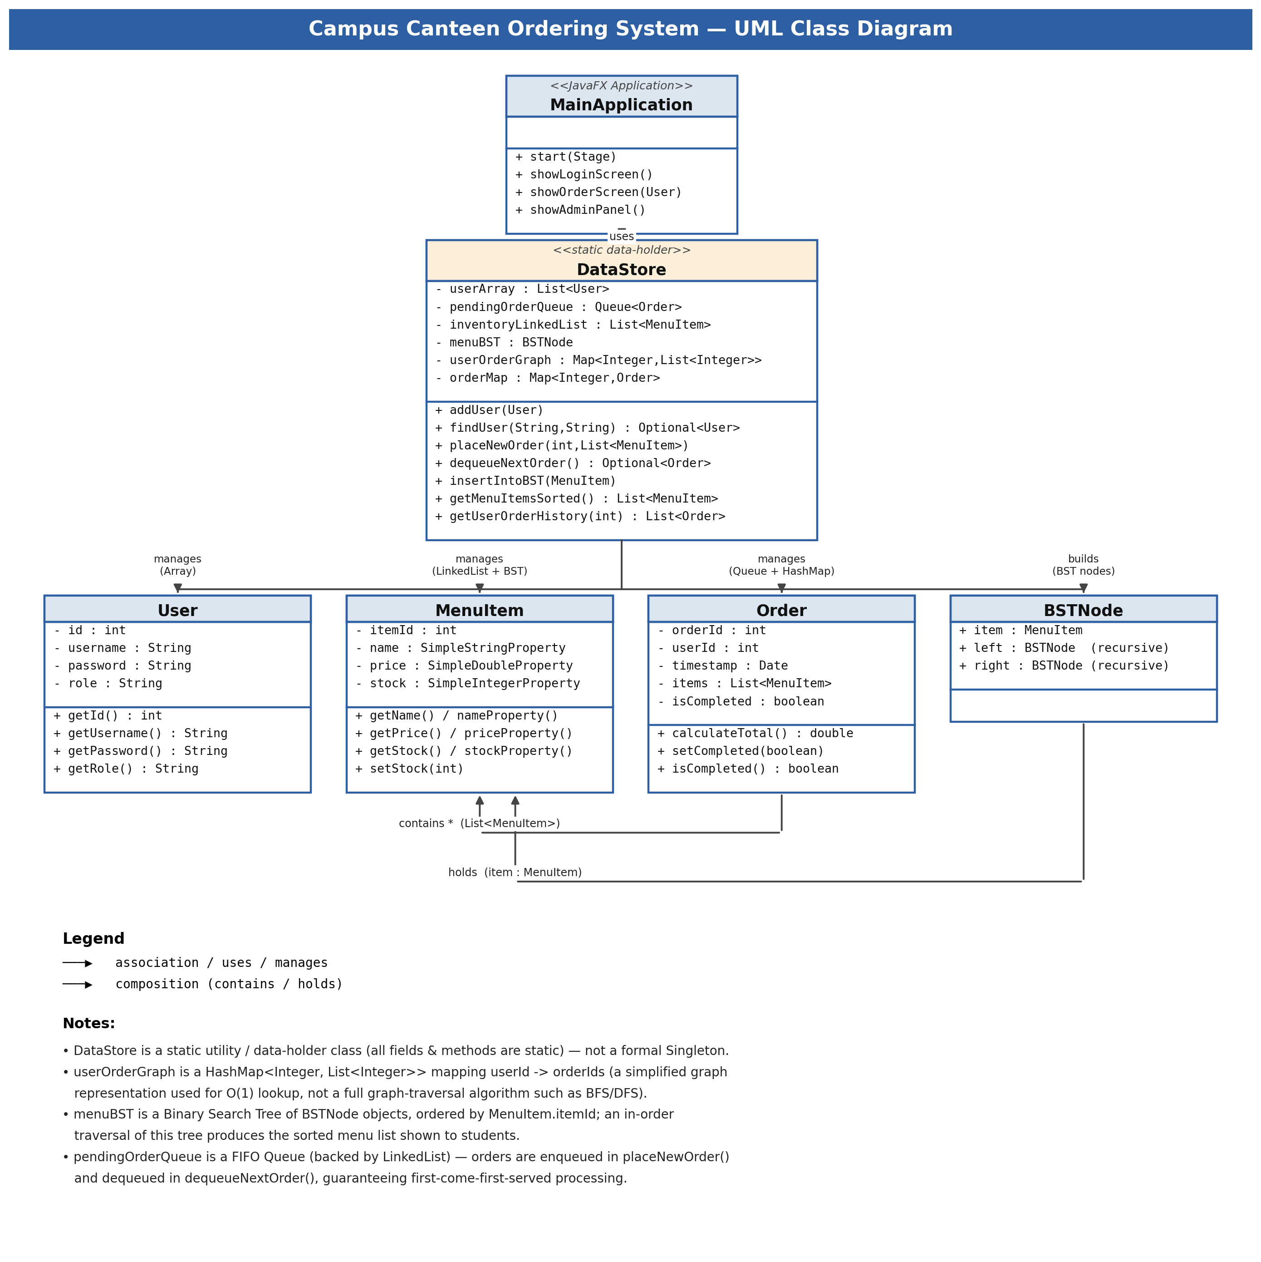
UML Class Diagram
Campus Canteen Ordering System | DSA CCP Project
4

Slide 5
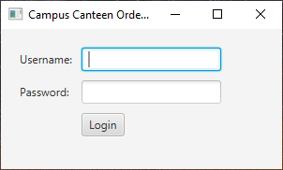
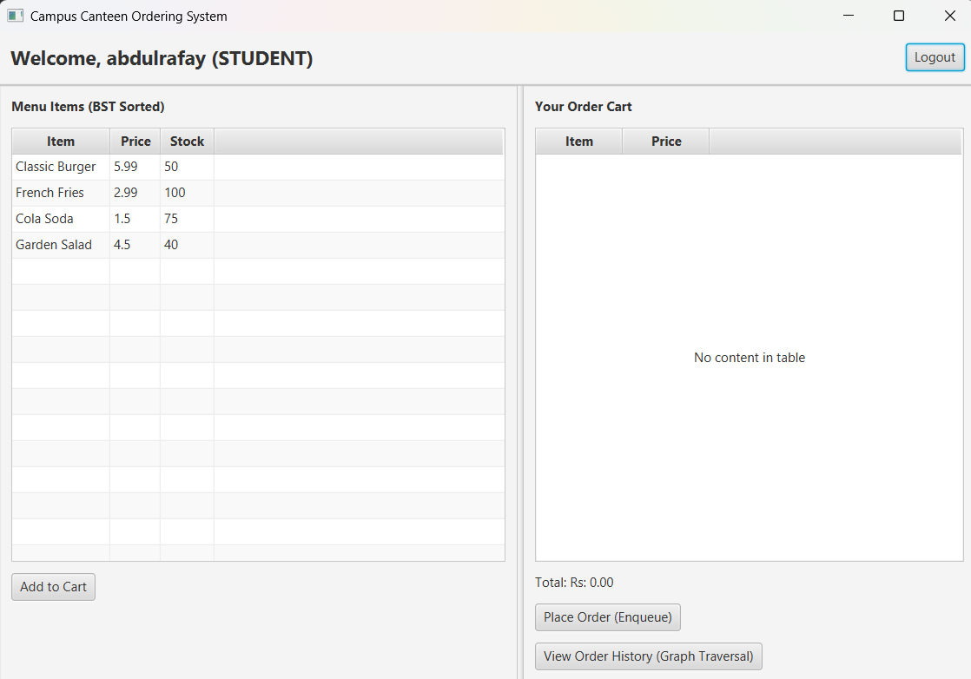
Student Flow — Login & Order
1. Login Screen
2. Student Panel — menu (BST-sorted) + cart, places order (enqueue)
Campus Canteen Ordering System | DSA CCP Project
5

Slide 6
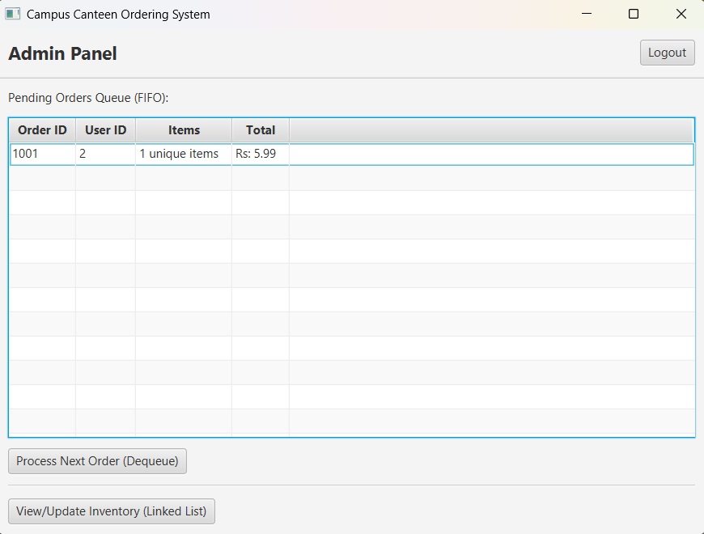
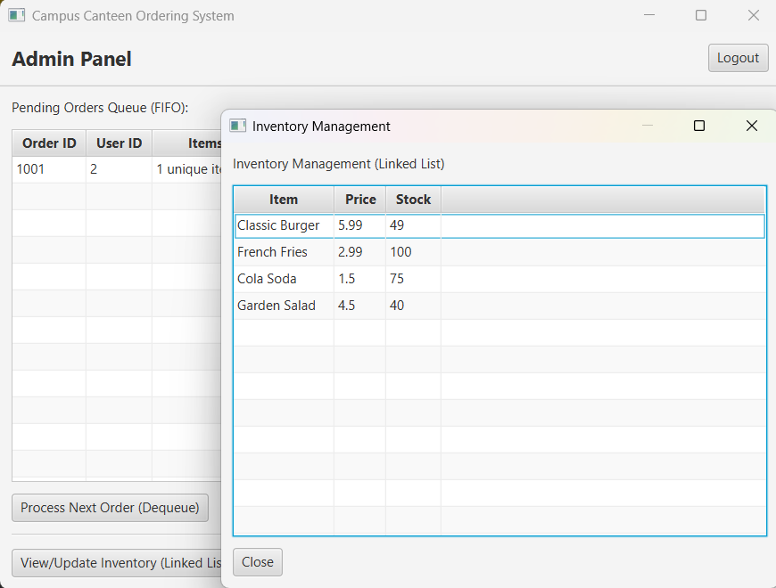
Admin Flow — Process Orders & Inventory
Admin Panel — pending orders queue (FIFO), Process Next Order (dequeue)
Inventory Management (Linked List) — live stock view & updates
Campus Canteen Ordering System | DSA CCP Project
6

Slide 7
Test Case Walkthrough
Demonstrating FIFO order processing across two students
1
abdulrafay logs in
User ID 2 — student1
2
Orders Classic Burger + Cola Soda
Order #1001 enqueued, total Rs. 7.49
3
farzainali logs in
User ID 3 — student2
4
Orders French Fries
Order #1002 enqueued, total Rs. 2.99
5
mahendardev (admin) logs in
Processes next order
6
Order #1001 dequeued first
FIFO verified — Order #1002 still pending
Campus Canteen Ordering System | DSA CCP Project
7

Slide 8
Data Structures — Why Each One?
Array / List
Queue (LinkedList)
Linked List
Binary Search Tree
HashMap
userArray
pendingOrderQueue
inventoryLinkedList
menuBST
userOrderGraph / orderMap
O(n) linear search on login — small, fixed user set.
Guarantees first-come-first-served order processing.
Simple sequential storage with easy stock updates.
In-order traversal returns the menu already sorted by itemId.
O(1) average lookup of a user's order history.
Campus Canteen Ordering System | DSA CCP Project
8

Slide 9
Conclusion & Future Work
What we achieved
Future enhancements
Fully working JavaFX ordering system
5 core data structures applied purposefully
FIFO-fair order processing, verified by test case
Live inventory sync on every order
Persist data with a real database (currently in-memory)
Replace HashMap order-mapping with a true adjacency-list graph + BFS/DFS
Add payment gateway integration
Push notifications when an order is ready
Thank You — Questions?

