Slide 1
Machine Learning Presentation
Generated by AI

Slide 2
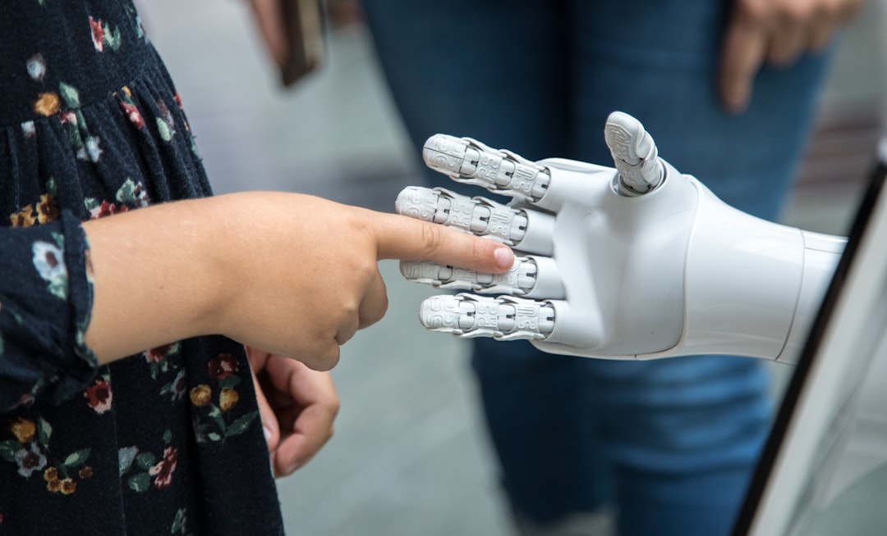
What is Machine Learning?
Automated learning from data
Improves accuracy over time
Enables predictive modeling

Slide 3
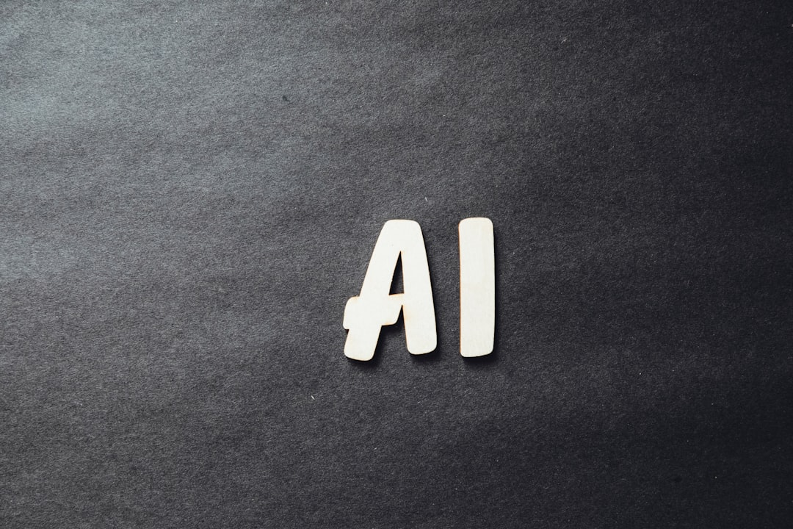
Types of Machine Learning
Supervised Learning
Unsupervised Learning
Reinforcement Learning

Slide 4
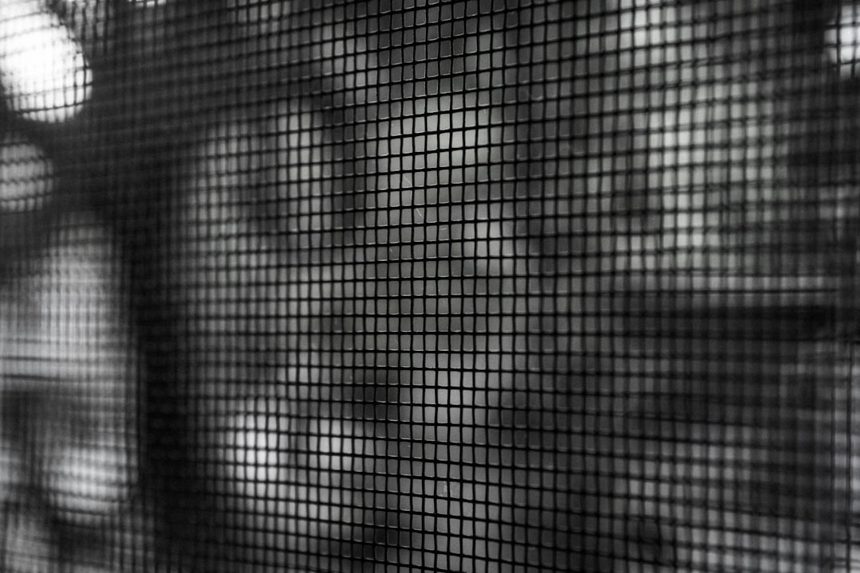
Machine Learning Applications
Image Recognition
Natural Language Processing
Predictive Maintenance

Slide 5
Machine Learning Challenges
Data Quality Issues
Overfitting and Underfitting
Interpretability and Explainability

Slide 6
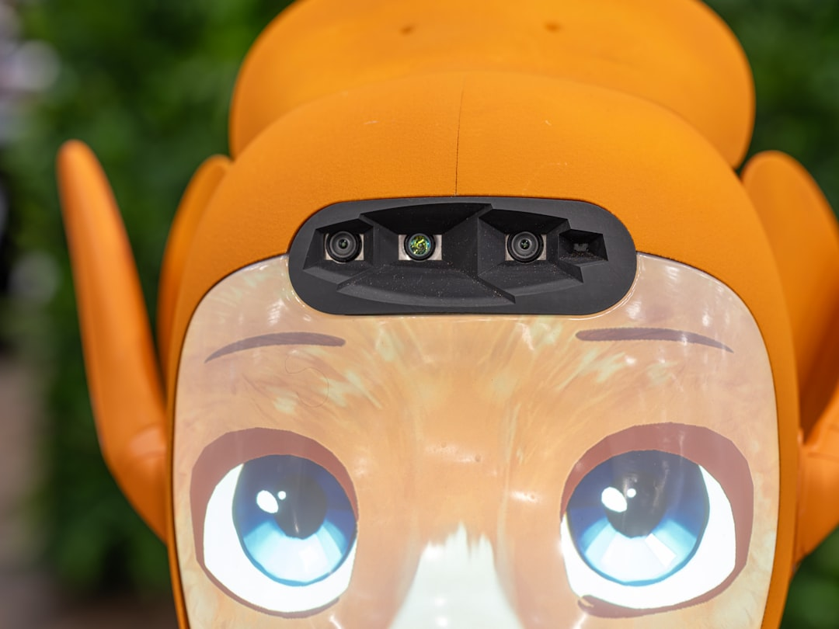
Future of Machine Learning
Increased Adoption
Advancements in Deep Learning
Integration with IoT Devices

