Slide 1
Introduction to Machine Learning
Generated by AI

Slide 2
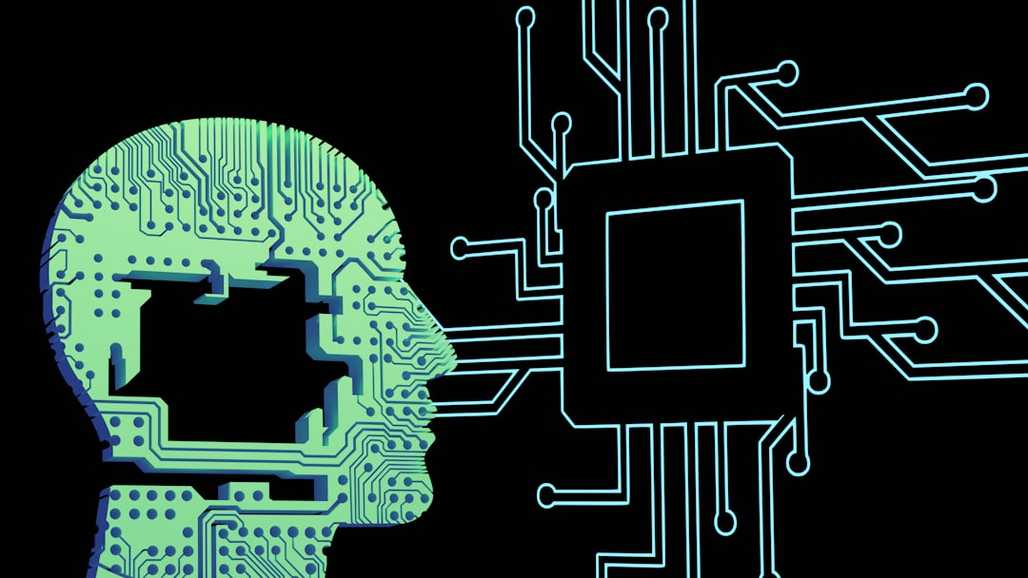
What is Machine Learning?
Automated learning from data
Improves performance over time
Enables predictive modeling

Slide 3
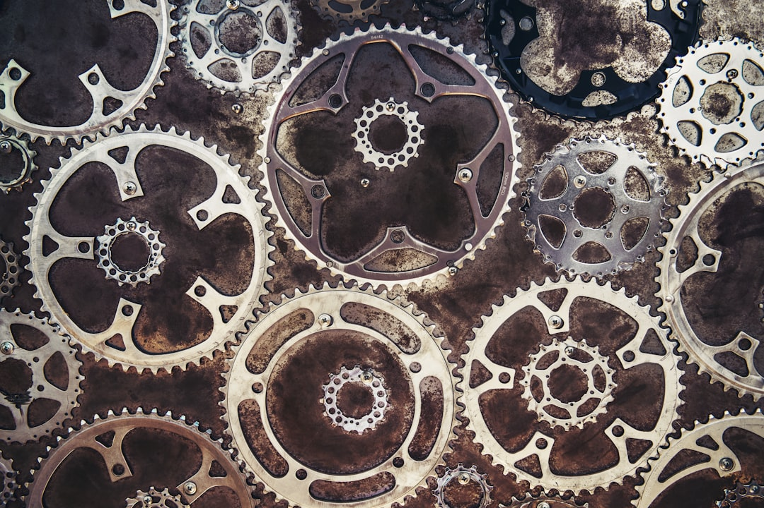
Types of Machine Learning
Supervised learning
Unsupervised learning
Reinforcement learning

Slide 4

Machine Learning Applications
Image recognition
Natural language processing
Predictive analytics

Slide 5
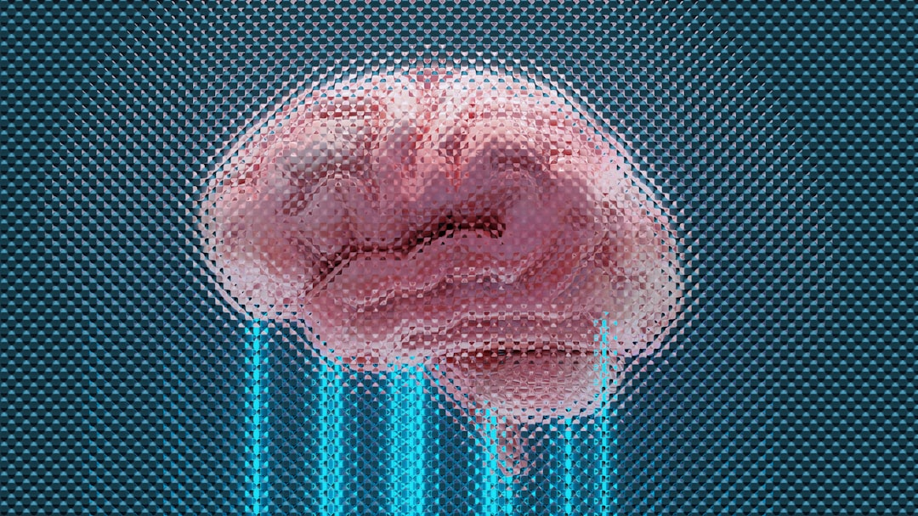
Machine Learning Benefits
Improved accuracy
Increased efficiency
Enhanced decision-making

Slide 6
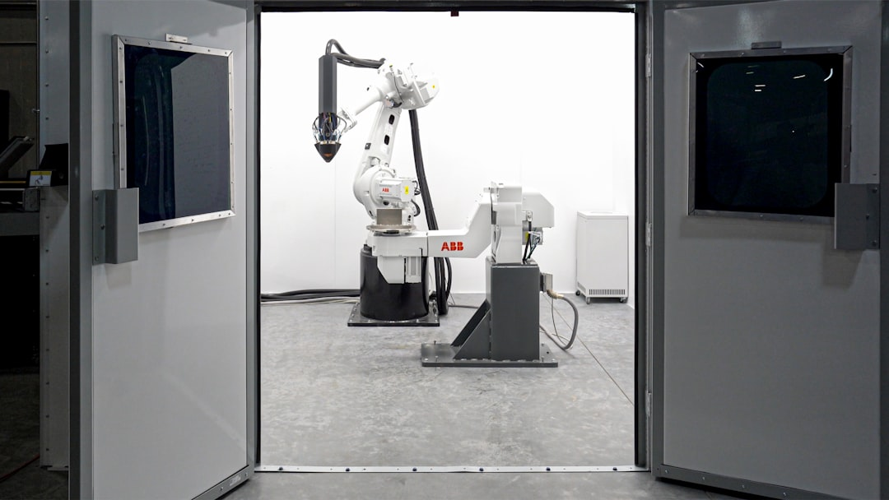
Future of Machine Learning
Growing demand for AI
Advancements in deep learning
Increased adoption in industries

