Slide 1
Zopper Presentation
Generated by AI

Slide 2
What is Zopper?
E-commerce platform for second-hand goods
Allows users to buy and sell used products
Operates in several countries worldwide

Slide 3

Key Features
User-friendly interface for easy product listing
Secure payment options for buyers and sellers
Real-time product updates and notifications

Slide 4

Benefits for Sellers
Easy product listing and management
Access to a large customer base
Opportunity to earn extra income

Slide 5
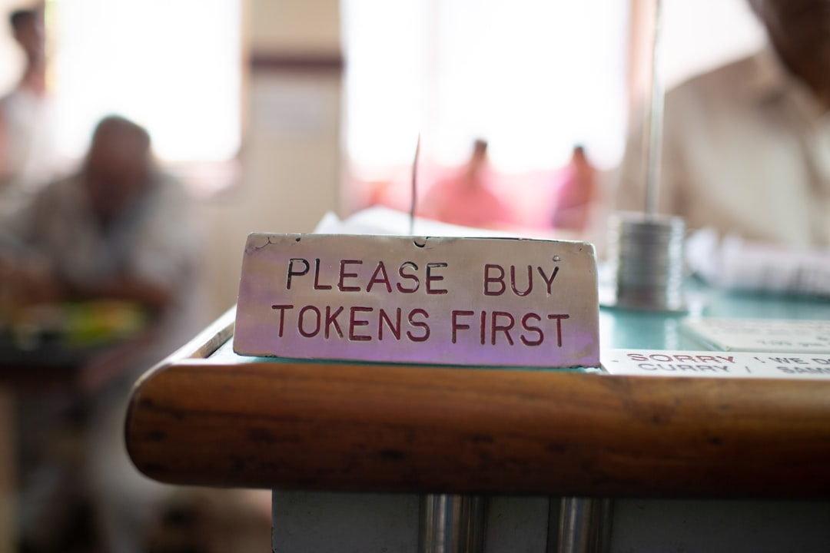
Benefits for Buyers
Access to a wide range of second-hand products
Competitive pricing and discounts
Convenient payment and delivery options

Slide 6

Conclusion
Zopper is a popular e-commerce platform
Offers a unique shopping experience for second-hand goods
A great option for buyers and sellers alike

