Slide 1
Document Databases
Introduction to Document-Oriented NoSQL Databases

Slide 2
What is a Document Database?
Stores data as documents (JSON/BSON/XML)
Schema flexible
Part of NoSQL family
📘 JSON – Definition
JSON (JavaScript Object Notation)
👉 Lightweight data format
👉 Human readable
👉 Key–Value pairs lo untundhi
👉 Mostly APIs & NoSQL databases lo use chestharu
{
"name": "Mahendher",
"age": 26,
"skills": ["Python", "Django"]
}

Slide 3
📗 BSON – Definition
BSON (Binary JSON)
👉 JSON ki binary version
👉 MongoDB lo internally use chestharu
👉 Faster processing
👉 Extra data types support (date, binary, objectId)
Example (conceptual):
name: "Mahendher"
age: 26
BSON is a binary representation of JSON used mainly
in MongoDB for fast data storage.

Slide 4
📙 XML – Definition
XML (eXtensible Markup Language)
👉 Tag based structure
👉 Old data exchange format
👉 Heavy compared to JSON
👉 Opening & closing tags untayi
Example: <student>
<name>Mahendher</name>
<age>26</age>
</student>
Xml is a markup language used to store and transport data using tags.

Slide 5
JSON vs BSON vs XML (Differences)
Feature | JSON | BSON | XML
Format | Text | Binary | Text
Readable | Yes | No | Yes
Speed | Fast | Very Fast | Slow
Size | Small | Medium | Large
Used in | APIs, NoSQL | MongoDB | Old systems
Structure | Key–Value | Binary key–value | Tags

Slide 6
SQL vs Document NoSQL – Differences
Feature | SQL Database | Document NoSQL Database
Structure | Tables & Rows | Collections & Documents
Schema | Fixed schema | Flexible schema
Data Format | Columns | JSON / BSON
Scalability | Vertical | Horizontal
Relations | Foreign keys | Embedded documents
Speed | Medium | Fast
Examples | MySQL, PostgreSQL | MongoDB, CouchDB

Slide 7
Key Features
Schema-less
Scalable
High Performance
Stores data in documents

Slide 8
Popular Document Databases
MongoDB
CouchDB
Firebase Firestore
Amazon DocumentDB

Slide 9
Where It Is Used
Web Applications
Mobile Apps
Real-time Systems
Content Management

Slide 10
Example Document
{ "name":"Mahendher", "age":26, "skills":["Python","Django"] }

Slide 11
Advantages
Easy to scale
Flexible structure
Fast queries
Developer friendly

Slide 12
Disadvantages
Not good for complex joins
Memory usage high

Slide 13
Comparison with SQL
SQL: Tables & Rows
Document DB: JSON Documents

Slide 14
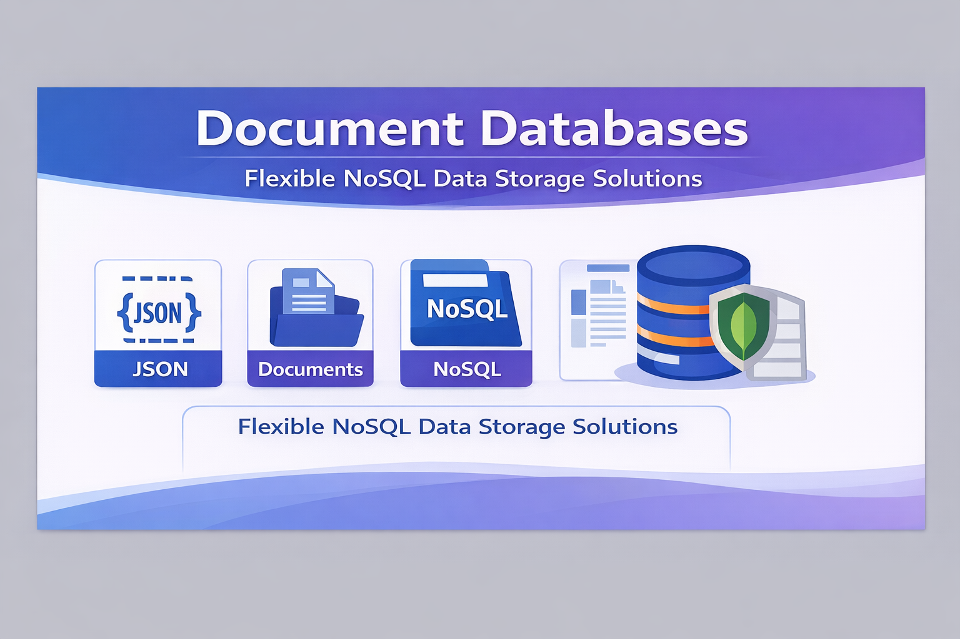

Slide 15
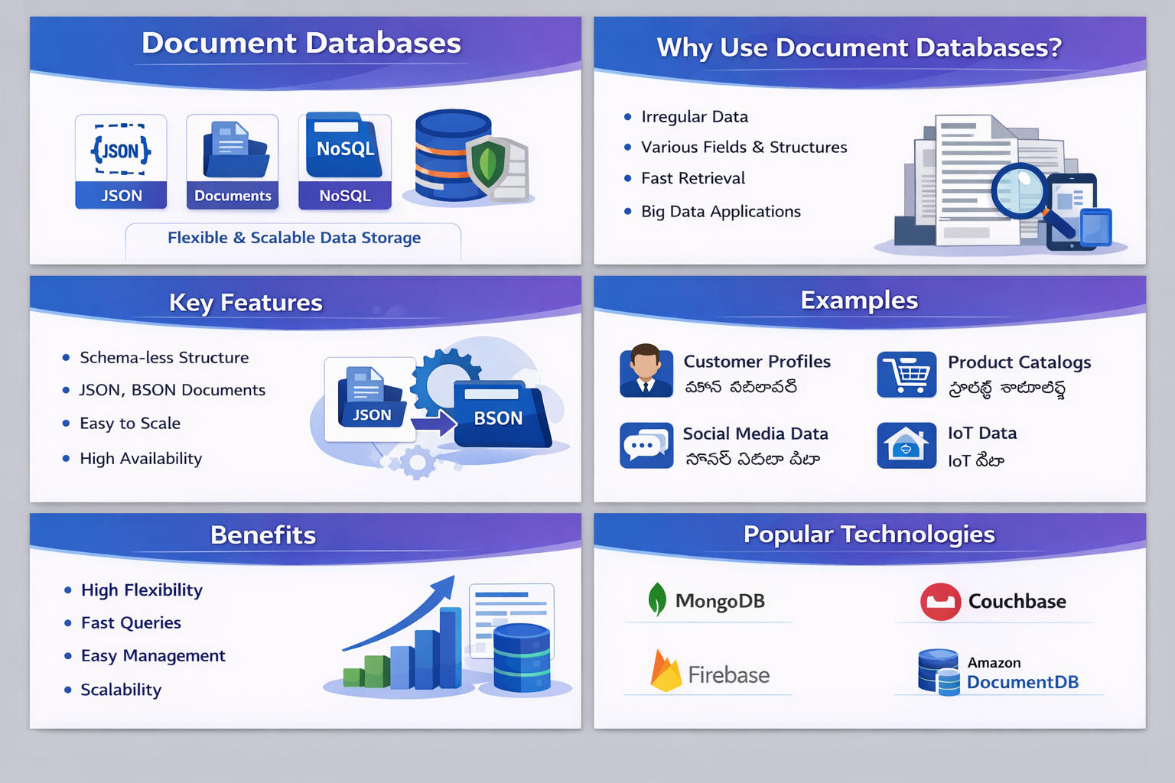

Slide 16
Thank You
Prepared by B. Mahendher

