Slide 1
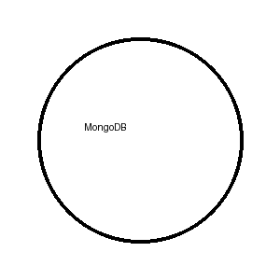
MongoDB (NoSQL Database)
MongoDB is a document-based NoSQL database.
Stores data in JSON-like format.

Slide 2
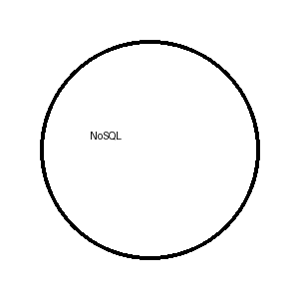
Key Features
Schema-less
High Performance
Scalable
Document Oriented

Slide 3
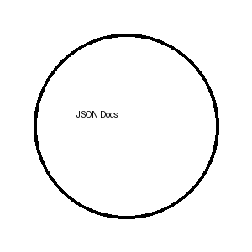
Why MongoDB?
Flexible data model
Fast development
Big data support

Slide 4
Where It Is Used
Web Apps
Mobile Apps
Real-time Systems
E-commerce

Slide 5
Sample Document
{ "name":"Mahendher", "skill":"Python", "db":"MongoDB" }

Slide 6
Thank You
Prepared by B. Mahendher

