Slide 1


Slide 2

#LifeKoKaroLift
SGC Coaching Week 10:
Inferential Statistics and Hypothesis Testing
Session By: Mahendra Singh Chouhan

Slide 3
Agenda: Session 2
Quick Recap –(10 mins)
EDA - Importance
Focused Teaching–(50 mins)
Inferential Statistics and Hypothesis Testing
Doubt resolution –(20 mins)
Discuss Individual problems

Slide 4
WHAT IS STATISTICS?
The goal of statistics is to make best guesses or draw conclusions from available data.
Types of Statistics?
Descriptive Statistics - It is used to organize, summarize and describe data for meaningful insights and data driven decision making
Inferential Statistics - It is used to estimate a property or characteristic of a population based on a sample
Predictive Statistics - It used to predict the future by analyzing historical data
Prescriptive Statistics - If you have multiple solutions, which one is the best solution?

Slide 5
Types of Data
Classification of Data:
Time-Series - Data which is collected over a period of time, usually in uniformly spaced time intervals.
Cross-Sectional – A snapshot of data from multiple variables in a single time period
Panel – A combination of time-series and cross-sectional data. It shows multiple variables over a time period. Panel data is also known as longitudinal data

Slide 6
INFERENTIAL STATISTICS
Sampling
Random Sampling
Probability distributions
Inference Statistics
Hypothesis Formation
Null vs. Alternate
P-value
Drawing Inference
Central Limit theorem
Critical Region
Type1/Type 2 Errors

Slide 7
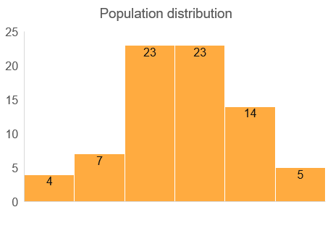



Sample vs. Population
Sample statistics
Sample mean (µ)
Sample Standard deviation (sigma)
Probability Distributions
Normal Distribution (Compare vs. Standard Normal)
Discrete probability distribution
Create using python (scipy.stats examples)
Random Sampling method
Expected value explanation
Business examples of data agencies to consolidate worldwide data
Notes:
For learners with more coding background, they find this area difficult and need to understand the probability distributions well.
Moreover data agencies, be it consumer or scan data research, adopt these principles.
https://www.datacamp.com/tutorial/probability-distributions-python

Slide 8
Null and Alternate Hypothesis
The hypothesis to be tested is called the null hypothesis and given the symbol H0.
The null hypothesis states that there is no difference between a hypothesized population mean and a sample mean. It is the status quo hypothesis. For example, if we were to test the hypothesis that employees work 70 hours per week, Can you tell what would be the null hypothesis?
We test the null hypothesis against an alternative hypothesis, which is given the symbol Ha. The alternative hypothesis is often the hypothesis that you believe yourself!
It includes the outcomes not covered by the null hypothesis. In this example, our alternative hypothesis would express that employees do not work for 70 hours in a week

Slide 9
Hypothesis Testing
The primary objective of statistics is to test a hypothesis.
A hypothesis is an educated guess about something. A hypothesis should be testable, either by experiment or observation.
For example:
A new medicine that someone thinks might be better
A new way of working that increases productivity
A Fairness cream that can make you fair or not
Hypothesis testing in statistics is a way for you to test the results of a survey or experiment to see if you have meaningful results. You’re basically testing whether your results are valid by figuring out the odds that your results have happened by chance. If your results may have happened by chance, the experiment won’t be repeatable and so you can’t conclude if it is true.

Slide 10
Risks in Sampling
Size Bias:
One particular subgroup in a population is likely to be over-represented or under-represented due to its size
Incorrect Response Bias:
A major problem with surveys is that you can never be sure that the person is actually responding truthfully.
Non-Response Bias:
One of the biggest problems in survey is that most people just don’t want to be bothered taking the time to respond to a poll of any kind

Slide 11
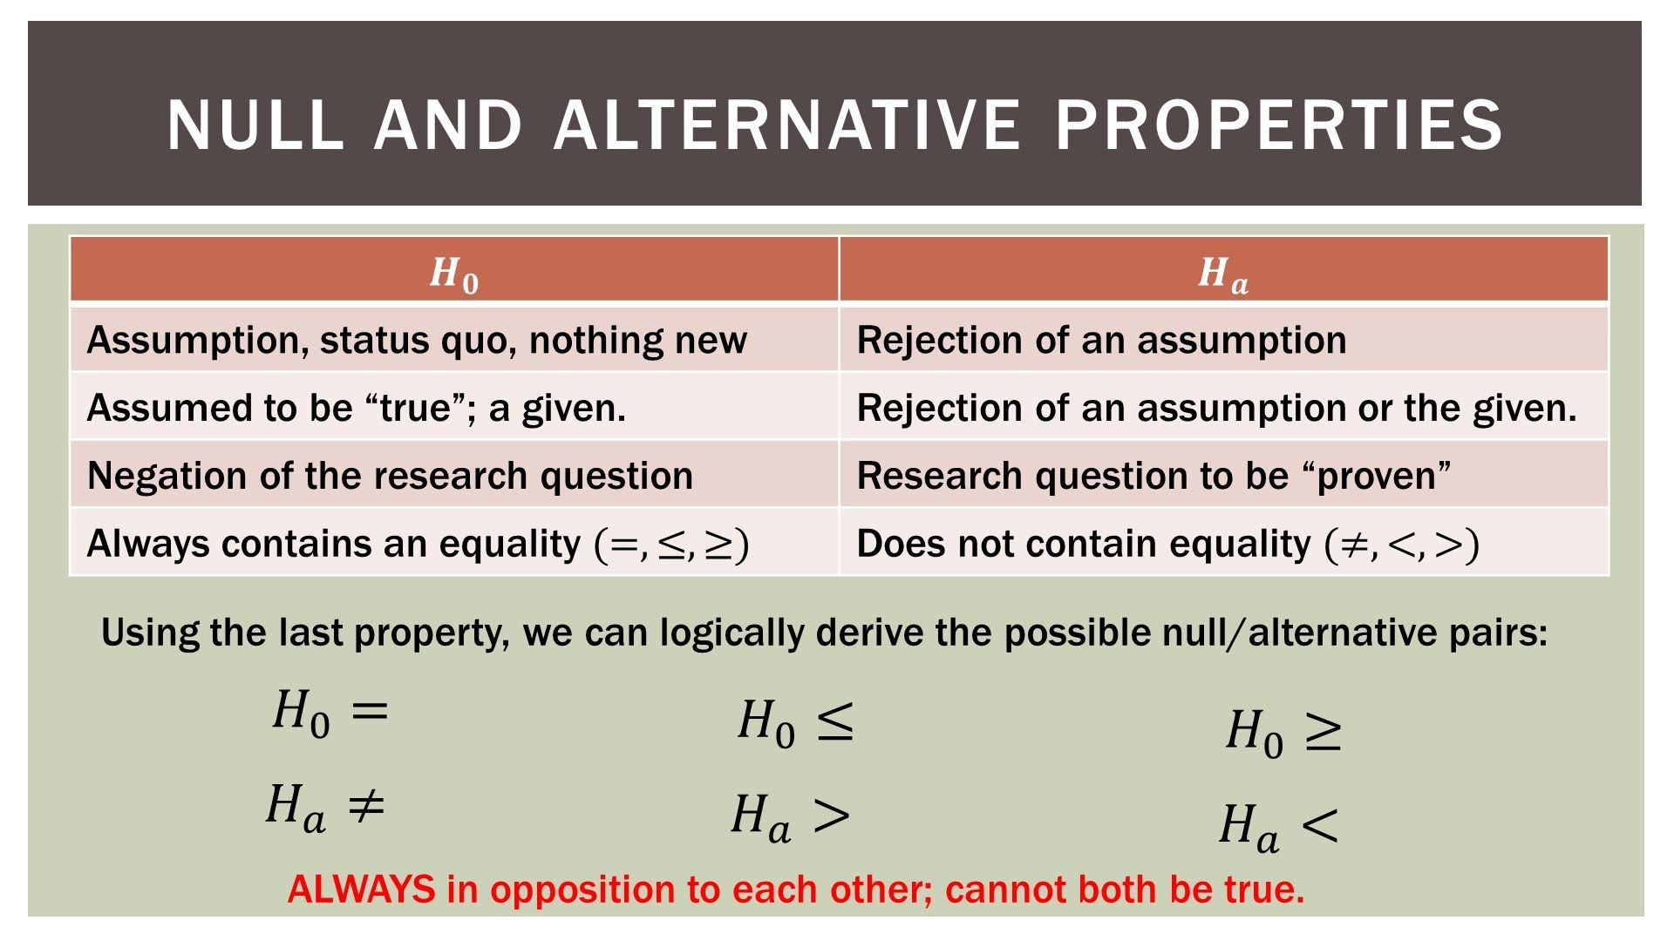
Null and Alternate Hypothesis

Slide 12
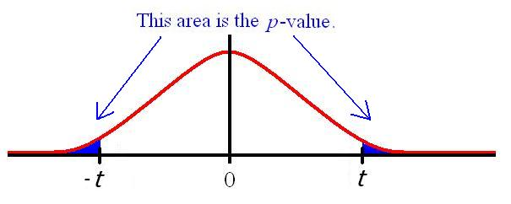
Converting Business Hypothesis to Statistical Test
Understanding
Diagnosis
Hypothesis
Evaluation
Prototype
Output
Hypothesis enables further analysis process and root causes of investigation.
E.g. (Business problem examples)
Most Customers in my target segment are in the age group of 31- 50
30% of patients tested for cancer are detected to be positive.
Task: What is the Null/alternate hypothesis for above examples?
Null vs. Alternate Hypothesis (Loan default example)
Tip: Best way to identify null/ alternate
(Status Quo vs. challenging statement)
p- value: Level of Significance
Accept / reject null using critical regions
Notes:
This is where tech background learners are most confused hence explanations need to be detailed.
https://www.investopedia.com/articles/active-trading/092214/hypothesis-testing-finance-concept-examples.asp#toc-example-2
https://stats.libretexts.org/Courses/Fresno_City_College/Book%3A_Business_Statistics_Customized_(OpenStax)/09%3A_Hypothesis_Testing_with_One_Sample/9.05%3A_Full_Hypothesis_Test_Examples

Slide 13
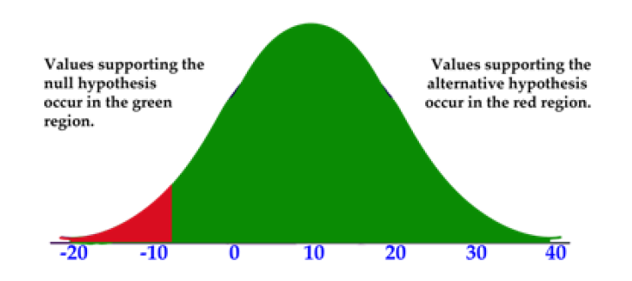
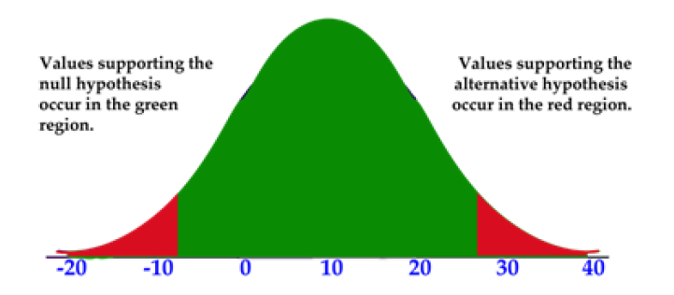
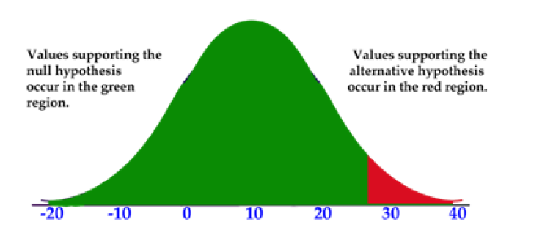
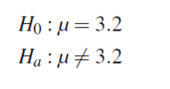
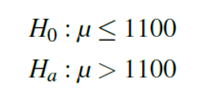

Hypothesis Testing and their Tails

Slide 14
Central Limit Theorem
Infer population behaviour using sample data
Sample mean (µ)
Sample Standard error (sigma/ √n) where n = count of observations
Confidence interval (Range for margin of error)
Chosen level of significance
Z-score as per significance level represents acceptable levels of deviation from mean
Prediction using the Confidence intervals:
Wider range ensures higher tolerance, but precision is lowered.
95% confidence is preferred in most business cases.
Business example:
Estimation of expected consumers for new products as per survey
Expected inventory planning using tolerance levels.
Notes:
Showing them calculation will help understand the concept.
Those with economics or statistics background will gain from real life business examples

Slide 15
Quiz?
What is the difference between normal distribution and standard normal distribution?
Notes:
https://www.statology.org/normal-distribution-vs-standard-normal-distribution/

Slide 16

Personalized Feedback and Doubt resolution
Doubt Resolution
Questions??

