Slide 1
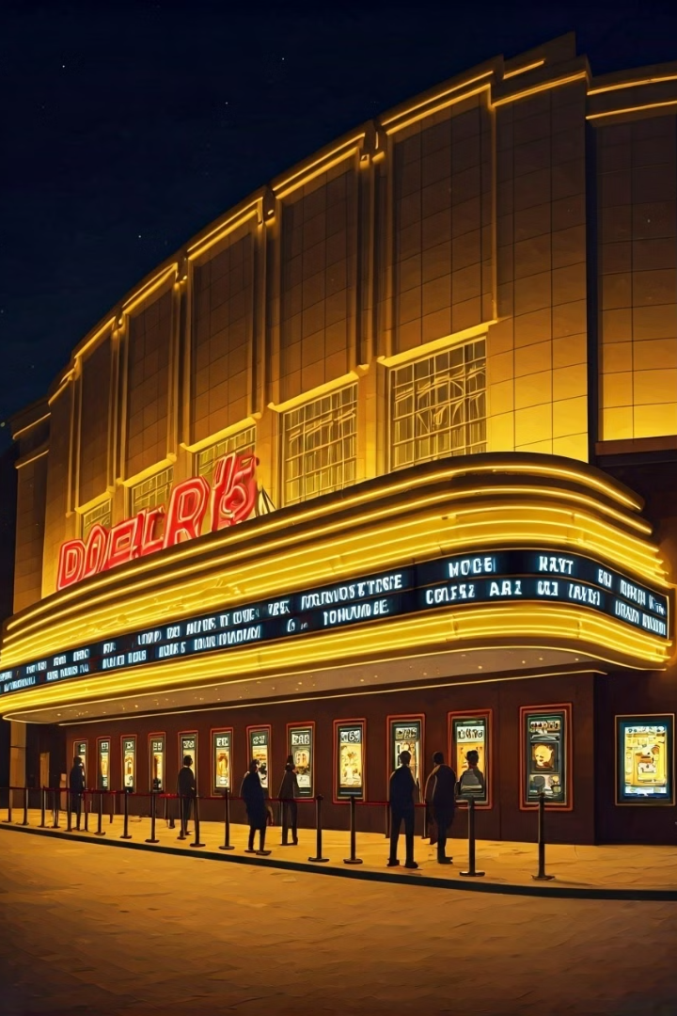
Revolutionizing Movie Ticket Booking
Introducing our comprehensive movie ticket booking application, designed to streamline the process of finding, selecting, and purchasing tickets for your favorite films. With a user-friendly interface and powerful backend capabilities, our platform aims to redefine the way moviegoers experience the joy of cinema.

Slide 2
Intuitive User Interface
Responsive Design
Interactive Browsing
Smooth Booking Process
Our application is built with a mobile-first approach, ensuring a seamless user experience across all devices. Whether you're booking tickets on the go or from the comfort of your home, our responsive design adapts to your screen size, providing a consistent and visually appealing interface.
Explore movie listings with ease using our dynamic search and filtering options. Quickly find films based on genre, ratings, showtimes, and more, allowing you to make informed decisions about your movie-going experience.
The ticket booking process is streamlined and intuitive, guiding you through seat selection, payment, and confirmation. Our user-friendly interface minimizes friction, ensuring a hassle-free experience from start to finish.

Slide 3
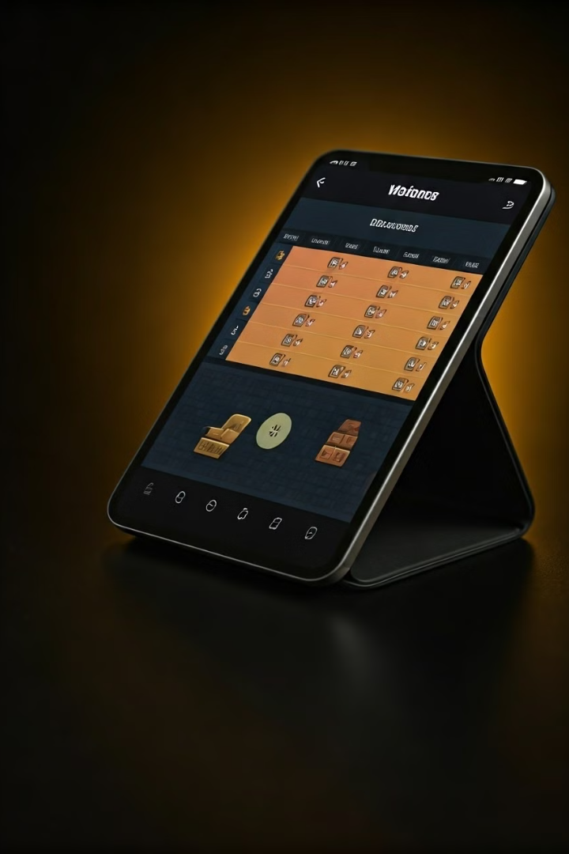
Intelligent Seat Selection
1
Seat Availability
Our application dynamically updates the available seats for each showtime, ensuring you can easily visualize and select the best spots for your viewing experience.
2
Seating Layout
The seating layout is clearly displayed, allowing you to choose the perfect seats based on your preferences, such as proximity to the screen, aisle access, or group seating arrangements.
3
Real-time Updates
As seats are booked, the application updates the seating chart in real-time, providing you with the most accurate and up-to-date information to make your selection.

Slide 4
Enhanced Ticket Management
Ticket Delivery
Ticket Modifications
Receive your tickets instantly upon completion of the booking process, either as mobile passes or printable PDF tickets. This ensures a seamless and convenient experience, eliminating the need for physical ticket collection.
Our application allows you to easily manage your tickets, facilitating actions such as rescheduling, upgrading, or even cancellations. This flexibility empowers you to adjust your plans without hassle.
Ticket History
Ticket Sharing
Access your complete ticket purchase history, including past and upcoming bookings, for a comprehensive overview of your movie-going activities. This feature enables you to keep track of your preferences and experiences.
Share your tickets with friends and family seamlessly, allowing them to access and manage their own copies of the tickets. This feature enhances the social aspect of the movie-going experience.

Slide 5





Seamless Payment and Checkout
Secure Payments
Mobile Wallet Support
Loyalty Integration
Gift Card Redemption
Our application integrates with leading payment gateways to provide a safe and reliable checkout experience. Rest assured that your financial information is protected throughout the transaction.
For added convenience, our application supports mobile wallet integration, allowing you to use your preferred digital payment methods, such as Apple Pay or Google Pay, for a streamlined checkout process.
Earn rewards and redeem points through our seamless integration with loyalty programs, ensuring you can maximize the benefits of your movie-going experiences.
Conveniently redeem gift cards and promotional codes during the checkout process, making it easy to apply discounts and offers to your ticket purchases.

Slide 6
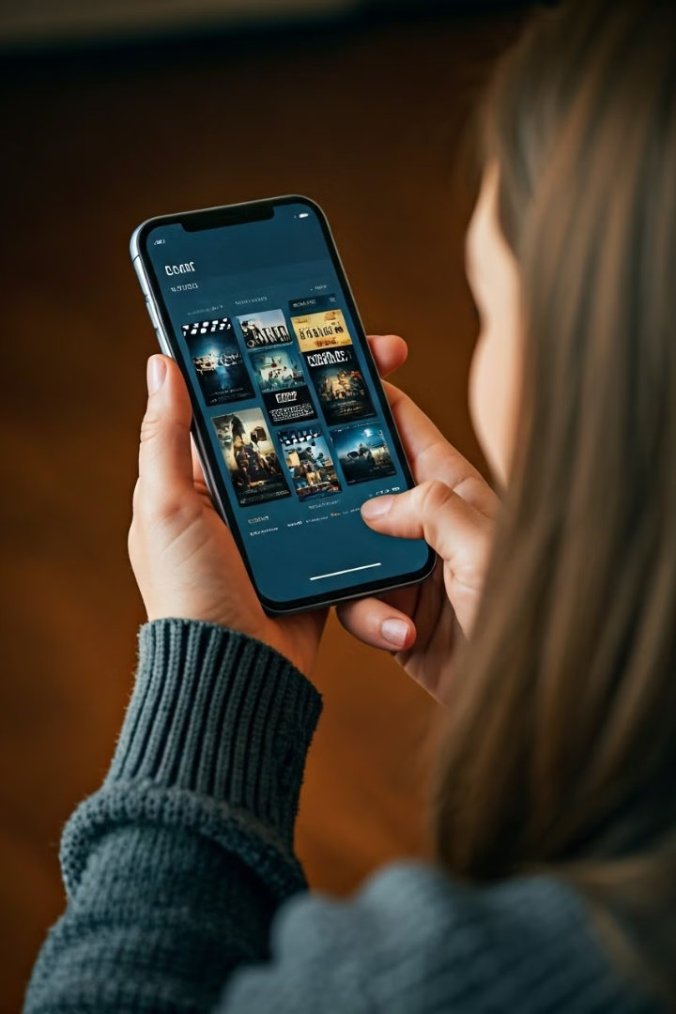
Personalized Recommendations
1
Personalized Movie Suggestions
Our advanced recommendation engine analyzes your viewing history and preferences to suggest movies that align with your tastes, ensuring you never miss a film you'll love.
2
Upcoming Event Notifications
Receive timely notifications about upcoming movie premieres, special events, or limited-time screenings that might interest you, keeping you informed and engaged with the latest cinematic offerings.
3
Personalized Promotions
Enjoy exclusive discounts, bundle offers, and personalized promotions tailored to your movie-going habits, allowing you to save on your ticket purchases and enhance your overall experience.
4
Saved Preferences
Your personal preferences, such as favorite genres, actors, or showtimes, are saved and used to provide a more personalized and streamlined booking process on each subsequent visit.

Slide 7
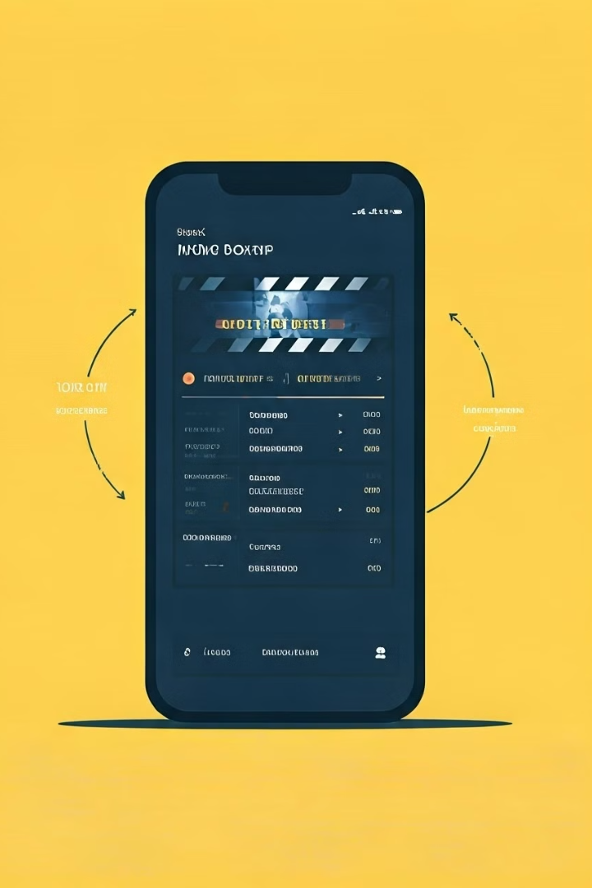



Seamless Integration with Theaters
Synchronized Showtime Data
Our application seamlessly integrates with theater management systems, ensuring real-time synchronization of showtimes, movie information, and seat availability across all locations.
Automated Ticket Fulfillment
When you complete a booking, the tickets are automatically issued and made available for immediate access, eliminating the need for manual processing or delays.
Streamlined Communication
Our platform facilitates seamless communication between users and theaters, allowing for efficient management of booking changes, cancellations, and updates to enhance the overall experience.

Slide 8
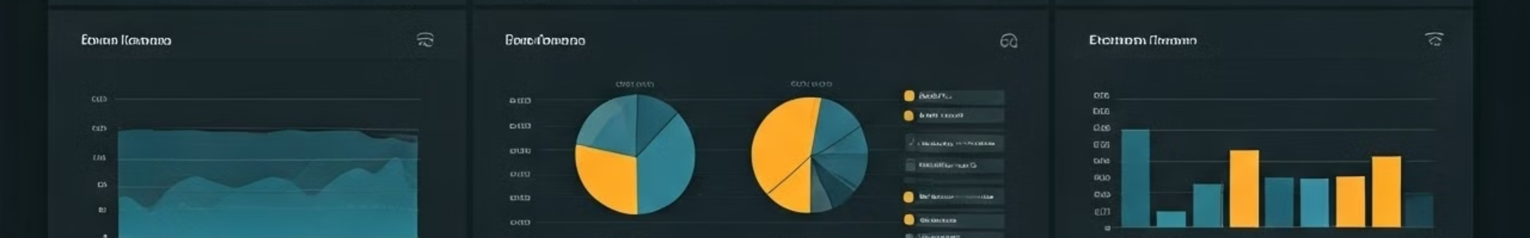
Powerful Analytics and Reporting
Ticket Sales
Detailed reports on ticket sales, including revenue, volume, and trends across different locations, showtimes, and movie titles.
User Behavior
Comprehensive analytics on user engagement, such as browsing patterns, seat selection preferences, and conversion rates, providing valuable insights to optimize the platform.
Marketing Effectiveness
Analyze the impact of targeted marketing campaigns, promotions, and recommendations, enabling data-driven decisions to enhance customer acquisition and retention.
Operational Efficiency
Monitor and optimize operational aspects, such as seat utilization, ticket fulfillment, and customer service response times, to improve overall efficiency and service quality.

