Slide 1


Introduction to Docker
Docker revolutionizes how we build, ship, and run applications through containerization. With 32% market share, it leads the industry in creating consistent environments across development and production.
by Mahendra js

Slide 2
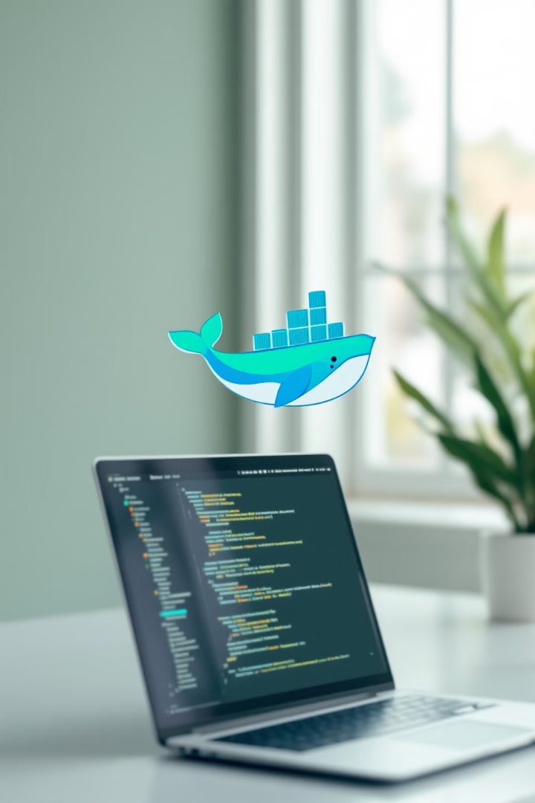



What is Docker?
Open-Source Platform
Develops, ships, and runs applications in isolated environments
Infrastructure Decoupling
Separates applications from underlying infrastructure
Lightweight Architecture
Ensures efficient resource usage with minimal overhead

Slide 3
Docker vs. Virtual Machines
Docker Containers
Virtual Machines
Share host OS kernel
Run full OS copy
Lightweight (MBs)
Heavy (GBs)
Start in seconds
Start in minutes
Higher density
Lower density

Slide 4





Docker Architecture
Docker Client
Command-line interface for users to interact with Docker
Docker Daemon
Background service managing containers, images, and volumes
REST API
Communication protocol between client and daemon
Docker Desktop
GUI application for Windows and Mac users

Slide 5








Docker Containers and Images
Images
Build
Read-only templates with application code and dependencies
Create images from Dockerfiles or existing containers
Run
Containers
Execute containers with commands like: docker run -it ubuntu /bin/bash
Runtime instances of images with read-write layer

Slide 6

Dockerfile and Image Creation
Run Container
Verify Image
Start with: docker run python-app
Build Image
Check with: docker images
Create Dockerfile
Run: docker build -t python-app .
Write instructions in a text file: FROM, COPY, RUN, CMD

Slide 7

Docker Hub and Registries
Docker Hub
Pull Images
Push Images
Public registry hosting thousands of official and community images
Download images using: docker pull ubuntu
Share images using: docker push my-image
Free tier available
Specify tags
Private repositories
Version control
Automatic caching
Access control

Slide 8






Why Use Docker?
Rapid Development
From code to production in minutes
Responsive Scaling
Spin up instances instantly as needed
Cost Efficiency
Maximize hardware utilization and reduce waste

