Slide 1

Introduction to Git
Git is a distributed version control system designed to track changes in source code during software development.
Created by Linus Torvalds in 2005, Git has become the industry standard for version control, enabling developers to collaborate efficiently on projects of any size.
Version control systems allow developers to track changes to files over time, revert to previous versions, and collaborate with others without overwriting each other's work
by Mahendra js

Slide 2
GIT & GITHub : Version Control System
GIT is free, opensource version control system.
Version Control System - VCS helps a software team manage changes to source code over time.
Version control software keeps track of every modification to the code in a special kind of database.
VCS System helps team to rollback to previous version in case of any issue with specific Version.
Need of Version Control System.
➤
➤
➤
➤
➤

Slide 3
GIT & GITHub : Version Control System
Types of VCS
Centralized Version Control System (CVCS) Distributed Version Control System (DVCS)
Centralized VCS - CVCS uses a central server to store all files and enables team collaboration.
CVCS works on a single repository to which users can directly access a central server.
➤
➤
➤
➤
➤

Slide 4
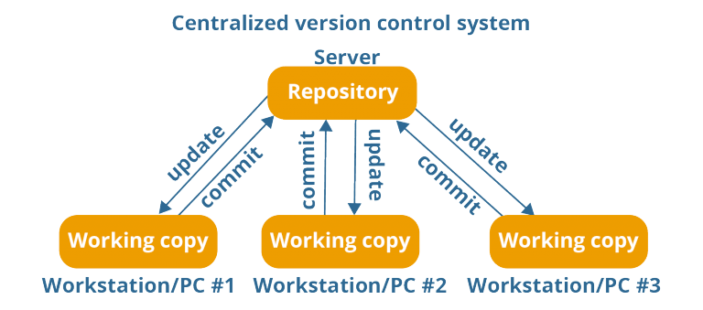
GIT & GITHub : Version Control System
➤
Here Each WorkStation is connect with Central Code Repository.
Drawbacks - It is not locally available.
Crash of CVCS will result in losing the entire data of the project.
➤
➤

Slide 5
GIT & GITHub : Version Control System
➤
Distributed Version Control System-
In Distributed VCS, every contributor has a local copy or “clone” of the main repository.
User can change and commit local Repo without any interference.
User can update their local Repo from the Central Server. User can update the Central Server from their Repo.
➤
➤
➤
➤

Slide 6
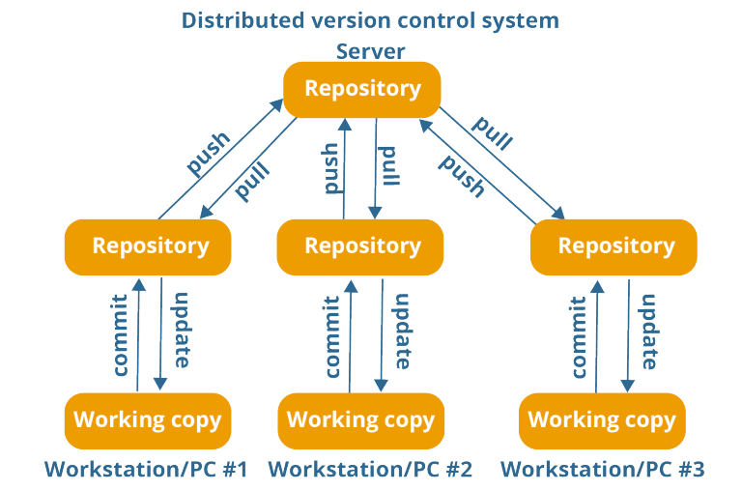
GIT & GITHub : Version Control System
➤
Operations in DVCS are fast.
New changes can be done locally without manipulating the central data.
If the central server gets crashed at any point of time, the lost data can be easily recovered from any one of the contributor’s local repositories.
➤
➤

Slide 7
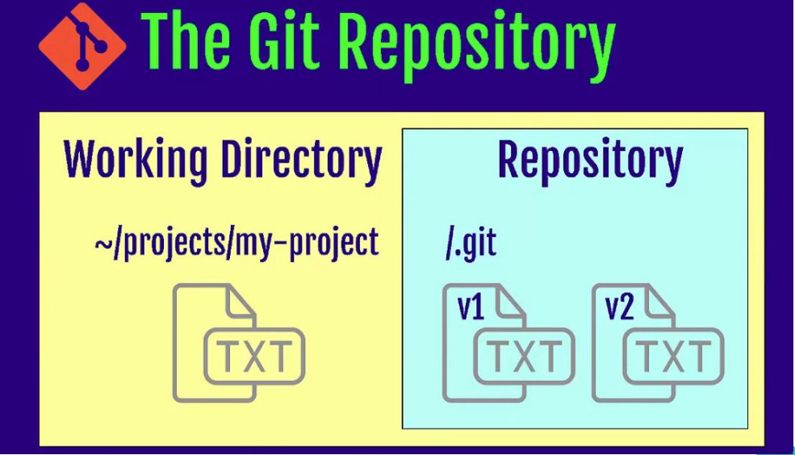
GIT & GITHub : Version Control System
➤
Git Repository
➤
GIT Repository contains Files, History, Config Managed by GIT.

Slide 8
GIT & GITHub : Version Control System
➤
Stage of GIT -
➤
Working Directory
Staging Area Git Directory
➤
➤
➤
Working Directory - Area of Live Files, also known as Untracked area of GIT.
Staging Area - Staging Area is when git starts tracking and saving changes that occur in files.
Git Directory - Also called ‘local Repo’, is your .git repo. It’s area where GIT save everything.
➤
➤

Slide 9
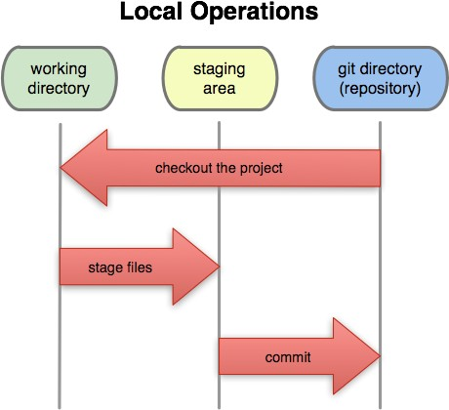
GIT & GITHub : Version Control System

Slide 10
GIT & GITHub : Version Control System
Remote Repository - GITHub
Remote repository is stored on a code hosting service like GitHub or on an internal server.
Branch in GIT - Branch in Git is a way to keep developing and coding a new feature or modification to the software and still not aﬀecting the main part of the project.
➤
➤
➤

Slide 11
GIT & GITHub : Version Control System
➤
GIT is open source and can be installed on all major OS.
➤
Linux
Mac Windows
➤
➤

Slide 12




Key Concepts
Repository
Commit
A storage location for your project. It contains all of your project's files and the entire revision history. Repositories can be local (on your computer) or remote (on a server).
A snapshot of your repository at a specific point in time. Each commit has a unique identifier and includes changes made since the last commit.
Merge
Branch
The process of combining changes from different branches. Merging integrates the changes from one branch into another.
An independent line of development that lets you work on features or fixes without affecting the main codebase until you're ready to merge your changes.

Slide 13
Setting Up Git
Install Git
Download and install Git from git-scm.com. Available for Windows, macOS, and Linux. Follow the installation wizard with default settings for simplicity.
Configure User Information
Set up your identity with commands: git config --global user.name "Your Name" and git config --global user.email "your.email@example.com". This information is included in each commit you make.
Initialize a Repository
Navigate to your project directory and run git init to create a new Git repository. This creates a hidden .git folder that stores all version control information.

Slide 14






Basic Git Workflow
Staging Area
A preparation area where you place files that you want to commit. Also known as the "index".
Working Directory
Contains the actual files you edit directly. This is where you make changes to your project files.
Repository
Where Git permanently stores your data as snapshots (commits) after you run the commit command.
This three-stage workflow is at the heart of Git's operation. You modify files in the working directory, selectively stage the changes you want to include in your next commit, then commit those changes to permanently store them in your Git repository.

Slide 15
Essential Git Commands
git init
Creates a new Git repository in the current directory
git add
Adds file changes to the staging area for the next commit
git commit
Records the staged snapshot in the project history
git status
Shows the status of changes as untracked, modified, or staged
git log
Displays a chronological list of commits
git diff
Shows the differences between working directory and staging area
These commands form the foundation of your daily Git usage. Understanding them well will allow you to perform most common version control tasks. As you become more comfortable with Git, you'll naturally expand your command repertoire.

Slide 16




Branching and Merging
Create Branch
Switch Branch
Merge Changes
Delete Branch
Use git branch [branch-name] to create a new branch, or git checkout -b [branch-name] to create and switch to it immediately.
Use git checkout [branch-name] to switch between branches. Your working directory will update to reflect the branch's files.
First checkout the target branch, then use git merge [source-branch] to incorporate changes from the source branch.
After merging, clean up with git branch -d [branch-name] to remove the merged branch if no longer needed.
Branching is Git's superpower. It allows multiple developers to work on different features simultaneously without interfering with each other. When work is complete, branches can be merged back together, combining everyone's changes.

Slide 17






Collaborating with Git
Pull Requests
Propose changes and request reviews
Push & Pull
Share and retrieve changes
Remote Repositories
Central storage on services like GitHub
Remote repositories are hosted versions of your project that all team members can access. Platforms like GitHub, GitLab, and Bitbucket provide services for hosting these repositories and add collaboration features.
The git push command sends your local commits to the remote repository, while git pull fetches and merges changes from the remote. Pull requests are a feature of hosting platforms that allow you to propose changes, discuss modifications, and merge code when everything is approved.

Slide 18



Git Best Practices
Commit Often
Write Clear Commit Messages
Make small, focused commits that address a single issue or feature. This creates a more detailed history and makes it easier to identify when and where problems were introduced.
Use present tense, imperative style messages that explain what the commit does, not what you did. A good format is: "Fix bug in authentication flow" rather than "Fixed bug" or "I fixed a bug."
Use Feature Branches
Review Before Committing
Create a new branch for each feature or bug fix. This keeps the main branch stable and allows you to work on multiple features in parallel without interference.
Always check what you're about to commit with git diff or git status. This helps avoid committing unintended changes, debug statements, or sensitive information.

