Slide 1

Mahendra
Technical Instructor
Docker & Kubernetes

Slide 2
Kubernetes or k8s
Container + orchestration

Slide 3
What is Container ?
A container is an “instantiation” of an image, or in other words an image that is put into action.
Images are put into action with container engines. Once it is put into action, it can do what it was meant to do

Slide 4
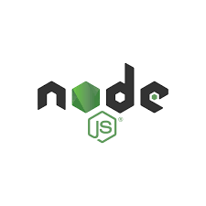


Why do you need containers ?
webserver
database
orchestration
Compatibility/Dependency
Long setup time
Different Dev/test/prod
Environments
Libraries
Dependencies
os
Hardware infrastructure

Slide 5
Container Technology
One way to resolve these conflicts is to package and deploy the application as a container.
A container is a set of one or more processes that are isolated from the rest of the system.
Software containers provide a way to package applications and to simplify their deployment and management.

Slide 6



What can it do ?
webserver Libs/Dep
Database Libs/Dep
orchestration Libs/Dep
Container
Container
Container
Containerize Applications
Run each service with its
Won dependencies in separate
Containers
Docker
os
Hardware infrastructure

Slide 7
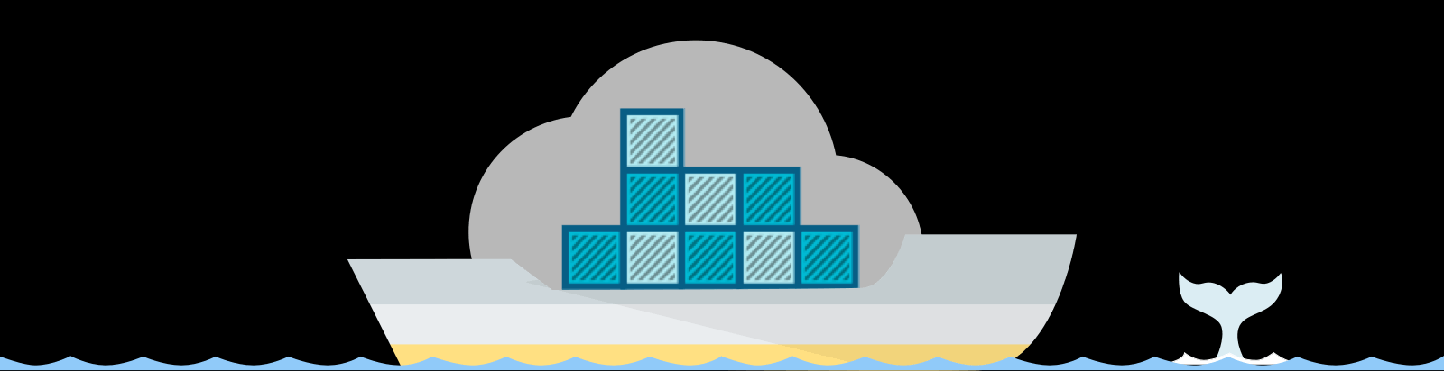
Containers
Container wrap a pieces of software in a complete file system that contains everything it needs to run:
code
Runtime
System tools
System libraries

Slide 8
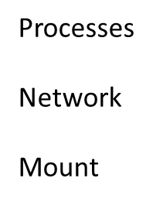
What are containers ?
container
container
container
Processes
Network
Mount
Docker
os kernel
Notes:
what are containers? Containers are completely isolated environments, as in they
can have their own processes or services, their own network interfaces, their own
mounts, just like Virtual machines, except that they all share the same OS kernel.

Slide 9




Operating system
software
software
software
software
OS kernel
Hardware

Slide 10




Sharing the kernel
software
software
software
software
Docker
OS ubuntu

Slide 11
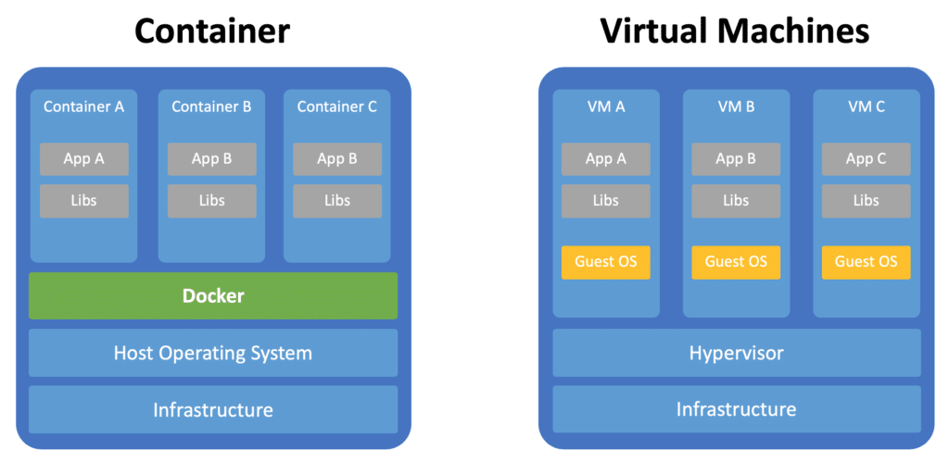
Containers vs Virtualization Machines

Slide 12
Virtual Machine
Enables multiple operating systems to run simultaneously on a single hardware platform.
Uses a hypervisor to divide hardware into multiple virtual hardware systems.
Requires a complete operating system environment to support the application

Slide 13
Containers
Runs directly on the host operating system, and it shares resources with all containers on the system.
Shares the host's kernel, but it isolates the application processes from the rest of the system.
Requires far fewer hardware resources than virtual machines, so containers are also quicker to start.
Includes all dependencies, such as system and programming dependencies, and configuration settings.

Slide 14
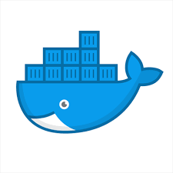
How is it done ?
docker run ansible docker run mongodb docker run nodejs docker run redis

Slide 15

Container Engine
A Container Engine allows a container to run as an independent application directly in an operating system.
Container engines also:
Provide a network interface Separate containers from each other
Provide a way for containers to access external storage

Slide 16
What is container image?
A container image is like the skeleton of an application with just enough of an operating system so that it can work.
It can be thought of as the root filesystem of the application.

Slide 17
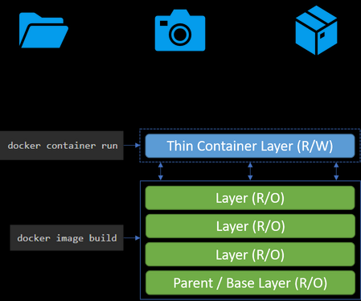
Container vs Image in Practice
An image is a collection of one or more RO layers
A container is an instantiation of an image
A container adds a RW layer on top of the RO image layer(s) where all changes are captured

Slide 18
Container vs image
. Image packs up the application and environment required by the application to run.
. A container is a running instance of the image.

Slide 19
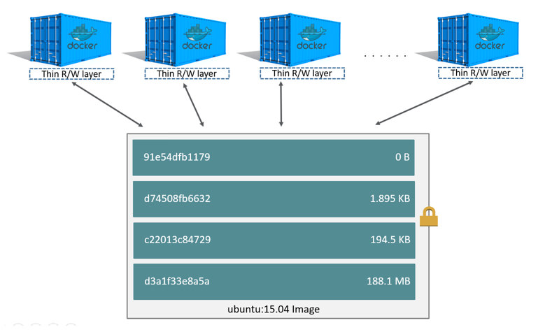
Use of Disk Space
A single image can be used by multiple containers simultaneously.
The only additional disk space used is in the RW layers or each of the containers.

Slide 20
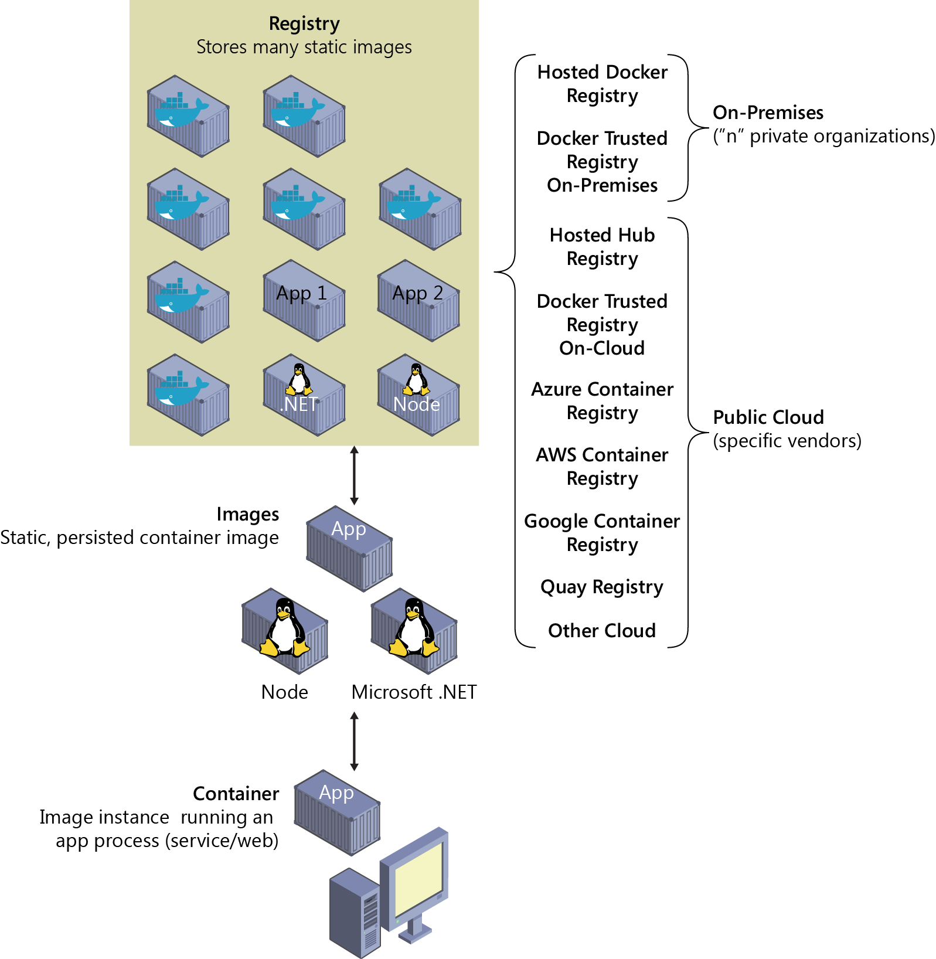
Image Registries
Images are stored in repositories called Image Registries.
Images can be downloaded pulled locally when needed to launch containers.

Slide 21

Orchestration
The platform must ensure the availability of containers that provide essential services.
The environment must respond to application usage spikes by increasing or decreasing the number of running containers and by load balancing the traffic.
The platform must detect the failure of a container or a host and react accordingly.
Developers might need an automated workflow to deliver later application versions transparently and securely.

Slide 22
Container orchestration
Orchestration
MySQL Docker Host
webserver Docker Host
webserver Docker Host
Webserver Docker Host

Slide 23
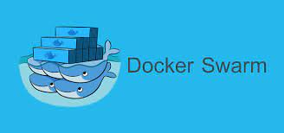


Orchestration Technologies

Slide 24
What is Kubernetes?
It is a container orchestration technology used to orchestrate the deployment and management of hundreds and thousands of containers in a clustered environment.

Slide 25
What Does Kubernetes Provide?
Provides a complete orchestration solution for container-based applications
– Deploy Applications
– Manage Applications
– Access Applications
– Scale Applications
Provides for scheduling of containers

Slide 26
Kubernetes
Kubernetes is an orchestration service that deploys, manages, and scales container-based applications across a cluster of container hosts.
Kubernetes redirects traffic to your containers with a load balancer, so that you can scale the number of containers that provide a service.
Kubernetes also supports user-defined health checks to monitor your containers and to restart them if they fail.

Slide 27
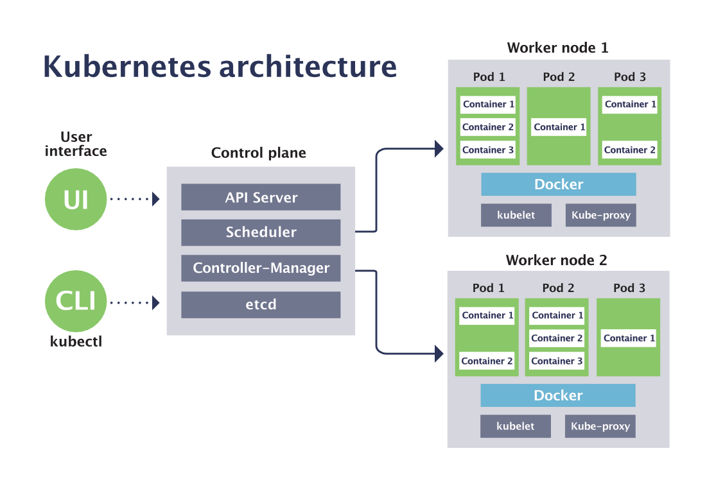


Container Runtime Engine
Run containers
Container Runtime Engine
Run containers

Slide 28
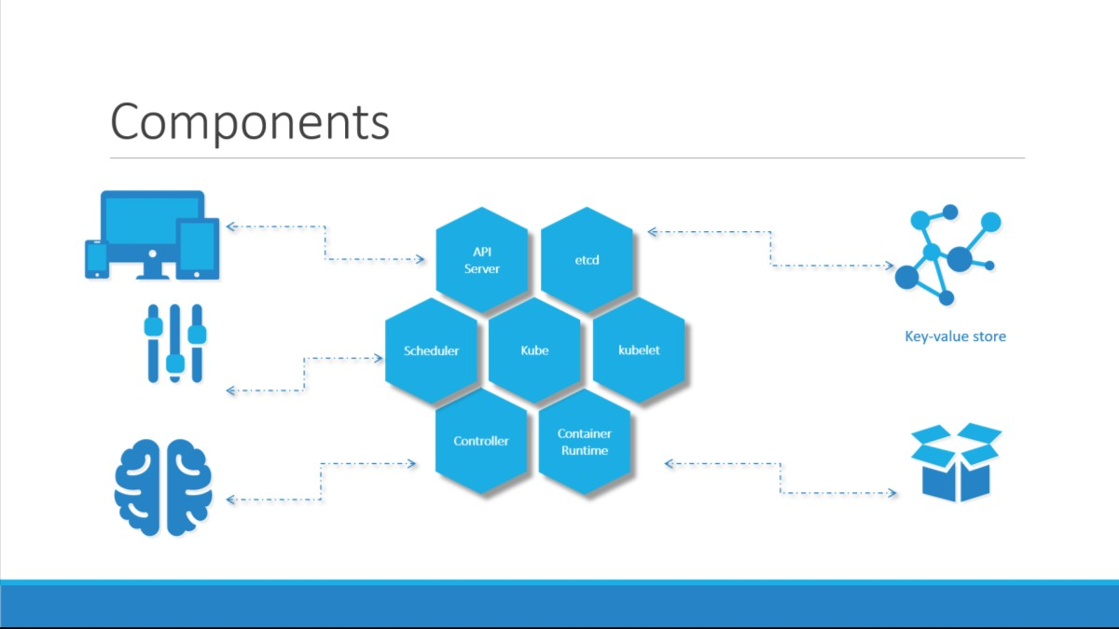

Slide 29
Control Plane Components
kube-apiserver
The API server is a component of the Kubernetes control plane that exposes the Kubernetes API.
The API server is the front end for the Kubernetes control plane.
etcd
Consistent and highly-available key value store used as Kubernetes' backing store for all cluster data.
kube-scheduler
Control plane component that watches for newly created Pods with no assigned node, and selects a node for them to run on

Slide 30
Control Plane Components
kube-controller-manager
Control Plane component that runs controller processes.
Some types of these controllers are:
Node controller: Responsible for noticing and responding when nodes go down.
Job controller: Watches for Job objects that represent one-off tasks, then creates Pods to run those tasks to completion.
Endpoints controller: Populates the Endpoints object (that is, joins Services & Pods).
Service Account & Token controllers: Create default accounts and API access tokens for new namespace

Slide 31
Node Component
kubelet
An agent that runs on each node in the cluster. It makes sure that containers are running in a Pod.
The kubelet takes a set of Pod Specs that are provided through various mechanisms and ensures that the containers described in those Pod Specs are running and healthy.
The kubelet doesn't manage containers which were not created by Kubernetes
Create Pods, Register node and monitor node and pods.

Slide 32
Node Component
kube-proxy
kube-proxy is a network proxy that runs on each node in your cluster, implementing part of the Kubernetes Service concept.
kube-proxy maintains network rules on nodes. These network rules allow network communication to your Pods from network sessions inside or outside of your cluster.
Container runtime
The container runtime is the software that is responsible for running containers.

Slide 33

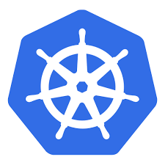
Architecture
Node
Node
Cluster
Master
Node1 | Node2 | Node3

Slide 34
Master vs Worker Nodes
</> kube-apiserver etcd Controller Scheduler Master
</> kubelet Container runtime Worker node
rkt
Cri-O

Slide 35
kubectl
Kubectl run hello-minikube
Kubectl cluster-info
Kubectl get nodes

Slide 36
Setup Kubernetes
.Minikube
.Kubeadm
In Cloud
.Google cloud platform
.Amazon web service
.Microsoft Azure

Slide 37
Design a kubernetes cluster

Slide 38
Objectives
Node Considerations
Resource Requirements
Network Considerations

Slide 39
Ask
Purpose
. Education
. Development & Testing
. Hosting Production Applications
Cloud or On Prem?
Workloads
How many?
What kind?
. Web
. Big Data/Analytics
Application Resource Requirements
. CPU Intensive
. Memory Intensive
Traffic
. Heavy traffic
. Burst Traffic

Slide 40
Purpose
.Education
.Minikube
.Single node cluster with kubeadm/GCP/AWS
.Development & Testing
.Multi-node cluster with a Single Master and Multiple workers
.Setup using kubeadm tool or quick provision on GCP or AWS or AKS

Slide 41
Hosting Production Applications
High Availability Multi node cluster with multiple master nodes
Kubeadm or GCP or Kops on AWS or other supported platforms
Upto5000 nodes
Upto150,000 PODs in the cluster
Upto300,000 Total Containers
Upto100 PODs per Node

Slide 42
Cloud or On prem?
Use Kubeadm for on prem
GKE for GCP
Kops for AWS
Azure Kubernetes Service(AKS) for Azure

Slide 43
Storage
High Performance –SSD Backed Storage
Multiple Concurrent connections –Network based storage
Persistent shared volumes for shared access across multiple PODs
Label nodes with specific disk types
Use Node Selectors to assign applications to nodes with specific disk types

Slide 44
Nodes
Virtual or Physical Machines
Minimum of 4 Node Cluster (Size based on workload)
Master vs Worker Nodes
Linux X86_64 Architecture
Master nodes can host workloads
Best practice is to not host workloads on Master nodes

Slide 45
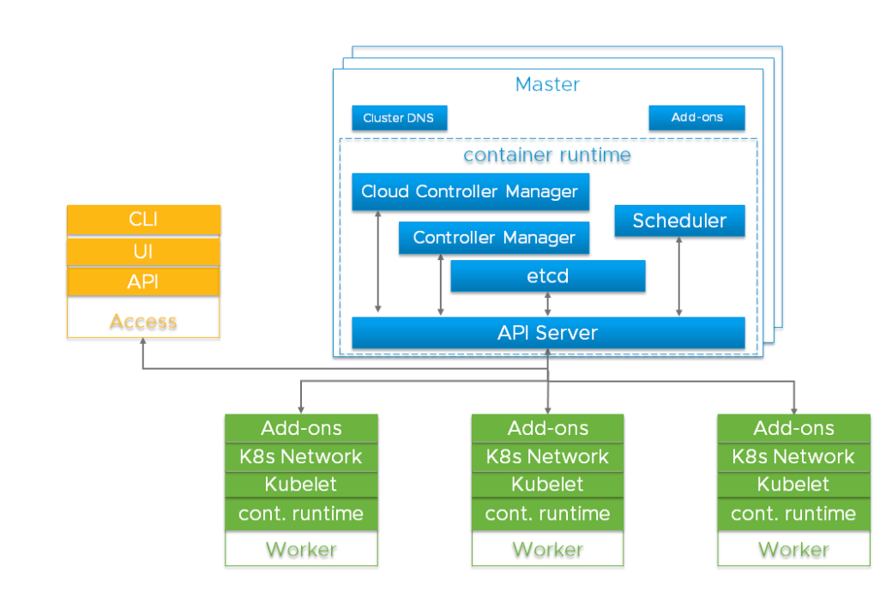
Master & Worker Nodes

Slide 46



Slide 47
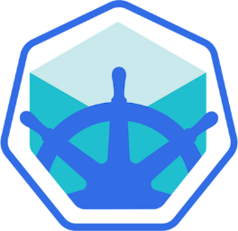
KUBEADM
Minikube
Deploys VMs
Requires VMs to be ready
Singe Node Cluster
Singe/Multi Node Cluster

Slide 48
Turnkey Solutions
You Provision VMs
You Configure VMs
You Use Scripts to Deploy Cluster
You Maintain VMs yourself
Eg: Kubernetes on AWS using KOPS
Hosted Solutions
(Managed Solutions)
Kubernetes-As-A-Service
Provider provisions VMs
Provider installs Kubernetes
Provider maintains VMs
Eg: Google Container Engine (GKE)

Slide 49





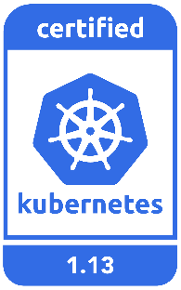


Turnkey Solutions
OpenShift
Cloud Foundry Container Runtime
VMware Cloud PKS
Vagrant

Slide 50

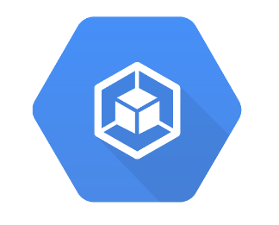

Hosted Solutions
Google Container Engine
(GKE)
Open Shift
Online
Amazon Elastic
Container Service
For kubernetes
(EKS)
Azure Kubernetes
Service

Slide 51




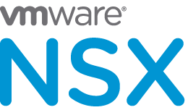



Networking Solution
GCE

Slide 52


Our Design
M
POD CIDR: 10.32.0.0/12
Service CIDR: 10.96.0.0/24
W
W

Slide 53
Nodes
Virtual or Physical Machines
Minimum of 4 Node Cluster (Size based on workload)
Master vs Worker Nodes
Linux X86_64 Architecture
Master nodes can host workloads
Best practice is to not host workloads on Master nodes

Slide 54

Minikube
Kubelet Kube-apiserver Etcd Node-controller Replication-controller Container runtime Minikube Node

Slide 55
Master & Worker Nodes

Slide 56
Kubernetes API Primitives
Kubernetes API primitive, also known as Kubernetes objects, are the basic building blocks of any application running in Kubernetes
Examples:
Pod
Node
Service
Service Account
Two primary members
Spec, desired state
Status, current state

Slide 57
Kubernetes API
The Kubernetes API is the front end of the Kubernetes control plane and is how users interact with their Kubernetes cluster.
The API (application programming interface) server determines if a request is valid and then processes it.
In essence, the API is the interface used to manage, create, and configure Kubernetes clusters.
It's how the users, external components, and parts of your cluster all communicate with each other.

Slide 58
How API Works
The core of Kubernetes' control plane is the API server.
The API server exposes an HTTP API that lets end users, different parts of your cluster, and external components communicate with one another.
The Kubernetes API lets you query and manipulate the state of API objects in Kubernetes (for example: Pods, Namespaces, ConfigMaps, and Events).
Most operations can be performed through the kubectl command-line interface or other command-line tools, such as kubeadm, which in turn use the API.

Slide 59
API Versioning
Three tiers of api maturity levels also referenced within the object apiVersion.
Alpha
The software may contains bugs
Enabling a feature may expose bugs
Support for a feature may be dropped at any time without notice
Beta
The software is well tested
Enabling feature is considered safe
The support for a feature will not be dropped, though details may change
Stable
Released, stable and api schema will not change
The stable versions of feature appear in released software for many subsequent versions.

Slide 60
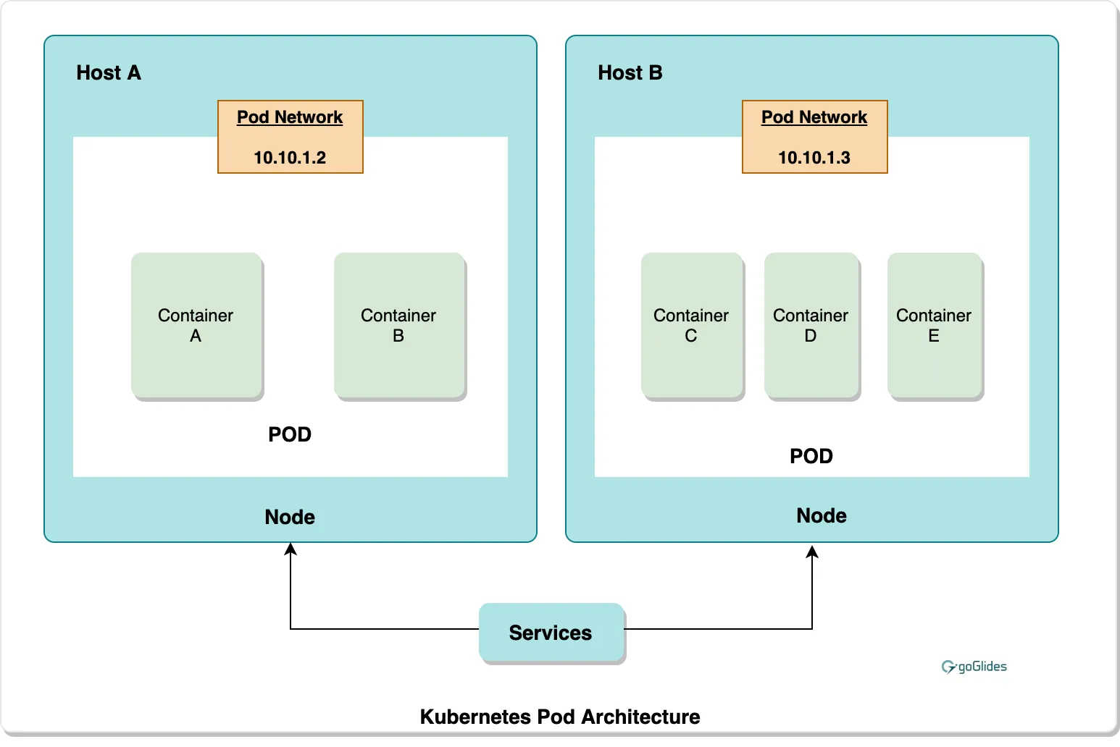
POD
A Pod is a group of one or more containers, with shared storage and network resources, and a specification for how to run the container.
Pods that run a single container.
Pods that run multiple containers that need to work together

Slide 61
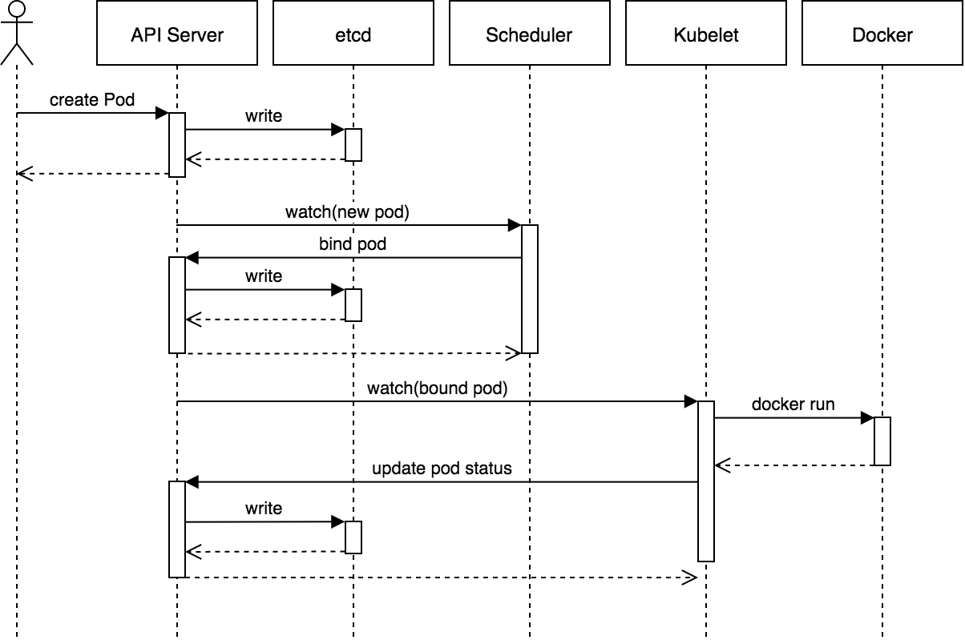
Birth of Pod

Slide 62
Pod Phase
Pending The Pod has been accepted by the Kubernetes cluster, but not created yet.
Running The Pod has been bound to a node, and all of the containers have been created. At least one container is still running or is in the process of starting or restarting.
Succeeded All containers in the Pod have terminated in success and will not be restarted.
Failed All containers in the Pod have terminated, and at least one container has terminated in failure. That is, the container either exited with non-zero status or was terminated by the system.
Unknown For some reason the state of the Pod could not be obtained. This phase typically occurs due to an error in communicating with the node where the Pod should be running.

Slide 63
Container States
Waiting If a container is not in either the Running or Terminated state, it is Waiting.
Running The Running status indicates that a container is executing without issues.
Terminated A container in the Terminated state began execution and then either ran to completion or failed for some reason.

Slide 64
Object model
Objects are a persistent entity that represent the desired state of the object within the cluster.
All objects must have
apiVersion
Kind
Metadata
Spec
apiVersion: v1
kind: Pod
metadata:
name: memory-demo
spec:
containers:
- name: memory-demo-ctr
image: polinux

Slide 65
Object Model requirement
apiVersion - Which version of the Kubernetes API you're using to create this object
kind - What kind of object you want to create
metadata - Data that helps uniquely identify the object, including a name string, UID, and optional namespace
spec - What state you desire for the object. The precise format of the object spec is different for every Kubernetes object, and contains nested fields specific to that object.

Slide 66
Object expression YAML
Files or other representations of kubernetes objects are generally represented in YAML.
A human friendly data serialization standard
User white space alignment to denote ownership
Three basic data types:
Mappings : hash or dictionary
Sequences: array or list
Scalars: string, number, Boolean etc

Slide 67
Object expression YAML
ApiVersion: v1 → scalar
Kind: Pod
Metadata
name: test → Mapping Hash Dictionary
Spec
containers: → Sequence array list
name:
image

Slide 68
Purpose of Manifests
Files that describe how Kubernetes should configure objects or even the cluster itself
Simpler than providing each instruction manually via the API or kubectl
Created/stored in YAML format
Designed for developers
Easy to integrate into source control

Slide 69
Best Practices for Manifests
One manifest deploys one component
Use versioned images for pods
Always use a Deployment (even for 1 pod)
Define/use environment variables

Slide 70
Probes
The kubelet can optionally perform and react to three kinds of probes on running containers:
liveness Probe: Indicates whether the container is running. If the liveness probe fails, the kubelet kills the container, and the container is subjected to its restart policy.
readiness Probe: Indicates whether the container is ready to respond to requests. If the readiness probe fails, the endpoints controller removes the Pod's IP address from the endpoints of all Services that match the Pod.
startup Probe: Indicates whether the application within the container is started.

Slide 71
Container Probes
A Probe is a diagnostic performed periodically by the kubelet on a Container. There are three handlers
Exec : Executes a specified command inside the container. The diagnostic is considered successful if the command exits with a status code of 0.
TCPSocket: Performs a TCP check against the Pod's IP address on a specified port. The diagnostic is considered successful if the port is open.
HTTPGet: Performs an HTTP GET request against the Pod's IP address on a specified port and path. The diagnostic is considered successful if the response has a status code greater than or equal to 200 and less than 400.

Slide 72
Init Containers
Init containers allow since pre-actions to run before the actual container is started .
Init containers run to completion sequentially.
Each init container must complete successfully before the next one starts
Example:
Copy source code from repo
Generate config file for application.
Check readiness of dependent services.

Slide 73
Termination of Pod
The user sends a command to delete a Pod.
The Pod object in the API server is updated with the time beyond which the Pod is considered “dead” (default of 30 seconds) along with the grace period.
The below actions happen in parallel:
The pod shows up as “Terminating” when listed in client commands.
When the Kubelet sees that a Pod has been marked as terminating because the time in 2 has been set, it begins the pod shutdown process.
The endpoint controller watches the pod is about to be deleted and hence removes the pod from all the endpoints which were serviced by the pod.
If the pod has defined a preStop hook, it is invoked inside of the pod. If the preStop hook is still running after the grace period expires, step 2 is then invoked with a small (2 second) extended grace period.
The processes in the Pod are sent the TERM signal.
When the grace period expires, any processes still running in the Pod are killed with SIGKILL.
The Kubelet will finish deleting the Pod on the API server by setting grace period 0 (immediate deletion). The Pod disappears from the API and is no longer visible from the client.

Slide 74
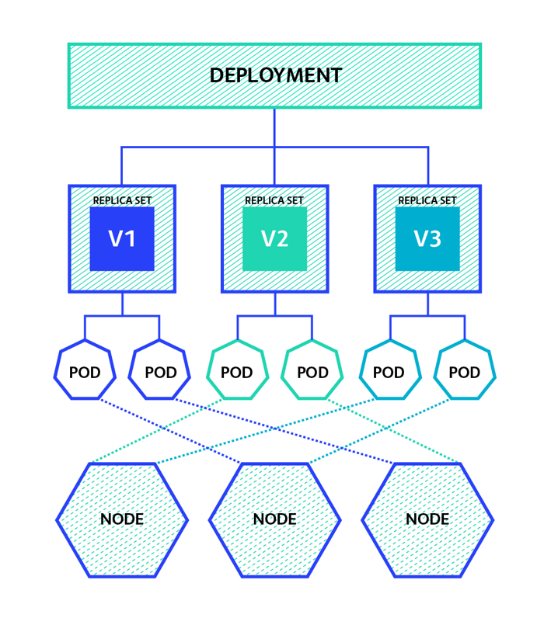
Replica Set
A Replica Set's purpose is to maintain a stable set of replica Pods running at any given time.
Often used to guarantee the availability of a specified number of identical Pods.

Slide 75
When Replica set Be Used
When you need to ensure that a specified number of pod replicas are running at a given time
When you need the ability to scale a certain set of pods

Slide 76

Deployment
A Deployment provides declarative updates for Pods and Replica Sets.
The use of plain Replica Sets are being phased out in favor of Deployments as they create Replica Sets automatically
Have the ability to use simple and rolling updates
They can either be Stateful or Stateless

Slide 77
Deployment use Case
Create a Deployment to rollout a Replica Set
Declare the new state of the Pods by updating the PodTemplateSpec of the Deployment
Rollback to an earlier Deployment revision if the current state of the Deployment is not stable
Scale up the Deployment to facilitate more load
Pause the Deployment to apply multiple fixes to its PodTemplateSpec and then resume it to start a new rollout
Use the status of the Deployment as an indicator the rollout .

Slide 78
DaemonSet
Ensures that all (or some) Nodes run a copy of a Pod.
As nodes are added to the cluster, Pods are added to them.
As nodes are removed from the cluster, those Pods are garbage collected.
Deleting a DaemonSet will clean up the Pods it created.

Slide 79
When DaemonSet be used
Daemon Sets are valuable for cluster services that need to be running
on every node or a specific subset of nodes

Slide 80
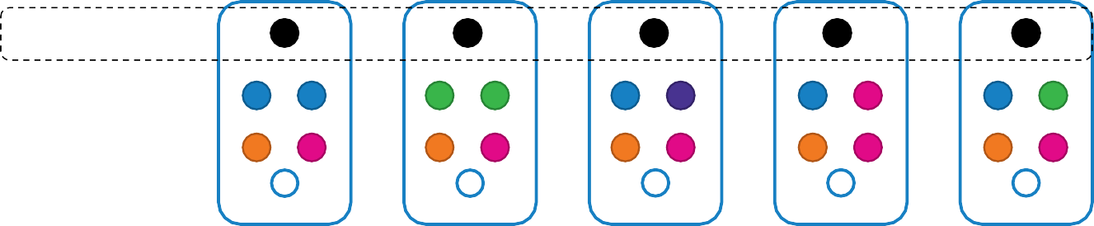



Daemon Sets – UseCase
Monitoring Solution
Logs Viewer
Daemon Sets

Slide 81
Daemon Sets – UseCase – kube-proxy
Kube-proxy
Kube-proxy
Kube-proxy
Kube-proxy
Kube-proxy
Kube-proxy
Daemon Sets

Slide 82
Daemon Sets – UseCase – Networking
Weave-net
weave-net
weave-net
weave-net
weave-net
weave-net
Daemon Sets

Slide 83
Kubernetes commands
kubectl --help -help with the kubeclt command and verbs
kubectl api-resources -list all API resources with their related verbs
kubectl explain RESOURCE -provides more details about the resource
kubectl get nodes -list all nodes in the cluster
kubectl get pods -list all pods in your current namespace
kubectl get deployments -list all deployments in your current namespace
-n | --namespace -specify a namespace
-o wide -display extra details
kubectl describe node -provide detailed info for a node
kubectl describe pod -provide detailed info for a pod
kubectl describe deployment -provide detailed info for a deploymen

Slide 84
Command help
kubectl create namespace -create a new namespace
kubectl create -f pod.yaml -create a pod from a manifest
kubectl apply -f pod.yaml -create/update a pod from a manifest
kubectl delete namespace -delete a namespace
kubectl delete pod -delete a pod
kubectl delete deployment -delete a deployment
-f -specify a yaml file describing objects to delete
-n | --namespace -specify a namespace
Troublshooting Commands
kubectl logs myapp -receive app logs from a pod
kubectl exec -it myapp -- bash -launch a shell in a pod and connect to it
kubectl cp myapp:/var/log/message /home/tux -copy a file (/var/log/messages) from a pod to the local filesystem
kubectl cp testscript.sh myapp:/usr/local/bin -copy a file (testscript.sh) into a pod
kubectl edit service myservice -opens the default editor and edits the raw yaml for a service

Slide 85
Secure Cluster Communication
Kubernetes is a complex platform and requires extensive configuration and management.
To keep Kubernetes workloads safe, especially in a production environment, you need to address key architectural vulnerabilities and platform dependencies, by implementing security best practices.

Slide 86
Enable Kubernetes Role-Based Access Control (RBAC)
RBAC can help you define who has access to the Kubernetes API and what permissions they have.
RBAC is usually enabled by default on Kubernetes 1.6 and higher (later on some hosted Kubernetes providers).
Because Kubernetes combines authorization controllers, when you enable RBAC, you must also disable the legacy Attribute Based Access Control (ABAC).
When using RBAC, prefer namespace-specific permissions instead of cluster-wide permissions.
Even when debugging, do not grant cluster administrator privileges. It is safer to allow access only when necessary for your specific situation.

Slide 87
Protect etcd with TLS, Firewall and Encryption
Since etcd stores the state of the cluster and its secrets, it is a sensitive resource and an attractive target for attackers.
If unauthorized users gain access to etcd they can take over the entire cluster. Read access is also dangerous because malicious users can use it to elevate privileges.
To configure TLS for etcd for client-server communication, use the following configuration options:
cert-file=: Certificate used for SSL/TLS connection with etcd
--key-file=: Certificate key (not encrypted)
--client-cert-auth: Specify that etcd should check incoming HTTPS requests to find a client certificate signed by a trusted CA
--trusted-ca-file=<path>: Trusted certification authority

Slide 88
Isolate Kubernetes Nodes
Kubernetes nodes must be on a separate network and should not be exposed directly to public networks.
If possible, you should even avoid direct connections to the general corporate network.
This is only possible if Kubernetes control and data traffic are isolated. Otherwise, both flow through the same pipe, and open access to the data plane implies open access to the control plane.
Ideally, nodes should be configured with an ingress controller, set to only allow connections from the master node on the specified port through the network access control list (ACL).

Slide 89
Monitor Network Traffic to Limit Communications
Containerized applications generally make extensive use of cluster networks.
Observe active network traffic and compare it to the traffic allowed by Kubernetes network policy, to understand how your application interacts and identify anomalous communications.
At the same time, if you compare active traffic to allowed traffic, you can identify network policies that are not actively used by cluster workloads.
This information can be used to further strengthen the allowed network policy, removing unneeded connections to reduce the attack surface.

Slide 90
Use Process Whitelisting
Process whitelisting is an effective way to identify unexpected running processes.
First, observe the application over a period of time to identify all processes running during normal application behavior.
Then use this list as your whitelist for future application behavior.
It is difficult to do runtime analysis at the process level.
Several commercial security solutions are available that can help analyze and identify anomalies in running processes across clusters.

Slide 91
Turn on Audit Logging
Make sure that audit logging is enabled and you are monitoring unusual or unwanted API calls, especially authentication failures.
These log entries display a “Forbidden” status message. Failure to authorize could mean that an attacker is trying to use stolen credentials.
When passing files to kube-apiserver, you can use the –audit-policy-file flag to turn on audit logging, and also define exactly which events should be logged

Slide 92
Keep Kubernetes Version Up to Date
You should always run the latest version of Kubernetes. A list of known Kubernetes vulnerabilities with severity scores can be found.
Always plan to upgrade your Kubernetes version to the latest available version.
Upgrading Kubernetes can be a complex process; if you are using a hosted Kubernetes provider, check if your provider handles automatic upgrades.

Slide 93
Lock Down Kubelet
The kubelet is an agent running on each node, which interacts with container runtime to launch pods and report metrics for nodes and pods.
Each kubelet in the cluster exposes an API, which you can use to start and stop pods, and perform other operations.
If an unauthorized user gains access to this API (on any node) and can run code on the cluster, they can compromise the entire cluster.

Slide 94
Secure kubelet
Here are configuration options you can use to lock the kubelet and reduce the attack surface:
Disable anonymous access with --anonymous-auth=false so that unauthenticated requests get an error response. To do this, the API server needs to identify itself to the kubelet. This can be set by adding the flags -kubelet-clientcertificate and --kubelet-client-key.
Set --authorization mode to a value other than AlwaysAllow to verify that requests are authorized. By default, the kubeadm installation tool sets this as a webhook, ensuring that kubelet calls SubjectAccessReview on the API server for authentication.
Include NodeRestriction in the API server –admission-control setting, to restrict kubelet permissions. This only allows the kubelet to modify pods bound to its own node object.

Slide 95
Secure kubelet
Set --read-only-port=0 to close read-only ports. This prevents anonymous users from accessing information about running workloads.
This port does not allow hackers to control the cluster, but can be used during the reconnaissance phase of an attack.
Turn off cAdvisor, which was used in old versions of Kubernetes to provide metrics, and has been replaced by Kubernetes API statistics. Set -cadvisor-port=0 to avoid exposing information about running workloads.
This is the default setting for Kubernetes v1.11. If you need to run cAdvisor, do so using a DaemonSet.

Slide 96
Use Third-Party Authentication for API Server
This provides additional security features such as multi-factor authentication, and ensures that kube-apiserver does not change when users are added or removed.
If possible, make sure that users are not managed at the API server level. You can also use OAuth 2.0 connectors like Dex.
Secure Kubernetes with Aqua
Aqua tames the complexity of Kubernetes security with KSPM (Kubernetes Security Posture Management) and advanced agentless Kubernetes Runtime Protection.
Aqua provides Kubernetes-native capabilities to achieve policy-driven, full-lifecycle protection and compliance for K8s applications

Slide 97
Kubernetes security
Use namespaces to establish security boundaries
Creating separate namespaces is an important first level of isolation between components.
We find it’s much easier to apply security controls such as Network Policies when different types of workloads are deployed in separate namespaces.
Separate sensitive workloads
To limit the potential impact of a compromise, it’s best to run sensitive workloads on a dedicated set of machines.
This approach reduces the risk of a sensitive application being accessed through a less-secure application that shares a container runtime or host.

Slide 98
Secure Cluster
Limiting resource usage on a cluster
Controlling what privileges containers run with
Preventing containers from loading unwanted kernel modules
Restricting network access
Controlling which nodes pods may access
Rotate infrastructure credentials frequently

Slide 99
Grafana
Grafana is a freeware, multi-platform analytics, and visualization solution. Irrespective of the data storage location, we can explore, query, and visualize the data.
It offers you the tools to transform your time-series database into excellent visualization and graphs.
Organizations utilize Grafana to monitor their log and infrastructure analytics, largely to enhance their functional effectiveness.
Dashboards track events and users because they automate the management, viewing, and collection of data.

Slide 100
Grafana
Grafana is a database monitoring and analysis tool. It enables us to build dashboards visualizations of the essential measures that we need to analyze. It has a good community of enthusiasts who will share recyclable dashboards.
It supports various data types, and as it is freeware, we can assure that the moment a new data source has been released, someone will support it. The most general use case of Grafa is visualizing the time series data, like CPU over time or memory.

Slide 101
Features of Grafana
The Dashboard: It is quite an excelling feature with well equipped and continually evolving part. The dashboard helps us make sense of complex data.
Alerts: The alerts can be set up and fired whenever there is an anticipated situation.
Native Support: It has native support of around a dozen databases.
Built-in Support: It offers built-in support for Prometheus, Influx DB, CloudWatch, Graphite, ElasticSearch.

Slide 102
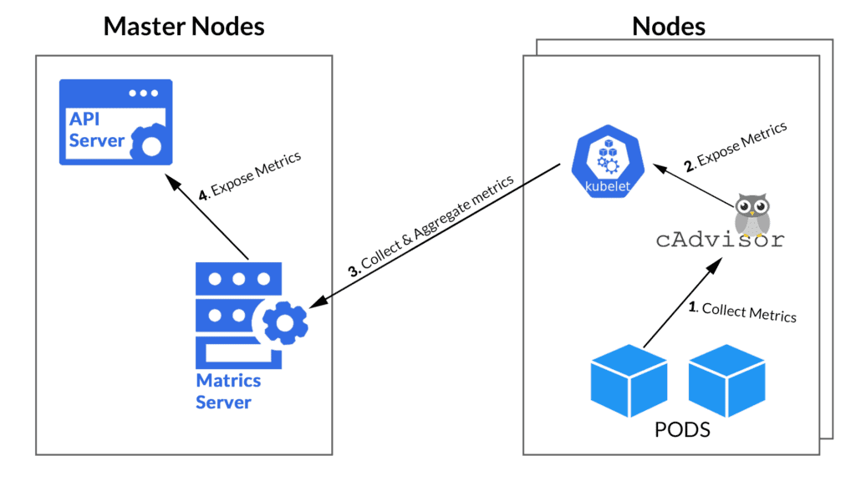
Kubernetes monitoring

Slide 103
Prometheus
An open-source monitoring tool, Prometheus seems to be the King 👑 of all the monitoring tools out there as of today.
Prometheus on Kubernetes is used for metrics-based monitoring and alerting. It pulls the real-time metrics, compresses and stores them in a time-series database.
The Prometheus sends an HTTP request (pull) called Scrape, found on the configuration in the deployment. It provides a query language and a robust data model that provides detailed and actionable metrics.

Slide 104
Prometheus Architecture
At its core, Prometheus has a main component called Prometheus Server, responsible for the actual monitoring work. The Prometheus server consists of:
Time Series Database that stores all the metric data like current CPU usage, memory usage etc.
Data Retrieval Worker is responsible for all the data pulling activities from applications, services, servers etc. and pushing them into the database.
HTTP Server API meant to accept queries for the stored data. The Server API is used to display the data in a dashboard or a Web UI.

Slide 105
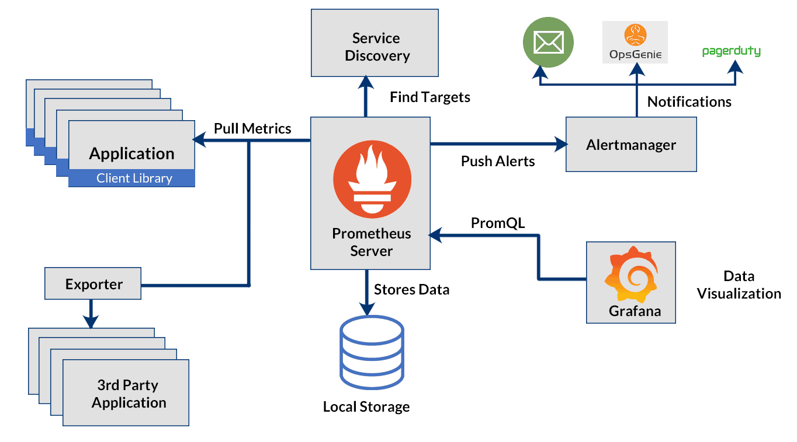
Prometheus Architecture

Slide 106
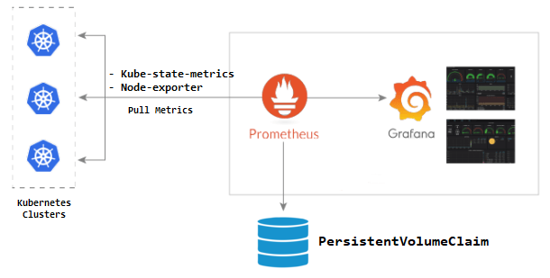
Grafana

