Slide 1
What is Container ?
A container is an “instantiation” of an image, or in other words an
image that is put into action.
Images are put into action with container engines. Once it is put into
action, it can do what it was meant to do

Slide 2
What is container image?
A container image is like the skeleton of an application with just enough of an operating system so that it can work.
It can be thought of as the root filesystem of the application.

Slide 3
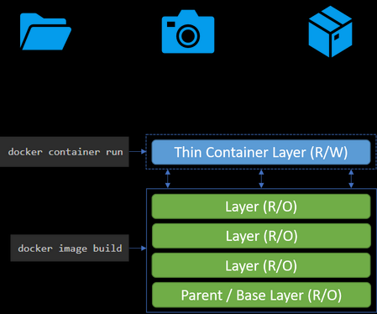
Container vs Image in Practice
An image is a collection of one or more RO layers
A container is an instantiation of an image
A container adds a RW layer on top of the RO image layer(s) where all changes are captured

Slide 4
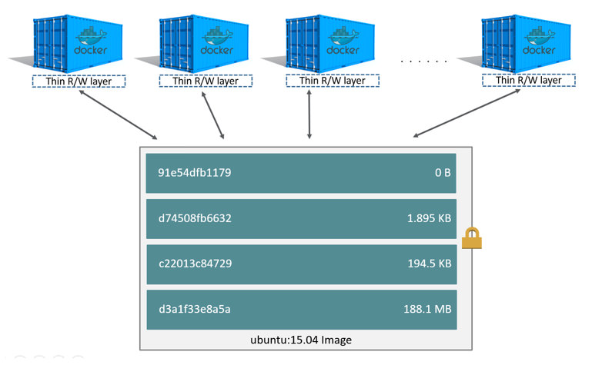
Use of Disk Space
A single image can be used by multiple containers simultaneously.
The only additional disk space used is in the RW layers or each of the containers.

Slide 5
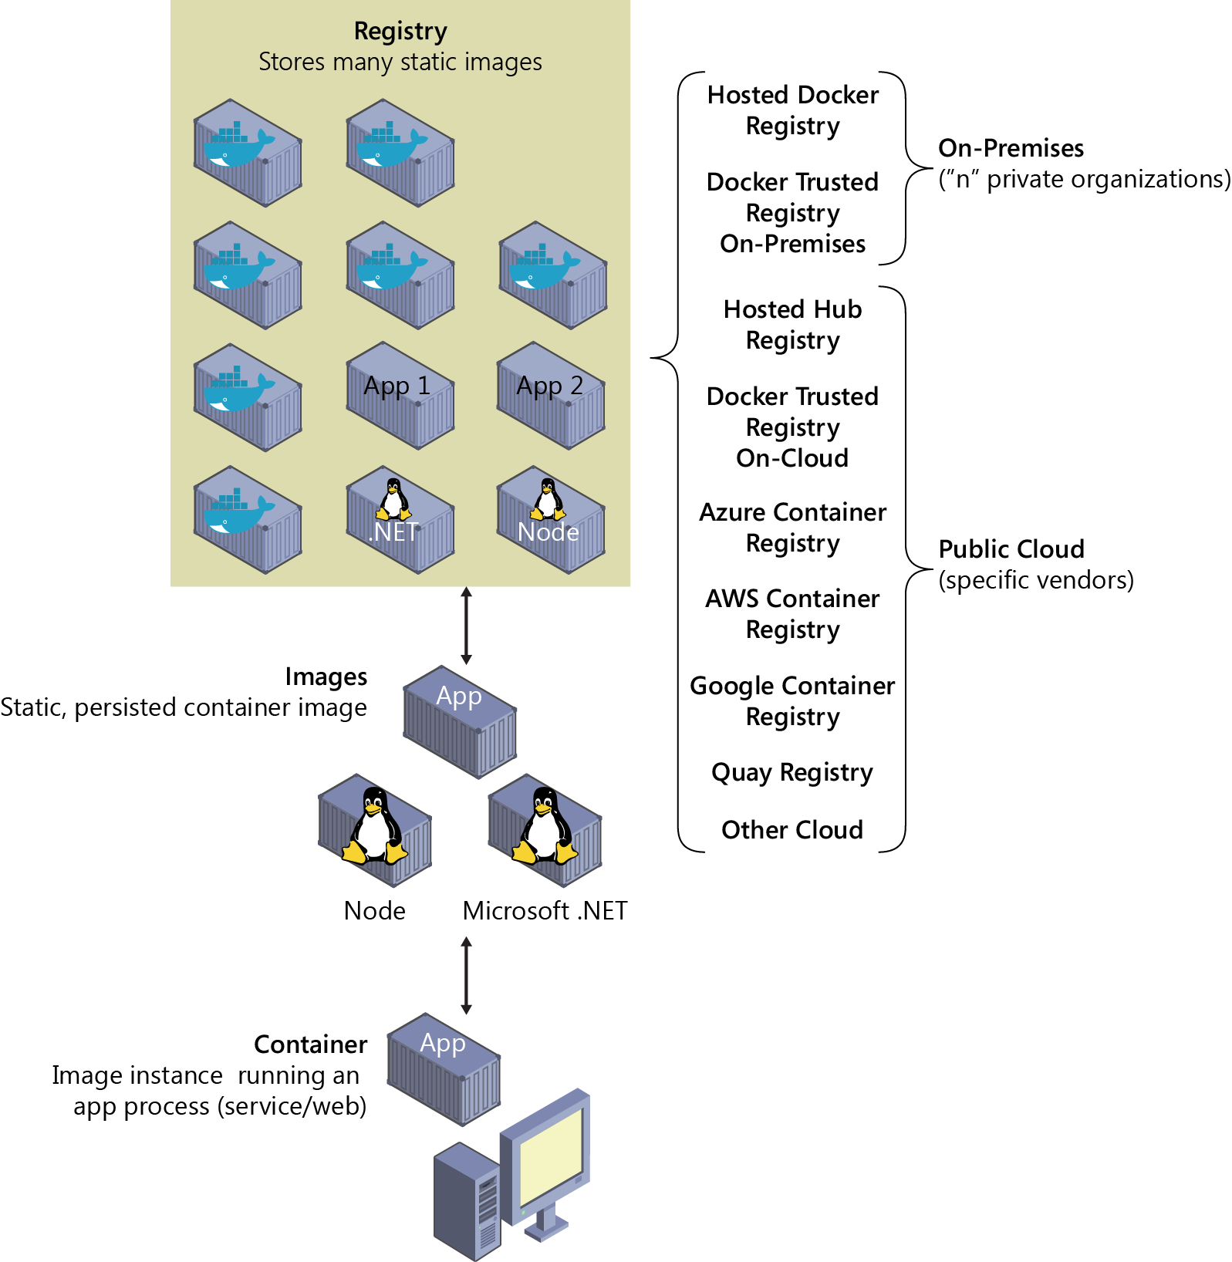
Image Registries
Images are stored in repositories called Image Registries.
Images can be downloaded (pulled) locally when needed to launch containers.

Slide 6
Container Engine
A Container Engine allows a container to run as an independent application directly in an operating system.
Container engines also:
Provide a network interface Separate containers from each other
Provide a way for containers to access external storage

Slide 7
Orchestration
Host |  |  |  | Host | Host
 | Host
Orchestration

Slide 8
What is Kubernetes?
It is a container orchestration technology used to orchestrate the deployment and management of hundreds and thousands of containers in a clustered environment.

Slide 9
What Does Kubernetes Provide?
Provides a complete orchestration solution for container based applications
– Deploy Applications
– Manage Applications
– Access Applications
– Scale Applications
Provides for scheduling of containers

Slide 10
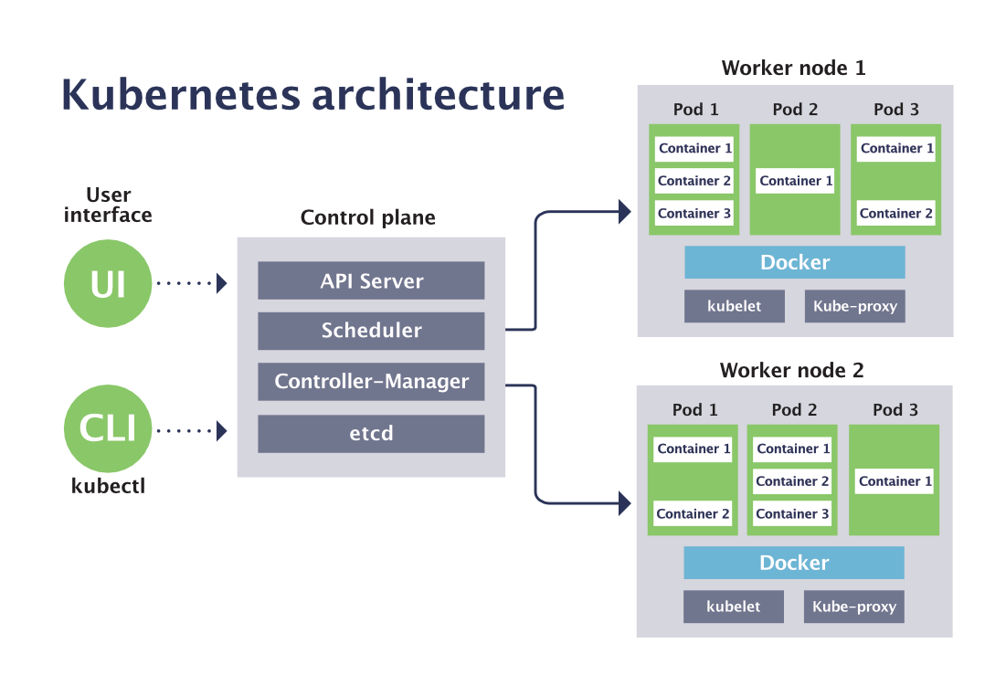


Container Runtime Engine
Run containers
Container Runtime Engine
Run containers

Slide 11
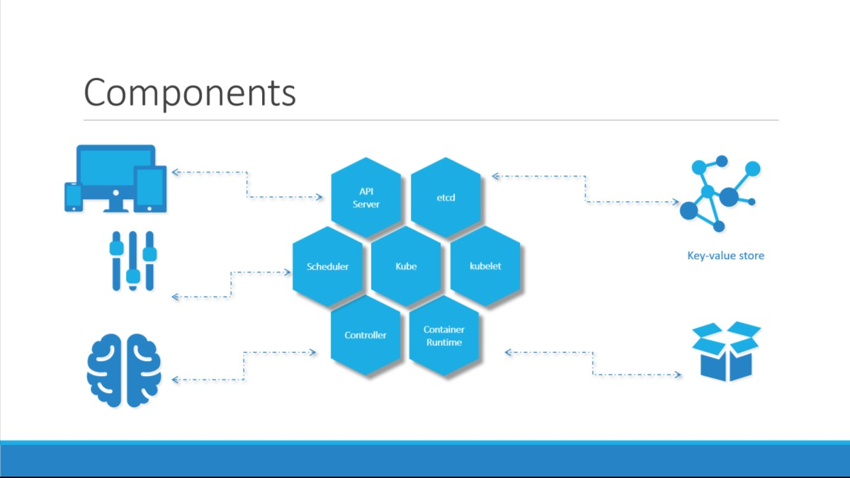

Slide 12
Kubernetes commands
kubectl --help -help with the kubeclt command and verbs
kubectl api-resources -list all API resources with their related verbs
kubectl explain RESOURCE -provides more details about the resource
kubectl get nodes -list all nodes in the cluster
kubectl get pods -list all pods in your current namespace
kubectl get deployments -list all deployments in your current namespace
-n | --namespace -specify a namespace
-o wide -display extra details
kubectl describe node -provide detailed info for a node
kubectl describe pod -provide detailed info for a pod
kubectl describe deployment -provide detailed info for a deploymen

Slide 13
Command help
kubectl create namespace -create a new namespace
kubectl create -f pod.yaml -create a pod from a manifest
kubectl apply -f pod.yaml -create/update a pod from a manifest
kubectl delete namespace -delete a namespace
kubectl delete pod -delete a pod
kubectl delete deployment -delete a deployment
-f -specify a yaml file describing objects to delete
-n | --namespace -specify a namespace
Troublshooting Commands
kubectl logs myapp -receive app logs from a pod
kubectl exec -it myapp -- bash -launch a shell in a pod and connect to it
kubectl cp myapp:/var/log/message /home/tux -copy a file (/var/log/messages) from a pod to the local filesystem
kubectl cp testscript.sh myapp:/usr/local/bin -copy a file (testscript.sh) into a pod
kubectl edit service myservice -opens the default editor and edits the raw yaml for a service

Slide 14
Difference
https://phoenixnap.com/blog/kubernetes-vs-mesos

Slide 15
Namespaces
An abstraction used by Kubernetes to support multiple virtual clusters on the same physical cluster.
Organize objects in a cluster and provide a way to divide cluster resources.
Resources names must be unique within a namespace, but not necessarily across namespaces.

Slide 16
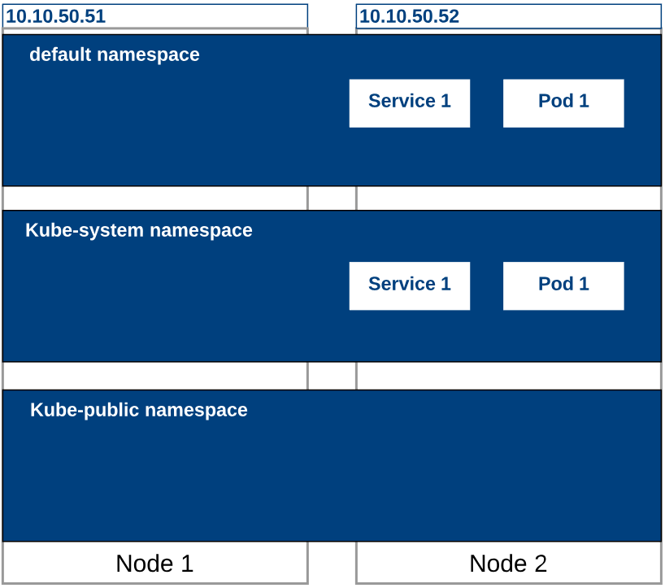
Namespaces
Default
The default namespace for objects with no other namespace
kube-system
The namespace for objects created by the Kubernetes system
kube-public
This namespace is created automatically and is readable by all users (including those not authenticated).
kube-node-lease
This is a placeholder for future functionality.

Slide 17
Kube-system Namespace
The namespace for objects created by the Kubernetes system
Created when the Kubernetes cluster is first created
All system pods, services, and other resources will be created in this namespace

Slide 18
Resource Quota
A resource quota in k8s is a mechanism that limits the total amount of compute, storage, and object resources that can be consumed within a project.
You can restrict aggregate resource consumption for CPU, memory, storage, object counts, and more at the namespace level.​
Resource quotas cover both resource "requests" (minimum resources reserved for a container) and "limits" (maximum allowed resources).

Slide 19
Limit vs Requests
Resource requests and limits in Kubernetes are mechanisms to control the amount of CPU and memory a container can use.
Resource Requests
A request is the minimum amount of CPU or memory that is guaranteed to be allocated to a container.​
When scheduling a pod, Kubernetes ensures there are enough resources available on a node to satisfy all the resource requests of the containers within the pod.​
If a node cannot accommodate the requests, the pod will not be scheduled and remains in a pending state.
Resource Limits
A limit is the maximum amount of CPU or memory that a container is allowed to use.​
If a container tries to exceed the memory limit, it will be terminated (OOMKilled); if it exceeds the CPU limit, it will be throttled.​
This prevents any single container from consuming excessive resources and impacting other workloads on the same node.

Slide 20
Limit Range
The administrator can set default values for resource requests/limits, so if users do not specify them, they are automatically injected.​
It enforces resource boundaries for all new pods and containers created in a project, ensuring no container can request or use less than the minimum or more than the maximum specified for CPU or memory.​
Limit ranges help prevent individual pods or containers from monopolizing resources or running without specified limits, strengthening multi-tenancy and cluster stability.

Slide 21
Kubernetes Manifests

Slide 22
Purpose of Manifests
Files that describe how Kubernetes should configure objects or even the cluster itself
Simpler than providing each instruction manually via the API or kubectl
Created/stored in YAML format
Designed for developers
Easy to integrate into source control

Slide 23
Best Practices for Manifests
One manifest deploys one component
Use versioned images for pods
Always use a Deployment (even for 1 pod)
Define/use environment variables

Slide 24
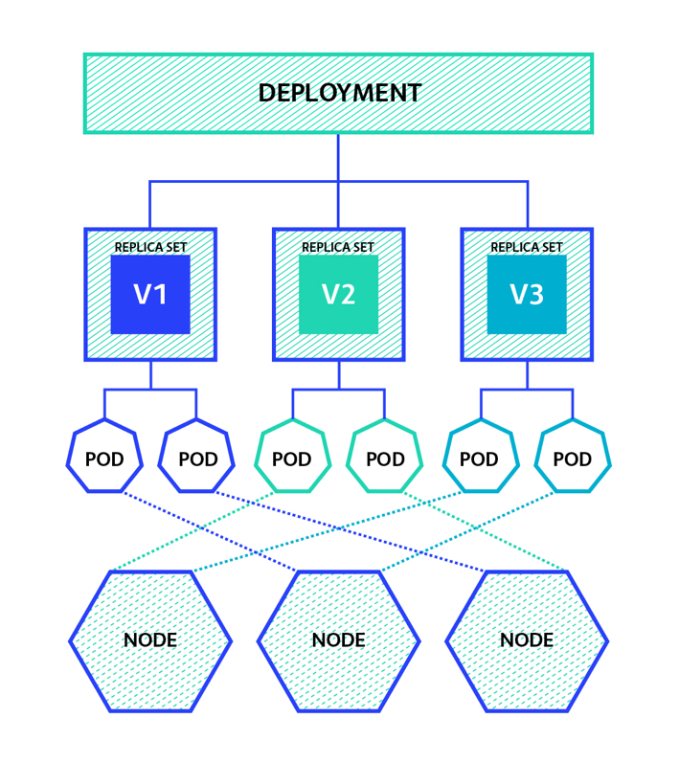
ReplicaSet
A ReplicaSet’s purpose is to maintain a stable set of replica Pods running at any given time.
Often used to guarantee the availability of a specified number of identical Pods.

Slide 25
When Replicaset Be Used
When you need to ensure that a specified number of pod replicas are running at a given time
When you need the ability to scale a certain set of pods

Slide 26
Stateful vs Stateless Deployments
Stateful
A stateful application requires permanent storage.
This storage is usually a networkbased solution.
Stateless
A stateless application does not need a permanent storage solution.
Any temporary storage is within the pod itself.

Slide 27
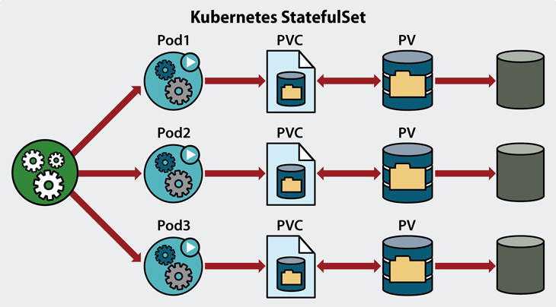
StatefulSet
Manages Pods that are based on an identical container spec.
Maintains a sticky identity for each of their Pods.
Pods are created from the same spec, but are not interchangeable.
(Each has a persistent identifier that it maintains across any rescheduling)

Slide 28
When StatefulSet Be Used
StatefulSets are valuable for applications that require one or more of
the following:
Stable, unique network identifiers
Stable, persistent storage
Ordered, graceful deployment and scaling
Ordered, automated rolling updates

Slide 29
DaemonSet
Ensures that all (or some) Nodes run a copy of a Pod.
As nodes are added to the cluster, Pods are added to them.
As nodes are removed from the cluster, those Pods are garbage collected.
Deleting a DaemonSet will clean up the Pods it created.

Slide 30
When DaemonSet be used
DaemonSets are valuable for cluster services that need to be running
on every node or a specific subset of nodes

Slide 31
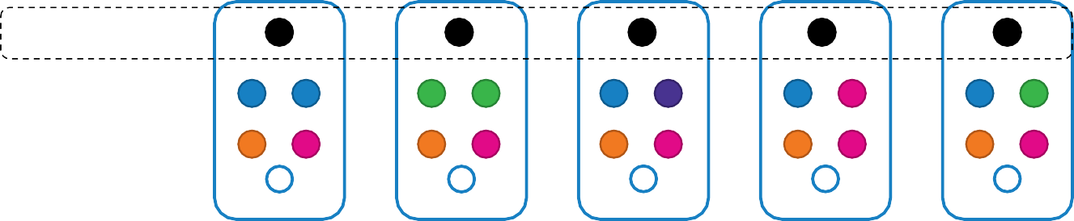



Daemon Sets – UseCase
Monitoring Solution
Logs Viewer
Daemon Sets

Slide 32
Daemon Sets – UseCase – kube-proxy
Kube-proxy
Kube-proxy
Kube-proxy
Kube-proxy
Kube-proxy
Kube-proxy
Daemon Sets

Slide 33
Daemon Sets – UseCase – Networking
Weave-net
weave-net
weave-net
weave-net
weave-net
weave-net
Daemon Sets

Slide 34

DaemonSet Definition
daemon-set-definition.yaml
replicaset-definition.yaml
apiVersion: apps/v1 kind: DaemonSet metadata:
name: monitoring-daemon
spec:
selector:
matchLabels:
app: monitoring-agent
template:
metadata: labels:
app: monitoring-agent
spec:
containers:
- name: monitoring-agent
image: monitoring-agent
apiVersion: apps/v1 kind: ReplicaSet metadata:
name: monitoring-daemon
spec:
selector:
matchLabels:
app: monitoring-agent
template: metadata:
labels:
app: monitoring-agent
spec:
containers:
- name: monitoring-agent
image: monitoring-agent
kubectl create –f daemon-set-definition.yaml
daemon-set Created

Slide 35


View DaemonSets
kubectl get daemonsets
NAME | DESIRED | CURRENT | READY | UP-TO-DATE | AVAILABLE | AGE
monitoring-daemon | 1 | 1 | 1 | 1 | 1 | 41
kubectl describe daemonsets monitoring-daemon
Name: Selector: Node-Selector: Labels:
monitoring-daemon
name=monitoring-daemon
<none>
name=monitoring-daemon
Desired Number of Nodes Scheduled: 2 Current Number of Nodes Scheduled: 2
Number of Nodes Scheduled with Up-to-date Pods: 2 Number of Nodes Scheduled with Available Pods: 1 Number of Nodes Misscheduled: 0
Pods Status: 2 Running / 0 Waiting / 0 Succeeded / 0 Failed Pod Template:
Labels: app=monitoring-agent Containers:

Slide 36

Deployment
A Deployment provides declarative updates for Pods and
ReplicaSets
The use of plain ReplicaSets are being phased out in favor of
Deployments as they create ReplicaSets automatically
Have the ability to use simple and rolling updates
They can either be Stateful or Stateless

Slide 37
Deployment use Case
Create a Deployment to rollout a ReplicaSet
Declare the new state of the Pods by updating the PodTemplateSpec of the Deployment
Rollback to an earlier Deployment revision if the current state of the Deployment is not stable
Scale up the Deployment to facilitate more load
Pause the Deployment to apply multiple fixes to its PodTemplateSpec and then resume it to start a new rollout
Use the status of the Deployment as an indicator that a rollout is

Slide 38
Services
A Service in Kubernetes is an API object that exposes a set of Pods as a network service, providing a stable endpoint (IP address and DNS name) to access the application running in those Pods.
Services enable communication between microservices and make it easy to route external and internal traffic to Pods in a reliable way.
Services enable applications to be accessed via the network both from inside and outside of the cluster, Enable apps to be accessed by users, the web, or even from other apps.

Slide 39
Why services are needed
Pods in Kubernetes are ephemeral, and their IP addresses change when recreated, making direct access unreliable.
A Service provides a permanent, stable IP address and DNS name to a set of Pods, decoupling clients and backends and enabling seamless pod replacement and scaling.
Services also handle load balancing between Pod replicas and facilitate service discovery for other components within the cluster.

Slide 40
How Services Work
Services select target Pods using label selectors. Any Pod that matches the selector is added as a backend endpoint for the Service.
When network traffic is sent to the Service’s IP, it is routed automatically to one of the matching Pods.
Each Service has a DNS name, making it easy to reference in applications and scripts.

Slide 41
Types of Services
Cluster IP: (default) Accessible only within the cluster.
Node Port: Exposes the Service on a static port on each node, accessible externally via <Node IP>:<Port>.
Load Balancer: Provisions an external IP using a cloud load balancer for public access (in supported environments).
External Name: Maps the Service to an external DNS name without proxying.
Headless: No cluster IP, provides direct access to individual Pods (usually for advanced DNS-based service discovery)

Slide 42
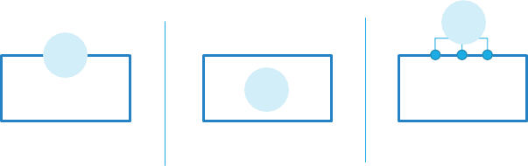
Service Types
NodePort
ClusterIP
Loadbalancer

Slide 43
ClusterIP
Description: The default type, exposes the Service on a cluster-internal IP.
Accessibility: Only reachable from within the cluster (no external access).
Use Case: Internal communications between microservices, backend APIs, and intra-cluster workloads where no outside access is required.
Example: Connecting a frontend deployment to an internal backend service over HTTP.

Slide 44
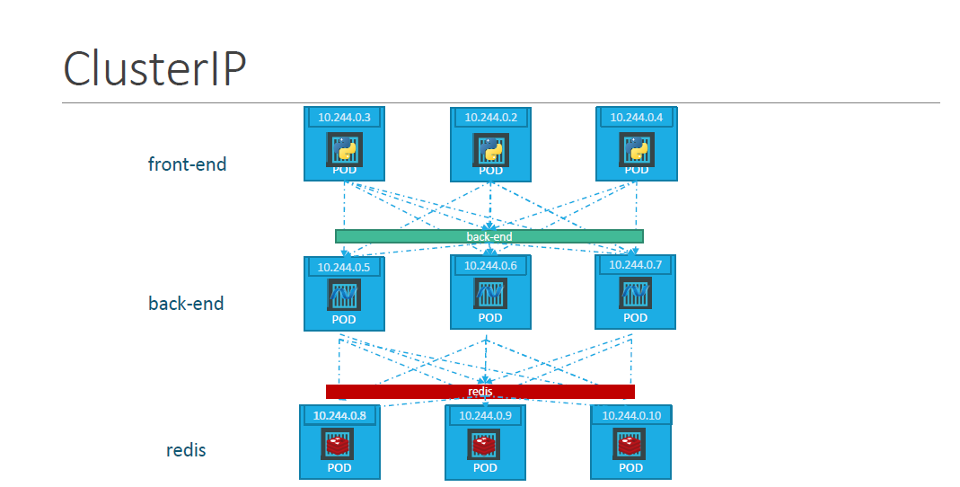

Slide 45
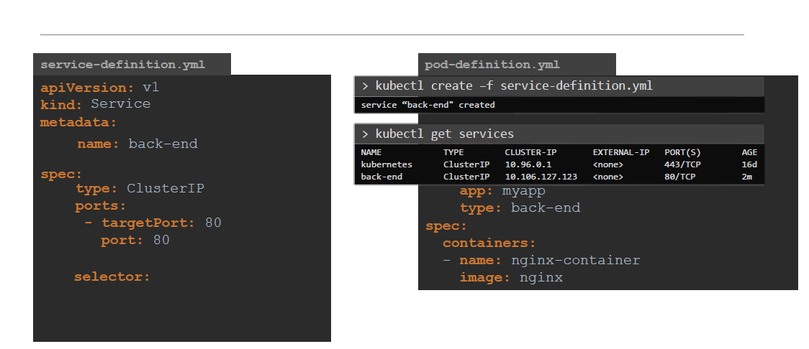
ClusterIP

Slide 46
NodePort
Description: Exposes the Service on each node's IP at a static port within a range (default: 30000-32767).
Accessibility: Accessible outside the cluster using <NodeIP>:<NodePort>.
Use Case: Development, demos, or where basic external access is needed without a managed load balancer.
Example: Accessing a demo web app from a developer’s laptop via the node’s external IP address.
Example: http://worker1.example.com:31008

Slide 47
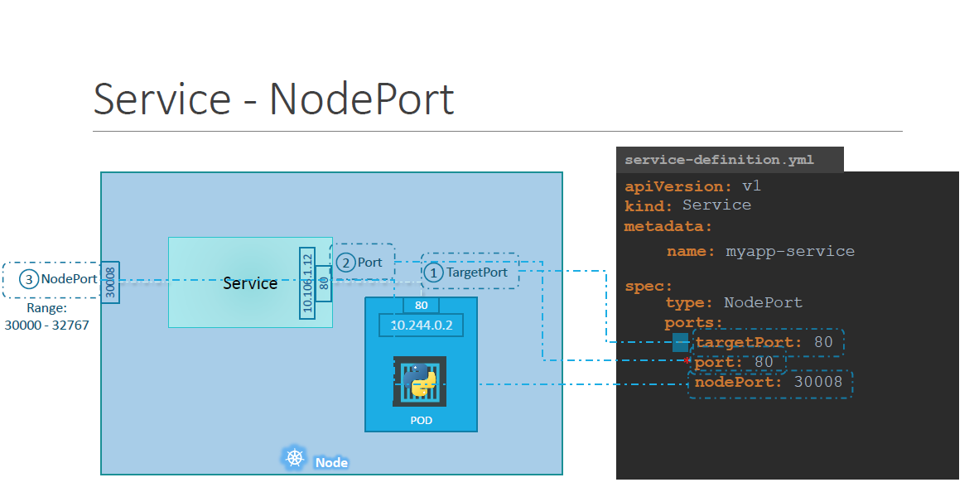

Slide 48
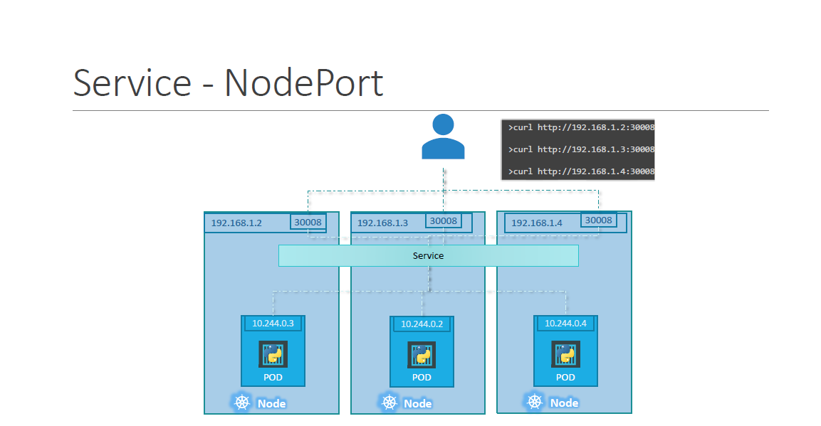

Slide 49
LoadBalancer
Provides unique IP addresses per app.
IPs come from a pool of available addresses that you allocate.
Public cloud providers have their own LoadBalancers that can be used. Some providers like AWS provide full FQDN instead of IPs for Kubernetes.
The LoadBalancer service type is not built into the Kubernetes cluster at the current time. This must be installed with an application like Metallb.

Slide 50
Load Balancer Service
Description: Integrates with cloud platforms to provision an external load balancer providing a fixed public IP.
Accessibility: Exposed to external traffic via a cloud-managed load balancer.
Use Case: Production deployments where external consumers or clients require highly available access (common in public cloud environments).
Example: Running a SaaS web application with high traffic that must be accessible over the internet.

Slide 51
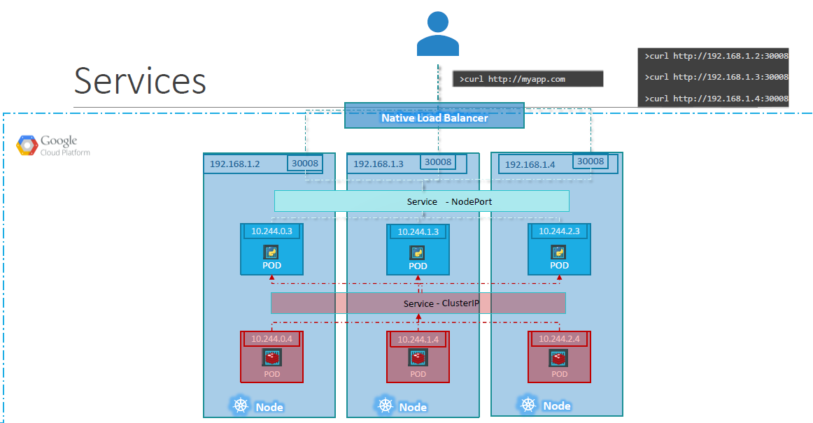

Slide 52
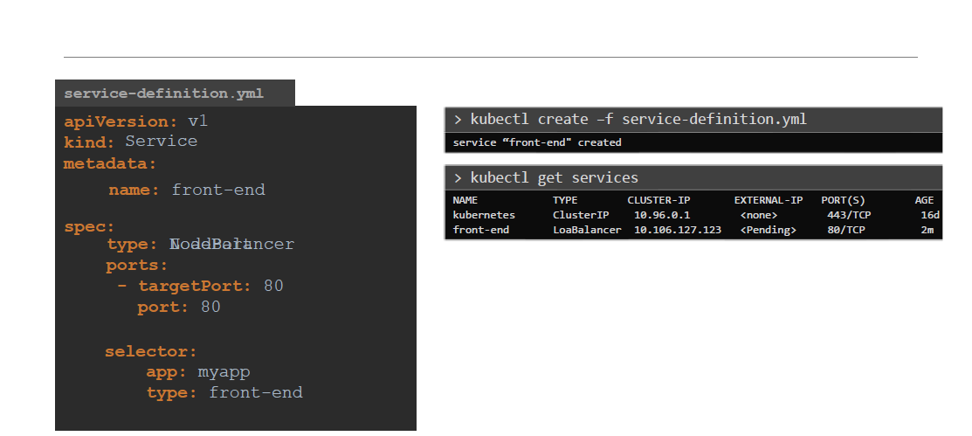
LoadBalancer

Slide 53
Ingress
An Ingress is a Kubernetes API object that manages external HTTP and HTTPS access to Services inside a cluster.
It acts as an intelligent router or reverse proxy, routing external traffic to the correct internal Services based on rules like:
. Path-based routing (/app, /api)
. Host-based routing (app.example.com)
. TLS termination (HTTPS)
. Load balancing for HTTP traffic

Slide 54
How Ingress Works
Ingress Resource: Defines routing rules (what host/path goes to which service).
Ingress Controller: A pod or set of pods (like NGINX, Traefik, HAProxy) that implements those rules.
External traffic hits the Ingress Controller.
The controller reads Ingress rules and forwards requests to the right Service, which then routes to a Pod.

Slide 55
Ingress Traffic Flow
User (Internet)
↓
[Ingress Controller] (e.g., NGINX)
↓
Ingress Resource Rules
↓
Kubernetes Service
↓
Pod

Slide 56
Ingress Controllers
Controller | Notes
NGINX | Most popular, rich features
Traefik | Lightweight, auto-discovery
HAProxy | High performance
Istio | Service mesh-based routing
AWS ALB | Managed Ingress on AWS

Slide 57
Service Discovery
Service Discovery in Kubernetes is the automatic detection of services and their accessible endpoints (like IPs or DNS names) within a cluster so that Pods can find and talk to each other without hardcoding IP addresses.
Because Pods are ephemeral and can be restarted or rescheduled, Kubernetes handles service discovery dynamically, using DNS and environment variables.

Slide 58
How service discovery works
DNS-Based Service Discovery (default and most common)
Kubernetes automatically sets up a DNS name for every Service.
A built-in DNS server (like CoreDNS) answers queries for <service-name>.<namespace>.svc.cluster.local.
Applications inside the cluster can call services by DNS name.
Example: Service: backend-service in namespace default
DNS Name: backend-service.default.svc.cluster.local
Pod A → backend-service.default.svc → ClusterIP → backend Pods

Slide 59
Example: How a Pod Connects to a Service
Assume:
Service name: api-service
Namespace: default
Your app connects using:
requests.get ("http://api-service.default.svc.cluster.local")
Kubernetes routes this through CoreDNS → Service → correct backend Pod.

Slide 60
Variables
Environment variables in Kubernetes are key-value pairs that are set inside containers within pods to provide configuration information.
They allow applications running inside containers to receive dynamic configuration data at runtime without hardcoding settings into the container image or application code.
Environment variables in Kubernetes provide a simple and standardized way to inject runtime configuration into containers, enhancing flexibility, security, and portability of applications running on Kubernetes.

Slide 61
ENV Value Types
env:
- name: APP_COLOR
value: pink
Plain Key Value
env:
- name: APP_COLOR
valueFrom:
configMapKeyRef:
ConfigMap
env:
- name: APP_COLOR
valueFrom:
secretKeyRef:
Secrets

Slide 62



ENV Variables in Docker
docker run -e APP_COLOR=blue simple-webapp-color
docker run -e APP_COLOR=green simple-webapp-color
docker run -e APP_COLOR=pink simple-webapp-color

Slide 63

Env Variables in kubernetes
docker run -e APP_COLOR=pink simple-webapp-color
pod-definition.yaml
apiVersion: v1 kind: Pod metadata:
name: simple-webapp-color
spec:
containers:
name: simple-webapp-color image: simple-webapp-color ports:
containerPort: 8080
env:
name: APP_COLOR
value: pink

Slide 64
ConfigMap
A ConfigMap stores non-confidential data in key-value pairs.
data such as URLs, flags, or application settings.
ConfigMaps do not provide encryption or secrecy; stored data is in plain text.
They have a size limit (typically 1 MiB).
Admins and developers use ConfigMaps to separate config from code so configurations can be easily changed without rebuilding container images.

Slide 65
ConfigMaps
ConfigMap
pod-definition.yaml
apiVersion: v1 kind: Pod metadata:
name: simple-webapp-color
spec:
containers:
name: simple-webapp-color image: simple-webapp-color ports:
containerPort: 8080
env:
_{name:} APP_COLOR
value: blue
name: APP_MODE
value: prod

Slide 66
ConfigMaps
ConfigMap
pod-definition.yaml
APP_COLOR : blue
APP_MODE : prod
apiVersion: v1 kind: Pod metadata:
name: simple-webapp-color
spec:
containers:
- name: simple-webapp-color image: simple-webapp-color ports:
- containerPort: 8080
envFrom:
- configMapRef:
name: app-config
APP_COLOR: blue
APP_MODE: prod
env:
- name: value:
- name: value:

Slide 67


Create ConfigMaps
ConfigMap
kubectl create configmap
APP_COLOR: blue APP_MODE: prod
kubectl create –f

Slide 68








Create ConfigMaps
ConfigMap
kubectl create configmap
APP_COLOR: blue APP_MODE: prod
<config-name> --from-literal=<key>=<value>
kubectl create configmap \
app-config --from-literal=APP_COLOR=blue \
--from-literal=APP_MOD=prod
kubectl create configmap
<config-name> --from-file=<path-to-file>
kubectl create configmap \
app-config --from-file=app_config.properties

Slide 69


Create ConfigMaps
ConfigMap
kubectl create –f
APP_COLOR: blue APP_MODE: prod
config-map.yaml
apiVersion: v1 kind: ConfigMap metadata:
name: app-config data:
APP_COLOR: blue APP_MODE: prod
kubectl create –f config-map.yaml

Slide 70


View ConfigMaps
kubectl get configmaps
NAME DATA
app-config 2
AGE
3s
kubectl describe configmaps
Name: app-config Namespace: default Labels: <none> Annotations: <none>
Data
==== APP_COLOR:
blue APP_MODE:
prod
Events: <none>

Slide 71
Secrets
A Secret is designed to store small amounts of sensitive information such as passwords, tokens, or keys.
Secrets keep confidential data separate from container images and pod specs to reduce exposure risk.
Like ConfigMaps, Secrets can be injected into pods as environment variables or mounted volumes.
Secrets have additional access control policies to restrict who can view or modify them due to their sensitive nature.
They are essential for storing credentials and sensitive tokens securely within Kubernetes environments.

Slide 72
Volume Mount Method
Mounting ConfigMaps and Secrets as volumes in Kubernetes pods is particularly useful when an application needs to consume configuration or sensitive data as files rather than environment variables.
Complex Configuration Files: Applications that read configuration from files such as JSON, YAML, XML, or INI files benefit from volume mounts.
Large or Multiple Configurations: When configurations are large, have multiple entries, or require structured folders, mounting as volumes is more manageable than injecting numerous environment variables.
Sensitive Credentials as Files: Certain applications require sensitive credentials, certificates, keys, or tokens stored in specific file formats or file paths. Mounting Secrets as volumes provides these files securely and correctly named.
Avoid Environment Variable Size Limits: Some environment variables have size limits; mounting large data avoids those constraints.

Slide 73

Create Secrets
Secret
kubectl create secret generic
DB_Host: mysql DB_User: root DB_Password: paswrd
kubectl create –f

Slide 74









Create Secrets
Secret
kubectl create secret generic
DB_Host: mysql DB_User: root DB_Password: paswrd
<secret-name> --from-literal=<key>=<value>
kubectl create secret generic \
app-secret --from-literal=DB_Host=mysql
\
--from-literal=DB_User=root
--from-literal=DB_Password=paswrd
kubectl create secret generic
<secret-name> --from-file=<path-to-file>
kubectl create secret generic \
app-secret --from-file=app_secret.properties

Slide 75

Create Secrets
Secret
kubectl create –f
DB_Host: mysql DB_User: root DB_Password: paswrd
secret-data.yaml
apiVersion: v1 kind: Secret metadata:
name: app-secret data:
DB_Host: bXlzcWw= DB_User: cm9vdA== DB_Password: cGFzd3Jk
DB_Host: mysql
DB_User: root DB_Password: paswrd
kubectl create –f secret-data.yaml

Slide 76




Encode Secrets
_{Secret} Declarative kubectl create –f
secret-data.yaml
apiVersion: v1 kind: Secret metadata:
name: app-secret data:
DB_Host: mysql DB_User: root DB_Password: paswrd
1
kubectl create –f secret-data.yaml
Create Secret
DB_Host: mysql DB_User: root DB_Password: paswrd
DB_Host: bXlzcWw=
DB_User: cm9vdA==
DB_Password: cGFzd3Jk
echo –n ‘mysql’ | base64
bXlzcWw=
echo –n ‘root’ | base64
cm9vdA==
echo –n ‘paswrd’ | base64
cGFzd3Jk

Slide 77



View Secrets
kubectl get secrets
NAME TYPE DATA
app-secret Opaque 3
default-token-mvtkv kubernetes.io/service-account-token 3
AGE
10m 2h
kubectl describe secrets
kubectl get secret app-secret –o yaml
Name: app-secret Namespace: default Labels: <none> Annotations: <none>
Type: Opaque Data
====
DB_Host: 10 bytes
DB_Password: 6 bytes
DB_User: 4 bytes
apiVersion: v1 data:
DB_Host: bXlzcWw= DB_Password: cGFzd3Jk DB_User: cm9vdA==
kind: Secret metadata:
creationTimestamp: 2018-10-18T10:01:12Z labels:
name: app-secret name: app-secret namespace: default
uid: be96e989-d2bc-11e8-a545-080027931072
type: Opaque

Slide 78




Decode Secrets
_{Secret} Declarative kubectl create –f
secret-data.yaml
apiVersion: v1 kind: Secret metadata:
name: app-secret data:
DB_Host: mysql DB_User: root DB_Password: paswrd
1
kubectl create –f secret-data.yaml
Create Secret
DB_Host: mysql DB_User: root DB_Password: paswrd
DB_Host: bXlzcWw=
DB_User: cm9vdA==
DB_Password: cGFzd3Jk
echo –n ‘bXlzcWw=’ | base64 --decode
mysql
echo –n ‘cm9vdA==’ | base64 --decode
root
echo –n ‘cGFzd3Jk’ | base64 --decode
paswrd

Slide 79

Secrets in Pods
secret-data.yaml
apiVersion: v1 kind: Secret metadata:
name: app-secret data:
DB_Host: bXlzcWw= DB_User: cm9vdA== DB_Password: cGFzd3Jk
pod-definition.yaml
apiVersion: v1 kind: Pod metadata:
name: simple-webapp-color
labels:
name: simple-webapp-color
spec:
containers:
name: simple-webapp-color image: simple-webapp-color ports:
containerPort: 8080
envFrom:
secretRef:
name:
app-secret
2
Inject into Pod
kubectl create –f pod-definition.yaml

Slide 80
Secrets in Pods
envFrom:
- secretRef:
name: app-config
ENV
env:
- name: DB_Password
valueFrom:
secretKeyRef: name: app-secret
key: DB_Password
SINGLE ENV
volumes:
- name: app-secret-volume
secret:
secretName: app-secret
VOLUME

Slide 81


Secrets in Pods as Volumes
volumes:
- name: app-secret-volume
secret:
secretName: app-secret
VOLUME
ls /opt/app-secret-volumes
DB_Host DB_Password DB_User
cat /opt/app-secret-volumes/DB_Password
paswrd
Inside the Container

Slide 82
Labels & Selectors
Labels:
Metadata that can be attached to API objects such as pods that generally represent identity.
They can be attributes in manifests or assigned manually.
Selectors:
Functions in kubectl that can query API objects that use labels.
Queries can be a simple get command or it can be an action such as delete that applies only to the labels that match the query.

Slide 83
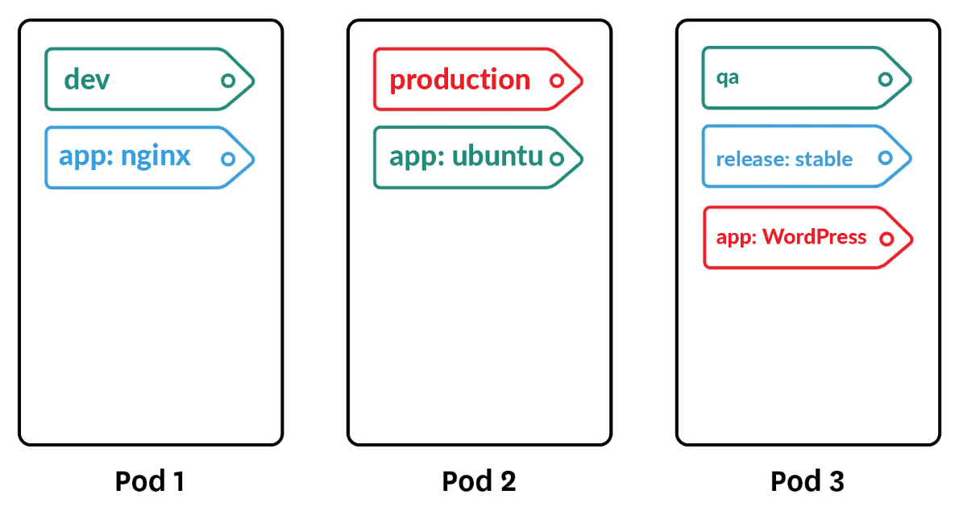
Labels & Selctor
kubectl get pods --selector owner=beatle
kubectl label pods pod5 surname=jones → add label to a pod
kubectl get pods --show-labels
kubectl delete pods --selector owner=beatle

Slide 84
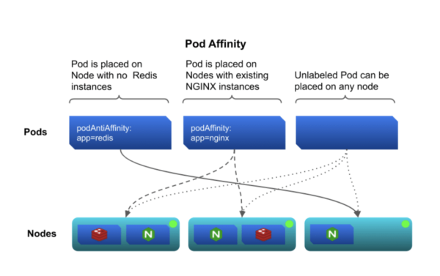
Node Affinity
Kubernetes provides a couple of options to create pod/node affinity.
Each option's approach is slightly different though the end results are similar.
Options:
– Node Selectors
– Taints and Tolerations

Slide 85
NodeSelectors
Command
kubectl label nodes worker01 disktype=ssd
apiVersion: v1
kind: Pod
metadata:
name: nginx
labels:
env: test
spec:
containers:
- name: nginx
image: nginx
imagePullPolicy: IfNotPresent
nodeSelector:
disktype: ssd
Labels are applied to Nodes
Pods specs are updated with NodeSelectors for the corresponding labels.
Pods will prefer to be scheduled on nodes with labels that match their nodeSelctor.
Approach: Attraction vs Rejection

Slide 86
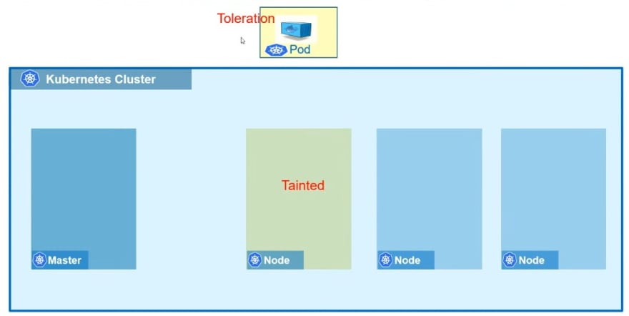
Taints & Tolerations
Taints are applied to Nodes
Pods specs are updated with tolerations for the corresponding taints.
The nodes will only allow pods with tolerations for their nodes' taints to be scheduled on them.
Approach: Rejection vs Attraction

Slide 87
Horizontal Scale
When deploying or redeploying an application, the replica spec can be defined.
If the number is changed and the manifest is redeployed, then the matching number of pod replicas will change also.
Horizontal scaling is adding more pods. Vertical scaling is adding more nodes or a new Kubernetes cluster.
kubectl scale deployments nginx-deployment --replicas=4

Slide 88
HorizontalPodAutoScaler
Monitors metrics of the cluster and uses these to automatically scale pod replicas out and back.
Example:
App to be scaled: php-apache
The minimum number of pods: 1
The maximum number: 10
If the CPU Utilization of the node is ≥ 50%,
then more pods will be created
Note: Other metrics can also be used with an autoscale
Manifests:-
apiVersion: autoscaling/v1
kind: HorizontalPodAutoscaler
metadata:
name: php-apache
namespace: default
spec:
scaleTargetRef:
apiVersion: apps/v1
kind: Deployment
name: php-apache
minReplicas: 1
maxReplicas: 10
targetCPUUtilizationPercentage: 50

Slide 89

Helm
Helm is a tool for managing packages of preconfigured Kubernetes resources.
“Helm installs charts into Kubernetes, creating a new release for each installation. And to find new charts, you search Helm chart repositories.”

Slide 90

Helm
Helm package, or chart, only contains the metadata that describes how to deploy the package.
This metadata is similar to the metadata that is contained in the header of a RPM package.
A Helm repository contains this metadata for all charts in the repository. The “files” that are installed when the chart is deployed are similar to the files/scrips/config/etc in a RPM package.
With Helm, these files are containers that reside in one or more separate container registries.

Slide 91
Three Central Concepts
A Chart is a Helm package ,Charts contain all of the resource definitions necessary to run an application, tool, or service inside of a Kubernetes cluster.
A Repository is the place where charts can be collected and shared.
A Release is an instance of a chart running in a Kubernetes cluster One chart can be installed multiple times into the same cluster Each time it is installed, a new Release is created

Slide 92
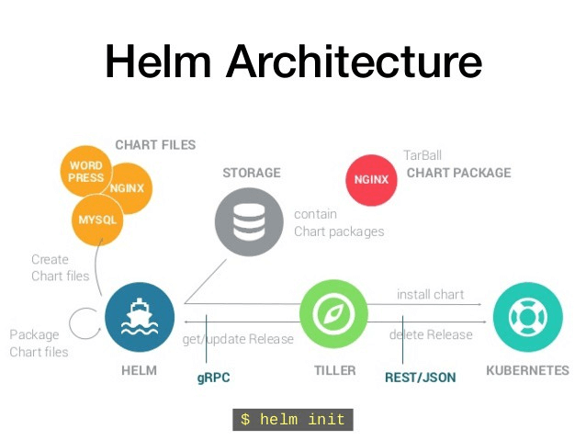
Helm and Templates
Helm uses templating to build the final manifest by replacing values in the template manifests with values provided on the CLI from the values file.
Templates are created using Go's templating syntax.

Slide 93

Helm Chart Structure
Helm charts are a directory structure stored in an archive file.
Chart.yaml provide description of the helm chart
values.yaml contains all possible values used in the templates
templates directory contains template yaml files used to generate the final yaml files

Slide 94
Helm repository
Syntax: helm repo MODE OPTIONS
Mode/Option Description
add -add a chart repository
remove -remove a chart repository
list -list chart repositories
update -update info of available charts

Slide 95
Helm Search
Starting with Helm v3 you can search for a chart in either Helm Hub or repositories.
Syntax: helm search MODE OPTIONS
Mode/Option Description
hub <chart> -search the Helm Hub for a chart
repo <chart> -search the added repositories for a chart

Slide 96
Information about charts
Syntax: helm show SUBCOMMAND REPO/CHART OPTIONS
Subcommand/Option Description
all -show all info for a chart
chart -show chart’s definition
readme -show chart’s README
values -show chart’s values

Slide 97
Install & Uninstall Charts
Syntax: helm install NAME REPO/CHART OPTIONS
Mode/Option Description
-f / --values <file> -specify values for the chart in a values file
--set <value> -specify values for the chart on the CLI
format: key=value[,key=value]
--generate-name -generate a release name if on is not provided
--dry-run -simulate an install
-n / --namespace -specify the namespace to install into
Syntax: helm uninstall NAME OPTIONS
Option Description
--keep-history -remove all resources and mark as deleted but
retain the release history
--dry-run -simulate an uninstall
-n / --namespace -specify the namespace the release is in

Slide 98
Upgrade & Rollback
Syntax: helm upgrade RELEASE REPO/CHART OPTIONS
Option Description
-f / --values <file> -specify values for the chart
--history-max -limit number of revisions saved per release
(default=10)
--dry-run -simulate an install
-n / --namespace -specify the namespace to install into
Syntax: helm rollback RELEASE REVISION OPTIONS
Option Description
--cleanup-on-fail -allow deletion of new resource created in this
rollback when rollback fails
--dry-run -simulate an uninstall
-n / --namespace -specify the namespace the release is in

Slide 99
Ingress Networking

Slide 100
Ingress Controller
Ingress exposes HTTP and HTTPS routes from outside the cluster to services within the cluster
Traffic routing is controlled by rules defined on the Ingress resource
Ingress can provide load balancing, SSL termination and namebased virtual hosting
You have the choice of either using NodePort or an External IP address for your ingress
RKE provides an Ingress controller based on the NGINX ingress controller and K3s is based on the Traefik ingress controlle

Slide 101
Node Port Controller Values
The NodePort Values specify the NodePort port rather than letting a random one get chosen.
(In this file, port 30443 is selected)
# Enable the creation of pod security policy
podSecurityPolicy:
enabled: false
# Create a specific service account
serviceAccount:
create: true
name: nginx-ingress
# Publish services on port HTTPS/30443
# These services are exposed on each node
controller:
service:
enableHttp: false
type: NodePort
nodePorts:
https: 30443

Slide 102
External IP Controller Values
The External IP Values allow you to define the external IP that you would like the application to be able to use.
This is a great resource for users with smaller installations that want to assign a single IP to a group of applications in a production environment.
# Enable the creation of pod security policy
podSecurityPolicy:
enabled: false
# Create a specific service account
serviceAccount:
create: true
name: nginx-ingress
# Publish services on port HTTPS/443
# These services are exposed on the node with
IP10.86.4.158
controller:
service:
enableHttp: false
externalIPs:
- 10.86.4.158

Slide 103
Internal Port Values
When configuring an app that will use an ingress, it is important that the service related to that app be configured to listen on a specific internal port.
(In this example, it will be expecting internaltraffic on port 1234)
kind: Service
apiVersion: v1
metadata:
name: example-service
spec:
selector:
app: example
ports:
- port: 1234

Slide 104
Ingress rules
After the ingress controller has been successfully deployed, the ingress rules can be defined in a separate manifest.
(Each service specified in this manifest will send traffic on that internal port 1234 on which the application services will be listening.)

Slide 105
What is CSI ?
In Kubernetes, CSI (Container Storage Interface) is a standard interface that allows third-party storage providers (like AWS, Azure, NetApp, etc.) to develop their own volume plugins that work natively with Kubernetes without modifying the core Kubernetes code.
CSI (Container Storage Interface) is a specification developed by the Cloud Native Computing Foundation (CNCF) in collaboration with Kubernetes, Mesos, and Docker. It defines how container orchestrators (like Kubernetes) can interact with storage systems.

Slide 106
Why CSI ?
Before CSI, Kubernetes used in-tree volume plugins, which were:
Difficult to maintain
Tied to Kubernetes release cycles
Risky, since bugs in a storage driver could crash the entire kubelet.
CSI decouples storage drivers from Kubernetes, enabling:
External (out-of-tree) drivers
Independent updates from Kubernetes releases
Better security and stability

Slide 107
Key Components of CSI in Kubernetes
Component | Description
CSI Driver | The plugin implemented by the storage vendor (e.g., CSI for AWS EBS, NFS).
External Provisioner | Creates volumes dynamically when PVCs are requested.
External Attacher | Handles volume attachment to nodes.
Node Plugin | Runs on each node, mounts and unmounts volumes.
Controller Plugin | Runs in the control plane, handles provisioning and attaching volumes.

Slide 108
Benefits of CSI ?
Vendor-neutral: One API works across different vendors
Supports dynamic provisioning, expansion, and snapshots
Independent of Kubernetes release cycle
More secure and modular

Slide 109
What are volumes?
A volume is storage that is ready to be used
For example:
. A database needs data for its data
. An application needs a place to store logs
. A web server needs content to display
A Persistent Volume should be available as long as the application needs it.
A Persistent Volume Claim is used by an application to reach out to the Persistent Volume.

Slide 110
Types of storage in k8s
Ephemeral storage is created and deleted along with the pod lifecycle, meaning data is lost when the pod is deleted or restarted.
Persistent storage uses resources that remain available even after pods are deleted, ensuring data durability and application state preservation across restarts or redeployments.

Slide 111
Why Use Storage in Kubernetes?
Data persistence for stateful applications (like databases).
Scalability to handle growing data requirements.
Separation of concerns: Developers use PVCs and don’t need to know the storage backend details.

Slide 112
Core storage concepts
Volumes: The fundamental unit of storage in Kubernetes. Volumes can be using local disk, network attached storage (like NFS, iSCSI), or cloud storage backends. Volumes allow sharing data between containers in a pod.
Persistent Volumes (PV): Cluster-wide storage resources abstracted from the specific implementation details (e.g., EBS, NFS). These are provisioned by admins or dynamically via Storage Classes.
Persistent Volume Claims (PVC): Requests for storage made by users or applications, specifying the size, access mode, and storage class required. PVCs are bound to matching PVs.
Storage Classes: Define classes or types of storage with different characteristics (e.g., SSD, HDD, high IOPS, backup policies) and enable dynamic provisioning of storage by Kubernetes.

Slide 113
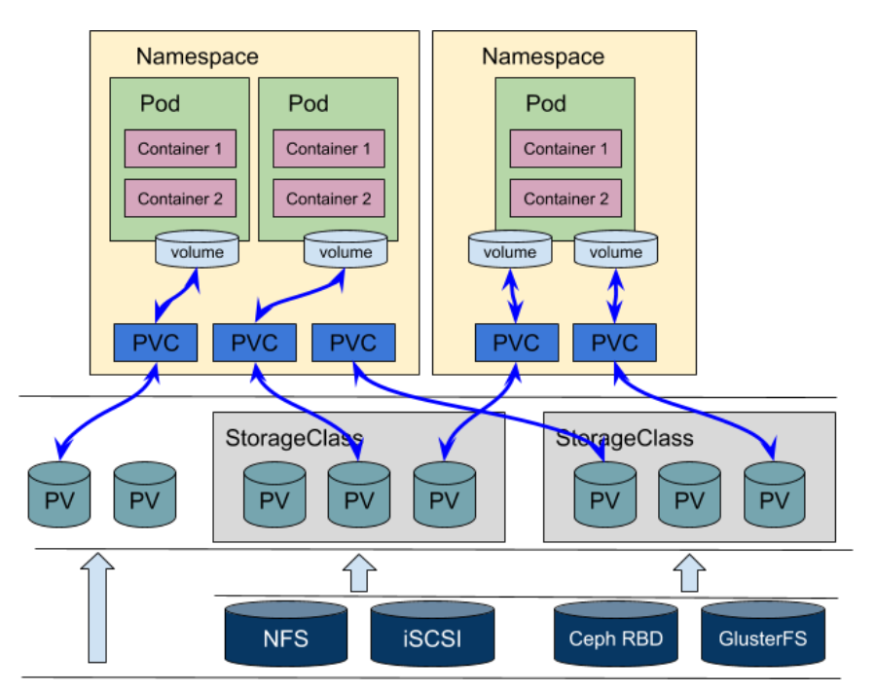
Persistent Volume & Persistent Volume Claim
The persistent volume is storage that is ready to be used.
The persistent volume claim is how the storage is connected to the application. It is the hand that utilizes the storage.

Slide 114
Reclaim Policy
In Kubernetes, the reclaim Policy of a Persistent Volume (PV) defines what happens to the volume after its Persistent VolumeClaim (PVC) is deleted:
Retain: The volume is not deleted and remains in the cluster in a "Released" state. The data on the volume is preserved, and manual intervention is needed to clean up and reuse the volume. This policy is useful when data recovery or backup is critical.
Delete: The volume and its associated storage asset are automatically deleted when the PVC is deleted. This is the default policy for dynamically provisioned volumes and is useful when automatic cleanup is desired to avoid orphaned volumes.

Slide 115
Access Modes
ReadWriteOnce (RWO): The volume can be mounted as read-write by a single node. Multiple pods on the same node can access it, but only one node at a time. This mode is ideal for most stateful applications like databases requiring exclusive write access to maintain data integrity.
ReadOnlyMany (ROX): The volume can be mounted as read-only by many nodes simultaneously. This suits use cases where multiple pods need to read the same data but never write, such as shared configuration files or static content.
ReadWriteMany (RWX): The volume can be mounted as read-write by many nodes simultaneously. This is used for shared writable storage needs, but it requires storage backends that support concurrent access like NFS or certain cloud file systems.
ReadWriteOncePod (RWOP): (Stable since Kubernetes v1.29) The volume can be mounted as read-write by a single pod, ensuring exclusive write access at the pod level across the cluster.

Slide 116
Storage Classes
A Storage Class in Kubernetes is a way for administrators to define different types or "classes" of storage that are offered in a cluster.
Storage Classes enable users to request a specific type of storage in their Persistent Volume Claims (PVCs) without manually creating volumes.
They also allow cluster admins to configure multiple classes for different use cases, such as standard storage for general workloads or high-performance storage for latency-sensitive applications.
There can be a default StorageClass applied if no specific class is requested by the user.
StorageClasses provide storage resource management and dynamic provisioning capabilities in Kubernetes, enhancing flexibility, automation, and efficiency of storage allocation in the cluster.

Slide 117
When to Use a Storage Class (Dynamic Provisioning)
Applications require different performance, size, or backend types of storage that change over time.
Clusters running in the cloud, or when automated, on-demand volume creation is needed.
Environments where administrators prefer not to manage storage resources manually.
Scalability and efficiency are priorities, especially for environments expecting frequent pod or PVC churn.

Slide 118
When to Use Static PV Provisioning
The underlying storage device must be set up, formatted, or initialized in a specific way before use.
Storage resources are tightly controlled, must be shared between multiple clusters, or managed outside of Kubernetes.
Security, compliance, or legacy reasons require manual intervention and storage lifecycle tracking.
Use cases where workload needs to attach to precisely pre-allocated storage.

Slide 119


Volumes & Mounts
56
apiVersion: v1 kind: Pod metadata:
name: random-number-generator
spec:
containers:
- image: alpine
name: alpine
command: ["/bin/sh","-c"]
args: ["shuf -i 0-100 -n 1 >> /opt/number.out;"]
volumeMounts:
- mountPath: /opt
name: data-volume
volumes:
- name: data-volume
hostPath:
path: /data
type: Directory
/opt
56
data-volume
56
/data
Node1

Slide 120
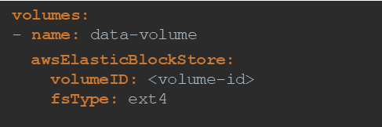












Volume Types
/data
/data
/data
Node1
Node2
Node3
volumes:
- name: data-volume
hostPath:
path: /data
type: Directory
data-volume
NFS

Slide 121



Persistent Volume
pv-definition.yaml
apiVersion: v1
kind: PersistentVolume
metadata:
name: pv-vol1
spec:
accessModes:
- ReadWriteOnce
capacity:
storage: 1Gi
awsElasticBlockStore: volumeID: <volume-id> fsType: ext4
ReadOnlyMany
ReadWriteOnce
ReadWriteMany
hostPath:
path: /tmp/data
kubectl create –f pv-definition.yaml
Persistent Volume (PV)
kubectl get persistentvolume
NAME
pv-vol1
CAPACITY
1Gi
ACCESS MODES RWO
RECLAIM POLICY
Retain
STATUS
Available
CLAIM
STORAGECLASS REASON
AGE
3m

Slide 122

Persistent Volume Claim
pvc-definition.yaml
pv-definition.yaml
apiVersion: v1
kind: PersistentVolumeClaim
metadata:
name: myclaim
spec:
accessModes:
- ReadWriteOnce
resources:
requests: storage: 500Mi
apiVersion: v1
kind: PersistentVolume
metadata:
name: pv-vol1
spec:
accessModes:
- ReadWriteOnce
capacity:
storage: 1Gi
awsElasticBlockStore: volumeID: <volume-id> fsType: ext4
hostPath:
path: /tmp/data
kubectl create –f pvc-definition.yaml

Slide 123
Resource Usage in Kubernetes

Slide 124
Role Based Access Control in Kubernetes

Slide 125
Secure Cluster Communication
Kubernetes is a complex platform and requires extensive configuration and management.
To keep Kubernetes workloads safe, especially in a production environment, you need to address key architectural vulnerabilities and platform dependencies, by implementing security best practices.

Slide 126
Enable Kubernetes Role-Based Access Control (RBAC)
RBAC can help you define who has access to the Kubernetes API and what permissions they have.
RBAC is usually enabled by default on Kubernetes 1.6 and higher (later on some hosted Kubernetes providers).
Because Kubernetes combines authorization controllers, when you enable RBAC, you must also disable the legacy Attribute Based Access Control (ABAC).
When using RBAC, prefer namespace-specific permissions instead of cluster-wide permissions.
Even when debugging, do not grant cluster administrator privileges. It is safer to allow access only when necessary for your specific situation.

Slide 127
Protect etcd with TLS, Firewall and Encryption
Since etcd stores the state of the cluster and its secrets, it is a sensitive resource and an attractive target for attackers.
If unauthorized users gain access to etcd they can take over the entire cluster. Read access is also dangerous because malicious users can use it to elevate privileges.
To configure TLS for etcd for client-server communication, use the following configuration options:
cert-file=: Certificate used for SSL/TLS connection with etcd
--key-file=: Certificate key (not encrypted)
--client-cert-auth: Specify that etcd should check incoming HTTPS requests to find a client certificate signed by a trusted CA
--trusted-ca-file=<path>: Trusted certification authority

Slide 128
Isolate Kubernetes Nodes
Kubernetes nodes must be on a separate network and should not be exposed directly to public networks.
If possible, you should even avoid direct connections to the general corporate network.
This is only possible if Kubernetes control and data traffic are isolated. Otherwise, both flow through the same pipe, and open access to the data plane implies open access to the control plane.
Ideally, nodes should be configured with an ingress controller, set to only allow connections from the master node on the specified port through the network access control list (ACL).

Slide 129
Monitor Network Traffic to Limit Communications
Containerized applications generally make extensive use of cluster networks.
Observe active network traffic and compare it to the traffic allowed by Kubernetes network policy, to understand how your application interacts and identify anomalous communications.
At the same time, if you compare active traffic to allowed traffic, you can identify network policies that are not actively used by cluster workloads.
This information can be used to further strengthen the allowed network policy, removing unneeded connections to reduce the attack surface.

Slide 130
Use Process Whitelisting
Process whitelisting is an effective way to identify unexpected running processes.
First, observe the application over a period of time to identify all processes running during normal application behavior.
Then use this list as your whitelist for future application behavior.
It is difficult to do runtime analysis at the process level.
Several commercial security solutions are available that can help analyze and identify anomalies in running processes across clusters.

Slide 131
Turn on Audit Logging
Make sure that audit logging is enabled and you are monitoring unusual or unwanted API calls, especially authentication failures.
These log entries display a “Forbidden” status message. Failure to authorize could mean that an attacker is trying to use stolen credentials.
When passing files to kube-apiserver, you can use the –audit-policy-file flag to turn on audit logging, and also define exactly which events should be logged

Slide 132
Keep Kubernetes Version Up to Date
You should always run the latest version of Kubernetes. A list of known Kubernetes vulnerabilities with severity scores can be found.
Always plan to upgrade your Kubernetes version to the latest available version.
Upgrading Kubernetes can be a complex process; if you are using a hosted Kubernetes provider, check if your provider handles automatic upgrades.

Slide 133
Secure kubelet
Here are configuration options you can use to lock the kubelet and reduce the attack surface:
Disable anonymous access with --anonymous-auth=false so that unauthenticated requests get an error response. To do this, the API server needs to identify itself to the kubelet. This can be set by adding the flags -kubelet-clientcertificate and --kubelet-client-key.
Set --authorization mode to a value other than AlwaysAllow to verify that requests are authorized. By default, the kubeadm installation tool sets this as a webhook, ensuring that kubelet calls SubjectAccessReview on the API server for authentication.
Include NodeRestriction in the API server –admission-control setting, to restrict kubelet permissions. This only allows the kubelet to modify pods bound to its own node object.

Slide 134
Secure kubelet
Set --read-only-port=0 to close read-only ports. This prevents anonymous users from accessing information about running workloads.
This port does not allow hackers to control the cluster, but can be used during the reconnaissance phase of an attack.
Turn off cAdvisor, which was used in old versions of Kubernetes to provide metrics, and has been replaced by Kubernetes API statistics. Set -cadvisor-port=0 to avoid exposing information about running workloads.
This is the default setting for Kubernetes v1.11. If you need to run cAdvisor, do so using a DaemonSet.

Slide 135
Use Third-Party Authentication for API Server
This provides additional security features such as multi-factor authentication, and ensures that kube-apiserver does not change when users are added or removed.
If possible, make sure that users are not managed at the API server level. You can also use OAuth 2.0 connectors like Dex.
Secure Kubernetes with Aqua
Aqua tames the complexity of Kubernetes security with KSPM (Kubernetes Security Posture Management) and advanced agentless Kubernetes Runtime Protection.
Aqua provides Kubernetes-native capabilities to achieve policy-driven, full-lifecycle protection and compliance for K8s applications

Slide 136
Secure Cluster
Limiting resource usage on a cluster
Controlling what privileges containers run with
Preventing containers from loading unwanted kernel modules
Restricting network access
Controlling which nodes pods may access
Rotate infrastructure credentials frequently

Slide 137
Security
Secure Hosts
Password based authentication
.SSH key based authentication
Secure Kubernetes
Kube-apiserver
Who can access ?
What they can do ?

Slide 138
Security
Authorization
What they can do ?
RBAC authorization
ABAC authorization
Node Authorization
Authentication
Who Can Access ?
Files username and password
Files username and token
Certificates
External Authentication-LDAP
Service Accounts

Slide 139

TLS Certificates

Slide 140
Images Secure
Docker login private
Docker run private.registry.io/apps/internal-app
Kubectl create secret docker-registry regcred
–docker-server=private.registry
–docker-username=registryuser
–dokcer-password=password
–docker-email=admin@Xyz.com
Apiversion: v1
Kind: Pod
Metadata:
name: nginx-pod
Spec:
containers:
- name: nginx
image: private.registry.io/apps/nginx
imagePullSecrets: regcred

Slide 141
What is RBAC ?
Role Based Access Control (RBAC) is a set of functions in Kubernetes that controls who/what is allowed to perform specific actions in Kubernetes.
Example Use Cases:
. Users who want to deploy new applications
. Applications who need to access specific resources
. Services that need to be accessed by multiple applications
. System-wide application and user permissions

Slide 142
Three Elements Of RBAC
Subjects: users/groups , Service Account , Processes in pods or Host OS
Resources: pod, deployment, namespace, service, configmap, secret ..
Operations (verbs): list, get , describe, create, delete, patch ..

Slide 143
What are Users?
Subjects that correlate to humans (or applications external to the cluster)
User/Group accounts are defined externally to the K8s Cluster:
– Certificate based
– Token based
– OAuth2
– Basic Authentication

Slide 144
What are service accounts ?
Subjects that correlate accounts created in the K8s cluster
Service Accounts can be created for and used by applications or by human users.
Service Accounts are defined internally to the cluster. They can be used for users or "services" to access resources in the cluster.
The Service Account will have an access token that it presents to have its access "authorized".
This token can be placed in a standard kubeconfg file or passed to the API with the access request.

Slide 145
What are Roles?
Roles are the mechanism that is used to link actions with resources. They are effectively the "permissions“ that are assigned to subjects
Link Operations with Resources Act as sets of permissions
Permissions add abilities but can not remove abilities
Can be namespace scoped (Roles) or cluster scoped (ClusterRoles)

Slide 146
What are RoleBindings/ClusterRoleBindings?
RoleBindings are the mechanism that is used to link, or bind, a Role to a Subject thereby granting the Subject the permission defined by the Role.
Role bindings come in two different types that an be assigned at the namespace level or at the cluster level.
Cluster scoped role bindings are defined as an object of kind ClusterRoleBinding and can only reference.
ClusterRoles where namespace scoped role bindings are of kind RoleBinding and can only reference Roles

Slide 147
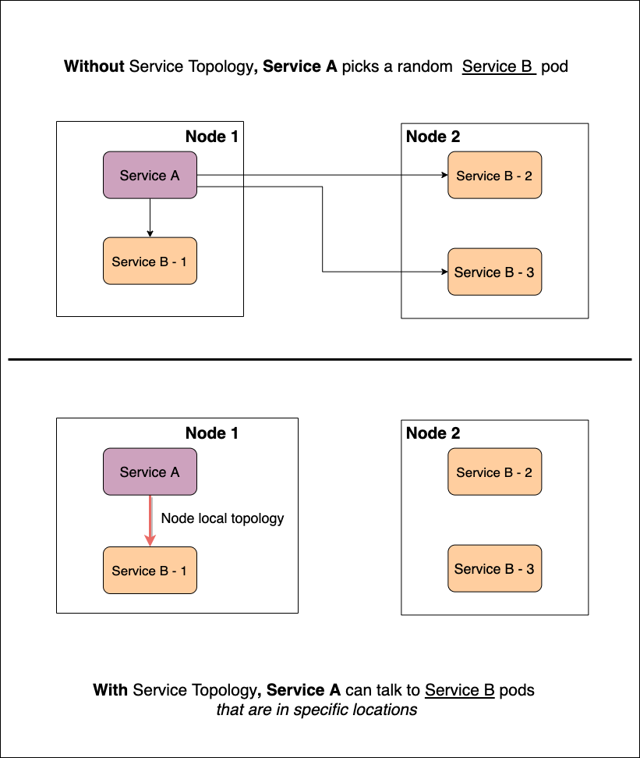
Service Topology aware traffic

Slide 148
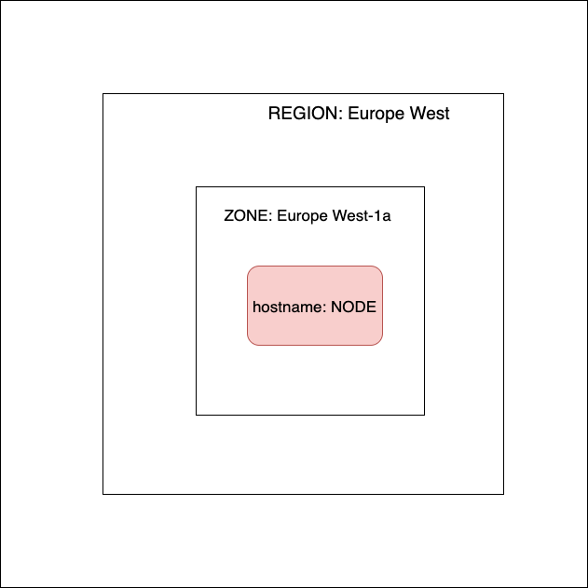
Service Topology

Slide 149
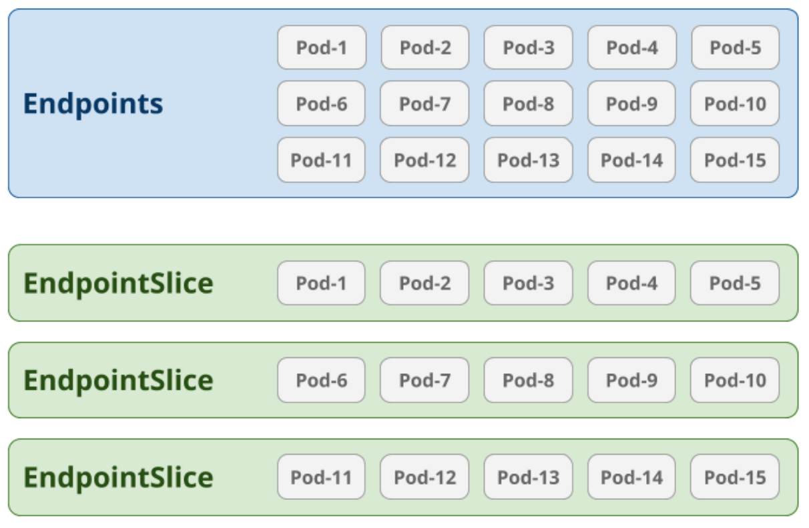
Endpoint Slice

Slide 150
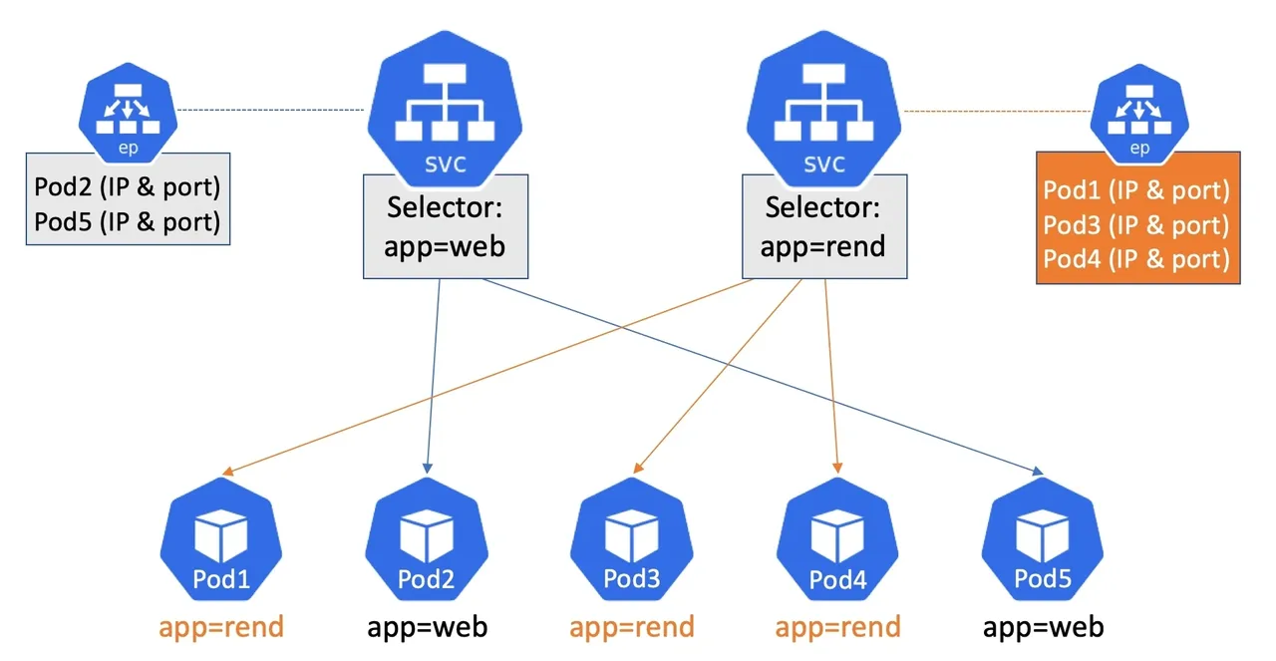
Endpoint slice
https://kubernetes.io/blog/2020/09/02/scaling-kubernetes-networking-with-endpointslices/

Slide 151
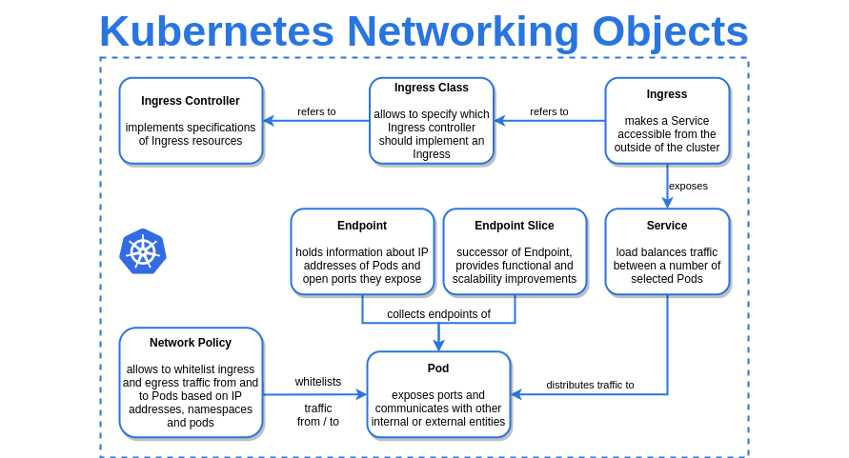

Slide 152
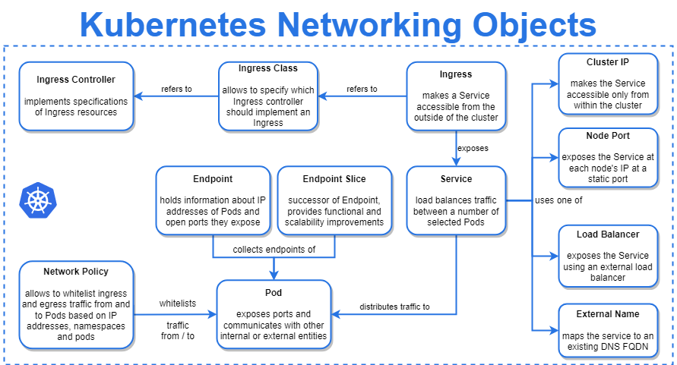

Slide 153
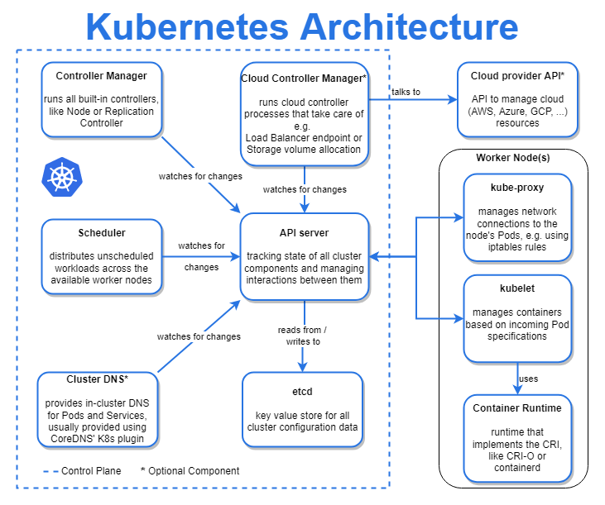

Slide 154
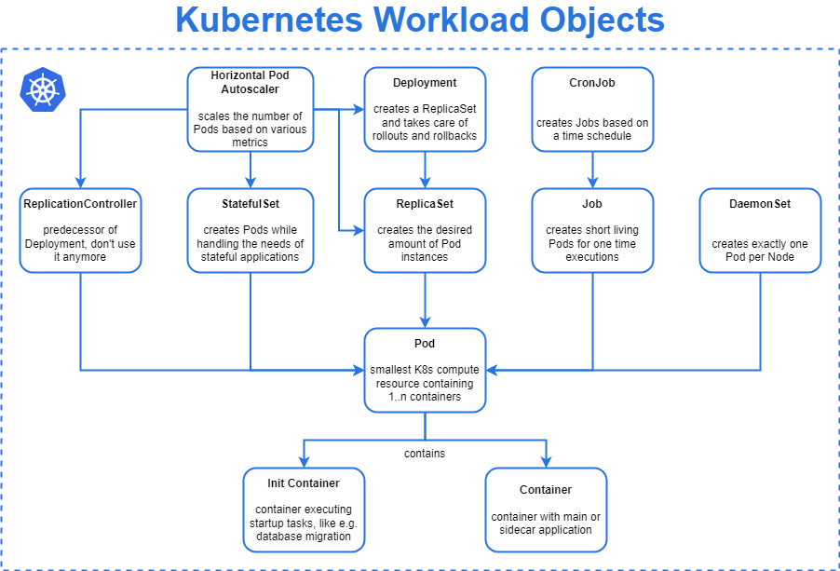

Slide 155
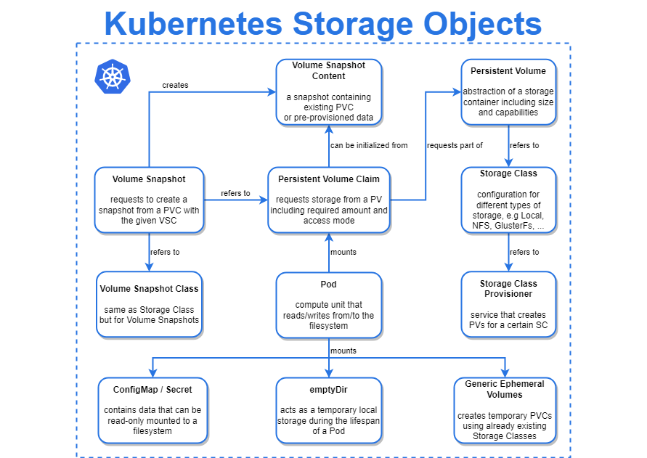

Slide 156
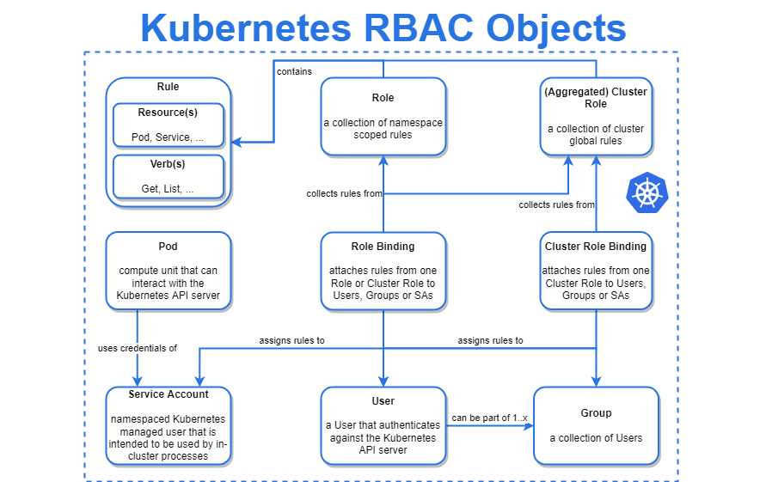

Slide 157
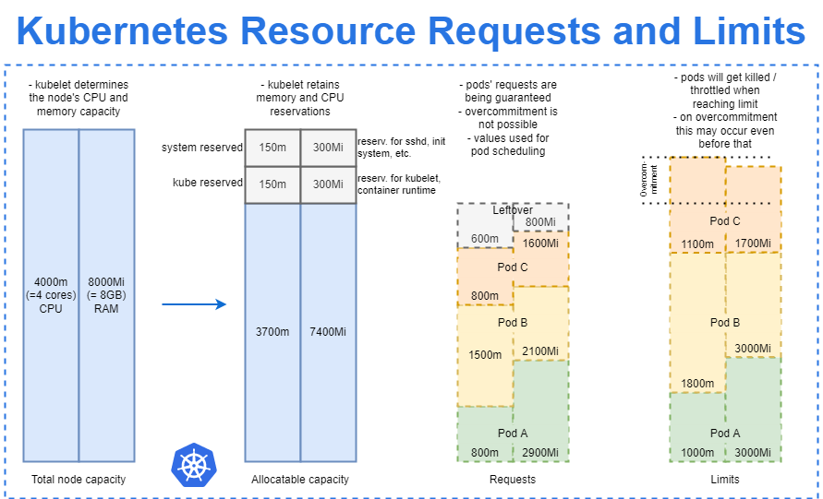

Slide 158
Terraform
Terraform is an infrastructure as code tool that lets you define both cloud and on-prem resources in human-readable configuration files that you can version, reuse, and share.
You can then use a consistent workflow to provision and manage all of your infrastructure throughout its lifecycle.
Terraform can manage low-level components like compute, storage, and networking resources, as well as high-level components like DNS entries and SaaS features.

Slide 159
How Does Terraform work
Terraform creates and manages resources on cloud platforms and other services through their application programming interfaces (APIs).
Providers enable Terraform to work with virtually any platform or service with an accessible API.
Terraform community have already written more than 1700 providers to manage thousands of different types of resources and services, and this number continues to grow.

Slide 160
Three stages
Write: You define resources, which may be across multiple cloud providers and services. For example, you might create a configuration to deploy an application on virtual machines in a Virtual Private Cloud (VPC) network with security groups and a load balancer.
Plan: Terraform creates an execution plan describing the infrastructure it will create, update, or destroy based on the existing infrastructure and your configuration.

Slide 161
Three stages
Apply: On approval, Terraform performs the proposed operations in the correct order, respecting any resource dependencies.
For example, if you update the properties of a VPC and change the number of virtual machines in that VPC, Terraform will recreate the VPC before scaling the virtual machines.

Slide 162
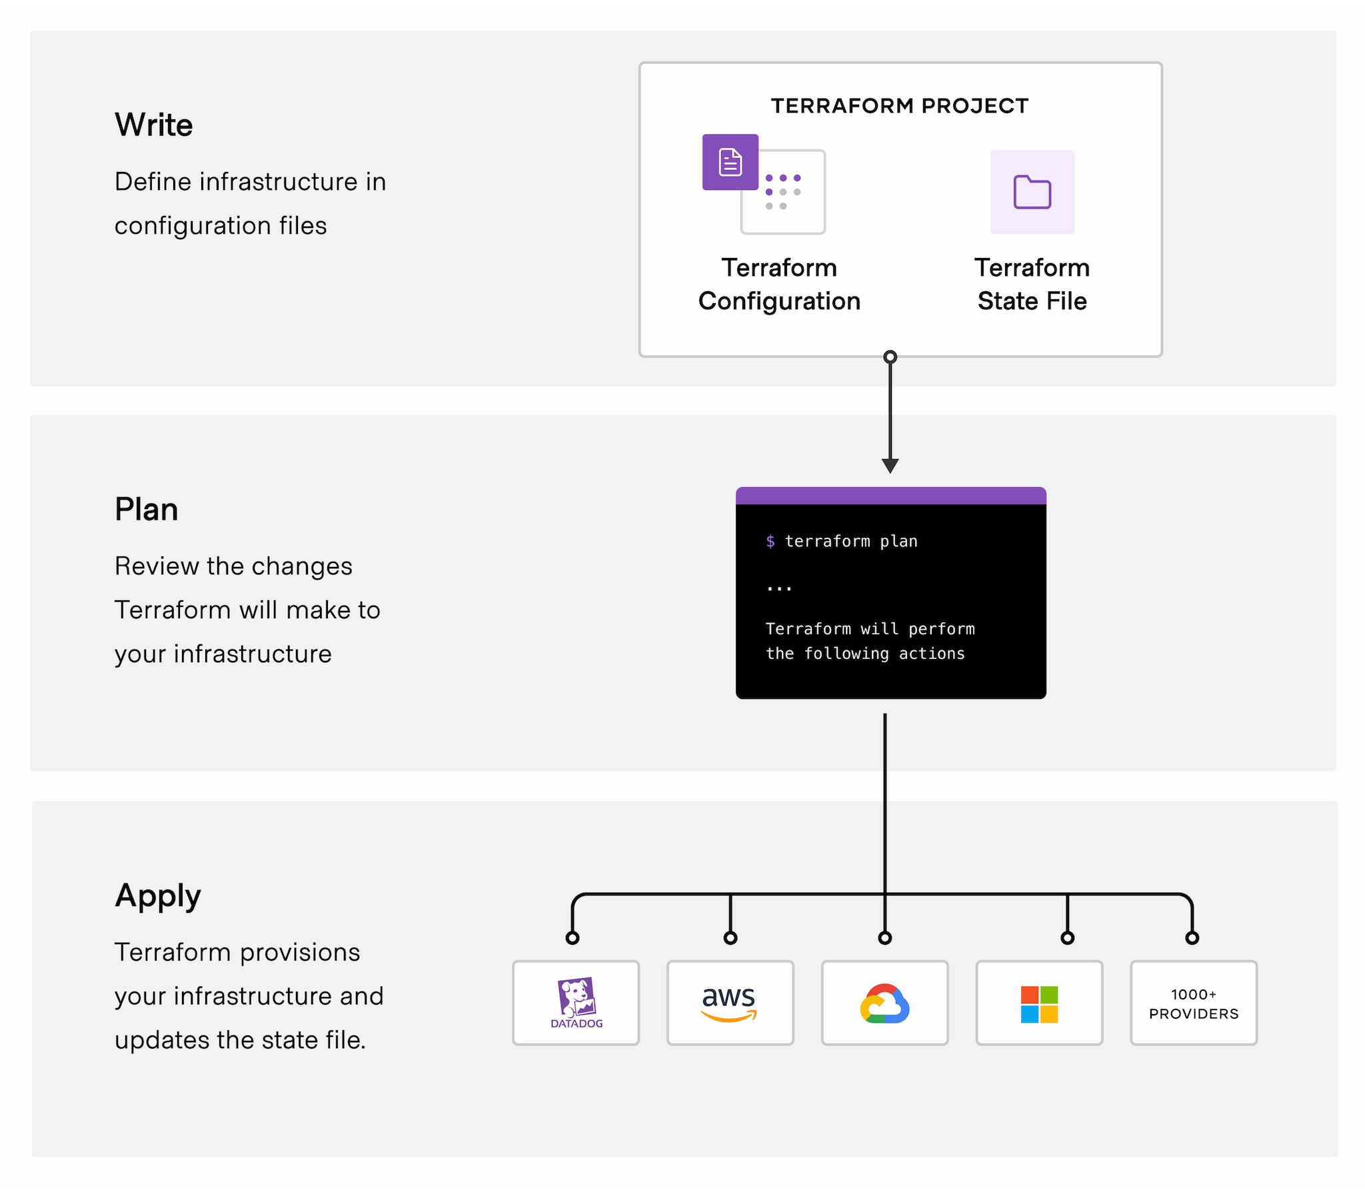

Slide 163
Why Terraform
Manage any infrastructure
Find providers for many of the platforms and services you already use in the Terraform Registry. You can also write your own.
Terraform takes an immutable approach to infrastructure, reducing the complexity of upgrading or modifying your services and infrastructure.

Slide 164
Track your infrastructure
Terraform generates a plan and prompts you for your approval before modifying your infrastructure.
It also keeps track of your real infrastructure in a state file, which acts as a source of truth for your environment.
Terraform uses the state file to determine the changes to make to your infrastructure so that it will match your configuration.

Slide 165
Automate changes
Terraform configuration files are declarative, meaning that they describe the end state of your infrastructure. You do not need to write step-by-step instructions to create resources because Terraform handles the underlying logic.
Terraform builds a resource graph to determine resource dependencies and creates or modifies non-dependent resources in parallel. This allows Terraform to provision resources efficiently.

Slide 166
Standardize configurations
Terraform supports reusable configuration components called modules that define configurable collections of infrastructure, saving time and encouraging best practices.
You can use publicly available modules from the Terraform Registry, or write your own.

Slide 167
Collaborate
Since your configuration is written in a file, you can commit it to a Version Control System (VCS) and use Terraform Cloud to efficiently manage Terraform workflows across teams.
Terraform Cloud runs Terraform in a consistent, reliable environment and provides secure access to shared state and secret data, role-based access controls, a private registry for sharing both modules and providers, and more.

Slide 168
User Cases
. Multi-Cloud Deployment
Application Infrastructure Deployment, Scaling, and Monitoring Tools.
Self-Service Clusters.
Policy Compliance and Management.
PaaS Application Setup
Software Defined Networking
Kubernetes
Kubernetes is an open-source workload scheduler for containerized applications. Terraform lets you both deploy a Kubernetes cluster and manage its resources

Slide 169
What is terraforming in AWS?
Terraform allows you to reference output variables from one module for use in different modules.
The benefit is that you can create multiple, smaller Terraform files grouped by function or service as opposed to one large file with potentially hundreds or thousands of lines of code.

Slide 170
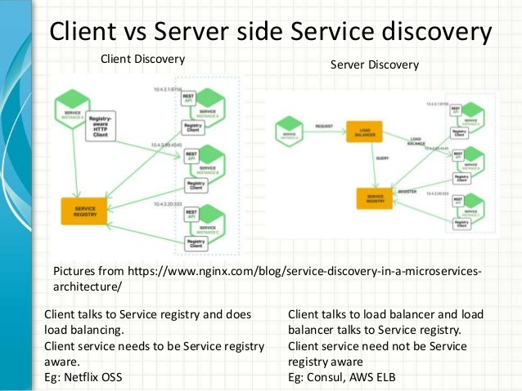
Service Discovery

Slide 171
Custom Resource definition (CRD)
Custom resource definitions lets you extend the kubernetes API
Resource are the endpoints in the kubernetes API that store collections of API objects.
For example, there is the built in deployment resource, that you can use to deploy applications
In the yaml files you describe the object, using the deployment resource type
You create the object on the cluster by using kubectl

Slide 172
Custom resource definitions (CRD)
A custom resource is a resource that you might add to cluster, it’s not available on every cluster
It’s an extension of the kubernetes API
Custom resource are also described in yam files
As an administrator you can dynamically add CRDs to add extra functionality to your cluster.

Slide 173
Kubernetes Operator
A Kubernetes operator is a method of packaging, deploying, and managing a Kubernetes application.
A Kubernetes application is both deployed on Kubernetes and managed using the Kubernetes API (application programming interface) and kubectl tooling.
A Kubernetes operator is an application-specific controller that extends the functionality of the Kubernetes API to create, configure, and manage instances of complex applications on behalf of a Kubernetes user.

Slide 174
Kubernetes operator
In Kubernetes, controllers of the control plane implement control loops that repeatedly compare the desired state of the cluster to its actual state. If the cluster's actual state doesn’t match the desired state, then the controller takes action to fix the problem.
An operator is a custom Kubernetes controller that uses custom resources (CR) to manage applications and their components. High-level configuration and settings are provided by the user within a CR.

Slide 175
Operator
A custom resource is the API extension mechanism in Kubernetes. A custom resource definition (CRD) defines a CR and lists out all of the configuration available to users of the operator.
The Kubernetes operator watches a CR type and takes application-specific actions to make the current state match the desired state in that resource.

Slide 176
Operator
Kubernetes operators introduce new object types through custom resource definitions. Custom resource definitions can be handled by the Kubernetes API just like built-in objects, including interaction via kubectl and inclusion in role-based access control (RBAC) policies.
A Kubernetes operator continues to monitor its application as it runs, and can back up data, recover from failures, and upgrade the application over time, automatically.

Slide 177
Operator framework
The Operator Framework is an open source project that provides developer and runtime Kubernetes tools, enabling you to accelerate the development of an operator.
The Operator Framework includes:
Operator SDK: Enables developers to build operators based on their expertise without requiring knowledge of Kubernetes API complexities.
Operator Lifecycle Management: Oversees installation, updates, and management of the lifecycle of all of the operators running across a Kubernetes cluster.
Operator Metering: Enables usage reporting for operators that provide specialized services.

Slide 178
Why kubernetes operator
A Kubernetes operator is designed to extend the capabilities of Kubernetes, and also simplify application management.
This is especially useful for stateful applications, which include persistent storage and other elements external to the application, and may require extra work to manage and maintain.
Kubernetes operators enable you to easily extend Kubernetes capabilities for specific software and use cases.
For example, database operators let a Kubernetes user securely deploy and manage specific databases.

Slide 179
Kubernetes operator workflow
User makes changes to a CRD
The operator tracks the CRD and identifies change events
The operator reconciles the CRD state with the desired state
The operator adjusts cluster state to the desired state

Slide 180
Operators
RBAC Manager Operator
This Kubernetes operator was designed by Fairwinds to simplify the use of RBAC on Kubernetes. RBAC Manager can help you easily set up and manage RBAC configurations with minimal manual work.
Istio Operator
This is a popular mesh tool that can help you orchestrate, secure, monitor, and manage communications across all microservices deployed on Kubernetes.

Slide 181
Operators
Starboard Operator
Starboard integrates security tools into the Kubernetes environment, allowing users to natively find and view risks associated with various resources in Kubernetes.
This operator automatically updates the security report resource in response to Kubernetes cluster workloads and other changes. For example, starting a new pod initiates a vulnerability scan and configuration audit

Slide 182
Operators
HPA Kubernetes Operator
This operator was designed by Banzai cloud to help you add pod autoscaling functionalities to your Helm charts.
The Horizontal Pod Autoscaler (HPA) operator tracks Deployments or StatefulSets, and then automatically deletes, updates, or creates HPAs according to predefined annotations located in the configuration file.

Slide 183
Kubernetes Service mesh
A Kubernetes service mesh is a tool that inserts security, observability, and reliability features to applications at the platform layer instead of the application layer
Service mesh allows you to separate the business logic of the application from observability, and network and security policies. It allows you to connect, secure, and monitor your microservices.
Connect: Service Mesh enables services to discover and talk to each other. It enables intelligent routing to control the flow of traffic and API calls between services/endpoints. These also enable advanced deployment strategies such as blue/green, canaries or rolling upgrades, and more.

Slide 184
Service Mesh
Secure: Service Mesh allows you secure communication between services. It can enforce policies to allow or deny communication. E.g. you can configure a policy to deny access to production services from a client service running in the development environment.
Monitor: Service Mesh enables observability of your distributed microservices system. Service Mesh often integrates out-of-the-box with monitoring and tracing tools (such as Prometheus and Jaeger in the case of Kubernetes) to allow you to discover and visualize dependencies between services, traffic flow, API latencies, and tracing.

Slide 185
Service Mesh
A service mesh is an infrastructure layer that manages how microservices communicate with each other in a distributed application.
Instead of each microservice having to handle things like service discovery, load balancing, retries, encryption, and monitoring itself, the service mesh takes care of it — usually by deploying lightweight network proxies alongside each service.

Slide 186
Key Idea
Think of a service mesh as a traffic controller for microservices:
Each service talks to its sidecar proxy (often Envoy)
The proxies talk to each other, handling communication, security, and observability
The service code stays focused on business logic, not networking logic

Slide 187
Features
Service Discovery : Finds where other services are running.
Traffic Management – Load balancing, routing, canary releases, blue/green deployments.
Security –mTLS (mutual TLS) for encrypted and authenticated communication.
Observability Metrics, logs, tracing of requests between services.
Resilience Retries, failovers, circuit breaking.

Slide 188
How it Works
Typical setup:
Control Plane – Manages configuration and policy (e.g., Istio Pilot).
Data Plane – The proxies (sidecars) that handle actual traffic between services.
Example flow:
Service A → Sidecar Proxy A → Sidecar Proxy B → Service B
Popular Service Meshes
Istio (most popular, uses Envoy)
Linkerd
Consul Connect
AWS App Mesh

Slide 189
GitOps
GitOps is a methodology for software development and infrastructure management that positions Git repositories as your workflow’s single source of truth.
Instead of manually running commands to apply changes, GitOps revolves around declarative config files that are versioned in your repositories.
CI/CD-driven tooling then consumes the files to automatically create and update your resources.

Slide 190
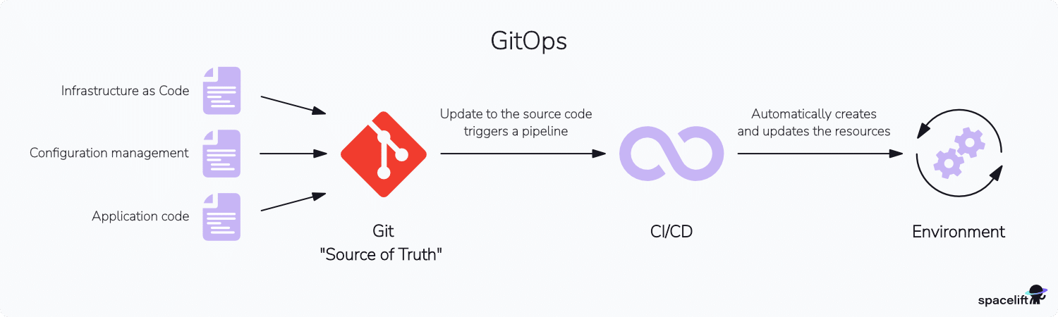
GitOps

Slide 191
GitOps tools
Many GitOps tools support an agent-driven pull-based architecture that makes it possible to fully automate deployments after new code changes are committed.
The agent runs in your production environment; it periodically checks your repositories for new changes, then automatically applies them.
Argocd
Spacelift
FluxCd

Slide 192
GitOps
GitOps is a modern way of managing infrastructure and application deployments using Git as the single source of truth.
Everything — configurations, environments, deployments — is stored, versioned, and audited in Git, and automatically applied to your cluster by a GitOps operator (like Argo CD or Flux CD).
So instead of manually using kubectl apply or CI scripts, your cluster pulls changes from Git and stays in sync with it.

Slide 193
What is Argo Cd ?
Argo CD (Argo Continuous Delivery) is a GitOps-based CD tool for Kubernetes. It automates deployment, management, and synchronization of Kubernetes resources using Git as the single source of truth

Slide 194
Why Argo CD ?
Reason | Description
1. GitOps Model | Everything (manifests, Helm charts, Kustomize, etc.) is stored in Git. Argo CD automatically syncs your cluster to match what’s in Git.
2. Declarative Deployments | Desired state (YAML manifests) is declared — Argo CD ensures the live cluster matches it.
3. Continuous Reconciliation | If someone manually changes resources in the cluster, Argo CD detects the drift and can auto-correct it.
4. Visual Dashboard | Web UI shows all applications, their sync/health status, and real-time diffs between Git and cluster.
5. Multi-Cluster Management | Deploy and manage applications across multiple Kubernetes clusters easily.
6. Security & Access Control | Role-based access (RBAC), SSO integration, and Git commit traceability improve security.
7. Easy Rollbacks | Rollback to any previous Git commit = rollback to a known good state.
8. Integration Friendly | Works with CI tools (like Jenkins, GitHub Actions, Tekton), Helm charts, Kustomize, etc.

Slide 195
Argo CD
What Is Argo CD?
Argo CD is a declarative, GitOps continuous delivery tool for Kubernetes.
Why Argo CD?
Application definitions, configurations, and environments should be declarative, and version controlled. Application deployment and lifecycle management should be automated, auditable, and easy to understand.
How it works?
Argo CD follows the GitOps pattern of using Git repositories as the source of truth for defining the desired application state. Kubernetes manifests can be specified in several ways

Slide 196
Sync Policy
Option | Description
prune: true | Deletes resources in the cluster that are no longer defined in Git. Prevents config drift.
selfHeal: true | If someone manually changes a resource in the cluster, Argo CD detects the drift and reverts it back to match Git.

Slide 197
Sync Behavior
Option | Meaning
CreateNamespace=true | Automatically create the destination namespace if it doesn’t exist.
PrunePropagationPolicy=foreground | Force foreground deletion (wait for dependents to be deleted).
ApplyOutOfSyncOnly=true | Apply only resources that are out of sync (faster).
Validate=false | Skip Kubernetes schema validation (useful for CRDs).
ServerSideApply=true | Use server-side apply (SSA) instead of kubectl apply.
Replace=true | Replace instead of patching resources during apply.
RespectIgnoreDifferences=true | Don’t override ignoreDifferences rules.

Slide 198
Sync
Feature | Key Field | Behavior
Manual Sync | (none) | You trigger sync manually
Auto Sync | automated | Syncs automatically on Git change
Auto Prune | prune: true | Removes orphaned resources
Self Heal | selfHeal: true | Reverts manual changes in cluster
Sync Options | syncOptions | Fine-tunes sync behavior (e.g., namespace creation, validation)

Slide 199
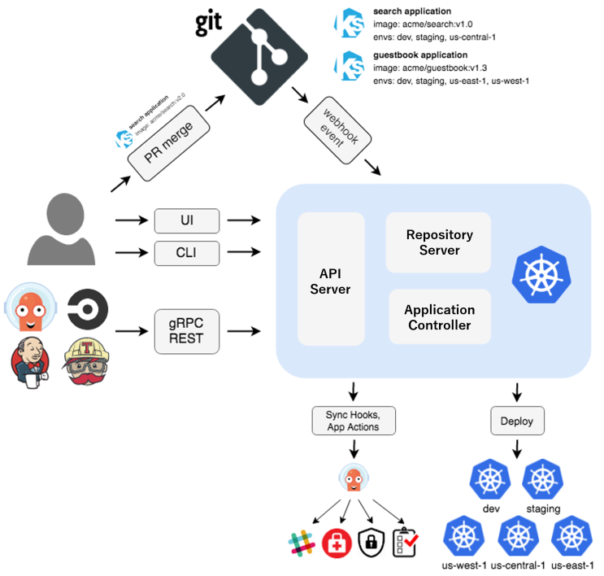
Architecture

Slide 200
Features of ArgoCd
Manual or automatic deployment of applications to a Kubernetes cluster.
Automatic synchronization of application state to the current version of declarative configuration.
Web user interface and command-line interface (CLI).
Ability to visualize deployment issues, detect and remediate configuration drift.
Role-based access control (RBAC) enabling multi-cluster management.
Single sign-on (SSO) with providers such as GitLab, GitHub, Microsoft, OAuth2, OIDC, LinkedIn, LDAP, and SAML 2.0
Support for webhooks triggering actions in GitLab, GitHub, and BitBucket.

