Slide 1

Financial Analytics

Slide 2
Objectives
Top 10 Companies with highest Market Capital
Top 10 Companies with highest Quarterly Sales
Bottom 10 Companies with lowest Market Capital
Bottom 10 Companies with lowest Quarterly Sales
14/07/2024
2

Slide 3

The Process
Data Collection
Data Cleaning
Data Analysis
Insights
14/07/2024
3

Slide 4
Data Collection
The Data has been collected in the form of a CSV file named “financial_data_analysis.csv”.
The CSV file has the data (Market capital and Quarterly Sales) of top 500 companies.
14/07/2024
4

Slide 5
Data Cleaning
Removed the S. No. column as it is not required for analysis.
Some values of the column ‘Sales Qtr. - Crore’ are written on the adjacent column. I used Paste Special dialogue box and check the ‘skip blanks’ option to move those values to its original column.
Then I used python to deal with NaN values and removed the outliers.
14/07/2024
5

Slide 6
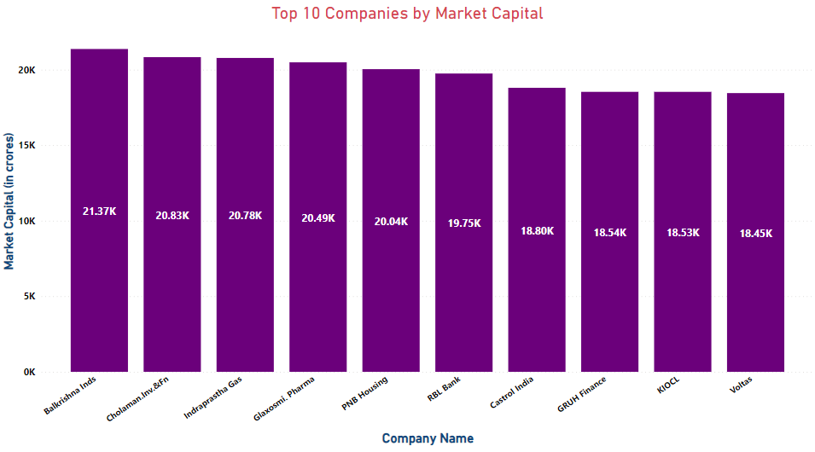
Data Analysis
Balkrishna Inds has the highest Market Capital at 21.37K Crores
14/07/2024
6

Slide 7
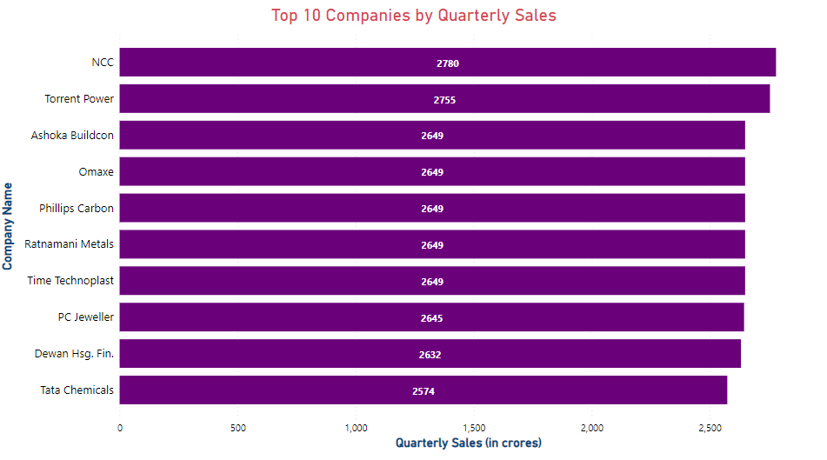
Data Analysis
NCC has the highest Quarterly Sales at 2780 Crores
14/07/2024
7

Slide 8
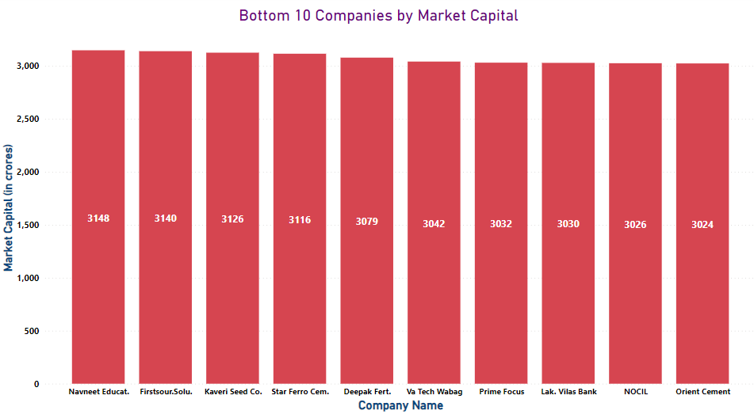
Data Analysis
Orient Cement has the lowest Market Capital at 3024 Crores
14/07/2024
8

Slide 9
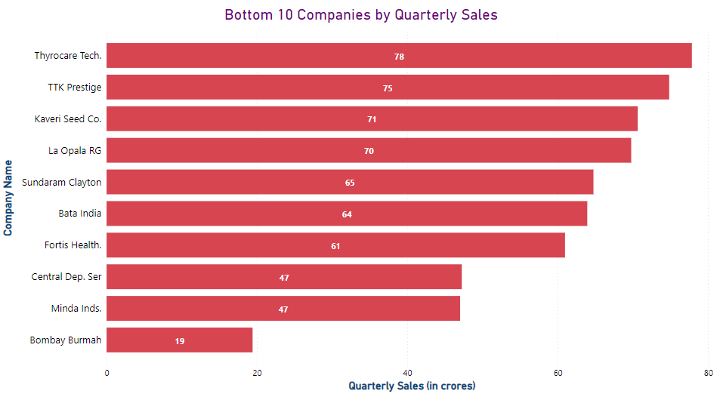
Data Analysis
Bombay Burmah has the lowest Quarterly Sales at 19 Crores only
14/07/2024
9

Slide 10
Insights
Balkrishna Industries and Cholaman Investment and Finance has the Highest Market Capital at 21.37K Crores and 20.83K Crores respectively which is 606.6 % more than Orient Cement which has the lowest Market Capital at 3024 Crores.
NCC has the Highest Quarterly Sales at 2780 Crores which is 14531.5 % more than Bombay Burmah which has the lowest Quarterly Sales of 19 Crores.
14/07/2024
10

Slide 11

Thank you

