Slide 1

Mitron Bank Analysis
Credit Card Offering for customers

Slide 2
PROBLEM STATEMENT
Mitron Bank aims to launch a new line of credit cards to diversify its product portfolio and expand its market presence. To ensure the success of this initiative, a pilot project using sample data has been proposed to analyze customer spending patterns and preferences. AtliQ Data Services, entrusted with this pilot, seeks to provide actionable insights derived from the data to guide the customization of credit cards based on customer needs and market trends.

Slide 3
OBJECTIVE
The primary objective of this project is to analyze the provided sample dataset encompassing 4000 customers across five cities, focusing on their online spending behaviors. By leveraging data analytics, the goal is to generate actionable insights and metrics that will aid in tailoring the credit card offerings to suit customer requirements and align with prevailing market trends. The end aim is to present these insights in a concise, visually impactful manner to facilitate decision-making by the top-level management and product strategy team at Mitron Bank. Additionally, the project involves incorporating supplementary data to strengthen and support the recommendations provided based on the analysis.

Slide 4
BUSINESS QUESTIONS
Demographic Classification:
Classify customers by demographics - age group, gender, occupation, etc.
Insights: Highlight patterns, preferences, and behaviors across these demographics.
Average Income Utilization %:
Calculate income utilization (avg_spends / avg_income) as a key metric.
Insights: Correlate higher income utilization with the likelihood of credit card usage.
Spending Insights:
Determine top spending categories and their correlation with occupation, gender, city, and age.
Insights: Identify influential factors in spending patterns for tailored credit card features.
Key Customer Segments:
Profile high-value customer segments considering demographics, spending behaviors, and financial preferences.
Insights: Uncover traits defining the most valuable users for the new credit cards.
Credit Card Feature Recommendations:
Propose key credit card features aligned with insights from the provided data and secondary internet research.
Insights: Support recommendations with data-driven insights for enhanced credit card usage.

Slide 5
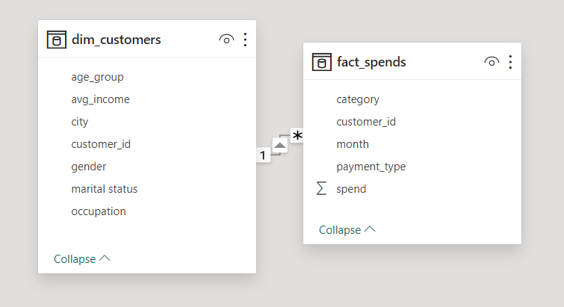
Data Model

Slide 6
DATA CLEANING
Checked for Duplicates
Checked Data Types
Checked for missing values
Checked for special characters

Slide 7
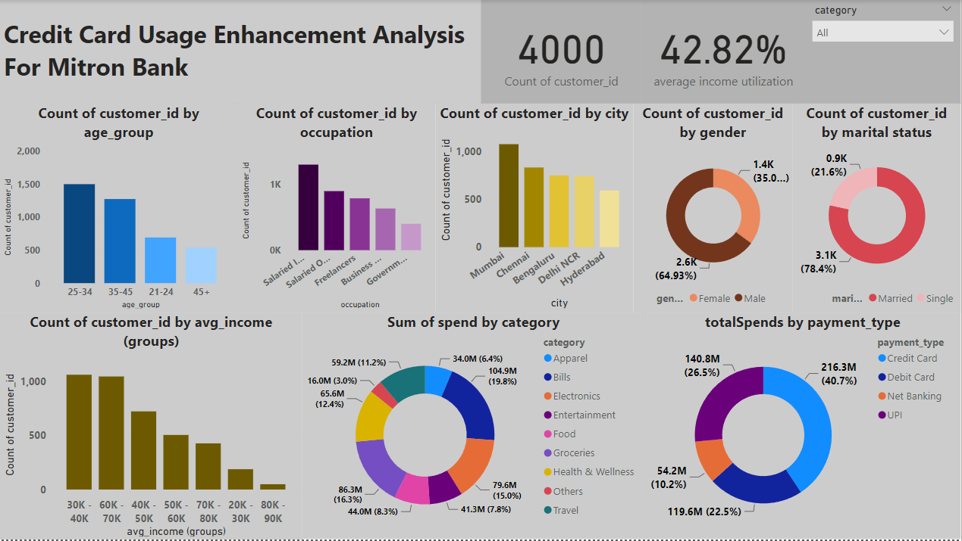
DashBoard

Slide 8
Insights
Age Group Preferences:
- 25-34 and 35-45 age groups spend more on Electronics, Bills, Groceries, Health, and Travel.
Female Spending Habits:
- Females focus on Food and Travel, aligning with male spending patterns.
Occupation-Related Patterns:
- IT Employees, Salaried Other Employees, and Freelancers exhibit substantial spending.
Actionable Recommendations:
Tailored Credit Card Rewards:
- Align rewards with age group preferences.
- Introduce gender-specific benefits on like Apparel, Food and Travel.
Targeted Occupation Offers:
- Customize credit card features for high-spending occupations.

Slide 9
Insights
Spending Categories:
-Bills are the most utilized category, followed by Electronics, Groceries, Health, and Travel.
Recommendations:
-Customized Offerings: Tailor credit card benefits for high-utilizing demographics and categories.
-Occupation-Centric Features: Align credit card features with spending habits of IT, Freelancers, and specific employee groups.

Slide 10
Insights
Tailored Credit Card Features for IT Employees:
Tech-Related Rewards:
- Offer rewards and cashback specifically designed for tech purchases, including gadgets, software, and electronics.
E-commerce Partnerships:
- Establish exclusive partnerships with popular e-commerce platforms to provide IT employees with special deals, discounts, or cashback offers, particularly on tech-related products.

Slide 11
Insights
Customers in Mumbai:
A significant portion of our customer base in Mumbai exhibits higher income utilization. To enhance their overall experience, we should consider offering exclusive benefits tailored to support their business establishment, purchases, transportation, and more.

Slide 12
Feature Recommendations:
Consider implementing cashback or rewards programs, particularly targeting high-spending categories like bills and more.
Introduce personalized rewards aligned with individual preferences for payment methods.
Offer special discounts or exclusive offers for popular spending categories such as Entertainment.
Provide user-friendly budgeting tools or alerts to address specific spending behaviors.
Explore strategic partnerships or collaborations to offer additional benefits tailored to the unique spending habits of our customers.

Slide 13

Thank You

