Slide 1
ML solution: Chances of a booking getting canceled
By
Mahendra Kumar

Slide 2
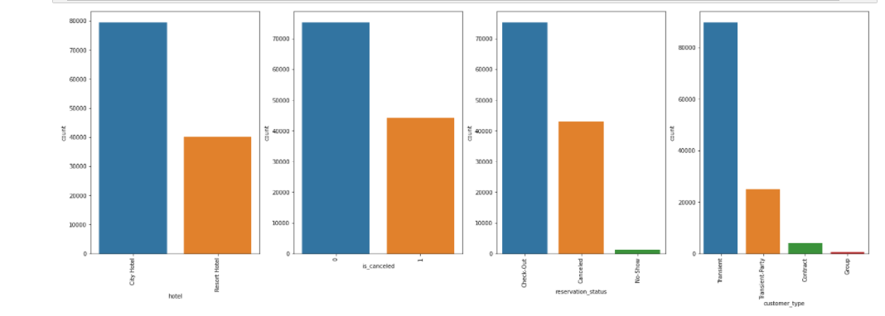
Data Analysis(data story)
The hotel data is having total 32 columns and 119390 observation.
There are total 119173 values are missing in all the columns out which company column is having largest missing values.
The missing value columns are country ,children, agent and company . These values are imputed using mean for integer/float data type and mode for categorical type of variable .
The categorical variables were transformed into numerical variables using One-hot encoding and Dummy encoding. The reservation status date column is removed.
Out of total bookings 62.95 % booking were not canceled and 37.04% were got canceled.

Slide 3
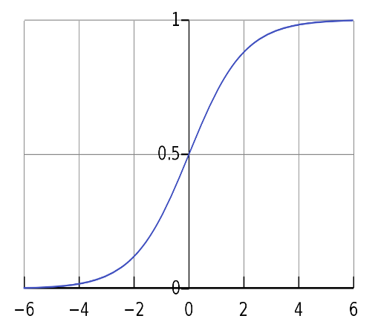
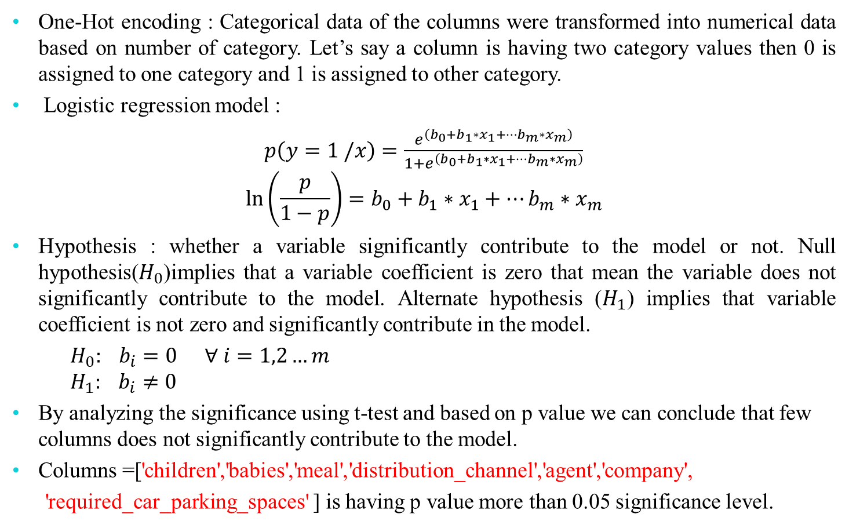
ML :Model Building
One-Hot encoding : Categorical data of the columns were transformed into numerical data based on number of category. Let’s say a column is having two category values then 0 is assigned to one category and 1 is assigned to other category.
Logistic regression model :
$p\left(y=1 /x\right)=\frac{e^{\left(b_{0}+b_{1}∗x_{1}+…b_{m}∗x_{m}\right)}}{1+e^{\left(b_{0}+b_{1}∗x_{1}+…b_{m}∗x_{m}\right)}}$
$$\ln\left(\frac{p}{1−p}\right)=b_{0}+b_{1}∗x_{1}+…b_{m}∗x_{m}$$
Hypothesis : whether a variable significantly contribute to the model or not. Null hypothesis($H_{0}$)implies that a variable coefficient is zero that mean the variable does not significantly contribute to the model. Alternate hypothesis ($H_{1}$) implies that variable coefficient is not zero and significantly contribute in the model.
${ H}_{0}: b_{i}=0$ $∀ i=1,2…m$
$${ H}_{1}: b_{i}≠0$$
By analyzing the significance using t-test and based on p value we can conclude that few columns does not significantly contribute to the model.
Columns =['children','babies','meal','distribution_channel','agent','company',
'required_car_parking_spaces' ] is having p value more than 0.05 significance level.

Slide 4
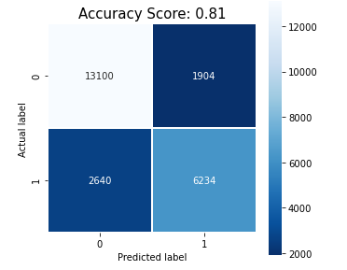
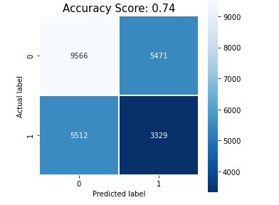
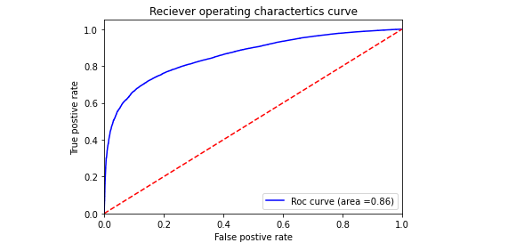
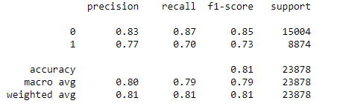
Results
When we choose all the columns as variables of the model the accuracy score is 0.74(i.e 74%).That means 74% of observations are correctly classified by the model. If we drop the insignificant variables based on the hypothesis analysis, the accuracy is increased to 0.81(i.e 81 %).

Slide 5
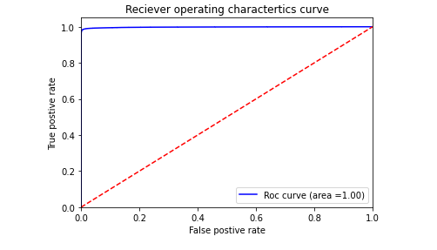
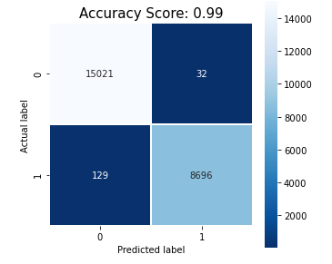
ML model :Dummy encoding
We have used logistics regression for ML model and dummy encoding to transform categorical column data into numerical data.
Dummy encoding is defined as it create as many column as number of category level present in the columns.
After applying the logistic regression the accuracy score is 0.99 (i.e 99 %). The accuracy has increased significantly by comparing to previous model which was having 81 % where we have used one-hot encoding.

Slide 6
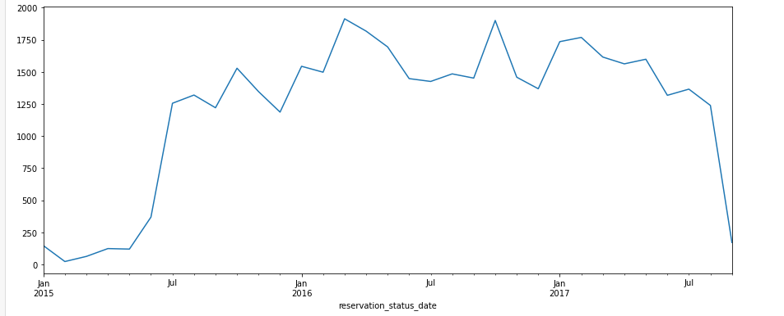
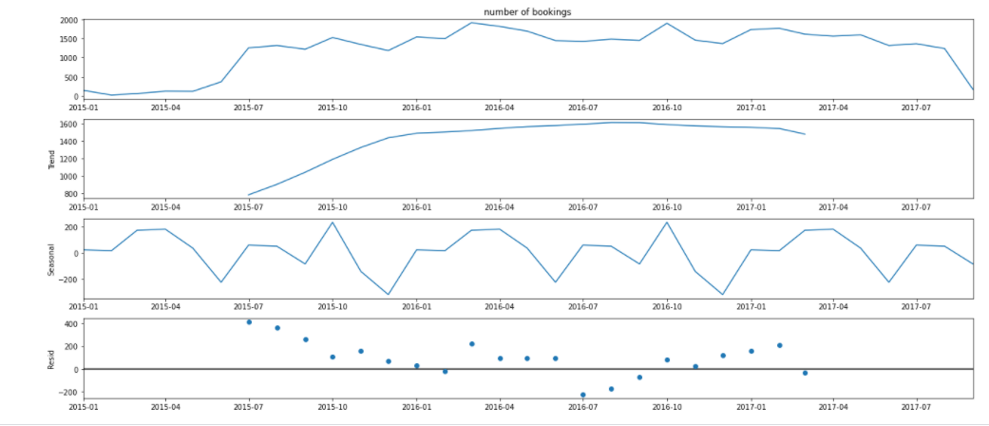
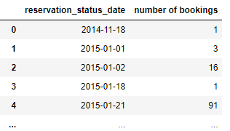
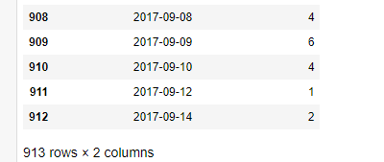
Approach :Forecast Number of booking
With time series forecasting the number of bookings a hotel will get in future can be predicted.
We can transform the data into the time series format in which we have reservation status date as time stamp and the number of bookings for the particular date can be obtain from data.

Slide 7
Thank
You
Notes:
Add background image and send it to back:
Click on the icon to add a Image >> Choose your Image >> Right Click on Image >> Send to Back >> Send to Back.
Change the image:
Right Click on Image >> Change Picture >> Choose your Image.

