Slide 1
Lesson 1
Retrieving Data Using the
SQL SELECT Statement

Slide 2

What You will Learn at the end of this Session ?
1.
  List the capabilities of SQL SELECT statements
2
1
2.
  Execute a basic SELECT statement
1-<number>

Slide 3
Capabilities of SQL SELECT Statements
Projection
Selection
Table 1
Table 1
Join
Table 1
Table 2
1-<number>
Notes:
Oracle Database: SQL Fundamentals I 1 - <number>
Capabilities of SQL SELECT Statements
A SELECT statement retrieves information from the database. With a SELECT statement, you can do the following:
Projection: Select the columns in a table that are returned by a query. Select as few or as many of the columns as required.
Selection: Select the rows in a table that are returned by a query. Various criteria can be used to restrict the rows that are retrieved.
Joins: Bring together data that is stored in different tables by specifying the link between them. SQL joins are covered in more detail in the lesson titled “Displaying Data from Multiple Tables Using Joins.”

Slide 4

Basic SELECT Statement
SELECT *|{[DISTINCT] column|expression [alias],...}
FROM table;
QUERY STATEMENT
SELECT
FROM
  SELECT identifies the columns to be displayed.
  FROM identifies the table containing those columns.
1-<number>

Slide 5
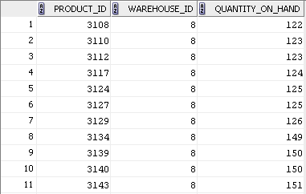
Selecting All Columns
SELECT *
FROM inventories ;
…
1-<number>
Notes:
Oracle Database: SQL Fundamentals I 1 - <number>
Selecting All Columns
You can display all columns of data in a table by following the SELECT keyword with an
asterisk (*). In the example in the slide, the INVENTORIES table contains four columns: PRODUCT_ID, WAREHOUSE_ID, QUANTITY_ON_HAND.
.
You can also display all columns in the table by listing all the columns after the SELECT keyword. For example, the following SQL statement (like the example in the slide) displays all columns and all rows of the INVENTORIES table:
SELECT product_id, warehouse_id, quantity_on_hand
FROM inventories;
Note: In SQL Developer, you can enter your SQL statement in a SQL Worksheet and click the “Execute Statement” icon or press [F9] to execute the statement. The output displayed on the Results tabbed page appears as shown in the slide.

Slide 6
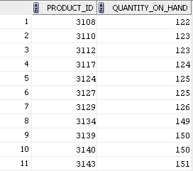
Selecting Specific Columns
SELECT product_id, quantity_on_hand
FROM inventories ;
…
1-<number>
Notes:
Oracle Database: SQL Fundamentals I 1 - <number>
Selecting Specific Columns
You can use the SELECT statement to display specific columns of the table by specifying the column names, separated by commas. The example in the slide displays all the department numbers and location numbers from the INVENTORIES table.
In the SELECT clause, specify the columns that you want in the order in which you want them to appear in the output. For example, to display location before department number (from left to right), you use the following statement:
SELECT product_id, quantity_on_hand
FROM inventories;
…

Slide 7

Writing SQL Statements
  Clauses are usually placed on separate lines.
SQL statements are not case sensitive
  SQL statements can be entered on one or more lines.
  Indents are used to enhance readability.
Writing SQL Statements
  Keywords cannot be abbreviated or split across lines.
  In SQL*Plus, you are required to end each SQL statement with a semicolon (;).
In SQL Developer, SQL statements can be optionally terminated by a semicolon (;). Semicolons are required when you execute multiple SQL statements
1-<number>

Slide 8


Column Heading Defaults
    Default heading alignment: Left-aligned
    Default heading display: Uppercase
  SQL Developer
    Character and Date column headings are left-aligned.
    Number column headings are right-aligned.
    Default heading display: Uppercase
  SQL*Plus
1-<number>

Slide 9
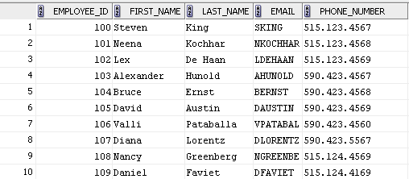
Column Heading Defaults
1-<number>
Notes:
In SQL Developer, column headings are displayed in uppercase and are left-aligned.

Slide 10
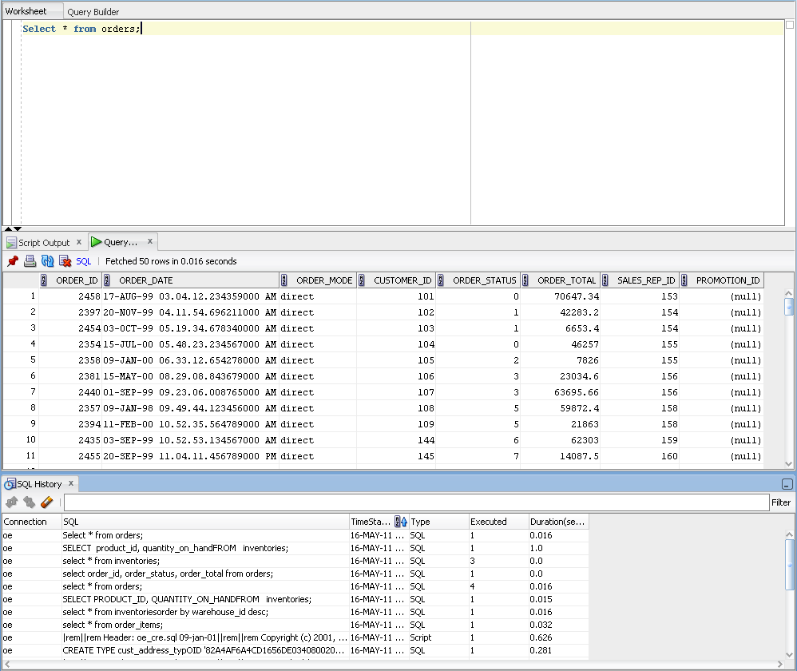
SQL Developer sample screenshot
Worksheet
Query Result
History
1-<number>

Slide 11


Arithmetic Expressions
Create expressions with number and date data by using arithmetic operators.
Operator
Description
  +
Add
  -
Subtract
*
Multiply
  /
Divide
1-<number>
Notes:
Oracle Database: SQL Fundamentals I 1 - <number>
Arithmetic Expressions
You may need to modify the way in which data is displayed, or you may want to perform calculations, or look at what-if scenarios. All these are possible using arithmetic expressions. An arithmetic expression can contain column names, constant numeric values, and the arithmetic operators.
Arithmetic Operators
The slide lists the arithmetic operators that are available in SQL. You can use arithmetic operators in any clause of a SQL statement (except the FROM clause).
Note: With the DATE and TIMESTAMP data types, you can use the addition and subtraction operators only.

Slide 12
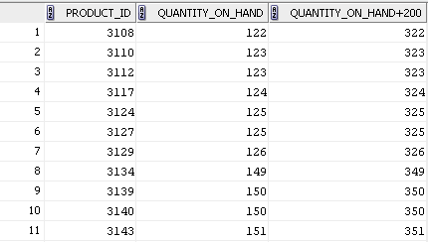
Using Arithmetic Operators
SELECT product_id, quantity_on_hand, quantity_on_hand+200
FROM inventories ;
1-<number>
Notes:
Oracle Database: SQL Fundamentals I 1 - <number>
Using Arithmetic Operators
The example in the slide uses the addition operator to calculate a quantity increase of 200 for all products. The slide also displays a QUANTITY_ON_HAND+300 column in the output.
Note that the resultant calculated column, QUANTITY_ON_HAND+200, is not a new column in the EMPLOYEES table; it is for display only. By default, the name of a new column comes from the calculation that generated it—in this case, QUANTITY_ON_HAND+200.
Note: The Oracle server ignores blank spaces before and after the arithmetic operator.
Operator Precedence
If an arithmetic expression contains more than one operator, multiplication and division are evaluated first. If operators in an expression are of the same priority, evaluation is done from left to right.
You can use parentheses to force the expression that is enclosed by the parentheses to be evaluated first.
Rules of Precedence
Multiplication and division occur before addition and subtraction.
Operators of the same priority are evaluated from left to right.
Parentheses are used to override the default precedence or to clarify the statement.

Slide 13
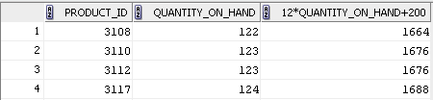
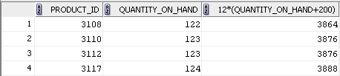
Operator Precedence
SELECT product_id, quantity_on_hand, 12*quantity_on_hand+200
FROM inventories ;
1
SELECT product_id, quantity_on_hand, 12*(quantity_on_hand+200)
FROM inventories ;
2
1-<number>
Notes:
Oracle Database: SQL Fundamentals I 1 - <number>
Operator Precedence (continued)
The first example in the slide displays the product_id, quantity_on_hand, and the cost of 12 numbers of each product if its price were increased by 200.. It calculates it by multiplying the quantity_on_hand with 12, plus 200. Note that multiplication is performed before addition.
Note: Use parentheses to reinforce the standard order of precedence and to improve clarity. For example, the expression in the slide can be written as (12*quantity_on_hand)+200 with no change in the result.
Using Parentheses
You can override the rules of precedence by using parentheses to specify the desired order in which the operators are to be executed.
It calculates it as follows: adding a quantity of 200 to the quantity_on_hand, and then multiplying that subtotal with 12. Because of the parentheses, addition takes priority over multiplication.

Slide 14
What is a NULL value ?
What is a NULL value ?
If a row does not have an entry for a particular column, that value is said to be NULL..
What is a NULL value ?
What is a NULL value ?
It is the absence of any character, zero, blank space etc.
Arithmetic operations on a NULL value always return a NULL value.
1-<number>

Slide 15
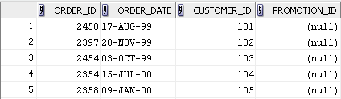
Defining a Null Value
  Null is a value that is unavailable, unassigned, unknown, or inapplicable.
  Null is not the same as zero or a blank space.
SELECT order_id, ROUND (order_date) “ORDER_DATE”,
customer_id, promotion_id
FROM orders ;
  …
Note: Round() will be explained later during the course of the presentation.
1-<number>
Notes:
Oracle Database: SQL Fundamentals I 1 - <number>
Defining a Null Value
If a row lacks a data value for a particular column, that value is said to be null or to contain a null.
Null is a value that is unavailable, unassigned, unknown, or inapplicable. Null is not the same as zero or a blank space. Zero is a number and blank space is a character.
Columns of any data type can contain nulls. However, some constraints (NOT NULL and PRIMARY KEY) prevent nulls from being used in the column.
In the PROMOTION_ID column in the ORDERS table, notice that none of the orders have a promotion ID. A null represents that fact.
Note: By default, SQL Developer uses the literal, (null), to identify null values. However, you can set it to something more relevant to you. To do so, select Preferences from the Tools menu. In the Preferences dialog box, expand the Database node. Click Advanced Parameters and on the right pane, for the “Display Null value As,” enter the appropriate value.

Slide 16
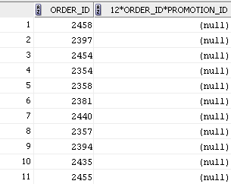
Null Values in Arithmetic Expressions
Arithmetic expressions containing a null value evaluate to null.
SELECT order_id, 12*order_id*promotion_id
FROM orders ;
…
1-<number>
Notes:
Oracle Database: SQL Fundamentals I 1 - <number>
Null Values in Arithmetic Expressions
If any column value in an arithmetic expression is null, the result is null. For example, if you attempt to perform division by zero, you get an error. However, if you divide a number by null, the result is a null or unknown.
In the example in the slide, 12*order_id*promotion_id evaluates to NULL as the promotion_id is NULL of all the orders.
For more information, see the section on “Basic Elements of Oracle SQL” in Oracle Database SQL Language Reference for 10g or 11g database.

Slide 17

Defining a Column Alias
column alias
Renames a column heading
  Requires double quotation marks if it contains spaces or special characters, or if it is case-sensitive
column alias
column alias
column alias
  Is useful with calculations
  Immediately follows the column name (There can also be the optional AS keyword between the column name and the alias.)
column alias
1-<number>

Slide 18
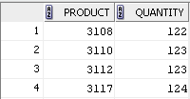
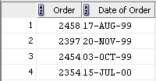
Using Column Aliases
SELECT product_id AS Product , quantity_on_hand Quantity
FROM inventories ;
…
SELECT order_id "Order " , ROUND(order_date) "Date of Order"
FROM orders ;
…
1-<number>
Notes:
Oracle Database: SQL Fundamentals I 1 - <number>
Using Column Aliases
The first example displays the products and the quantities of all the products. Note that the optional AS keyword has been used before the column alias name. The result of the query is the same whether the AS keyword is used or not. Also, note that the SQL statement has the column aliases, product and quantity, in lowercase, whereas the result of the query displays the column headings in uppercase. As mentioned in the preceding slide, column headings appear in uppercase by default.
The second example displays the products and the quantities of all the products. Because Date of Order contains spaces, it has been enclosed in double quotation marks. Note that the column heading in the output is exactly the same as the column alias.

Slide 19
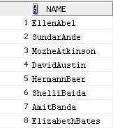
Concatenation Operator
A concatenation operator:
  Links columns or character strings to other columns
  Is represented by two vertical bars (||)
  Creates a resultant column that is a character expression
SELECT first_name || last_name AS "NAME"
FROM customers ;
…
1-<number>
Notes:
Oracle Database: SQL Fundamentals I 1 - <number>
Concatenation Operator
You can link columns to other columns, arithmetic expressions, or constant values to create a character expression by using the concatenation operator (||). Columns on either side of the operator are combined to make a single output column.
In the example, ORDER_ID and ORDER_MODE are concatenated, and given the alias ORDERS. Note that the ID of the order and mode of the order are combined to make a single output column.
The AS keyword before the alias name makes the SELECT clause easier to read.
Null Values with the Concatenation Operator
If you concatenate a null value with a character string, the result is a character string. ORDER_ID || NULL results in ORDER_ID.
Note: You can also concatenate date expressions with other expressions or columns.

Slide 20

Literal Character Strings
  A literal is a character, a number, or a date that is included in the SELECT statement.
Literal
Literal Character Strings
  Date and character literal values must be enclosed within single quotation marks.
Each character string is output once for each row returned
Literal
Literal
1-<number>

Slide 21
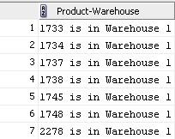
Using Literal Character Strings
SELECT product_id || ' is in Warehouse ' || warehouse_id
AS "Product-Warehouse"
FROM inventories ;
…
1-<number>
Notes:
Oracle Database: SQL Fundamentals I 1 - <number>
Using Literal Character Strings
The example in the slide displays the product id and Warehouse numbers of all products. The column has the heading Product-Warehouse. Note the spaces between the single quotation marks in the SELECT statement. The spaces improve the readability of the output.
In the following example, the last name and salary for each employee are concatenated with a literal, to give the returned rows more meaning:
SELECT last_name ||': 1 Month salary = '||salary Monthly
FROM employees;

Slide 22
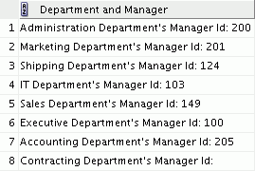
Alternative Quote (q) Operator
  Specify your own quotation mark delimiter.
  Select any delimiter.
  Increase readability and usability.
SELECT department_name || q ' [ Department's Manager Id: ] '
|| manager_id
AS " Department and Manager "
FROM departments ;
1-<number>
Notes:
Oracle Database: SQL Fundamentals I 1 - <number>
Alternative Quote (q) Operator
Many SQL statements use character literals in expressions or conditions. If the literal itself contains a single quotation mark, you can use the quote (q) operator and select your own quotation mark delimiter.
You can choose any convenient delimiter, single-byte or multibyte, or any of the following character pairs: [ ], { }, ( ), or < >.
In the example shown, the string contains a single quotation mark, which is normally interpreted as a delimiter of a character string. By using the q operator, however, brackets [] are used as the quotation mark delimiters. The string between the brackets delimiters is interpreted as a literal character string.

Slide 23
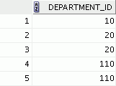
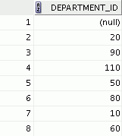
Duplicate Rows
The default display of queries is all rows, including duplicate rows.
1
2
SELECT department_id
FROM employees ;
SELECT DISTINCT department_id
FROM employees ;
…
1-<number>
Notes:
Oracle Database: SQL Fundamentals I 1 - <number>
Duplicate Rows
Unless you indicate otherwise, SQL displays the results of a query without eliminating the duplicate rows. The first example in the slide displays all the department numbers from the EMPLOYEES table. Note that the department numbers are repeated.
To eliminate duplicate rows in the result, include the DISTINCT keyword in the SELECT clause immediately after the SELECT keyword. In the second example in the slide, the EMPLOYEES table actually contains 20 rows, but there are only seven unique department numbers in the table.
You can specify multiple columns after the DISTINCT qualifier. The DISTINCT qualifier affects all the selected columns, and the result is every distinct combination of the columns.
SELECT DISTINCT department_id, job_id
FROM employees;
Note: You may also specify the keyword UNIQUE, which is a synonym for the keyword DISTINCT.
…

Slide 24
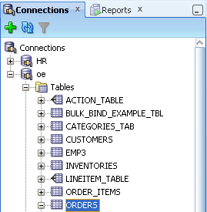
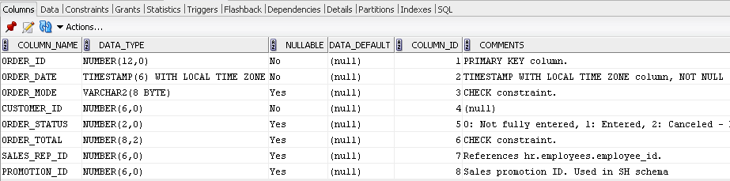
Displaying the Table Structure using SQL Developer
  Select the required table in the “Connections” tree in the SQL Developer and use the “Columns” tab to view the table structure.
Here, the table structure of the Orders table is displayed.
1-<number>
Notes:
Oracle Database: SQL Fundamentals I 1 - <number>
Displaying the Table Structure
You can display the structure of a table by using the DESCRIBE command. The command displays the column names and the data types, and it shows you whether a column must contain data (that is, whether the column has a NOT NULL constraint).
In the syntax, table name is the name of any existing table, view, or synonym that is accessible to the user.
Using the SQL Developer GUI interface, you can select the table in the Connections tree and use the Columns tab to view the table structure.
Note: The DESCRIBE command is supported by both SQL*Plus and SQL Developer.

Slide 25
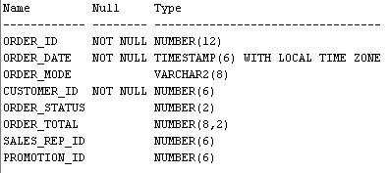
Using the DESCRIBE Command
Use the DESCRIBE command to display the structure of a table.
DESCRIBE orders ;
1-<number>
Notes:
Oracle Database: SQL Fundamentals I 1 - <number>
Using the DESCRIBE Command
The example in the slide displays information about the structure of the EMPLOYEES table using the DESCRIBE command.
In the resulting display, Null indicates that the values for this column may be unknown. NOT NULL indicates that a column must contain data. Type displays the data type for a column.
The data types are described in the following table:

Slide 26
Quiz
Identify the SELECT statements that execute successfully.
  SELECT first_name, last_name, job_id, salary*12
  AS Yearly Sal
  FROM employees;
  SELECT first_name, last_name, job_id, salary*12
  "yearly sal"
  FROM employees;
  SELECT first_name, last_name, job_id, salary AS
  "yearly sal"
  FROM employees;
  SELECT first_name+last_name AS name, job_Id,
  salary*12 yearly sal
  FROM employees;
1-<number>
Notes:
Oracle Database: SQL Fundamentals I 1 - <number>
Answer: 2, 3

Slide 27
Quiz
Identify the SELECT statements that execute successfully.
  SELECT product_id, warehouse_id AS “Product”, “Warehouse”
  FROM employees;
  SELECT order_id|| is in ||order_mode|| mode AS
  “Order Mode”
  FROM inventories;
  Write an SQL query to display all the quantity_on_hand in the warehouse with warehouse_id
1-<number>
Notes:
Oracle Database: SQL Fundamentals I 1 - <number>
Answer: 5, 6 do not execute.
7. SELECT quantity_on_hand FROM inventories WHERE warehouse_id = 8 ;

Slide 28

Session Summary
In this lesson, you should have learned how to:
1.
    Returns all rows and columns from a table
3
2
2.
    Returns specified columns from a table
1
    Uses column aliases to display more descriptive column headings
3.
Syntax :
SELECT *|{[DISTINCT] column|expression [alias],...}
FROM table;
1-<number>

Slide 29

Practice 1: Overview This practice covers the following topics:
  Selecting all data from different tables
Selecting
  Performing arithmetic calculations and specifying column names
Practice 1: Overview
Performing
Describing
  Describing the structure of tables
1-<number>
Notes:
Oracle Database: SQL Fundamentals I 1 - <number>
Practice 1: Overview
In this practice, you write simple SELECT queries. The queries cover most of the SELECT clauses and operations that you learned in this lesson.

