Slide 1
Restricting and Sorting Data
Lesson 1

Slide 2

What You will learn at the end of this Session?
  Limit the rows that are retrieved by a query
1.1.
3
2
  Sort the rows that are retrieved by a query
22..
1
  Use ampersand substitution to restrict and sort output at run time
3.
2-<number>
Notes:
What You will learn at the end of this session?
When retrieving data from the database, you may need to do the following:
Restrict the rows of data that are displayed
Specify the order in which the rows are displayed
This lesson explains the SQL statements that you use to perform the actions listed above.

Slide 3
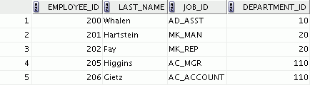

Limiting Rows Using a Selection
EMPLOYEES
…
“retrieve all
employees in department 90”
2-<number>
Notes:
Oracle Database: SQL Fundamentals I 2 - <number>
Limiting Rows Using a Selection
In the example in the slide, assume that you want to display all the employees in department 90. The rows with a value of 90 in the DEPARTMENT_ID column are the only ones that are returned. This method of restriction is the basis of the WHERE clause in SQL.

Slide 4
Limiting the Rows That Are Selected
  Restrict the rows that are returned by using the :
  WHERE clause
  The WHERE clause follows the FROM clause.
SELECT *|{[DISTINCT] column|expression [alias],...}
FROM table
[WHERE condition(s)];
2-<number>
Notes:
Oracle Database: SQL Fundamentals I 2 - <number>
Limiting the Rows That Are Selected
You can restrict the rows that are returned from the query by using the WHERE clause. A WHERE clause contains a condition that must be met and it directly follows the FROM clause. If the condition is true, the row meeting the condition is returned.
In the syntax:
WHERE Restricts the query to rows that meet a condition
condition Is composed of column names, expressions, constants, and a comparison operator. A condition specifies a
combination of one or more expressions and logical (Boolean)
operators, and returns a value of TRUE, FALSE, or UNKNOWN.
The WHERE clause can compare values in columns, literal, arithmetic expressions, or functions. It consists of three elements:
Column name
Comparison condition
Column name, constant, or list of values

Slide 5
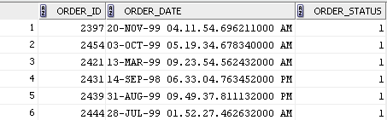
Using the WHERE Clause
SELECT order_id, order_date, order_status
FROM orders
WHERE order_status = 1 ;
2-<number>
Notes:
Oracle Database: SQL Fundamentals I 2 - <number>
Using the WHERE Clause
In the example, the SELECT statement retrieves the order ID, order date and order status of all orders whose status is 1.
Note: You cannot use column alias in the WHERE clause.

Slide 6

Character Strings and Dates
  Character strings and date values are enclosed with single quotation marks.
  Character values are case-sensitive and date values are format-sensitive.
  The default date display format is DD-MON-RR.
SELECT order_id, order_date, order_mode
FROM orders
WHERE order_mode = 'direct‘ ;
SELECT last_name
FROM employees
WHERE hire_date = '17-FEB-96' ;
2-<number>
Notes:
Oracle Database: SQL Fundamentals I 2 - <number>
Character Strings and Dates
Character strings and dates in the WHERE clause must be enclosed with single quotation marks (''). Number constants, however, need not be enclosed with single quotation marks.
All character searches are case-sensitive.
Oracle databases store dates in an internal numeric format, representing the century, year, month, day, hours, minutes, and seconds. The default date display is in the DD-MON-RR format.
Note: For details about the RR format and about changing the default date format, see the lesson titled “Using Single-Row Functions to Customize Output.” Also, you learn about the use of single-row functions such as UPPER and LOWER to override the case sensitivity in the same lesson.

Slide 7


Comparison Operators
Operator
Meaning
  =
Equal to
  >
Greater than
>=
Greater than or equal to
  <
Less than
  <=
Less than or equal to
  <>
Not equal to
BETWEEN
...AND...
Between two values (inclusive)
IN(set)
Match any of a list of values
LIKE
Match a character pattern
IS NULL
Is a null value
2-<number>
Notes:
Oracle Database: SQL Fundamentals I 2 - <number>
Comparison Operators
Comparison operators are used in conditions that compare one expression with another value or expression. They are used in the WHERE clause in the following format:
Syntax
... WHERE expr operator value
Example
... WHERE hire_date = '01-JAN-95'
... WHERE salary >= 6000
... WHERE last_name = 'Smith'
Remember, an alias cannot be used in the WHERE clause.
Note: The symbols != and ^= can also represent the not equal to condition.

Slide 8
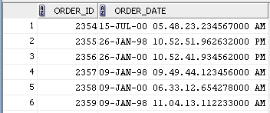
Using Comparison Operators
SELECT order_id, order_date
FROM orders
WHERE order_id <= 2400 ;
…
2-<number>
Notes:
Oracle Database: SQL Fundamentals I 2 - <number>
Using Comparison Operators
In the example, the SELECT statement retrieves the order ID and order date from the orders table for any order whose order ID is less than or equal to 2400. Note that there is an explicit value supplied to the WHERE clause. The explicit value of 2400 is compared to the order ID value in the order_id column of the orders table.

Slide 9
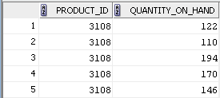
Range Conditions Using the BETWEEN Operator
Use the BETWEEN operator to display rows based on a range of values:
SELECT product_id, quantity_on_hand
FROM inventories
WHERE product_id BETWEEN 3100 AND 3108;
Lower limit
Upper limit
2-<number>
Notes:
Oracle Database: SQL Fundamentals I 2 - <number>
Range Conditions Using the BETWEEN Operator
You can display rows based on a range of values using the BETWEEN operator. The range that you specify contains a lower limit and an upper limit.
The SELECT statement in the slide returns rows from the INVENTORIES table for any product whose product ID is between 3100 and 3108.
Values that are specified with the BETWEEN operator are inclusive. However, you must specify the lower limit first.
You can also use the BETWEEN operator on character values:
SELECT last_name
FROM employees
WHERE last_name BETWEEN 'King' AND 'Smith';

Slide 10

Membership Condition Using the IN Operator
Use the IN operator to test for values in a list:
SELECT order_id, order_mode, order_status
FROM orders
WHERE order_id IN (2458, 2397, 2454) ;
2-<number>
Notes:
Oracle Database: SQL Fundamentals I 2 - <number>
Membership Condition Using the IN Operator
To test for values in a specified set of values, use the IN operator. The condition defined using the IN operator is also known as the membership condition.
The slide example displays order ID, order mode and order status for all the orders whose order_ID is 2458, 2397 or 2454.
Note: The set of values can be specified in any random order—for example, (201,100,101).
The IN operator can be used with any data type. The following example returns a row from the EMPLOYEES table, for any employee whose last name is included in the list of names in the WHERE clause:
SELECT employee_id, manager_id, department_id
FROM employees
WHERE last_name IN ('Hartstein', 'Vargas');
If characters or dates are used in the list, they must be enclosed with single quotation marks ('').
Note: The IN operator is internally evaluated by the Oracle server as a set of OR conditions, such as a=value1 or a=value2 or a=value3. Therefore, using the IN operator has no performance benefits and is used only for logical simplicity.

Slide 11
Pattern Matching Using the LIKE Operator
  Use the LIKE operator to perform wildcard searches of valid search string values.
  Search conditions can contain either literal characters or numbers:
    % denotes zero or many characters.
    _ denotes one character.
SELECT first_name
FROM employees
WHERE first_name LIKE 'S%' ;
2-<number>
Notes:
Oracle Database: SQL Fundamentals I 2 - <number>
Pattern Matching Using the LIKE Operator
You may not always know the exact value to search for. You can select rows that match a character pattern by using the LIKE operator. The character pattern–matching operation is referred to as a wildcard search. Two symbols can be used to construct the search string.
The SELECT statement in the slide returns the first name from the EMPLOYEES table for any employee whose first name begins with the letter “S.” Note the uppercase “S.” Consequently, names beginning with a lowercase “s” are not returned.
The LIKE operator can be used as a shortcut for some BETWEEN comparisons. The following example displays the last names and hire dates of all employees who joined between January, 1995 and December, 1995:
SELECT last_name, hire_date
FROM employees
WHERE hire_date LIKE '%95';

Slide 12

Combining Wildcard Characters
  You can combine the two wildcard characters (%, _) with literal characters for pattern matching:
  You can use the ESCAPE identifier to search for the actual % and _ symbols.
SELECT last_name
FROM employees
WHERE last_name LIKE '_o%' ;
2-<number>
Notes:
Oracle Database: SQL Fundamentals I 2 - <number>
Combining Wildcard Characters
The % and _ symbols can be used in any combination with literal characters. The example in the slide displays the names of all employees whose last names have the letter “o” as the second character.
ESCAPE Identifier
When you need to have an exact match for the actual % and _ characters, use the ESCAPE identifier. This option specifies what the escape character is. If you want to search for strings that contain SA_, you can use the following SQL statement:
SELECT employee_id, last_name, job_id
FROM employees WHERE job_id LIKE '%SA\_%' ESCAPE '\';
The ESCAPE identifier identifies the backslash (\) as the escape character. In the SQL statement, the escape character precedes the underscore (_). This causes the Oracle server to interpret the underscore literally.

Slide 13
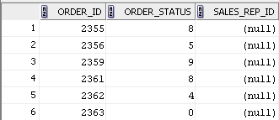
Using the NULL Conditions
Test for nulls with the IS NULL operator.
SELECT order_ID, order_status, sales_rep_id
FROM orders
WHERE sales_rep_id IS NULL;
…
2-<number>
Notes:
Oracle Database: SQL Fundamentals I 2 - <number>
Using the NULL Conditions
The NULL conditions include the IS NULL condition and the IS NOT NULL condition.
The IS NULL condition tests for nulls. A null value means that the value is unavailable, unassigned, unknown, or inapplicable. Therefore, you cannot test with =, because a null cannot be equal or unequal to any value. The example in the slide retrieves the last names and managers of all employees who do not have a manager.
Here is another example: To display the last name, job ID, and commission for all employees who are not entitled to receive a commission, use the following SQL statement:
SELECT last_name, job_id, commission_pct
FROM employees
WHERE commission_pct IS NULL;
…

Slide 14


Defining Conditions Using the Logical Operators
Operator
Meaning
  AND
Returns TRUE if both component conditions are true
  OR
Returns TRUE if either component condition is true
NOT
Returns TRUE if the condition is false
2-<number>
Notes:
Oracle Database: SQL Fundamentals I 2 - <number>
Defining Conditions Using the Logical Operators
A logical condition combines the result of two component conditions to produce a single result based on those conditions or it inverts the result of a single condition. A row is returned only if the overall result of the condition is true.
Three logical operators are available in SQL:
AND
OR
NOT
All the examples so far have specified only one condition in the WHERE clause. You can use several conditions in a single WHERE clause using the AND and OR operators.

Slide 15

Using the AND Operator
AND requires both the component conditions to be true:
SELECT order_mode, order_status, customer_id
FROM orders
WHERE order_mode = ' direct '
AND customer_id = 103;
2-<number>
Notes:
Oracle Database: SQL Fundamentals I 2 - <number>
Using the AND Operator
In the example, both the component conditions must be true for any record to be selected. Therefore, only those orders that have their modes as Direct and that have a Customer ID as 103 are selected.
All character searches are case-sensitive.
AND Truth Table
The following table shows the results of combining two expressions with AND:

Slide 16
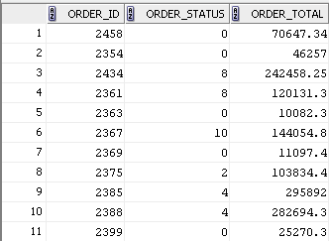
Using the OR Operator
OR requires either component condition to be true:
SELECT order_id, order_status, order_total
FROM orders
WHERE order_status = 0
OR order_total >= 100000 ;
2-<number>
Notes:
Oracle Database: SQL Fundamentals I 2 - <number>
Using the OR Operator
In the example, either component condition can be true for any record to be selected. Therefore, any order that has an order status of 0 or has an order_total value of 100000 or more is selected.

Slide 17
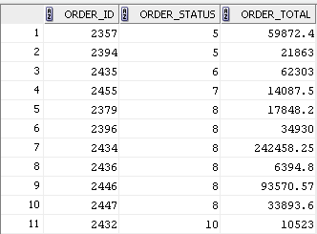
Using the NOT Operator
SELECT order_id, order_status, order_total
FROM orders
WHERE order_status
NOT IN (0,1,2,3) ;
…
2-<number>
Notes:
Oracle Database: SQL Fundamentals I 2 - <number>
Using the NOT Operator
The example in the slide displays the order_id, order_status and order_total of all the orders whose order_status is not 0, 1, 2 or 3.
Note: The NOT operator can also be used with other SQL operators, such as BETWEEN, LIKE, and NULL.
... WHERE job_id NOT IN ('AC_ACCOUNT', 'AD_VP')
... WHERE salary NOT BETWEEN 10000 AND 15000
... WHERE last_name NOT LIKE '%A%'
... WHERE commission_pct IS NOT NULL

Slide 18


Rules of Precedence
Operator
Meaning
  1
Arithmetic operators
  2
Concatenation operator
  3
Comparison conditions
  4
IS [NOT] NULL, LIKE, [NOT] IN
  5
[NOT] BETWEEN
  6
Not equal to
  7
NOT logical condition
  8
AND logical condition
  9
OR logical condition
You can use parentheses to override rules of precedence.
2-<number>
Notes:
Oracle Database: SQL Fundamentals I 2 - <number>
Rules of Precedence
The rules of precedence determine the order in which expressions are evaluated and calculated. The table in the slide lists the default order of precedence. However, you can override the default order by using parentheses around the expressions that you want to calculate first.

Slide 19


Rules of Precedence
SELECT *
FROM inventories
WHERE warehouse_id = 9
OR quantity_on_hand = 150
AND product_id = 3139 ;
1
…
SELECT *
FROM inventories
WHERE ( warehouse_id = 9
OR quantity_on_hand = 150 )
AND product_id = 3139 ;
2
2-<number>
Notes:
Oracle Database: SQL Fundamentals I 2 - <number>
Rules of Precedence (continued)
1. Precedence of the AND Operator: Example
In this example, there are two conditions:
The first condition is that the quantity on hand is 150 and the product ID 3139.
The second condition is that the warehouse ID is 9.
Therefore, the SELECT statement reads as follows:
“Select the row if a product has 150 quantitites on hand and its product ID is 3139, or if its warehouse ID 9.”
2. Using Parentheses: Example
In this example, there are two conditions:
The first condition is that the warehouse ID is 9 or quantity_on_hand is 9
The second condition is that the product ID is 3139.
Therefore, the SELECT statement reads as follows:
“Select the row if a product has a warehouse ID 9 or its quantity_on_hand is 150, and if the product has a product ID 3139.”

Slide 20
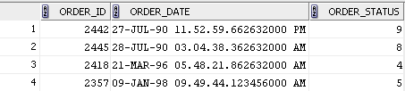
Using the ORDER BY Clause
  Sort the retrieved rows with the ORDER BY clause:
    ASC: Ascending order, default
    DESC: Descending order
  The ORDER BY clause comes last in the SELECT statement:
SELECT order_id, order_date, order_status
FROM orders
ORDER BY order_date ;
…
2-<number>
Notes:
Oracle Database: SQL Fundamentals I 2 - <number>
Using the ORDER BY Clause
The order of rows that are returned in a query result is undefined. The ORDER BY clause can be used to sort the rows. However, if you use the ORDER BY clause, it must be the last clause of the SQL statement. Further, you can specify an expression, an alias, or a column position as the sort condition.
Syntax
SELECT expr
FROM table
[WHERE condition(s)]
[ORDER BY {column, expr, numeric_position} [ASC|DESC]];
In the syntax:
ORDER BY specifies the order in which the retrieved rows are displayed
ASC orders the rows in ascending order (This is the default order.)
DESC orders the rows in descending order
If the ORDER BY clause is not used, the sort order is undefined, and the Oracle server may not fetch rows in the same order for the same query twice. Use the ORDER BY clause to display the rows in a specific order.
Note: Use the keywords NULLS FIRST or NULLS LAST to specify whether returned rows containing null values should appear first or last in the ordering sequence.

Slide 21
Sorting
      Sorting in descending order:
      Sorting by column alias:
SELECT order_id, round(order_date), order_status
FROM orders
ORDER BY order_date desc;
1
SELECT order_id, round(order_date), order_status “Order Status”
FROM orders
ORDER BY order_date desc ;
2
2-<number>
Notes:
Oracle Database: SQL Fundamentals I 2 - <number>
Sorting
The default sort order is ascending:
Numeric values are displayed with the lowest values first (for example, 1 to 999).
Date values are displayed with the earliest value first (for example, 01-JAN-92 before
01-JAN-95).
Character values are displayed in the alphabetical order (for example, “A” first and “Z” last).
Null values are displayed last for ascending sequences and first for descending sequences.
You can also sort by a column that is not in the SELECT list.
Examples
1. To reverse the order in which the rows are displayed, specify the DESC keyword after the column name in the ORDER BY clause. The example in the slide sorts the result by the most recently acquired order
2. You can also use a column alias in the ORDER BY clause.
Note: The DESC keyword used here for sorting in descending order should not be confused with the DESC keyword used to describe table structures.

Slide 22
Sorting
  Sorting by using the column’s numeric position:
  Sorting by multiple columns:
SELECT last_name, job_id, department_id, hire_date
FROM employees
ORDER BY 3;
3
SELECT last_name, department_id, salary
FROM employees
ORDER BY department_id, salary DESC;
4
2-<number>
Notes:
Oracle Database: SQL Fundamentals I 2 - <number>
Sorting (continued)
Examples
3. You can sort query results by specifying the numeric position of the column in the SELECT clause. The example in the slide sorts the result by the department_id as this column is at the third position in the SELECT clause.
4. You can sort query results by more than one column. The sort limit is the number of columns in the given table. In the ORDER BY clause, specify the columns and separate the column names using commas. If you want to reverse the order of a column, specify DESC after its name. The result of the query example shown in the slide is sorted by department_id in ascending order and also by salary in descending order.

Slide 23


Substitution Variables
... salary = ? …
… department_id = ? …
... last_name = ? ...
I want
to query
different
values.
2-<number>
Notes:
Oracle Database: SQL Fundamentals I 2 - <number>
Substitution Variables
So far, all the SQL statements were executed with predetermined columns, conditions, and their values. Suppose that you want a query that lists the employees with various jobs and not just those whose job_ID is SA_REP. You can edit the WHERE clause to provide a different value each time you run the command, but there is also an easier way.
By using a substitution variable in place of the exact values in the WHERE clause, you can run the same query for different values.
You can create reports that prompt users to supply their own values to restrict the range of data returned, by using substitution variables. You can embed substitution variables in a command file or in a single SQL statement. A variable can be thought of as a container in which values are temporarily stored. When the statement is run, the stored value is substituted.

Slide 24

Substitution Variables
substitution variables
  Use substitution variables to:
    Temporarily store values with single-ampersand (&) and double-ampersand (&&) substitution
Substitution Variables
  Use substitution variables to supplement the following:
    WHERE conditions
    ORDER BY clauses
    Column expressions
    Table names
    Entire SELECT statements
Substitution Variables
2-<number>
Notes:
Oracle Database: SQL Fundamentals I 2 - <number>
Substitution Variables (continued)
You can use single-ampersand (&) substitution variables to temporarily store values.
You can also predefine variables by using the DEFINE command. DEFINE creates and assigns a value to a variable.
Restricted Ranges of Data: Examples
Reporting figures only for the current quarter or specified date range
Reporting on data relevant only to the user requesting the report
Displaying personnel only within a given department
Other Interactive Effects
Interactive effects are not restricted to direct user interaction with the WHERE clause. The same principles can also be used to achieve other goals, such as:
Obtaining input values from a file rather than from a person
Passing values from one SQL statement to another
Note: Both SQL Developer and SQL* Plus support substitution variables and the DEFINE/UNDEFINE commands. Neither SQL Developer nor SQL* Plus support validation checks (except for data type) on user input. If used in scripts that are deployed to users, substitution variables can be subverted for SQL injection attacks.

Slide 25
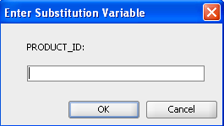
Using the Single-Ampersand Substitution Variable
Use a variable prefixed with an ampersand (&) to prompt the user for a value:
SELECT product_id, warehouse_id, quantity_on_hand
FROM inventories
WHERE product_id = &product_id ;
2-<number>
Notes:
Oracle Database: SQL Fundamentals I 2 - <number>
Using the Single-Ampersand Substitution Variable
When running a report, users often want to restrict the data that is returned dynamically. SQL*Plus or SQL Developer provides this flexibility with user variables. Use an ampersand (&) to identify each variable in your SQL statement. However, you do not need to define the value of each variable.
The example in the slide creates a SQL Developer substitution variable for product ID. When the statement is executed, SQL Developer prompts the user for a product ID and then displays the product_ID, warehouse_ID and quantity_on_hand for that product ID.
With the single ampersand, the user is prompted every time the command is executed if the variable does not exist.

Slide 26
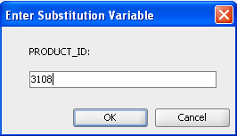
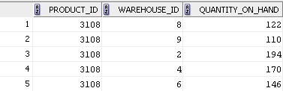
Using the Single-Ampersand Substitution Variable
2-<number>
Notes:
Oracle Database: SQL Fundamentals I 2 - <number>
Using the Single-Ampersand Substitution Variable (continued)
When SQL Developer detects that the SQL statement contains an ampersand, you are prompted to enter a value for the substitution variable that is named in the SQL statement.
After you enter a value and click the OK button, the results are displayed in the Results tab of your SQL Developer session.

Slide 27
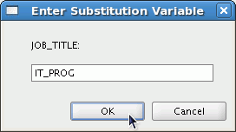

Character and Date Values with
Substitution Variables
Use single quotation marks for date and character values:
SELECT last_name, department_id, salary*12
FROM employees
WHERE job_id = '&job_title' ;
2-<number>
Notes:
Oracle Database: SQL Fundamentals I 2 - <number>
Character and Date Values with Substitution Variables
In a WHERE clause, date and character values must be enclosed with single quotation marks. The same rule applies to the substitution variables.
Enclose the variable with single quotation marks within the SQL statement itself.
The slide shows a query to retrieve the employee names, department numbers, and annual salaries of all employees based on the job title value of the SQL Developer substitution variable.

Slide 28
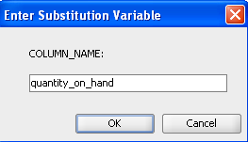
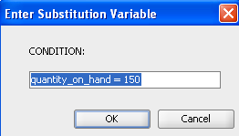
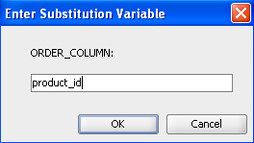
Specifying Column Names, Expressions, and Text
SELECT &column_name
FROM inventories
WHERE &Condition
ORDER BY &Order_column ;
2-<number>
Notes:
Oracle Database: SQL Fundamentals I 2 - <number>
Specifying Column Names, Expressions, and Text
You can use the substitution variables not only in the WHERE clause of a SQL statement, but also as substitution for column names, expressions, or text.
Example
The example in the slide displays any column that is specified by the user at run time, from the INVENTORIES table. For each substitution variable in the SELECT statement, you are prompted to enter a value, and then click OK to proceed.
If you do not enter a value for the substitution variable, you get an error when you execute the preceding statement.
Note: A substitution variable can be used anywhere in the SELECT statement, except as the first word entered at the command prompt.

Slide 29
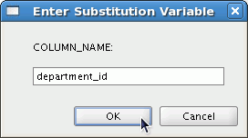

Using the Double-Ampersand
Substitution Variable
Use double ampersand (&&) if you want to reuse the variable value without prompting the user each time:
SELECT employee_id, last_name, job_id, &&column_name
FROM employees
ORDER BY &column_name ;
…
2-<number>
Notes:
Oracle Database: SQL Fundamentals I 2 - <number>
Using the Double-Ampersand Substitution Variable
You can use the double-ampersand (&&) substitution variable if you want to reuse the variable value without prompting the user each time. The user sees the prompt for the value only once. In the example in the slide, the user is asked to give the value for the variable, column_name, only once. The value that is supplied by the user (department_id) is used for both display and ordering of data. If you run the query again, you will not be prompted for the value of the variable.
SQL Developer stores the value that is supplied by using the DEFINE command; it uses it again whenever you reference the variable name. After a user variable is in place, you need to use the UNDEFINE command to delete it:
UNDEFINE column_name

Slide 30
Using the DEFINE Command
  Use the DEFINE command to create and assign a value to a variable.
DEFINE order_num = 2458
SELECT order_id, order_date, order_mode, order_total
FROM orders
WHERE order_id = &order_num ;
UNDEFINE order_num
  Use the UNDEFINE command to remove a variable.
2-<number>
Notes:
Oracle Database: SQL Fundamentals I 2 - <number>
Using the DEFINE Command
The example shown creates a substitution variable for an order number by using the DEFINE command. At run time, this displays the order_id, order_date, order_mode and order_total for that order.
Because the variable is created using the SQL Developer DEFINE command, the user is not prompted to enter a value for the order_ID Instead, the defined variable value is automatically substituted in the SELECT statement.
The ORDER_NUM substitution variable is present in the session until the user undefines it or exits the SQL Developer session.

Slide 31
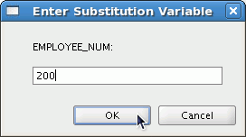
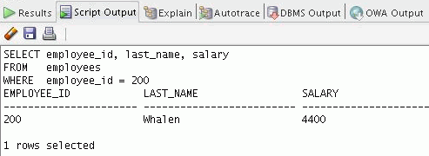
Using the VERIFY Command
Use the VERIFY command to toggle the display of the substitution variable, both before and after SQL Developer replaces substitution variables with values:
SET VERIFY ON
SELECT employee_id, last_name, salary
FROM employees
WHERE employee_id = &employee_num;
2-<number>
Notes:
Oracle Database: SQL Fundamentals I 2 - <number>
Using the VERIFY Command
To confirm the changes in the SQL statement, use the VERIFY command. Setting SET VERIFY ON forces SQL Developer to display the text of a command after it replaces substitution variables with values. To see the VERIFY output, you should use the Run Script (F5) icon in the SQL Worksheet. SQL Developer displays the text of a command after it replaces substitution variables with values, in the Script Output tab as shown in the slide.
The example in the slide displays the new value of the EMPLOYEE_ID column in the SQL statement followed by the output.
SQL*Plus System Variables
SQL*Plus uses various system variables that control the working environment. One of the variables is VERIFY. To obtain a complete list of all the system variables, you can issue the SHOW ALL command on the SQL*Plus command prompt.

Slide 32
Quiz
Which of the following are valid operators for the WHERE clause?
  >=
  IS NULL
  !=
  IS LIKE
  IN BETWEEN
  <>
2-<number>
Notes:
Oracle Database: SQL Fundamentals I 2 - <number>
Answer: 1, 2, 3, 6

Slide 33

Session Summary
  Use the WHERE clause to restrict rows of output:
    Use the comparison conditions
    Use the BETWEEN, IN, LIKE, and NULL operators
    Apply the logical AND, OR, and NOT operators
3
2
1
  Use ampersand substitution to restrict and sort output at run time
  Use the ORDER BY clause to sort rows of output:
3.
SELECT *|{[DISTINCT] column|expression [alias],...}
FROM table
[WHERE condition(s)]
[ORDER BY {column, expr, alias} [ASC|DESC]] ;
2-<number>
Notes:
Session Summary
In this lesson, you should have learned about restricting and sorting rows that are returned by the SELECT statement. You should also have learned how to implement various operators and conditions.
By using the substitution variables, you can add flexibility to your SQL statements. This enables the queries to prompt for the filter condition for the rows during run time.

Slide 34

Practice 2: Overview
This practice covers the following topics:
Selecting data
  Selecting data and changing the order of the rows
  that are displayed
Practice 2: Overview
substitution variables
  WHERE clause
  Restricting rows by using the WHERE clause
  Using substitution variables to add flexibility to your
  SQL SELECT statements
ORDER BY clause
  Sorting rows by using the ORDER BY clause
2-<number>
Notes:
Oracle Database: SQL Fundamentals I 2 - <number>
Practice 2: Overview
In this practice, you build more reports, including statements that use the WHERE clause and the ORDER BY clause. You make the SQL statements more reusable and generic by including the ampersand substitution.

