Slide 1


RAJIV GANDHI COLLEGE OF ENGINEERING & RESEARCH, NAGPUR Department of Computer Science and Engineering
Project Seminar On
“Smart Voting System”
Presented by:
1.Prashanth Potu
2. Kedar Gorte
3.Ashish Samarth
4.Mahendra Bhalavi
Under Guidance of
Prof. Kalyani Pendke

Slide 2
Content
Introduction
Literature Survey
Problem Statement
Existing System
Aim & Objective
Proposed Work
System Flow
Methodology/Algorithm
Implementation Strategies
S/W & H/W Requirements
Cost Estimation
Patent Search
Conclusion
References/Bibliography

Slide 3
Introduction
Now a days in India two types of method are used for voting. The first method is secret ballot paper, in which lots of paper are used and second method is EVM (electronic voting machine) which is used since 2003. we have to propose a method or way for online voting that is more secure than the existing system. In this proposed project face detection and recognition concept is used to identify the exact person. There are three levels of verification were used for the voters in our proposed system.
The first one is Unique id number verification, second level of verification is election commission id or voter card number, if your election commission id number is correct then you have to go for third level of security which is the main security level where the system recognize the face of the real voter from the current database of face images given by the election commission. If the captured image is matched with the respective image of the voter in the database, then a voter can cast their vote in the election. as you have to know that in existing system is not much more secure because in existing system security level is only voter card so any one can give other person vote with voter card but here we proposed a way for voting which is more secure than existing system.

Slide 4
Many people couldn't vote because the voter has to reach the poll booths to vote or some people like those who are living far away from their original birth place where they are allowed to vote. So to get rid of their drawbacks, a new System is introduced i.e. Online Voting System, which provides accuracy, security, flexibility, mobility etc. An online voting System in a web based application to use in the election process. Initially ballot paper technique was used in the election process. Then the Electronic Voting Machine comes, these are easy to store the data and easily manageable. These are more secure than the ballot paper and less time consuming.Now, we proposed a system with biometric authentication to make the voting process more secure and reduce the time taken in the voting process. By the use of this, the electorate can solidify their vote for his or her preferred candidate through the use of their system

Slide 5
Literature Survey
In the current voting system, the ballet machines where used in which the symbols of various political parties are displayed. When we press the button with the respective party’s (political party) symbol the voting is done. The chance of fake person casting their vote is more in the existing system. The voting person may use the fake voting card and cast his vote, this may cause problem. In the existing system, the person has to travel long places to his constituency to cast his vote.

Slide 6
Therefore, we need an effective method to identify the fake voters during voting. So, the process is used for detecting the right person and also making the system to work in online, which will help the voters to cast their vote from their place itself.

Slide 7
PROBLEM STATEMENT
The basic methodology as applied to online voting systems would involve giving voters realistic voting tasks to accomplish using a variety of ballot design. Voting task performance is measured using variables such as accuracy, time and workload. The voting server collects the vote and filters out duplicate or invalid votes. Each voter can then check his vote online to ensure that his vote has been counted.

Slide 8
Existing System
The existing system is not too effective. At present there are two types of voting methods, they are:
1) Ballot Voting
2) EVM Voting
Ballot Voting
A ballot is a device used to cast votes in an election, and may be a piece of paper used in secret voting. In this the voter is given a paper which consists of all the party symbols along with representative names in it. Here, people come to the polling booth, take the ballot paper and vote by putting a stamp on the desired party symbol. Finally, the ballot paper is folded and dropped into the ballot box. At last, the votes are counted by the Election commission officers.

Slide 9
B. EVM (Electronic Voting Machine) Voting
An EVM is a device which is used for voting. This machine consists of party symbols along with the representative’s name and a button at the end for each and every party name. The voters come near the EVM machine after completion of their verification at the early level before voting. After verification the voter goes near the EVM and casts their vote by pressing the button. The above procedures are not so accurate as there may be possibility for the false/fake voting. The ballot papers may be lost at the time of counting which may affect results of the particular area or people may miscount the number of votes which leads authority into wrong hands. EVM machines sometimes get corrupted and polling gets stopped temporarily and a lot of time is wasted or EVM may be tampered and the casted votes may be polled to a particular party only, even the vote is casted to different candidates or parties. This may lead authority into the wrong hands.They also lack security as one’s vote can be casted by another voter or even a miscellaneous person. This factor is known as fake voting. Without proper authentication there is a possibility of fake voting. So, the existing system is not efficient for voting. Even though there is very little false/fake voting, this minor setback can turn the results in the opposite direction.

Slide 10
Aim and Objective
The aim is to develop an application that seeks to use various stages of security authentication to enhance the election process for political party elections using the real case study, i.e. The University of Ibadan, in the end imparting an internet platform which permits all eligible electorate to workout their franchise from any region for the duration of the election period. The targets are:
1) To create a secured online voting platform where authenticity of votes and voters are ensured with the use of mechanisms such as facial recognition and one – time password .
2) To enhance Voter’s identity due to the fact that biometric functions can not be shared.
3) To ease the trouble of queuing in the course of balloting duration in elections.
4) To save Voter’s time by providing online voting platform ,thus, saving the trouble of going to the actual location.

Slide 11
Proposed Work
In this project we are working with three different security levels
Level 1: -
Unique id number (UID). At the time of voter registration system will request for the unique id from the voter. The entered unique id is verified from the database provide by the election commission.
Eigen Face Algorithm
The main concept of Eigen Face algorithm is to follow the appearance –based approach to face recognition. It is used to capture the variation in a collection of face images and this information is use to encode the particular images of individual faces. Then the encoded images of individual faces are compared with the collection of face images in a holistic manner. The Eigen faces itself form a basis set of all images used to construct the covariance matrix. The formed smaller set of basis images are used to represent the original training images which produces dimension reduction.

Slide 12
By comparing how faces are represented by the basis set, the classification can be achieved. Face Images are projected into a feature space (“Face Space”) that best encodes the variation among known face images. The face space is defined by the “eigen faces”, which are the eigenvectors of the set of faces.
Level 2:
Smart Voting System Support through Face Recognition doesn’t fully show the all the equipment that are to be connected to raspberry pi, but covers all major functional units.

Slide 13
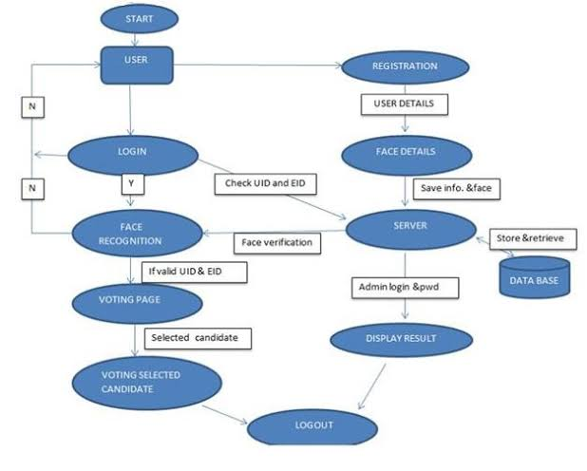
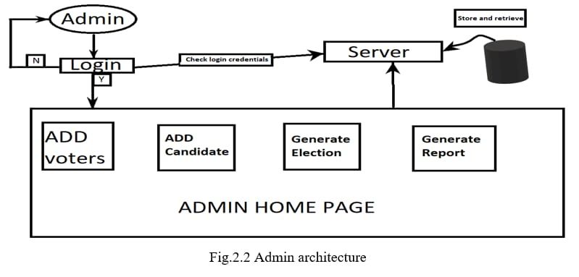
System Diagram/Architecture

Slide 14
Methodology
Algorithms
Randomized Search CV
PCA ( Particle Component Algorithm)
Xgboost Algorithm

Slide 15
Implementation Strategies
First we have to make a dataset where we can store data.
In Dataset we have to store information we can implement :
By using algorithms
Randomized Search CV : In this algorithm, we have to report to dataset unique id number also we can recognise the face in the dataset to identify fake and real voters.
PCA (Particle Component Algorithm) :In this algorithm we can predict the voter percent and also predict the total number of real voters and fake voters by forming number of components
Xgboost Algorithm :In this algorithm, the testing and training is performed.It is easy to find fake voters and predict the results of the voters.

Slide 16
Software and Hardware Requirements :
Python
Machine Learning
SQL
Django

Slide 17
Conclusion
As we see that existing voting system has many defects such as lengthy process, time taking, not secure, bogus voting, no security level but now we can say that our approach is more useful and secure from the existing system. Since, we are using three level of security in this proposed system the false voters can be easily identified. The facial authentication technique is very much useful in identifying the fraud voters, so we can avoid the bogus votes during election commission. The voters can cast their voting from anywhere by login to our proposed smart voting system through internet.

Slide 18
As every operation is performed through internet connectivity so, it is onetime investment for government. Voters’ location is not important but their voting is important. As data is stored in centralized repository so, data is accessible at any time as well as backup of the data is possible. Smart voting system provides updated result at each and every minute. Also requires less man power and resources. The database needs to be updated every year or before election so that new eligible citizens may be enrolled and those who are dead are removed from the voter list.

Slide 19
References
https://www.seminarsonly.com/computer%20science/smart-voting-system.php
Yamini, K., Kumar, S. M., Sonia, S., Yugandhar, P. V, & Bharath, T. (2019). Class Attendance Using Face Detection and Recognition with OPENCV. 3822– 3826.
Soomro, Z. A., & Ali, A. (2020). FPGA based real- time face authorization system for electronic voting system.
Kavitha, S. N. (n.d.). Biometrics Secured Voting System with Fingerprint , Face and Iris Verification. 743–746.
Wagner, P. (2012). Face Recognition with Python. 1– 16
Pandit, Varad, Prathamesh Majgaonkar, Pratik Meher, Shashank Sapaliga, and Sachin Bojewar. "Intelligent security lock." In Trends in Electronics and Informatics (ICEI), 2017 International Conference on, pp. 713-716. IEEE, 2017
Nilam Choudhary, Shikhar Agarwal, Geerija Lavania. (2019) “Smart Voting System through Facial Recognition” Int. J. Sci. Res. in Computer Science and Engineering Vol-7(2), April 2019, E-ISSN: 2320-7639.
S. V. Tathe, A. S. Narote, S. P. Narote “Face Detection and Recognition in Videos” Sinhgad College of Engineering 2016 IEEE
Peter N. Belhumeur, Joao P. Hespanha, and David J. Kriegman “Eigenfaces vs. Fisherfaces: Recognition Using Class Specific Linear Projection” IEEE transactions on pattern analysis and machine intelligence, VOL. 19, NO. 7, JULY 1997

