Slide 1
Amazon Sales Dashboard
Sales Analysis & Insights Presentation

Slide 2
Project Overview
Project Name: Amazon Sales Dashboard
Purpose: Analyze sales performance using Power BI
Scope: Covers sales channels, SKU performance, and courier status

Slide 3
Dataset Overview
Columns: Order ID, Date, Fulfilment, Sales Channel, SKU, Amount, Qty, etc.
Includes order, product, shipping, and payment information

Slide 4
Business Objectives
Track daily/monthly sales performance
Identify top-performing products and categories
Monitor courier status and delivery issues
Evaluate promotion and B2B impacts

Slide 5
Key Metrics & KPIs
Total Sales Amount
Total Orders and Quantity Sold
Top Categories and SKUs
Courier Delivery Status Breakdown
Sales by Channel and Fulfilment Type

Slide 6
Dashboard Visuals
Insert screenshots of Power BI visuals here:
• Monthly Sales Trend
• Top 10 SKUs by Revenue
• Courier Status Pie Chart
• Sales Channel Comparison

Slide 7
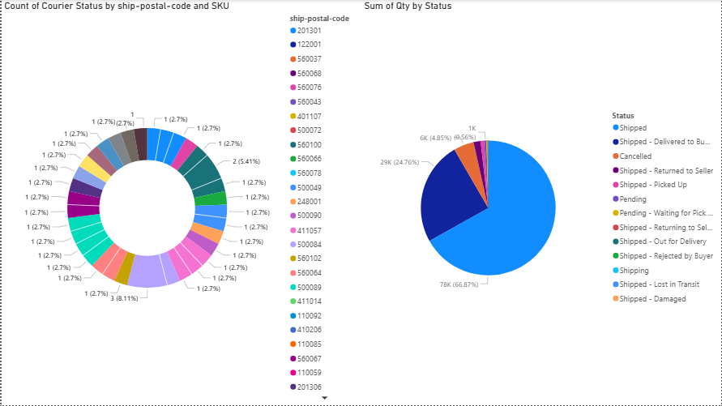

Slide 8
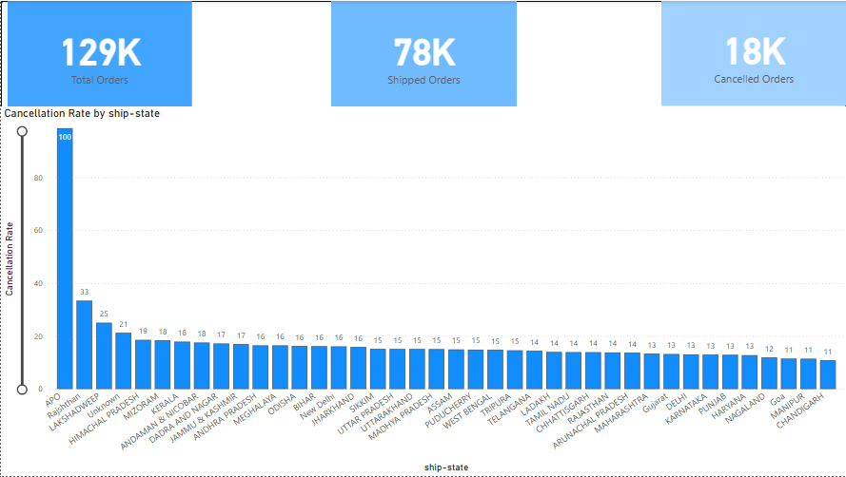

Slide 9
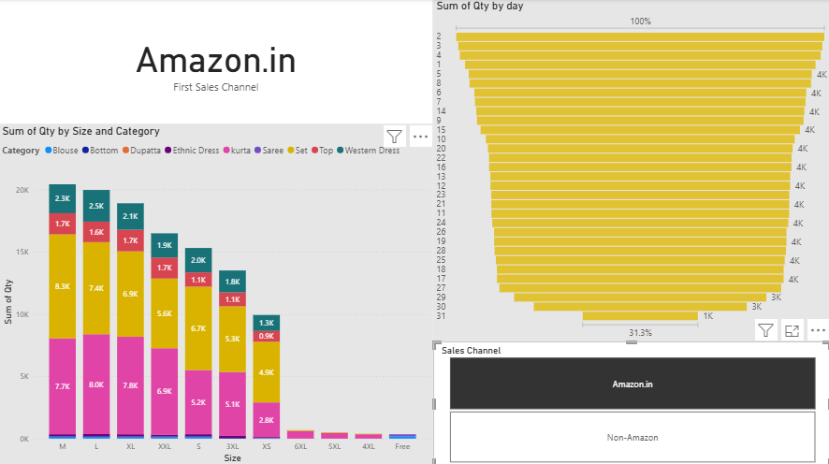

Slide 10
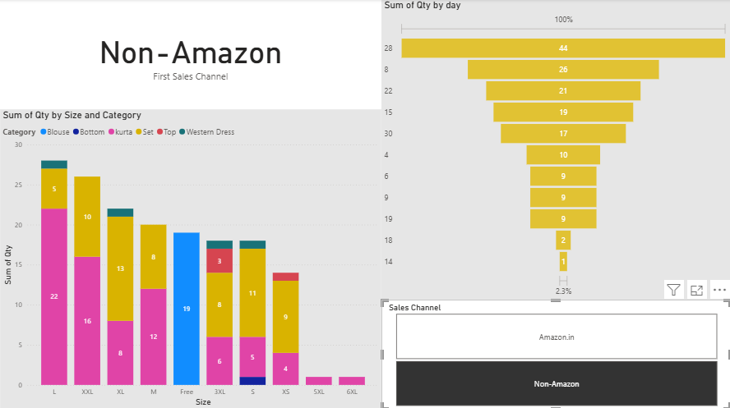

Slide 11
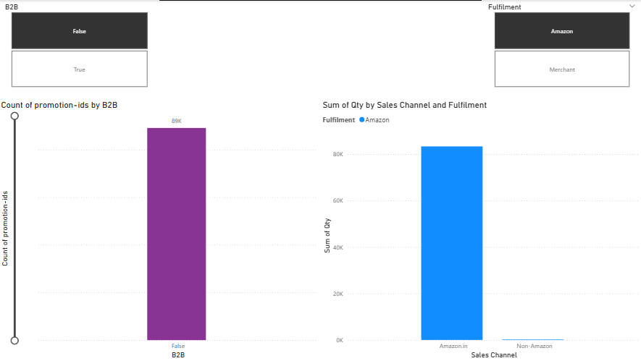

Slide 12
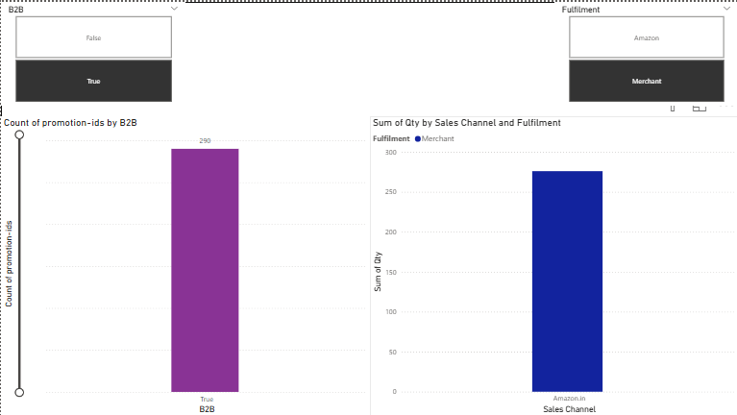

Slide 13
Insights & Recommendations
High returns from specific SKUs – consider product quality check
Courier delays in some states – optimize delivery partner allocation
Strong B2B growth – expand wholesale offerings
Promotions driving spikes – schedule more targeted campaigns

Slide 14
Conclusion
Amazon’s Power BI dashboard provides actionable insights
Clear understanding of sales performance and bottlenecks
Supports data-driven decision-making for growth

Slide 15
Appendix (DAX / Notes)
• Sample DAX Measures:
Total Sales = SUM(Amazon_cleaned_dataset'[Amount])
Total Orders = DISTINCTCOUNT(Amazon_cleaned_dataset'[Order ID])

