Slide 1

Since 1989
Procedure
for online EPS Claim
by Member through UAN Member Portal

Slide 2
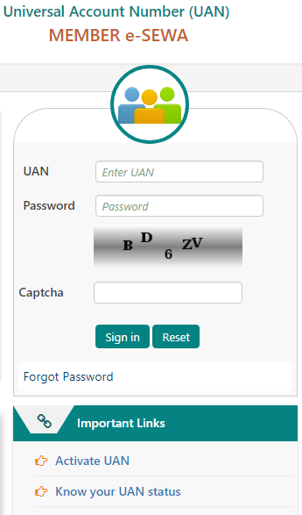
Visit at
https://unifiedportal-mem.epfindia.gov.in/memberinterface/
Login into your UAN Account with your password
.

Slide 3
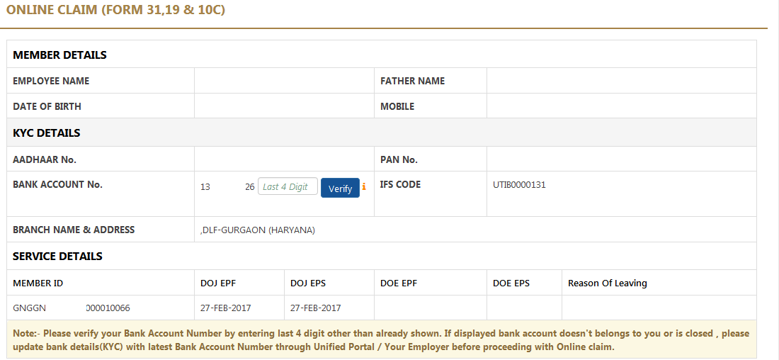
Kindly enter the last 4 digit bank a/c no. in box then click verify button
.

Slide 4
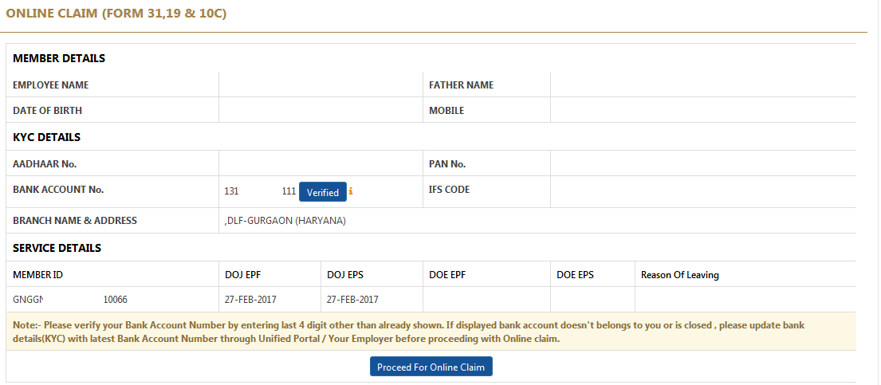
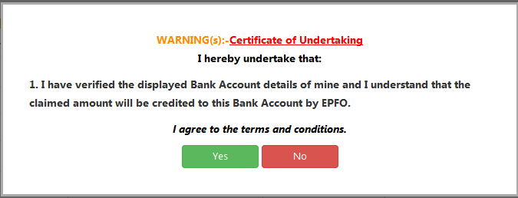
Click proceed for online Claim
.

Slide 5
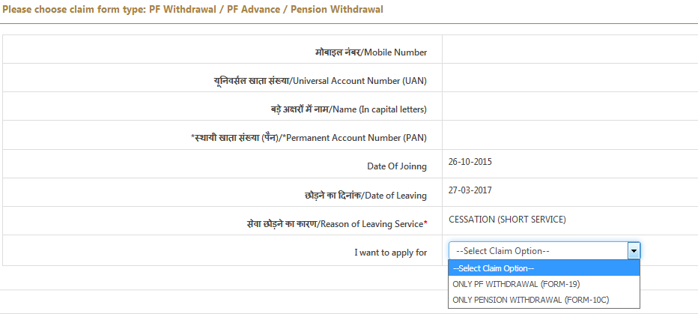
Choose the option for I want to apply for
Only Pension Withdrawal (FORM-10C)
.

Slide 6
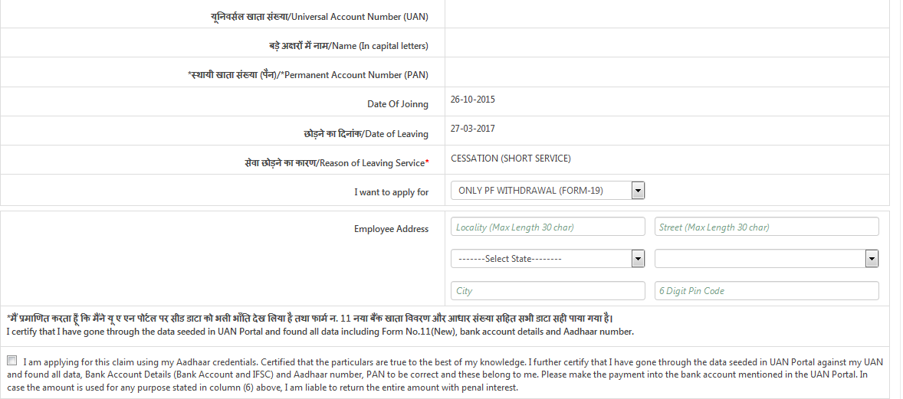

Kindly fill your Postal address then you can click the check box.
.

Slide 7
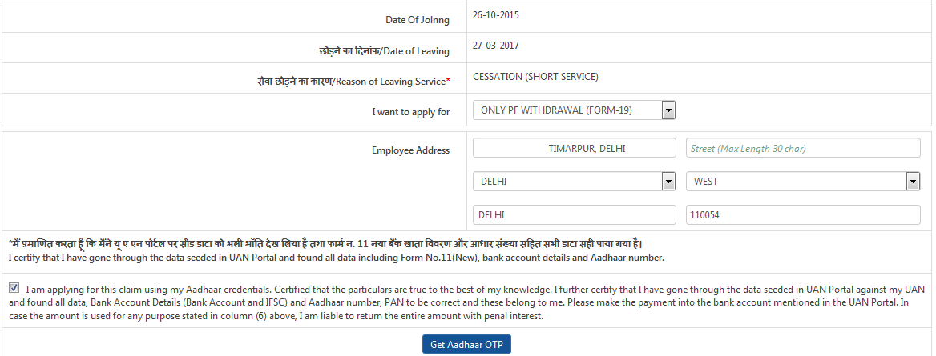
After clicking the box please click to Get Aadhaar OTP and submit the PF/EPS Claim online.
.

Slide 8

Since 1989

