Slide 1
Product – END MILL
Sai Solutions
15 June, 2020

Slide 2
Topics
Introduction of Endmill
Material Specific Solutions
Top Cut –Endmill
Customer Expectations
Endmill Design
Endmill Flutes
Factors Influence Endmill Performance
Experience

Slide 3

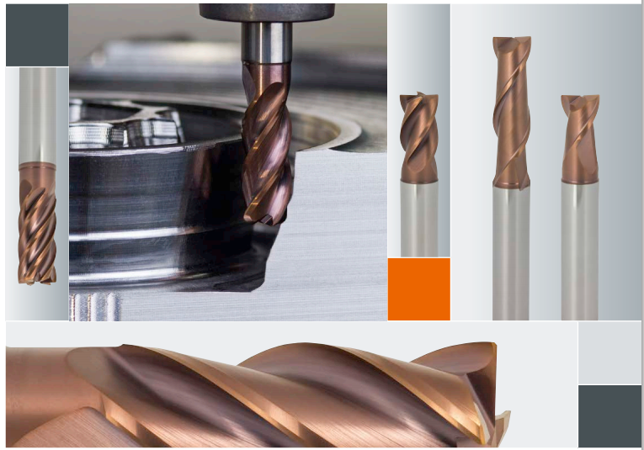
Introduction of Endmill

Slide 4
Material Specific Solutions
Franken multi cut used for steel .
Franken TINOX cut used for hard material .
Franken ALU cut used for Aluminum material.
Franken FIBER cut used for Medial a& Aero space.
Franken micro cut - unknown.
Franken Top cut used for all material.

Slide 5
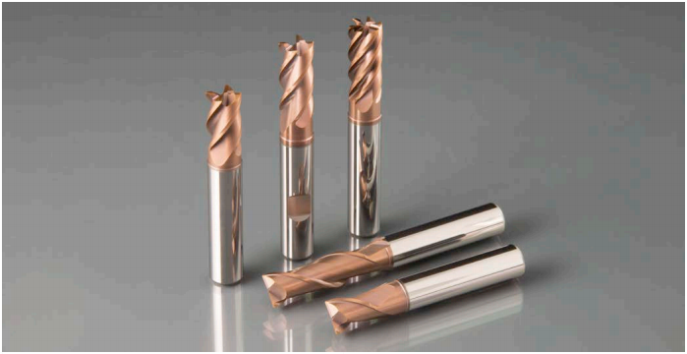
Top Cut –Endmill
TOP-Cut tools are versatile end mills made from solid carbide or HSS which can be used in nearly all materials and milling strategies due to their special geometry properties.
Characteristics •
Variable helix angle
Tapered core diameter
High-performance coating
Optionally available with internal coolant supply, axial exit (ICA).
Main feature: Universal use, for all material groups. In this brochure we present a selection of the most important solid carbide TOP-Cut end mills. For every tool we give, depending on the respective material group safe starting conditions (vc / fz) and directions about the recommended coolant.

Slide 6
Customer Expectations
Tool Life
Low Inventory
Value of Money.

Slide 7
Endmill Design
Short Design
Long Design
Extra Long Design

Slide 8
Endmill Flutes
2 Flute
3 Flute
6 Flute
2 Flute & 3Flute are used for rough and semi finish
6 Flute finish to be used.

Slide 9
FACTORS INFLUCNG ENDMILL PERFORMANCE
Inputs:
Work piece material
Type of operation
Machine
Tool Clamping's
In Actual Working Conditions
Tool Geometry
Tool Holder
Cutting Method.
Machine Capability
Work Piece Clamping's
Lubrication/ Cooling
Machine Operator

Slide 10
Factors Influence Endmill Performance
Inputs:
Work piece material
Type of operation
Machine
Tool Clamping's
In Actual Working Conditions
Tool Geometry
Tool Holder
Cutting Method.
Machine Capability
Work Piece Clamping's
Lubrication/ Cooling
Machine Operator

Slide 11
Experience
Best Solution for all material group
Application based solutions
Support to optimize your manufacturing prizes.
Suitable solution available for modern milling.

Slide 12
Q & A

Slide 13
Thank You

