Slide 1
Apache Kafka Knowledge Sharing Session
By MAHENDRAN S
12-2-2020

Slide 2
Transaction Management -Synchronous vs Asynchronous Transactions
Transaction Management
What is Messaging
What is Java Message Service(JMS) and Domains
JMS Programming Model & JMS Advantages
Most popular JMS Providers
Overview of Apache Kafka
Design Goals of Apache Kafka
Kafka Framework – Core APIs
Kafka Framework – Architecture and Core APIs
Kafka Framework Architecture - Consumer, Producer, Topic, ZooKeeper.
Life cycle of an Entry (or Record) in Kafka Cluster
Brokers, Topics and their Partitions – in Apache Kafka Architecture
Information Required for Producer and Consumer
Kafka Setup & Configurations
Examples
Q&A

Slide 3
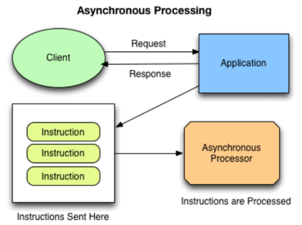
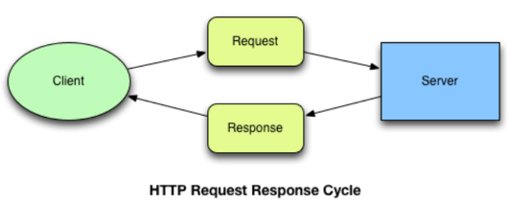
Transaction Management -Synchronous vs Asynchronous Transactions
In the case of synchronous transactions, application pauses its execution until a response is returned from the Server. In the case of asynchronous transactions, application can continue performing other, background operations.

Slide 4
What is Messaging
Currently, most of the enterprise applications are using messaging concept for asynchronous communication between heterogeneous applications using JMS or AMQP.
The message is a piece of information. It can be a text, XML document, JSON data or an Entity (Java Object) etc. The message is very useful data to communicate between different systems.
Messaging means exchanging information between different components in the same system or different systems.

Slide 5
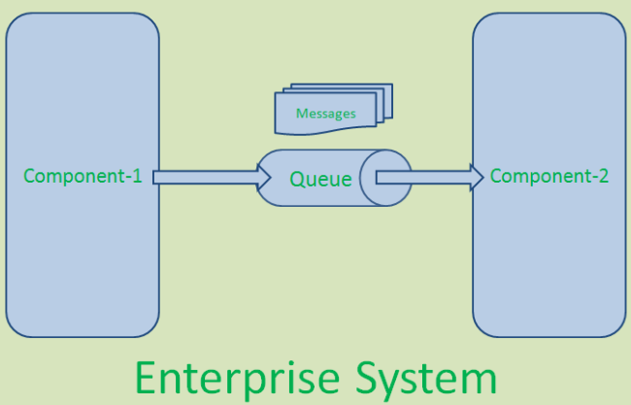
What is Messaging

Slide 6
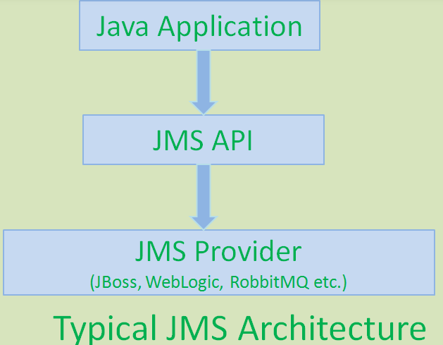
What is Java Message Service(JMS)?
JMS API is a Java API which contains a common set of interfaces to implement enterprise based messaging systems.
JMS API is used to implement Messaging systems in Java-based applications only, it does not support other languages.
JMS API is used to create, send, receive and read messages or exchange messages between different systems.

Slide 7
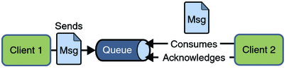
JMS Messaging Domains.
There are two types of messaging domains in JMS.
Point-to-Point Messaging Domain
Publisher/Subscriber Messaging Domain
Point-to-Point Messaging Domain:
In PTP model, one message is delivered to one receiver only. Here, Queue is used as a message oriented middleware (MOM).
The Queue is responsible to hold the message until receiver is ready.
In PTP model, there is no timing dependency between sender and receiver.

Slide 8
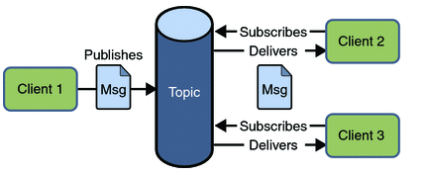
JMS Messaging Domains- Publisher/Subscriber
In Pub/Sub model, one message is delivered to all the subscribers. It is like broadcasting. Here, Topic is used as a message oriented middleware that is responsible to hold and deliver messages.
In PTP model, there is timing dependency between publisher and subscriber.

Slide 9
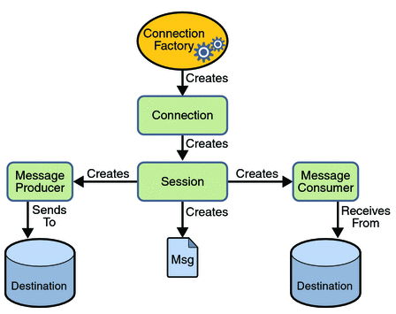
JMS Programming Model

Slide 10
JMS Advantages
Asynchronous: JMS Sender can send messages and continue on its own work. It does not wait for the completion of message consumption by JMS Receiver.
Reliable: It provides assurance that message is delivered.
Robust and Reliable: JMS ensures that a message is delivered one and only once to the destination system. So we can develop reliable applications very easily.

Slide 11
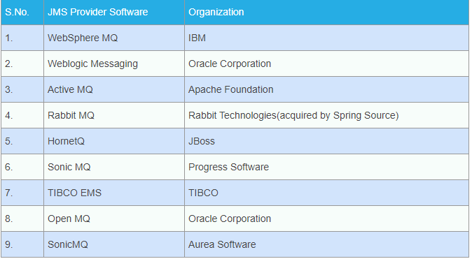
Most popular JMS Providers

Slide 12
Overview of Apache Kafka
Kafka has been originally developed at LinkedIn and has become a top level Apache project during 2011.
Apache Kafka is a distributed streaming platform.
Apache Kafka Architecture is a good choice for scalable real-time distributed streaming.
Apache Kafka can be used for building real-time streaming application that can transform the data streams or deduce some intelligence out of them.

Slide 13
Design Goals of Apache Kafka
Scalability – The framework should handle scalability in all the four dimensions (event producers, event processors, event consumers and event connectors [we shall learn about these in due course of this tutorial]).
High-Volume – It should be capable of working with huge volume of data streams.
Data Transformations – Kafka should provide provision for deriving new data streams using the data streams from producers.
Low latency – To address traditional use cases of messaging, which require low latency.
Fault Tolerance – The Kafka cluster should handle failures with the masters and data bases.

Slide 14
Kafka Framework – Core APIs
Topic [It is soul of Kafka].
Producers.
Consumers.
Stream Processors.
Connectors.

Slide 15
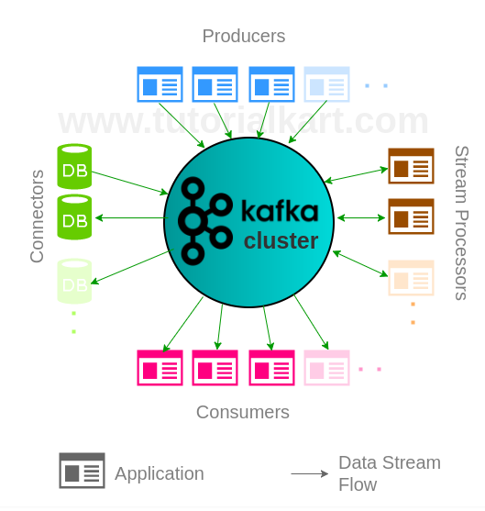
Kafka Framework – Architecture and Core APIs

Slide 16
Kafka Framework Architecture - Producers
It is an applications that send data streams to topics in Kafka Cluster.
A producer can send the stream of records to multiple topics.
Apache Kafka Producer API enables an application to become a producer.
Producers are source of data streams in Kafka Cluster.
Producers are scalable. Multiple producer applications could be connected to the Kafka Cluster.
A single producer can write the records to multiple Topics [based on configuration].

Slide 17
Kafka Framework Architecture - Consumers
It is an applications that feed on data streams from topics in Kafka Cluster.
A consumer can receive stream of records from multiple topics through subscription.
Apache Kafka Consumer API enables an application to become a consumer.
Consumers are scalable.
Multiple consumer applications could be connected to the Kafka Cluster.
A single consumer can subscribe to the records of multiple Topics [based on configuration].

Slide 18
Kafka Framework Architecture- Stream Processors
It is an applications that transform data streams of topics to other data streams of topics in Kafka Cluster.
Apache Kafka Streams API enables an application to become a stream processor.
Stream Processors first act as sink and then as source in Kafka Cluster.
Stream Processors are scalable. Multiple Stream Processing applications could be connected to the Kafka Cluster.
A single Stream Processor can subscribe to the records of multiple Topics [based on configuration] and then write records back to multiple Topics.

Slide 19
Kafka Framework Architecture- Connectors
It is responsible for pulling stream data from Producers or transformed data from Stream Processors and delivering stream data to Consumers or Stream Processors.
Connectors are those which allow the integration of things like Relational Databases to the Kafka Cluster and automatically monitor the changes. They also help to pull those changes onto the Kafka cluster.
Connectors provide a single source of ground truth data. Which means that we have a record of changes, a Topic has undergone.

Slide 20
Kafka Framework Architecture - Topic
Topic is a category in which streams of events/records are stored in Kafka cluster.
A Kafka Topic could be divided into multiple partitions. Partitions are the ones that realize parallelism and redundancy in Kafka.
Kafka Cluster
Kafka Cluster consists of multiple brokers and a Zookeeper.
Kafka Broker
Broker is an instance of Kafka that communicate with ZooKeeper. Each broker holds partition(s) of topic(s). Some of those partitions are leaders and others are replicas of leader partitions from other brokers.

Slide 21
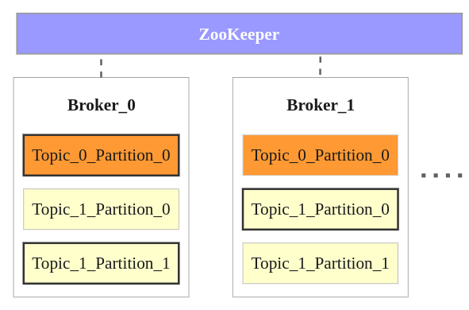
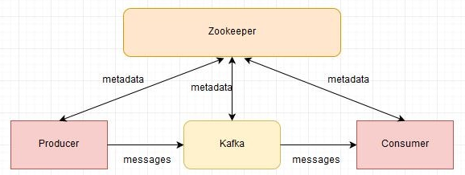
Zookeeper in Kafka
Zookeeper is a centralized service for maintaining configuration information, naming, providing distributed synchronization, and providing group services. All of these kinds of services are used in some form or another by distributed applications.

Slide 22
Life cycle of an Entry (or Record) in Kafka Cluster
A record is created by a Producer and is written to one of the existing Topics in Kafka cluster or a new topic is created and written to it.
The record in the Topic is waiting for the Consumer or Stream Processor to consume it.
The Consumer or Processor now may transform the record into a new record or enrich it and write back to the cluster into a new Topic or store in RDBMS.
There could be multiple transformations by multiple Stream Processors on the record.
Any application can become a Producer, Consumer or Stream Processor based on the role it plays in the Cluster. Kafka Cluster is flexible on how an application wants to connect to it.

Slide 23
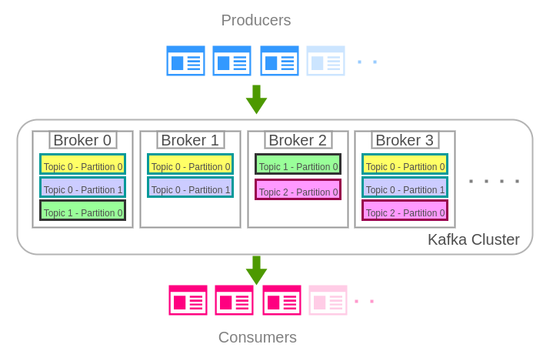
Brokers, Topics and their Partitions – in Apache Kafka Architecture

Slide 24
Kafka Broker & Kafka Topic
Kafka broker is the Kafka instance, Kafka cluster can multiple instances.
Record:
Producer sends messages to Kafka in the form of records.
A record is a key-value pair. It contains the topic name and partition number to be sent.
Kafka broker keeps records inside topic partitions. Records sequence is maintained at the partition level.
Topic: Producer writes a record on a topic and the consumer listens to it. A topic can have many partitions but must have at least one.
Partition:
A topic partition is a unit of parallelism in Kafka, i.e. two consumers cannot consume messages from the same partition at the same time.
A consumer can consume from multiple partitions at the same time.
Offset: A record in a partition has an offset associated with it. Think of it like this: partition is like an array; offsets are like indexs.

Slide 25
Information Required for Producer
BOOTSTRAP_SERVERS_CONFIG: The Kafka broker's address. If Kafka is running in a cluster then you can provide comma (,) separated addresses. For example:localhost:9091,localhost:9092
CLIENT_ID_CONFIG: Id of the producer so that the broker can determine the source of the request.
KEY_SERIALIZER_CLASS_CONFIG: The class that will be used to serialize the key object. In our example, our key is Long, so we can use the LongSerializer class to serialize the key. If in your use case you are using some other object as the key then you can create your custom serializer class by implementing the Serializer interface of Kafka and overriding the serialize method.
VALUE_SERIALIZER_CLASS_CONFIG: The class that will be used to serialize the value object. In our example, our value is String, so we can use the StringSerializer class to serialize the key. If your value is some other object then you create your custom serializer class.

Slide 26
Information Required for Consumer
BOOTSTRAP_SERVERS_CONFIG: The Kafka broker's address. If Kafka is running in a cluster then you can provide comma (,) seperated addresses. For example: localhost:9091,localhost:9092.
GROUP_ID_CONFIG: The consumer group id used to identify to which group this consumer belongs.
KEY_DESERIALIZER_CLASS_CONFIG: The class name to deserialize the key object. We have used Long as the key so we will be using LongDeserializer as the deserializer class. You can create your custom deserializer by implementing the Deserializer interface provided by Kafka.
VALUE_DESERIALIZER_CLASS_CONFIG: The class name to deserialize the value object. We have used String as the value so we will be using StringDeserializer as the deserializer class. You can create your custom deserializer.

Slide 27
Kafka Setup & Configurations
Zookeeper start:
.\bin\windows\zookeeper-server-start.bat .\config\zookeeper.properties
Kafka Server Start
.\bin\windows\kafka-server-start.bat .\config\server.properties
Topic Creation
\bin\windows\kafka-topics.bat --create --zookeeper localhost:2181 --replication-factor 1 --partitions 1 --topic javainuse-topic
For details information , refer the Apache Kafka Setup and installation document.

Slide 28
Examples
Refer the Apache Kafka examples provided.

Slide 29
Q&A

Slide 30
Thanks for listening

