Slide 1
Kafka Stream Knowledge Sharing Session
By
MAHENDRAN S

Slide 2
AGENDA
Problem Statement & Business Impact of Nokia Support Portal Application.
Root Cause Analysis and Summary
Solution.
Q & A

Slide 3
Messaging
Nowadays, most of the enterprise applications are using messaging concept for asynchronous communication between heterogeneous applications using JMS or AMQP.
The message is a piece of information. It can be a text, XML document, JSON data or an Entity (Java Object) etc. The message is very useful data to communicate between different systems.

Slide 4
NAM Deployment Architecture
H/W LB & Fault Tolerant
IPlanet WS(S/W LB)
NAM
WebLogic Platform
Java Virtual Memory(JVM)

Slide 5
Kafka VS RabbitMQ
What is Apache Kafka?
Apache Kafka is a leading performer. We can say Kafka outplays RabbitMQ as well as all other message brokers. Moreover, Kafka scales nicely up to 100,000 msg/sec even on a single server, as we add more hardware. The output of Kafka’s design:
To a topic, messages published are distributed into partitions.
In partition, messages are represented as a log stream.
The consumer is responsible for moving through this stream.
Moreover, messages from each partition are processed in-order only.
b. What is RabbitMQ?
RabbitMQ supports a huge number of development platforms, with ease of use and maturity. Basically, it scales nicely about 20,000 msg/sec on a single server. Although, as we add more servers, it also scales well. The output of RabbitMQ design: Learn Apache Kafka Architecture and its fundamental concepts
Messages published to queues (through exchange points).
Multiple consumers can connect to a queue.
Message broker distribute messages across all available consumers.
Also, we can redeliver the message if the consumer fails.
Delivery order guaranteed for queues with a single consumer (this is not possible when the queue has multiple consumers).

Slide 6
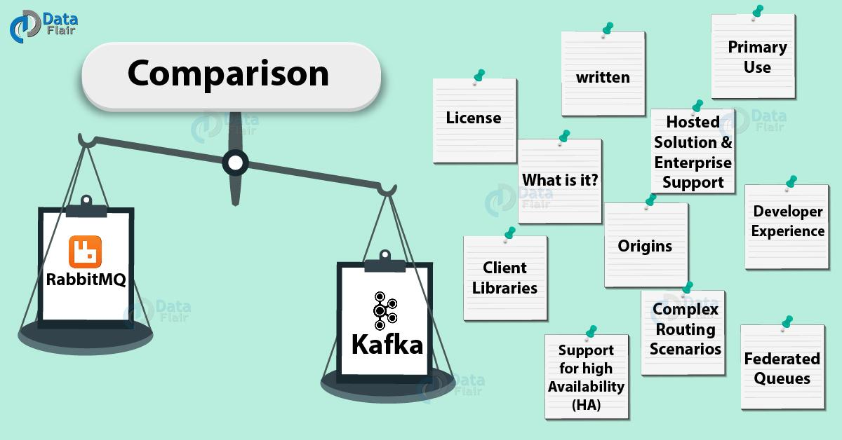
Kafka VS RabbitMQ

Slide 7
Root Cause Analysis – Summary.
The java collection interface used for :
Creating the in-memory cache during server startup using NCP.jar
Store the Service Information and Company related information.
There are some irrelevant logger statement, which is logging the XML info into the heap memory.
In spite of all these , it seems that java garbage collection (GC) , which is used to clean up the java memory by removing unused object in regular interval by JVM is not happened properly.

Slide 8
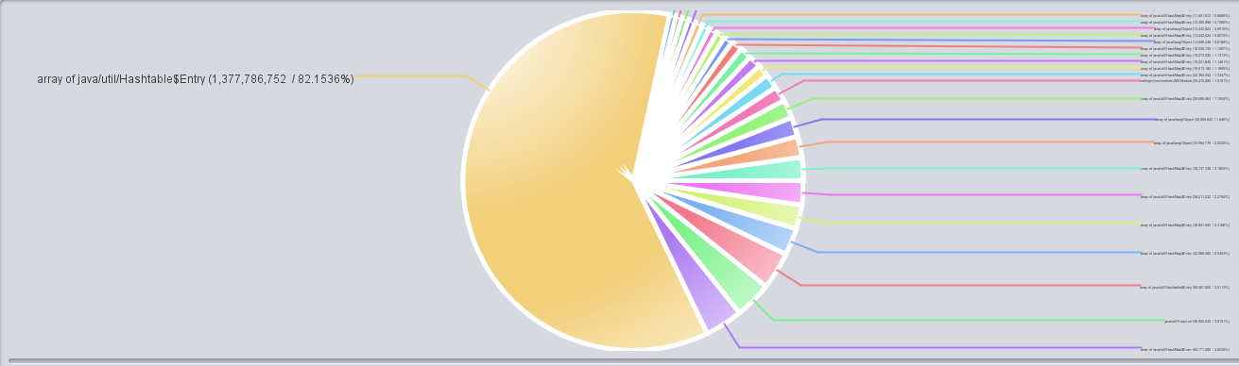
Java Virtual Memory Dump Analysis Report – Leakage Suspect

Slide 9
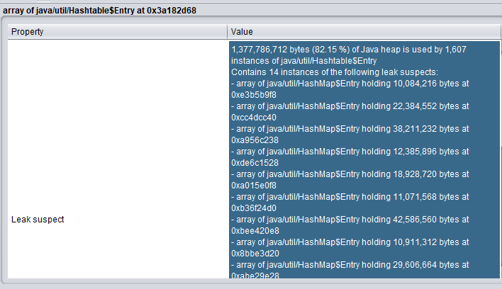
Java Virtual Memory Dump Analysis Report – Leakage Suspect

Slide 10
Recommended Solution.
Change the java virtual memory(JVM) structure into optimized structure ( Immediate Solution) :
Increase JVM size to 4GB , it will be supported ONLY with 64bits JVM.
Set the NewSize and MaxNewSize as 1 GB.
Change the default GC algorithm (CMS) to Parallel OldGC and set the ParallelCMSThreads as 8 to achieve the high throughput.
APP_MANAGED_ARGS="-verbose:gc -XX:NewSize=1024m -XX:MaxNewSize=1024m -XX:SurvivorRatio=8 -ms4096m -mx4096m -XX:MaxPermSize=256m -XX:+HeapDumpOnOutOfMemoryError -XX:+UseParallelOldGC -XX:ParallelCMSThreads=8“
Need to analyze Service and company related information that are stored in the collection and optimize these objects ( Long term solution)
It seems that NAM application code , logging the few unwanted information into log file which is internally stored in JVM so we need to look at such code and optimize it. ( Long term solution)

Slide 11

Q & A

