Slide 1
Java

Slide 2
What is java?
Simple
Object – Oriented
Platform independent – WORA
Secured
Portable
Distributed
Robust
High Performance
Multithreaded

Slide 3
JVM
Java Virtual Machine (JVM) is a engine that provides runtime environment to drive the Java Code or applications. It converts Java bytecode into machines language. JVM is a part of Java Run Environment (JRE).

Slide 4
Overview
Basics
OOPs concepts
Strings
Exception Handling
Multithreading
IOStreams
Collections

Slide 5
Basics
Keywords
Data Types
Type Casting
Variables
Method
Operators

Slide 6
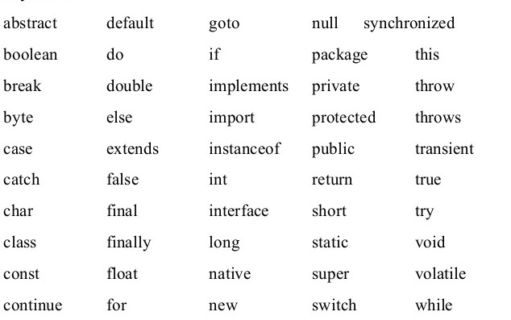
Keywords

Slide 7
Data Types
Primitive
  int
  float
  long
  double
  boolean
  char
  short
  byte
Non Primitive
  String
  Array
  etc.

Slide 8
Type Casting
Conversion of one datatype to other datatype
Different types
  Upcasting - Variable of Parent class refering to the object of Child class
  Downcasting - An object of a base class convert into the type of one of the derived classes

Slide 9
Variables
Variables are containers for storing data values.
Different types
  Instance Variable
  Local Variable
  Static Variable

Slide 10
Method
A method is a block of code which only runs when it is called. You can pass data, known as parameters, into a method. Methods are used to perform certain actions, and they are also known as functions
Access Specifier - Access specifier or modifier is the access type of the method. It specifies the visibility of the method.
Types – public, private, protected, default

Slide 11
Operators
Operators are used to perform operations on variables and values.
Types
  Unary - Bitwise
  Arithmetic - Logical
  Shift - Ternary
  Relational - Assignment

Slide 12
OOPs Concepts
Class
Object
Abstraction
Encapsulation
Inheritance
Polymorphism

Slide 13
Classes and Objects
Class – Template or a blueprint where objects are created/group of similar objects
Object – Instance of class & exists physically
Constructors – Used to initialize the object & is invoked at the time of object creation
Wrapper Classes - To convert primitive datatypes into object and object into primitive datatypes
Autoboxing
Unboxing

Slide 14
Inheritance
Parent – child relation
extends keyword
Types
  Single - Multiple - Hybrid
  Multilevel - Hierarchial
this & super keywords
Method overriding
Method overloading

Slide 15
Polymorphism
Polymorphism – performing one action in different ways
Type casting – conversion of one datatype to other datatype
instanceof operator – to check whether the object is an instance of the specified subclass or interface

Slide 16
Encapsulation
Encapsulation in Java is a process of wrapping code and data together into a single unit, for example, a capsule which is mixed of several medicines.
We can create a fully encapsulated class in Java by making all the data members of the class private. Now we can use setter and getter methods to set and get the data in it.
Package - A java package is a group of similar types of classes, interfaces and sub-packages.

Slide 17
Abstraction and Interface
Abstraction - Hiding internal details and showing functionality
Abstract class – can have non-abstract classes
Interfaces – will have only abstract classes

Slide 18
Control Statements
Looping Statements
  for
  while
  do..while
Branch Statements
  if, else..if
  switch
Selection Statement
  break,return

Slide 19
Array
Java provides a data structure, the array, which stores a fixed-size sequential collection of elements of the same type. An array is used to store a collection of data, but it is often more useful to think of an array as a collection of variables of the same type.
Single Dimensional array – array[]
Multi Dimensional array – array[][]

Slide 20
Strings
Immutable
Substring
Methods of String class
StringBuffer class
StringBuilder class
StringBuffer vs StringBuilder
StringTokenizer
String comparison – equals(),==,compareTo()
String concatenation – concat(),+

Slide 21
Exception Handling
Hierarchy
Types of exceptions
Keywords – try,catch,finally,throw,throws
Try – catch block
Finally block
Throw vs Throws
Exception Propagation
Final vs Finally vs Finalize
Custom Exception

Slide 22
Multithreading
Life cycle of a thread
Creating a thread
Sleep
Wait
Joining a thread
Thread priority
Daemon thread
Thread pool & Thread group
Thread Scheduler

Slide 23
Synchronization
What actually is Synchronization..?
Why synchronization..?
Thread synchronization & types
Mutual Exclusive
    Synchronized method.
    Synchronized block.
    Static synchronization.
Cooperation (Inter - thread communication)
Deadlock

Slide 24
Collections
The Collection in Java is a framework that provides an architecture to store and manipulate the group of objects.
List - ArrayList, Vector, LinkedList
Map - HashMap, LinkedHashMap, HashTable
Set - HashSet, LinkedHashSet, SortedSet
Queue – LinkedList, PriorityQueue

Slide 25
IO Stream
Java I/O (Input and Output) is used to process the input and produce the output.
Stream - A stream is a sequence of data. In Java, a stream is composed of bytes. It's called a stream because it is like a stream of water that continues to flow.
  InputStream
  OutputStream
  Reader
  Writer

Slide 26
Serialization
It is a mechanism of writing the state of an object into a byte stream.
Marker interface - interfaces with no field or methods or empty interface in java is called marker interface
Implements serializable interface
Deserialization
Transient keyword

