Slide 1

BARKATULLAH UNIVERSITY INSTITUTE OF TECHNOLOGY
A MAJOR PROJECT ON
DIAGNOSIS AND PREDICTION OF ADHD DISEASE
USING MACHINE LEARNING METHOD ON EEG DATA
SUMBITTED BY:-
ASHWINI KUMAR MISHRA
INSTRUCTOR:-
Mrs. Kavita Rawat.

Slide 2
TODAYS AGENDA
INTRODUCTION
OBJECTIVE
TECHINICAL DESCRIPTION
TECHNOLOGY USED
PROPOSED METHODOLOGY
RESULT
CONCLUSION AND FUTURE WORK

Slide 3
INTRODUCTION
ADHD stands for Attention-Deficit Hyperactivity Disorder.
ADHD is a neurodevelopmental disorder that primarily affects children, but it can persist into adulthood.
ADHD is a highly prevalent disorder, affecting approximately 5-10% of children and 2-5% of adults worldwide.
It is characterized by persistent patterns of inattention, hyperactivity, and impulsivity that can interfere with daily functioning and development.
Inattention symptoms include difficulty sustaining attention, being easily distracted, forgetfulness, and trouble organizing tasks.
Hyperactivity symptoms involve excessive fidgeting, restlessness, difficulty staying seated, and excessive talking.

Slide 4
OBJECTIVE
The main aim of our work is to classify ADHD and control patient from EEG data using machine learning. This system takes the value of electrodes and generates final output as a prediction of ADHD.
It removes the dependencies on the doctors.
It helps out the poor and helpless people with the normal medical checkup.
It helps people avoid paying huge amount to the doctors unnecessarily.
It extends the role of the technology in the medical field.

Slide 5
TECHINICAL DESCRIPTION
GOOGLE COLAB:Developed by Google, Colab provides a Jupyter Notebook environment that enables users to write and execute code, perform data analysis, and create machine learning models using popular libraries like TensorFlow, PyTorch, and scikit-learn.
Python, a versatile and dynamic programming language, has become the language of choice for many machine learning practitioners and researchers. Its simplicity, readability, and vast ecosystem of libraries have made it the go-to language for developing and implementing machine learning algorithms and models.

Slide 6
TECHNOLOGY USED
MACHINE LEARNING: Machine learning is based on the idea that computers can learn from data and improve their performance over time without being explicitly programmed for every task.
Types of Machine Learning:
Supervised Learning: In supervised learning, the algorithm learns from labeled data, where each input data point is associated with a corresponding target output.
Unsupervised Learning: Unsupervised learning deals with unlabeled data, where the algorithm's objective is to find underlying patterns, structures, or relationships within the data. Clustering and dimensionality reduction are common tasks in unsupervised learning.
Reinforcement Learning: Reinforcement learning involves an agent learning to interact with an environment to maximize a reward signal. The agent takes actions, and based on the feedback from the environment, it learns to make better decisions over time.

Slide 7
TECHNOLOGY USED
LOGISTIC REGRESSION: Logistic regression is a statistical algorithm used for binary classification, which predicts the probability of an event occurring based on input features. It is a supervised learning technique and is widely used in various fields, including medicine, finance, marketing, and social sciences. Despite its name, logistic regression is a classification algorithm rather than a regression algorithm.
K-Neighbors Classifier: The K-Neighbors Classifier is a popular algorithm for classification tasks in machine learning. It is a type of instance-based or lazy learning algorithm, where the training data points are stored and used during the prediction phase. The algorithm classifies new instances by finding the K nearest neighbors in the training dataset and assigning the class label based on the majority vote of those neighbors

Slide 8
TECHNOLOGY USED
Gaussian Naive Bayes : Gaussian Naive Bayes, is a popular algorithm for classification tasks, particularly in situations where the features are continuous and assumed to have a Gaussian (normal) distribution. It is a variant of the Naive Bayes algorithm and is based on Bayes' theorem and the assumption of feature independence. .
Decision Tree Classifier: The Decision Tree Classifier is a popular algorithm for classification tasks in machine learning. It builds a decision tree model that makes predictions by recursively splitting the input features based on their values and the associated class labels.

Slide 9
TECHNOLOGY USED
Random Forest Classifier : The Random Forest Classifier is an ensemble learning algorithm that combines multiple decision trees to make predictions. It is a powerful and widely used algorithm for classification tasks, known for its robustness and ability to handle complex datasets.

Slide 10
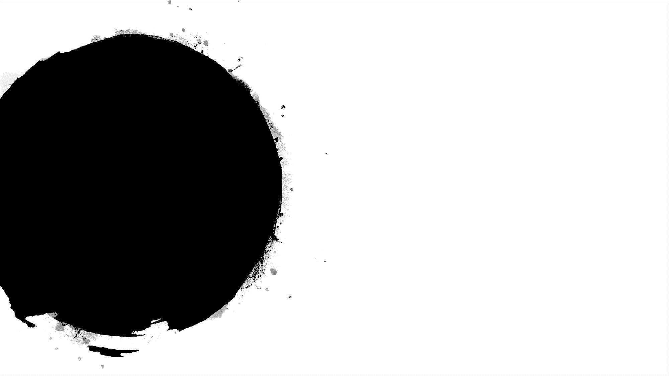
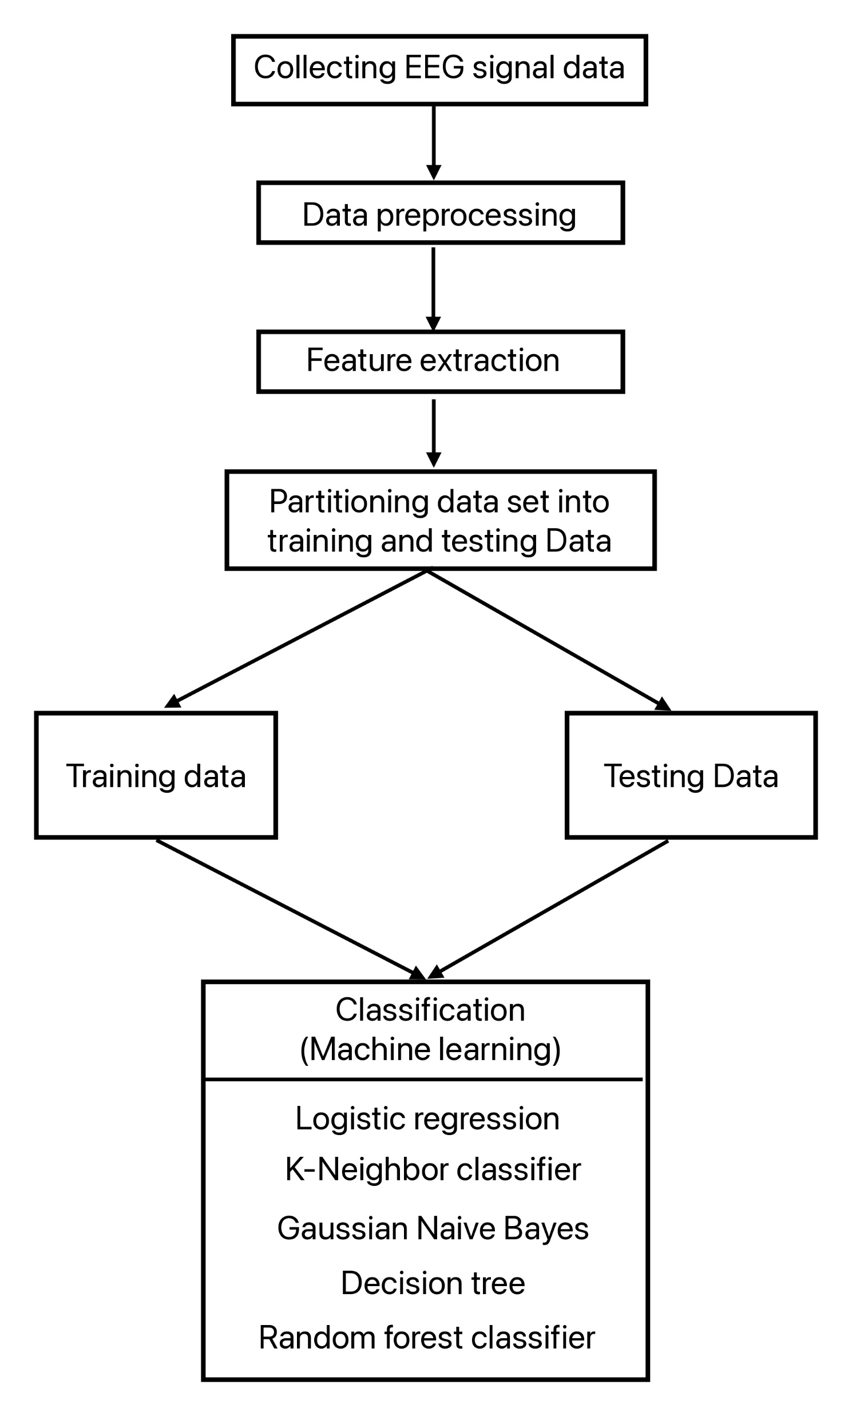

PROPOSED METHODOLOGY

Slide 11
RESULT
In this research work, the data set contained information worth 105343 rows and 20 columns. And the training and testing size were 70% and 30% respectively
This project uses machine learning algorithms namely Logistic Regression, KNeighbors Classifier, Gaussian Naïve Bayes, Decision Tree Classifier, Random Forest Classifier, having the accuracy 60.25%, 92.01%, 63.39%, 84.43% and 89.70% respectively. Among all those algorithms, K-Neighbors Classifier had a highest accuracy with 92.01%.

Slide 12
RESULT
Comparative Study of K-Neighbors Classifier with other four algorithms:-
Algorithms | Accuracy(%)
Logistic Regression | 60.25
K-Neighbours Classifier | 92.01
Gaussian NB | 63.39
Decision Tree Classifier | 84.43
Random Forest Classifier | 89.70

Slide 13
CONCLUSION AND FUTURE WORK
Conclusion :
We developed a Prediction Engine which enables the user to check whether he/she has ADHD disease. The Prediction engine provides an optimal performance compared to other state of art approaches. The Prediction Engine makes use of five algorithms to predict the presence of a disease namely: Logistic Regression, K-Nearest Neighbours (KNN), GaussianNB, Decision Tree Classifier, Random Forest Classifier. Among all that five algorithm K-Nearest Neighbours had given the highest accuracy.
The reason to choose K-Nearest Neighbours algorithm among all are:
• It is effective, if the training data is large.
• Among all K-Nearest Neighbours had a highest accuracy.

Slide 14
CONCLUSION AND FUTURE WORK
Future Work:
To enhance the accuracy deep learning can be used because deep learning gives a good accuracy on large dataset.
To enhance the functionality of the prediction engine providing the details of 5 nearest hospitals or medical facilities to the user input location.
Provide a user account which allows the user to keep track of their medical test data and get suggestions or support to meet the right specialists or the tests to be taken
Provide admin controls to upload, delete the dataset which will be used to train the model.
Automate the process of training the model and extracting pickle files of the trained models which will be consumed by the API’s to predict the disease.
Mail the detailed report of the prediction engine results along with the information of 5 nearest medical facilities details having location and contact information

Slide 15
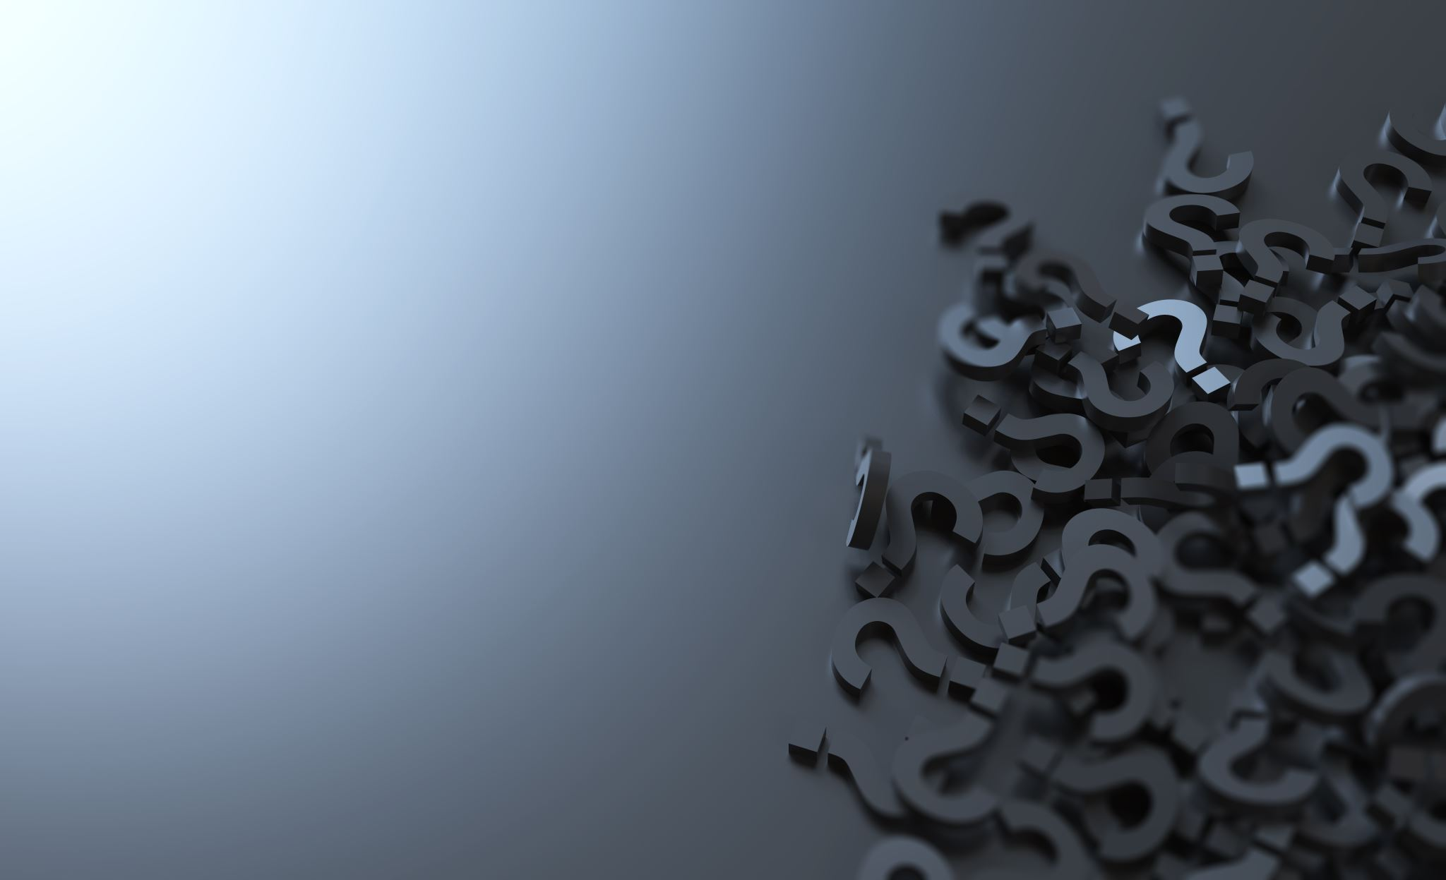
THANK YOU

