Slide 1
Unit-7
Computer Arithmetic

Slide 2

Outline
  Addition and Subtraction
  Multiplication Algorithms (Booth Multiplication Algorithm)
  Decimal Arithmetic Unit
Looping

Slide 3
Addition and Subtraction
Section - 1

Slide 4
Addition and Subtraction
Operation | Add Magnitudes | Subtract Magnitudes
 |  | When A > B | When A < B | When A = B
(+A) + (+B) | + (A + B)
(+A) + (-B) |  | + (A - B) | - (B - A) | + (A - B)
(-A) + (+B) |  | - (A - B) | + (B - A) | + (A - B)
(-A) + (-B) | - (A + B)
(+A) - (+B) |  | + (A - B) | - (B - A) | + (A - B)
(+A) - (-B) | + (A + B)
(-A) - (+B) | - (A + B)
(-A) - (-B) |  | - (A - B) | + (B - A) | + (A - B)

Slide 5
Flowchart for Addition & Subtraction
Subtract operation
Add operation
A_{s} = Sign bit of A
Minuend in A
Subtrahend in B
Augend in A
Addend in B
B_{s} = Sign bit of B
= 0
A_{s}⊕B_{s}
= 1
= 1
A_{s}⊕B_{s}
= 0
A_{s} = B_{s}
A_{s} ≠ B_{s}
A_{s} ≠ B_{s}
A_{s} = B_{s}
EA ← A+B’+1
AVF ← 0
EA ← A+B
= 0
= 1
A < B
E
A ≥ B
AVF ← E
A ← A’
≠ 0
A
= 0
A ← A+1
A_{s} ← A_{s}’
A_{s} ← 0
E = Carry
AVF = add overflow flip-flop
END
(result is in A and A_{s})

Slide 6
Multiplication Algorithms (Booth Multiplication Algorithm)
Section - 2

Slide 7




Multiplication
Traditional way of binary multiplication
Multiply operation
Multiplicand in B Multiplier in Q
23
10111
x
19
x
10011
$$A_{S} ← Q_{S }⊕ B_{S}$$
$$Q_{S} ← Q_{S }⊕ B_{S}$$
$$A←0,E←0$$
$$SC←n$$
10111
10111
00000
= 0
$$Q_{n}$$
= 1
00000
10111
$$EA←A+B$$
437
110110101
$$shr EAQ$$
$$SC←SC −1$$
≠ 0
SC
= 0
END
(PRODUCT is in AQ)

Slide 8
Perform 23 x 19
Multiplicand B = 10111 | E | A | Q | SC
Multiplier in Q | 0 | 00000 | 10011 | 101
Q_{n} = 1; add B |  | 10111
First partial product | 0 | 10111
Shift right EAQ | 0 | 01011 | 11001 | 100
Q_{n} = 1; add B |  | 10111
Second partial product | 1 | 00010
Shift right EAQ | 0 | 10001 | 01100 | 011
Q_{n} = 0; shift right EAQ | 0 | 01000 | 10110 | 010
Q_{n} = 0; shift right EAQ | 0 | 00100 | 01011 | 001
Q_{n} = 1; add B |  | 10111
Fifth partial product | 0 | 11011
Shift right EAQ | 0 | 01101 | 10101 | 000
Final product in AQ = 0110110101

Slide 9
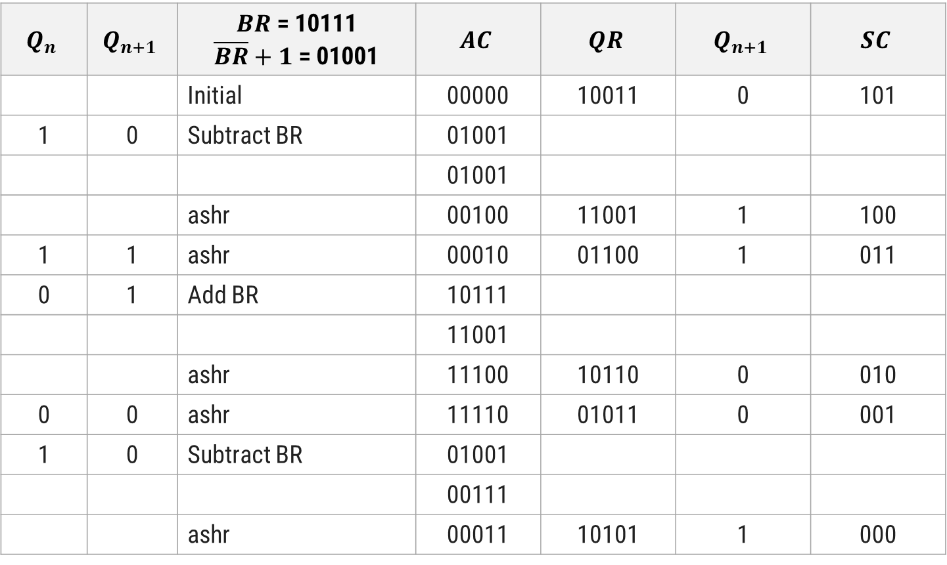
Multiply (-9) x (-13) using Booth Algorithm
$$Q_{n}$$ | $$Q_{n+1}$$ | $BR$ = 10111 $\overline{BR}+1$ = 01001 | $$AC$$ | $$QR$$ | $$Q_{n+1}$$ | $$SC$$
 |  | Initial | 00000 | 10011 | 0 | 101
1 | 0 | Subtract BR | 01001
 |  |  | 01001
 |  | ashr | 00100 | 11001 | 1 | 100
1 | 1 | ashr | 00010 | 01100 | 1 | 011
0 | 1 | Add BR | 10111
 |  |  | 11001
 |  | ashr | 11100 | 10110 | 0 | 010
0 | 0 | ashr | 11110 | 01011 | 0 | 001
1 | 0 | Subtract BR | 01001
 |  |  | 00111
 |  | ashr | 00011 | 10101 | 1 | 000

Slide 10

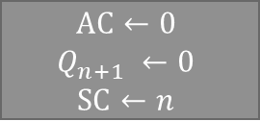

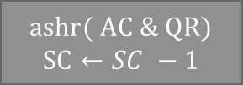

Booth Multiplication Algorithm
Multiply operation
Multiplicand in BR Multiplier in QR
$$AC←0$$
$$Q_{n+1} ←0$$
$$SC←n$$
= 10
$$Q_{n}Q_{n+1}$$
= 01
= 00
= 11
$$AC←AC+\overline{BR}+1$$
$$AC←AC+BR$$
$ashr( AC \& QR)$
$$SC←SC −1$$
≠ 0
SC
= 0
END

Slide 11
Decimal Arithmetic Unit
Section - 3

Slide 12
BCD Adder
Two BCD digits are applied to 4-bit binary adder which produce result ranging from 0 to 19 i.e. 9 + 9 + 1 = 19
Output sum of two decimal numbers must be represented in BCD.
Problem is to find rule by which binary number is to be converted to correct BCD
1
97
1001
0111
+
99
+
1001
1001
196
1
0011
0000
Both groups generate carry
+0110
+0110
Add 0110 to each
1
1001
0110
If codes are illegal or carry is generated in the group then we add 0110 to that particular group

Slide 13
BCD Adder
Binary Sum |  |  |  |  | BCD Sum
K | Z₈ | Z₄ | Z₂ | Z₁ | C | S₈ | S₄ | S₂ | S₁ | Decimal
0 | 0 | 0 | 0 | 0 | 0 | 0 | 0 | 0 | 0 | 0
0 | 0 | 0 | 0 | 1 | 0 | 0 | 0 | 0 | 1 | 1
0 | 0 | 0 | 1 | 0 | 0 | 0 | 0 | 1 | 0 | 2
0 | 0 | 0 | 1 | 1 | 0 | 0 | 0 | 1 | 1 | 3
0 | 0 | 1 | 0 | 0 | 0 | 0 | 1 | 0 | 0 | 4
0 | 0 | 1 | 0 | 1 | 0 | 0 | 1 | 0 | 1 | 5
0 | 0 | 1 | 1 | 0 | 0 | 0 | 1 | 1 | 0 | 6
0 | 0 | 1 | 1 | 1 | 0 | 0 | 1 | 1 | 1 | 7
0 | 1 | 0 | 0 | 0 | 0 | 1 | 0 | 0 | 0 | 8
0 | 1 | 0 | 0 | 1 | 0 | 1 | 0 | 0 | 1 | 9
Binary Sum |  |  |  |  | BCD Sum
K | Z₈ | Z₄ | Z₂ | Z₁ | C | S₈ | S₄ | S₂ | S₁ | Decimal
0 | 1 | 0 | 1 | 0 | 1 | 0 | 0 | 0 | 0 | 10
0 | 1 | 0 | 1 | 1 | 1 | 0 | 0 | 0 | 1 | 11
0 | 1 | 1 | 0 | 0 | 1 | 0 | 0 | 1 | 0 | 12
0 | 1 | 1 | 0 | 1 | 1 | 0 | 0 | 1 | 1 | 13
0 | 1 | 1 | 1 | 0 | 1 | 0 | 1 | 0 | 0 | 14
0 | 1 | 1 | 1 | 1 | 1 | 0 | 1 | 0 | 1 | 15
1 | 0 | 0 | 0 | 0 | 1 | 0 | 1 | 1 | 0 | 16
1 | 0 | 0 | 0 | 1 | 1 | 0 | 1 | 1 | 1 | 17
1 | 0 | 0 | 1 | 0 | 1 | 1 | 0 | 0 | 0 | 18
1 | 0 | 0 | 1 | 1 | 1 | 1 | 0 | 0 | 1 | 19

Slide 14

BCD Adder
Correction from binary to BCD is needed in following conditions
  K = 1
  Z₈ and Z₄ or Z₈ and Z₂ must have 1
Addend
Augend
4-bit binary adder
Carry out
K
Carry in
Z₈ Z₄ Z₂ Z₁
$$C=K+Z8Z4+Z8Z2$$
Output carry
0
4-bit binary adder
S₈ S₄ S₂ S₁

