Slide 1
PROGRAMMING IN PYTHON-I | C2111C1 | SEMESTER 1
Unit 2
Introduction to Python
From history and features to variables, operators, data types and strings
School of Computer Science, Engineering & Technology • ITM (SLS) Baroda University

Slide 2
Contents
1
History of Python
7
Operators in Python
2
Python versions: 1.x, 2.x, 3.x
8
print(), type() and id() functions
3
Introduction, features & applications
9
User input & data types
4
Setting up Python & first program
10
Mutable vs immutable objects
5
Indentation & comments
11
Python strings
6
Variables & identifiers
Programming in Python-I | Unit 2: Introduction to Python
1

Slide 3
SECTION 1
History of Python
How a Christmas-break project became one of the world's most used languages
Programming in Python-I | Unit 2: Introduction to Python
2

Slide 4
HISTORY
Origin & Conception
Late 1980s – 1990, at Centrum Wiskunde & Informatica (CWI), Netherlands
Creator: Guido van Rossum, a Dutch programmer
He was contributing to ABC, a teaching-oriented language, and liked its simplicity — but wanted more flexibility and extensibility
Goal: a language that is easy to learn and read, yet powerful enough for serious software development
Development began during Guido's Christmas break in December 1989
Programming in Python-I | Unit 2: Introduction to Python
3
Notes:
[Remember] Ask students to recall the creator's name and the year Python's development began.

Slide 5
HISTORY
Birth of Python (1991)
First release: Python 0.9.0 in February 1991, on the alt.sources newsgroup
This first version already included:
  Functions
  Exception handling
  Core data types — str, list, dict
  Modules
  Classes with inheritance
Fun fact: the name "Python" comes from Monty Python's Flying Circus, a British comedy series — not the snake!
Programming in Python-I | Unit 2: Introduction to Python
4
Notes:
[Understand] Discuss why building exception handling and classes in from v0.9 mattered for the language's later growth.

Slide 6
HISTORY
Major Version Timeline
Version series | Years active | Key highlights
Python 1.x | 1991 – 2000 | First official release; functions, modules, exceptions; lambda, map, filter, reduce
Python 2.x | 2000 – 2020 | List & dict comprehensions, garbage collection, partial Unicode, print as a statement
Python 3.x | 2008 – present | print() as a function, full Unicode, f-strings, async/await, type hints
Programming in Python-I | Unit 2: Introduction to Python
5
Notes:
[Understand] Ask which era introduced list comprehensions, and which introduced f-strings.

Slide 7
HISTORY
Milestones & Influences
1994 — Python 1.0 released, adding lambda, map, filter, and reduce
2000 — Python 2.0 adds list comprehensions and a cycle-detecting garbage collector
3 Dec 2008 — Python 3.0 ("Py3K") released to correct the language's fundamental design flaws
ABC — the predecessor language — supported exception handling and interfaced with the Amoeba OS
Python was influenced by: ABC, and Modula-3
Programming in Python-I | Unit 2: Introduction to Python
6
Notes:
[Remember] Quick recall check on key dates before moving to the 2-vs-3 comparison.

Slide 8
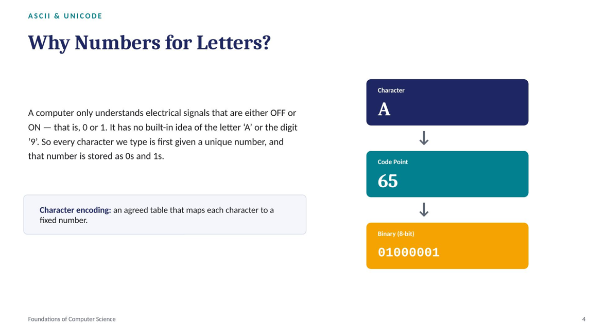

Slide 9
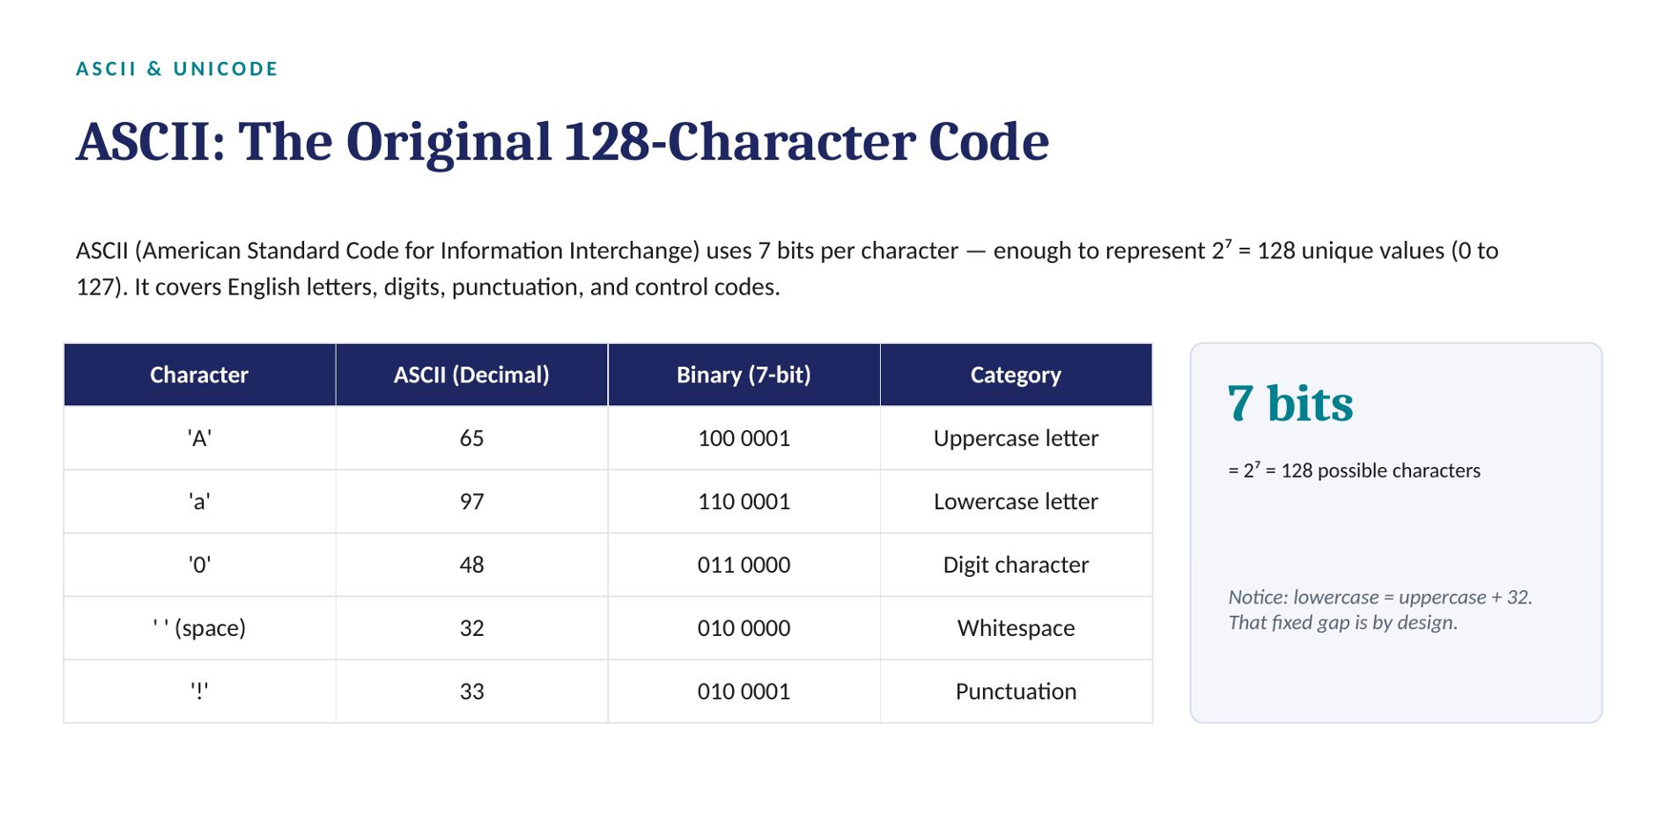

Slide 10
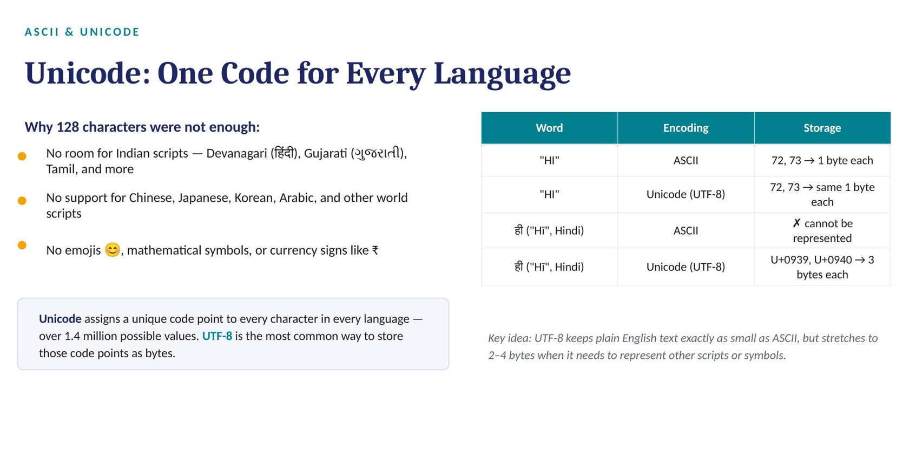

Slide 11
HISTORY
Python 2 vs Python 3
Aspect | Python 2 | Python 3
Released | 16 Oct 2000 | 3 Dec 2008
print | Statement: print "hi" | Function: print("hi")
Default string type | ASCII | Unicode
Integer division | Returns nearest whole number | True division for int & float
Iteration helper | xrange() | range()
Library support | Legacy libraries | Actively maintained, modern libraries
Status today | End-of-life since Jan 2020 (v2.7 final) | Current standard — this course uses Python 3
Programming in Python-I | Unit 2: Introduction to Python
7
Notes:
[Analyze] Have students explain, in their own words, why Python 3's Unicode-by-default design matters for global text (e.g. Hindi, emoji).

Slide 12
SECTION 2
Introduction, Features & Applications
What Python is, why it is popular, and where it is used in industry
Programming in Python-I | Unit 2: Introduction to Python
8

Slide 13
INTRODUCTION
What is Python?
Python is an easy-to-learn, powerful, high-level programming language
It is both a general-purpose programming language and a scripting language
Its elegant syntax, dynamic typing (language where variable types are checked at runtime), and interpreted nature make it ideal for scripting and rapid application development
It is interpreted and object-oriented
Adopted by top technology organizations: Google, Dropbox, Quora, Mozilla, Hewlett-Packard, Qualcomm, IBM, Cisco
Programming in Python-I | Unit 2: Introduction to Python
9
Notes:
[Understand] Ask students to name one company from the list and guess what they might use Python for.

Slide 14
WHY PYTHON?
Features of Python
1
Easy to Code
2
Open Source & Free
3
GUI Support
4
Object-Oriented
Developer-friendly syntax — can be learned in a couple of hours or days, easier than Java, C++, or C#.
Free to download and use on Windows, Mac, or Linux; large global contributor community.
Wide array of GUI toolkits can be imported directly into the interpreter.
Supports classes and object encapsulation for efficient, reusable program design.
Programming in Python-I | Unit 2: Introduction to Python
10
Notes:
[Understand] Discuss which feature students find most attractive as beginners, and why.

Slide 15
WHY PYTHON?
Features of Python (Cont.)
5
High-Level Language
6
Interpreted by Nature
7
Highly Portable
Abstracts away memory management and hardware architecture from the programmer.
Executes one line at a time; no separate compile step, easing debugging. Compiles to byte-code internally.
Code written on Windows runs on Mac or Linux with little to no change.
8
Dynamically Typed
9
Extensive Libraries
10
Multi-Language Support
A variable's type is decided at run time, not declared in advance.
A huge standard and third-party library ecosystem means less code written from scratch.
Coded in C; can call C, C++, Java (via Jython) and .NET (via IronPython) code.
Programming in Python-I | Unit 2: Introduction to Python
11
Notes:
[Apply] Ask students to match each feature to a scenario from their own future projects.

Slide 16
WHERE PYTHON IS USED
Applications of Python
1
Web Development
2
Game Development
3
Machine Learning & AI
4
Data Science & Visualization
Rapid web app development using frameworks like Django, Flask, and Pyramid — with built-in security and scalability.
Libraries such as PySoy and PyGame power titles like Civilization IV and Disney's Toontown Online.
Industry-standard for ML/AI thanks to libraries such as Pandas, Scikit-Learn, and NumPy.
Pandas and NumPy extract insights; Matplotlib and Seaborn visualize them.
Programming in Python-I | Unit 2: Introduction to Python
12
Notes:
[Understand] Connect Application #3 (ML/AI) directly to the course's later units on this topic.

Slide 17
WHERE PYTHON IS USED
Applications of Python (Cont.)
5
Desktop GUI Apps
6
Web Scraping
7
Business Applications
Tkinter, wxWidgets, Kivy, and PyQt build calculators, to-do apps, and more complex desktop software.
BeautifulSoup pulls data from websites for price comparison, job listings, and research.
Scalable, extensible platforms such as Tryton support e-commerce and ERP systems.
8
Audio & Video
9
CAD Applications
10
Embedded Systems
Media applications like TimPlayer and Cplay are built with Python for stable playback.
Computer-Aided Design tools such as Fandango use Python for complex object modelling.
Being C-based, Python powers embedded boards such as the Raspberry Pi.
Programming in Python-I | Unit 2: Introduction to Python
13
Notes:
[Apply] Poll the class on which application area interests them most for a mini-project.

Slide 18
SECTION 3
Getting Started with Python
Installing Python, setting the path, and writing your first program
Programming in Python-I | Unit 2: Introduction to Python
14

Slide 19
GETTING STARTED
Setting the Path & Installing Python
Setting the Path
Installing Python
Python can reside in any directory; the OS needs a search path to find its executable code
Set it via the Environment Variable settings of your computer
Steps: My Computer → Properties → Advanced System Settings → Environment Variables → New
In Variable name, enter path; in Variable value, add the path up to C:\Python (or wherever Python is installed)
Download an installer from the official site: python.org
Official releases exist for Windows, Linux/Unix, macOS, and even iOS
Most Linux/Unix systems already have Python pre-installed
Verify installation: run python --version in a terminal
Programming in Python-I | Unit 2: Introduction to Python
15
Notes:
[Apply] Live-demo the installer and path setup, or have students verify python --version on their own machines.

Slide 20
GETTING STARTED — EXTRA
Additional: Anaconda & Google Colab
Two beginner-friendly alternatives to a manual install, both used later in this course:
Anaconda Distribution — bundles Python with Jupyter Notebook, common data-science libraries (NumPy, Pandas), and the conda package manager
Google Colab — a free, browser-based Python notebook that needs zero local installation and runs on Google's servers
Colab is convenient for coursework: files auto-save to Google Drive and GPU/TPU access is free for smaller workloads
Recommended for this course: use Google Colab for practicals and a local install (or Anaconda) for offline practice
Programming in Python-I | Unit 2: Introduction to Python
16
Notes:
[Understand] Explain trade-offs: local install gives full control; Colab removes setup friction — useful framing before the lab manual's 11 practicals.

Slide 21
GETTING STARTED
First Python Program
The classic first program, then a small program that stores and prints user information:
# Program 1: Hello World
print("hello world")
# Program 2: printing stored information
name = "Tanvi"
branch = "Artificial Intelligence"
age = "27"
print("My name is: ", name)
print("My age is: ", age)
Programming in Python-I | Unit 2: Introduction to Python
17
Notes:
[Apply] Have students run Program 1, then modify Program 2 to print their own name and branch.

Slide 22
GETTING STARTED
Comments in Python
Comments explain code to humans; Python's interpreter ignores them entirely. Two forms:
# Single-line comment: starts with #
# defining the marks of a student
marks = 90
name = "Tanvi" # inline comment after code
branch = "Computer Science" # defining branch
# Multi-line comment style 1: repeated #
# we are defining a for loop
# to iterate the given list
"""
Multi-line comment style 2:
a triple-quoted string used as a comment
"""
20
Notes:
[Understand] Note that triple-quoted strings are technically string literals, not true comments — but are commonly used as block comments and docstrings.

Slide 23
GETTING STARTED
Indentation in Python
Indentation = the spaces (or tabs) at the start of a line that define a block of code
Unlike C, C++, or Java (which use { } braces), Python uses indentation to decide which lines belong together
It is the single most significant syntax rule in Python
Improper indentation raises an IndentationError and interrupts execution
Without indentation, Python cannot tell which statement belongs to which block
Programming in Python-I | Unit 2: Introduction to Python
18
Notes:
[Remember] Emphasize this early — indentation errors are the most common beginner mistake.

Slide 24
GETTING STARTED
Basic Rules of Indentation
Rules to Follow
Where Indentation Applies
Use the same number of spaces within one block — 4 spaces per level is the standard
Tabs are allowed, but spaces are recommended; never mix tabs and spaces in the same block
Indentation level increases after a colon ( : ) in statements like if, for, while, def, class
Inside loops — for, while
Inside functions and classes
Inside conditional statements — if, elif, else
Inside exception handling — try, except, finally
Programming in Python-I | Unit 2: Introduction to Python
19
Notes:
[Understand] Show a short if/else snippet and ask students to identify the indentation levels aloud.

Slide 25
SECTION 4
Variables & Identifiers
Naming and storing data the Python way
Programming in Python-I | Unit 2: Introduction to Python
21

Slide 26
VARIABLES
Variables in Python
A variable is a name given to a value stored in memory, for later use — like a label on a box
A variable is created the moment a value is first assigned to it, and its value can be updated later
x = 5
y = "Tanvi"
print(x)
print(y)
Programming in Python-I | Unit 2: Introduction to Python
22
Notes:
[Remember] Reinforce the box/label metaphor before moving to dynamic typing.

Slide 27
1
VARIABLES
What Is a Variable?
A variable is a named label that points to a value stored in memory.
age
KEY IDEA
age = 19
city = "Vadodara"
is_pass = True
the label
on the box
=
= is the assignment operator — it stores the value on the right into the name on the left. Once assigned, that name can be reused anywhere in the program without retyping the value.
19
Unlike C or Java, Python variables need no type declaration — the type is decided automatically from the value you assign. This is called dynamic typing.
REMEMBER
A variable doesn't store the box's location — it stores a reference to the value. When you assign a new value to the same name, the old value is simply forgotten.
ITM (SLS) Baroda University | School of Computer Science, Engineering & Technology (SoCSET)
Practical 2 · Variables, Data Types & Operators
Notes:
[Bloom's: Understand] Use the physical box-with-a-label analogy on the board. Emphasize dynamic typing as the key difference from languages like C/Java that some students may have touched in school.

Slide 28
1
VARIABLES
Naming Variables — Rules & Conventions
A good variable name reads like a sentence, and a valid one follows five simple rules.
Rule | Valid Example | Invalid Example
Start with a letter or underscore | student_name, _temp | 1roll_no ✗
Letters, digits, underscores only | marks2, roll_1 | student-name ✗
Case-sensitive | Age and age are different names | —
Cannot be a reserved keyword | class_name | class ✗ for ✗ import ✗
Use snake_case by convention | total_price, is_valid | TotalPrice (avoid)
Good practice: roll_number is clearer than rn — descriptive names make code readable months later, by you or a teammate.
ITM (SLS) Baroda University | School of Computer Science, Engineering & Technology (SoCSET)
Practical 2 · Variables, Data Types & Operators
Notes:
[Bloom's: Apply] Have students individually spot which of a set of sample names on the board are valid vs. invalid before revealing the answer — quick formative check.

Slide 29
VARIABLES
Choosing Good Variable Names
Prefer meaningful names over short ones — roll_no is clearer than rn
Keep names a reasonable length — roll_no_of_a_student is unnecessarily long
Be consistent with a naming style throughout a project — e.g., always roll_no or always RollNo, not a mix
Additional: PEP 8 (Python's official style guide) recommends snake_case for variables and functions — e.g., total_marks, student_name
Programming in Python-I | Unit 2: Introduction to Python
25
Notes:
[Evaluate] Show two versions of the same snippet — one with poor names, one PEP 8-compliant — and ask which is easier to read and why.

Slide 30
VARIABLES
Identifiers in Python
Identifiers are user-defined names for variables, functions, classes, and modules
Rules to create a valid identifier:
  May combine lowercase, uppercase letters, digits, and underscore — e.g. myClass, var_1, print_this_to_screen
  Cannot start with a digit — 1variable is invalid, variable1 is valid
  Cannot consist of digits only
  No limit on the length of an identifier
  Cannot be a Python keyword — e.g. import, if, else, break, continue
Programming in Python-I | Unit 2: Introduction to Python
26
Notes:
[Remember] Quick recall of the five identifier rules before the valid/invalid examples.

Slide 31
VARIABLES
Valid & Invalid Identifiers
Identifier | Valid? | Reason
ab10c | Valid | Contains only letters and numbers
abc_DE | Valid | Contains all permitted character types
_ | Valid | A lone underscore is a valid identifier
_abc | Valid | Identifiers may start with an underscore
99 | Invalid | Cannot be made of digits only
9abc | Invalid | Cannot start with a number
x+y | Invalid | Only underscore is allowed as a special character
for | Invalid | for is a reserved keyword
Programming in Python-I | Unit 2: Introduction to Python
27
Notes:
[Apply] Cold-call students to justify one row each — reinforces the rules through explanation.

Slide 32
VARIABLES
Dynamic Typing & Casting
Variables need no declared type, and can even change type after being set:
x = 4 # x is of type int
x = "Tanvi" # x is now of type str
print(x)
# Casting: force a specific type
a = str(3) # a will be '3'
b = int(3) # b will be 3
c = float(3) # c will be 3.0
# Get the Type
print(type(x))
Programming in Python-I | Unit 2: Introduction to Python
23
Notes:
[Apply] Ask students to predict type(x) before and after reassignment — checks understanding of dynamic typing.

Slide 33
1
VARIABLES
Multiple Assignment
Python lets you assign several variables in a single line — cleaner and faster to write.
# assign three at once
roll_no, name, branch =
21, "Aarav", "CSE"
# same value to many names
x = y = z = 0
ITM (SLS) Baroda University | School of Computer Science, Engineering & Technology (SoCSET)
Practical 2 · Variables, Data Types & Operators
Notes:
[Bloom's: Apply] Live-demo the swap trick in the terminal — it usually draws an audible reaction and helps the multiple-assignment syntax stick.

Slide 34
SECTION 5
Operators in Python
Arithmetic, comparison, assignment, logical, bitwise, and special operators
Programming in Python-I | Unit 2: Introduction to Python
28

Slide 35
OPERATORS
Arithmetic Operators
Operator | Description | Syntax
+ | Addition: adds two operands | x + y
- | Subtraction: subtracts two operands | x - y
* | Multiplication: multiplies two operands | x * y
/ | Division (float): true division | x / y
// | Division (floor): integer division | x // y
% | Modulus: remainder of division | x % y
** | Power: first operand raised to the second | x ** y
Programming in Python-I | Unit 2: Introduction to Python
29
Notes:
[Apply] Give students a mixed expression and have them evaluate it by hand before running it.

Slide 36
OPERATORS
Operator Precedence (Order of Operations)
When an expression mixes operators, Python follows a fixed precedence — similar to BODMAS/PEMDAS:
  1. Parentheses ( )
  2. Exponent **
  3. Multiplication *, Division /, Floor division //, Modulus % (left to right)
  4. Addition +, Subtraction - (left to right)
Example: 2 + 3 * 4 evaluates ** and * before + , giving 2 + 12 = 14, not 20
When in doubt — or to make code more readable for others — add parentheses explicitly
Programming in Python-I | Unit 2: Introduction to Python
30
Notes:
[Analyze] Walk through 2 + 3 * 4 ** 2 step by step on the board.

Slide 37
OPERATORS
Relational (Comparison) Operators
Operator | Description | Syntax
> | Greater than | x > y
< | Less than | x < y
== | Equal to | x == y
!= | Not equal to | x != y
>= | Greater than or equal to | x >= y
<= | Less than or equal to | x <= y
Programming in Python-I | Unit 2: Introduction to Python
31
Notes:
[Understand] Contrast == (comparison) with = (assignment) explicitly — a very common beginner confusion.

Slide 38
OPERATORS
Assignment Operators
Operator | Example | Equivalent to
= | x = 5 | x = 5
+= | x += 5 | x = x + 5
-= | x -= 5 | x = x - 5
*= | x *= 5 | x = x * 5
/= | x /= 5 | x = x / 5
%= | x %= 5 | x = x % 5
//= | x //= 5 | x = x // 5
**= | x **= 5 | x = x ** 5
Programming in Python-I | Unit 2: Introduction to Python
32
Notes:
[Apply] Ask students to rewrite total = total + price as a compound assignment.

Slide 39
OPERATORS
Logical Operators
Operator | Description | Syntax
and | True if both operands are true | x and y
or | True if either operand is true | x or y
not | True if the operand is false | not x
Programming in Python-I | Unit 2: Introduction to Python
33
Notes:
[Apply] Build a small truth-table exercise combining and/or/not on two Boolean variables.

Slide 40
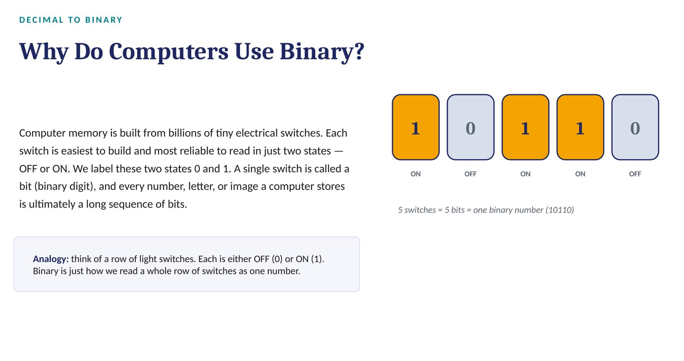

Slide 41
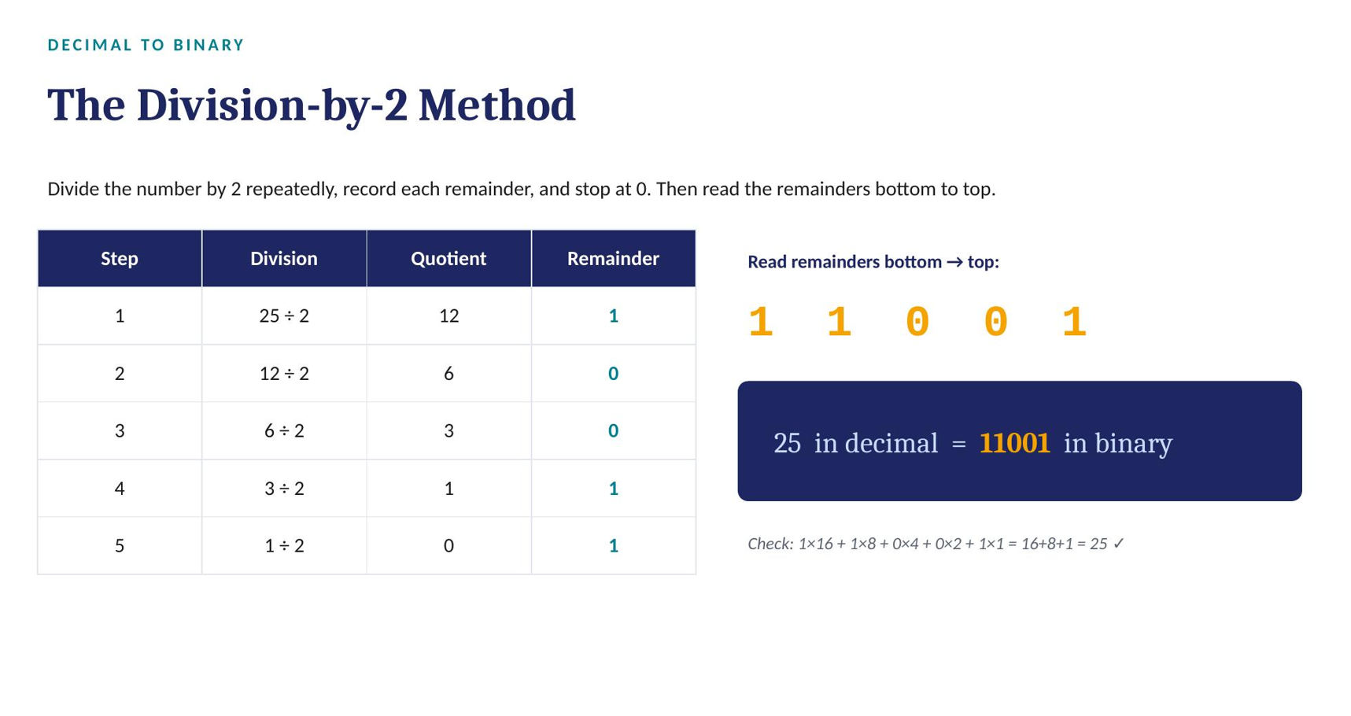

Slide 42
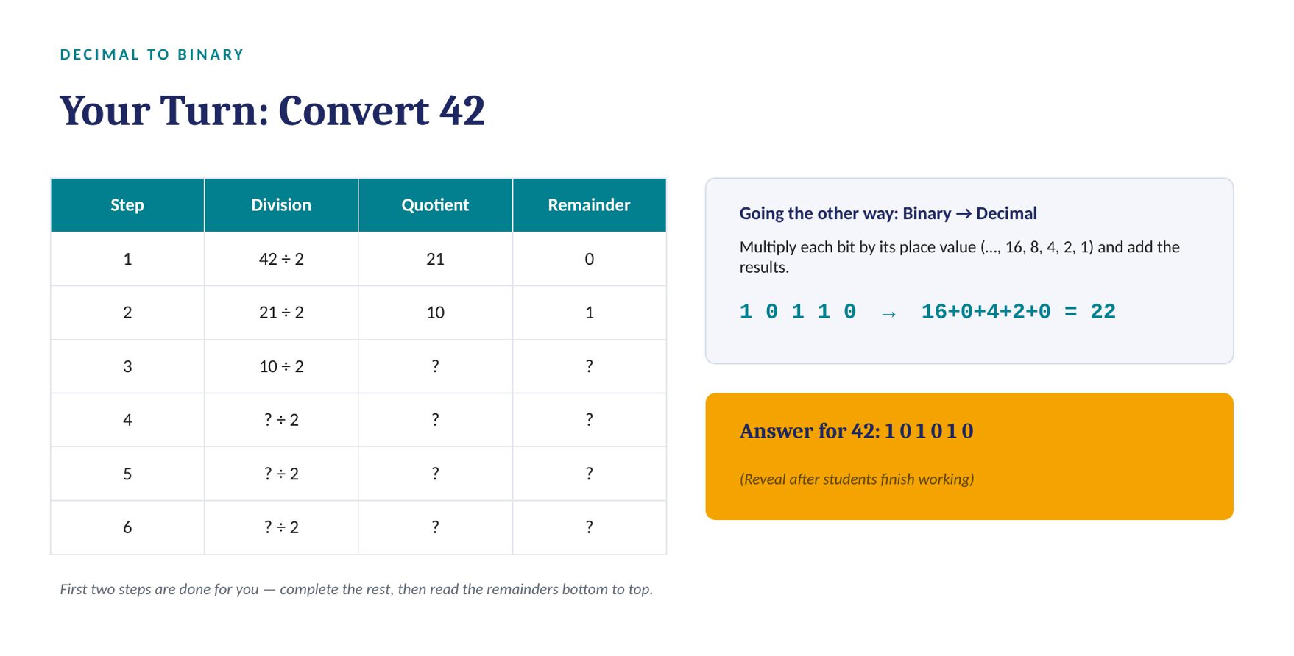

Slide 43
OPERATORS
Bitwise Operators — Overview
Operator | Description | Syntax
& | Bitwise AND | x & y
| | Bitwise OR | x | y
~ | Bitwise NOT (one's complement) | ~x
^ | Bitwise XOR | x ^ y
>> | Bitwise right shift | x >> n
<< | Bitwise left shift | x << n
Programming in Python-I | Unit 2: Introduction to Python
34
Notes:
[Remember] These operate on the binary representation of integers — preview before the worked examples.

Slide 44
OPERATORS
Bitwise AND (&) and OR (|)
a = 4 (0100 in binary), b = 5 (0101 in binary):
a, b = 4, 5
print(a & b) # AND -> 0100 = 4
print(a | b) # OR -> 0101 = 5
# a b | AND | OR
# 0 0 | 0 | 0
# 0 1 | 0 | 1
# 1 0 | 0 | 1
# 1 1 | 1 | 1
Programming in Python-I | Unit 2: Introduction to Python
35
Notes:
[Apply] Have students compute a & b and a | b for a=6, b=3 by hand, then verify in code.

Slide 45
OPERATORS
Bitwise XOR (^) and NOT (~)
XOR is true only when bits differ. NOT flips every bit (one's complement):
Python stores integers with infinite precision, but ~ still follows the rule ~x = -(x + 1)
a, b = 4, 5
print(a ^ b) # XOR: 0100 ^ 0101 = 0001 -> 1
a = 10 # binary 1010
print(~a) # ~a = -(1010 + 1) = -11
Programming in Python-I | Unit 2: Introduction to Python
36
Notes:
[Analyze] Ask why ~5 equals -6, tying it back to the -(x+1) rule.

Slide 46
The underlying rule for any XOR operation is:
0 ^ 0 = 0 (Same)
1 ^ 1 = 0 (Same)
1 ^ 0 = 1 (Different)
0 ^ 1 = 1 (Different)

Slide 47
OPERATORS
Bitwise Shift Operators (>> and <<)
Right shift (>>): moves bits right; bits that fall off the right are discarded
Left shift (<<): moves bits left; bits that fall off the left are discarded, 0s fill in on the right
a = 7 # 0111
print(a >> 1) # -> 0011 = 3 (shift right by 1)
print(a << 1) # -> 1110 = 14 (shift left by 1)
Programming in Python-I | Unit 2: Introduction to Python
37
Notes:
[Apply] Ask: what does a << n compute in decimal terms? (multiplies by 2**n)

Slide 48
OPERATORS
Special Operators
Membership Operators
Identity Operators
in — True if a value is found in a sequence (string, list, tuple, set, dictionary)
not in — True if a value is NOT found in the sequence
Example: 5 in [1, 5, 9] → True
is — True if two variables refer to the same object in memory
is not — True if they do not refer to the same object
Two equal values are not necessarily identical objects
Programming in Python-I | Unit 2: Introduction to Python
38
Notes:
[Understand] Contrast membership (value present?) with identity (same object in memory?) — these are often confused.

Slide 49
OPERATORS
Equality ( == ) vs Identity ( is )
Feature | Equality (==) | Identity (is)
Compares | Values | Memory address / object identity
True when | Contents match | Variables point to the same object
Checks | Logical equality | Object reference equality
Example | [1,2] == [1,2] -> True | [1,2] is [1,2] -> False
[Analyze] This slide often surprises students — spend extra time on the caching note.
Programming in Python-I | Unit 2: Introduction to Python
39
Notes:
Note: small integers (-5 to 256) and some strings may show True for both == and is due to Python's internal caching — a common source of confusion.

Slide 50
SECTION 6
Built-in Functions, Input & Data Types
print(), type(), id(), user input, and Python's data model
Programming in Python-I | Unit 2: Introduction to Python
40

Slide 51
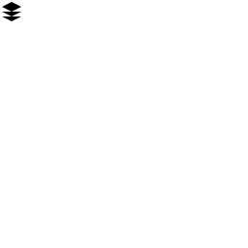
?
QUICK REFRESHER
What Is a Function, Again?
A function is a named, reusable block of code that performs a specific job when you “call” it by writing its name followed by parentheses.
function_name(argument)
↑ ↑
name the value passed in
print and input are both built-in functions — Python provides them ready-made, no setup required.
Programming in Python-I | print() & input() | BTech CSE Semester 1 | ITM (SLS) Baroda University
3 / 17
Notes:
Bloom's Level: Remembering. Keep this brief — just enough vocabulary to make the rest of the session click.
51

Slide 52

1
OUTPUT
print() — Basic Syntax
print() displays whatever you give it on the screen, then moves to a new line.
print("Hello, Python!")
Hello, Python!
print(25)
25
Text (a “string”) goes inside quotes. Numbers do not need quotes — print() can display text, numbers, or the result of a calculation.
Programming in Python-I | print() & input() | BTech CSE Semester 1 | ITM (SLS) Baroda University
4 / 17
Notes:
Bloom's Level: Remembering. Emphasize the quotes-vs-no-quotes distinction early; it prevents a common early error.
52

Slide 53
1
PRINT() SYNTAX
The Full Syntax of print()
print() can take far more than just text — here is its complete signature.
print(*objects, sep=' ', end='\n', file=sys.stdout, flush=False)
Parameter | Default | What It Controls
*objects | required | One or more values to display — text, numbers, variables
sep | ' ' (single space) | What is inserted between multiple objects
end | '\n' (newline) | What is added after the final object
file | sys.stdout (screen) | Where output is sent — rarely changed by beginners
flush | False | Whether to force output immediately — rarely needed
ITM (SLS) Baroda University | School of Computer Science, Engineering & Technology (SoCSET)
print() and input() — Basic Syntax in Detail
Notes:
[Bloom's: Understand] Only sep and end matter for beginners day-to-day — flag file and flush as 'exists, rarely touched' so students aren't intimidated by the full signature. The next several slides drill into objects, sep, and end one at a time.

Slide 54
1
PRINT() SYNTAX
print() — Displaying Text and Numbers
print() shows whatever you give it on screen, then moves to a new line by default.
print("Hello, Python!")
Hello, Python!
print(25)
25
print(3.14)
3.14
SYNTAX RULE
Text — called a "string" — must go inside quotes, single or double. Numbers do not need quotes at all: print() can display text, numbers, or the result of a calculation directly.
Quotes are a syntax marker, not part of the output — that's why "Hello, Python!" prints without its quotation marks.
ITM (SLS) Baroda University | School of Computer Science, Engineering & Technology (SoCSET)
Notes:
[Bloom's: Remember] Emphasize the quotes-are-syntax-not-output point explicitly — it's an early source of confusion when students later try to print a variable and wonder why there are no quotes around its value.

Slide 55
1
PRINT() SYNTAX
print() — Printing Multiple Values
Separate values with commas — print() joins them with a single space automatically.
name = "Riya"
age = 19
print("Name:", name, "Age:", age)
Name: Riya Age: 19
HOW IT WORKS
Each comma-separated item is one of the *objects in print()'s signature. It can be a string, a number, or a variable — print() automatically converts every item to text before joining them.
There's no need to manually convert numbers to strings before printing them alongside text — print() handles that for you.
ITM (SLS) Baroda University | School of Computer Science, Engineering & Technology (SoCSET)
print() and input() — Basic Syntax in Detail
Notes:
[Bloom's: Apply] Contrast this with concatenation using + (which would raise a TypeError mixing str and int) — print()'s comma-joining sidesteps that entirely, which is worth pointing out as a design choice.

Slide 56
1
PRINT() SYNTAX
print() — The sep Parameter
sep controls what goes between values, instead of the default single space.
Example | Effect
sep="-" | Joins values with a hyphen — handy for dates
sep=", " | Joins values comma-and-space — like a list
sep="" | No separator at all — values run together
print("2026", "07", "29", sep="-")
2026-07-29
print("apple", "mango", "kiwi", sep=", ")
apple, mango, kiwi
ITM (SLS) Baroda University | School of Computer Science, Engineering & Technology (SoCSET)
print() and input() — Basic Syntax in Detail
Notes:
[Bloom's: Apply] Have students predict the output of sep="" before revealing it — it's the edge case most likely to trip them up in the practice task.

Slide 57
1
PRINT() SYNTAX
print() — Escape Sequences
Special character combinations, starting with a backslash, that control formatting inside a string.
Sequence | Meaning | Example
\n | New line | print("Hi\nBye")
\t | Tab space | print("Name:\tRiya")
\\ | A literal backslash | print("C:\\Users")
\" | A literal double quote | print("She said \"hi\"")
\' | A literal single quote | print('It\'s here')
print("Hi\nBye")
Hi
Bye
print("Name:\tRiya")
Name: Riya
ITM (SLS) Baroda University | School of Computer Science, Engineering & Technology (SoCSET)
Notes:
[Bloom's: Understand] \n is by far the most-used escape sequence — students will lean on it heavily once they start formatting multi-line output, so make sure it's solid before moving on.

Slide 58
2
INPUT() SYNTAX
The Full Syntax of input()
Far simpler than print() — one optional argument, one guaranteed return type.
variable_name = input(prompt)
prompt
return value
pausing
An optional string shown to the user before they type. Skip it and Python waits silently.
input() always hands back a str — the exact text the user typed, nothing more.
The whole program halts at this line until the user presses Enter.
ITM (SLS) Baroda University | School of Computer Science, Engineering & Technology (SoCSET)
Notes:
[Bloom's: Understand] The 'always returns str' point deserves heavy emphasis here — it's foreshadowed now and drilled with a concrete failing example two slides later.

Slide 59
2
INPUT() SYNTAX
input() — A Basic Example
input() pauses the program and waits for the user to type something and press Enter.
city = input("Which city are you from? ")
Which city are you from? Vadodara
print("Nice! I have heard great things about", city)
Nice! I have heard great things about Vadodara
STEP BY STEP
1. Python displays the prompt string
2. Execution pauses at this exact line
3. The user types text and presses Enter
4. That text is stored in city as a string
ITM (SLS) Baroda University | School of Computer Science, Engineering & Technology (SoCSET)
Notes:
[Bloom's: Apply] Live-run this in the terminal so students see the pause happen in real time — the concept of 'the program is waiting' is more intuitive live than described.

Slide 60
2
INPUT() SYNTAX
input() Always Returns a String
Even if the user types a number, Python stores it as text — this trips up almost every beginner once.
age = input("Enter your age: ")
Enter your age: 19
print(age + 1)
TypeError: can only concatenate str
(not "int") to str
WHY THIS HAPPENS
age holds the text "19", not the number 19 — they look identical on screen but behave completely differently. Python cannot add a whole number to text, so it raises a TypeError the moment you try.
ITM (SLS) Baroda University | School of Computer Science, Engineering & Technology (SoCSET)
Notes:
[Bloom's: Analyze] This is the single most valuable slide in the deck for preventing future debugging sessions — pause here and let a student explain, in their own words, why the error happens.

Slide 61
WHY BEFORE HOW
Why Do We Need id() and type()?
Python variables are just labels pointing to objects in memory. Two big questions naturally follow:
?
"Which box is this?"
T
"What's inside the box?"
Every object lives at a unique memory location. Python's memory manager creates and reclaims these boxes as your program runs.
Python is dynamically typed — a variable can hold an int today and a string tomorrow. The interpreter must always know an object's type to operate on it correctly.
id() answers: which memory box holds this value, right now?
type() answers: what kind of value is stored in this box?
Python-I | C2111C1 | id() and type()
2
Notes:
Bloom's Level: Understand. Delivery tip: Ask students — 'If I hand you an Aadhar card, id() is like the enrollment number, type() is like which document category it belongs to.' Anchor the analogy before code.

Slide 62
TYPE()
type() — Definition & Syntax
type(object)
>>> city = "Ahmedabad"
>>> type(city)
<class 'str'>
>>> type(city) == str
True
Returns the class (type) of the given object.
Key points
Every value in Python is an object — even numbers and functions.
type() called with ONE argument returns that object's class.
The return value itself is a type object, e.g. <class 'int'>.
Commonly used for debugging, validation, and dynamic dispatch.
Note: type() with three arguments type(name, bases, dict) dynamically CREATES a new class — a different, advanced use (not covered today).
Python-I | C2111C1 | id() and type()
3
Notes:
Bloom's Level: Understand. Delivery tip: Emphasize 'everything in Python is an object' — write it on the board as a recurring theme for the whole course.

Slide 63
TYPE()
type() in Action — Mixed Data Types
int
str
list
dict
>>> pincode = 390001
>>> type(pincode)
<class 'int'>
>>> student_name = "Aarav"
>>> type(student_name)
<class 'str'>
>>> marks = [78, 85, 91]
>>> type(marks)
<class 'list'>
>>> student = {"name": "Aarav",
... "city": "Ahmedabad"}
>>> type(student)
<class 'dict'>
Python-I | C2111C1 | id() and type()
4
Notes:
Bloom's Level: Apply. Delivery tip: Live-type these four in the shell rather than showing static text — pause after each and predict the output together as a class.

Slide 64
ID()
id() — Definition & Syntax
id(object)
>>> aadhaar_holder = "Priya Sharma"
>>> id(aadhaar_holder)
140724930012144
# A large integer -- like a
# memory "house number"
Returns a unique integer identifier for the object, constant for its lifetime.
Key points
No two objects that exist at the same time share an id().
In CPython (the standard implementation), id() is the object's memory address.
The id is only guaranteed unique WHILE the object is alive — once garbage-collected, that id can be reused.
Two variables can share the same id if they refer to the SAME object.
Python-I | C2111C1 | id() and type()
5
Notes:
Bloom's Level: Understand. Delivery tip: Draw a quick 'memory street' sketch on the board — houses with numbers — to make id() tangible before showing code.

Slide 65
ID()
id() in Action — Comparing Variables
# Example 1: same value assigned to two names
>>> city1 = "Vadodara"
>>> city2 = "Vadodara"
>>> id(city1) == id(city2)
True
# Example 2: same object, two labels
>>> roll_no = [101, 102, 103]
>>> backup = roll_no
>>> id(roll_no) == id(backup)
True
# Example 3: equal VALUES, but different objects
>>> marks_a = [78, 85, 91]
>>> marks_b = [78, 85, 91]
>>> id(marks_a) == id(marks_b)
False
Python-I | C2111C1 | id() and type()
6
Notes:
Bloom's Level: Apply. Delivery tip: Run Example 3 live and let students be surprised that equal-looking lists have different ids — this sets up the next slide perfectly.

Slide 66
DATA TYPES
Data Types in Python
A data type classifies what kind of value is stored and which operations apply to it
Since everything in Python is an object, data types are actually classes and variables are instances of them
Python's standard built-in data types:
  Numeric • Sequence Type • Boolean • Set • Dictionary
Programming in Python-I | Unit 2: Introduction to Python
44
Notes:
[Remember] Ask students to name a real value for each of the five categories.

Slide 67
WHY BEFORE HOW
Why Does a Language Need Data Types?
A data type tells Python three things about a value: how much memory to reserve, what operations are valid, and how to interpret the raw bits.
M
O
C
Memory
Operations
Correctness
An int, a float, and a long string need very different amounts of storage. The type tells Python how many bytes to allocate.
"390001" + "001" concatenates text, but 390001 + 1 adds numbers. The type decides what + , - , * actually do.
Mixing types incorrectly (e.g. adding a string fee to a numeric fee) raises errors early -- catching mistakes before they become bugs.
Python-I | C2111C1 | Data Types
2
Notes:
Bloom's Level: Understand. Delivery tip: Ask students what happens if they try '390001' + 1 in the shell -- let the TypeError motivate the whole lecture.

Slide 68
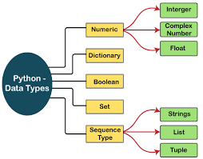

Slide 69
OVERVIEW
Python's Built-in Data Types — The Map
Numeric
Text
Sequence
int, float, complex
str
list, tuple, range
Mapping
Set
Boolean
dict
set, frozenset
bool
Plus a special value: None — represents "no value", its own type NoneType.
Python-I | C2111C1 | Data Types
3
Notes:
Bloom's Level: Remember. Delivery tip: Present this as the roadmap for the rest of the lecture -- point at each box as you promise 'we'll cover this one next.'

Slide 70
DATA TYPES
Numeric, Sequence & Boolean Types
Numeric — int, float, complex
  int: positive/negative whole numbers, unlimited size
  float: real numbers with a decimal point (or scientific notation using e/E)
  complex: written as (real) + (imaginary)j, e.g. 2 + 3j
Sequence Type — ordered collections: String, List, Tuple
Boolean — bool, with values True or False (capitalized) only
Use type() to confirm the data type of any object
Programming in Python-I | Unit 2: Introduction to Python
45
Notes:
[Apply] Show type(2+3j) and type(True) live to confirm the class names.

Slide 71
NUMERIC TYPES
int, float, complex
int — whole numbers, positive or negative, no size limit (e.g. roll_no).
float — real numbers with a decimal point (e.g. cgpa, fees with paise).
complex — numbers with a real and imaginary part: a + bj (rare in intro courses).
>>> roll_no = 45
>>> type(roll_no)
<class 'int'>
>>> cgpa = 8.75
>>> type(cgpa)
<class 'float'>
>>> fees = 125000.50
>>> hostel_fee = 45000
>>> total = fees + hostel_fee
>>> total
170000.5
>>> type(total)
<class 'float'>
>>> signal = 3 + 4j
>>> type(signal)
<class 'complex'>
>>> signal.real
3.0
>>> signal.imag
4.0
Note: int + float always promotes the result to float (see Example 2).
Python-I | C2111C1 | Data Types
4
Notes:
Bloom's Level: Apply. Delivery tip: Spend most time on int/float since students will use these daily -- mention complex only briefly as 'exists, rarely used in this course.'

Slide 72
DATA TYPES
Mutable vs Immutable Objects
Mutable
Immutable
Can be changed in place after creation — same object, same memory id
Examples: list, dict, set, byte array
e.g. lst.append(1) modifies the same list object
Cannot be changed after creation — any "change" creates a new object
Examples: int, float, complex, string, tuple, frozenset, bytes
e.g. s = s + "x" creates a brand-new string
Programming in Python-I | Unit 2: Introduction to Python
46
Notes:
[Analyze] Use id(obj) before and after a modification to prove whether the object changed in place or was replaced.

Slide 73
A mutable object allows you to change, add, or remove its contents without changing its unique memory identity (id()).
Example using a List
# Create a mutable list
my_list = [1, 2, 3]
print("Original ID:", id(my_list)) # Example: 140228392
# Modify an element in-place
my_list[0] = 99
my_list.append(4)
print("Modified List:", my_list) # Output: [99, 2, 3, 4]
print("Same ID? :", id(my_list)) # Example: 140228392 (The ID did not change)

Slide 74
An immutable object cannot be modified once it is created. If you try to perform an operation that alters its value, Python will automatically spawn a new object at a completely different memory address.
Example using a String
# Create an immutable string
my_string = "Hello"
print("Original ID:", id(my_string)) # Example: 140559200
# Attempting direct modification will crash your code:
# my_string[0] = 'Y' -> Throws a TypeError!
# Modifying via concatenation creates a new object
my_string = my_string + " World"
print("New String:", my_string) # Output: Hello World
print("New ID:", id(my_string)) # Example: 140559850 (The ID changed!)

Slide 75
DATA TYPES
Mutability at a Glance
Data type | Mutable? | Example change | Effect
int, float | Immutable | a = a + 1 | New object created
str | Immutable | s = s + "x" | New string created
tuple | Immutable | Not allowed | Error if attempted
frozenset | Immutable | Not allowed | Error if attempted
list | Mutable | lst.append(1) | Same object modified
dictionary | Mutable | d["x"] = 2 | Same object modified
set | Mutable | s.add(3) | Same object modified
Programming in Python-I | Unit 2: Introduction to Python
47
Notes:
[Evaluate] Ask students why function default arguments using mutable objects (e.g. a list) can be a subtle bug — a classic Python gotcha.

Slide 76
SECTION 7
Python Strings
Creating, indexing, slicing, formatting, and manipulating text
Programming in Python-I | Unit 2: Introduction to Python
48

Slide 77
STRINGS
What is a String?
A string is a sequence of characters — e.g. English has 26 letters, but computers store everything as binary
In Python, a string is an immutable sequence of Unicode code points
Strings cannot be changed in place — any "change" returns a brand-new string
Because Python str is Unicode, it can represent Hindi, emojis, accented characters, and more
Programming in Python-I | Unit 2: Introduction to Python
49
Notes:
[Understand] Connect this to earlier immutability discussion — strings are the running example.

Slide 78
CONCEPT
What is a String?
A string is a sequence of characters — letters, digits, symbols, or spaces — enclosed in quotes.
quote_styles.py
# Three ways to write a string
name = 'Vadodara'
city = "Ahmedabad"
quote = '''Truth alone
triumphs, not falsehood'''
print(type(name))
# Output: <class 'str'>
•
Immutable
Once created, a string's characters cannot be changed in place.
•
Ordered
Every character has a fixed position (index), starting from 0.
•
A built-in type
Python's data type for text is called str.
Python Programming-I • Strings
2
Notes:
[Remember] Define strings as sequences of characters. Emphasize the three quoting styles: single, double, and triple quotes, and that triple quotes allow multi-line text. Mention str as the type name.

Slide 79
SYNTAX & EXAMPLES
Creating Strings
Assign text to a variable using = and any matching pair of quotes.
single_quote = 'Gujarat'
double_quote = "Baroda University"
empty_string = ''
# Multi-line string with triple quotes
address = '''ITM (SLS) Baroda University
Vadodara, Gujarat'''
print(single_quote)
print(address)
# Output:
# Gujarat
# ITM (SLS) Baroda University
# Vadodara, Gujarat
Which quote should I use?
▸ Use double quotes
When the text itself contains an apostrophe: "It's a demo"
▸ Use single quotes
Default choice for short, simple text.
▸ Use triple quotes
For text spanning multiple lines, or docstrings.
Python Programming-I • Strings
3
Notes:
[Apply] Have students type these into IDLE/Colab themselves. Discuss why triple quotes are useful for addresses, multi-line messages, and docstrings.

Slide 80
CONCEPT + DIAGRAM
String Indexing
Every character in a string has a position number called an index. Python supports both positive (left→right) and negative (right→left) indices.
0
1
2
3
4
5
6
7
Positive index →
V
A
D
O
D
A
R
A
-8
-7
-6
-5
-4
-3
-2
-1
← Negative index
indexing.py
city = "VADODARA"
print(city[0]) # V (first character)
print(city[3]) # O
print(city[-1]) # A (last character)
Python Programming-I • Strings
4
Notes:
[Understand] Walk through the diagram: index 0 is the first character, -1 is always the last. Ask students to predict city[-8] and city[8] (IndexError) before revealing.

Slide 81
STRINGS
Accessing Characters — Example
s = 'python_program'
print('s =', s) # s = python_program
print('s[0] =', s[0]) # first character -> p
print('s[-1] =', s[-1]) # last character -> m
print(‘s[2] =‘, s[2]) #
print(‘s[-3] =', s[-3]) #
Programming in Python-I | Unit 2: Introduction to Python
52
Notes:
[Remember] Reinforce zero-based indexing before moving to slicing.

Slide 82
STRINGS
Slicing Strings
Slicing extracts a substring using the [start:stop:step] operator
start — index where slicing begins (inclusive); default is 0
stop — index where slicing ends (exclusive); default is the string's length
step — how many characters to jump each time (stride); default is 1
Programming in Python-I | Unit 2: Introduction to Python
53
Notes:
[Understand] Emphasize "stop is exclusive" — the most common slicing mistake.

Slide 83
EXTRACTING SUBSTRINGS
String Slicing
Syntax: string[start : stop : step] → stop is excluded
slicing.py
Reading a slice
place = "ITM BARODA"
place[0:3] # 'ITM'
place[4:] # 'BARODA'
place[:3] # 'ITM'
place[::-1] # reversed string
place[::2] # every 2nd char
S
start
Index to begin from (included). Default: 0
S
stop
Index to stop before (excluded). Default: end of string
S
step
How many characters to skip. Default: 1; use -1 to reverse
Python Programming-I • Strings
5
Notes:
[Apply] Have students slice their own name string to extract initials, reverse it, and take every alternate letter. Reinforce that stop is exclusive — a very common source of off-by-one errors.

Slide 84
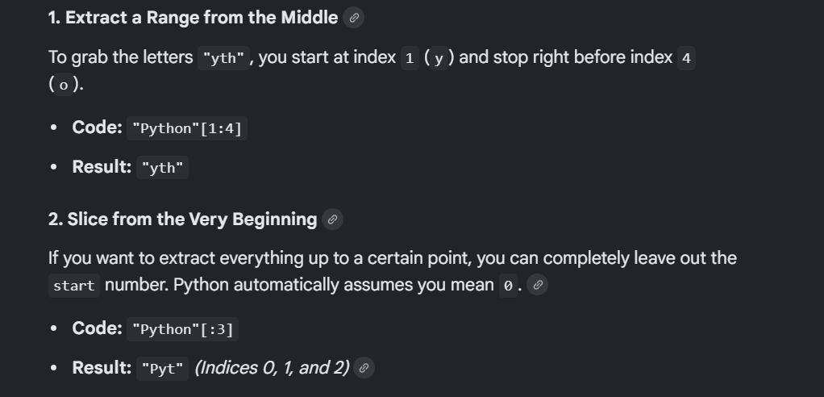

Slide 85
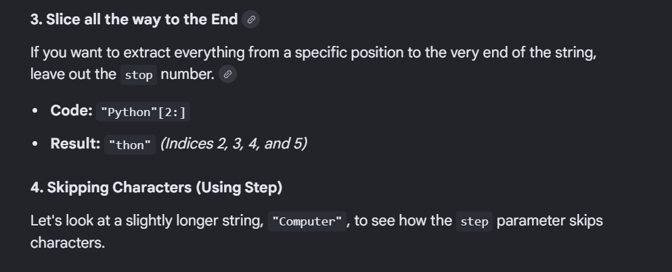

Slide 86

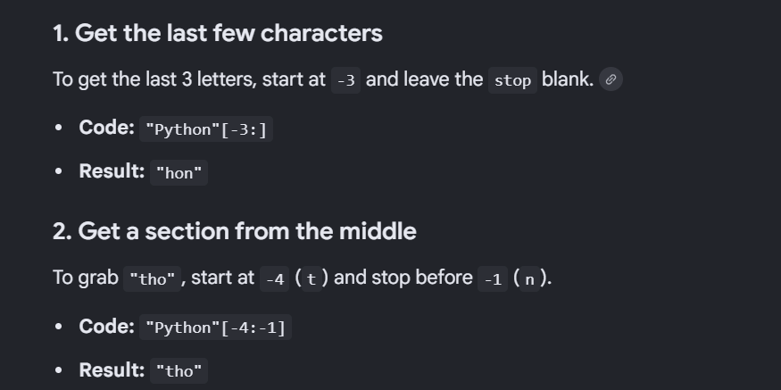

Slide 87
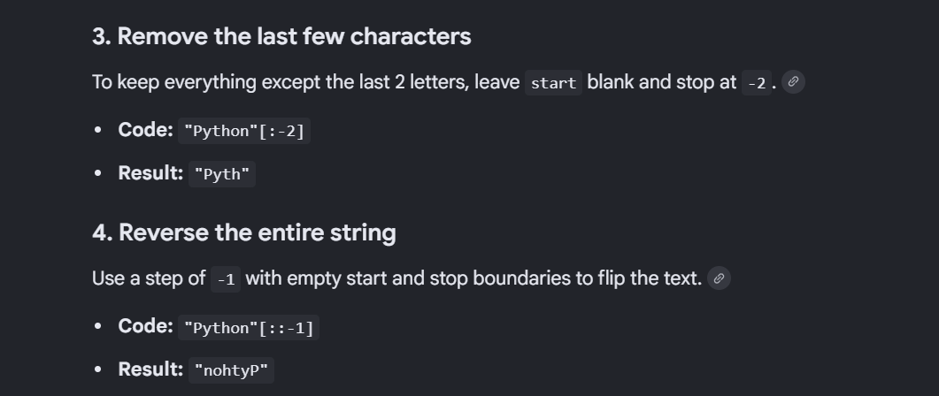

Slide 88
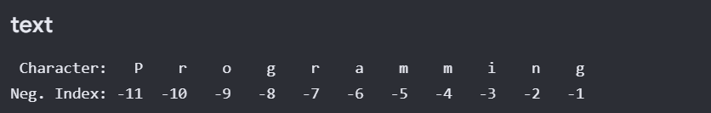
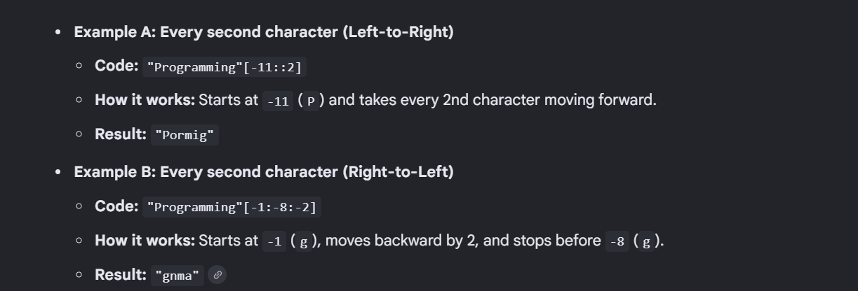

Slide 89
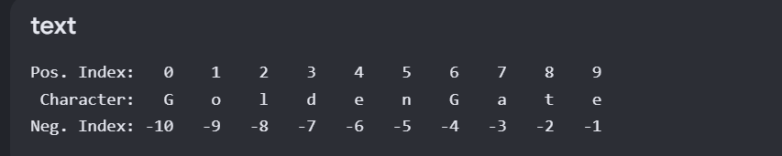
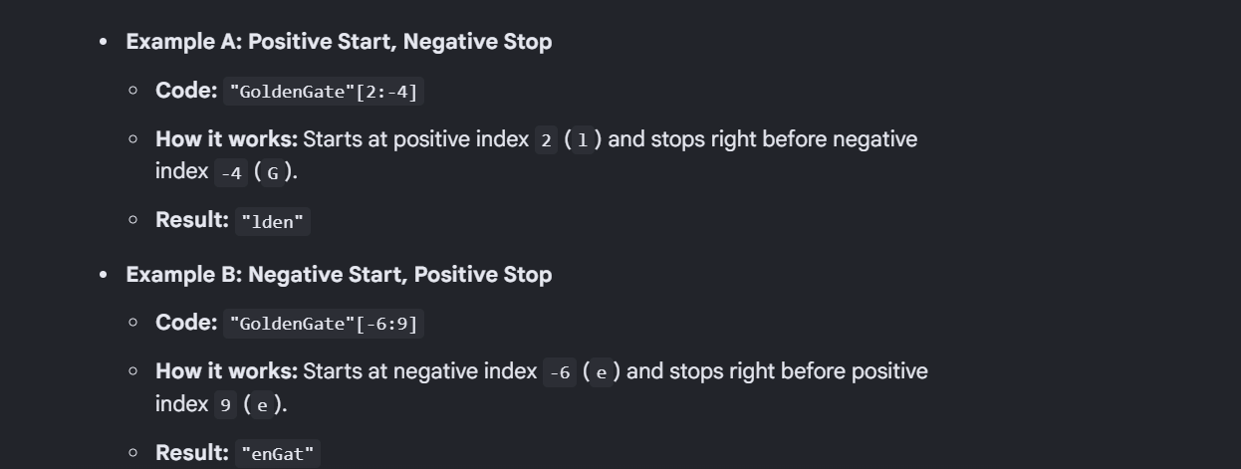

Slide 90
STRINGS
Slicing — Worked Examples
b = "Hello, World!"
print(b[1:5]) #
print(b[:5]) #
print(b[2:]) #
number_string = "1020304050"
print(number_string[0:-1:2]) #
print(number_string[::-1]) #
Programming in Python-I | Unit 2: Introduction to Python
54
Notes:
[Apply] Ask students to slice their own name string to get just the first three letters.

Slide 91
IMPORTANT RULE
Strings Are Immutable
Once a string is created, its characters cannot be changed in place. Any "modification" actually creates a brand-new string.
this_works.py
city = "Baroda"
city[0] = 'V'
# Traceback (most recent call last):
# TypeError: 'str' object does not
# support item assignment
city = "Baroda"
city = 'V' + city[1:]
print(city)
# Output: Vadora
✗ Trying to change a character directly
✓ Reassigning the variable to a new string
Python Programming-I • Strings
6
Notes:
[Understand] This is a common beginner pitfall. Emphasize: immutability means the object doesn't change, but the variable name can be reassigned to a new string. This sets up why string methods always return new strings.

Slide 92
STRINGS
Strings Are Immutable
Elements of a string cannot be changed once assigned — but the whole string can be reassigned, or deleted with del:
my_string = 'pythonprogram'
my_string[5] = 'a'
# TypeError: 'str' object does not support item assignment
my_string = 'Python' # reassignment is fine
print(my_string) # Python
del my_string
print(my_string)
# NameError: name 'my_string' is not defined
Programming in Python-I | Unit 2: Introduction to Python
55
Notes:
[Evaluate] Ask why reassignment works but index-assignment doesn't — ties back to "new object on change".

Slide 93
+ AND * OPERATORS
Concatenation & Repetition
+
Concatenation
×
Repetition
Joins two or more strings end-to-end using +
Repeats a string a fixed number of times using *
first = "IRCTC"
second = "Ticket"
combo = first + " " + second
print(combo)
# Output: IRCTC Ticket
border = "-" * 20
print(border)
print("Ram" * 3)
# Output:
# --------------------
# RamRamRam
Python Programming-I • Strings
7
Notes:
[Apply] Note that + only works between two strings (not string + int — leads to TypeError, a good segue to type conversion). Try building a decorative separator line for console output using * .

Slide 94
STRINGS
Concatenation, Repetition & Length
Joining strings with + is concatenation; * repeats a string; len() returns its length:
str1, str2 = 'Hello', 'World!'
print(str1 + str2) # HelloWorld!
print(str1 + " " + str2)# Hello World!
print(str1 * 3) # HelloHelloHello
a = "Hello, World!"
print(len(a)) # 13
Programming in Python-I | Unit 2: Introduction to Python
58
Notes:
[Apply] Ask students to build "Name: <name>, Age: <age>" using only + concatenation, to motivate formatting next.

Slide 95
STRING METHODS, PART 1
Built-in Methods — Case & Search
Case Conversion
Search & Check
upper()
find()
'delhi'.upper()
'Vadodara'.find('do')
→ 'DELHI'
→ 3
lower()
count()
'DELHI'.lower()
'banana'.count('a')
→ 'delhi'
→ 3
startswith()
title()
'new delhi'.title()
'UPI123'.startswith('UPI')
→ 'New Delhi'
→ True
capitalize()
in
'gujarat'.capitalize()
'IIT' in 'IIT Bombay'
→ 'Gujarat'
→ True
Python Programming-I • Strings
8
Notes:
[Remember] Go through each method with a live example on IRCTC/UPI-style strings. Emphasize that these methods return new strings/booleans — they never modify the original (immutability).

Slide 96
STRINGS
Common String Methods — Case & Search
Method | Description
upper() / lower() | Converts to upper case / lower case
capitalize() / title() | Capitalizes the first letter / each word
swapcase() / casefold() | Swaps case / aggressive lower-casing for comparisons
strip() / lstrip() / rstrip() | Removes leading/trailing whitespace
find() / rfind() / index() | Locates the position of a substring
count() | Counts occurrences of a substring
isalpha() / isdigit() / isalnum() | Checks character composition
Programming in Python-I | Unit 2: Introduction to Python
56
Notes:
[Remember] Group these as "case" and "search" families to aid memory.

Slide 97
STRINGS
Common String Methods — Modify, Split & Join
Method | Description
replace(old, new) | Replaces occurrences of a substring
split(sep) | Splits a string into a list at each separator
splitlines() | Splits a string at line breaks
join(iterable) | Joins list elements into one string, using this string as separator
startswith() / endswith() | Checks how the string begins or ends
zfill() / ljust() / rjust() / center() | Pads a string to a given width
format() / f-strings | Insert values into a string template
Programming in Python-I | Unit 2: Introduction to Python
57
Notes:
[Apply] Live demo: "-".join(["2026","07","30"]) to show join() building a date string.

Slide 98
We need string formatting in Python because it allows us to insert variables, evaluate expressions, and organize text data dynamically without messing up code structure.

Slide 99
BUILDING READABLE OUTPUT
String Formatting with f-strings
Prefix a string with f and place variables inside { } to build formatted text easily.
receipt.py
name = "Priya Sharma"
amount = 450
upi_id = "priya@okhdfc"
receipt = f"Paid Rs.{amount} to {name} ({upi_id})"
print(receipt)
# Output:
# Paid Rs.450 to Priya Sharma (priya@okhdfc)
# Numbers can be formatted too
pi = 3.14159
print(f"Value of pi = {pi:.2f}") # Value of pi = 3.14
Python Programming-I • Strings
10
Notes:
[Apply] Contrast f-strings with old-style + concatenation to show why f-strings are preferred: cleaner, and automatically converts non-string types like int/float without manual str() calls.

Slide 100
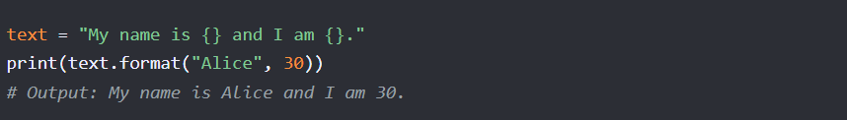
The format() method in Python inserts values into a string using curly bracket {} placeholders. It returns a brand-new formatted string without changing the original text
Basic Placeholders (Ordered)
Values insert automatically into the {} placeholders based on the exact order they are passed

Slide 101
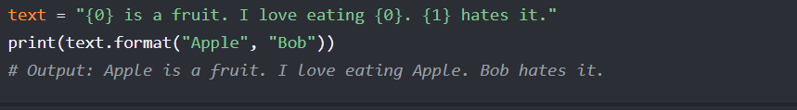
Positional Indexing
You can use numbers inside the braces to choose exactly which value goes where. This allows you to repeat or reorder values easily

Slide 102
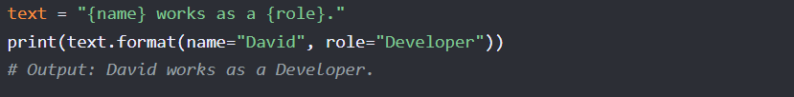
Named Keyword Arguments
You can assign specific labels to your placeholders. This makes longer sentences much easier to read and maintain.

Slide 103
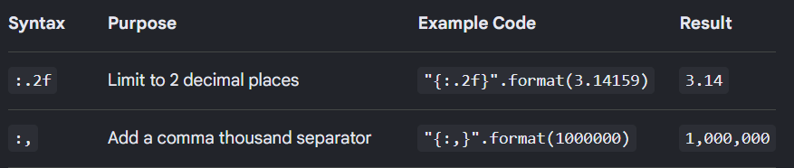
By adding a colon : inside the placeholder, you can control padding, decimal precision, and binary/hexadecimal conversions.

Slide 104
STRINGS
String Formatting: format() and f-strings
age = 27
txt = "My name is Tanvi, and I am {}"
print(txt.format(age))
quantity, itemno, price = 3, 567, 49.95
order = "I want {0} of item {1} for {2:.2f} rupees."
print(order.format(quantity, itemno, price))
# f-string (Python 3.6+) — cleanest modern style
print(f"My name is Tanvi, and I am {age}")
Programming in Python-I | Unit 2: Introduction to Python
59
Notes:
[Evaluate] Ask which of the three styles (concatenation, format(), f-string) is most readable, and why f-strings are now preferred in modern Python code.

