Slide 1
Datatypes in Python
Unit 3
C2111C1 | Programming in Python-I
Notes:
Learning outcomes: Understand what a list is, create lists, access elements using indexing and slicing, modify list contents, use built-in list methods. [REMEMBER]

Slide 2
Lists in Python
C2111C1 | Programming in Python-I
Notes:
Learning outcomes: Understand what a list is, create lists, access elements using indexing and slicing, modify list contents, use built-in list methods. [REMEMBER]

Slide 3
What is a List?
An ordered, mutable collection of items in a single variable
Can store multiple data types (integers, strings, floats, objects) so it is heterogenous data type
It is a sequenced data type, Items are indexed starting from 0
Lists allow duplicates
my_list = [1, 'apple', 3.14, True]
# Indices: 0 1 2 3
✓ Mutable = changeable after creation | ✓ Ordered = position matters
Notes:
Mutable means we can change it after creation. Ordered means position matters. Use an analogy: Like a shopping cart—you can add items, remove items, rearrange them. [UNDERSTAND]

Slide 4
Why Use Lists? Real-World Context
Store related data together
Process multiple items in a loop
Flexible: Add/remove items anytime
Common pattern in programming
🇮🇳 UPI: [₹500, ₹1200, ₹250] → Payment transaction history
🇮🇳 IRCTC: ["A1", "A2", "B1"] → Booked train seats
🇮🇳 Zomato: ["5-star", "4-star", "3-star"] → Customer ratings
Notes:
Discuss each real-world use case. Ask: Have you seen this data structure before? [UNDERSTAND]

Slide 5
Creating a List
Method 1: Square Brackets
colors = ['red', 'green', 'blue']
['red', 'green', 'blue']
Method 2: Using list() Constructor
mixed = [10, 'hello', 3.14, True]
numbers = list(range(5))
[10, 'hello', 3.14, True]
[0, 1, 2, 3, 4]
Empty list: empty = []
Empty list (constructor): empty = list()
Notes:
Demonstrate each method. Ask: Can you create a list of your courses? [APPLY]

Slide 6
Accessing Elements: Indexing
Use square brackets with index number (starts at 0)
my_list = ["a", "b", "c", "d"]
Index: 0 1 2 3
Examples:
my_list[0] → 'a' | my_list[2] → 'c'
my_list[4] → IndexError: list index out of range
⚠️ Common Mistake: Indexing starts at 0, not 1! Accessing index 4 in 4-item list causes error.
Notes:
Emphasize: Indexing starts at 0, not 1. This is a common mistake. Show error when accessing index 4 in a 4-item list. [APPLY]

Slide 7
Negative Indexing: Access from the End
Use negative numbers to count backward from the end
["apple", "banana", "orange", "grape"]
Index (forward): 0 1 2 3
Index (backward): -4 -3 -2 -1
Examples:
my_list[-1] → 'grape' (last item)
my_list[-3] → 'banana' (3rd from end)
💡 Useful: Get last element without knowing list length with my_list[-1]
Notes:
Show the symmetry: index 0 = -4, index 1 = -3, etc. This is useful when you want the last element without knowing the list length. [APPLY]

Slide 8
Slicing: Extract Part of a List
Syntax: list[start:stop:step]
start = Include this index (default: 0) | stop = Exclude this index (default: end) | step = Jump by this
Examples:
my_list = ['a', 'b', 'c', 'd', 'e']
my_list[1:4] → ['b', 'c', 'd'] # indices 1, 2, 3
my_list[::2] → ['a', 'c', 'e'] # every 2nd element
my_list[-3:-1] → ['c', 'd'] # last 3, exclude last 1
Notes:
Key insight: stop is exclusive. Demonstrate with visual highlighting on the diagram. [APPLY]

Slide 9
Slicing Examples & Reverse
my_list = ["a", "b", "c", "d", "e"]
my_list[:3] → ["a", "b", "c"]
my_list[2:] → ["c", "d", "e"]
First 3 elements
From index 2 to end
my_list[:] → ["a", "b", "c", "d", "e"]
my_list[::-1] → ["e", "d", "c", "b", "a"]
Entire list (copy)
Reverse!
🇮🇳 Flipkart: Extract first 5 customers from order list: orders[:5]
💡 Reverse a string: "hello"[::-1] → "olleh"
Notes:
Why is step=-1 useful? Demonstrate reversing a string. [ANALYZE]

Slide 10
What are Nested Lists?
A list that contains one or more lists as elements
Also called multi-dimensional lists or lists of lists
Elements can be lists, strings, numbers, or other data types
Useful for representing tables, matrices, and hierarchical data
Example:
matrix = [[1, 2, 3], [4, 5, 6], [7, 8, 9]]
student_data = [["Alice", 85], ["Bob", 92], ["Charlie", 78]]

Slide 11

Nested List in python
nested list in Python is simply a list that contains other lists as its individual elements. This data structure is commonly used to store multi-dimensional data, such as matrices, grids, or grouped records.
Example 1: Nested List Access
fruits[5] = 'grape'
IndexError: list assignment index out of range
nested = [['a', 'b'], ['c', 'd’]]
Print(nested[0][1])
print(nested)
Notes:
Show the error case. Ask: Why cannot you assign to an index that does not exist? [APPLY]

Slide 12
Accessing Elements in Nested Lists
Using Index Numbers
matrix = [[1, 2, 3], [4, 5, 6], [7, 8, 9]]
matrix[0] # Returns [1, 2, 3]
matrix[1][2] # Returns 6
matrix[-1] # Returns [7, 8, 9] (last row)
matrix[2][-1] # Returns 9 (last element of last row)
Visual Representation:
Matrix: Indices: How to Access:
[1, 2, 3] [0] matrix[0][0] = 1
[4, 5, 6] → [1] → matrix[1][2] = 6
[7, 8, 9] [2] matrix[2][1] = 8
Index format: matrix[row][column]

Slide 13
Lists are Mutable: Change Contents
You can modify, add, or remove elements after creating a list
This is different from tuples (immutable) and strings (immutable)
Lists: You CAN change
colors = ['red', 'green']
colors[0] = 'yellow'
print(colors) # ✓ Works!
colors = ('red', 'green')
colors[0] = 'yellow'
TypeError! ✗
Mutability = Can change after creation | This is what makes lists powerful!
Notes:
Mutability is a key difference between lists, tuples, and strings. Lists give you flexibility. [UNDERSTAND]

Slide 14
Modify Single Elements
Example 1: Change One Item
fruits = ['apple', 'banana', 'orange']
fruits[1] = 'mango'
print(fruits) # ['apple', 'mango', 'orange']
Example 2: Nested List Access
fruits[5] = 'grape'
IndexError: list assignment index out of range
nested = [['a', 'b'], ['c', 'd']]
nested[0][1] = 'x'
print(nested) # [['a', 'x'], ['c', 'd']]
🇮🇳 IRCTC: Update seat booking: seats[0] = "B2" (new seat number)
Notes:
Show the error case. Ask: Why cannot you assign to an index that does not exist? [APPLY]

Slide 15
Modify Multiple Elements: Slicing
Replace a slice:
colors = ['red', 'green', 'blue', 'yellow']
colors[1:3] = ['purple', 'orange']
print(colors) # ['red', 'purple', 'orange', 'yellow']
colors[2:2] = ['pink']
print(colors) # ['red', 'green', 'pink', 'blue', 'yellow']
⚠️ The slice size on left and right don't need to match!
Notes:
This is powerful but confusing. Emphasize: The slice size on left and right do not need to match. [APPLY]

Slide 16
Add Single Item: append()
Syntax: list.append(element)
Adds one item to the END of the list (in-place)
Before:
numbers = [10, 20, 30]
Numbers = [10,20,30]
numbers.append(40)
print(numbers) # [10, 20, 30, 40]
⚠️ append() returns None; it modifies in-place. Wrong: x = list.append(5) → x is None
🇮🇳 UPI: Build transaction history: transactions.append(₹500)
Notes:
Show the common mistake of assigning append() result to a variable. [APPLY]

Slide 17
Add Single Item at particular place: insert()
Syntax: list.insert(index, element)
Adds an element at a specific index (position) in the list.
Numbers = [10,20,30]
numbers.insert(0,40)
print(numbers) # [40, 10, 20, 30]
numbers = [10, 20, 30]
fruits = ["apple", "banana"] print("Original list:", fruits)
fruits.insert(1, "blueberry") print("After insert():", fruits)
Notes:
Show the common mistake of assigning append() result to a variable. [APPLY]

Slide 18
Add Multiple Items : extend()
Syntax: list.extend(iterable)
Adds multiple elements to the end of the list.
# Create the initial list
fruits = ["apple", "banana"]
# Create another list to add
more_fruits = ["cherry", "orange"]
# Extend the first list
fruits.extend(more_fruits)
# View the final result
print(fruits)
# Output: ['apple', 'banana', 'cherry', 'orange']
Notes:
Show the common mistake of assigning append() result to a variable. [APPLY]

Slide 19
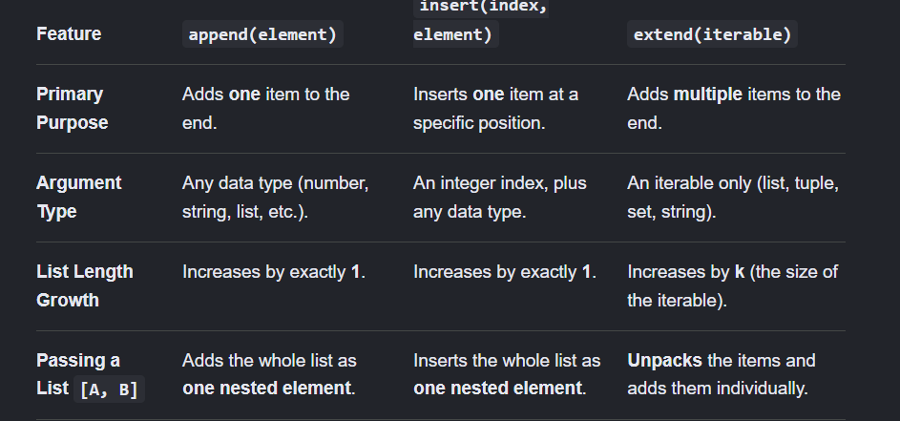

Slide 20
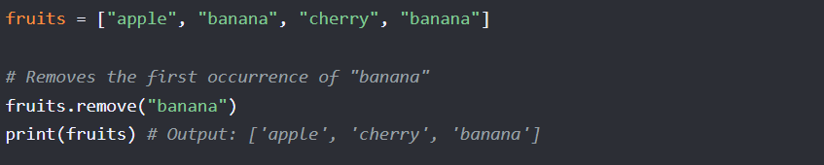
Delete by Value: remove()
Syntax: list.remove(element)
Removes FIRST occurrence of element; raises ValueError if not found
Use .remove() when you know the value of the item you want to delete, but you do not know its index position
🇮🇳 Flipkart: Remove item from cart: cart.remove("phone case")
Notes:
Contrast with pop(). Ask: What if I do not know if the item is in the list? [APPLY]

Slide 21
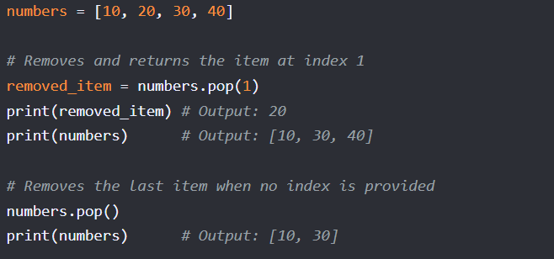
Delete by Index: pop()
Syntax: list.pop(index) — index is optional (default: -1, last item)
Removes AND RETURNS the element at given index
Use .pop() when you want to delete an element at a specific index and you need to know what that element was.
Notes:
Key difference from remove(): pop() returns the value AND requires index. Perfect for stack/queue patterns. [APPLY]

Slide 22
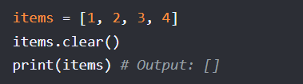
Delete All : clear()
Syntax: list.clear()
It removes all elements simultaneously, leaving behind an empty list structure []
Use .clear() when you want to wipe out everything inside the list.
Notes:
[UNDERSTAND]

Slide 23
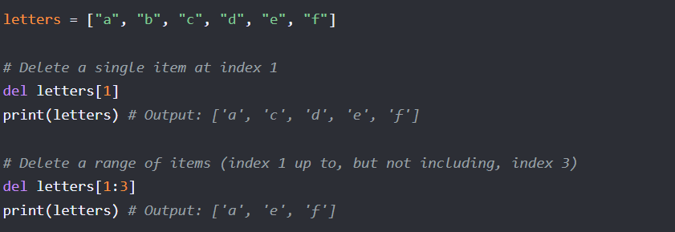
Delete list: del
Syntax: del listname
The del keyword is a built-in Python statement used to delete items by index or index ranges (slices).
Can remove a single item, an entire slice range, or delete the list variable completely from memory.
Notes:
[UNDERSTAND]

Slide 24
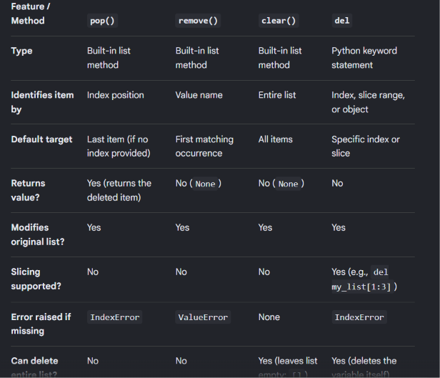

Slide 25
Copy a List
Assignment does not copy the list. It simply creates a new reference (or alias) pointing to the exact same list in computer memory
original = [10, 20, 30]
# Assignment
assigned_list = original
# Modify the assigned list
assigned_list.append(40)
print("Original:", original) # Output: [10, 20, 30, 40]
print("Assigned:", assigned_list) # Output: [10, 20, 30, 40]
Notes:
This is a critical concept. Demonstrate the reference trap. Mention deep copy for nested lists. [ANALYZE]

Slide 26
Copy a List
The .copy() method creates a shallow copy. It allocates a brand-new, independent list container in memory and populates it with the elements of the original list.
original = [10, 20, 30]
# Using the copy function
copied_list = original.copy()
# Modify the copied list
copied_list.append(40)
print("Original:", original) # Output: [10, 20, 30] (Unchanged!)
print("Copied:", copied_list) # Output: [10, 20, 30, 40]
Notes:
This is a critical concept. Demonstrate the reference trap. Mention deep copy for nested lists. [ANALYZE]

Slide 27
Built-in Functions on Lists
Function
Syntax
Example
Result
len()
len(list)
len([1,2,3])
3
max()
max(list)
max([10,5,20])
20
min()
min(list)
min([10,5,20])
5
sum()
sum(list)
sum([1,2,3])
6
ratings = [4.5, 3.8, 4.9]
average = sum(ratings) / len(ratings) # 4.4
🇮🇳 Zomato: Calculate total order value: total = sum(item_prices)
Notes:
Discuss use cases. Ask: How would you find the range of values (max - min)? [APPLY]

Slide 28
Find Items: count() and index()
count() - How many?
index() - Where?
Syntax: list.count(element)
Syntax: list.index(element)
numbers = [1, 2, 2, 3, 2]
print(numbers.count(2)) # 3
colors = ['red', 'green', 'blue', 'green']
print(colors.index('green')) # 1
If not found - count() returns 0, index() raises error
colors.count('yellow') # 0 (safe)
colors.index('yellow') # ValueError! (check first)
🇮🇳 IRCTC: Find first available seat: first_free = seats.index("available")
Notes:
Both are useful for searching. Show the difference: one counts, one locates. [APPLY]

Slide 29
Order Lists: sort() and reverse()
sort() - Arrange in order
Reverse sort:
Syntax: list.sort(reverse=False)
numbers.sort(reverse=True)
print(numbers) # [5, 4, 3, 1, 1]
numbers = [3, 1, 4, 1, 5]
numbers.sort()
print(numbers) # [1, 1, 3, 4, 5]
reverse() - Flip order
Don't modify original:
Syntax: list.reverse()
sorted(numbers) # Returns new sorted list
reversed(numbers) # Returns iterator
items = [1, 2, 3]
items.reverse()
print(items) # [3, 2, 1]
🇮🇳 Flipkart: Sort prices ascending: prices.sort()
Notes:
Emphasize: sort() modifies in-place, sorted() returns a new list. [APPLY]

Slide 30
Check Membership: in and not in
Syntax: element in list → Returns True/False
colors = ['red', 'green', 'blue']
print('red' in colors) # True
print('yellow' in colors) # False
print('yellow' not in colors) # True
🇮🇳 IRCTC: Check if seat is booked: if seat in booked_seats:
Notes:
Membership testing is common. Discuss performance: O(n) for lists vs O(1) for sets. [APPLY]

Slide 31
Combine & Repeat Lists
Concatenate (+) - Join lists
Repeat (*) - Duplicate items
Syntax: list1 + list2
Syntax: list * n
[1, 2] + [3, 4] → [1, 2, 3, 4]
(Creates new list)
['a', 'b'] * 3 → ['a', 'b', 'a', 'b', 'a', 'b']
(Creates new list)
Compare operations:
cart1 = ['phone', 'case']
cart2 = ['charger', 'screen']
all_items = cart1 + cart2 # ['phone', 'case', 'charger', 'screen']
🇮🇳 Generate weekly schedule: daily_tasks * 4 (repeat 4 weeks)
💡 + creates new list | extend() modifies in-place | * repeats pattern
Notes:
Show the difference between + (creates new) and extend() (modifies). [APPLY]

Slide 32
Practice: Real-World Scenario
🇮🇳 Zomato Restaurant App
restaurants = ['Biryani House', 'Pizza Palace', 'Dosa Delight']
Tasks:
1. Add "Samosa Shop"
2. Sort alphabetically
3. Find "Pizza Palace" index
4. Check if "Samosa Shop" exists
restaurants.append('Samosa Shop')
restaurants.sort()
idx = restaurants.index('Pizza Palace')
Exists = 'Samosa Shop' in restaurants
print(restaurants, idx, Exists)
['Biryani House', 'Dosa Delight', 'Pizza Palace', 'Samosa Shop'] 2 True
Notes:
[APPLY]

Slide 33
Practice: Nested Lists (2D)
Student Grade Management:
grades = [[85, 90, 88], [92, 88, 91], [78, 85, 82]]
# Student 1, 2, 3 with 3 subject grades
Tasks:
1. Access 2nd student,1st subject
2. Update grade: 78 → 88
3. Find 1st student average
grades[1][0] → 92
grades[2][0] = 88
avg = sum(grades[0]) / len(grades[0]) → 87.67
Updated: [[85,90,88], [92,88,91], [88,85,82]]
Notes:
[APPLY]

Slide 34
Tuples in Python
Immutable Sequences & Real-World Applications

Slide 35
3
What Are Tuples?
KEY CHARACTERISTICS
# Creating tuples
student_data = ("Aarav", 19, "B.Tech", 9.2)
coordinates = (10, 20)
single_tuple = (42,) # Note the comma!
empty_tuple = ()
Ordered collection of immutable elements
Enclosed in parentheses ( )
Support indexing, slicing, and iteration
Cannot be modified after creation
TUPLE VS LIST
Feature | Tuple | List
Mutable | ✗ | ✓
Indexed | ✓ | ✓
Syntax | ( ) | [ ]
Key Takeaway
Tuples can hold any data type; single-element tuples need a trailing comma. Without a trailing comma, Python cannot tell if you want to group a value or create a tuple
3
Notes:
Emphasize immutability as the defining feature. Clarify that reassigning the variable is fine — you just can't change the elements inside. Analogy: like a printed book, you can buy a new one, but can't erase words in the current copy.

Slide 36
4
Tuple Creation Methods
1. Using Parentheses
2. Without Parentheses (implicit)
cities = ("Mumbai", "Delhi", "Bangalore")
grades = 'A', 'B', 'A+', 'B+'
3. Using tuple() Constructor
4. Mixed Data Types
numbers = tuple([1, 2, 3, 4, 5])
converted = tuple("hello")
mixed = (1, "name", 3.14, True, None)
Key Takeaway: Tuples can hold any data type; single-element tuples need a trailing comma.
4

Slide 37
5
Indexing & Slicing
POSITIVE & NEGATIVE INDEXING
metro_stations = ("Dadar", "Bandra", "Andheri", "Borivali", "Thane")
# 0 1 2 3 4
# -5 -4 -3 -2 -1
print(metro_stations[0]) # "Dadar"
print(metro_stations[-1]) # "Thane"
print(metro_stations[-3]) # "Andheri"
SLICING TUPLES — TUPLE[START:STOP:STEP]
print(metro_stations[1:4]) # ("Bandra", "Andheri", "Borivali")
print(metro_stations[::2]) # ("Dadar", "Andheri", "Thane")
print(metro_stations[::-1]) # Reversed order, full tuple
5

Slide 38
6
Tuple Immutability
WHY IMMUTABILITY MATTERS
Tuples cannot be changed after creation
Safer for critical data (e.g., coordinates, dates)
Can be used as dictionary keys
✗ What You CAN'T Do
✓ What You CAN Do
coordinates = (10, 20, 30)
coordinates[0] = 15 # TypeError
coordinates.append(40) # AttributeError
del coordinates[0] # TypeError
old_coords = (10, 20)
new_coords = old_coords + (30,) # (10, 20, 30)
# Reassign the variable
coordinates = (5, 10, 15)
6

Slide 39
7
Tuple Operations
t1 = (1, 2, 3)
t2 = (4, 5)
result = t1 + t2 # Concatenation -> (1, 2, 3, 4, 5)
repeated = (0, 1) * 3 # Repetition -> (0, 1, 0, 1, 0, 1)
print(2 in t1) # Membership -> True
print(10 in t1) # Membership -> False
print(len(t1 + t2)) # Length -> 5
7

Slide 40
8
Tuple Methods & Functions
BUILT-IN METHODS (LIMITED SET)
USEFUL BUILT-IN FUNCTIONS
grades = ('A', 'B', 'A', 'A+', 'B', 'A')
print(grades.count('A')) # count() -> 3
print(grades.index('B')) # index() -> 1
print(grades.index('A+')) # index() -> 3
numbers = (5, 2, 8, 1, 9)
print(max(numbers)) # 9
print(min(numbers)) # 1
print(sum(numbers)) # 25
print(sorted(numbers)) # [1, 2, 5, 8, 9] (list)
Note: Tuples support only count() and index() because they're immutable — no add/remove methods exist.
8

Slide 41
9
Tuple Packing & Unpacking
PACKING
UNPACKING
student_id, name, cgpa = 2401, "Priya", 9.1
student_info = student_id, name, cgpa
emp_id, emp_name, dept = (101, "Rohan", "Engineering")
print(emp_name) # "Rohan"
9
Notes:
Unpacking is one of Python's most elegant features. Show how it simplifies code compared to indexing. The *args example is Bloom's Synthesis level — let students experiment.

Slide 42
10
Tuples as Dictionary Keys
WHY TUPLES AS KEYS?
location_map = {
(19.0760, 72.8777): "Mumbai",
(28.6139, 77.2090): "Delhi",
(13.0827, 80.2707): "Chennai",
}
print(location_map[(19.0760, 72.8777)]) # "Mumbai"
location_map[(23.1815, 79.9864)] = "Indore"
for coords, city in location_map.items():
print(f"{city}: {coords}")
Immutable — required for dict keys
Lists cannot be dictionary keys
Common for coordinates, composite IDs
10

Slide 43
12
Tuple vs List — When to Use?
Use a Tuple When…
Use a List When…
Data should not change (e.g., RGB values)
Needed as dictionary keys
Returning multiple values from a function
Protecting data from accidental edits
Data needs frequent modification
Building a dynamic, growing collection
Order matters but flexibility is needed
REAL-WORLD EXAMPLE
rgb_color = (255, 128, 0) # Tuple: fixed configuration
students = ["Aarav", "Priya", "Rohan"]
students.append("Neha") # List: dynamic, can grow
location = (19.076, 72.877) # Tuple: constant GPS coordinates
12

Slide 44
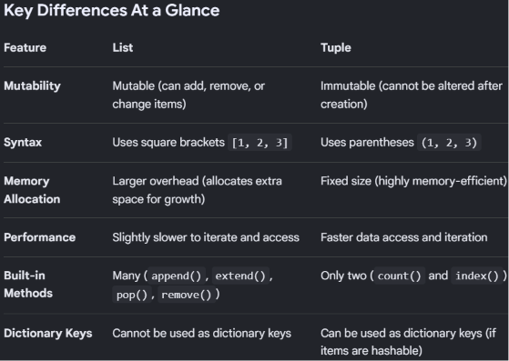

Slide 45
{ }
Sets in Python
Data Structure Fundamentals
Notes:
Welcome slide. Introduce sets as one of Python's four core built-in collection types, distinguished by uniqueness and unordered storage.

Slide 46
∈
What is a Set?
An unordered collection — items have no fixed position or index
Heterogenous datatype
Contains only unique elements; duplicates are dropped automatically
The set itself is mutable, but every element inside it must be immutable
Written with curly braces {} or built using the set() constructor
>>> my_set = {1, 2, 2, 3}
>>> print(my_set)
{1, 2, 3}
Duplicate 2 is stored only once — sets never repeat values.
∅
Sets vs. related types: A list keeps order and duplicates. A tuple is like a list but immutable. A set keeps neither order nor duplicates.
Notes:
Emphasize: uniqueness + no order. Elements must be hashable (immutable) — e.g., you can't put a list inside a set, but a tuple is fine.

Slide 47
{ }
Creating Sets
1
Literal Syntax
2
set() Constructor
3
From an Iterable
my_set = {1, 2, 3}
my_set = set()
my_set = set([1, 2, 3])
Fastest way to write a set with known values.
The only way to create an empty set.
Converts a list, tuple, or string into a set.
!
Common pitfall: {} creates an empty dict, not an empty set. Always use set() for an empty set.
Notes:
Walk through all three creation methods, then flag the classic empty-dict-vs-empty-set trap — a frequent beginner bug.

Slide 48
∪
Set Operations
Union
Intersection
A ∪ B — all elements from both sets
A ∩ B — elements common to both
A
B
A
B
a | b
a & b
Difference
Symmetric Difference
A − B — in A, but not in B
A △ B — in either, but not both
A
B
A
B
a - b
a ^ b
Notes:
The diagrams use a cut-out technique: shaded region shows exactly which part of A and B ends up in the result. Method-call form (.union(), .intersection(), etc.) works identically to the operators shown.

Slide 49
SET OPERATIONS • 1 OF 4
∪
Union
A ∪ B
A
B
All elements present in A, in B, or in both.
1
2
3
4
5
6
OPERATOR
METHOD
a | b
a.union(b)
EXAMPLE
>>> a = {1, 2, 3, 4}
>>> b = {3, 4, 5, 6}
>>> a | b
{1, 2, 3, 4, 5, 6}
a = {1, 2, 3, 4} b = {3, 4, 5, 6}
Notes:
Union combines everything — think of it as merging two guest lists into one, with no repeats.

Slide 50
SET OPERATIONS • 2 OF 4
∩
Intersection
A ∩ B
A
B
Only the elements that appear in both A and B.
1
2
3
4
5
6
OPERATOR
METHOD
a & b
a.intersection(b)
EXAMPLE
>>> a = {1, 2, 3, 4}
>>> b = {3, 4, 5, 6}
>>> a & b
{3, 4}
a = {1, 2, 3, 4} b = {3, 4, 5, 6}
Notes:
Intersection answers 'what do these two groups have in common?' — useful for finding shared interests, mutual contacts, etc.

Slide 51
SET OPERATIONS • 3 OF 4
−
Difference
A − B
A
B
Elements in A that are NOT in B — direction matters.
1
2
3
4
5
6
OPERATOR
METHOD
a - b
a.difference(b)
EXAMPLE
>>> a = {1, 2, 3, 4}
>>> b = {3, 4, 5, 6}
>>> a - b
{1, 2}
a = {1, 2, 3, 4} b = {3, 4, 5, 6}
Order matters: b - a gives {5, 6} instead — the opposite result.
Notes:
Difference is the only one of the four operations where order changes the answer — worth pausing on this.

Slide 52
SET OPERATIONS • 4 OF 4
△
Symmetric Difference
A △ B
A
B
Elements in either A or B, but never in both.
1
2
3
4
5
6
OPERATOR
METHOD
a ^ b
a.symmetric_difference(b)
EXAMPLE
>>> a = {1, 2, 3, 4}
>>> b = {3, 4, 5, 6}
>>> a ^ b
{1, 2, 5, 6}
a = {1, 2, 3, 4} b = {3, 4, 5, 6}
Unlike difference, order doesn't matter: b ^ a gives the same result.
Notes:
Symmetric difference is 'everything except what they share' — the mirror image of intersection.

Slide 53
+
What is add()?
Inserts a single element into an existing set
Changes the set in place — no new set is created
If the element is already present, the set is left unchanged
The element must be immutable (hashable) — e.g. a number, string, or tuple
SYNTAX
set_name.add(element)
EXAMPLE
>>> fruits = {"apple", "banana"}
>>> fruits.add("cherry")
>>> fruits
{'apple', 'banana', 'cherry'}
∅
create a ppt for add() function in set with example
Notes:
Emphasize the in-place nature and the None return value — a very common beginner trap.

Slide 54
★
Key Behaviors
=
✓
∅
Duplicates Are Ignored
Only Hashable Elements
Returns None
Adding an element that already exists changes nothing — no error is raised.
Numbers, strings, and tuples work. Lists, dicts, and sets do not — they're mutable.
add() modifies the set in place and gives back nothing — it is never used for its return value.
>>> s = {1, 2, 3}
>>> s.add(2)
>>> s
{1, 2, 3}
>>> s.add((1, 2))
>>> s
{1, 2, 3, (1, 2)}
>>> result = s.add(9)
>>> print(result)
None
Notes:
Three properties students must internalize: idempotent on duplicates, hashability requirement, and the None return value.

Slide 55
update() Method
Purpose
Adds multiple elements from an iterable (list, tuple, set, etc.) into an existing set, modifying it in-place.
Syntax
set.update(iterable)
Example
fruits = {"apple", "banana"}
fruits.update(["orange", "grape"])
print(fruits)
# Output: {'apple', 'banana', 'orange', 'grape'}
✓ update() returns None — it modifies the original set directly

Slide 56
remove() Method
Purpose
Removes a specified element from a set. Raises a KeyError if the element does not exist.
Syntax
set.remove(element)
Example
numbers = {1, 2, 3, 4, 5}
numbers.remove(3)
print(numbers)
# Output: {1, 2, 4, 5}
numbers.remove(10) # Raises KeyError: 10
⚠ Use remove() only when you're certain the element exists — otherwise it will crash

Slide 57
discard() Method
Purpose
Removes a specified element from a set. Unlike remove(), it does nothing (no error) if the element does not exist.
Syntax
set.discard(element)
Example
colors = {"red", "blue", "green"}
colors.discard("blue")
print(colors)
# Output: {'red', 'green'}
colors.discard("yellow") # No error, no action
✓ Safer than remove() — use it when the element might not exist

Slide 58
pop() Method
Purpose
Removes and returns an arbitrary (random) element from a set. Raises a KeyError if the set is empty.
Syntax
set.pop()
Example
letters = {"a", "b", "c", "d"}
removed = letters.pop()
print(removed) # e.g. 'a' (arbitrary element)
print(letters) # remaining set, e.g. {'b', 'c', 'd'}
⚠ Since sets are unordered, pop() does not guarantee which element is removed

Slide 59
clear() Method
Purpose
Removes all elements from a set, leaving it empty. The set object itself still exists — just with no items.
Syntax
set.clear()
Example
numbers = {1, 2, 3, 4, 5}
numbers.clear()
print(numbers) # Output: set()
print(len(numbers)) # Output: 0
✓ Returns None — modifies the set in-place, does not create a new set

Slide 60
del Statement
Purpose
Deletes an entire set object, freeing it from memory. This is a Python keyword, not a set method — it does not remove individual elements.
Syntax
del set_name
Example
colors = {"red", "blue", "green"}
del colors
print(colors) # Raises NameError:
# name 'colors' is not defined
⚠ Unlike clear(), del removes the variable itself — it can no longer be referenced

Slide 61
Built-in Functions with Sets
Python offers general-purpose built-in functions (not set methods) that work directly on sets:
Function
Description
Example
len(set)
Returns the number of elements
len({1,2,3}) → 3
sum(set)
Returns the sum of elements
sum({1,2,3}) → 6
max(set)
Returns the largest element
max({4,1,9}) → 9
min(set)
Returns the smallest element
min({4,1,9}) → 1
sorted(set)
Returns a sorted list
sorted({3,1,2}) → [1,2,3]
any(set)
True if any element is truthy
any({0,0,1}) → True
all(set)
True if all elements are truthy
all({1,1,0}) → False

Slide 62
Frozenset in Python
Immutable Set Collections

Slide 63
What is a Frozenset?
A frozenset is an immutable, unordered collection of unique elements in Python.
Key Characteristics:
Immutable - Cannot be changed after creation
Unordered - No index-based access
Unique Elements - Duplicates are automatically removed
Hashable - Can be used as dictionary keys
No Duplicates - Stores only unique values

Slide 64
Think of hashable as meaning "permanently unique and unchangeable."
In Python, if an object is hashable, it can be given a permanent ID number that never changes
Imagine a high-security club that uses fingerprints (hash values) to instantly recognize members.
Hashable objects are like stone statues: They never warp, melt, or change shape. The club can scan them, assign them a permanent ID, and find them in the database instantly.
Unhashable objects are like clay sculptures: They are mutable. If you change the shape of the clay, its fingerprint changes. The club refuses to register them because their identity keeps shifting.

Slide 65
Python needs hashable objects to power Dictionaries and Sets.
Because Python can find hashable objects instantly by their ID number, only hashable objects can be used as Dictionary Keys or items in a Set.
Hashable (Unchangeable): Text (str), numbers (int/float), and tuple.
Unhashable (Changeable): Lists (list), dictionaries (dict), and sets (set).

Slide 66
Frozenset vs Set
Feature | Set | Frozenset
Mutable | Yes | No
Hashable | No | Yes
Dict Key | No | Yes
Add/Remove | Yes | No

Slide 67
Creating Frozensets
Empty frozenset:
fs = frozenset()
From list:
fs = frozenset([1, 2, 3, 4])
From string:
fs = frozenset('hello')
From another set:
s = {1, 2, 3}
fs = frozenset(s)
With duplicate removal:
fs = frozenset([1, 2, 2, 3, 3, 3])

Slide 68
Frozenset Operations
Supported Operations:
NOT Supported (Immutable):
len(fs) - Get length
add() - Cannot add elements
fs1 | fs2 - Union
remove() - Cannot remove
fs1 & fs2 - Intersection
pop() - Cannot pop
fs1 - fs2 - Difference
clear() - Cannot clear
fs1 ^ fs2 - Symmetric difference
update() - Cannot update
fs1 <= fs2 - Subset check

Slide 69
Example: Basic Operations
Creating frozensets:
fs1 = frozenset([1, 2, 3])
fs2 = frozenset([2, 3, 4])
Union (|):
result = fs1 | fs2
print(result) # frozenset({1, 2, 3, 4})
Intersection (&):
result = fs1 & fs2
print(result) # frozenset({2, 3})
Difference (-):
result = fs1 - fs2
print(result) # frozenset({1})

Slide 70
{ }
Dictionary in python
Data Structure Fundamentals
Notes:
Welcome slide. Introduce sets as one of Python's four core built-in collection types, distinguished by uniqueness and unordered storage.

Slide 71
CORE CONCEPT
What is a Dictionary?
An unordered, mutable collection that stores data as key : value pairs — like a real dictionary maps a word to its meaning.
dict = { key : value }
"roll_no"
→
101
•
Mutable
Can add, change, or remove entries after creation
"name"
→
"Raj"
•
Keys are unique
Duplicate keys overwrite the earlier value
"cgpa"
→
8.5
•
Fast lookup
Values are retrieved directly by key, not position
Blue = key · Yellow = value
Python Dictionaries
2

Slide 72
Introduction to Dictionaries
What is a Dictionary?
A dictionary is an unordered, mutable collection that stores data as key-value pairs. Each key must be unique and immutable, while values can be of any type.
Key Characteristics
🔑
Key-Value Pairs
🔄
Mutable
Data stored as {key: value}
Can add, update, or remove items
🚫
No Duplicate Keys
⚡
Fast Lookup
Each key must be unique
Access values quickly using keys

Slide 73
Creating & Accessing a Dictionary
Syntax
dict_name = {key1: value1, key2: value2}
Example
student = {
"name": "Riya",
"age": 21,
"course": "Computer Science"
}
print(student["name"]) # Output: Riya
print(student.get("age")) # Output: 21
✓ Access values using square brackets [ ] or the get() method

Slide 74
GETTING STARTED
Creating Dictionaries
Literal syntax
dict() constructor
Empty dictionary
Most common way — curly braces with pairs
Build from keyword arguments
Start empty, fill in later
student = {
"name": "Raj",
"roll": 101
}
student = dict(
name="Raj",
roll=101
)
cart = {}
# or
cart = dict()
Python Dictionaries
3

Slide 75
READING DATA
Accessing Dictionary Elements
Two ways to retrieve a value
dict[key]
.get(key)
Raises KeyError if the key is missing
Returns None (or a default) if missing — safer
print(student["name"])
# Raj
print(student.get("age"))
# None
Handling a missing key
print(student["age"])
# KeyError: 'age'
print(student.get("age", "Not Provided"))
# Not Provided
Python Dictionaries
4

Slide 76
UPDATING DATA
Adding & Modifying Values
Assign to a key using dict[key] = value. A new key adds an entry; an existing key updates it.
BEFORE
student = {
"name": "Raj",
"roll": 101
}
# Add a new key
student["cgpa"] = 8.5
# Modify an existing key
student["name"] = "Rajat"
{"name": "Raj", "roll": 101}
Only 2 keys — no CGPA field yet
AFTER
{"name": "Rajat", "roll": 101,
"cgpa": 8.5}
Name updated + cgpa key added
Python Dictionaries
5

Slide 77
update() Method
Purpose
adds or modifies elements in a dictionary using key-value pairs from another dictionary or an iterables object.
Syntax
dict.update(iterable)
Example
profile = {"name": "Alex"} # Update using keyword arguments profile.update(status="Active", score=95) print(profile)
# Output: {'name': 'Alex', 'status': 'Active', 'score': 95}
✓ update() returns None — it modifies the original set directly

Slide 78
profile = {"name": "Alex"}# Update using a list of key-value tuples
new_data = [("city", "Delhi"), ("verified", True)]
profile.update(new_data)
print(profile)
# Output: {'name': 'Alex', 'city': 'Delhi', 'verified': True}

Slide 79
pop() Method
Removes a key from a dictionary and returns its value. Raises KeyError if the key doesn't exist (unless a default is given).
Syntax: dict.pop(key, default)
student = {"name": "Riya", "age": 21, "grade": "A"}
# Remove and return the value for "age"
age = student.pop("age")
print(age) # 21
print(student) # {'name': 'Riya', 'grade': 'A'}
# Using a default to avoid KeyError
city = student.pop("city", "Not Found")
print(city) # Not Found
✓ Without a default, a missing key raises KeyError. ✓ With a default, it returns that value instead of raising an error.

Slide 80
Dictionary popitem() Method
Removes and returns the last inserted key-value pair as a tuple. Raises KeyError if the dictionary is empty.
Syntax: dict.popitem()
student = {"name": "Riya", "age": 21, "grade": "A"}
# Removes and returns the LAST inserted pair
item = student.popitem()
print(item) # ('grade', 'A')
print(student) # {'name': 'Riya', 'age': 21}
# Calling on an empty dictionary raises KeyError
empty = {}
empty.popitem() # KeyError: 'popitem(): dictionary is empty'
✓ Since Python 3.7, dicts preserve insertion order, so popitem() removes the most recently added item (LIFO).

Slide 81
Dictionary clear() Method
Removes all key-value pairs from a dictionary, leaving it empty. The dictionary itself still exists, just with no items.
Syntax: dict.clear()
student = {"name": "Riya", "age": 21, "grade": "A"}
print(student) # {'name': 'Riya', 'age': 21, 'grade': 'A'}
# Remove all key-value pairs
student.clear()
print(student) # {}
print(len(student)) # 0
✓ clear() empties the dictionary in place — it does not create a new dictionary or return a value (returns None).

Slide 82
The del Statement in Dictionary
del is a keyword (not a method) used to remove a specific key-value pair, or delete the entire dictionary itself. Raises KeyError if the key doesn't exist.
Syntax: del dict[key] or del dict
student = {"name": "Riya", "age": 21, "grade": "A"}
# Delete a single key-value pair
del student["age"]
print(student) # {'name': 'Riya', 'grade': 'A'}
# Deleting a missing key raises KeyError
# del student["city"] -> KeyError: 'city'
# Delete the entire dictionary object
del student
# print(student) -> NameError: name 'student' is not defined
✓ del dict[key] removes one pair. ✓ del dict removes the whole variable — it no longer exists afterward.

Slide 83
Dictionary keys() Method
Returns a view object containing all the keys of a dictionary. The view stays in sync with the dictionary if it changes later.
Syntax: dict.keys()
student = {"name": "Riya", "age": 21, "grade": "A"}
# Get all keys
k = student.keys()
print(k) # dict_keys(['name', 'age', 'grade'])
# Convert to a list
print(list(k)) # ['name', 'age', 'grade']
# View updates automatically
student["city"] = "Ahmedabad"
print(k) # dict_keys(['name', 'age', 'grade', 'city'])
✓ keys() returns a dynamic view, not a copy — it reflects any later additions or removals in the dictionary.

Slide 84
Dictionary values() Method
Returns a view object containing all the values of a dictionary. The view stays in sync with the dictionary if it changes later.
Syntax: dict.values()
student = {"name": "Riya", "age": 21, "grade": "A"}
# Get all values
v = student.values()
print(v) # dict_values(['Riya', 21, 'A'])
# Convert to a list
print(list(v)) # ['Riya', 21, 'A']
# View updates automatically
student["age"] = 22
print(v) # dict_values(['Riya', 22, 'A'])
✓ values() returns a dynamic view, not a copy — it reflects any later changes to the dictionary's values.

Slide 85
