Slide 1
Unit-2
Classes,Objects & methods

Slide 2
Object oriented programming(OOP)
Object-Oriented Programming (OOP) is a programming paradigm that revolves around the concept of "objects." In OOP, you structure your code using objects, which are instances of classes.
A class is a blueprint or template for creating objects that share common properties (attributes) and behaviors (methods).
There are four basic principles of OOP:
Encapsulation
Inheritance
Abstraction
Polymorphism

Slide 3
OOP Principles
Encapsulation: Encapsulation refers to the practice of bundling data (attributes) and the methods (functions) that operate on that data into a single unit called a class. This provides data hiding and allows for controlled access to the internal state of objects. By encapsulating data, you can control how it's manipulated and prevent unintended interference.
Inheritance: Inheritance allows you to create a new class (subclass or derived class) that inherits attributes and behaviors from an existing class (superclass or base class). This promotes code reuse and allows you to create specialized classes based on a more general template.

Slide 4
OOP Principles
Polymorphism: Polymorphism means the ability of objects of different classes to be treated as objects of a common superclass. It allows you to define a single interface or method signature that multiple classes can implement in their own way. This promotes flexibility and extensibility in your code.
Abstraction: Abstraction involves simplifying complex reality by modeling classes based on their essential characteristics. It allows you to focus on the necessary features while hiding unnecessary details. Abstraction helps manage complexity and makes code more manageable.

Slide 5
Encapsulation
Encapsulation is one of the four fundamental OOP concepts.
The wrapping of Data and Methods into a single unit (called class) ika Encapsulation.
Encapsulation is the technique of making the fields in a class private and providing access to the fields via public methods.
If a field is declared private, it cannot be accessed by anyone outside the class, thereby hiding the fields within the class. For this reason, encapsulation is also referred to data hiding.

Slide 6
Encapsulation (Cont..)
Encapsulation can be described as a protective barrier that prevents the code and data being randomly accessed by other code defined outside the class. Access to the data and code is tightly controlled by an interface.
The main benefit of encapsulation is the ability to modify our implemented code without breaking the code of others who use our code. With this feature Encapsulation gives maintainability, flexibility and extensibility to our code.

Slide 7

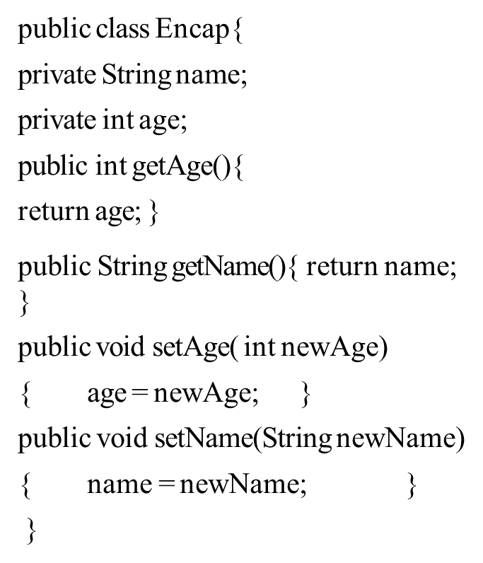
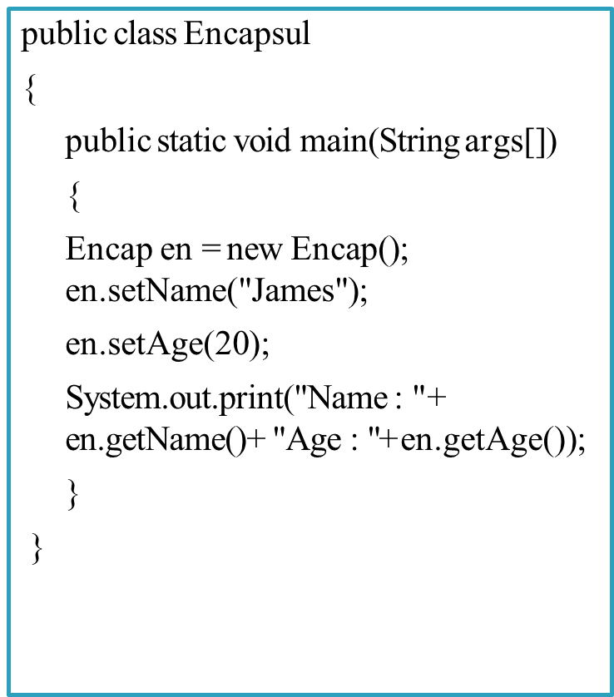
Example

Slide 8
Inheritance
¨Inheritance can be defined as the process where one object acquires the properties of another. With the use of inheritance the information is made manageable in a hierarchical order.
¨When we talk about inheritance the most commonly used keyword would be extends and implements.
¨These words would determine whether one object IS-A type of another. By using these keywords we can make one object acquire the properties of another object.

Slide 9
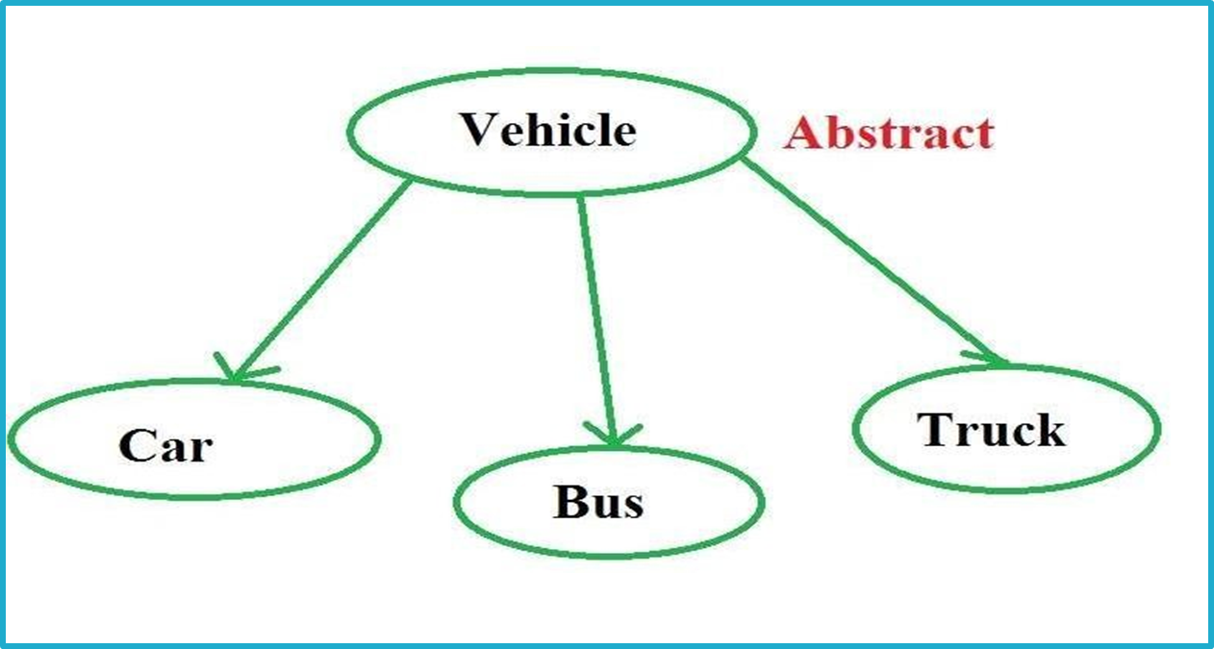
Example

Slide 10

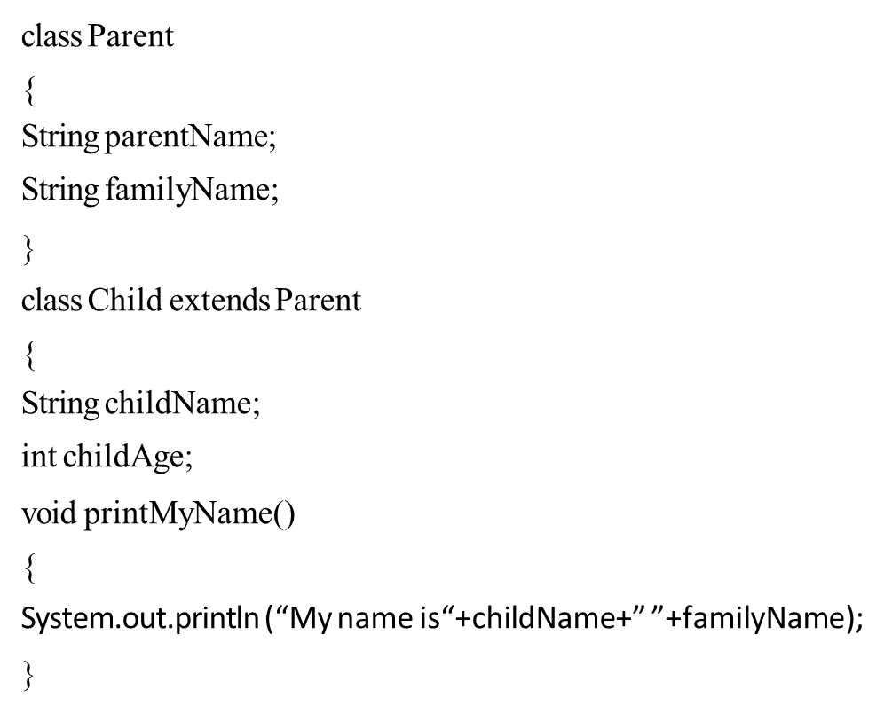
Example

Slide 11
Abstraction
Providing the essential features without its inner details is called abstraction (or) hiding internal implementation is called Abstraction.
We can enhance the internal implementation without affecting outside world. Abstraction provides security.
A class contains lot of data and the user does not need the entire data.
The advantage of abstraction is that every user will get his own view of the data according to his requirements and will not get confused with unnecessary data.

Slide 12
Polymorphism
Polymorphism is the ability of an object to take on many forms. The most common use of polymorphism in OOP occurs when a parent class reference is used to refer to a child class object.
Any java object that can pass more than one IS-A test is considered to be polymorphic. In Java, all java objects are polymorphic since any object will pass the IS-A test for their own type and for the class Object.
It is important to know that the only possible way to access an object is through a reference variable. A reference variable can be of only one type. Once declared the type of a reference variable cannot be changed.

Slide 13
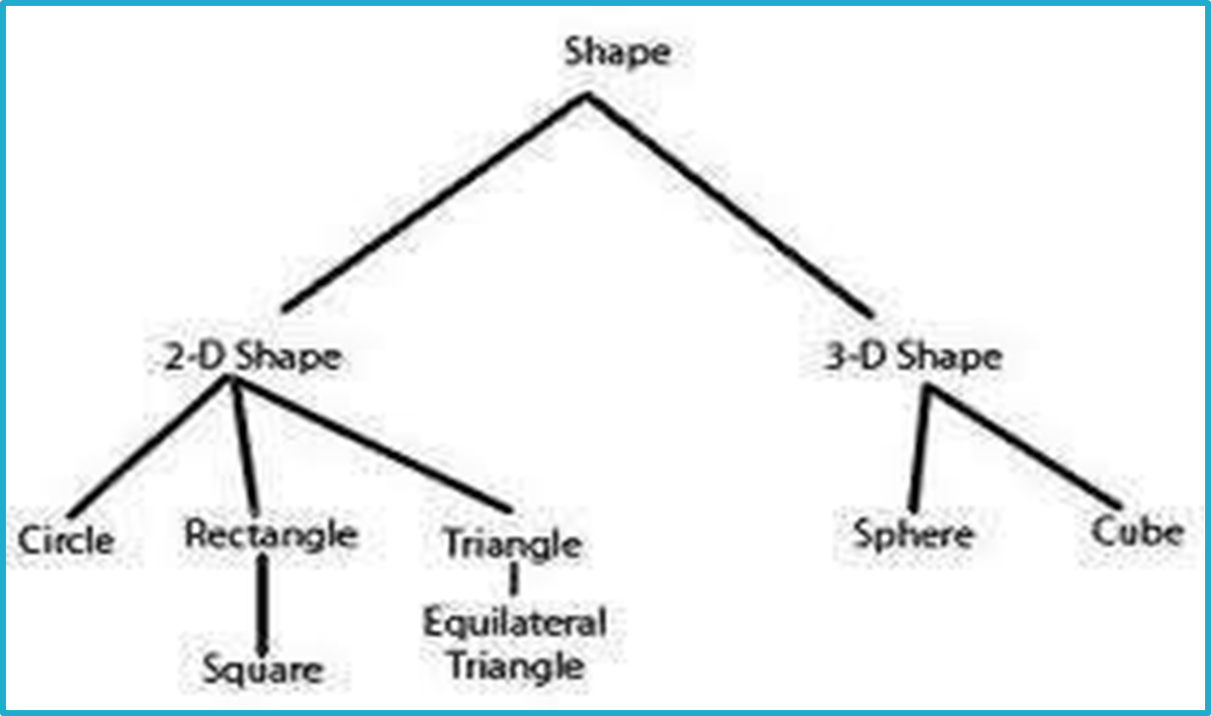
Example

Slide 14
Example
int add (int a, int b)
float add (float a, int b)
float add (int a , float b)
void add (float a)
int add (int a)

Slide 15
Classes & Objects
Object-Objects have states and behaviors. Example:A dog has states- color, name, breed as well as behaviors- wagging, barking, eating. An object is an instance of a class.
Class-A class can be defined as a template/blueprint that describe the behaviors/states that object of its type support.

Slide 16
Class
¨In object-oriented programming, a class is a programming language construct that is used as a blueprint to create objects.
This blueprint includes attributes and methods that the created objects all share.
Usually, a class represents a person, place, or thing - it is an abstraction of a concept within a computer program.
Fundamentally, it encapsulates the state and behavior of that which it conceptually represents.
It encapsulates state through data placeholders called member variables; it encapsulates behavior through reusable code called methods.

Slide 17
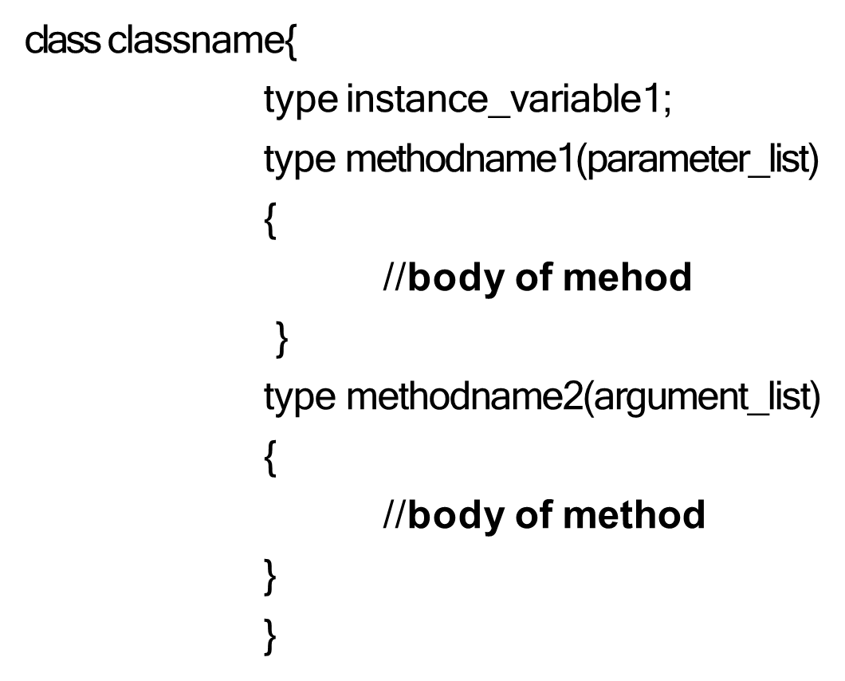
Class - Syntax

Slide 18
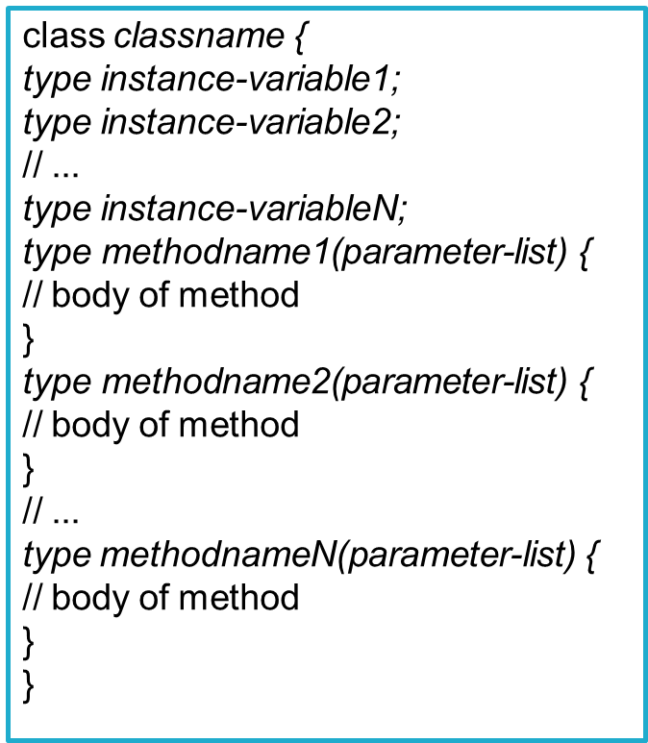
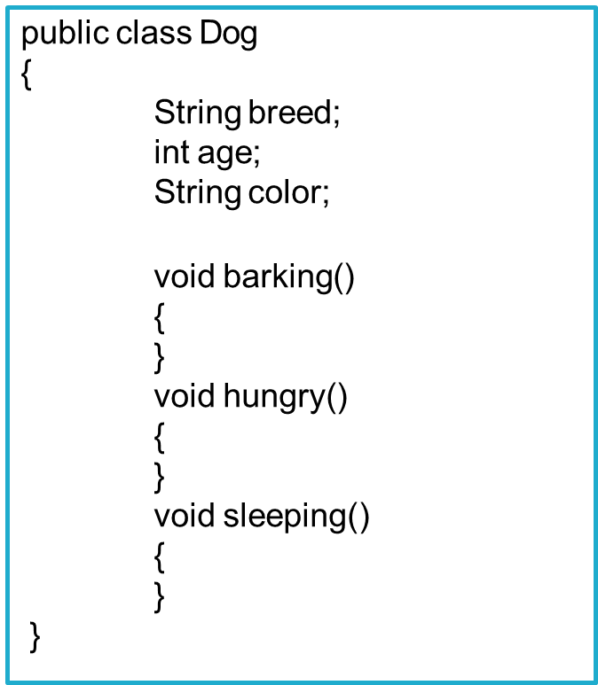
Declaring Class

Slide 19
Objects
An Object is a real time entity. An object is an instance of a class. An object will have some properties and it can perform some actions.
Object contains variables and methods. The objects which exhibit similar properties and actions are grouped under one class. “To give a real world analogy, a house is constructed according to a specification.

Slide 20
Creating Object using new operator
To access the properties and methods of a class,we must declare a variable of that class type. This variable does not define an object. Instead, it is simply a variable that can refer to an object.
We must acquire an actual, physical copy of the object and assign it to that variable. We can do this using new operator. The new operator dynamically allocates memory for an object and returns a reference to it. This reference is, more or less, the address in memory of the object allocated by new.
This reference is then stored in the variable. Thus, in Java, all class objects must be dynamically allocated.

Slide 21
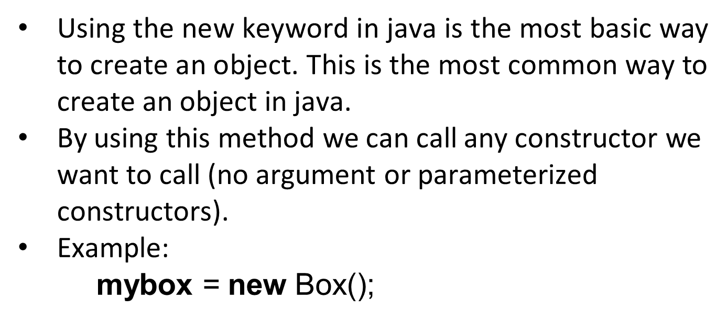
New operator

Slide 22

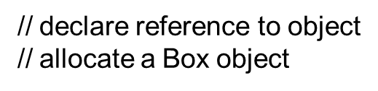
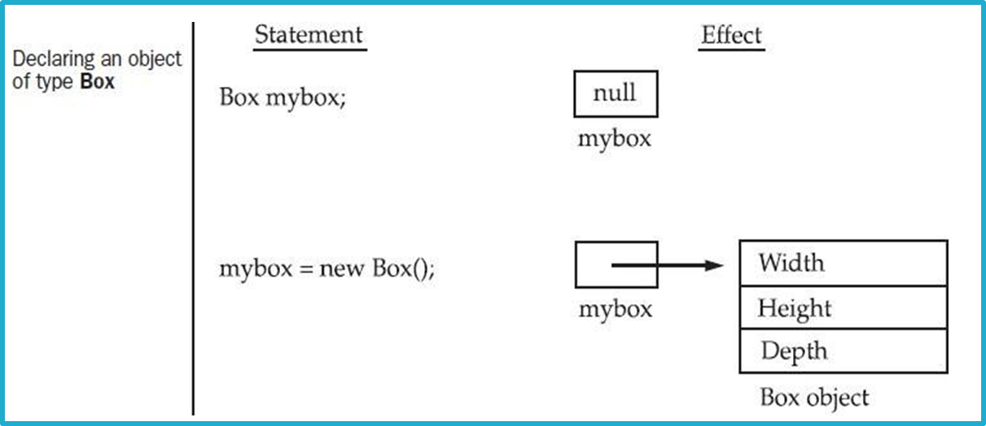
Declaring object

Slide 23
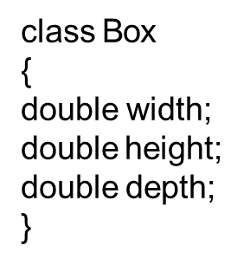





Example of class and Object

Slide 24
Difference in classes and object
It is fact that the difference between classes and objects is often the source of some confusion.
But we can say that, Classes have logical existence, whereas objects have physical existence
For example, furniture itself does not have any physical existence, but chair, table etc. do have physical existence.

Slide 25
Access Controls and Modifiers
Access control decides who can access variables, methods, and classes in Java.
How and where a member of a class is accessed is determined by the access specifiers.
The members of a class have their visibility in the same class or other classes. The classes have their associated accessibility.
To implement access control, we use Access Modifiers.

Slide 26
Access Specifier
The access specifiers in java are:
public: When a class member is declared with the public access specifiers, it can be accessed from anywhere in the program. The public classes,methods, or fields are used only if you explicitly want to offer access to these members.
private: You can access the private methods and fields only within the same class to which the methods and fields belong. When you declare a method or field as private, it is not visible within the subclasses and is not inherited by the subclasses.

Slide 27
Access Specifier
protected: You can access the protected methods and fields from within the same class to which the methods and fields belong, within its subclasses, and within the classes of the same package, but not from other packages. The protected access specifier cannot be used with class declaration
Default: If you do not specify any access specifier while declaring class, method or field then they are considered with default access specifier. The class, method or field with default access specifier can be accessed from within the same package to which they belongs. These are not accessible outside the package it belong

Slide 28
Methods
¨A Java method is a collection of statements that are grouped together to perform an operation.
¨When you call the System.out.println method, for example, the system actually executes several statements in order to display a message on the console.
This is the general form of a method:
type name(parameter-list) {
/ / body of method
}

Slide 29
Methods
The word method is commonly used in object- oriented programming. It is similar to a function in any other programming language.
Method in java can’t be declared outside the class. All methods have a name that starts with a lowercase character.

Slide 30
Methods
Syntax:
returntype method_name(arg1,arg2,….,argN){
//statements;
}

Slide 31
Method (Cont..)
Here, returntype specifies the type of data returned by the method. This can be any valid type, including class types that you create.
If the method does not return a value, its return type must be void.
The name of the method can be any legal identifier other than those already used by other items within the current scope.

Slide 32
Method (Cont..)
The parameter-list is a sequence of type and identifier pairs separated by commas. Parameters are essentially variables that receive the value of the arguments passed to the method when it is called.
If the method has no parameters, then the parameter list will be empty

Slide 33
Why Method?
¨To make code reusable: If we need to do the same thing or almost the same thing, many times ,write a method to do it and then call the method each time you have to do the task.
¨To parameterize the code:-We will often use parameters to change the way the methods behaves.
¨For top-down programming:-We can easily solve a bigger problem or a complex one by breaking it into sma ler parts. For the same purpose, we write methods. The entire complex problem can be broken down into methods.
¨To simplify the code:-Because the complex code inside a methods is hidden from other parts of the program, it prevents accidental errors or confusion.

Slide 34
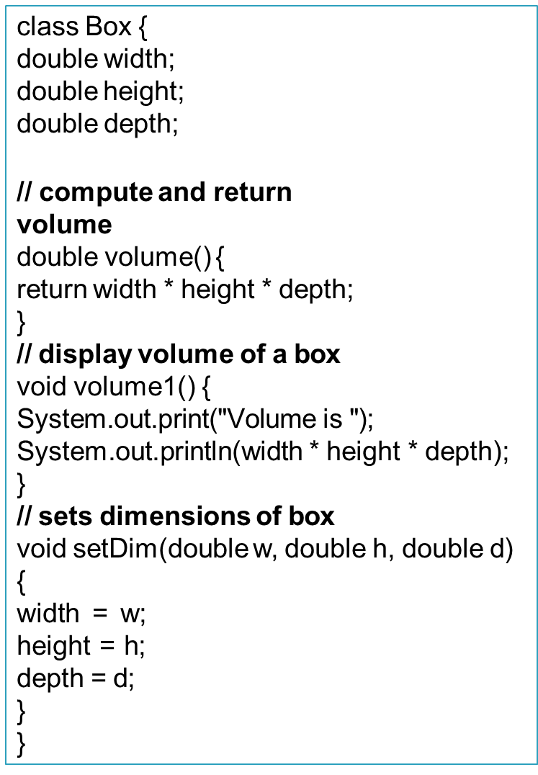

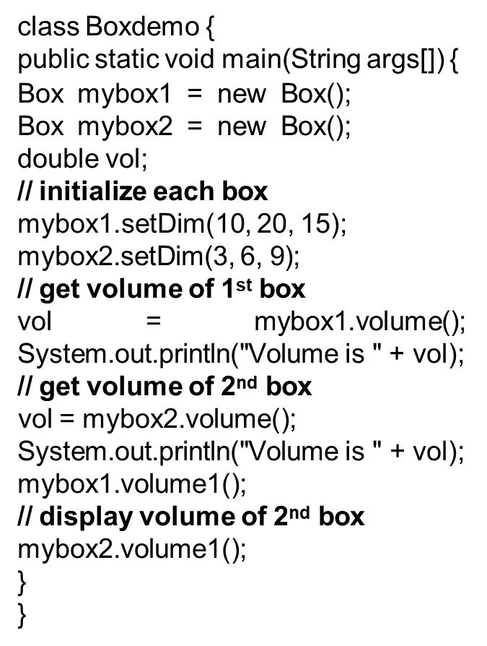
Example

Slide 35
Method Overloading
¨If two methods have the same name but different parameter lists within one class is called “Method Overloading”.
¨Overloaded methods must have different parameter lists. You cannot overload methods based on different modifiers or return types.
¨When overloaded methods are used, the java compiler decides which method is to be invoked by the number and/or types of parameters you pass to the method

Slide 36
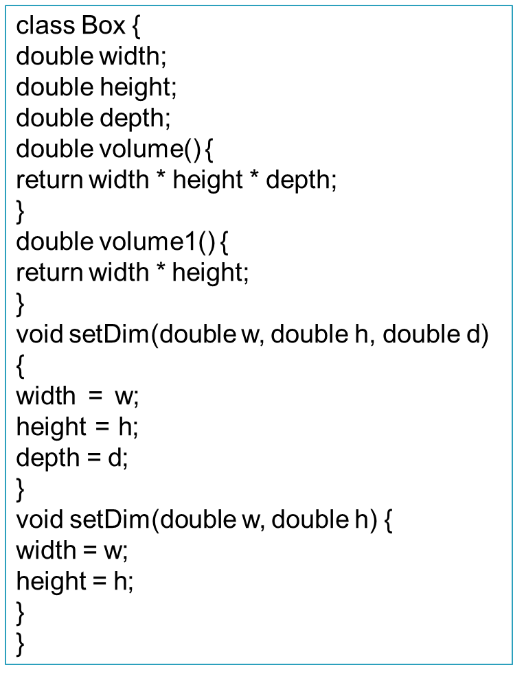

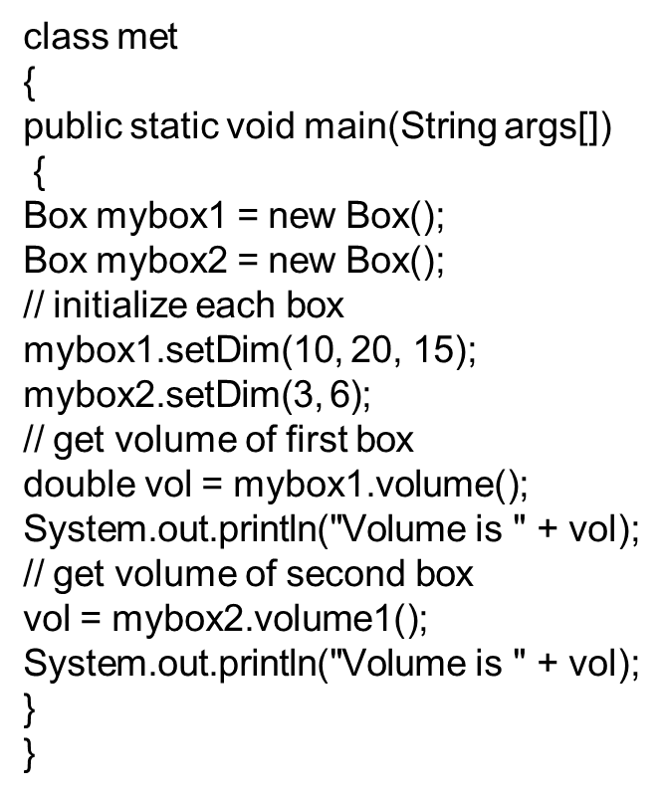
Example

Slide 37
Recursion
Each time a method is called, a new space is allocated on the internal stack for all the variable in the method, which means there is no reason you can’t call the same method again – a new set of variables will be allocated on the stack automatically
Recursion is a technique in which a method calls itself.
This technique provides a way to break complicated problems down into simple problems which are easier to solve.
Examples of recursion are:
  Factorial of number
  Fibonacci series

Slide 38
Recursion
Syntax:
type methodname(){
//code to be executed methodname();//calling same method
}
Example:
void demo(){
System.out.println(“hello”); demo();
}

Slide 39
Example
public class Recursion {
int factorial(int n){
if (n == 1) return 1; else
return(n * factorial(n-1));
}
public static void main(String[] args) {
System.out.println("Factorial of 5 is: "+factorial(5));
}
}

Slide 40
Constructor
¨A constructor is similar to a method that initializes the instance variables of a class.
¨A constructor have the same name as the class name.
¨A constructor may have or may not have parameters. Parameters are local variables to receive data.
¨Once defined, the constructor is automatically called immediately after the object is created, before the new operator completes.

Slide 41
Constructor (Cont..)
A constructor without any parameters is called default constructor.
A constructor with one or more parameters is called parameterized constructor.
A constructor does not return any value, not even void because implicitly the return type of a constructor is the class itself.
A constructor is called only once per object.

Slide 42
No-argument Constructor
Similar to methods, a Java constructor may or may not have any parameters (arguments).
If a constructor does not accept any parameters, it is known as a no-argument constructor.
Syntax:
constructor()
{
//syntax
}

Slide 43
Example
class Main {
int i;
private Main() {
i = 5;
System.out.println("Constructor is called");
}
public static void main(String[] args) { Main obj = new Main();
System.out.println("Value of i: " + obj.i);
}
}

Slide 44
Default Constructor
If we do not create any constructor, the Java compiler automatically create a no-argument constructor during the execution of the program. This constructor is called default constructor.
Default constructor is used to initialize every object with same data. Syntax:
Constructor_name(){
//statements
}

Slide 45
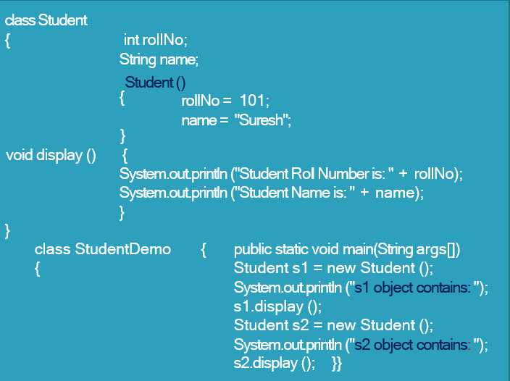
Example

Slide 46
Parameterized Constructor
A Java constructor can also accept one or more parameters. Such constructors are known as parameterized constructors (constructor with parameters).
Parameterized constructor is used to initialize each object with different data.
Syntax:
constructor(parameters)
{
//statements
}

Slide 47
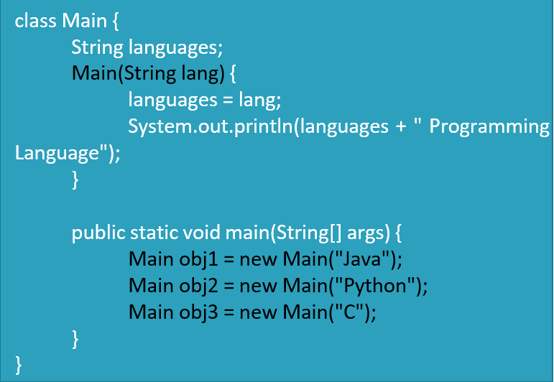
Example

Slide 48
Constructor Overloading
The constructor overloading can be defined as the concept of having more than one constructor with different parameters so that every constructor can perform a different task.

Slide 49
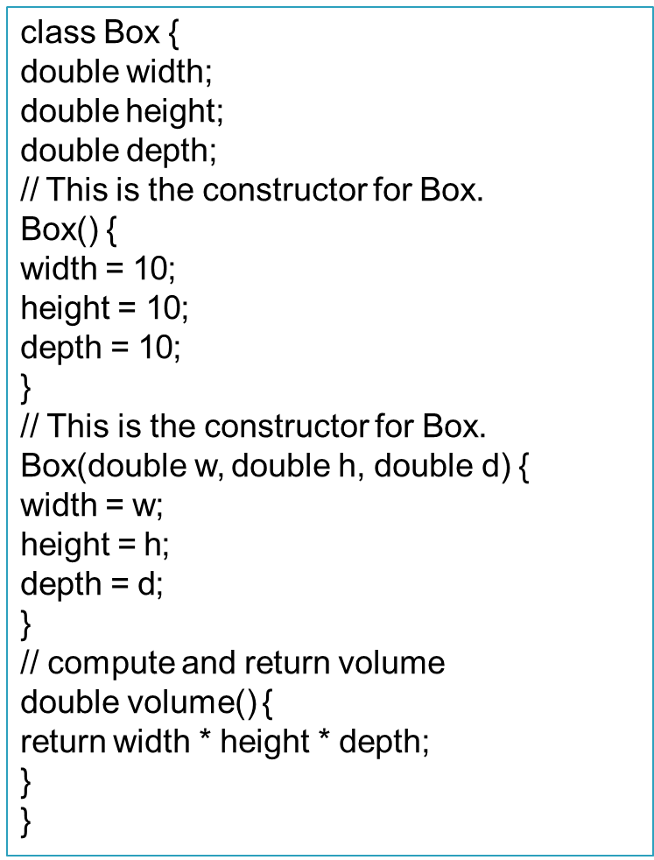
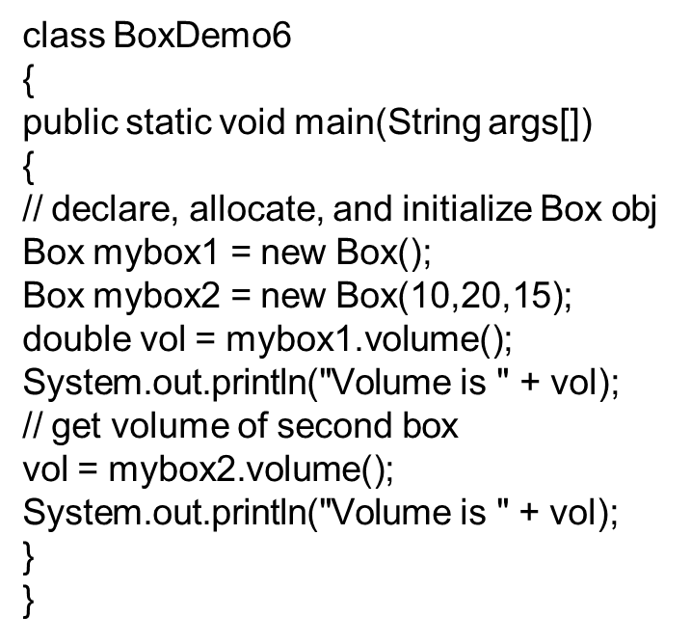
Example

Slide 50
this keyword
this keyword in java is a reference variable which points to the current object in the java.
The main purpose of using this keyword is to solve the confusion when we have same variable name for instance & local variable

Slide 51
this keyword→ When to use?
To access the class/instance variable
Passing ‘this’ as an argument in the method call
To implicitly invoking the current class method
Returning current object from method
Passing ‘this’ as an argument to constructor

Slide 52
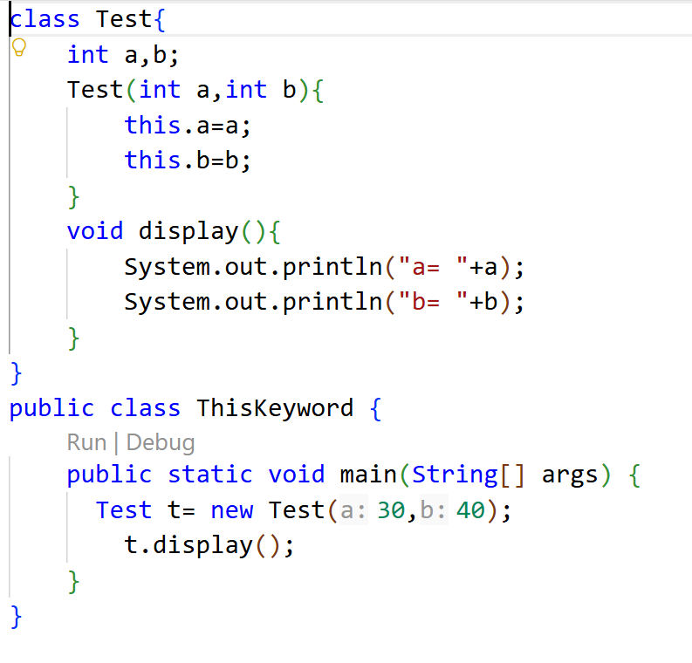
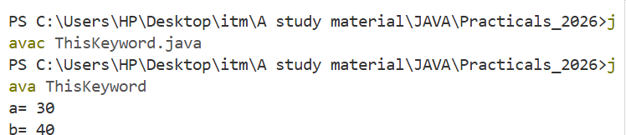
Accessing class variable

Slide 53
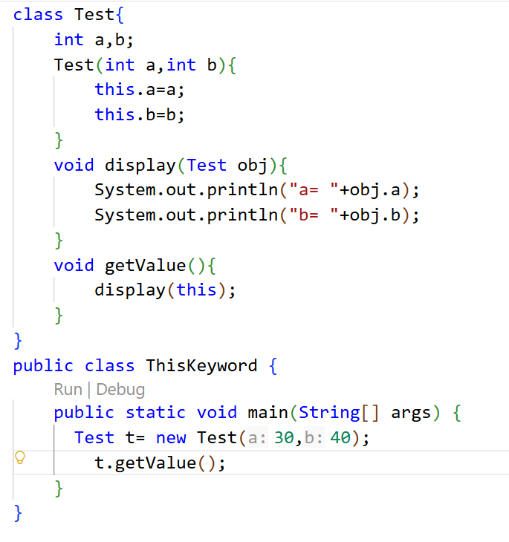
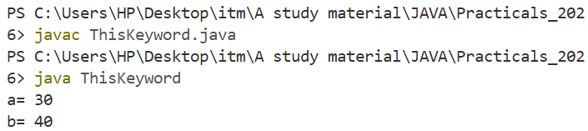
‘this’ as method parameter

Slide 54
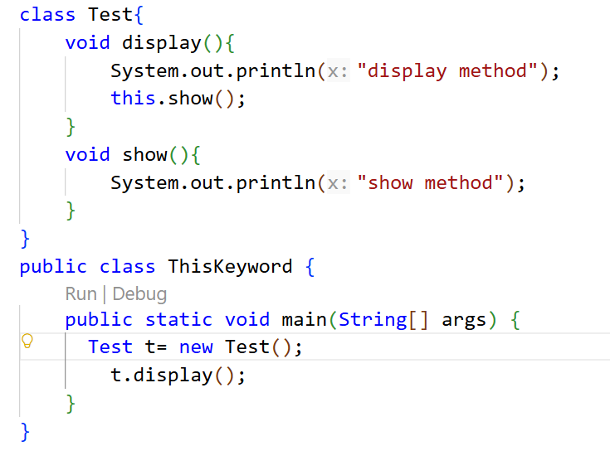
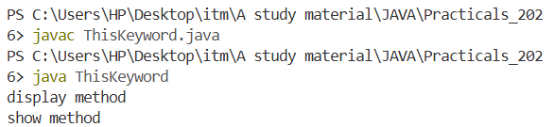
Invoking current class method

Slide 55
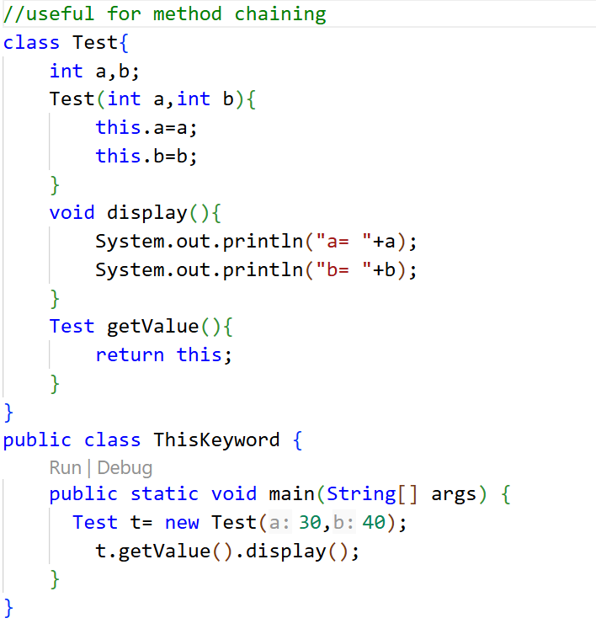
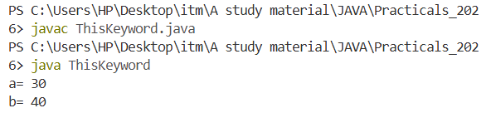
Return with ‘this’

Slide 56
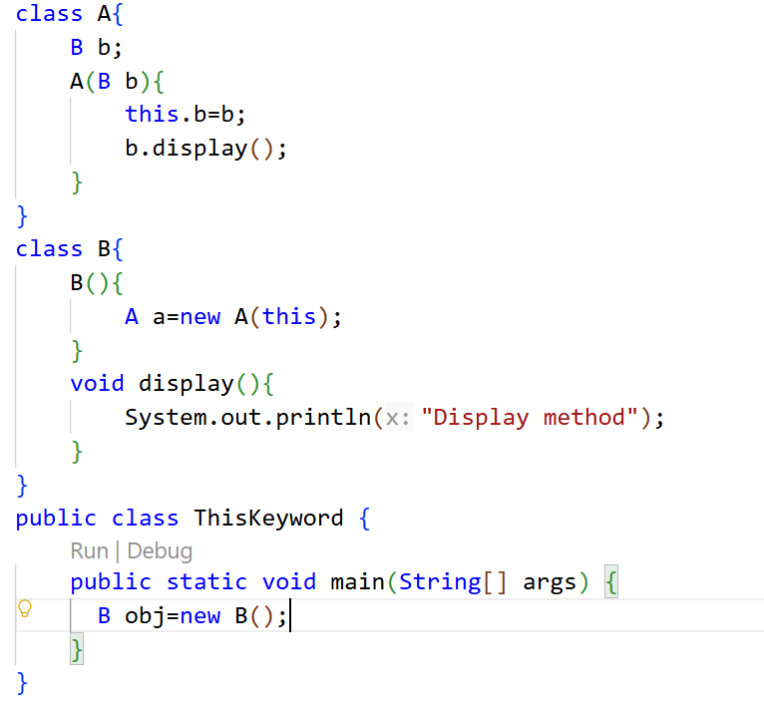
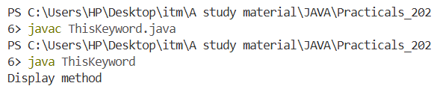
Argument to constructor

Slide 57
this() method
this() is a special call used only inside a constructor to call another constructor of the same class.
It lets you reuse initialization logic instead of duplicating it across multiple constructors.
this() must be the first statement of the constructor where it is used.

Slide 58
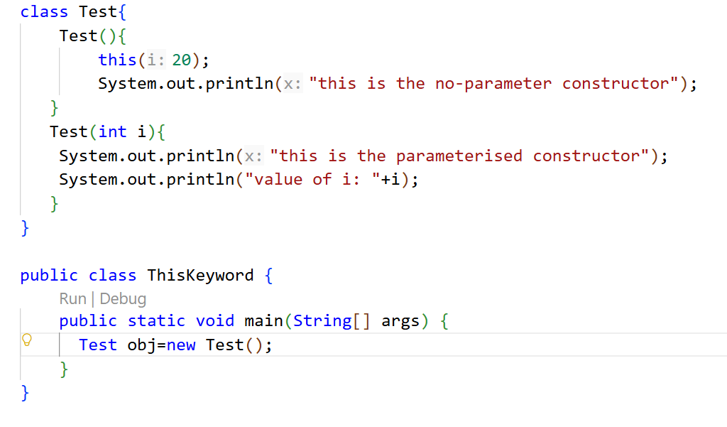
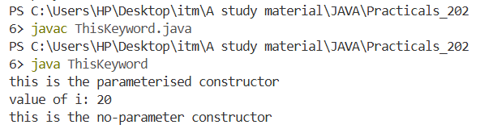
this() method

Slide 59
Static keyword
The main purpose of the static keyword is efficient memory management of class members.
“static” means a member (variable, method, block, or nested class) belongs to the class itself, not to any individual object.
It's shared across all instances instead of being copied per object.

Slide 60
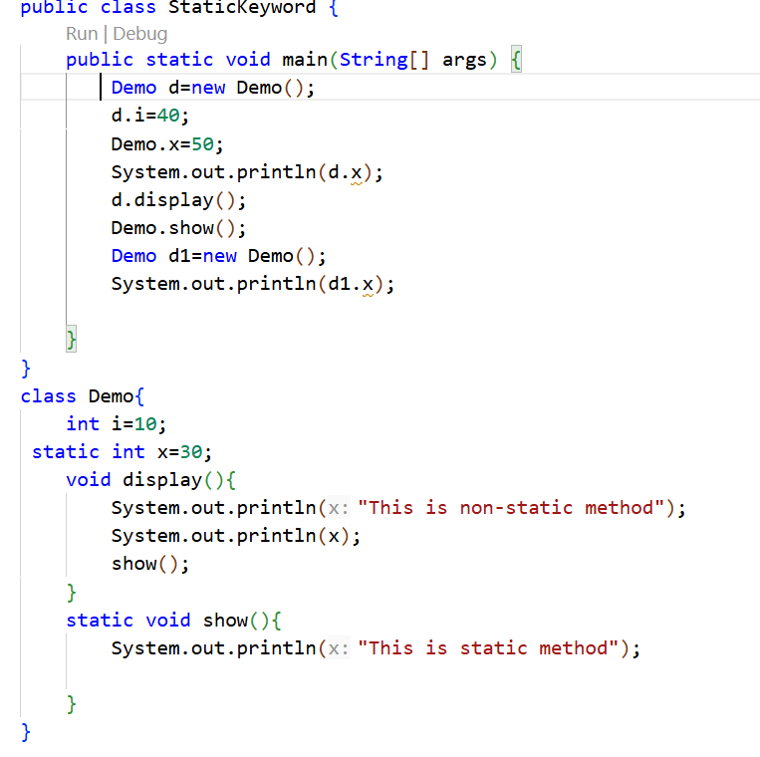
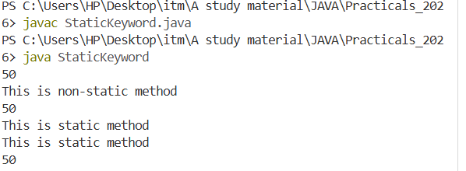
Static keyword

Slide 61
Static Keywords - Points to remember
Can only directly access other static members (variables/methods) of the class.
Cannot use this or super — there's no current object.
Cannot directly call non-static (instance) methods or fields.

Slide 62
final Keyword
final means "cannot be changed once set."
It can be applied to variables, methods, and classes — each with a different effect.
Here, we will see only final variables.
final methods & classes we will see in chapter-3 (Inheritance)

Slide 63
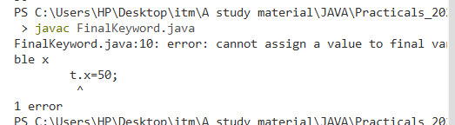
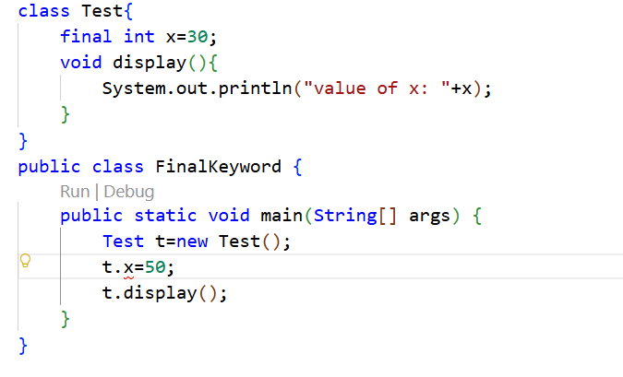
final variable

Slide 64
Garbage collection
In java, objects are created dynamically using the new operator.
After an object is no longer needed, the memory occupied by that object should be made available for reuse.
In the languages like C/C++, the programmer has to manually remove dynamically created objects using the delete operators.
Java does not require this, it automatically manages unused objects using the mechanism called Garbage collection.

Slide 65
Garbage Collection working
When an object is created, it occupies some memory
If no reference points to that object anymore, the object becomes eligible for garbage collection
The GC identifies such unused objects & can reclaim the memory occupied by them
The programmer doesn’t explicitly destroy objects
GC happens automatically & at the JVM’s Discretion. It is not guaranteed to happen immediately after an object becomes unused

Slide 66
Making object eligible for GC
Using null keyword
Reassigning the reference variable
Object created inside a method
Island of Isolation

Slide 67
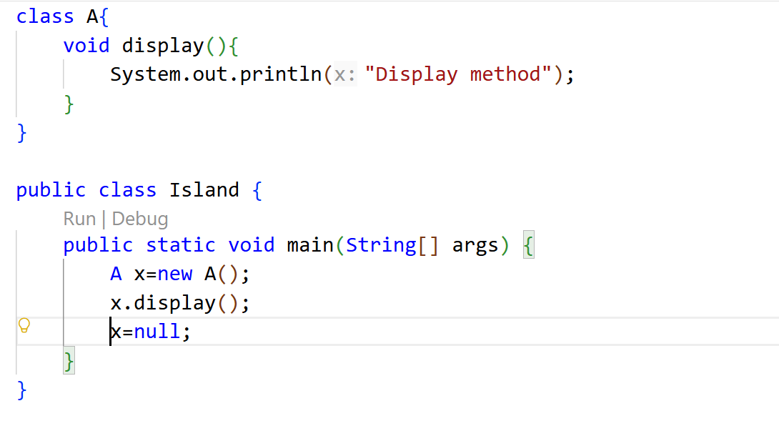
Using null keyword

Slide 68
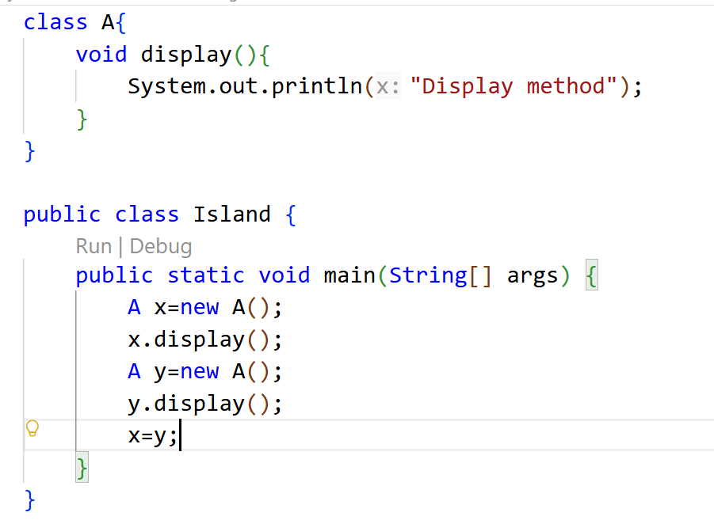
Reassigning the reference varaible

Slide 69
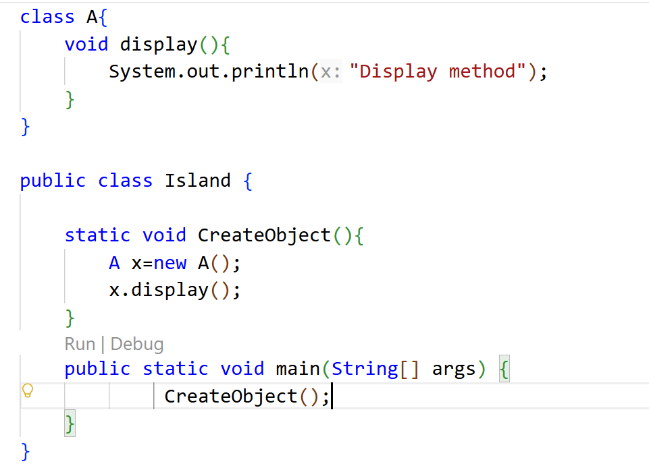
Object created inside Method

Slide 70
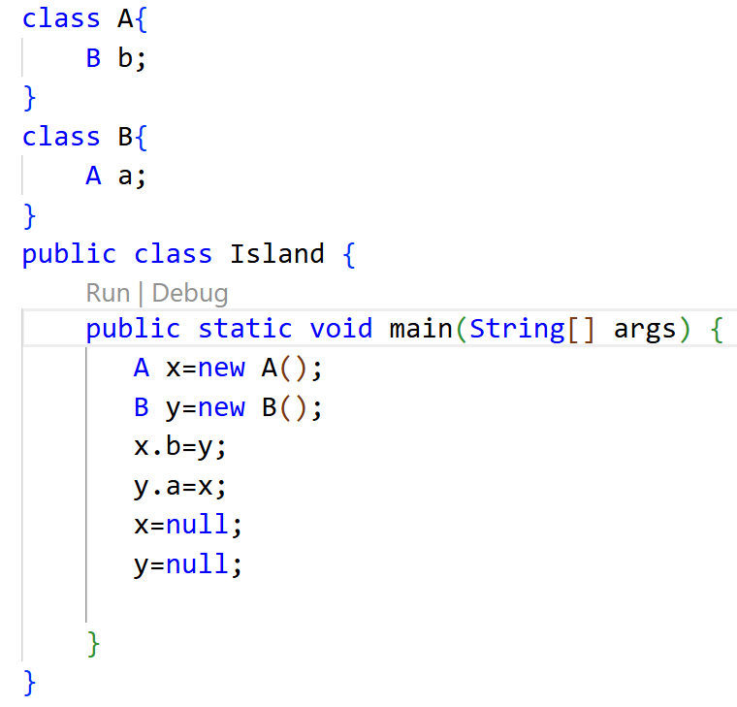
Isolation of Island

Slide 71
Methods for requesting GC to run
By using System class method
  System.gc()
By using runtime class
  Objectname.gc()
  When we request GC to run finalize() method is called internally.

Slide 72
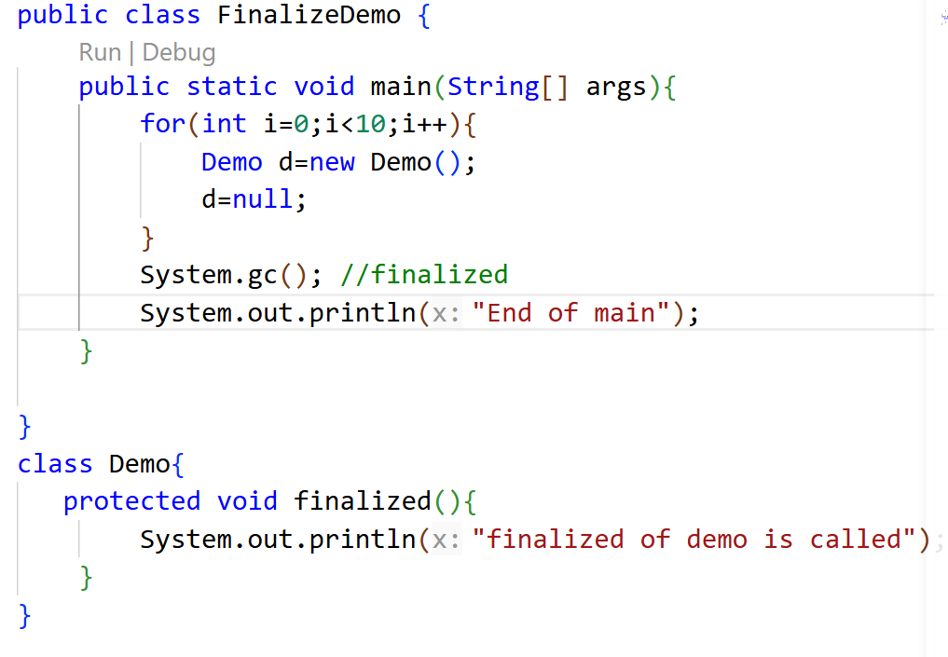
Using System class

Slide 73
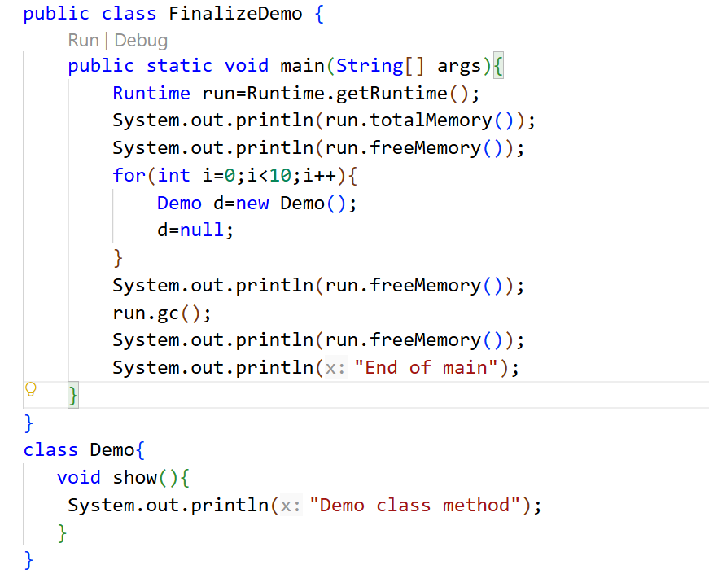
Using runtime class

Slide 74
Nested Classes
A class that is declared inside another class is called inner class.
A nested class is associated with its enclosing class(outer class). It is not treated as a completely independent class in terms of its enclosing scope.
A nested class can access the members of its outer class, including private members.
But outer class does not automatically get direct access to the inner class’s instance members. It would need the object of inner to access its instance variable.

Slide 75
Nested Classes
Syntax:
public class Outer{
public class Inner{
//Statements
}
//Statements
}

Slide 76
Types of inner class
Member Inner Class
Static Nested Class
Method local Inner Class
Anonymous Inner Class

Slide 77
Member Inner class
It is a normal inner class that is declared directly inside an outer class.
Class files generated for inner class
  Outer.class
  Outer$Inner.class

Slide 78
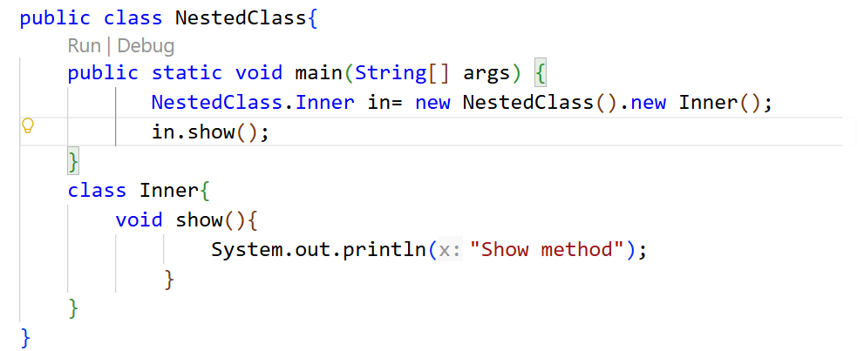
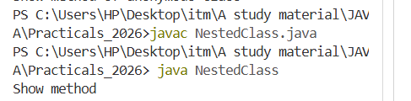
Accessing inner class from main method of same class

Slide 79
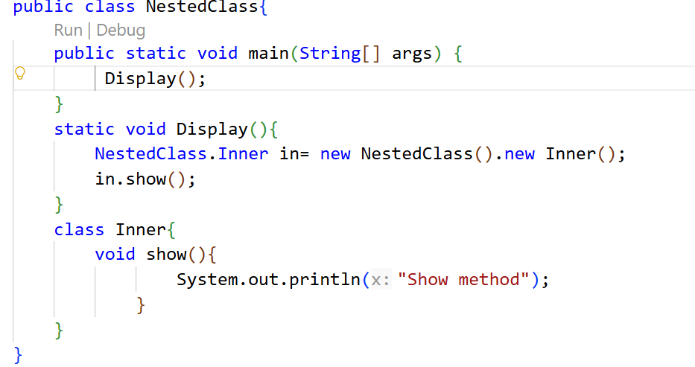
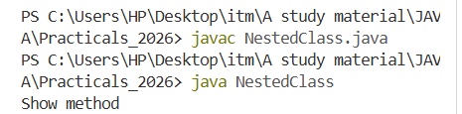
Accessing inner class from instance method of same class

Slide 80
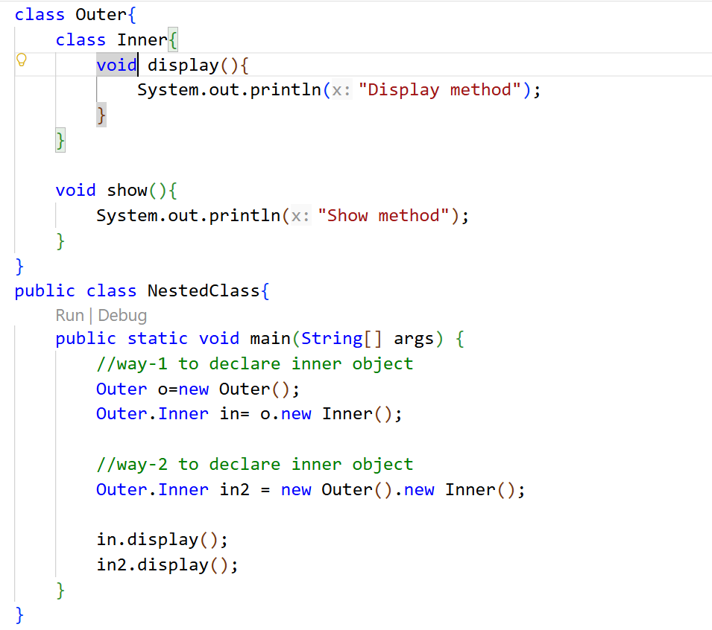
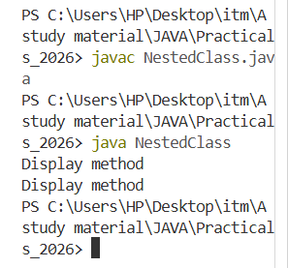
Accessing inner class from outside of outer class

Slide 81
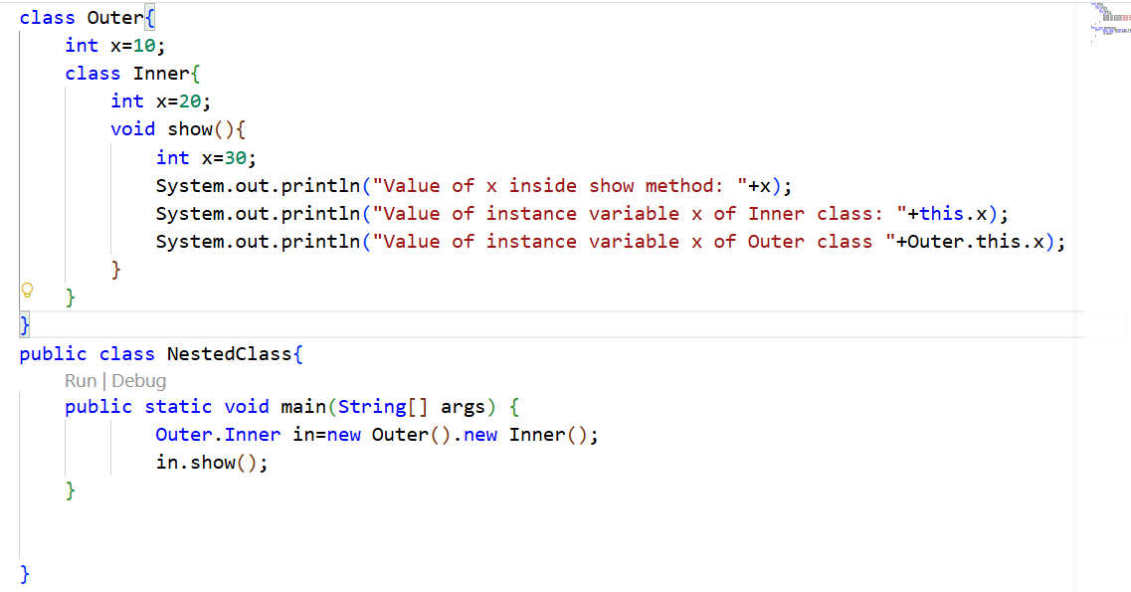
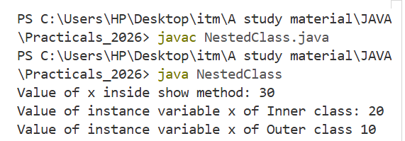
inner class with this keyword

Slide 82
Static inner class
An inner class with static keyword is called static inner class
We can’t access the non-static members of the enclosing(outer) class in the static inner classes directly.
To do so we will need to create the object of outer class in it.

Slide 83


Can’t access non-static member directly

Slide 84


Accessing non-static member using Outer class object

Slide 85
Method local inner class
These are the Inner classes inside a method.
Need of inner class inside a method is to define method specific repeatedly required functionality.
We can access method local inner classes only within a method where we declare. Outside of a method we can’t access it.
Because of its less scope method inner classes are rarely used.
We can declare inside of instance(class) method or static method.
If we declare inner class inside instance method both static & non-static variables can be accessed by it.
But if we declare it inside static method, we can access on static variables through it.

Slide 86


Method/local inner class

Slide 87
Anonymous Inner Class
An anonymous inner class is one that is not assigned a name.
Anonymous inner class are useful when:
  We need a class only once
  We don’t want to create a separate named class
  Provide a quick/specific implementation of an interface or abstract class
  Implementation is small

Slide 88


Anonymous inner class

