Slide 1
UNIT- 1
BASICS OF JAVA

Slide 2
INTRODUCTION
Java was developed by James Gosling in 1991 at Sun Microsystems which is now subset of Oracle.
The language was initially called ‘Oak’, but was renamed as ‘Java’ in 1995.
Java is both programming language and a platform.
A platform is a hardware or software where the programs run.
Most platforms can be described as a combination of the operating system and underlying hardware. The Java platform differs from most other platforms in that it's a software-only platform that runs on top of other hardware-based platforms.
Java platform has two components:
  Java Virtual Machine(JVM)
  Application Programming Interface

Slide 3
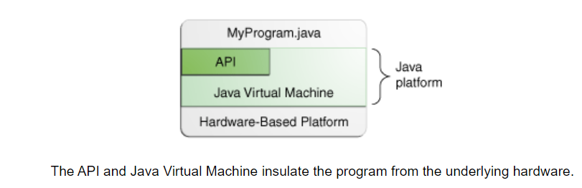
INTRODUCTION

Slide 4
POP v/s OOP
 | Procedure Oriented Programming | Object Oriented Programming
Divided Into | In POP, program is divided into small parts called functions. | In OOP, program is divided into parts called objects.
Importance | In POP,Importance is not given to data but to functions as well as sequence of actions to be done. | In OOP, Importance is given to the data rather than procedures or functions because it works as areal world.
Approach | POP follows Top Down approach. | OOP follows Bottom Up approach.
Access Specifiers | POP does not have any access specifier. | OOP has access specifiers named Public, Private, Protected, etc.
Data Moving | In POP, Data can move freely from function to function in the system. | In OOP, objects can move and communicate with each other through member functions.

Slide 5
POP v/s OOP
Expansion | To add new data and function in POP is not so easy. | OOP provides an easy way to add new data and function.
Data Access | In POP, Most function uses Global data for sharing that can be accessed freely from function to function in the system. | In OOP, data can not move easily from function to function, it can be kept public or private so we can control the access of data.
Data Hiding | POP does not have any proper way for hiding data so it is less secure. | OOP provides Data Hiding so provides more security.
Overloading | In POP, Overloading is not possible. | In OOP, overloading is possible in the form of Function Overloading and Operator Overloading.
Examples | Example of POP are : C, VB, FORTRAN, Pascal. | Example of OOP are : C++, JAVA, VB.NET, C#.NET.

Slide 6
Java Platforms/Editions
Java is available in different platform editions to support application development on a wide range of devices, from small embedded systems to large enterprise servers.
The java platforms are as following:
  Java Standard Edition (SE)
  Java Enterprise Edition (EE)
  Java Micro Edition (ME)
  Java FX

Slide 7
Java Platforms: Standard Edition
Java SE is the foundation of the Java platform and provides the core functionality required to develop general-purpose applications.
It includes the Java programming language, the Java Virtual Machine (JVM), and the standard API libraries.
Usecases: Desktop Applications, Web Servers. Small to Medium Scale Web Applications

Slide 8
Java Platforms: Enterprise Edition/ Jakarta Enterprise Edition
Java EE is built on top of Java SE and provides a set of specifications that extend the functionality of Java SE for building large-scale, distributed, and multi-tiered enterprise applications.
Mostly used for Dynamic web pages (Java Servlets), encapsulate business logics (JavaBeans), message standards (Java Message Services)
Use-cases: Large-scale Enterprise Applications, E-commerce Platforms, CRM Systems

Slide 9
Java Platforms: Micro Edition
Java ME is a subset of the Java SE platform designed for developing applications on small devices with limited processing power and memory, such as mobile phones, embedded systems, and IoT devices.
Used for:
  A specification for small, resource-constrained devices
  A set of APIs for developing mobile applications(Mobile Information Devices Profile)
  APIs for connecting and interacting with Bluetooth-enabled devices
  APIs for handling multimedia content on mobile devices
Use-cases: Mobile Applications, Embedded Systems, IoT devicesc

Slide 10
Java Platforms: JavaFX
JavaFX is a modern framework for building rich desktop applications with attractive graphical user interfaces.
It was developed as a successor to Swing and provides advanced features for creating interactive and multimedia-rich applications.
JavaFX separates the user interface design from application logic using FXML, an XML-based markup language.
It also supports CSS for styling, making it easier to create visually appealing applications.
We will be study regarding this more in UNIT-4

Slide 11
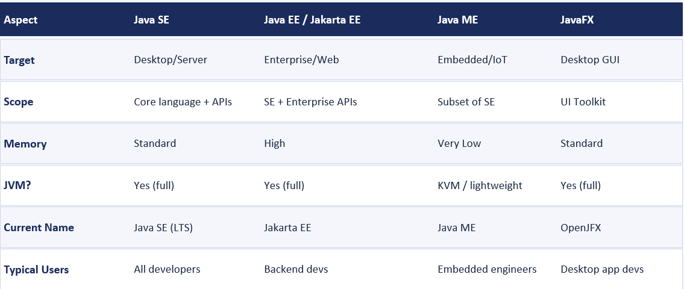
Java Platforms: Comparison

Slide 12
Uses of java
It is used for developing Android Apps
Helps you to create Enterprise Software
Wide range of Mobile java Applications
Scientific Computing Applications
Use for Big Data Analytics
Java Programming of Hardware devices
Used for Server-Side Technologies like Apache, JBoss, GlassFish, etc.

Slide 13
Components of Java Programming
To convert the source code to machine code Java uses three components:
Java Development Kit
Java Runtime Environment
Java Virtual Machine

Slide 14
Java Development kit
JDK is a software development environment used for making java applications & applets. It is possible to install more than one JDK version on the same computer.
JDK contains tools required to write Java program & JRE to execute them. It includes compiler, Java application launcher, Appletviewer etc.
NOTE: Compiler converts source code to the bytecode & App Launcher opens JRE, loads the necessary class & execute its main method

Slide 15
Java Runtime Environment
JRE is a piece of software that is designed to run other software. It contains the class libraries, loader class & JVM.
JRE does not include any tool for java development like debugger, compiler etc. It uses important package classes like math, swing, util, lang, awt & runtime libraries.
NOTE: For developing the java programs we need JDK but to run java program only JRE is needed

Slide 16
Working of JRE
The JRE combines the Java code that you create by using the JDK with additional built-in code called libraries. It then creates a JVM instance, or local copy, that finally runs the Java programs.
JVMs are available for multiple operating systems, and the JRE generates a single copy of your Java code that runs on all types of JVMs.
In this way, the JRE facilitates platform independence for Java applications. You can write them once and run them anywhere.

Slide 17
Java Virtual Machine
JVM is an engine that provides a runtime environment to drive a java code or application. It is a part of JRE which converts bytecode to machine language.
Bytecode: Computer object code that an interpreter converts into binary machine code so it can be read by a computer’s hardware processors.
JVM provides the platform independent way to execute java source code. When we compile java program, the bytecode is generated. Bytecode is an intermediary language between java source & the host system.
JVM comes with JIT(just-in-time) compiler that converts java source code into low level language.
NOTE: Although JVM provides platform independent way to execute source code but itself is platform dependent. It also allocate & deallocate the memory space

Slide 18
Java compiler
(javac)
Byte code
Java Source code
Byte code loaded into JVM
Java Interpreter
Host System
JVM

Slide 19
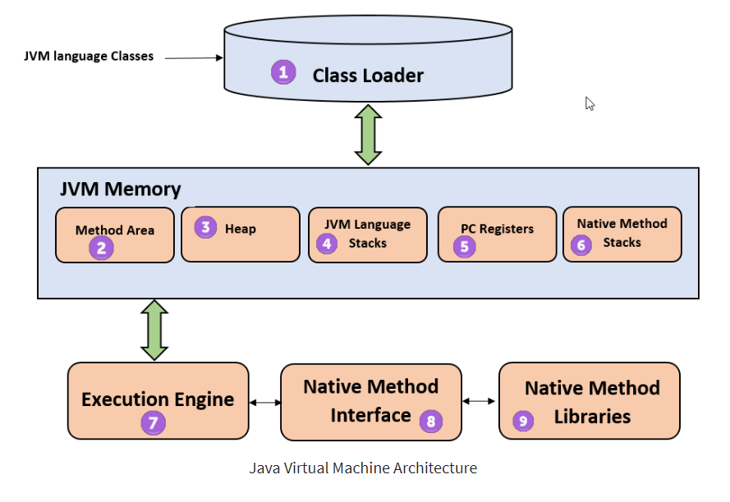
JVM Architecture

Slide 20
JVM Architecture
Class Loader:
The class loader is a subsystem used for loading class files. It performs three major functions viz. Loading, Linking, and Initialization.
Method Area:
JVM Method Area stores class structures like metadata, the constant runtime pool, and the code for methods.
Heap:
All the Objects, their related instance variables, and arrays are stored in the heap. This memory is common and shared across multiple threads.

Slide 21
JVM Architecture
JVM Language Stack:
Java language Stacks store local variables, and it’s partial results. Each thread has its own JVM stack, created simultaneously as the thread is created. A new frame is created whenever a method is invoked, and it is deleted when method invocation process is complete.
Program Counter(PC) registers:
PC register store the address of the Java virtual machine instruction which is currently executing. In Java, each thread has its separate PC register.
Naïve Method Stack:
Native method stacks hold the instruction of native code depends on the native library. It is written in another language instead of Java.

Slide 22
JVM Architecture
Execution engine:
It is a type of software used to test hardware, software, or complete systems. The test execution engine never carries any information about the tested product.
Native Method Interface:
The Native Method Interface is a programming framework. It allows Java code which is running in a JVM to call by libraries and native applications.
Native Method Libraries:
Native Libraries is a collection of the Native Libraries(C, C++) which are needed by the Execution Engine.

Slide 23
JVM memory management
Memory management is the process of allocating new objects and removing unused objects to make space for those new object allocations.
Java maintains memory on its own and doesn't require a programmer's explicit assistance.
Garbage collection guarantees that memory may be released when not needed and that unused space is cleaned up.

Slide 24
Features
Simple: Learning & practicing java is easy because of its resemblance to C & C++
Object Oriented Programming language: Java supports object oriented language.
Distributed: Java is designed for the distributed environment of the internet because it handles TCP/IP protocols. Java also supports Remote Method Invocation(RMI) which enables a program to invoke methods across a network
Robust: Java program will not crash because of its exception handling & memory management.

Slide 25
Features
Portable: Java does not have implementation dependent aspects and yet yields or gives same result on any machine. Hence becoming Platform Independent
Interpreted & high performance: Java programs are compiled to generated the byte code. This byte code can be downloaded & interpreted by the interpreter. The .class file will have byte code instructions and JVM which contains an interpreter will execute the byte code.
Along with interpreter there will be JIT(Just In Time) compiler which enhance the speed of execution

Slide 26
Features
Architectural Neutral language: Java byte code is not machine dependent, it can run on any machine with any processor and with any OS
Multithreaded: Executing different parts of programs simultaneously is called multithreading. This is an essential feature to design server-side programs.
Dynamic: We can develop programs in Java which dynamically changes on Internet. Eg.: Applet

Slide 27
Syntax
class Classname{
public static void main(String args[ ]){
System.out.println();
}
}

Slide 28
The main() method
The main() method holds significant importance in Java programming as it acts as the entry point for the program's execution, allowing it to be run from the command line or any Java runtime environment.
While compiling a Java program, the presence of a main() method is not strictly required, but during execution, the JVM searches for this method and initiates program execution from there.
The main() method in Java must have a public access modifier, enabling it to be accessed from outside the class.
Being a static method, it can be called without creating an instance of the class.
Additionally, it does not return any value and accepts a String array as a parameter, allowing command-line arguments to be passed to the program.

Slide 29
The main() method
The modifiers public and static can be written in either order (static public or public static), but the convention is to use public static as shown in syntax.
You can define a main() method with any access modifier or with/without static keyword, but then it is not a valid main() method, as the main method which the JVM uses as an entry-point should be defined as such.
You can name the argument anything you want, but most developers choose "args" or "argv"
You can write a program without defining a main() it gets compiled without compilation errors. But when you execute it, a run time error is generated saying "Main method not found".

Slide 30
The main() method
Public: The main() method in Java has a public access specifier, making it globally accessible. This is crucial because the Java Runtime Environment (JRE) calls this method from outside of your current class. It's essential to keep the main() method public; otherwise, access restrictions will prevent it from being executed by any program.
Static: The main() method in Java must be declared as static. By making the main() method static, it can be invoked directly by the JVM without the need to create an instance of the class. This is essential because the JVM needs a starting point to execute the program, and it does so by calling the main() method without instantiating the class.

Slide 31
The main() method
Void: The main() method in Java is declared with a return type of "void" to indicate that it does not return any value. The purpose of the main() method is to serve as the entry point for the Java program, and it is invoked by the Java Virtual Machine (JVM) to start the execution of the program.
Main: It's just the name of method or a function name. This name is fixed and as it's called by the JVM as entry point for an application. It's not a keyword.

Slide 32
Structure of System.out.println()
System.out.println() is a method in Java or a statement that is used to display a message, data, or string on the screen as the output. It displays the arguments that are passed to it.
System: This is the final class that is defined in java.lang package.
out: This is an instance of PrintStream type, and the access specifiers are final and public.
println(): This is a method in the PrintStream class.
We can also use print() method to print the arguments. But it prints the output without adding the new line.

Slide 33
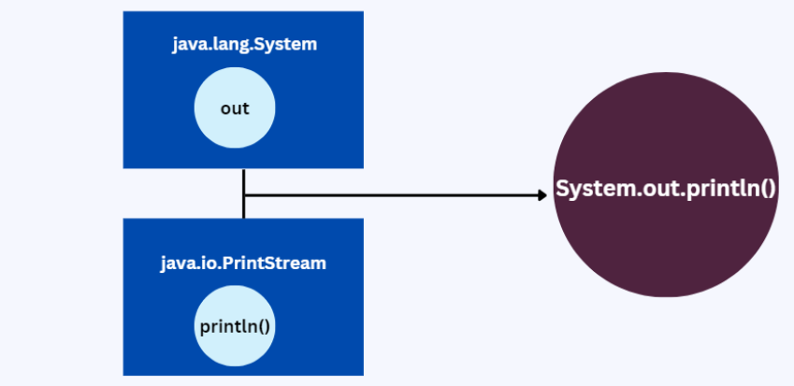

Slide 34
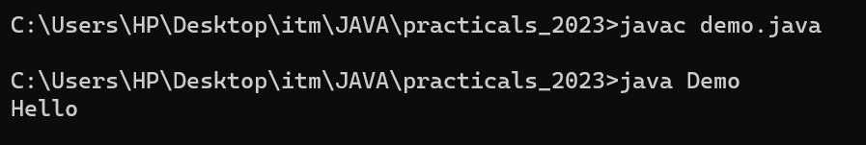
Simple Program
class Classname{
public static void main(String args[ ]){
System.out.println(“Hello World”);
}
}
OUTPUT:

Slide 35
DATA TYPES
Data Types in Java are defined as specifiers that allocate different sizes and types of values that can be stored in the variable or an identifier.
Java is a static-typed language that means the data type of the variable is known at compile time.
The type of the variable determines its value & operations.
Datatypes in JAVA are categorized into:
  Primitive Data-type
  Non-primitive Data-type

Slide 36
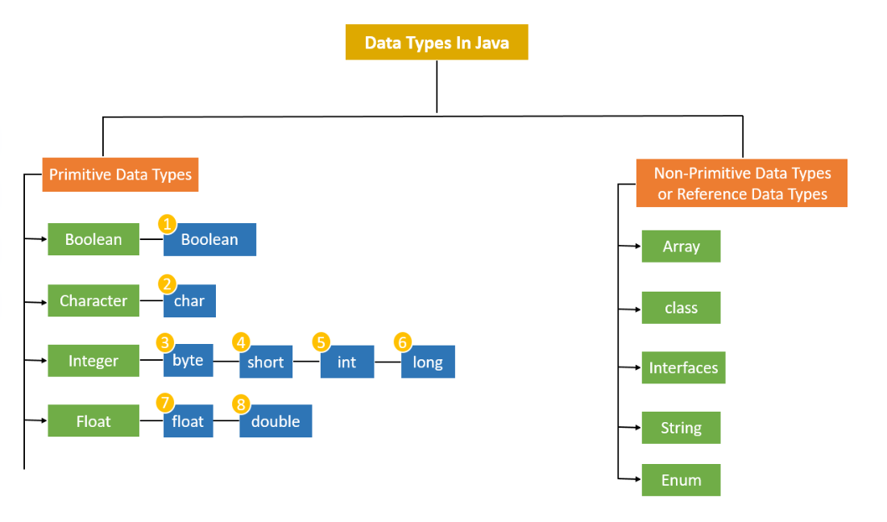

Slide 37
Primitive Data-types
Primitive Data Types are predefined and available within the Java language. Primitive values do not share state with other primitive values.
There are 8 Primitive data-types that are categorized into:
Integers : byte, short, int, long
Floating-points: float , double
Boolean: boolean
Character: char

Slide 38
Primitive data-type
byte:
The byte is the smallest data type among all the integer data types. It is an 8-bit signed two’s complement integer. It stores whole numbers ranging from -128 to 127. Its size is 1 byte.
It is space efficient because it is smaller than integer datatype. It can be a replacement for int data-type usage but it doesn’t have the size range as the integer datatype.
Syntax: byte bytevariable;
Eg. : byte b=10;

Slide 39
Primitive data-type
short:
This data-type is also similar to the integer datatype. However it’s 2 times smaller than the integer datatype. Its minimum range is -32,768 and maximum range is 32,767. It has a size of 2bytes.
Syntax: short shortvariable;
Example: short s = 234;

Slide 40
Primitive data-type
int:
int is used for storing integer values. Its size is 4 bytes and has a default value of 0.
The maximum values of integer is 2^31 and the minimum value is -2^31. It can be used to store integer values unless there is a need for storing numbers larger or smaller than the limits.
Syntax: int intvariable;
Eg.: int i= 2037437

Slide 41
Primitive data-type
long:
This datatype primarily stores huge sized numeric data. It is a 64 bit integer and ranges from -2^63 to +(2^63)-1. It has a size of 8 bytes and is useful when you need to store data which is longer than int datatype.
Syntax: long longvariable;
Example: long l = 372036854775;

Slide 42
Primitive data-type
float:
It is a floating-point data type that stores the values, including their decimal precision. It is not used for precise data such as currency or research data.
A Float value is a single-precision 32-bit or 4 bytes IEEE 754 floating-point. It can have a 7-digit decimal precision. It ends with an ‘f’ or ‘F’ and have the default value = 0.0f. It stores fractional numbers ranging from 3.4e-038 to 3.4e+038
Syntax: float floatVariable;
Example: float f= 3.97f;

Slide 43
Primitive data-type
double:
The double data type is similar to float. The difference between the two is that is double twice the float in the case of decimal precision. It is used for decimal values just like float and should not be used for precise values. In java the double is the default floating data-type.
A double value is a double-precision 64-bit or 8 bytes IEEE 754 floating-point. It can have a 15-digit decimal precision. Its default value is 0.0d & stores fractional numbers ranging from 1.7e-308 to 1.7e+308
Syntax: double doubleVariable; Example: double d= 873.98343

Slide 44
Primitive data-type
char:
char as the name suggests is useful for storing single value characters. Its default value is ‘\u0000’ with the max value being ‘\uffff’ and has a size of 2 bytes. This is the unicode format which java uses inplace of ASCII.
Syntax: char charvariable;
Example: char ch = ‘D’;

Slide 45
Primitive data-type
boolean:
boolean is a special datatype which can have only two values ‘true’ and ‘false’. It has a default value of ‘false’ and a size of 1 byte. It comes in use for storing flag values.
Syntax: boolean boolvariable;
Example- boolean flag=true;

Slide 46
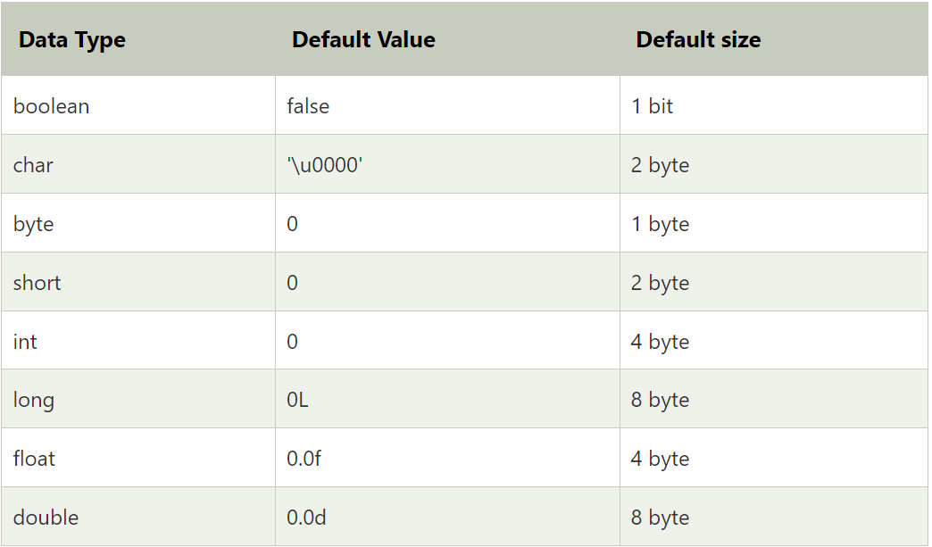

Slide 47
Primitive data-type
Points to Remember:
All numeric data types are signed(+/-).
The size of data types remain the same on all platforms (standardized)
char data type in Java is 2 bytes because it uses UNICODE character set. By virtue of it, Java supports internationalization. UNICODE is a character set which covers all known scripts and language in the world

Slide 48
Identifiers
An identifier is the name given to program elements such as variables, methods, classes, interfaces, packages, and objects.
Identifiers help programmers uniquely identify these elements in a Java program.
Example:
int roll_no=10;
class Student{
void Display(){ }
}
Variable Identifier
Class Identifier
Method Identifier

Slide 49
Variables
Variable in Java is a data container that stores the data values during Java program execution. Every variable is assigned data type which designates the type and quantity of value it can hold. Variable is a memory location name of the data.
The Java variables have mainly three types :
Local variables: variables defined inside methods, constructors or blocks are called local variables.
Instance variables: Instance variables are variables within a class but outside any method..
Static variables: Class variables are variables declared within a class, outside any method, with the static keyword.

Slide 50
Variables
Declaration of variable:
type identifier;
Example: int a;
Initialization of variable declaration:
type identifier;
Identifier = value;
OR type identifier = value;
Example: int a;
a = 5;
OR
int a= 5;

Slide 51
Variables
class demo{
static int a = 1; //static variable
int data = 99; //instance variable
void method() {
int b = 90; //local variable
}
}

Slide 52
Rules for Variable declaration
Rules to Declare a Variable
A variable name can consist of Capital letters A-Z, lowercase letters a-z digits 0-9, and two special characters such as _ underscore and $ dollar sign.
The first character must not be a digit.
Blank spaces cannot be used in variable names.
Java keywords cannot be used as variable names.
Variable names are case-sensitive.
There is no limit on the length of a variable name but by convention, it should be between 4 to 15 chars.
Variable names always should exist on the left-hand side of assignment operators.

Slide 53
Taking User Input (Scanner class)
Many Java programs need to interact with users by accepting data during execution.
Java provides Scanner class to read the data from user
Scanner class is available in java.util package, we have to import it whenever we need to take user input
  import java.util.Scanner;

Slide 54
Taking User Input (Scanner class)
To use the Scanner class, a Scanner object is created using System.in, which represents the standard input stream.
Scanner sc = new Scanner(System.in)

Slide 55
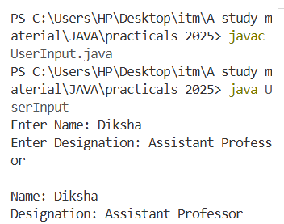
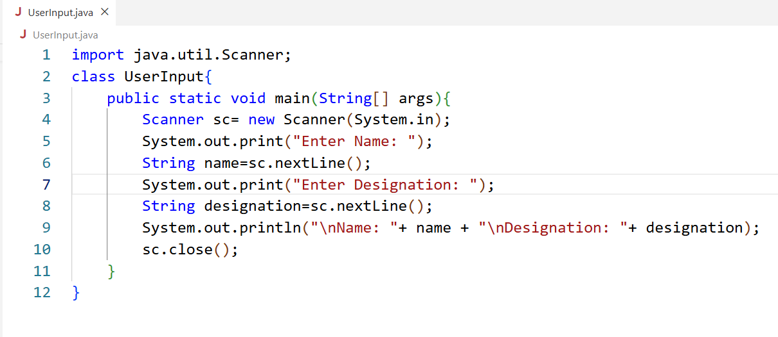
Taking User Input (Scanner class)
Program
Output

Slide 56
Command line arguments
Sometimes we need to pass information into a program while it is running. This can be accomplished by passing command line arguments to main()
The information passed is stored in the string array passed to the main() method and it is stored as a string. It is the information that directly follows the program’s name on the command line when it is running.

Slide 57
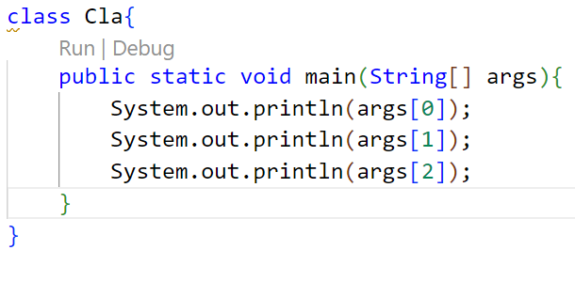
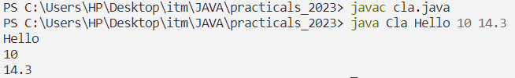
Example-1
OUTPUT:

Slide 58
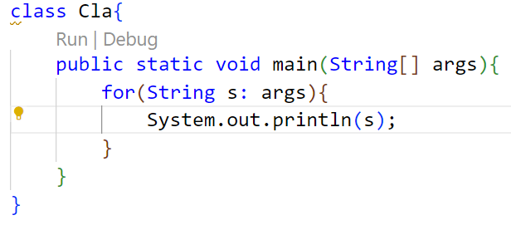
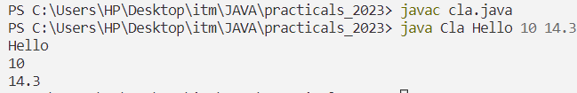
Example-2
OUTPUT:

Slide 59
varargs
If we don't know how many argument we will have to pass in the method, varargs is the better approach.
The varargs allows the method to accept zero or multiple arguments. Before varargs either we use overloaded method or take an array as the method parameter but it was not considered good because it leads to the maintenance problem.
Syntax: returntype method_name(datatype… value)

Slide 60
Rules for defining varargs
While using the varargs, you must follow some rules otherwise program code won't compile. The rules are as follows:
There can be only one variable argument in the method.
Variable argument (varargs) must be the last argument.
Example:
void xyz(String… a, String b…) //gives compile time error
void xyz(String… a, int b) //gives compile time error
void xyz(int a, String… b) //works fine

Slide 61
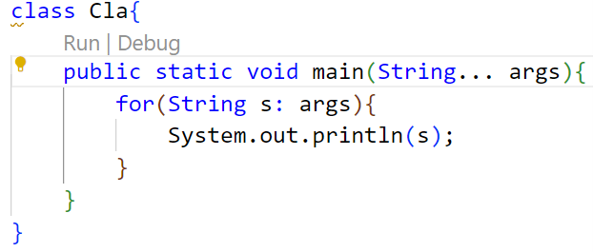
Example-3 : CLA using varargs
OUTPUT:

Slide 62
Type Conversion & Type Casting
A significant part of programming involves playing around with data. While performing some tasks, situations might arise where the data type has to be changed from one type to another.
For example, while calculating the area of a circle using Pi, we get a decimal number, and that needs to be converted to integer if we desire to obtain the answer in integer format.
Since Java is strongly typed, one often needs to convert from one data type to another. The programmer or the compiler can easily do this by using type casting and type conversion concepts.

Slide 63
Type Conversion
Type conversion is a process in which the data type is automatically converted into another data type. The compiler does this automatic conversion at compile time.
For type conversion to take place, the destination data type must be larger than the source type.
This type of type conversion is also called Widening Type Conversion/ Implicit Conversion/ Casting Down. In this case, as the lower data types with smaller sizes are converted into higher ones with a larger size, there is no chance of data loss.

Slide 64

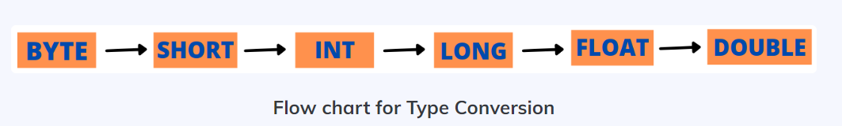
Type Conversion

Slide 65
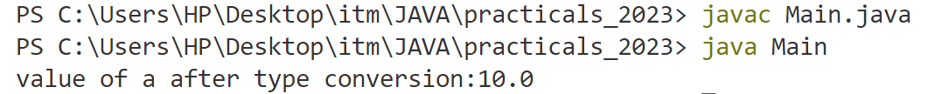
Type Conversion
class Main {
public static void main(String[] args) {
int a= 10;
float b=a;
System.out.println( “value of a after type conversion:” + b);
}
}

Slide 66
Type Casting
Type casting is a process in which the programmer manually converts one data type into another data type. For this the casting operator (), the parenthesis is used. Unlike type conversion, the source data type must be larger than the destination type in type casting. The below flow chart has to be followed for successful type casting.
Type casting is also called Narrowing Type Casting/ Explicit Conversion/ Casting Up. In this case, as the higher data types with a larger size are converted into lower ones with a smaller size, there is a chance of data loss. This is the reason that this type of conversion does not happen automatically.

Slide 67

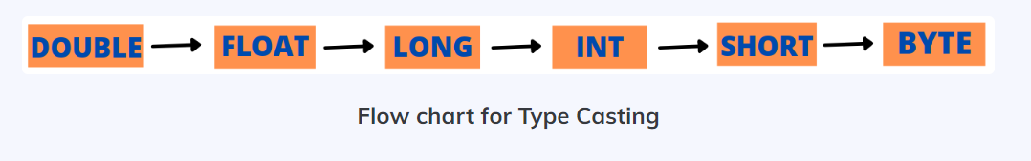
Type Casting

Slide 68
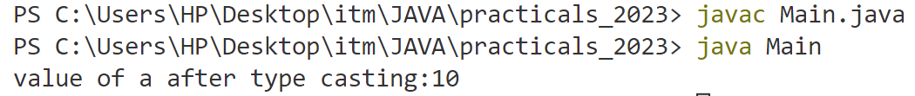
Type Casting
class Main {
public static void main(String[] args) {
float a= 10.56f;
int b=int(a);
System.out.println( “value of a after type casting:” + b);
}
}

Slide 69
Reserved Words/Keywords
Reserved words or keywords are words that have a specific meaning to the compiler and cannot be used for other purposes in the program.
For example, when the compiler sees the word class, it understands that the word after class is the name for the class.
Below are the keywords that are used in Java:

Slide 70
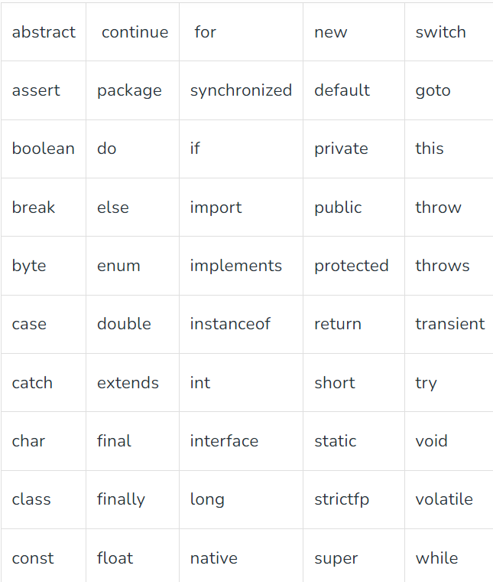
Reserved Words/Keywords

Slide 71
Comments
In Java, comments are preceded by two slashes (//) in a line, or enclosed between /* and */ in one or multiple lines.
When the compiler sees //, it ignores all text after // in the same line.
When it sees /*, it scans for the next */ and ignores any text between /* and */.
Comments in a program are called inline documentation

Slide 72
Access Modifiers
There are four types of Java access modifiers:
Private: The access level of a private modifier is only within the class. It cannot be accessed from outside the class.
Default: The access level of a default modifier is only within the package. It cannot be accessed from outside the package. If you do not specify any access level, it will be the default.
Protected: The access level of a protected modifier is within the package and outside the package through child class. If you do not make the child class, it cannot be accessed from outside the package.
Public: The access level of a public modifier is everywhere. It can be accessed from within the class, outside the class, within the package and outside the package.

Slide 73
Operators
An operator is a symbol that performs an operation. An operator acts on variables called operands.
We can divide all the Java operators into the following groups:
  Arithmetic Operators
  Relational Operators
  Bitwise Operators
  Logical Operators
  Assignment Operators
  Special Operators

Slide 74
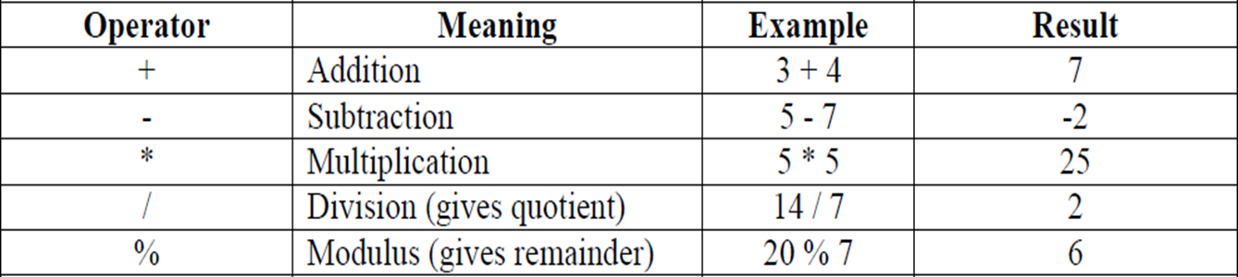
Operators: Arithmetic Operators

Slide 75
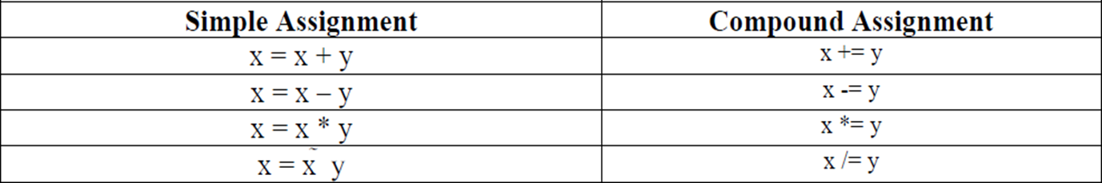
Operators: Assignment Operators

Slide 76
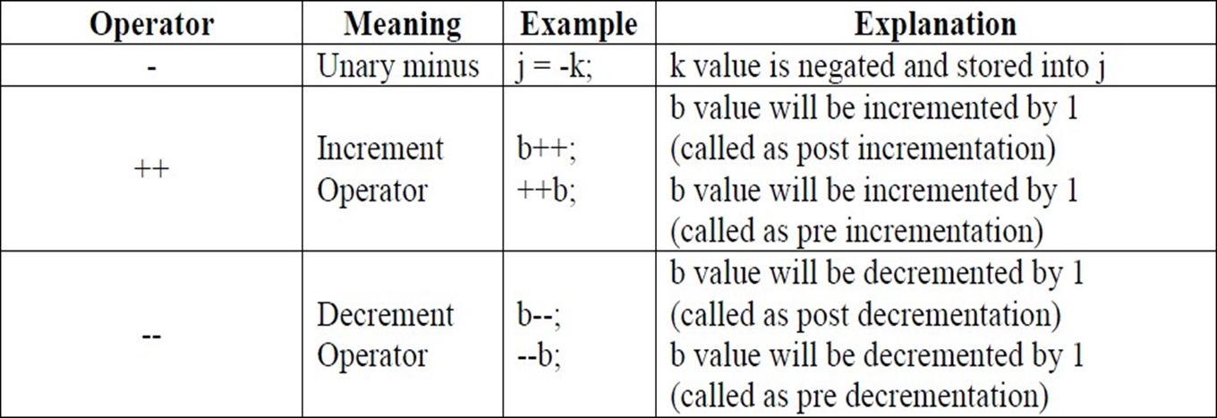
Operators: Unary Operators

Slide 77
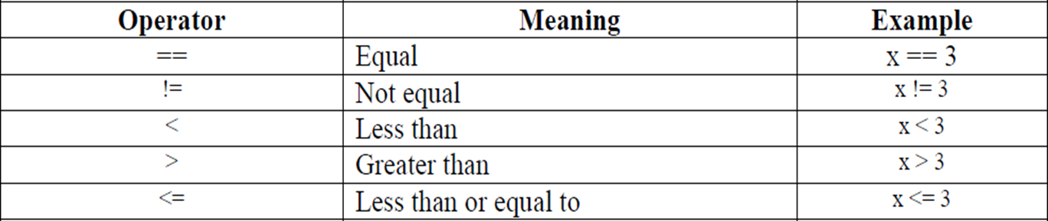
Operators: Relational Operators

Slide 78
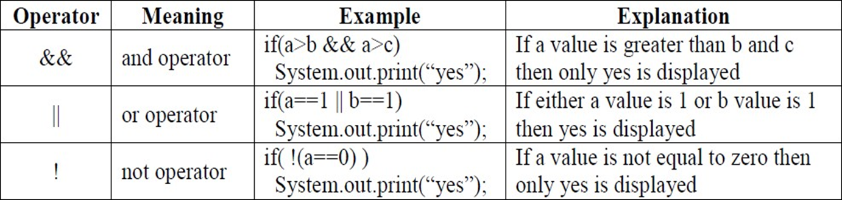
Operators: Logical/ Short Circuit Operators

Slide 79
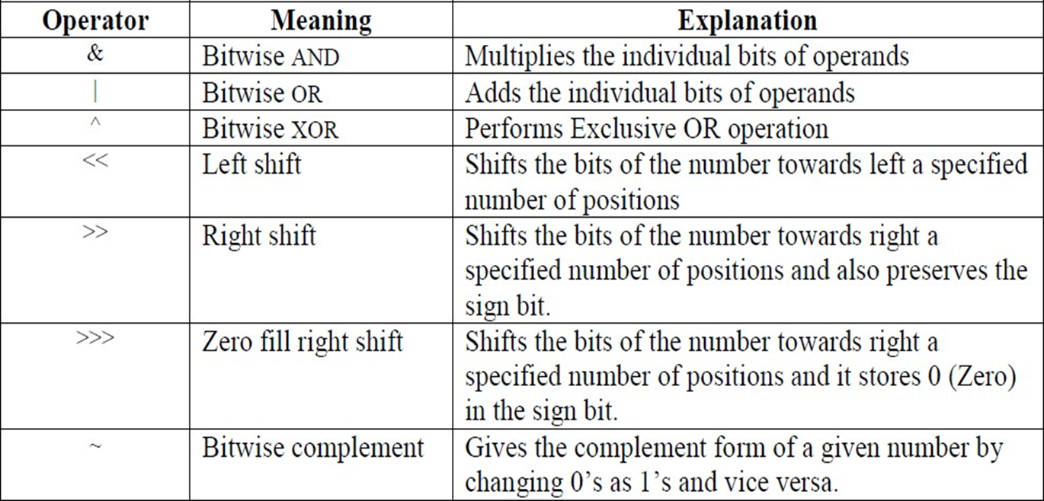
Operators: Bitwise Operators

Slide 80
Operators: Ternary/ Conditional Operators
This operator is called ternary because it acts on 3 variables. The syntax for this operator is:
Variable = Expression1? Expression2: Expression3;
First Expression1 is evaluated. If it is true, then Expression2 value is stored into variable otherwise Expression3 value is stored into the variable.
e.g.: max = (a>b) ? a: b;

Slide 81
Special Operator: instanceof
Java supports some special operator of interest such as instanceof operator.
The Instanceof is an object reference operator and returns true if the object on the left-hand side is instance of the class given on the right-hand side.
Example-
person instanceof student
It is true if the object person belongs to the class student, otherwise it is false.

Slide 82
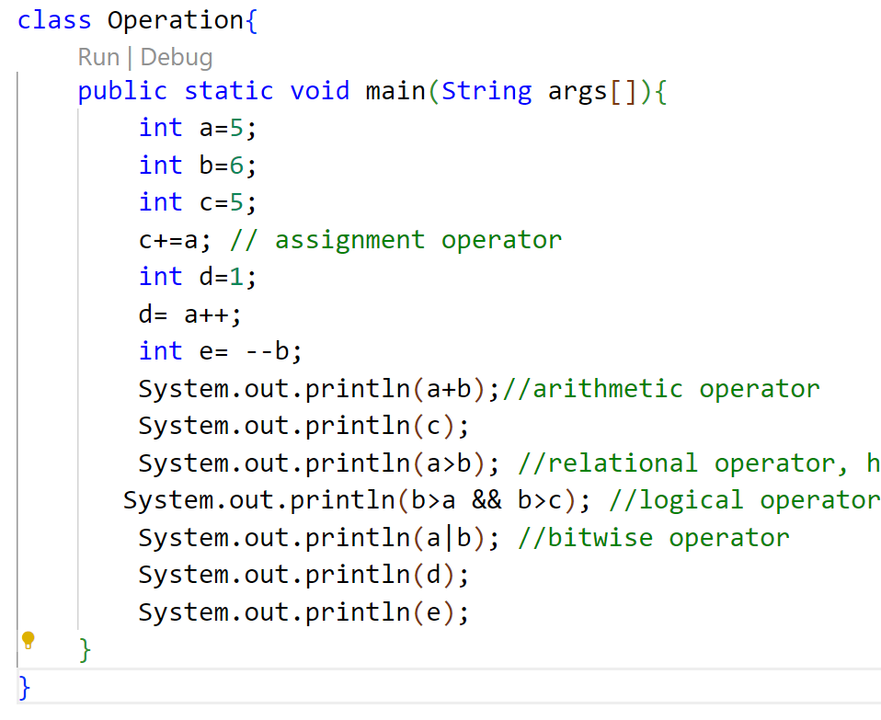
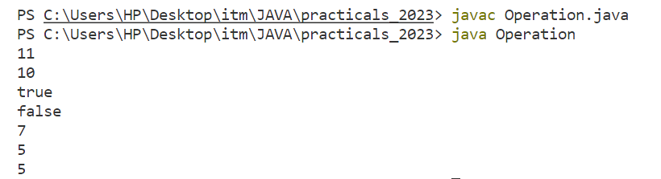
Operator: Example
Output

Slide 83
Control Statements
Control statements are the statements which alter the flow of execution and provide better control to the programmer on the flow of execution.
In Java control statements are categorized into:
  Selection/Decision making control statements
  Iteration/Looping control statements
  Jump control statements

Slide 84
Selection Statements
decision-making statements decide which statement to execute and when to execute.
Decision-making statements evaluate the Boolean expression and control the program flow depending upon the result of the condition provided.
There are two types of decision-making statements in Java”
  If statement: if, if-else, if-elseif ,nested if
  switch statement

Slide 85
if statement
if statement performs a task depending on whether a condition is true or false.
Syntax: if(condition){
//statements
}
NOTE: here if the condition gets false, no output will be displayed
Example:
int a=5;
if(a> 10){
System.out.println(“Given condition is true”)
}

Slide 86
if-else statement
if statement performs a task depending on whether a condition is true or false. If block specify a block of code to be executed if the condition is true & else block specify a block of code to be executed if the condition is false
Syntax: if(condition){
//statements
}
else{
//Statements
}
Example:
int a=5;
if(a> 10){
System.out.println(“Given condition is true”)
}
else{
System.out.println(“Given condition is false”)
}

Slide 87
else if statement
the else if statement is used to specify a new condition if the first condition is false.
Example:
int a=5;
if(a> 10){
System.out.println(“Value of a: ” +a);
}
else if(a==10){
System.out.println(“Value of a: ” +a);
}
else{
System.out.println(“Given condition is false”);
}
Syntax: if(condition){
//statements
}
else if(condition){
//statement
}
else{
//Statements
}

Slide 88
Nested if statement
If the inner condition satisfies then only outer if will be executed. Along with if conditions we can write else conditions also.
Example:
int a=5;
if(a< 10){
if(a==7){
System.out.println(“Value of a: ” +a);
}
else{
System.out.println(“Given condition is false”);
}
Syntax: if(condition){
//statements
if(condition){
//statement
}
}
else{
//Statements
}

Slide 89
Switch case
Switch Statement: When there are several options and we have to choose only one option from the available ones, we can use switch statement.
Syntax: switch (expression){
Case value1: //statements;
case value2: //statements;
.
.
.
default: //statement
}

Slide 90
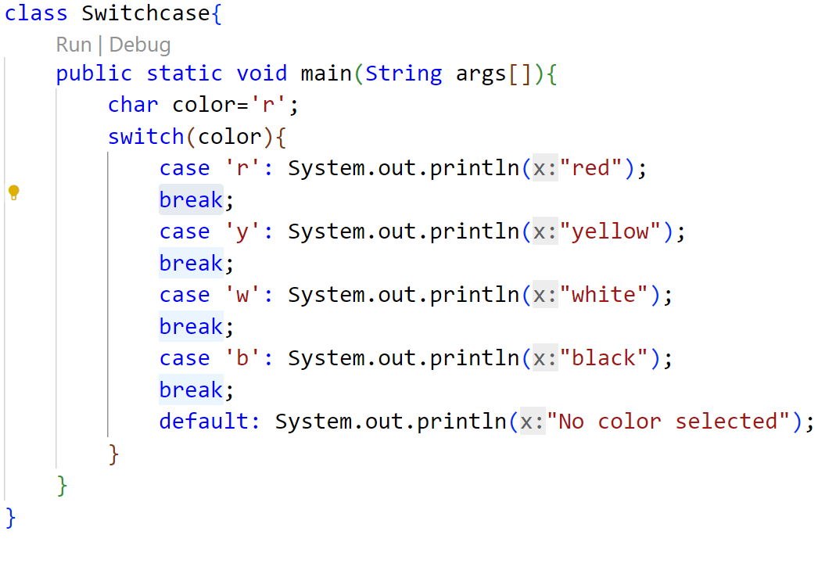
Switch case: example1
OUTPUT

Slide 91
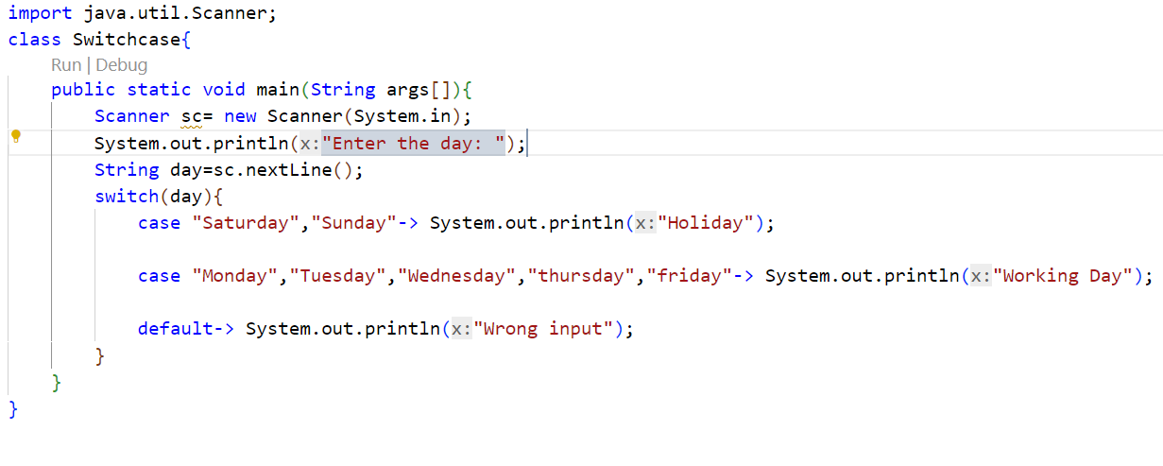
Switch case: example2(Without break)

Slide 92
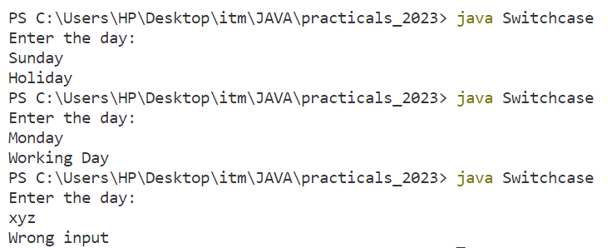
Switch case: example2(Without break)
OUTPUT

Slide 93
Looping/Iteration Statements
Iteration statements in java are for, while and do-while.
These statements are used to repeat same set of instructions specified number of times called loops.
A loop repeatedly executes the same set of instructions until a termination condition is met.

Slide 94
While loop
while loop repeats a group of statements as long as condition is true.
Once the condition is false, the loop is terminated.
In while loop, the condition is tested first; if it is true, then only the statements are executed. while loop is called as entry control loop.
Syntax: while (condition)
{
//Statements;
}

Slide 95
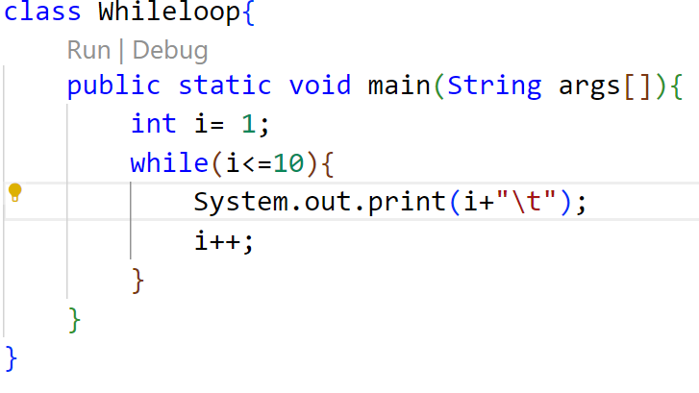
While loop: Example
OUTPUT

Slide 96
do-while loop
do…while loop repeats a group of statements as long as condition is true.
In do...while loop, the statements are executed first and then the condition is tested.
do…while loop is also called as exit control loop.
Syntax: do{
//statements;
} while (condition);

Slide 97
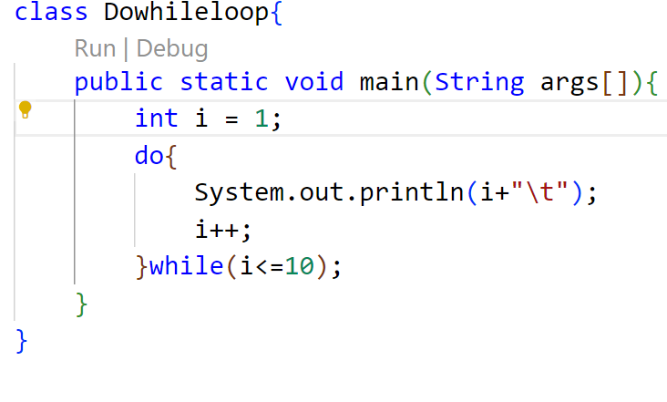
do-while loop: Example
OUTPUT

Slide 98
for loop
The for loop is also same as do…while or while loop, but it is more compact syntactically.
The for loop executes a group of statements as long as a condition is true.
Syntax: for (initialisation; condition; inc/dec)
{
//Statements;
}

Slide 99
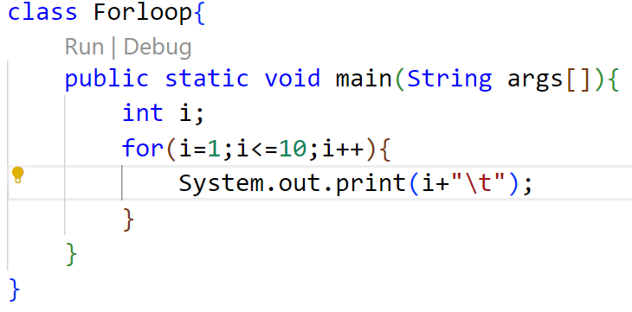

for loop: Example
OUTPUT

Slide 100
Jump Statement
Java supports three jump statements:
  break
  continue
  return.
These statements transfer control to another part of the program.

Slide 101
Break Statement
break can be used inside a loop to come out of it.
break can be used inside the switch block to come out of the switch block.
break can be used in nested blocks to go to the end of a block. Nested blocks represent a block written within another block.
Syntax:
break; (or)
break label; //here label represents the name of the block.

Slide 102
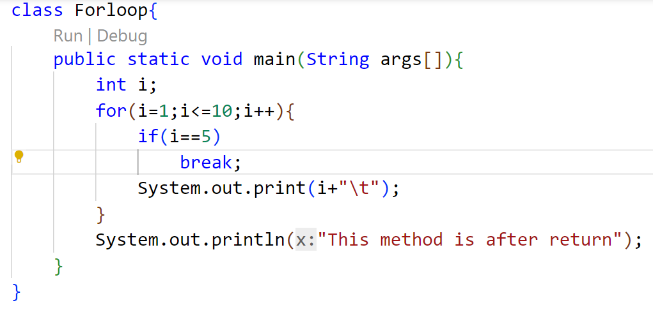
Break: Example
OUTPUT

Slide 103
Continue statement
This statement is useful to continue the next repetition of a loop/ iteration.
When continue is executed, subsequent statements inside the loop are not executed.
Syntax: continue;

Slide 104
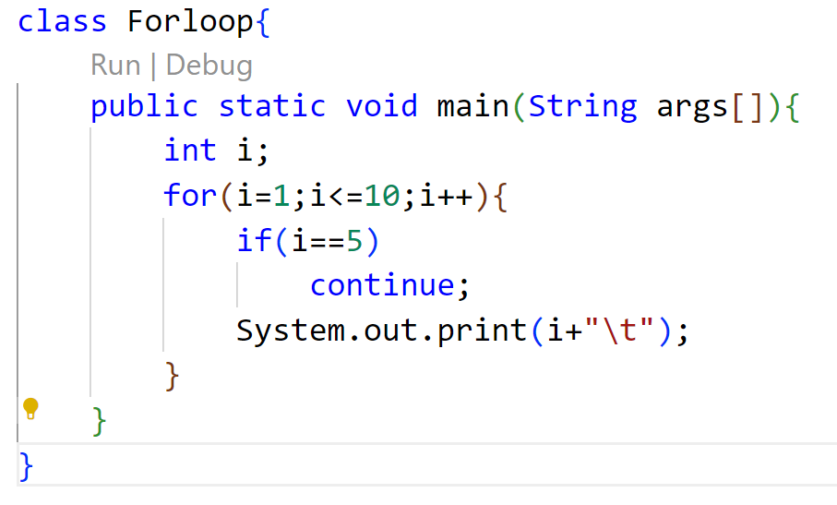
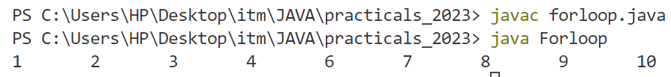
Continue: Example
OUTPUT

Slide 105
Return statement
return statement is useful to terminate a method and come back to the calling method.
return statement in main method terminates the application.
return statement can be used to return some value from a method to a calling method.
Syntax:
return; (or)
return value; // value may be of any type

Slide 106
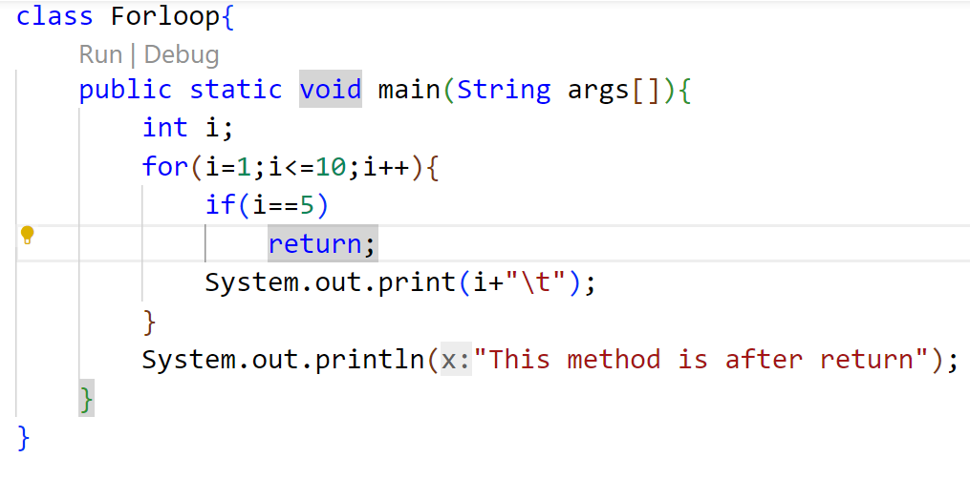

Return: Example
OUTPUT

Slide 107
Array
An array represents a group of elements of same data type. Arrays are generally categorized into two types:
  Single Dimensional arrays (or 1 Dimensional arrays)
  Multi-Dimensional arrays (or 2 Dimensional arrays, 3 Dimensional arrays, …)
Creating an array
  Declare an array
  Create memory location
  Putting values to memory locations

Slide 108
Declaring array variable
To declare an array, write the data type, followed by a set of square brackets[ ], followed by the identifier name.
datatype[] arrayRefvar; // preferred way.
or
dataType arrayRefVar[]; // works but not preferred way.
double[] myList;
or
double myList[];

Slide 109
Array Creation
To create array, write the new keyword, followed by the square[ ] brackets containing the number of elements you want to have in array.
For Example:
Or
int arr[ ]; //declaration
arr[ ] = new int[10]; //object creation
int arr[ ] = new int[10]; //declare & object creation

Slide 110
Array Creation
Another way to create array if the elements are known:
Example:
int arr[ ]={//array elements with comma operator };
int arr[] = {10,20,30,40,50};

Slide 111
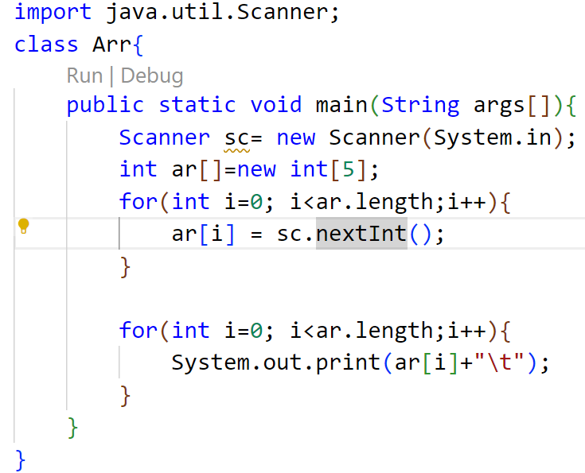
Example 1

Slide 112
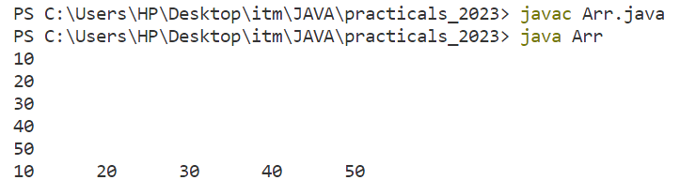
Example 1
OUTPUT

Slide 113
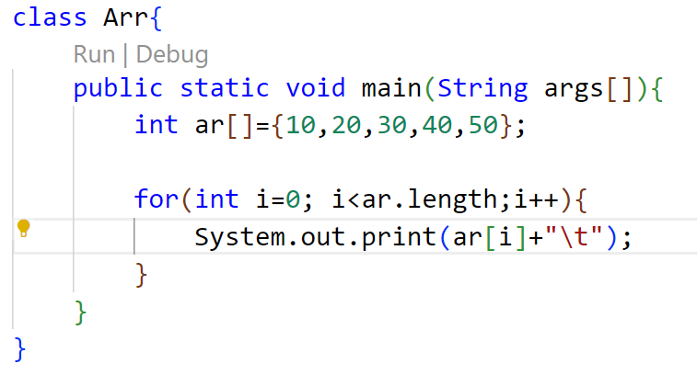

Example 2
OUTPUT

Slide 114
Array Length
In order to get the number of elements in an array, you can use the length field of an array.
The length field of an array returns the size of the array.
Syntax:-
arrayName.length

Slide 115
For each loop
The for-each loop is used to traverse array or collection in Java. It is easier to use than simple for loop because we don't need to increment value and use subscript notation.
It works on the basis of elements and not the index. It returns element one by one in the defined variable.
Syntax:
for(datatype var: arrayname){
//statement
}

Slide 116
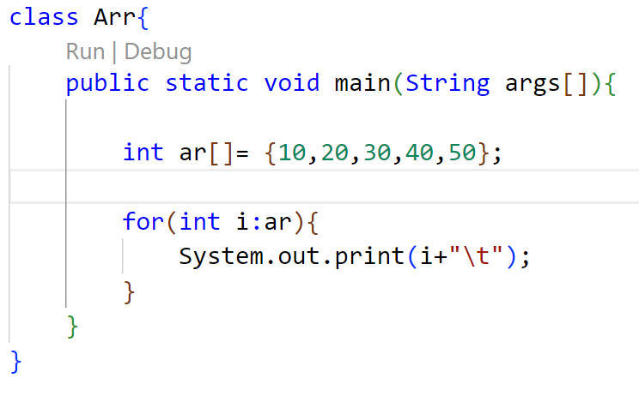
Example
OUTPUT

Slide 117
Multi-dimensional array
A multidimensional array is an array of arrays. That is, each element of a multidimensional array is an array itself.
For example:
int[][] arr={{1,2,3},{4,5,6}}
To access the elements of the arr array, specify two indexes: one for the array, and one for the element inside that array.

Slide 118
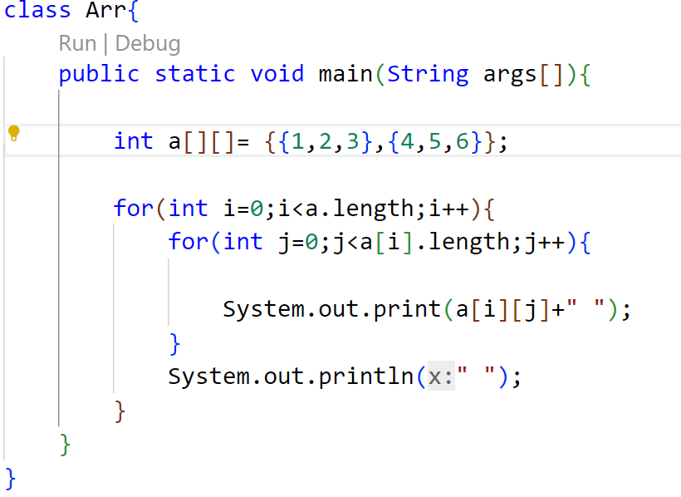

Multi-dimensional array: using for loop
OUTPUT

Slide 119
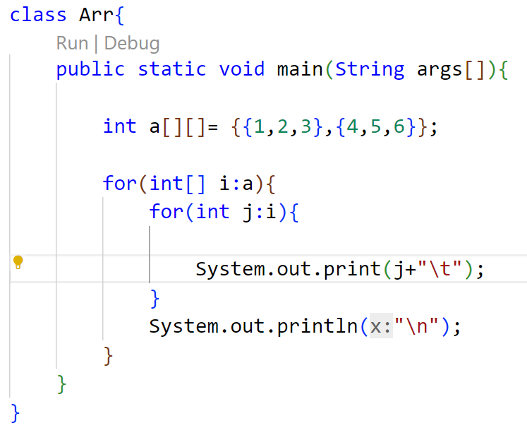
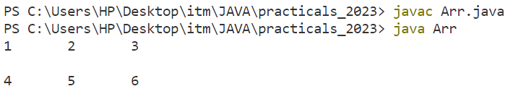
Multi-dimensional array: using for each loop
OUTPUT

Slide 120
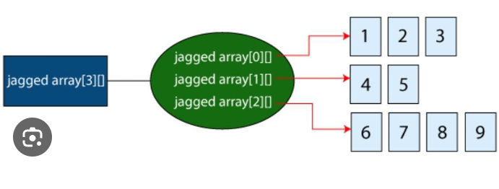
Jagged array
Jagged array are the multidimensional arrays with different size

Slide 121
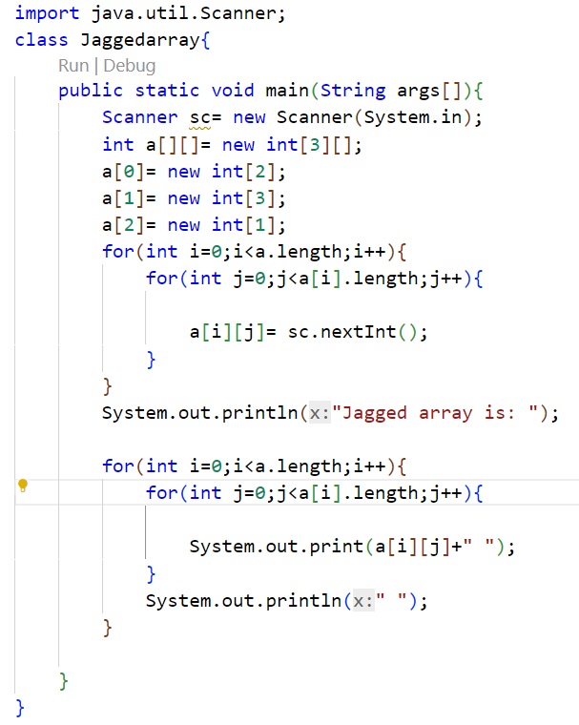
Jagged array

Slide 122
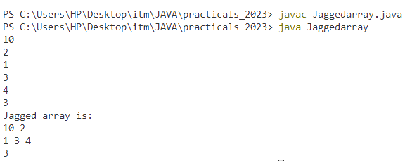
Jagged array
OUTPUT

Slide 123
Advantages & disadvantages of array
Advantages:
Code Optimization: It makes the code optimized, we can retrieve or sort the data efficiently.
Random access: We can get any data located at an index position.
Disadvantages:
Size Limit: We can store only the fixed size of elements in the array. It doesn't grow its size at runtime. To solve this problem, collection framework is used in Java which grows automatically.

Slide 124
String
Strings are very important in the world of programming languages as they are used to process long textual/symbolic information.
Strings are considered fundamental data types in almost all programming languages. These languages use character arrays to process long textual information.
In java, string class is provided to work with strings along with the facility of character arrays.
The strings are immutable as once an object of the String class is created & initialized with some value, it cannot be changed.

Slide 125
String
To handle string data in Java, we require objects of the String class.
The String class is included in the java.lang package. Therefore each class can use the String class without importing any package.
Example: String str = “Hello”

Slide 126
Operation on String
The string class in java provides various methods that enable you to perform various tasks like:
Convert a string into a character
Convert numbers into strings
Search strings
Create substrings
Change the case of string
Get a string length
Compare strings

Slide 127
length() method
The length method returns the length of the a string. This method calculates all the characters, symbols & numbers enclosed in double quotes (“”).
The method returns an integer value
Syntax:
varname.length()
Example:
String a=“hello”;
System.out.println(“The length of a string is: ”+a.length);

Slide 128
toLowerCase()
toUpperCase()
The toLowerCase() method returns a string after converting all uppercase letters of the invoking string into lowercase.
Syntax: stringname.toLowerCase()
The toUpperCase() method returns a string after converting all lowercase letters of the invoking string into Uppercase.
Syntax: stringname.toUpperCase()

Slide 129
substring()
This method returns a new String instance that is a substring of the original String instance.
The substring() method is available in the following two forms:
substring(int begin)
It takes a single parameter, which creates a new string that begins at the index specified by the argument value & ends at the last character of the string.
Example:
String str = “EDUCATION”
system.out.println(str.substring(4));

Slide 130
substring()
substring(int begin, int end)
This takes two parameters, the starting index and the ending index.
The character at the start index is included in substring but the character at the end index is not.
Example:
String str = “EDUCATION”
System.out.println(str.substring(3,6));

Slide 131
concat()
We can concatenate strings in two ways
Using addition(+)operator
Using concat() method.
Example:
String str = “Hello”
String str1 = “Java”
System.out.println(str+str1);
System.out.println(str.concat(str1));

Slide 132
equals & equalsIgnoreCase()
These methods are used for comparing two strings.
equals() compare the positions of the individual characters in a string.
The equalsIgnoreCase() method does the same but ignores the case of characters
Example:
String str = “Java is oopl”
String str1 = “JAVA IS OOPL”
System.out.println(str.equals(str1));
System.out.println(str.equalsIgnoreCase(str1));

Slide 133
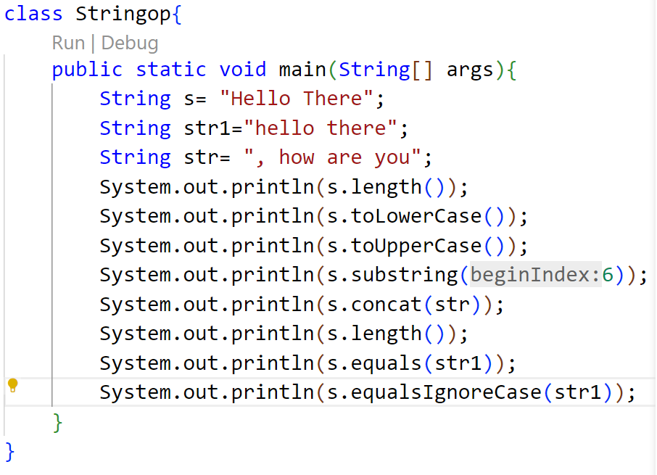
Example

Slide 134
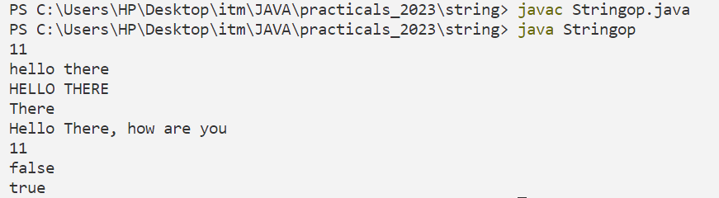
Example
OUTPUT

Slide 135
Stringbuffer
StringBuffer class gives the facility to create a sequence of characters with mutable (modifiable) attributes.
Syntax:
StringBuffer str = new StringBuffer();
The various StringBuffer methods are:
length()
capacity()
reverse()
append()
insert()
delete()
deleteCharAt()
replace()

Slide 136
length()
It defines the number of characters in the String.
Example:
StringBuffer str = new StringBuffer("ContentWriter");
int len = str.length();
System.out.println("Length : " + len); } }

Slide 137
capacity()
It defines the capacity of the string occupied in the buffer. The capacity method also counts the reserved space occupied by the string.
The default capacity of the stringbuffer is of 16 characters.
If the number of the character increases from its current capacity, it increases the capacity by (oldcapacity*2)+2.
Example:
StringBuffer str = new StringBuffer("ContentWriter");
int cap = str.capacity();
System.out.println("Capacity : " + cap); //capacity= str+16=29

Slide 138
append()
The append() method is used to append the string or number at the end of the string.
Example:
StringBuffer str = new StringBuffer(“Hello");
str.append(“java");
System.out.println(str);
str.append(0);
System.out.println(str);

Slide 139
insert()
The insert() method is used to insert the string into the previously defined string at a particular indexed position.
In the insert method as a parameter, we provide two-argument, first is the index and second is the string.
Example:
StringBuffer stringName = new StringBuffer(" Welcome");
System.out.println(stringName);
stringName.insert(8, " to java");
System.out.println(stringName);

Slide 140
reverse()
The reverse() method reverses all the characters of the object of the StringBuffer class. And, as an output, this method returns or gives the reversed String object.
Example:
StringBuffer sb = new StringBuffer("Welcome to Java");
System.out.println("Original String: " + sb);
stringName.reverse();
System.out.println("Reversed String: " + sb);

Slide 141
delete()
The delete() method deletes a sequence of characters from the StringBuffer object.
Syntax:
stringName.delete(int startIndex, int endIndex)
Example:
StringBuffer sb= new StringBuffer(“welcometojava");
System.out.println("Original String: " + sb);
myString.delete(0, 4);
System.out.println("String after deleting sequence of characters: " + sb);

Slide 142
deleteCharAt()
The deleteCharAt() method deletes only the character at the specified index.
Syntax:
stringName.deleteCharAt(int index)
Example:
StringBuffer sb= new StringBuffer(“Welcome to java");
System.out.println("Original String: " + sb);
myString.deleteCharAt(7);
System.out.println("Resulting String " + sb);

Slide 143
replace()
The replace() method of the StringBuffer class replaces a sequence of characters with another sequence of characters.
Syntax:
stringName.replace(int startIndex, int endIndex, String string)
Example:
StringBuffer s = new StringBuffer(“Welcome to java");
System.out.println("Original String: " + s);
s.replace(12, 15, "Tutorial");
System.out.println("Resulting String after replacing: " + s);

Slide 144
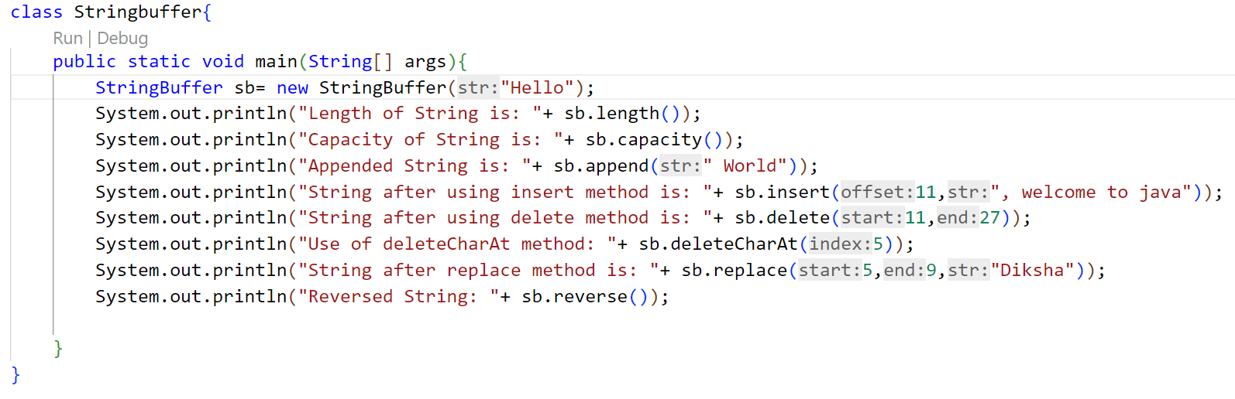
Example

Slide 145

Example

Slide 146
Wrapper Class
In java, wrapper classes are used to convert primitive types into class objects.
Basically, generic classes only work with objects and don't support primitives. As a result, if we want to work with them, we have to convert primitive values into wrapper objects.
Each primitive type has corresponding wrapper classes.
All wrapper classes belongs to the java.lang package

Slide 147

Wrapper Class

Slide 148
Need of Wrapper Class
Whenever the primitive types are required as an object, wrapper classes can be used. Wrapper classes also include methods to unwrap the object and give back the data type.
In java.util package, the classes handle only objects. In this case wrapper class are helpful as they convert primitive data type to objects.
In the Collection framework, Data Structures such as ArrayList store data only as objects and not the primitive types.
Wrapper classes have methods that support object creation from other object types such as string.
Wrapper classes are also used for synchronization in multithreading. As in synchronization process, we try to achieve that the shared resource will be used by only one thread at a time. Objects are needed for this.

Slide 149
Wrapper Class
Creating wrapper object:
Using wrapper class constructor //deprecated
Using wrapper class only
Using valueOf() method

Slide 150
Using wrapper class constructor
•We can create a wrapper object using the wrapper class and its constructor by passing the value to it.
Syntax:
ClassName object = new ClassName(argument);
Example:
Integer number = new Integer(58);
However, the way of creating an instance of wrapper classes using constructor is deprecated as of the latest version of JDK.
This is because each time new memory is allocated in the heap when we create an object with the help of the constructor.
Also, the constructor Character(char) has been deprecated since JDK version 9.

Slide 151
Using Wrapper Class
We can create without using constructor as well by using the wrapper class instead of the primitive type to create a wrapper object without passing the value to the constructor
To get the value, we can print the particular object.
Syntax:
ClassName object = value;
Example:
Integer intValue = 10;
System.out.println(intValue);

Slide 152
Using valueof() method
By using valueOf Static method, a Wrapper object can be created.
Syntax:
ClassName object = ClassName.valueOf(argument);
Example:
int a= 10;
Integer num= Integer.valueOf(a);

Slide 153

Wrapper class methods

Slide 154
Autoboxing
Autoboxing is when the Java compiler performs the automatic conversion of the primitive data types to the object of their corresponding wrapper classes. For example, converting an int to Integer, a double to Double, etc.
The Java compiler applies autoboxing when a primitive value is:
Passed as a parameter to a method that expects an object of the corresponding wrapper class.
Assigned to a variable of the corresponding wrapper class.
To explicitly convert primitive to object we use valueOf() method.

Slide 155

Autoboxing: Example

Slide 156

Autoboxing: Example
OUTPUT

Slide 157
Auto-Unboxing
Unboxing is automatically converting an object of a wrapper type (Integer, for example) to its corresponding primitive (int) value.
The Java compiler applies unboxing when an object of a wrapper class is:
Passed as a parameter to a method that expects a value of the corresponding primitive type.
Assigned to a variable of the corresponding primitive type.
To explicitly convert object to corresponding primitive type we use xxxValue() method.

Slide 158

Auto-Unboxing: Example

Slide 159

Auto-Unboxing: Example
OUTPUT

Slide 160
toString() method
The toString() method returns the String representation of the object.
If you print any object, Java compiler internally invokes the toString() method on the object. So overriding the toString() method, returns the desired output, it can be the state of an object etc. depending on your implementation.

Slide 161


toString() method

Slide 162

parseXXX() method
parseXXX() method is use to convert String to a primitive type.

Slide 163

parseXXX() method

