Slide 1

UNIT 01
Basics of Java & Array & String
An introduction to fundamental programming structures, memory manipulation, and standard class APIs in Java.
Prepared By: Asst. Prof. Jeeten Dave
class JavaBasics {
public static void main(String[] args) {
// Fundamental building blocks
String unit = "Basics of Java";
String[] topics = {"Array", "String"};
System.out.println(unit);
}
}

Slide 2
Topics in this Unit
Basics of Java
Features of Java
Byte Code and Java Virtual Machine
Java Development Kit (JDK)
Data Types & Operators
Control Statements (if-else, switch, loops, break, continue)
Array & String
Single & Multidimensional Arrays
String & String Buffer Classes
Operations on Strings
Command Line Arguments
Use of Wrapper Classes

Slide 3
UNIT 01
History & Evolution of Java
A journey through the architectural shifts, language lineage, and core design principles that shaped the world's most robust programming language.
C
1972 Efficiency
Direct hardware manipulation and modular programming.
C+
1983 Object Orientation
Introduced classes, encapsulation, and abstractions.
J
1995 Platform Independence
"Write Once, Run Anywhere" via the JVM.

Slide 4
Introduction to Java
More than a Coffee Bean
While the name literally translates to a coffee bean, Java is a powerful, robust programming language. Its creation was fueled by two fundamental drivers of technological innovation.
Language Evolution
Why Computer Languages Evolve
01. Environmental Adaptation
To adopt to changing environments and uses.
02. Architectural Refinement
To implement refinements and improvements in the art of programming.

Slide 5
LINEAGE & INFLUENCE
Java’s Lineage
The creation of Java was rooted in the continuous process of refinement and adaptation, inheriting its core character from its predecessors.
01. Direct Descent
Java is closely related to C++, which is a direct descendant of the C language.
02. Character Inheritance
It inherits much of its fundamental character and syntax from C and C++.
03. Object-Oriented Influence
Java's robust Object-Oriented features were heavily shaped as responses to C++.

Slide 6
THE FOUNDATION
The Birth of C
C fundamentally changed how programming was approached. It emerged from the critical need for a structured, efficient, and high-level language to replace assembly when creating system programs.
ASSEMBLY VS. C
Bridging the Hardware Gap
Assembly language communicates directly with computer hardware. C replaces complex low-level statements with cleaner, structured equivalents.
ASSEMBLY CODE
add a, b, c
C LANGUAGE Equivalent
a = b + c;

Slide 7
Language Design
The Trade-offs
Prior to C, programmers had to choose between languages that optimized one set of traits over another, forcing critical compromises.
➔Ease-of-use vs. Power
➔Safety vs. Efficiency
➔Rigidity vs. Extensibility
Historical Limitations
FORTRAN
Efficient for scientific applications, but unsuitable for system-level code.
BASIC
Easy to learn, but lacks power and structured programming models.
Assembly Language
Highly efficient, but extremely difficult to learn, write, and debug.

Slide 8
Historical Challenges
Spaghetti Code
Early computer languages like BASIC, COBOL, and FORTRAN were not designed around structured principles, creating immense maintenance hurdles.
➔The GOTO Reliance: Relied upon GOTO as a primary means of program control.
➔Tangled Logic: Produced tangled jumps that made code virtually impossible to understand.
The Pascal Limitation
Structured but Inefficient
While Pascal adopted structured programming models, it was severely limited by performance constraints and lack of language features.
Efficiency Issues
Failed to include crucial features necessary to make it applicable to a wide range of programs.
System-Level Barrier
Given standard dialects at the time, it was impractical to use Pascal for writing operating systems or system-level code.

Slide 9
Historical Context
A Pressing Need
By the 1970s, the computer revolution was at its peak. Software demand rapidly outpaced programmers' ability to produce it.
➔ Unreconciled Traits: No single language had successfully combined efficiency, power, and structure.
Language Evolution
The Lineage of C
BCPL Language
Created by Martin Richards, starting the development process of system languages.
B Language
Invented by Ken Thompson, directly influenced by BCPL and leading to C in the 1970s.
C Language & Unix
First implemented by Dennis Ritchie on Unix, combining efficiency with high-level power.

Slide 10
Language Philosophy
A Programmer's Language
C marked the beginning of the modern age of computer languages, successfully synthesizing conflicting attributes into a powerful, efficient, and structured tool.
➔ UNIX Standard: For years, the de facto standard was UNIX-supplied.
➔ ANSI Adoption: Formally standardized in December 1989.
The Design Legacy
Built for Working Developers
Unlike earlier languages designed as academic exercises or by bureaucratic committees, C was built, implemented, and developed by real, working programmers.
Honed by Real Use
Its features were honed, tested, and constantly rethought by the actual people who used the language to solve real-world problems.
Java's Heritage
C is truly a language designed by and for programmers. Java directly inherited this legacy.

Slide 11
Language Evolution
C++: The Next Step
Throughout computing history, rising program complexity has driven the need for better management. C++ emerged as a direct response to this challenge.
➔ Structured Roots: Building on C's 1960s legacy to push past the limits of structured programming.
Milestones
Handling Complexity
1. Binary Toggling
Manual input of binary machine instructions. Only viable for very small programs.
2. Assembly Language
Introduced symbolic representations, helping programmers manage growing applications.
3. High-Level Structured Code
FORTRAN and C introduced advanced tools and structured paradigms to handle complex logic.

Slide 12
Language Evolution
Breaking Limits
C++ added features that enabled the complexity threshold to be broken, allowing programmers to comprehend and manage much larger systems.
➔ C Foundation: Built on C, retaining all of its original features, attributes, and structural benefits.
➔ An Enhancement: Not an attempt to create a completely new language, but to enhance a highly successful one.
Milestones
The Birth of C++
1. Bjarne Stroustrup (1979)
Invented while working at Bell Laboratories in Murray Hill, New Jersey.
2. "C with Classes"
The original name given to the language during its early development stage.
3. Official Shift (1983)
The name was formally changed to C++, bringing object-oriented programming to the main stage.

Slide 13
Language Evolution
Limits of Complexity
While structured languages enabled programmers to write moderately complex programs, software eventually reaches a threshold where its size exceeds what can be managed.
➔ The OOP Solution: A new programming methodology invented in the early 1980s to organize complex code.
Milestones
Organizing Complex Programs
1. Inheritance
Allows code reuse and hierarchical classification, streamlining system development.
2. Encapsulation
Binds code and data together to keep them safe from outside interference.
3. Polymorphism
Enables a single interface to control access to a general class of actions.

Slide 14
Language Origin
The Genesis of Java
Conceived in 1991 at Sun Microsystems, Java arose not from the Internet, but from a need for architecture-neutral software for consumer devices.
➔ The Core Problem: C/C++ programs require expensive, time-consuming compiler targets for every specific CPU.
➔ Platform-Independent: An easier, cost-efficient solution was needed to support diverse embedded electronic systems.
Milestones
Evolutionary Timeline
1. Conception (1991)
Conceived by James Gosling and team at Sun Microsystems. Development took 18 months.
2. Initially "Oak"
The language was originally named Oak, but later renamed to Java in 1995.
3. Consumer Devices & Beyond
Initially designed to run embedded software within target electronic systems like microwave ovens.

Slide 15
Language Catalyst
The Web Synergy
James Gosling and his team designed a portable, platform-independent language to run code across differing environments.
➔ Consumer Phase: Without the Web, Java may have remained an obscure consumer electronics language.
➔ The Internet Boom: The rapid rise of the World Wide Web perfectly matched Java's unique portable nature.
Milestones
Propelled to the Forefront
1. Portable Foundations
Engineered to yield platform-independent code capable of running across highly diverse CPU architectures.
2. The Web Emerges
The World Wide Web took shape simultaneously as the language was being actively implemented by its creators.
3. Forefront of Design
The massive digital push for portable applications propelled Java straight into internet programming dominance.

Slide 16
Language Pivot
The Internet Shift
By 1993, the Java team realized that the same portability challenges faced in embedded controllers were exactly what the emerging Internet needed to solve.
➔ The Embedded Link: Portability issues in controller code mirrored the programming demands of the early Web.
➔ The Great Pivot: This profound realization shifted Java's focus entirely from consumer devices to Internet programming.
Milestones
Propelled to Success
1. The Portability Spark
The urgent desire for an architecture-neutral programming language provided the initial development spark.
2. Internet Expansion
A problem originally addressed on a small scale was seamlessly scaled up to meet massive web demands.
3. Massive Adoption
Aligning Java with the growth of the Internet ultimately transformed it and secured its monumental, large-scale success.

Slide 17
Language Heritage
C/C++ Foundation
Java intentionally derives much of its character from C and C++ to ensure instant appeal to experienced developers.
➔ Familiar Syntax: Designed to echo C/C++ features to appeal to legions of programmers.
➔ Shared Success: Incorporates the same fundamental attributes of its predecessors.
Milestones
A Programmer's Language
1. Real-World Refinement
Grounded in the core needs, challenges, and practical experiences of real, working programmers.
2. Cohesive & Logical
Provides complete logical consistency and full structural control directly to the developer.
3. No Training Wheels
An uncompromising environment engineered specifically for professional application design.

Slide 18
Language Relationship
Not a Upgrade
While Java shares significant syntax with C++, it is not an enhanced version or a direct replacement. They operate in parallel.
➔ Incompatible: Java is neither upwardly nor downwardly compatible with C++.
➔ Familiarity: C++ programmers will feel right at home due to strong similarities.
Coexistence
Different Problem Spaces
1. Java's Design Domain
Java was specifically designed from the ground up to solve a unique set of network and portability problems.
2. C++'s Design Domain
C++ was built to tackle a completely different set of engineering challenges, primarily focusing on system-level control.
3. Shared Future
Neither language replaces the other; both are destined to coexist productively for many years to come.

Slide 19
The Catalyst
Internet &
Evolution
The environmental change that prompted Java was the need for platform-independent programs destined for distribution on the Internet.
➔ Shift in Paradigm: Java embodies fundamental changes in the way programmers approach writing software.
➔ A Global Force: Java became to Internet programming what C was to system programming: a force that changed the world.
Core Advancements
Key Feature Innovations
1. Refined OOP Paradigm
Java enhanced and polished the object-oriented structure originally inherited from C++.
2. Built-in Multithreading
Integrated, native support for multithreaded execution to handle concurrent processing easily.
3. Simplified Networking
Provided an extensive, robust standard library designed specifically to streamline global Internet access.

Slide 20

Versatility & Power
Uses of Java
From mobile devices to enterprise servers, Java provides the robust foundation for modern digital ecosystems.
➔ Ubiquitous: Powering billions of active devices worldwide.
➔ Scalable: The trusted choice for enterprise-level server environments.
Application Domains
Where Java Thrives
1. Mobile & Android Apps
Used for developing Android Apps and a wide range of mobile Java applications.
2. Enterprise & Server-Side
Helps create Enterprise Software and powers Server-Side Technologies like Apache, JBoss, and GlassFish.
3. Science, Big Data & Hardware
Utilized in Scientific Computing, Big Data Analytics, and hardware device programming.

Slide 21
OOP v/s POP Paradigm Comparison
Procedural Oriented (POP)
Object Oriented (OOP)
1. Program Division:
Programs are divided into small, sequential parts called functions.
2. Core Focus:
Importance is given to the sequence of actions and procedures rather than data.
3. Structural Flow:
Follows a strict Top-Down approach for program execution.
4. Security & Access:
Does not have any access specifiers or built-in data hiding.
5. Data Movement:
Data can move freely from function to function across the system.
1. Program Division:
Programs are structured into autonomous, reusable objects.
2. Core Focus:
Primary importance is given to data protection and modeling real-world logic.
3. Structural Flow:
Employs a highly modular, scalable Bottom-Up approach.
4. Security & Access:
Secures data using specifiers named Public, Private, & Protected.
5. Data Movement:
Objects securely communicate with each other through member functions.

Slide 22
OOP v/s POP (Contd.) Paradigm Comparison
Procedural Oriented (POP)
Object Oriented (OOP)
1. Extension: Adding new data and functions is not easy.
2. Data Access: Most functions share global data, which can be accessed freely across the system.
3. Security: No proper way of hiding data, making it less secure.
4. Overloading: Feature overloading is not possible in POP systems.
5. Key Examples:
C, VB, FORTRAN, Pascal
1. Extension: Provides an easy way to add new data and functions.
2. Data Access: Data can be public or private to control access, preventing free movement.
3. Security: Provides strong Data Hiding for enhanced and robust security.
4. Overloading: Supports both Function Overloading and Operator Overloading.
5. Key Examples:
C++, JAVA, VB.NET, C#.NET

Slide 23
Components of Java Programming
To convert source code to machine-executable code, Java utilizes three interconnected core components:
01JDK
Java Development Kit
• Used to write, compile, and build Java applications and applets.
• Contains the complete JRE alongside essential development tools.
• Includes the compiler (javac), debugger, and documentation generators.
02JRE
Java Runtime Environment
• Provides the execution environment to run compiled Java applications.
• Packages class libraries, class loaders, and the virtual machine (JVM).
• Required by end-users who only need to execute Java programs.
03JVM
Java Virtual Machine
• An abstract computing machine that runs the compiled Java bytecode.
• Converts bytecode into platform-specific machine language instructions.
• Achieves platform independence ("Write Once, Run Anywhere").

Slide 24
Java Development Kit (JDK)
A comprehensive software development environment used for building Java applications and applets.
Contains essential tools required to write Java programs and the JRE to execute them. Multiple JDK versions can coexist on the same system.
01 / PROCESSOR
Compiler
Translates human-readable Java source code (.java files) into platform-independent bytecode (.class files).
02 / ENVIRONMENT
Runtime (JRE)
Provides the necessary libraries, class loaders, and the Java Virtual Machine (JVM) to execute compiled applications.
03 / UTILITIES
Dev Tools
Includes highly essential debugging packages, build automation utilities, and documentation generators (javadoc).
EXECUTION FLOW:The Compiler converts source code into bytecode. Subsequently, the Application Launcher initializes the JRE, loads the required classes, and executes the application's main method.

Slide 25
Java Runtime Environment (JRE)
A software layer designed to execute Java applications by providing class libraries and the virtual machine.
01 / ENVIRONMENT
Execution Purpose
Designed strictly to run other software. It packages essential class libraries, loader classes, and the JVM required for execution.
02 / LIBRARIES
Package Support
Does not include dev tools like compilers or debuggers. Uses standard packages like math, swing, util, lang, and awt.
03 / COMPONENTS
Core Architecture
Class Library: Core API packages to run Java apps.
JVM: Converts bytecode to machine-specific code.
DEVELOPMENT VS RUNTIME:For developing Java programs, you need the JDK. However, to run compiled Java programs, only the JRE is required.

Slide 26
Working of JRE
A step-by-step mechanism of how JRE execution enables write-once, run-anywhere capability.
01 / INTEGRATION
Code & Libraries
Combines your custom Java code (compiled via JDK) with built-in system libraries to prepare for execution.
02 / INSTANTIATION
JVM Creation
Creates a local JVM instance (or active copy) that dynamically loads, verifies, and runs the Java application.
03 / UNIVERSAL RUN
Multi-OS Support
Runs a single compiled copy of your Java code across diverse, platform-specific JVMs built for different OS.
PLATFORM INDEPENDENCE: In this way, the JRE facilitates absolute platform independence for Java applications. You can write your code once and run it anywhere.

Slide 27
Java Virtual Machine (JVM)
An engine within the JRE that provides a runtime environment to drive and execute Java applications.
01 / RUNTIME
Execution Engine
Serves as the core engine providing a virtual environment to load, verify, and run Java code.
02 / BYTECODE
Binary Translation
Converts intermediate bytecode into hardware-readable binary machine code for execution on host systems.
03 / OPTIMIZATION
JIT Compilation
Utilizes JIT (Just-In-Time) compilers to translate bytecode into highly optimized low-level machine language.
NOTE ON DEPENDENCY: Although JVM enables platform-independent execution of Java source code, the JVM software itself is platform-dependent and handles memory allocation.
Notes:
Bytecode: Computer object code that an interpreter converts into binary machine code so it can be read by a computer’s hardware processors.

Slide 28
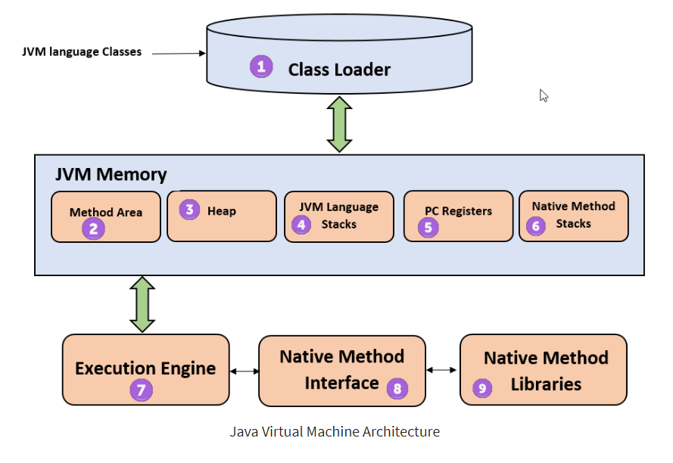
Java Virtual Machine (JVM) Architecture
A complete blueprint of loading, memory allocation, and execution subsystems.
01 / SUBSYSTEM DIAGRAM
Architecture Flow
02 / CLASS LOADER
Loading, Linking & Initialization
Dynamically loads class files into the JVM memory and handles security checks and linking.
03 / RUNTIME DATA AREAS
JVM Memory Allocation
Allocates distinct memory regions for Method Area, Heap, JVM Stacks, and PC Registers.
04 / EXECUTION ENGINE
Execution & Native Interfaces
Translates intermediate bytecode to native instructions using JIT compilers and interpreters.
Notes:
Program Counter (PC) Register - a small, dedicated runtime memory area within the Java Virtual Machine (JVM) that stores the memory address of the bytecode instruction currently being executed

Slide 29
JVM Architecture (Contd.)
A deep dive into class loading, memory layout, registers, and execution sub-systems.
01 / SUBSYSTEM
Class Loader
The class loader is a subsystem used for loading class files. It performs three major functions viz. Loading, Linking, and Initialization.
04 / THREAD MEMORY
JVM Language Stack
Stores local variables and partial results. A thread has its own JVM stack, creating frames on invocation and deleting them on completion.
02 / MEMORY AREA
Method Area
JVM Method Area stores class structures like metadata, the constant runtime pool, and the code for methods.
05 / EXECUTION STATE
Program Counter (PC) Registers
PC registers store the address of the executing JVM instruction. In Java, every active thread maintains its own independent, separate PC register.
03 / SHARED MEMORY
Heap
All the Objects, their related instance variables, and arrays are stored in the heap. This memory is common and shared across multiple threads.
06 / EXECUTION
Execution Engine
Native method stacks hold instructions of native code which depend on native libraries, and are typically written in languages other than Java.

Slide 30
JVM Architecture (Contd.)
A deep dive into execution subsystems, native interfaces, and library integrations.
07 / SUBSYSTEM
Execution Engine
It is a type of software used to test hardware, software, or complete systems. The test execution engine never carries any information about the tested product.
08 / INTERFACE
Native Method Interface
The Native Method Interface is a programming framework. It allows Java code which is running in a JVM to call by libraries and native applications.
09 / LIBRARIES
Native Method Libraries
Native Libraries is a collection of the Native Libraries(C, C++) which are needed by the Execution Engine.

Slide 31
JVM Memory Management
An overview of how Java handles object allocation, self-maintenance, and reclamation.
01 / PROCESS
Memory Allocation
The process of allocating space for new objects and removing unused objects to make room for subsequent allocations.
02 / AUTOMATION
Self-Maintenance
Java automatically manages memory in the background, requiring no explicit assistance or manual tracking from the programmer.
03 / RECLAMATION
Garbage Collection
Guarantees that memory is automatically released when no longer needed, ensuring that unused space is cleanly recycled.

Slide 32
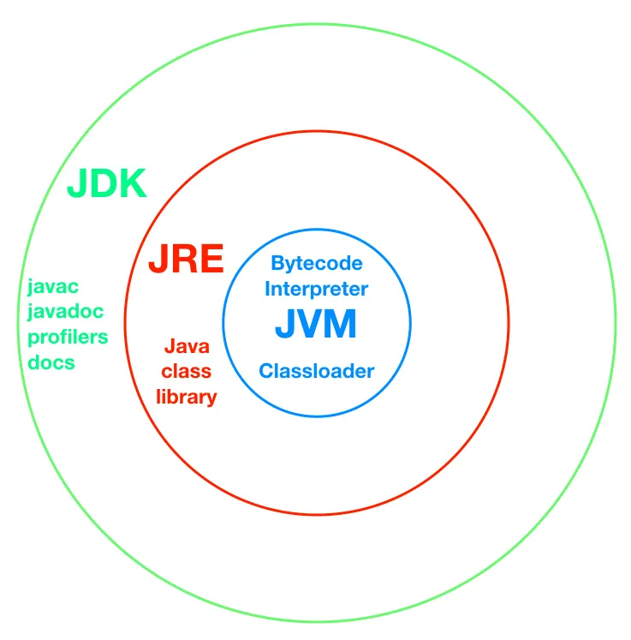
JDK vs. JRE vs. JVM
Understanding the core components, runtime relationships, and development tools in the Java ecosystem.

Slide 33
JDK vs. JRE vs. JVM
Understanding the core components, runtime relationships, and development tools in the Java ecosystem.
01 / RUNTIME ENGINE
JVM
The Java Virtual Machine is the core execution engine that runs compiled Java bytecode on any device or OS.
Key Components:
Bytecode Interpreter
Classloader Subsystem
Garbage Collector
02 / ENVIRONMENT
JRE
The Java Runtime Environment provides the minimum requirements to execute a Java application.
Key Components:
JVM (Execution Engine)
Java Class Libraries
Support Files & Resources
03 / DEVELOPMENT
JDK
The Java Development Kit is a full software development environment used to build and compile Java programs.
Key Components:
JRE (Runtime Environment)
Compiler (javac)
Tools (javadoc, debugger)

Slide 34
Features of Java
Core design principles that make Java a versatile, powerful, and enduring programming language.
01 / ACCESSIBLE
Simple
Learning & practicing Java is easy because of its strong resemblance to C & C++.
02 / PARADIGM
OOP
Java is designed as a purely object oriented programming language from the ground up.
03 / NETWORKED
Distributed
Designed for internet environments. Handles TCP/IP protocols and supports Remote Method Invocation (RMI).
04 / STABLE
Robust
Java programs prevent crashes through strict built-in exception handling & active memory management.

Slide 35
Features of Java (Contd.)
Exploring portability, bytecode interpretation, and JIT-compiled execution performance.
05 / INDEPENDENT
Portable
Java does not have implementation dependent aspects and yet yields or gives the same result on any machine.
Platform Independent
Write Once, Run Anywhere (WORA) philosophy guarantees code runs identically across all supporting operating systems.
06 / EFFICIENT
Interpreted & High Performance
Java programs are compiled to intermediate bytecode, which is dynamically downloaded and interpreted by the JVM.
Execution Enhancements:
JIT Compiler: Enhances speed by compiling hot code paths into native machine instructions.
JVM Interpreter: Direct execution of byte code via a highly optimized execution loop.

Slide 36
Features of Java (Contd.)
Understanding concurrency, network adaptability, and architectural independence.
07 / COMPATIBLE
Architectural Neutral
Java byte code is not machine dependent. It can run on any machine with any processor and with any operating system.
08 / CONCURRENT
Multithreaded
Executing different parts of programs simultaneously. This is an essential feature to design robust server-side programs.
09 / ADAPTIVE
Dynamic
Develop programs in Java which dynamically change on the Internet, such as Applet-based web execution environments.

Slide 37
Java Platforms
Exploring the distinct runtime environments and frameworks of the Java ecosystem.
01 / EMBEDDED
J2ME
Micro Edition
Specifies libraries for devices with limited storage, display, and power capacities like mobile devices, PDAs, and embedded systems.
02 / ENTERPRISE
J2EE
Enterprise Edition
Extends Java SE with various robust APIs designed useful for multi-tier client–server enterprise applications.
03 / CORE
J2SE
Standard Edition
The foundational framework for general-purpose use on desktop PCs, servers, and similar computing hardware environments.
04 / GRAPHICS
Java FX
Rich UI Platform
A lightweight user-interface platform for developing and deploying rich internet applications with high performance visual assets.

Slide 38
Basic Program Syntax
The fundamental structural blueprint for writing executable Java applications.
class Classname {
public static void main(String args[]) {
System.out.println();
}
}

Slide 39
The main() Method
The foundational entry point and execution mechanism in Java programming.
01 / EXECUTION
Program Entry
JVM Entry Point
Acts as the execution starting point. While not required for compilation, the JVM searches for this exact method to initiate execution.
02 / KEY MODIFIERS
Public & Static
Access & Lifecycle
Must be public so the JRE can access it globally. Must be static so the JVM can invoke it without instantiating the class.
03 / SIGNATURE
Void & Args
Return & Input
Does not return any value (void) and accepts a String[] array parameter to receive command-line arguments.

Slide 40
The main() Method rules
Key behaviors, compiler traits, and structural conventions of Java's entry point.
01 / MODIFIERS
Modifier Order
Syntax Convention
The modifiers public and static can be written in either order, but the standard convention is public static.
02 / JVM ENTRY
Strict Rules
Execution Match
Any access modifier is compiled, but the JRE requires the exact signature to serve as the active entry-point.
03 / PARAMETERS
Args Naming
Array Argument
You can name the array argument anything you want, but most Java developers choose "args" or "argv".
04 / EXECUTION
Runtime Error
No Compile Errors
Programs compile cleanly without a main() method, but execution triggers a "Main method not found" runtime error.

Slide 41
The main() Method Modifiers
Understanding how public accessibility and static lifecycle control Java's entry point.
01 / ACCESS SPECIFIER
Public Access
Global JRE Accessibility
The main() method must have a public access specifier so that the Java Runtime Environment (JRE) can call it from outside of your class.
Without this public exposure, strict access restrictions will prevent the JVM from executing your program entirely.
02 / LIFECYCLE
Static Modifier
Instance-Free Invocation
Must be declared as static so that it can be invoked directly by the JVM without needing to instantiate the class first.
This provides a clean, predictable starting point for application execution before any objects actually exist in memory.

Slide 42
The main() Method
Understanding the void return type and the fixed method identifier.
01 / RETURN TYPE
Void Return Type
No Return Value Requirement
The main() method in Java is declared with a return type of void to indicate that it does not return any value.
Its purpose is simply to serve as the entry point for the Java program, invoked by the JVM to start execution.
02 / IDENTIFIER
Main Method Name
Fixed Starting Signature
It's just the name of the method. This name is fixed because it is called by the JVM as the entry point for an application.
Note that while the name is strictly required by the launcher, main is not a keyword in Java.

Slide 43
Structure of System.out.println()
System.out.println() is a core Java statement used to display messages, data, or strings on the screen as output.
01 / CLASS
System
Standard System Class
This is the final class defined in the java.lang package, providing access to system resources.
02 / INSTANCE
out
PrintStream Object
An instance of the PrintStream type. Its access specifiers are defined as both final and public.
03 / METHOD
println()
Output Function
A public method in the PrintStream class used to output values followed by a clean newline.
Alternative: You can also use the print() method to output arguments without adding a new line at the end.

Slide 44
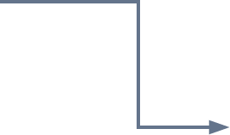
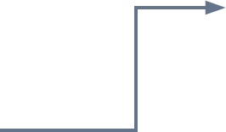
Anatomy of System.out.println()
Visualizing how the System class, out instance, and println() method orchestrate console output.
01 / SYSTEM CLASS
java.lang.System
A final class providing standard resources. Contains the static member out.
03 / STATEMENT PIPELINE
System.out.println()
Invokes the println() output method on the static out PrintStream object hosted within the System class.
02 / PRINTSTREAM CLASS
java.io.PrintStream
The class defining output features. Implements the println() method.

Slide 45
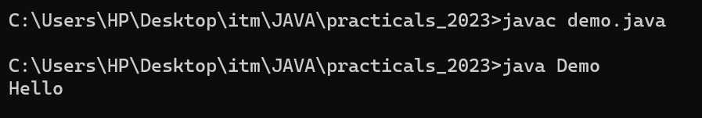
Simple Program
The foundational anatomy of a Java application and its command-line execution.
PROGRAM EXECUTION
Console Output
To run a Java program, compile the source file into bytecode, then launch it using the Java Virtual Machine.
class Classname {
public static void main(String args[]) {
System.out.println("Hello World");
}
}

Slide 46
Java Code Execution
The lifecycle of a Java program from raw source code to machine execution.
Java compiler
(javac)
Byte code
Java Source code
Byte code loaded into JVM
Java Interpreter
Host System
JVM

Slide 47
Java Code Execution
The lifecycle of a Java program from raw source code to machine execution.
01 / SOURCE
Source Code
The developer writes human-readable program files containing raw Java code.
02 / COMPILER
Java Compiler
The javac compiler translates code into a platform-independent format.
03 / BYTECODE
Bytecode
Universal bytecode is successfully generated and loaded into the JVM.
04 / JVM EXECUTION
Interpreter
The Java Interpreter translates and executes bytecode directly on the target Host System.

Slide 48
DATA TYPES
Understanding specifiers, static typing, and core categories in Java.
01 / SPECIFIERS
Core Definition
Data types act as specifiers that allocate different memory sizes and define the types of values that can be stored in a variable or identifier.
02 / STATIC TYPING
Compile-Time
Java is a static-typed language. This means the data type of every variable must be declared and is validated at compile time.
03 / CLASSIFICATION
Categorization
Java data types are divided into two fundamental groups:
Primitive: basic predefined types (e.g., int, char).
Non-Primitive: user-defined reference types.

Slide 49
Data Types in Java
The fundamental classification of variables into predefined primitives and reference-based non-primitive types.
01 / Predefined Values
Primitive Data Types
Predefined in the language and directly store independent values in memory.
Logical: boolean (true/false)
Textual: char (single 16-bit Unicode character)
Integers: byte, short, int, long
Floating-Point: float, double
02 / Reference Types
Non-Primitive Types
Created by the programmer (except String) and store references to memory objects.
Arrays: Collect multiple values of the same type
Classes: Blueprints defining objects and behaviors
Interfaces: Outline specifications to be implemented
Strings: Built-in sequences of characters
Enums: Predefined sets of strict constant values

Slide 50
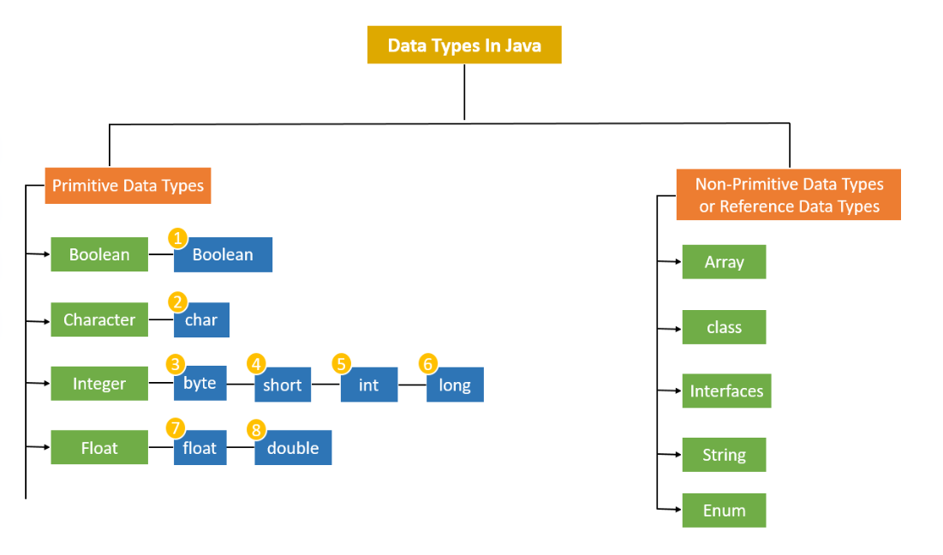
Data Types in Java
The fundamental classification of variables into predefined primitives and reference-based non-primitive types.

Slide 51
PRIMITIVE DATA TYPES
Primitive data types are predefined in Java and do not share state with other values.
01 / INTEGRAL
Integers
Stores whole numbers without decimals.
Available Types:
byte
short
int
long
02 / FRACTIONAL
Floats
Stores fractional numbers with decimals.
Available Types:
float
double
03 / LOGICAL
Boolean
Stores truth values representing states.
Available Types:
boolean
04 / TEXTUAL
Character
Stores single characters or ASCII/Unicode values.
Available Types:
char

Slide 52
01 / Integral Type
Primitive Data Type: byte
Overview & Properties
The byte is the smallest data type among all the integer data types in Java.
Memory Size
1 Byte (8-bit signed)
Value Range
-128 to 127
It is implemented as an 8-bit signed two’s complement integer.
Memory Efficiency
Highly space-efficient for large arrays where memory savings are critical. It can serve as a direct replacement for int when the values strictly stay within its range limits.
Syntax & Example
byte bytevariable; // Syntax
byte b = 10; // Example

Slide 53
01 / Integral Type
Primitive Data Type: short
Overview & Properties
The short data type is a 16-bit signed two's complement integer, being twice as small as a standard integer.
Memory Size
2 Bytes (16-bit signed)
Value Range
-32,768 to 32,767
Memory Efficiency
Highly space-efficient for large arrays where memory savings are critical. It acts as an optimal choice to conserve memory compared to int when the values strictly stay within its range limit.
Syntax & Example
short shortvariable; // Syntax
short s = 234; // Example

Slide 54
01 / Integral Type
Primitive Data Type: int
Overview & Properties
The int data type is a 32-bit signed two's complement integer, serving as the standard choice for whole numbers.
Memory Size
4 Bytes (32-bit signed)
Value Range
-2³¹ to 2³¹ - 1
It is widely used for storing general integer values, unless memory optimization is extremely critical.
Standard Integer Use
Designed for general-purpose arithmetic and array indexing. The int type is the default choice for integer values in Java, balancing memory use and processing performance.
Syntax & Example
int intvariable; // Syntax
int i = 2037437; // Example

Slide 55
01 / Integral Type
Primitive Data Type: long
Overview & Properties
The long data type is a 64-bit signed two's complement integer, designed for storing very large whole numbers.
Memory Size
8 Bytes (64-bit signed)
Value Range
-2⁶³ to 2⁶³ - 1
Huge Numeric Storage
Useful when you need to store values wider than what int can provide. It acts as the standard choice for system timestamps, high-range counters, and heavy scientific calculations.
Syntax & Example
long longvariable; // Syntax
long l = 372036854775; // Example

Slide 56
02 / Floating Point Type
Primitive Data Type: float
Overview & Properties
The float data type is a single-precision 32-bit IEEE 754 floating-point, designed for saving memory in large arrays of floating-point numbers.
Memory Size
4 Bytes (32-bit floating-point)
Value Range
-3.40282347 × 10³⁸ to +3.40282347 × 10³⁸
Precision & Usage Limit
Provides approximately 7 decimal digits of precision. It is not recommended for precise calculations such as currency, financial transactions, or critical research data.
Syntax & Example
float floatVariable; // Syntax
float f = 3.97f; // Example (default value = 0.0f)

Slide 57
03 / Floating Point Type
Primitive Data Type: double
Overview & Properties
The double data type is a double-precision 64-bit IEEE 754 floating-point, representing twice the precision of float.
Memory Size
8 Bytes (64-bit floating-point)
Value Range
-1.7976931348623157 × 10³⁰⁸ to 1.7976931348623157 × 10³⁰⁸
Precision & Usage Limit
Provides approximately 15 decimal digits of precision. While it is the default floating data-type in Java, it is still not recommended for precise calculations like currency.
Syntax & Example
double doubleVariable; // Syntax
double d = 873.98343; // Example (default = 0.0d)

Slide 58
04 / Character Type
Primitive Data Type: char
Overview & Properties
The char data type is useful for storing single value characters. Java uses Unicode format to support international character sets.
Memory Size
2 Bytes (16-bit unsigned integer)
Value Range
'\u0000' (0) to '\uffff' (65,535)
Unicode vs ASCII
Unlike older languages using 8-bit ASCII, Java uses Unicode. This allows it to represent written characters from almost all of the world's languages natively.
Syntax & Example
char charVariable; // Syntax
char ch = 'D'; // Example

Slide 59
01 / Logical Type
Primitive Data Type: boolean
Overview & Properties
The boolean data type is a special primitive type designed solely to store logical flags. It has no standard size definition in the JVM, but is commonly represented using 1 byte.
Memory Size
1 Byte (or 1 bit inside arrays)
Default Value
false
Values & Flag Usage
Can only represent two possible states: true and false. It is widely used to track conditional states, control program flow, and manage binary flags.
Syntax & Example
boolean boolvariable; // Syntax
boolean flag = true; // Example

Slide 60
02 / Summary Table
Primitive Data Types: Defaults & Sizes
DATA TYPE
DEFAULT VALUE
DEFAULT SIZE
boolean
false
1 bit
char
'\u0000'
2 byte
byte
0
1 byte
short
0
2 byte
int
0
4 byte
long
0L
8 byte
float
0.0f
4 byte
double
0.0d
8 byte

Slide 61
03 / Core Characteristics
Primitive Data Types: Points to Remember
PROPERTY 01
Signed Numerics
All numeric data types in Java are signed (+/-). There are no unsigned keyword variations for numeric primitives, ensuring consistent arithmetic behavior.
PROPERTY 02
Platform Standard
The size of primitive data types remains identical across all platforms. This strict standardization forms the backbone of Java's "Write Once, Run Anywhere" promise.
PROPERTY 03
Unicode Character Set
The char type is 2 bytes because Java utilizes the UNICODE standard. This enables full internationalization support, covering almost all active scripts worldwide.

Slide 62
04 / Language Fundamentals
Understanding Variables in Java
A variable is a named memory location that acts as a data container during Java program execution. Every variable must have an assigned data type which defines the type and quantity of value it can hold.
TYPE 01
Local Variables
Variables defined inside methods, constructors, or blocks are called local variables. They are only accessible within the scope they are declared.
TYPE 02
Instance Variables
Variables declared within a class but outside any method. These variables are associated with class instances and objects.
TYPE 03
Static Variables
Class variables declared within a class, outside any method, prefixed with the static keyword to share a single copy.

Slide 63
05 / Language Fundamentals
Variables: Declaration & Initialization
PHASE 01
Variable Declaration
Specifies the name and data type of the variable to allocate memory before usage.
SYNTAX & EXAMPLE
type identifier;
int a;
PHASE 02
Variable Initialization
Assigns a specific initial value to the variable. Can be done separately or inline.
METHOD A (SPLIT)
int a;
a = 5;
METHOD B (COMBINED)
int a = 5;

Slide 64
05 / Language Fundamentals
Variables: Code Demonstration
class demo {
static int a = 1; // static variable
int data = 99; // instance variable
void method() {
int b = 90; // local variable
}
}
1. Static Variable (static int a)
Declared with the static keyword inside the class. It creates a single shared copy across all class instances.
2. Instance Variable (int data)
Declared inside the class but outside any method. It is unique to each instantiated object of the class.
3. Local Variable (int b)
Declared inside the body of a method. It is only accessible and active within that specific method's scope.

Slide 65
05 / Language Fundamentals
Rules for Variable Declaration
01 / Allowed Characters & Syntax
Character Set: Can consist of uppercase (A-Z), lowercase (a-z), digits (0-9), and special characters _ (underscore) and $ (dollar sign).
First Character: Must not begin with a digit.
Case Sensitivity: Variable names in Java are strictly case-sensitive.
Positioning: Must always exist on the left-hand side of assignment operators.
02 / Constraints & Conventions
No Blank Spaces: Spaces are strictly prohibited within variable names.
Reserved Keywords: Java keywords cannot be used as variable identifiers.
Length Convention: There is no official limit on length, but by convention, it should be kept between 4 and 15 characters for readability.

Slide 66
06 / Language Fundamentals
Type Conversion & Type Casting
01 / THE CHALLENGE
Data Play
A significant part of programming involves playing around with data. Situations often arise where the data type has to be changed from one type to another to perform tasks.
02 / PRACTICAL CASE
Real-world Example
When calculating a circle's area using Pi, we get a decimal. This needs to be converted to an integer format if we desire to obtain the final answer as an integer.
03 / JAVA SOLUTION
Strong Typing
Since Java is strongly typed, type conversion is crucial. The programmer or compiler can easily manage this using type casting and type conversion concepts.

Slide 67
07 / Language Fundamentals
Type Conversion
01 / AUTOMATIC PROCESS
Implicit Action
Type conversion is a process in which the data type is automatically converted into another data type. The compiler does this automatic conversion at compile time.
02 / MANDATORY RULE
Size Requirement
For type conversion to take place, the destination data type must be larger than the source type, ensuring there is enough capacity to hold the value.
03 / SAFE WIDENING
No Data Loss
Also called Widening Type Conversion, Implicit Conversion, or Casting Down. As smaller types are converted to larger ones, there is absolutely no chance of data loss.

Slide 68

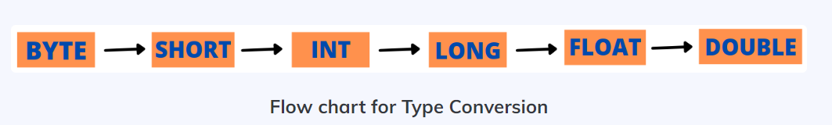
07 / Language Fundamentals
Type Conversion

Slide 69
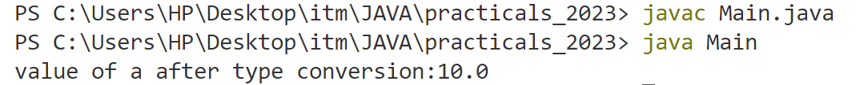
07 / Language Fundamentals
Implicit Type Conversion
CODE EXAMPLE
class Main {
public static void main(String[] args) {
int a = 10;
float b = a; // Implicit Conversion (int to float)
System.out.println("value of a after type conversion: " + b);
}
}
EXECUTION OUTPUT

Slide 70
07 / Language Fundamentals
Type Casting
Concept & Operator
Manual conversion controlled by the programmer.
Type casting is required when you need to explicitly convert a value into a different data type that is smaller in size.
• Uses the explicit casting operator ()
• The source type must be larger than the destination type
Behavior & Risk
Narrowing with potential loss of data.
Also known as Narrowing Type Casting, Explicit Conversion, or Casting Up.
• Converting to a smaller size introduces a risk of data loss
• Because of this risk, Java never performs this automatically

Slide 71

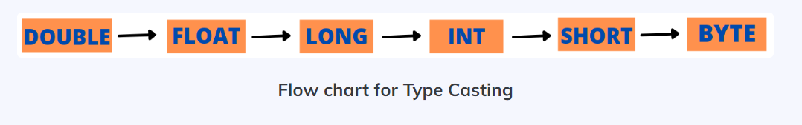
07 / Language Fundamentals
Type Casting

Slide 72
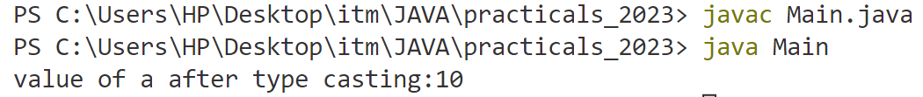
07 / Language Fundamentals
Type Casting
Main.java
ANALYSIS
Type Mismatch Risk
• Compilation Failure:
Assigning a float directly to an int causes a "possible loss of precision" error.
• Correct Syntax Required:
int b = (int) a;
class Main {
public static void main(String[] args) {
float a = 10.56f;
int b = a; // Compilation Error without explicit cast
System.out.println("value of a after type casting:" + b);
}
}
Terminal - Output

Slide 73
07 / Language Fundamentals
Reserved Words / Keywords
Core Concept
Reserved words or keywords are pre-defined words that hold special significance within the programming language.
They have a specific meaning to the compiler.
They cannot be used as identifiers (names for variables, methods, or classes).
How the Compiler Interprets
When the compiler encounters a keyword, it triggers specific grammatical rules:
class MyProgram {
// compiler expects "MyProgram"
// to be the name of the class
}
The keyword class informs the compiler that the following word is the unique class identifier.
➔ Next Up: Below are the key reserved words used to define structures, data types, and control flows in Java.

Slide 74
07 / Language Fundamentals
Reserved Words / Keywords
abstract | continue | for | new | switch
assert | package | synchronized | default | goto
boolean | do | if | private | this
break | else | import | public | throw
byte | enum | implements | protected | throws
case | double | instanceof | return | transient
catch | extends | int | short | try
char | final | interface | static | void
class | finally | long | strictfp | volatile
const | float | native | super | while

Slide 75
07 / Language Fundamentals
Comments in Java
Single-Line Comments
// comment
Preceded by // at the start or middle of a line.
The compiler ignores all text from the slashes to the end of that specific line.
Multi-Line Comments
/* comment */
Enclosed between /* and */.
Can span across one or multiple lines.
The compiler scans for the closing tag and ignores everything in between.
➔ Inline Documentation: Comments are completely ignored by the compiler, serving solely as documentation to make code readable and maintainable.

Slide 76
07 / Language Fundamentals
Access Modifiers
private
The most restrictive access level. Only visible within its own class.
Scope:
Inside the class only
No access from outside
default
Active when no modifier is specified. Package-private visibility.
Scope:
Inside the package
No access from external packages
protected
Tailored for inheritance. Visible to subclasses across packages.
Scope:
Same package
Subclasses in other packages
public
The most permissive level. Open access across the entire project.
Scope:
Everywhere
All classes and packages

Slide 77
07 / Language Fundamentals
Operators in Java
An operator is a symbol that performs an operation on variables called operands. Java categorizes these operators into six primary groups:
calculateArithmetic
Performs basic mathematical operations like addition, subtraction, and multiplication.
compare_arrowsRelational
Compares two values and determines equality or difference, returning boolean values.
memoryBitwise
Manipulates individual bits of integer types to perform low-level logical calculations.
alt_routeLogical
Combines multiple conditions using AND, OR, and NOT logic to control program flow.
inputAssignment
Assigns values to variables, supporting both simple and shorthand compound operations.
auto_awesomeSpecial
Includes advanced Java-specific operators like ternary (?:) and instanceof.

Slide 78
07 / Language Fundamentals
Arithmetic Operators
+
Addition
3 + 4
Result: 7
-
Subtraction
5 - 7
Result: -2
*
Multiplication
5 * 5
Result: 25
/
Division (gives quotient)
14 / 7
Result: 2
%
Modulus (gives remainder)
20 % 7
Result: 6

Slide 79
07 / Language Fundamentals
Assignment Operators
+=
Addition Assignment
x = x + y
Equivalent: x += y
-=
Subtraction Assignment
x = x - y
Equivalent: x -= y
*=
Multiplication Assignment
x = x * y
Equivalent: x *= y
/=
Division Assignment
x = x / y
Equivalent: x /= y

Slide 80
07 / Language Fundamentals
Unary Operators
-
Unary Minus
j = -k;
Negates the value of k and stores it in j.
Increment
b++;
++b;
Post-increment: Increments b after its value is evaluated.
Pre-increment: Increments b before its value is evaluated.
++
Decrement
b--;
--b;
Post-decrement: Decrements b after its value is evaluated.
Pre-decrement: Decrements b before its value is evaluated.
--

Slide 81
07 / Language Fundamentals
Relational Operators
==
Equal to
Example: x == 3
!=
Not equal to
Example: x != 3
<
Less than
Example: x < 3
>
Greater than
Example: x > 3
<=
Less than or equal to
Example: x <= 3

Slide 82
07 / Language Fundamentals
Logical / Short Circuit Operators
And Operator
if(a > b && a > c)
System.out.print("yes");
If a value is greater than b and c then only "yes" is displayed.
&&
Or Operator
if(a == 1 || b == 1)
System.out.print("yes");
If either a value is 1 or b value is 1 then "yes" is displayed.
||
Not Operator
if(!(a == 0))
System.out.print("yes");
If a value is not equal to zero then only "yes" is displayed.
!

Slide 83
07 / Language Fundamentals
Bitwise Operators
&
Bitwise AND
Multiplies the individual bits of operands
|
Bitwise OR
Adds the individual bits of operands
^
Bitwise XOR
Performs Exclusive OR operation
<<
Left shift
Shifts the bits of the number left a specified number of positions
>>
Right shift
Shifts the bits right a specified number of positions and preserves the sign bit
>>>
Zero fill right shift
Shifts the bits right and stores 0 (Zero) in the sign bit
~
Bitwise complement
Gives the complement form of a number by changing 0's to 1's and vice versa

Slide 84
07 / Language Fundamentals
Ternary / Conditional Operators
Ternary Operator
Takes three operands to evaluate conditions efficiently.
Syntax:
Variable = Expression1 ? Expression2 : Expression3;
?:
Execution Logic
First, Expression1 is evaluated (must return boolean).
If true, the value of Expression2 is assigned.
If false, the value of Expression3 is assigned.
Practical Example
max = (a > b) ? a : b;
If the variable a is greater than b, a is assigned to max; otherwise, b is assigned.

Slide 85
07 / Language Fundamentals
Special Operator: instanceof
Object Reference Operator
Tests whether an object is an instance of a specific class or interface type at runtime.
Syntax:
object instanceof ClassName
instanceof
Execution Logic
Evaluates the left-hand side object reference against the right-hand side type.
Returns true if the object belongs to or can be cast to the specified class.
Returns false if the object reference is null or of an incompatible type.
Practical Example
person instanceof student
If the variable person refers to an object of class student, it evaluates to true; otherwise, it is false.

Slide 86
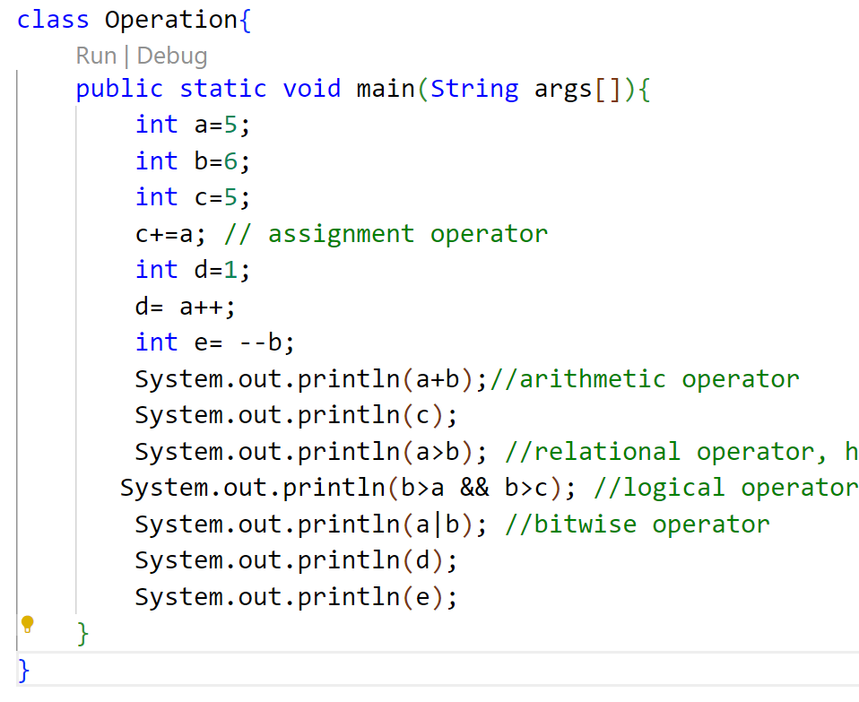
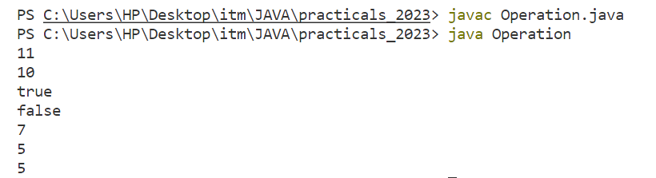
07 / Language Fundamentals
Operator: Example
codeJava Source Code
terminalConsole Output

Slide 87
08 / Language Fundamentals
Control Statements
Definition
Control statements are the statements which alter the flow of execution and provide better control to the programmer on the flow of execution.
01
Selection
Decision making control statements that direct program flow based on conditional evaluations.
02
Iteration
Looping control statements designed to repeat execution blocks efficiently while conditions are met.
03
Jump
Unconditional branching statements that immediately transfer control flow to other sections of code.

Slide 88
09 / Language Fundamentals
Selection Statements
Definition
Decision-making statements decide which statement to execute and when. They evaluate Boolean expressions and control the program flow depending upon the result of the condition provided.
01
If Statements
Executes a block of code based on whether a condition is true or false. Includes standard if, if-else, if-else-if, and nested if statements.
02
Switch Statement
A multi-way branch control statement that evaluates an expression and routes program execution to multiple matching options cleanly.

Slide 89
09 / Language Fundamentals
If Statement
Definition
The if statement is a decision-making control statement that performs a task depending on whether a given condition evaluates to true or false.
SYNTAX
if (condition) {
// statements to execute
}
EXAMPLE
int a = 5;
if (a > 10) {
// False (5 > 10)
System.out.println("Condition is true");
}
➔ NOTE: Since the condition is false, no output is displayed.

Slide 90
09 / Language Fundamentals
If-Else Statement
Definition
The if-else statement is a decision-making control statement that performs a task depending on whether a given condition evaluates to true or false.
SYNTAX
if (condition) {
// statements to execute if true
} else {
// statements to execute if false
}
EXAMPLE
int a = 5;
if (a > 10) {
System.out.println("Condition is true");
} else {
System.out.println("Condition is false");
}
➔ NOTE: Since 5 > 10 is false, the else block executes.

Slide 91
09 / Language Fundamentals
Else-If Statement
Definition
The else if statement is used to specify a new condition if the first condition is false.
SYNTAX
if (condition1) {
// statements
} else if (condition2) {
// statement
} else {
// statements
}
EXAMPLE
int a = 5;
if (a > 10) {
System.out.println(...);
} else if (a == 10) {
System.out.println(...);
} else {
System.out.println("Given condition is false");
}
➔ NOTE: Since first two conditions are false, else executes.

Slide 92
09 / Language Fundamentals
Nested if statement
Definition
If the inner condition satisfies then only outer if will be executed. Along with if conditions we can write else conditions also.
SYNTAX
if (condition) {
//statements
if (condition) {
//statement
}
} else {
//Statements
}
EXAMPLE
int a = 5;
if (a > 10) {
System.out.println("Value of a: " + a);
} else if (a == 10) {
System.out.println("Value of a: " + a);
} else {
System.out.println("Given condition is false");
}
➔ NOTE: Since a = 5, the else block executes.

Slide 93
09 / Language Fundamentals
Switch Statement
Definition
The switch statement is used to choose and execute only one option from multiple available choices based on an expression's value.
SYNTAX
switch (expression) {
case value1:
// statements
break;
case value2:
// statements
default:
// default statements
}
KEY CONCEPTS
Expression: Evaluated once and compared with each case value.
Break: Terminates the switch block execution. If omitted, execution falls through to subsequent cases.
Default Case: Optional block that runs if no matching case is found.

Slide 94
09 / Language Fundamentals
Switch Case: Example 1
SOURCE CODE
class Switchcase {
public static void main(String args[]) {
char color = 'r';
switch (color) {
case 'r': System.out.println("red");
break;
case 'y': System.out.println("yellow");
break;
case 'w': System.out.println("white");
break;
case 'b': System.out.println("black");
break;
default: System.out.println("No color selected");
}
}
}
TERMINAL OUTPUT
PS C:\Users\HP\Desktop\itm\JAVA\practicals_2023> javac Switchcase.java
PS C:\Users\HP\Desktop\itm\JAVA\practicals_2023> java Switchcase
red

Slide 95
09 / Language Fundamentals
Switch Case: Example 2 (Without Break)
SOURCE CODE
import java.util.Scanner;
class Switchcase {
public static void main(String args[]) {
Scanner sc = new Scanner(System.in);
System.out.println("Enter the day: ");
String day = sc.nextLine();
switch (day) {
case "Saturday", "Sunday" ->
System.out.println("Holiday");
case "Monday", "Tuesday", "Wednesday",
"Thursday", "Friday" ->
System.out.println("Working Day");
default ->
System.out.println("Wrong input");
}
}
}
KEY FEATURES
Arrow Syntax (->):
Introduced in modern Java. Only the expression or block to the right of the arrow is executed. No fall-through occurs, completely eliminating the need for explicit break; statements.
Multiple Case Labels:
Allows grouping multiple comma-separated constants within a single case block, making the syntax highly compact and clean.

Slide 96
09 / Language Fundamentals
Switch Case: Example 2 (Outputs)
TEST RUN 01
PS C:\...\practicals_2023> java Switchcase
Enter the day:
Sunday
OUTPUT
Holiday
TEST RUN 02
PS C:\...\practicals_2023> java Switchcase
Enter the day:
Monday
OUTPUT
Working Day
TEST RUN 03
PS C:\...\practicals_2023> java Switchcase
Enter the day:
xyz
OUTPUT
Wrong input

Slide 97
09 / Language Fundamentals
Looping/Iteration Statements
01 / Types
Java Loop Types
Iteration statements in java are:
for
while
do-while
02 / Purpose
Repetitive Execution
These statements are used to repeat same set of instructions specified number of times called loops.
03 / Control
Termination
A loop repeatedly executes the same set of instructions until a termination condition is met.

Slide 98
09 / Language Fundamentals
While Loop
01 / REPETITION
Loop Condition
A while loop repeats a group of statements as long as the specified condition remains true.
02 / TERMINATION
Loop Exit
Once the condition evaluates to false, the loop is immediately terminated and control exits.
03 / CONTROL FLOW
Entry Control Loop
The condition is tested first. Statements are executed only if the condition is true.
SYNTAX STRUCTURE
while (condition)
{
// Statements;
}

Slide 99
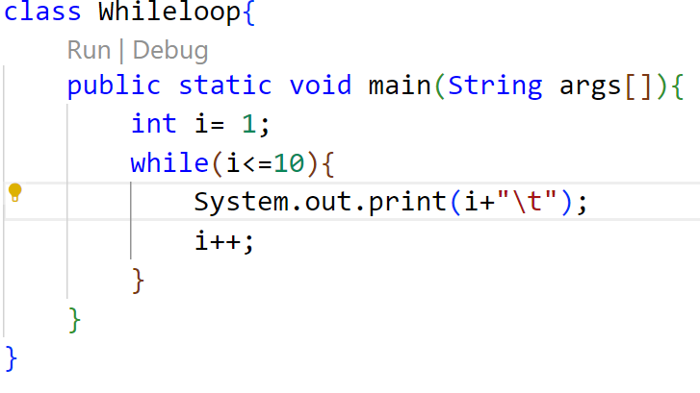
09 / Language Fundamentals
While Loop: Example
01 / CODE
Java Implementation
02 / OUTPUT
Console Execution

Slide 100
09 / Language Fundamentals
do-while Loop
01 / REPETITION
Loop Condition
A do...while loop repeats a group of statements as long as the specified condition remains true.
02 / EXECUTION
First Execution
In a do...while loop, the statements are executed first, and then the loop condition is tested.
03 / CONTROL FLOW
Exit Control Loop
Because it evaluates the condition at the end of the loop, it is commonly referred to as an exit control loop.
SYNTAX STRUCTURE
do
{
// Statements;
} while (condition);

Slide 101
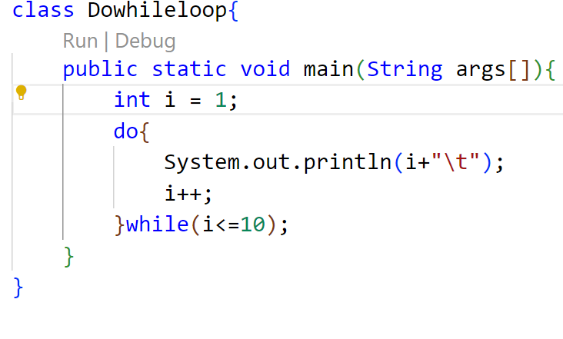
09 / Language Fundamentals
do-while Loop: Example
01 / CODE
Java Implementation
02 / OUTPUT
Console Execution

Slide 102
09 / Language Fundamentals
for Loop
01 / SYNTAX
Compact Structure
The for loop is also same as do…while or while loop, but it is more compact syntactically.
02 / EXECUTION
Conditional Execution
The for loop executes a group of statements as long as a condition is true.
SYNTAX STRUCTURE
for (initialisation; condition; inc/dec)
{
// Statements;
}

Slide 103
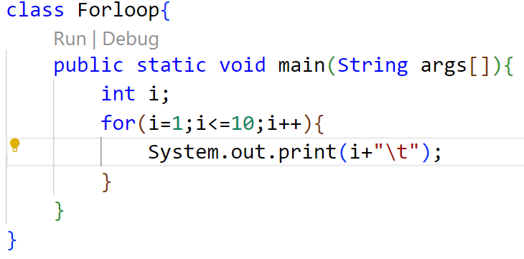

09 / Language Fundamentals
for Loop: Example
01 / CODE
Java Implementation
02 / OUTPUT
Console Execution

Slide 104
09 / Language Fundamentals
Jump Statement
01 / Overview
Transferring Control
Java supports three jump statements that immediately redirect the execution flow of your code.
These statements unconditionally transfer control to another part of the program.
Supported Statements
break
Exits the innermost loop or switch block immediately.
continue
Skips the current loop iteration and proceeds to the next.
return
Exits from the current method back to the caller.

Slide 105
09 / Language Fundamentals
Break Statement
01 / Core Concept
Exiting Execution Blocks
1. Loop Termination
Used inside loops (for, while, do-while) to immediately break loop execution and jump to the next statement.
2. Switch Escape
Used inside a switch block to exit the block immediately once a matching case is handled, preventing fall-through.
3. Nested Break
Used in nested blocks to transfer control to the very end of an outer labeled block structure.
02 / Syntax Structure
break;
Standard syntax used to exit the innermost enclosing loop or switch block directly.
break label;
Labeled break statement used to transfer control out of a deeply nested block to the end of the named target block.

Slide 106
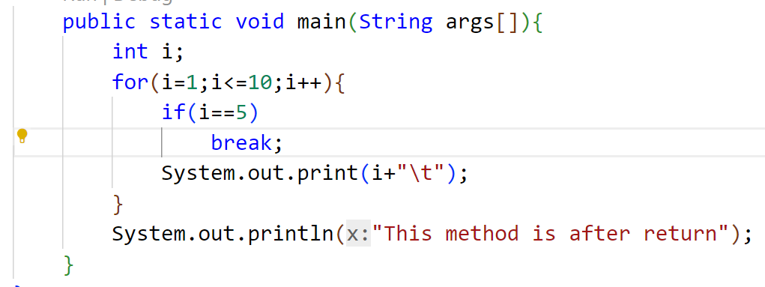
09 / Language Fundamentals
Break: Example
forloop.java
How it works
The loop is initialized with i=1 and set to run up to 10.
When i reaches 5, the break condition is met, and the break; statement terminates the loop execution immediately, transferring control to the statement after the loop.
Output

Slide 107
09 / Language Fundamentals
Continue Statement
01 / Core Concept
Skipping Loop Iterations
1. Loop Continuation
This statement is useful to continue the next repetition of a loop/ iteration.
2. Conditional Skip
When continue is executed, subsequent statements inside the loop are not executed.
02 / Syntax Structure
continue;
Standard syntax used to immediately transfer control to the loop condition or update statement of the innermost enclosing loop.

Slide 108
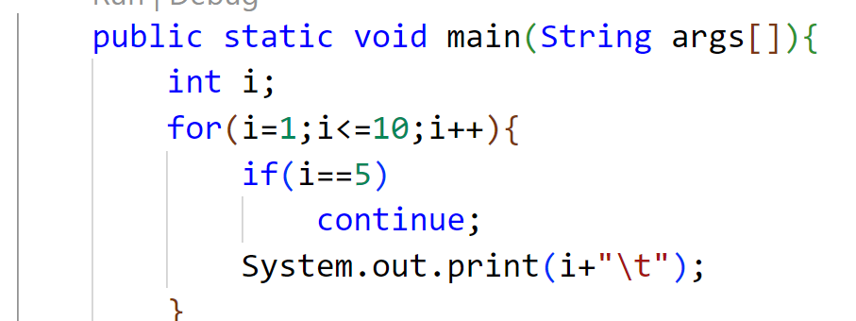
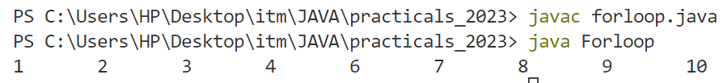
09 / Language Fundamentals
Continue: Example
forloop.java
How it works
The loop is initialized with i=1 and set to run up to 10.
When i reaches 5, the condition is met, and the continue; statement skips the print statement, transferring control back to the update expression of the loop.
Output

Slide 109
09 / Language Fundamentals
Return Statement
01 / Core Concept
Control Flow & Value Return
1. Method Termination
Useful to terminate a method and come back to the calling method.
2. Application Exit
Using the return statement in the main method terminates the application.
3. Return Values
Can be used to return some value from a method to a calling method.
02 / Syntax Structure
return;
Terminates method execution without returning a value.
return value;
Terminates method and passes a specified value back (may be of any type) to the caller.

Slide 110
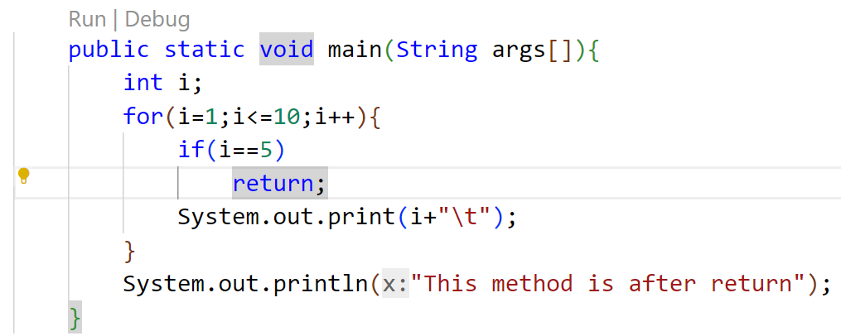

09 / Language Fundamentals
Return: Example
forloop.java
How it works
The loop is initialized with i=1 and runs up to 10.
When i reaches 5, the condition is met and the return; statement terminates the entire main method, skipping all subsequent statements.
Output

Slide 111
09 / Language Fundamentals
Array
01 / Core Concept
Understanding Arrays
An array represents a group of elements of the same data type. Arrays are generally categorized into two main types:
1. Single Dimensional Arrays
Often referred to as 1-Dimensional arrays, representing a simple linear list of elements.
2. Multi-Dimensional Arrays
Includes 2-Dimensional, 3-Dimensional, or higher nested arrays for complex structures.
02 / Implementation Workflow
Creating an Array
Step 1: Declare the Array
Introduce the array variable name and specify the type of data it holds.
Step 2: Create Memory Location
Allocate the required block of memory using the 'new' keyword.
Step 3: Populate the Array
Assign specific values to each individual memory location in the array.

Slide 112
09 / Language Fundamentals
Declaring Array Variable
To declare an array, write the data type, followed by a set of square brackets [], followed by the identifier name.
syntax.java
declare.java
// 01 / Preferred syntax
datatype[] arrayRefVar;
// 02 / Alternative syntax
datatype arrayRefVar[];
// 01 / Preferred way
double[] myList;
// 02 / Alternative way
double myList[];

Slide 113
09 / Language Fundamentals
Array Creation
To create an array, write the new keyword, followed by the square brackets [] containing the number of elements you want to have in the array.
twostep.java
onestep.java
// 01 / Declaration
int arr[];
// 02 / Object Creation
arr = new int[10];
// Single Step Combination
// declare & object creation
int arr[] = new int[10];

Slide 114
09 / Language Fundamentals
Array Creation
Another way to create an array if the elements are known:
syntax.java
example.java
// 01 / Syntax
int arr[] = {/*elements*/};
// 02 / Inline Commented
int arr[ ] = {//comma operator};
// 01 / Array Initialization
int arr[] = {10, 20, 30, 40, 50};

Slide 115
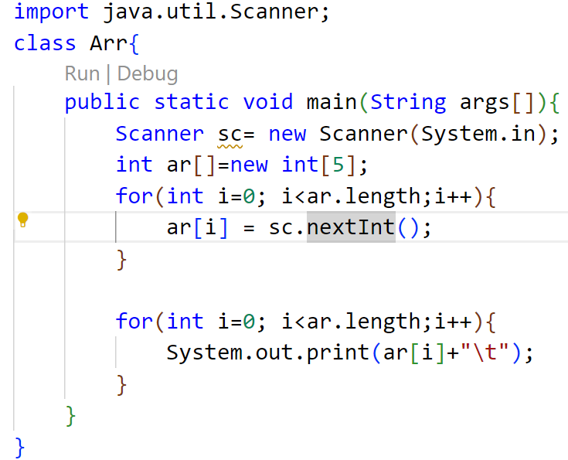
09 / Language Fundamentals
Example 1
Arr.java

Slide 116
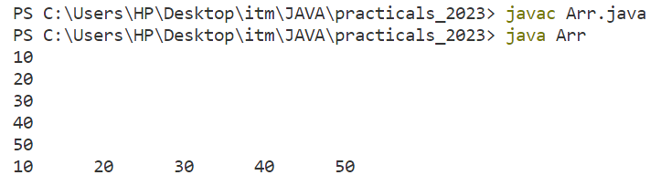
09 / Language Fundamentals
Example 1
Execution Output:
Terminal - Output

Slide 117
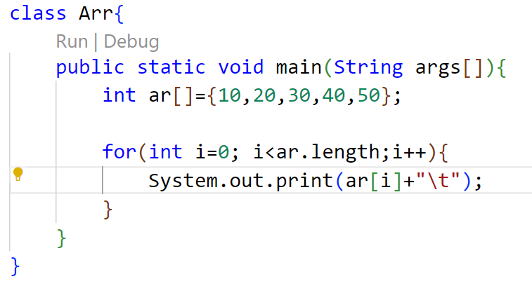

09 / Language Fundamentals
Example 2
Arr.java
Terminal - Output

Slide 118
09 / Language Fundamentals
Array Length
Syntax
Purpose
To get the number of elements in an array, you can use the built-in length field.
The length property dynamically returns the total size (or capacity) of the allocated array.
arrayName.length

Slide 119
09 / Language Fundamentals
For-Each Loop
Syntax
Purpose
The for-each loop is used to traverse arrays or collections in Java. It is easier to use than a simple for loop because you don't need to increment values or use subscript notation.
It works on the basis of elements instead of indices, returning each element one by one into the defined variable.
for(datatype var : arrayname) {
// statement
}

Slide 120
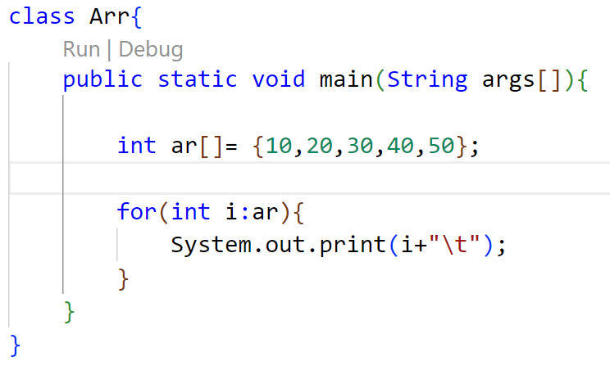
09 / Language Fundamentals
Example: For-Each Loop
Arr.java
Terminal Output

Slide 121
09 / Language Fundamentals
Multi-dimensional Array
Declaration
Concept
A multidimensional array is an array of arrays. That is, each element of a multidimensional array is an array itself.
To access the elements of the arr array, specify two indexes: one for the row array, and one for the element inside that array.
// Syntax & Initialization
int[][] arr = {
{1, 2, 3},
{4, 5, 6}
};

Slide 122
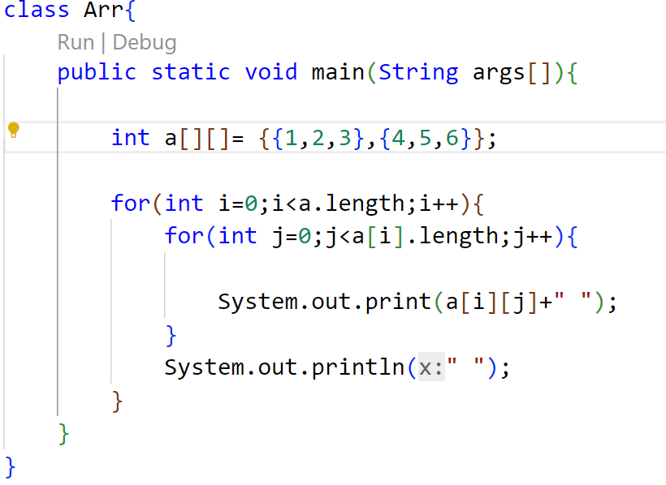

09 / Language Fundamentals
Multi-dimensional Array: For Loop
Arr.java
Terminal Output

Slide 123
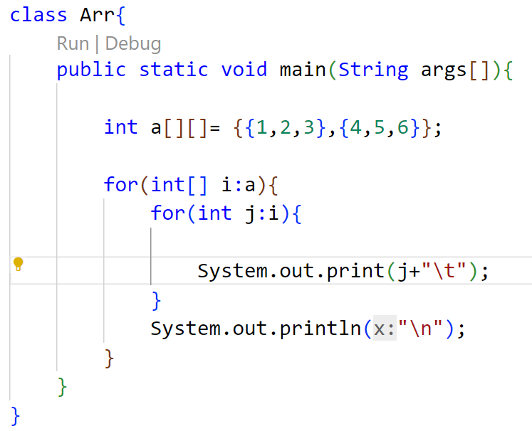
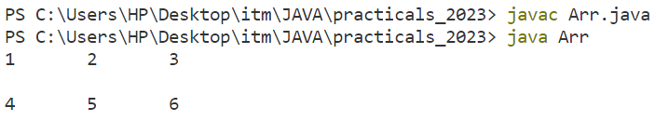
09 / Language Fundamentals
Multi-dimensional Array: For-Each Loop
Arr.java
Terminal Output

Slide 124
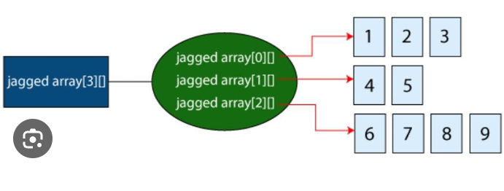
09 / Language Fundamentals
Jagged Array: Structure
Definition
A jagged array is a multi-dimensional array where the member arrays can be of different sizes and lengths.
KEY CHARACTERISTICS
✦Each row is an independent array
✦Optimizes memory for uneven datasets
✦Individually allocated row dimensions
Memory Visualization

Slide 125
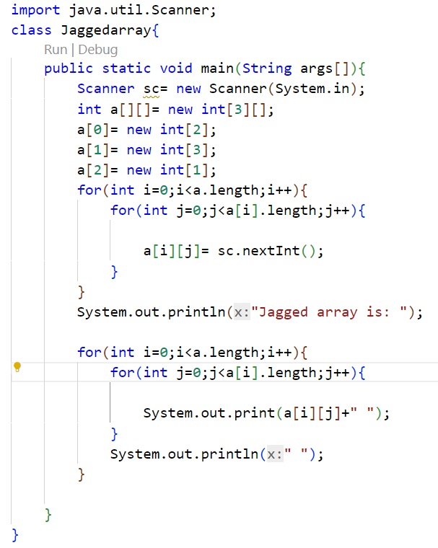
09 / Language Fundamentals
Jagged Array: Code Implementation
Jaggedarray.java
Code Walkthrough
The program demonstrates how to declare, allocate memory for, and traverse a jagged array in Java.
KEY STEPS IN THE CODE
✦ Declaration: int a[][] = new int[3][] defines a 2D array with 3 rows.
✦ Row Allocation: Defines columns of sizes 2, 3, and 1 dynamically.
✦ Traversal: Employs nested loops using .length to handle varied row sizes safely.

Slide 126
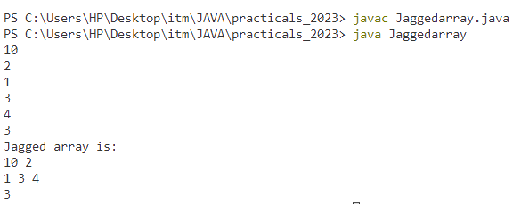
09 / Language Fundamentals
Jagged Array: Output
Terminal Output
Execution & Results
The console output confirms the compilation process and demonstrates the behavior of the dynamically allocated rows.
KEY OBSERVATIONS
✦ Compilation & Run: The code is compiled with javac and run smoothly using the java command.
✦ Console Input: Values like row size and matrix inputs (10, 2, 1, 3, 4, 3) are provided sequentially.
✦ Formatted Display: The jagged array is printed back with uneven columns (2, 3, and 1 elements respectively).

Slide 127
09 / Language Fundamentals
Arrays: Advantages & Disadvantages
add_circleAdvantages
1. Code Optimization
It makes the code optimized, allowing us to retrieve or sort the data with high efficiency.
2. Random Access
We can instantly access or retrieve any data located at a specific index position.
remove_circleDisadvantages
1. Size Limit
We can store only a fixed size of elements. Once initialized, the array cannot grow in size at runtime.
Java Solution: Use the Collection Framework (like ArrayList) which dynamically grows automatically.

Slide 128
09 / Language Fundamentals
String: Fundamentals
codeOverview & Implementation
1. Fundamental Nature
Strings are very important in the world of programming languages as they are used to process long textual/symbolic information. They are considered fundamental data types in almost all languages.
2. Java Implementation
In java, string class is provided to work with strings along with the facility of character arrays.
lock_clockCore Feature
Immutability
The strings are immutable as once an object of the String class is created & initialized with some value, it cannot be changed.
Important Note: String objects are constant and read-only once instantiated.

Slide 129
09 / Language Fundamentals
String: Objects & Package
layersObjects & Packages
1. Handling String Data
To handle string data in Java, we require objects of the String class.
2. Automatic Import
The String class is included in the java.lang package. Therefore each class can use the String class without importing any package.
codeImplementation & Syntax
Syntax Example
We can initialize a String by assigning a sequence of characters wrapped in double quotes.
Example: String str = “Hello”

Slide 130
09 / Language Fundamentals
Operation on String
settings Overview & Capabilities
The string class in java provides various methods that enable you to perform various tasks like character extraction, conversion, case shifting, and comparison.
Robust Manipulation
These operations allow developers to handle text data with speed and high efficiency, ensuring data format consistency across applications.
format_list_numbered Common Tasks
Convert a string into a character
Convert numbers into strings
Search strings
Create substrings
Change the case of string
Get a string length
Compare strings

Slide 131
09 / Language Fundamentals
String Method: length()
straightenMethod Overview
1. Character Calculation
The length() method returns the length of a string. It calculates all the characters, symbols & numbers enclosed in double quotes (“”).
2. Whitespace Inclusion
All spaces and punctuation marks inside the string literals are accurately counted towards the final total length.
codeReturn & Syntax
Output Value
The method returns an integer value representing the total count.
Syntax Example
int length = str.length();

Slide 132
09 / Language Fundamentals
String Methods: Case Conversion
arrow_downwardtoLowerCase()
The toLowerCase() method returns a string after converting all uppercase letters of the invoking string into lowercase.
Syntax
stringname.toLowerCase()
arrow_upwardtoUpperCase()
The toUpperCase() method returns a string after converting all lowercase letters of the invoking string into Uppercase.
Syntax
stringname.toUpperCase()

Slide 133
09 / Language Fundamentals
String Method: substring()
content_cutMethod Overview
1. Single Parameter Form
The substring(int begin) method returns a new String instance that is a substring of the original.
2. Extraction Range
It begins at the index specified by the argument value and ends at the last character of the original string.
codeSyntax & Example
Syntax
str.substring(int beginIndex)
Code Example
String str = "EDUCATION";
str.substring(4); // "ATION"

Slide 134
09 / Language Fundamentals
String Method: substring(begin, end)
content_cutMethod Overview
1. Two Parameter Form
The substring(int begin, int end) method returns a new String containing a subset of the original characters.
2. Inclusive & Exclusive
The start index is inclusive, while the end index is exclusive. The extracted string length is always end - begin.
codeSyntax & Example
Syntax
str.substring(int begin, int end)
Code Example
String str = "EDUCATION";
str.substring(3, 6); // "CAT"

Slide 135
09 / Language Fundamentals
String Method: concat()
add_circleMethod Overview
1. Addition (+) Operator
The standard addition operator provides an intuitive and common way to concatenate multiple strings together.
2. concat() Method
The explicit concat() method appends one string to the end of another, returning a newly combined string.
codeSyntax & Example
Syntax
str.concat(String str2)
Code Example
String str = "Hello";
String str1 = "Java";
str + str1; // "HelloJava"
str.concat(str1); // "HelloJava"

Slide 136
09 / Language Fundamentals
String Methods: equals() & equalsIgnoreCase()
swap_horizMethod Overview
1. Purpose
These methods are used for comparing the content of two strings.
2. Case Sensitivity
equals() compares characters sequentially and requires exact case matches.
equalsIgnoreCase() performs the same comparison but ignores case differences.
codeSyntax & Example
Syntax
str.equals(String str2)
str.equalsIgnoreCase(String str2)
Code Example
String str = "Java is oopl";
String str1 = "JAVA IS OOPL";
str.equals(str1); // false
str.equalsIgnoreCase(str1); // true

Slide 137
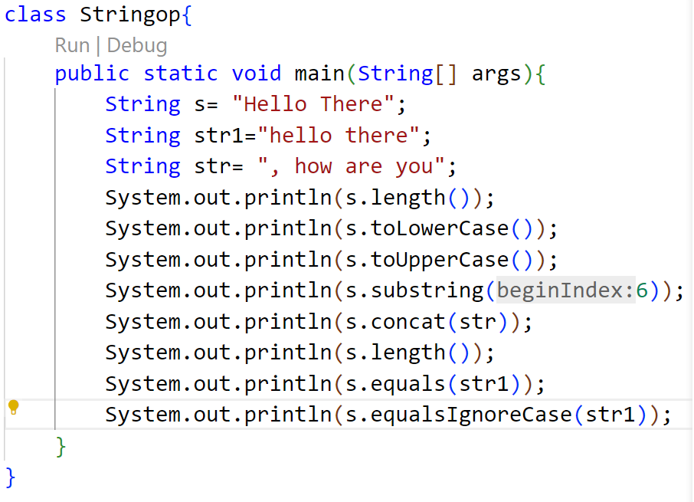
09 / Language Fundamentals
String Methods: Code Example
Stringop.java

Slide 138
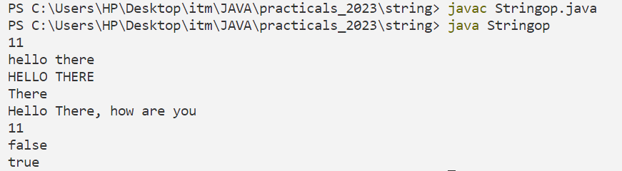
09 / Language Fundamentals
String Methods: Execution Output
Terminal — Output

Slide 139
09 / Language Fundamentals
StringBuffer Class
OVERVIEW
The StringBuffer class provides the capability to create a sequence of characters with mutable (modifiable) attributes, offering an efficient alternative to immutable Strings.
COMMON METHODS
1.length()
5.insert()
2.capacity()
6.delete()
SYNTAX EXAMPLE
StringBuffer str = new StringBuffer();
3.reverse()
7.deleteCharAt()
4.append()
8.replace()

Slide 140
09 / Language Fundamentals
StringBuffer: length()
METHOD OVERVIEW
It defines the number of characters currently present in the StringBuffer.
RETURN VALUE
int - the total character count
CODE EXAMPLE
StringBuffer str = new StringBuffer("ContentWriter");
int len = str.length();
System.out.println("Length : " + len);
// Output: Length : 13

Slide 141
09 / Language Fundamentals
StringBuffer: capacity()
METHOD OVERVIEW
Defines the total allocated buffer space. This includes the reserved space and the length of the occupied string.
DEFAULT CAPACITY
16 characters
CAPACITY GROWTH FORMULA
(oldCapacity * 2) + 2
CODE EXAMPLE
StringBuffer str = new StringBuffer("ContentWriter");
int cap = str.capacity();
System.out.println("Capacity : " + cap);
// Output: Capacity : 29

Slide 142
09 / Language Fundamentals
StringBuffer: append()
METHOD OVERVIEW
The append() method is used to append the specified string or representation of data at the end of the existing string.
SUPPORTED TYPES
String, char, int, double, boolean, etc.
CODE EXAMPLE
StringBuffer str = new StringBuffer("Hello");
str.append("java");
System.out.println(str); // Hellojava
str.append(0);
System.out.println(str); // Hellojava0

Slide 143
09 / Language Fundamentals
StringBuffer: insert()
METHOD OVERVIEW
The insert() method is used to insert the string into the previously defined string at a particular indexed position.
REQUIRED PARAMETERS
index — position to insert
string — value to be inserted
CODE EXAMPLE
StringBuffer sb = new StringBuffer(" Welcome");
System.out.println(sb);
// Output: Welcome
sb.insert(8, " to java");
System.out.println(sb);
// Output: Welcome to java

Slide 144
09 / Language Fundamentals
StringBuffer: reverse()
METHOD OVERVIEW
The reverse() method reverses all the characters of the object of the StringBuffer class. And, as an output, this method returns or gives the reversed String object.
CODE EXAMPLE
StringBuffer sb = new StringBuffer("Welcome to Java");
System.out.println("Original String: " + sb);
// OUTPUT: Original String: Welcome to Java
sb.reverse();
System.out.println("Reversed String: " + sb);
// OUTPUT: Reversed String: avaj ot emocleW

Slide 145
09 / Language Fundamentals
StringBuffer: delete()
METHOD OVERVIEW
The delete() method deletes a sequence of characters from the StringBuffer object.
SYNTAX / PARAMETERS
startIndex — start index (inclusive)
endIndex — end index (exclusive)
CODE EXAMPLE
StringBuffer sb = new StringBuffer("welcometojava");
System.out.println(sb);
// Output: welcometojava
sb.delete(0, 4);
System.out.println(sb);
// Output: ometojava

Slide 146
09 / Language Fundamentals
StringBuffer: deleteCharAt()
Method Overview
The deleteCharAt() method deletes only the character at the specified index.
Syntax
sb.deleteCharAt(int index)
Code Example
StringBuffer sb = new StringBuffer("Welcome to java");
System.out.println(sb);
// Output: Welcome to java
sb.deleteCharAt(7);
System.out.println(sb);
// Output: Welcometo java

Slide 147
09 / Language Fundamentals
StringBuffer: replace()
METHOD OVERVIEW
The replace() method replaces a sequence of characters with another sequence of characters.
SYNTAX / PARAMETERS
startIndex — start index (inclusive)
endIndex — end index (exclusive)
str — replacement string
CODE EXAMPLE
StringBuffer sb = new StringBuffer("Welcome to java");
System.out.println(sb);
// Output: Welcome to java
sb.replace(12, 15, "Tutorial");
System.out.println(sb);
// Output: Welcome to jTutorial

Slide 148
09 / Language Fundamentals
StringBuffer: Comprehensive Example
CODE DEMONSTRATION
CONSOLE OUTPUT
StringBuffer sb = new StringBuffer("Hello");
// Demonstration of various methods
sb.length(); // Returns 5
sb.capacity(); // Returns 21
sb.append(" World");
sb.insert(11, ", welcome to java");
sb.delete(11, 27);
sb.deleteCharAt(5);
sb.replace(5, 9, "Diksha");
sb.reverse();
Length of String is: 5
Capacity of String is: 21
Appended String is: Hello World
String after insert is: Hello World, welcome to java
String after delete is: Hello Worlda
Use of deleteCharAt: HelloWorlda
String after replace is: HelloDikshada
Reversed String: adahskiDolleH

Slide 149
09 / Language Fundamentals
Command Line Arguments
KEY CONCEPT
Sometimes we need to pass information into a program while it is running.
This is accomplished by passing arguments directly to the main() method.
STORAGE & EXECUTION
The passed information is stored as strings in the command line's string array argument.
Execution Detail:
Arguments immediately follow the program's name on the command line during startup.

Slide 150
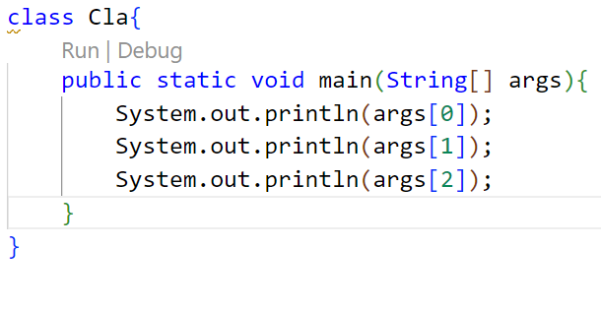
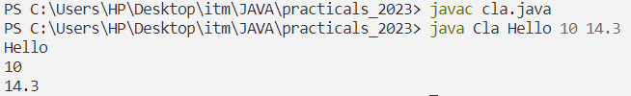
09 / Language Fundamentals
Command Line Arguments: Example 1
CODE DEMONSTRATION
CONSOLE OUTPUT

Slide 151
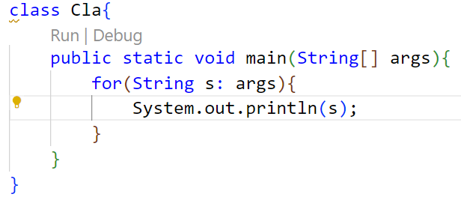
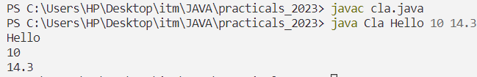
09 / Language Fundamentals
Command Line Arguments: Example 2
CODE DEMONSTRATION
CONSOLE OUTPUT

Slide 152
09 / Language Fundamentals
Variable Arguments (varargs)
Overview & Purpose
Why use varargs?
If we don't know how many arguments we will have to pass in the method, varargs is the better approach. It allows the method to accept zero or multiple arguments.
The Alternative
Before varargs, we had to use overloaded methods or pass parameters as arrays, which was not considered ideal due to maintenance overhead.
Syntax & Structure
Method Declaration Syntax
returntype method_name(datatype... value)
The ellipsis (...) identifies that an arbitrary number of arguments (including zero) can be passed.

Slide 153
09 / Language Fundamentals
Rules for Defining Varargs
COMPILER CONSTRAINTS
Strict Compilation Rules
Single Varargs Parameter:
There can be at most one variable argument parameter in any method signature.
Must Be Last:
The variable argument parameter (varargs) must always be the last argument in the method.
CODE VALIDATION
// ERROR: Multiple varargs
void xyz(String... a, String b...)
// ERROR: Varargs not last
void xyz(String... a, int b)
// VALID: Correct syntax
void xyz(int a, String... b)

Slide 154
09 / Language Fundamentals
Example-3 : CLA using varargs
SOURCE CODE
CONSOLE OUTPUT
class Cla {
public static void main(String... args) {
for(String s: args) {
System.out.println(s);
}
}
}
# Compile the program
$ javac cla.java
# Run with command line arguments
$ java Cla Hello 10 14.3
Hello
10
14.3

Slide 155
09 / Language Fundamentals
Wrapper Class
OBJECT CONVERSION
Bridging Primitives & Objects
Type Conversion:
Used to convert primitive types into class objects to enable object-oriented features.
Generics Compatibility:
Generic classes only work with objects. Wrapper classes let you use primitives with generics.
SYSTEM INTEGRATION
Type Mapping & Package
One-to-One Mapping:
Each primitive type in Java has a unique corresponding wrapper class (e.g., int to Integer).
Standard Package:
All wrapper classes belong to the java.lang package, meaning they are imported automatically.

Slide 156
09 / Language Fundamentals
Wrapper Class Mappings
PRIMITIVE | WRAPPER CLASS
boolean | Boolean
char | Character
byte | Byte
short | Short
PRIMITIVE | WRAPPER CLASS
int | Integer
long | Long
float | Float
double | Double

Slide 157
09 / Language Fundamentals
Need of Wrapper Class
OBJECT REPRESENTATION
Bridging the Gap
Primitive WrappingAllows primitive types to be used where objects are strictly required, such as in java.util utility classes.
Bidirectional MethodsProvides built-in utility methods to easily wrap values into objects and unwrap them back.
COLLECTION FRAMEWORK
Data Structures
Object-Only StorageCollections like ArrayList only store object references, preventing direct use of primitives.
String ParsingEnables robust object creation and conversion from alternative types like Strings.
CONCURRENCY
Thread Control
Locking & SynchronizationRequired in multithreading synchronization to lock shared resources, as locking mechanisms natively require object references rather than primitive types.

Slide 158
09 / Language Fundamentals
Wrapper Class Creation
METHOD 01
Class Constructor
DEPRECATED
Using wrapper class constructor to instantiate a wrapper object by passing the value.
METHOD 02
Direct Assignment
Creating wrapper object directly by assigning values, using wrapper class only.
METHOD 03
valueOf() Method
Using the static valueOf() factory method to efficiently obtain a wrapper class instance.

Slide 159
09 / Language Fundamentals
Using Wrapper Class Constructor
METHOD 01
Class Constructor
We can create a wrapper object using the wrapper class and its constructor by passing the value to it.
Syntax:
ClassName object = new ClassName(argument);
Example:
Integer number = new Integer(58);
STATUS & WARNINGS
Usage Status
DEPRECATED
However, the way of creating an instance of wrapper classes using constructor is deprecated as of the latest version of JDK.
This is because each time new memory is allocated in the heap when we create an object with the help of the constructor.
Also, the constructor Character(char) has been deprecated since JDK version 9.

Slide 160
09 / Language Fundamentals
Using Wrapper Class
CONCEPT
Direct Assignment
We can create without using constructor as well by using the wrapper class instead of the primitive type to create a wrapper object without passing the value to the constructor.
Accessing Values
To get the value, we can print the particular object.
CODE STRUCTURE
Syntax & Example
Syntax:
ClassName object = value;
Example:
Integer intValue = 10;
System.out.println(intValue);

Slide 161
09 / Language Fundamentals
Using valueOf() Method
METHOD 02
Static Factory Method
By using valueOf Static method, a Wrapper object can be created.
CODE STRUCTURE
Syntax & Example
Syntax:
ClassName object = ClassName.valueOf(argument);
Example:
int a= 10;
Integer num= Integer.valueOf(a);

Slide 162
09 / Language Fundamentals
Wrapper Class Methods
typeValue()
Converts the value of this Number object to the specified primitive data type returned
compareTo()
Compares this Number object to the argument
equals()
Determines whether this Number object is equal to the argument
valueOf()
Returns an Integer object holding the value of the specified primitive data type value
toString()
Returns a String object representing the value of specified Integer type argument
parseInt()
Returns an Integer type value of a specified String representation
decode()
Decodes a String into an integer
min()
Returns the smaller value after comparison of the two arguments
max()
Returns the larger value after comparison of the two arguments
round()
Returns the closest round off long or int value as per the method return type

Slide 163
09 / Language Fundamentals
Autoboxing
CONCEPT DEFINITION
Autoboxing is when the Java compiler performs the automatic conversion of the primitive data types to the object of their corresponding wrapper classes.
For example, converting an int to Integer, a double to Double, etc.
EXPLICIT CONVERSION
To explicitly convert primitive to object we use the valueOf() method.
COMPILER BEHAVIOR
The Java compiler applies autoboxing when a primitive value is:
Passed as a parameter to a method that expects an object of the corresponding wrapper class.
Assigned to a variable of the corresponding wrapper class.

Slide 164
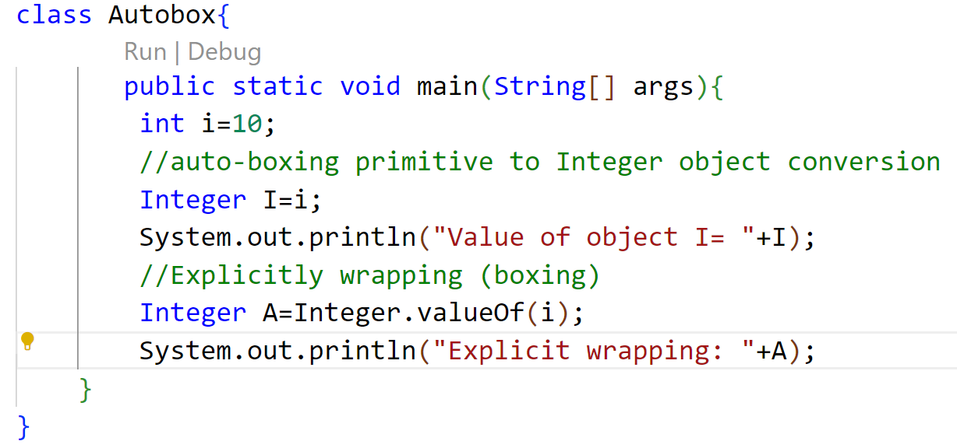
09 / Language Fundamentals
Autoboxing: Example
Autobox.java

Slide 165
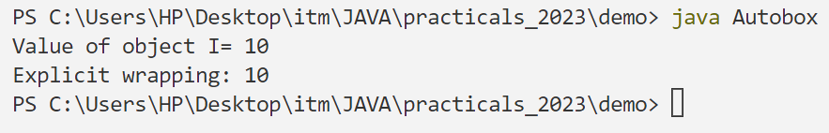
09 / Language Fundamentals
Autoboxing: Example
Console Output

Slide 166
09 / Language Fundamentals
Auto-Unboxing
What is Unboxing?
Unboxing is automatically converting an object of a wrapper type (Integer, for example) to its corresponding primitive (int) value.
Explicit Conversion
To explicitly convert object to corresponding primitive type we use xxxValue() method.
Automatic Unboxing
The Java compiler applies unboxing when an object of a wrapper class is:
•Passed as a parameter to a method that expects a value of the corresponding primitive type.
•Assigned to a variable of the corresponding primitive type.

Slide 167
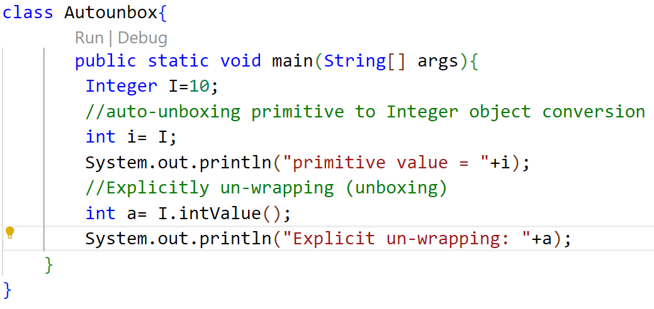
09 / Language Fundamentals
Auto-Unboxing: Example
Autounbox.java

Slide 168

09 / Language Fundamentals
Auto-Unboxing: Example
OUTPUT

Slide 169
09 / Language Fundamentals
toString() Method
Core Purpose
String Representation
The toString() method returns the String representation of the object.
Compiler Behavior
Automatic Invocation
If you print any object, Java compiler internally invokes the toString() method on the object.
So overriding the toString() method, returns the desired output, it can be the state of an object etc. depending on your implementation.

Slide 170
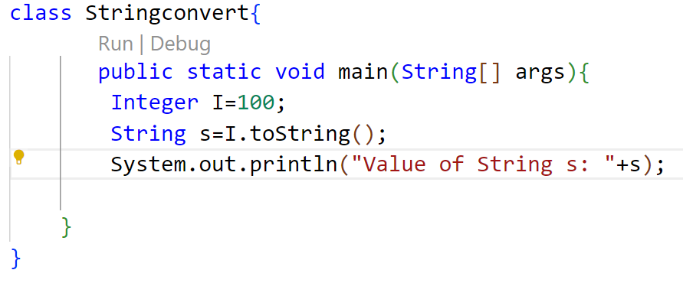
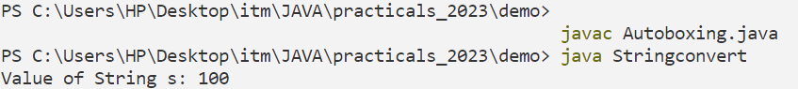
09 / Language Fundamentals
toString() Method: Example
JAVA CODE
TERMINAL OUTPUT

Slide 171
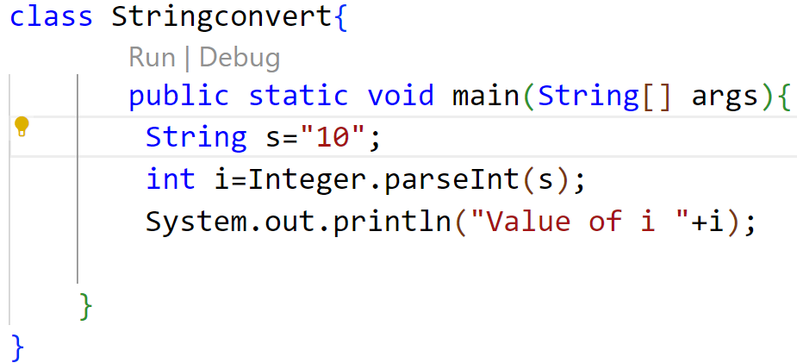
09 / Language Fundamentals
parseXXX() Method
Core Purpose
String Conversion
parseXXX() method is use to convert String to a primitive type.
JAVA CODE

Slide 172
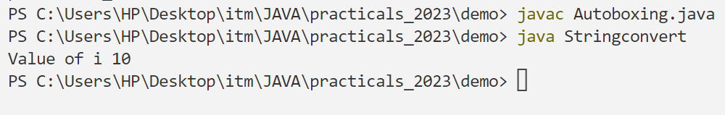
09 / Language Fundamentals
parseXXX() Method: Example
TERMINAL OUTPUT

