Slide 1

Unit 02 Overview
Classes, Objects & Methods
Section 01
Core Fundamentals
Class & Object
Object Reference
new Operator
this Keyword
static Keyword
Section 02
Methods & Logic
Constructors
Constructor Overloading
Method Overloading
Recursion
Object Passing & Return
finalize() Method
Section 03
Scope & Architecture
Access Control
Access Modifiers
Nested Classes
Inner Classes
Anonymous Inner Classes

Slide 2
OVERVIEW
Object-Oriented Programming (OOP)
Core Concept
A programming paradigm centered around "objects"—structuring code into instances of defined classes.
The Blueprint
A class acts as a template for creating objects that share common attributes (properties) and behaviors (methods).
Four Basic Principles of OOP:
01
Encapsulation
Bundling data and methods into a single class unit to restrict direct internal access.
02
Inheritance
Deriving new classes from existing superclasses to promote reusable code structure.
03
Abstraction
Hiding complex implementation details to present only essential functionality.
04
Polymorphism
Enabling different objects to execute custom behaviors through a shared interface.

Slide 3
CORE CONCEPTS
OOP Principles
01
Encapsulation
Encapsulation refers to the practice of bundling data (attributes) and the methods (functions) that operate on that data into a single unit called a class.
This provides data hiding and allows for controlled access to the internal state of objects. By encapsulating data, you can control how it's manipulated and prevent unintended interference.
02
Inheritance
Inheritance allows you to create a new class (subclass or derived class) that inherits attributes and behaviors from an existing class (superclass or base class).
This promotes code reuse and allows you to create specialized classes based on a more general template.

Slide 4
CORE CONCEPTS
OOP Principles
03
Abstraction
Abstraction involves simplifying complex reality by modeling classes based on their essential characteristics.
It allows you to focus on the necessary features while hiding unnecessary details. Abstraction helps manage complexity and makes code more manageable.
04
Polymorphism
Polymorphism means the ability of objects of different classes to be treated as objects of a common superclass.
It allows you to define a single interface or method signature that multiple classes can implement in their own way. This promotes flexibility and extensibility in your code.

Slide 5
CORE CONCEPTS
Encapsulation
01
Bundling Unit
Encapsulation is one of the four fundamental OOP concepts.
It is the wrapping of Data and Methods into a single unit (called a class).
02
Access Control
It is the technique of making class fields private.
Controlled access to these internal fields is provided exclusively via public methods.
03
Data Hiding
Private fields cannot be accessed by external code, protecting class variables from direct exposure.
Due to this security mechanism, encapsulation is commonly termed data hiding.

Slide 6
CORE CONCEPTS
Encapsulation Overview
01
Protective Barrier
Encapsulation can be described as a protective barrier that prevents code and data from being randomly accessed by other code defined outside the class.
Access to the data and code is tightly controlled by an interface.
02
Key Advantages
The main benefit of encapsulation is the ability to modify implemented code without breaking the code of others who use our code.
With this feature Encapsulation gives maintainability, flexibility and extensibility to our code.

Slide 7
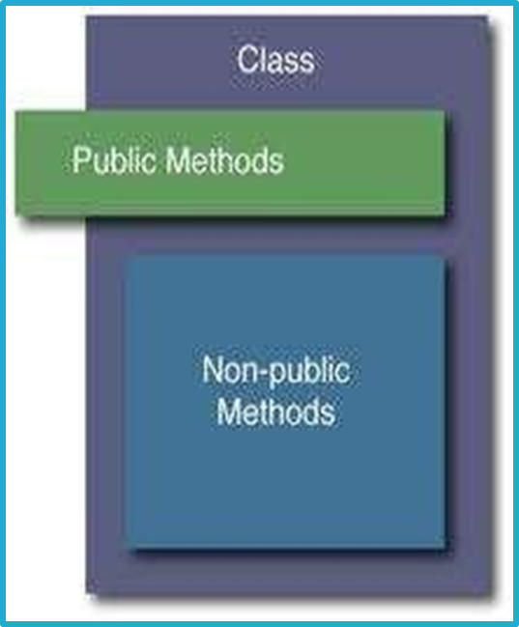
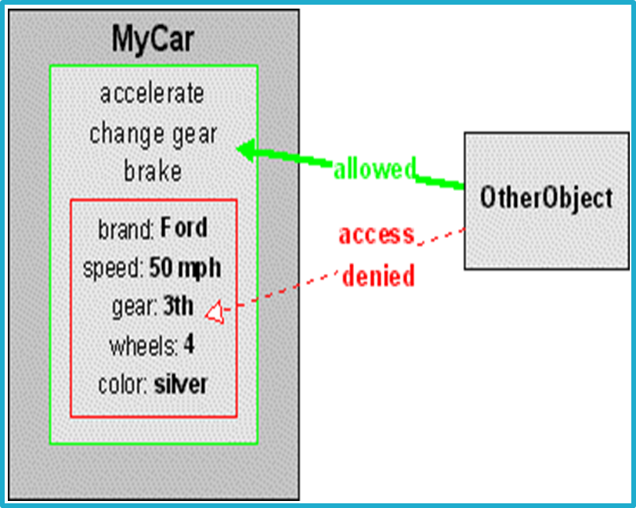
CORE CONCEPTS
Encapsulation Architecture
01
Class Structure & Scope
02
Access Control & Interface

Slide 8
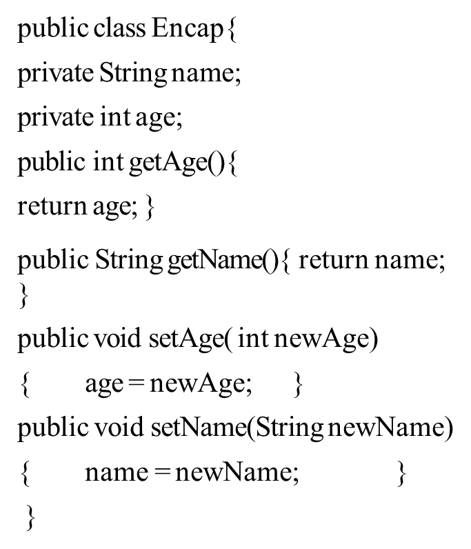
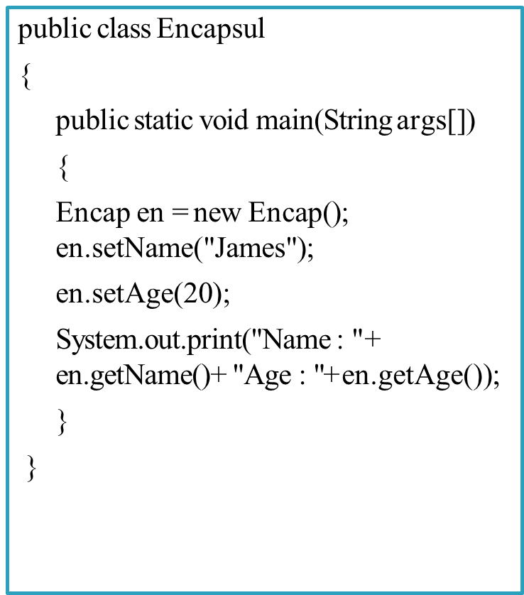
CORE CONCEPTS
Encapsulation Code Example
01
Encapsulated Class Definition
02
Main Execution & Access

Slide 9
CORE CONCEPTS
Inheritance Architecture
01
Core Definition
Inheritance is the mechanism by which one object acquires the properties and behaviors of another object.
It organizes information into a structured, manageable hierarchical order.
02
Key Keywords
When implementing inheritance, the primary keywords utilized are:
extends
implements
03
IS-A Relationship
These keywords determine whether one object is an IS-A type of another.
Through this relationship, objects acquire and reuse existing properties from parent classes.

Slide 10

CORE CONCEPTS
Example: Vehicle Abstraction Hierarchy
ABSTRACT CLASS
Vehicle
Base class definition
CONCRETE CLASS
Car
Extends Vehicle base behaviors with specific passenger car implementation.
CONCRETE CLASS
Bus
Inherits core properties while adding mass transit capability logic.
CONCRETE CLASS
Truck
Specializes the abstract hierarchy for heavy cargo transport.

Slide 11
CORE CONCEPTS
Example: Java Class Inheritance
ParentChildExample.java
SUPERCLASS (BASE)
Parent Class
Defines base fields shared across family members:
parentName : String
familyName : String
class Parent {
String parentName;
String familyName;
}
class Child extends Parent {
String childName;
int childAge;
void printMyName() {
System.out.println(
"My name is" + childName +
" " + familyName);
}
}
SUBCLASS (DERIVED)
Child extends Parent
Inherits base properties and adds specific logic:
Adds childName and childAge attributes.
printMyName() directly accesses inherited familyName.

Slide 12
CORE CONCEPTS
Abstraction in Object-Oriented Programming
01. DEFINITION
Essential Features
Providing essential features while hiding internal implementation details is the core foundation of Abstraction.
02. SECURITY
Encapsulated Safety
Enhances internal implementation safely without affecting external systems, providing crucial security boundaries.
03. DATA RELEVANCE
Selective Exposure
Classes contain extensive data, but abstraction ensures users are only exposed to the subset they actually need.
04. USER EXPERIENCE
Tailored Data Views
Every user receives a personalized view specific to their requirements, preventing confusion from clutter.

Slide 13
CORE CONCEPTS
Example: Abstract Bank Class
Bank.java
ABSTRACT CLASS (BASE)
Bank Class Template
Defines base structure for derived bank account types:
public abstract class Bank
Cannot be directly instantiated without subclassing
public abstract class Bank {
private int accno;
private String name;
private float balance;
private float loan;
void display_to_cler() {
System.out.println(
"Accno = " + accno);
System.out.println(
"Name = " + name);
}
}
ENCAPSULATION & METHODS
Data Protection & Access
Restricts direct access to member variables:
private fields: accno, name, balance, loan
display_to_cler() prints account info

Slide 14
CORE CONCEPTS
Polymorphism in OOP
01. DEFINITION
Multiple Forms
Polymorphism is the ability of an object to take on many forms. The most common use in OOP occurs when a parent class reference is used to refer to a child class object.
02. IS-A TEST
Object Polymorphism
Any Java object passing more than one IS-A test is considered polymorphic. All Java objects pass the IS-A test for their own type and for the class Object.
03. REFERENCES
Type Immutability
Access to an object is only through a reference variable of a single type. Once declared, the type of a reference variable cannot be changed.

Slide 15
CORE CONCEPTS
Example: Shape Hierarchy
Shape
CATEGORY 01
2-D Shape
Circle
Rectangle
└─ Square (Derived)
Triangle
└─ Equilateral Triangle (Derived)
CATEGORY 02
3-D Shape
Sphere
Cube

Slide 16
POLYMORPHISM IN JAVA
Method Overloading Examples
int add (int a, int b) 2 PARAMETERS (INT, INT)
float add (float a, int b) 2 PARAMETERS (FLOAT, INT)
float add (int a, float b) 2 PARAMETERS (INT, FLOAT)
void add (float a) 1 PARAMETER (FLOAT)
int add (int a) 1 PARAMETER (INT)

Slide 17
OBJECT-ORIENTED PROGRAMMING
Classes & Objects
CONCEPT 01
Class
A template or blueprint that describes the behaviors and states that objects of its type support.
Key Characteristics:
Serves as a structural design / blueprint
Defines attributes & methods
Does not consume memory until instantiated
CONCEPT 02
Object
A real-world instance of a class having distinct states and behaviors.
Example: Dog Object
States: Color, Name, Breed
Behaviors: Wagging, Barking, Eating

Slide 18
OBJECT-ORIENTED PROGRAMMING
Class Definition & Concepts
PILLAR 01
Object Blueprint
A programming language construct used as a master template to instantiate objects.
Core Functions:
Acts as a structural blueprint
Defines shared attributes
Defines common methods
PILLAR 02
Abstraction
An abstract representation of real-world concepts within software systems.
Models Entities Such As:
Person (e.g., User, Employee)
Place (e.g., Location, Store)
Thing (e.g., Account, Product)
PILLAR 03
Encapsulation
Bundles data placeholders and executable code into a single logical unit.
Core Components:
State: Member variables
Behavior: Reusable methods

Slide 19
OBJECT-ORIENTED PROGRAMMING
Class Syntax Structure
ClassDeclaration.java
SYNTAX BREAKDOWN
Core Elements
1. Class Name
Defines the identifier used to instantiate objects from this template.
2. Instance Variables
Hold the attribute state unique to each instance created from the class.
3. Class Methods
Contain executable statements that define the behaviors and operations.
class classname {
// State / Variables
type instance_variable1;
// Method 1 Definition
type methodname1(parameter_list) {
// body of method
}
// Method 2 Definition
type methodname2(argument_list) {
// body of method
}
}

Slide 20
OBJECT-ORIENTED PROGRAMMING
Declaring a Class
GeneralSyntax.java
Dog.java
class classname {
// State / Variables
type instance_variable1;
type instance_variable2;
// Method Definitions
type method1(params) {
// body of method
}
type method2(params) {
// body of method
}
}
public class Dog {
// Instance Variables
String breed;
int age;
String color;
// Methods (Behavior)
void barking() { ... }
void hungry() { ... }
void sleeping() { ... }
}

Slide 21
OBJECT-ORIENTED PROGRAMMING
Understanding Objects
CORE DEFINITION
Real-Time Entity
Instance of a Class
An Object is a real-time entity and an instance of a class. It possesses distinct properties and can perform specific actions.
COMPOSITION
State & Action
Variables & Methods
Objects contain variables (state) and methods (behavior). Objects exhibiting similar properties and actions are grouped together under one class.
CONCEPTUAL MODEL
Real-World Analogy
Blueprint vs. House
“To give a real world analogy, a house is constructed according to a specification.”
The class serves as the architectural specification, whereas the house itself is the physical object.

Slide 22
OBJECT-ORIENTED PROGRAMMING
Creating Objects Using new Operator
STEP 01
Declare Variable
Reference Declaration
To access properties and methods, declare a variable of that class type. This variable does not define an object yet—it simply holds a reference.
STEP 02
Allocate Memory
The new Operator
Acquire an actual physical copy of the object using the new operator. It dynamically allocates memory and returns its address reference.
STEP 03
Store Reference
Dynamic Link
The memory address reference is stored in the variable. Consequently, in Java, all class objects are dynamically allocated.

Slide 23
OBJECT-ORIENTED PROGRAMMING
The new Operator in Java
CORE METHOD
Object Creation
Most Common Approach
Using the new keyword is the primary and most basic way to create objects in Java.
FLEXIBILITY
Constructor Call
Supports All Signatures
Invokes any desired constructor during creation, supporting no-argument or parameterized constructors.
SYNTAX EXAMPLE
Instantiation
Basic Statement
mybox = new Box();
Allocates memory dynamically for a new Box object.

Slide 24
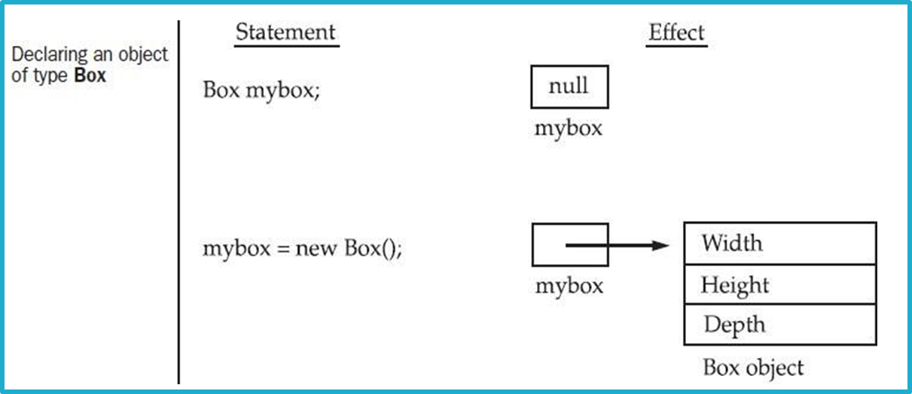
OBJECT-ORIENTED PROGRAMMING
Declaring & Instantiating Objects
SYNTAX BREAKDOWN
Declaration Steps
1. Declare Reference Variable
Box mybox;
Creates a reference variable that initially holds null.
2. Allocate Memory & Assign
mybox = new Box();
Allocates physical memory for the Box object and points mybox to it.
Combined Shortcut
Box mybox = new Box();
MEMORY MODEL
Statement vs. Effect

Slide 25
OBJECT-ORIENTED PROGRAMMING
Example of Class & Object
CLASS DEFINITION
Class Structure
Instance Variables
class Box {
double width;
double height;
double depth;
}
Defines template attributes that belong to each instance of the class.
MEMORY ALLOCATION
The new Operator
Dynamic Allocation
new Box();
The new operator dynamically allocates memory for an object at runtime.
INSTANTIATION SYNTAX
Object Instance
Combined Statement
Box mybox = new Box();
mybox is an instance (object) of class Box, holding a reference to the created object.

Slide 26
OBJECT-ORIENTED PROGRAMMING
Difference Between Classes & Objects
CONCEPTUAL BLUEPRINT
Classes
Core Existence
Classes have logical existence. They act as a theoretical template or specification without taking up physical memory on their own.
Real-World Analogy
Furniture itself does not have any physical existence—it is an abstract concept representing a category.
CONCRETE INSTANCE
Objects
Core Existence
Objects have physical existence. An object is a real instance created dynamically in memory based on its class specification.
Real-World Analogy
Chair, Table, etc. do have physical existence as tangible objects created under the furniture category.

Slide 27
OBJECT-ORIENTED PROGRAMMING
Access Controls & Modifiers
CORE CONCEPT
Access Control
Who Can Access
Decides who can access variables, methods, and classes in Java.
MECHANICS
Specifiers
Access Determination
How and where a member of a class is accessed is determined by the access specifiers.
VISIBILITY
Member Scope
Class Boundaries
Members have visibility in the same class or other classes based on accessibility.
IMPLEMENTATION
Modifiers
Tooling
To implement access control in Java, we use Access Modifiers.

Slide 28
OBJECT-ORIENTED PROGRAMMING
Access Specifiers: Public & Private
UNRESTRICTED ACCESS
public
Global Scope
When a class member is declared with public, it can be accessed from anywhere in the program.
Usage Intent
Public classes, methods, or fields are used only if you explicitly want to offer unrestricted access to these members.
RESTRICTED ACCESS
private
Encapsulated Scope
You can access private methods and fields only within the same class to which they belong.
Subclass Boundaries
Private members are not visible within subclasses and are strictly not inherited by subclasses.

Slide 29
OBJECT-ORIENTED PROGRAMMING
Access Specifiers: Protected & Default
SUBCLASS & PACKAGE SCOPE
protected
Subclass & Package Access
You can access protected methods and fields from within the same class, its subclasses, and classes of the same package, but not from other packages.
Declaration Restriction
The protected access specifier cannot be used with class declarations.
PACKAGE-ONLY SCOPE
Default
Implicit Assignment
If you do not specify any access specifier while declaring a class, method, or field, it is considered with the default access specifier.
Package Accessibility
Accessible from within the same package to which they belong, but strictly not accessible outside the package.

Slide 30
Methods
¨A Java method is a collection of statements that are grouped together to perform an operation.
¨When you call the System.out.println method, for example, the system actually executes several statements in order to display a message on the console.
This is the general form of a method:
type name(parameter-list) {
/ / body of method
}

Slide 31
OBJECT-ORIENTED PROGRAMMING
Methods: Definition & Syntax
CORE CONCEPT
What is a Method?
Definition
A Java method is a collection of statements that are grouped together to perform an operation.
Practical Example
When you call System.out.println, for example, the system actually executes several statements in order to display a message on the console.
SYNTAX STRUCTURE
General Form
typename(parameter-list) {
// body of method
}
Key Components
type: Return data type (or void)
name: Identifier used to call the method
parameter-list: Sequence of input parameters

Slide 32
OBJECT-ORIENTED PROGRAMMING
Methods: Overview & Rules
CORE CONCEPT
What is a Method?
OOP Context
The word method is commonly used in object-oriented programming.
Function Analogy
It is similar to a function in any other programming language.
DECLARATION & CONVENTION
Naming & Scope
Declaration Scope
Name of method can be declared outside the class.
Naming Convention
All methods have a name that starts with a lowercase character.

Slide 33
OBJECT-ORIENTED PROGRAMMING
Methods: Syntax Rules & Parameters
RETURN TYPE & NAMING
Type & Identifier
Data Type Specifier
Specifies the type of data returned by the method. This can be any valid type, including custom class types. If no value is returned, return type must be void.
Method Name
Specified by name. Can be any legal identifier other than items already used within the current scope.
METHOD INPUTS
Parameter List
Structure & Sequence
The parameter-list is a sequence of type and identifier pairs separated by commas.
Variable Role & Empty State
Parameters act as variables that receive argument values passed when invoked. If the method requires no parameters, the list remains empty.

Slide 34
OBJECT-ORIENTED PROGRAMMING
Why Use Methods?
REUSABILITY
To Make Code Reusable
If you need to do the same task multiple times, write a method once and call it each time you need to execute the task.
FLEXIBILITY
To Parameterize Code
Use parameters to dynamically alter and control how the method behaves across different scenarios.
ARCHITECTURE
Top-Down Programming
Easily solve bigger or complex problems by breaking them down into smaller, manageable sub-methods.
MAINTAINABILITY
To Simplify Code
Encapsulates complex internal logic from other program parts, preventing accidental errors and confusion.

Slide 35
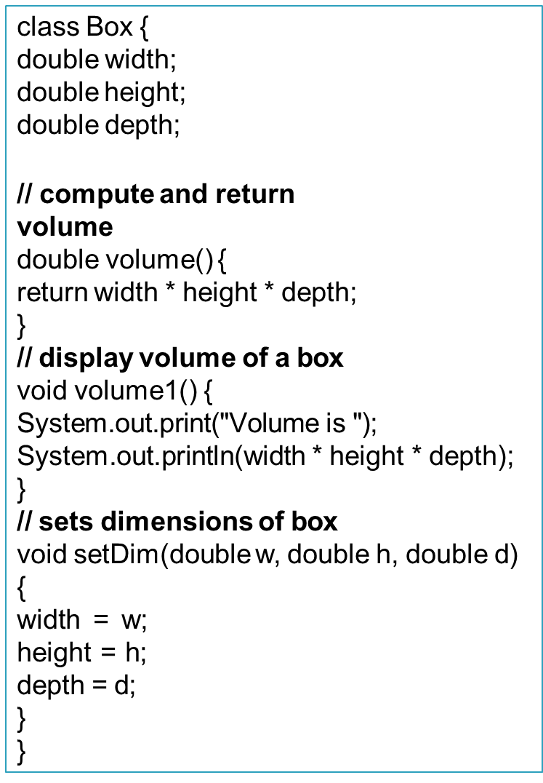
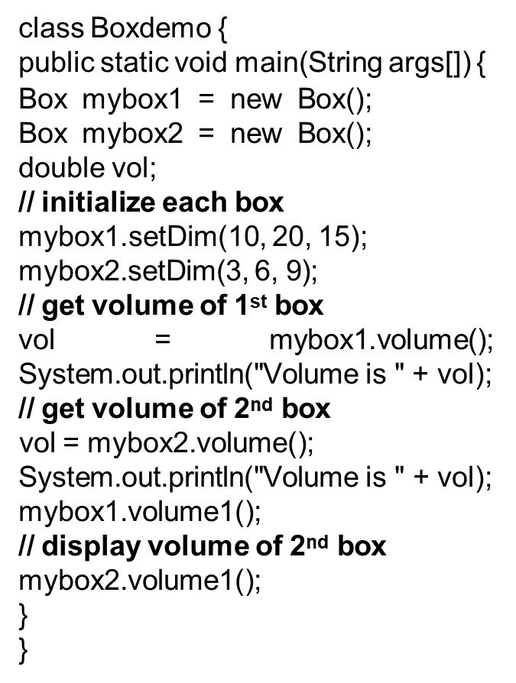
OBJECT-ORIENTED PROGRAMMING
Example: Class Methods in Action
CLASS DEFINITION
Box Class Logic
CLASS USAGE
BoxDemo Execution

Slide 36
OBJECT-ORIENTED PROGRAMMING
Method Overloading
DEFINITION
Same Name, Unique Params
If two methods have the same name but different parameter lists within one class, it is called "Method Overloading".
REQUIREMENTS
Parameter Signature
Overloaded methods must have different parameter lists. You cannot overload methods based solely on different modifiers or return types.
COMPILER LOGIC
Method Resolution
When overloaded methods are used, the Java compiler decides which method to invoke based on the number and types of parameters passed.

Slide 37
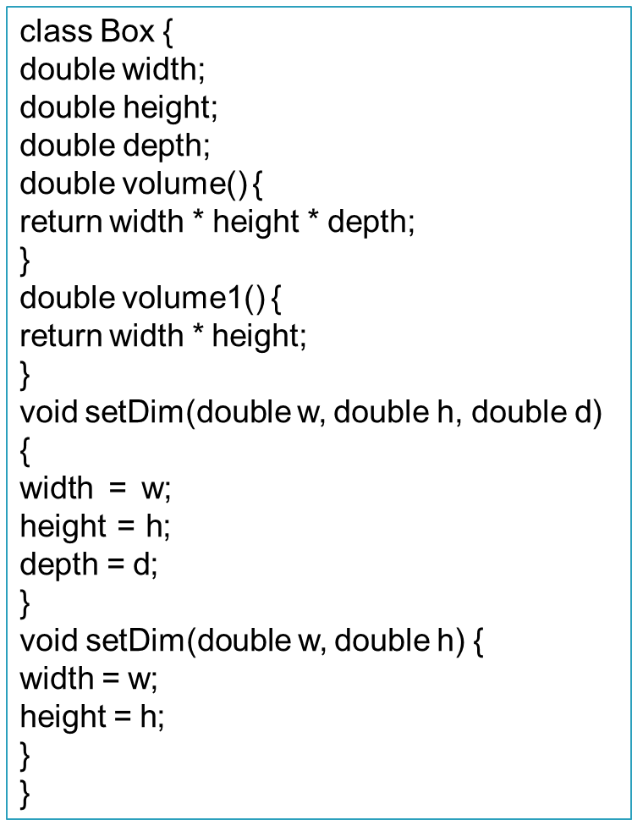
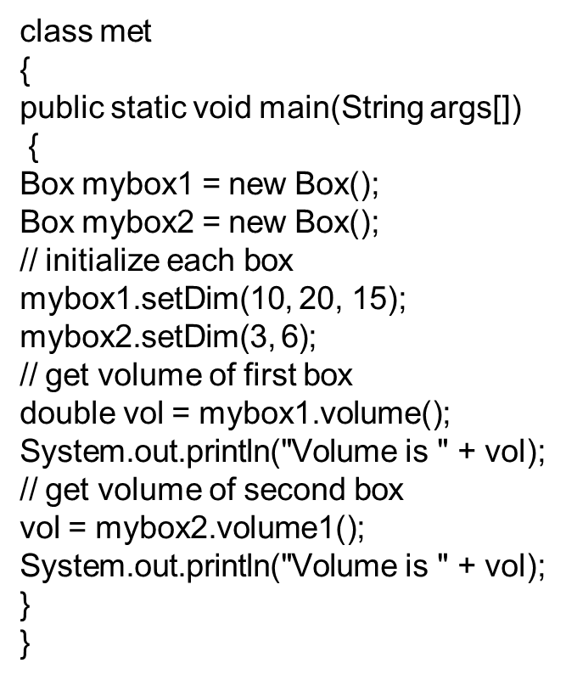
OBJECT-ORIENTED PROGRAMMING
Example: Method Overloading
CLASS DEFINITION
Box Class Logic
CLASS USAGE
BoxDemo Execution

Slide 38
OBJECT-ORIENTED PROGRAMMING
Core Concept: Recursion
DEFINITION
Self-Calling Method
Recursion is a programming technique in which a method calls itself directly or indirectly.
MEMORY MECHANISM
Stack Allocation
Each method call allocates new space on the internal stack for its local variables, enabling recursive calls automatically.
BENEFITS & EXAMPLES
Problem Breakdown
Provides a way to break complicated problems down into simpler problems that are easier to solve.
Examples:
Factorial of a number
Fibonacci series

Slide 39
OBJECT-ORIENTED PROGRAMMING
Recursion: Syntax & Simple Example
GENERAL SYNTAX
Recursive Structure
type methodname() {
// code to be executed
methodname(); // calling same method
}
A recursive method contains a call to itself within its own body definition.
BASIC EXAMPLE
Demonstration Method
void demo() {
System.out.println("hello");
demo(); // recursive call
}
When executed, this simple example continuously prints "hello" by invoking itself repeatedly.

Slide 40
OBJECT-ORIENTED PROGRAMMING
Recursion: Factorial Example
JAVA CODE
Factorial Class
public class Recursion {
static int factorial(int n) {
if (n == 1) return 1;
else return(n * factorial(n-1));
}
public static void main(String[] args) {
System.out.println(
"Factorial of 5 is: " + factorial(5));
}
}
CODE BREAKDOWN
Method Logic
1. Base Case
When n == 1, returns 1. This terminates the recursive call chain and prevents infinite execution.
2. Recursive Step
Multiplies n by the result of calling factorial(n-1).
3. Program Output
Evaluating factorial(5) yields 5 * 4 * 3 * 2 * 1:
Factorial of 5 is: 120

Slide 41
OBJECT-ORIENTED PROGRAMMING
Constructor: Overview & Key Features
CORE DEFINITION
Role & Naming
1. Special Initialization Method
A constructor is similar to a method that initializes the instance variables of a class.
2. Identical Class Naming
A constructor must have the exact same name as the class name in which it is defined.
EXECUTION & PARAMETERS
Invocation Behavior
1. Flexible Parameters
A constructor may or may not have parameters. Parameters act as local variables to receive data during instantiation.
2. Automatic Call
Once defined, it is automatically invoked immediately after object creation, before the new operator completes.

Slide 42
OBJECT-ORIENTED PROGRAMMING
Constructor: Types & Rules
CONSTRUCTOR TYPES
Classification
1. Default Constructor
A constructor without any parameters is called default constructor.
2. Parameterized Constructor
A constructor with one or more parameters is called parameterized constructor.
RETURN & EXECUTION
Key Rules
1. No Return Type
A constructor does not return any value, not even void because implicitly the return type of a constructor is the class itself.
2. Single Invocation
A constructor is called only once per object.

Slide 43
OBJECT-ORIENTED PROGRAMMING
Constructor: No-argument Type
CORE DEFINITION
Overview & Concept
1. Parameter Flexibility
Similar to methods, a Java constructor may or may not have any parameters (arguments).
2. Zero Arguments
If a constructor does not accept any parameters, it is known as a no-argument constructor.
SYNTAX & STRUCTURE
Basic Declaration
Syntax Format
constructor()
{
// syntax / code body
}
Contains empty parentheses with no parameter signatures defined inside.

Slide 44
OBJECT-ORIENTED PROGRAMMING
Private Constructor: Code Example
SOURCE CODE
Main.java
class Main {
int i;
private Main() {
i = 5;
System.out.println("Constructor is called");
}
public static void main(String[] args) {
Main obj = new Main();
System.out.println("Value of i: " + obj.i);
}
}
EXECUTION & ANALYSIS
Key Takeaways
1. Private Access
The constructor private Main() restricts instantiation from outside the class.
2. Same-Class Invocation
Inside main(), new Main() works because it resides within the same class definition.
3. Console Output
Constructor is called
Value of i: 5

Slide 45
OBJECT-ORIENTED PROGRAMMING
Constructor: Default Type
CORE DEFINITION
Overview & Concept
1. Automatic Generation
If we do not create any constructor, the Java compiler automatically creates a no-argument constructor during execution.
2. Object Initialization
A default constructor is used to initialize every object of the class with the exact same data.
SYNTAX & STRUCTURE
Basic Declaration
Syntax Format
Constructor_name()
{
// statements
}
Generated with empty parameters and default body when no explicitly declared constructor exists.

Slide 46
OBJECT-ORIENTED PROGRAMMING
Default Constructor: Code Example
SOURCE CODE
StudentDemo.java
class Student {
int rollNo; String name;
Student() { rollNo = 101; name = "Suresh"; }
void display() {
System.out.println("Roll No: " + rollNo);
System.out.println("Name: " + name);
}
}
class StudentDemo {
public static void main(String[] args) {
Student s1 = new Student();
System.out.println("s1 object contains: ");
s1.display();
Student s2 = new Student();
System.out.println("s2 object contains: ");
s2.display();
}
}
EXECUTION & ANALYSIS
Key Takeaways
1. No-Arg Constructor
The Student() constructor initializes rollNo and name upon creation.
2. Automatic Initialization
Invoking new Student() triggers default values for object instance variables.
3. Console Output
Student Roll Number is: 101
Student Name is: Suresh

Slide 47
OBJECT-ORIENTED PROGRAMMING
Constructor: Parameterized Type
CORE DEFINITION
Overview & Concept
1. Accepts Parameters
A Java constructor can accept one or more parameters to receive initial values.
2. Custom Initialization
Parameterized constructors allow initializing each object with distinct, customizable data.
SYNTAX & STRUCTURE
Basic Declaration
Syntax Format
Constructor_name(parameters)
{
// statements
}
Parameters are specified within parentheses to pass initial values during object instantiation.

Slide 48
OBJECT-ORIENTED PROGRAMMING
Parameterized Constructor: Code Example
SOURCE CODE
Main.java
class Main {
String languages;
Main(String lang) {
languages = lang;
System.out.println(languages +
" Programming Language");
}
public static void main(String[] args) {
Main obj1 = new Main("Java");
Main obj2 = new Main("Python");
Main obj3 = new Main("C");
}
}
EXECUTION & ANALYSIS
Key Takeaways
1. Parameterized Constructor
The Main(String lang) constructor accepts a string argument to initialize field state.
2. Dynamic Value Passing
Passing distinct parameters during new instantiation sets custom instance data for each object.
3. Console Output
Java Programming Language
Python Programming Language
C Programming Language

Slide 49
OBJECT-ORIENTED PROGRAMMING
Constructor Overloading: Core Concept
CORE DEFINITION
Definition & Purpose
1. Multiple Constructors
The concept of defining more than one constructor within the same class.
2. Versatile Execution
Allows every constructor to perform a different initialization task depending on requirements.
KEY REQUIREMENT
Parameter Distinction
1. Different Parameters
Overloaded constructors must differ in parameter list (number, type, or sequence of arguments).
2. Flexible Object Creation
Provides callers multiple tailored entry points to instantiate objects with varied initial data.

Slide 50
OBJECT-ORIENTED PROGRAMMING
Constructor Overloading: Code Example
CLASS DEFINITION
Box.java
class Box {
double width, height, depth;
// Default constructor
Box() { width = height = depth = 10; }
// Parameterized constructor
Box(double w, double h, double d) {
width = w; height = h; depth = d;
}
// Compute and return volume
double volume() {
return width * height * depth;
}
}
EXECUTION CLASS
BoxDemo6.java
class BoxDemo6 {
public static void main(String[] args) {
// Instantiate using default constructor
Box mybox1 = new Box();
// Instantiate using parameterized constructor
Box mybox2 = new Box(10, 20, 15);
double vol;
vol = mybox1.volume();
System.out.println("Volume is " + vol);
vol = mybox2.volume();
System.out.println("Volume is " + vol);
}
}

