Slide 1

Airbnb Inc.
By Maher Jaweed

Slide 2
Table of Contents
1. Executive Summary
2. Company and Industry Overview
3. Historical Strategy & Market Positioning
4. Competitive Landscape and Comparison
5. Key Strategic Initiatives (2025)
6. Regional Strategy Breakdown
7. Platform Risks and Mitigation
8. Conclusion & Recommendation

Slide 3
1. Executive Summary
Evolving Strategy & Global Presence: Since its 2008 founding, Airbnb has grown to 7.7 million listings across 220+ countries, shifting from a market disruptor to an industry leader, especially after its 2020 IPO.
Competitive Edge & 2025 Focus: Despite strong competition, Airbnb remains dominant in the U.S. and second in Europe by emphasizing innovation. Safety programs like AirCover, coupled with a strategy centered on affordability, host incentives, and real estate partnerships help Airbnb stay ahead of competitors.
Localized Regulatory Strategy: From complying with EU and Japanese regulations, to expanding in Latin America and India through local partnerships, Airbnb adapts operations to local laws.
Financial Outlook & Recommendations: With projected 2025 revenue of nearly $12 billion and improving financials, continued investment in host support and regulatory compliance is key to sustaining market leadership.

Slide 4
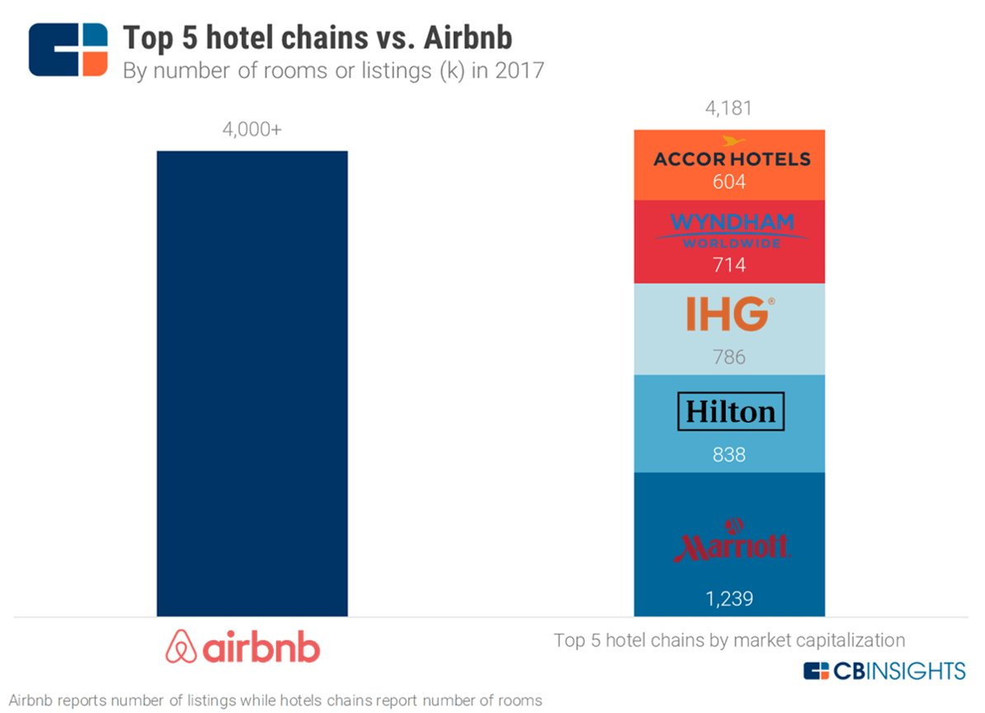
Executive Summary

Slide 5
KEY METRIC | HISTORICAL PERFORMANCE | 2025-2029 FORECAST ASSUMPTION | FORECAST RATIONALE
Host Bookings | Increased by 25% from 2020 to 2024. Significant growth as global travel demand rebounded post-pandemic. | Expected to increase between 5% to 8% annually. | Bookings to remain strong but decline likely to regulatory pressure and market maturity.
Revenue Growth | Strong double-digit growth, 10.7B revenue in 2024. Increase host supply. | Expected to reach ∼12B by 2025, showing steady growth YoY | Driven by expanded host programs, new host incentives, and regional partnerships.
 | Improved steadily post-pandemic, post-IPO. Increased cost control measures and operational efficiency. | Expected to stabilize at 35-40% by 2029. | Reflects ongoing cost control and optimized operations.
Strategic Initiatives | Launched Aircover, expanded host incentives. Enhanced guest confidence through Superhost program and guest/host reviews. | Continued focus on host support, regulatory alignment, and AI-powered tools for hosts, including automated dispute resolution, and personalized guest targeting | Focused on improving host loyalty, operational efficiency, and maintaining competitive advantage.
Margins

Slide 6
2. Company and Industry Overview
Founded: 2008 | IPO: December 2020
Headquarters: San Francisco, California
Industry: Travel and Hospitality Technology
Business Model: Peer-to-peer short-term rentals has revolutionized the hospitality industry by offering these core services.
Core Services: Lodging, Experiences, Long-term stays
Global Reach: Active in 220+ countries and regions, which shows Airbnb's global presence.
Hosts are the backbone of Airbnb’s ecosystem – offering over 7.7 million listings globally (2024).

Slide 7
Nights and Experiences Booked

Slide 8
Booking % Growth YOY

Slide 9
Projected Revenue Growth

Slide 10
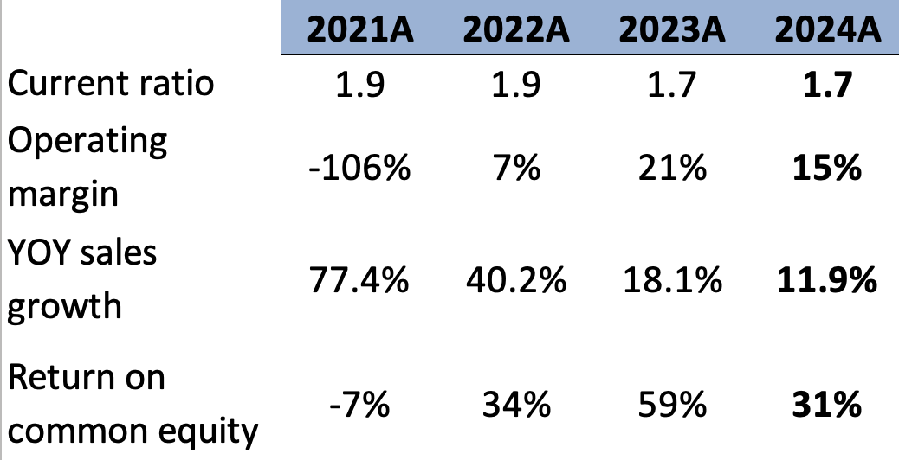
Noticeable Financial Ratios
Airbnb maintains stable liquidity, ensuring capability to meet short-term obligations amid strategic regulatory shifts and targeted growth strategies.
Significant improvement from negative margins highlights successful strategic adjustments toward profitability, supported by host incentives and regulatory compliance initiatives.
Declining growth rates reflect a strategic shift from rapid expansion to sustainable, compliant growth with targeted local partnerships and quality-focused initiatives.
Strong ROE improvement indicates successful operational efficiency, strong market position, and effective capital allocation amid regional and compliance-focused strategic adjustments.

Slide 11
Key points of 3 Statement Model and Valuation
We assumed that Airbnb's sales growth over the next five years will increase at a decreasing rate, following a log pattern for each sector, as the company stabilizes and faces market saturation.
We assumed that in our forecast, Airbnb will not receive any tax benefit since the company has been profiting in 2022, after pandemic period.
We assumed that in the next 5 years, Airbnb unearned fees will increase due to the higher volume of transactions, these are mostly service fees that will be record as revenue after guests checking in.
For stock repurchases, we assume that Airbnb will conduct annual buybacks due to its increasing market share and relatively high profit margins.

Slide 12
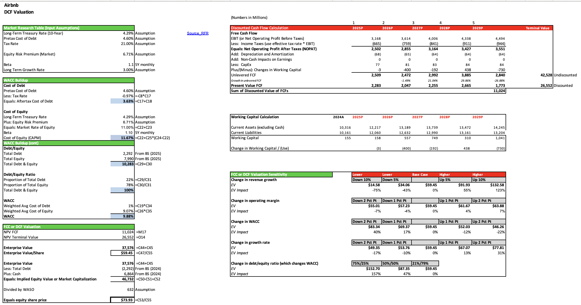

Slide 13
3. Historical Strategy & Market Positioning
IPO to Present: Shift from growth-at-all-costs to regulatory cooperation and platform quality.
Key Milestones:
2020: Airbnb City Portal launched to enhance regulatory cooperation with governments.
2021: AirCover for Hosts introduced to strengthen host protection with up to $3 million coverage.
Host advisory Board
2023: Embraced EU regulatory frameworks to shape EU-wide regulations, including
data-sharing and host registration.
2024: Airbnb-Friendly Apartments launch to partner with real estate developers to legally allow short-term
rentals in apartments.
Market Trends: Regulatory pressure, rising costs, demand for affordable stays

Slide 14
4. Competitive Landscape and Comparison in the US market
Platform | Host Insurance | Regulatory Approach | Incentives | Tech Tools | Market Share
Direct booking | None | GDPR | Moderate | Moderate | 28%
Airbnb | $3M AirCover | Pro-regulation | High | Advanced | 43%
Vrbo | $1M Liability | Low-visibility | Moderate | Moderate | 9%
Booking.com | None built-in | Quiet compliance | Moderate | Hotel-heavy | 21%
In Europe, Booking.com holds the leading position with approximately 50% of the market share, followed by Airbnb with 40%. The remaining share is divided between Vrbo and direct bookings.

Slide 15
SWOT
Strengths: First-mover advantage and Global recognition Strong community trust tools (AirCover, ID verification) Massive Global Network | Weakness: Dependence on third-party hosts Limited control over inventory Regulatory complexity and enforcement vary city-by-city
Opportunities: Expansion of “Airbnb-Friendly Apartments” and long-term stay Strategic partnerships with real estate developers and governments Reduce listing cost by increasing listing quantity | Threats: Stiff Competition Online Theft and Hacking Currency Risk

Slide 16
5. Key Strategic Initiatives (2025)
New Host Incentives: Cash bonuses, referral boosts
Airbnb Rooms: Promoting affordability & spare room listings
Co-Host Marketplace: Matching part-time hosts with professional co-hosts
Airbnb-Friendly Real Estate: Expanding legal hosting options
AirCover Upgrades: $3M protection, damage, liability, lost income

Slide 17
6. Regional Strategy Breakdown
North America
Regulation hotspots (e.g., NYC), pivot to long stays, Airbnb-Friendly Apartments
Europe
Support for EU regulation, compliance in Paris/Berlin/Amsterdam
Asia-Pacific
Japan: Full compliance with Minpaku law
China: Market exit
Korea & India: Localized integration and partnerships
Latin America
Opportunity market; expanding Airbnb-Friendly concept

Slide 18
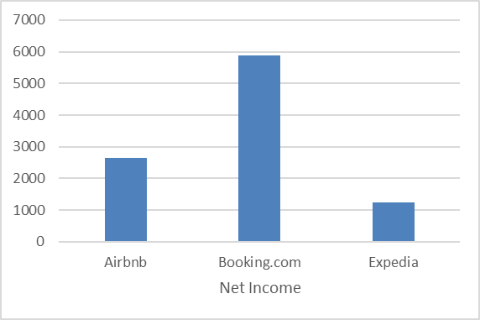
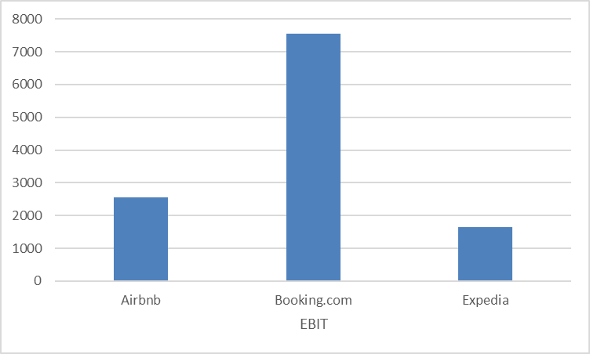
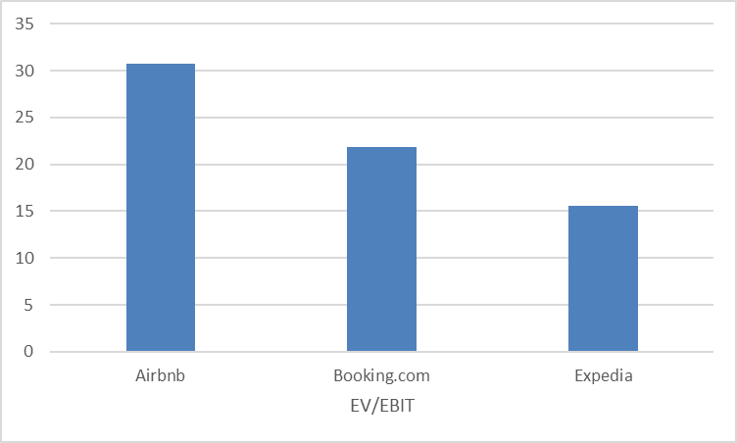
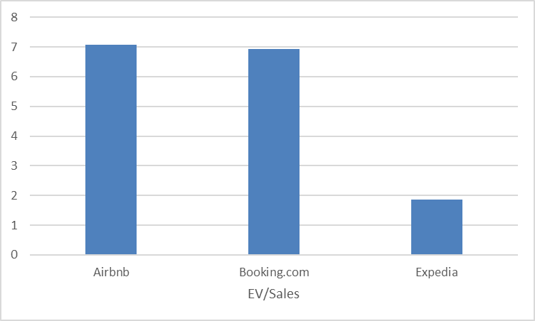
Valuation and Financial Analysis
Profitability Ratios | Airbnb | Booking.com | Expedia
ROE | 0.31 | -1.46 | 0.80
ROA | 0.13 | 0.21 | 0.06
Gross margin | 0.83 | 1.00 | 1.00
Operating margin | 0.15 | 0.32 | 0.10
Pre-tax margin | 0.29 | 0.28 | 0.11
Net income margin | 0.24 | 0.25 | 0.09
Airbnb vs Competitors, EBITDA and NI 2024 ($million)

Slide 19
7. Platform Risks and Mitigation
Brand Risk: Managed via AirCover, Party Ban, Neighborhood Support line
Customer Experience: 24/7 service, Superhost Support, trust tech (ID, reviews)
Host Quality: Superhost program, community standards enforcement
2025 Revenue Growth: based on market cap, bookings$10.7B (2024) to projected ~$12B DCF or Multiple Analysis: Optional and margins
Key Assumptions: Night stays growth, ADR (average daily rate), expansion of hosting programs

Slide 20
Managing Host-Related Risks
Airbnb enforces strict host standards and guidelines to ensure quality and consistency. To achieve Superhost status, hosts must maintain a 4.8 or higher overall rating, a 90% or higher response rate, have hosted at least 10 reservations or 3 reservations totaling at least 100 nights, and maintain a cancellation rate below 1% .
The platform utilizes a two-way rating and review system, allowing both guests and hosts to evaluate each other. This system fosters accountability and transparency, contributing to a trustworthy community.
Airbnb operates a Resolution Center with 24/7 customer support to mediate disputes such as refund requests, cancellations, and property damage claims. Issues must be reported within 72 hours of discovery to be eligible under Airbnb's Rebooking and Refund Policy .
Through its AirCover program, Airbnb provides comprehensive protection, offering guests rebooking or full refunds if a stay falls short of expectations, and giving hosts up to $3 million in damage protection and $1 million in liability insurance .

Slide 21
Managing Host-Related Risks
To prevent fraud and ensure safety, Airbnb requires identity verification for all primary hosts, co-hosts, and booking guests. This process involves verifying personal information such as legal name, address, and phone number .
Airbnb enforces its policies using AI and manual reviews, which led to the removal of 59,000 fake listings and the prevention of 157,000 fraudulent accounts from joining the platform in a single year .
The company collaborates with local governments to ensure legal compliance, including adhering to zoning laws, safety regulations, and collecting required taxes. Since 2014, Airbnb has collected and remitted $13.5 billion in tourism taxes globally .
To protect its brand, Airbnb responds swiftly to high-profile incidents, offers public apologies and refunds when necessary, and runs initiatives like Airbnb.org, which has provided housing to over 100,000 people fleeing crises such as the conflict in Ukraine .

Slide 22
Navigating Rental Regulations
Airbnb and its hosts have filed multiple lawsuits challenging restrictive short-term rental regulations.
However, these restrictions affect the entire short-term rental sector, not Airbnb alone. For example, in New York City, all short-term rentals—whether hotels, motels, or Airbnb listings—are required to register with the Mayor’s Office of Special Enforcement (OSE).
In Maui County, Hawaii, Airbnb has collaborated with governments through Memoranda of Understanding (MoUs) to facilitate enforcement of short-term rental regulations.
Airbnb view policy makers as allies, positioning itself as a collaborator.
Airbnb’s lobbying spending has reached record levels as in 2022, the company spent about $1 million on U.S. federal lobbying. At the state level, Airbnb spent at least $651,000 lobbying in 9 different states in 2023, targeting places considering strict short-term rental rules.
Airbnb mobilizes local hosts politically by organizing advocacy groups and encouraging them to lobby officials, framing home-sharing as vital economic support for communities.

Slide 23
8. Conclusion & Recommendation
Strategic Evolution:
Airbnb has successfully transitioned from hypergrowth to a balanced strategy that prioritizes regulatory compliance and platform trust.
Platform Strengths:
Strong brand loyalty, technological leadership, and host-first initiatives position Airbnb as a resilient market leader.
Key Insight:
Host engagement and legal rental supply are critical to sustaining competitive advantage in a highly regulated global landscape.

Slide 24
Recommendation
Continue scaling “Airbnb-Friendly” partnerships to expand compliant inventory in high-regulation markets
Double down on host incentives (e.g., AirCover upgrades, cash bonuses) to maintain supply and platform reliability
Invest in regulatory alignment tools (e.g., City Portal, data-sharing compliance) to avoid legal setbacks and support local partnerships
Monitor host churn and satisfaction metrics to proactively address supply-side risks

