Slide 1
Traffickers
Maryland Traffic Risk Analysis
Hamza Siddiqui, Hridyansh Gupta, Maher Thakkar, Manas M Bhat and Parika Rawat
BUDT704_Group10

Slide 2
TABLE OF CONTENTS
Data Overview
Accidents Areas
1
2
Predicting Accidents
3
Racial Bias in Traffic Police?
4
Conclusion
5
What do Traffic Violations in Maryland look like?
Which areas in Maryland produced the most accidents?
Is there any racial bias in traffic control police who give out the violations?
Can we use Machine Learning to predict accidents?
You can describe the topic of the section here

Slide 3
1
Data Overview
Traffic Violations in Maryland 2012-2018:
1,811,977 violations recorded.
A violation is the act of breaking any traffic laws either federal or state.
Data covers all the traffic violations in Maryland State.
Every Traffic violation is recorded by Maryland State Police Department
https://www.kaggle.com/datasets/rounak041993/traffic-violations-in-maryland-county

Slide 4
1
Data Overview
Observations we care about are:
Car Make
Car Model
Vehicle Type
Race of Driver
Accident or not
Personal Injury
Property Damage
Gender of Driver
Time of Stop
Cleaned Observations are underlined and in red
Drivers License State
Driver State
Violation Type
Latitude
Longitude
Arrest Type
Vehicle Model
Property Damage
Alcohol or not
Date of Stop

Slide 5
2
Accident Areas
Which areas in Maryland are most prone to accidents?
In order to give the Police Department a better idea of where people cause accidents, we will determine where the most traffic violations occur with accidents.
We used longitude and latitude in order to determine where the violations occur.
In order to best display our findings for the Police Department, we used a heat map that shows all of the violations that emphasize where the most accidents occur.
Glenmont MD is the area that we determined with the most accidents in accordance with the dataset.

Slide 6
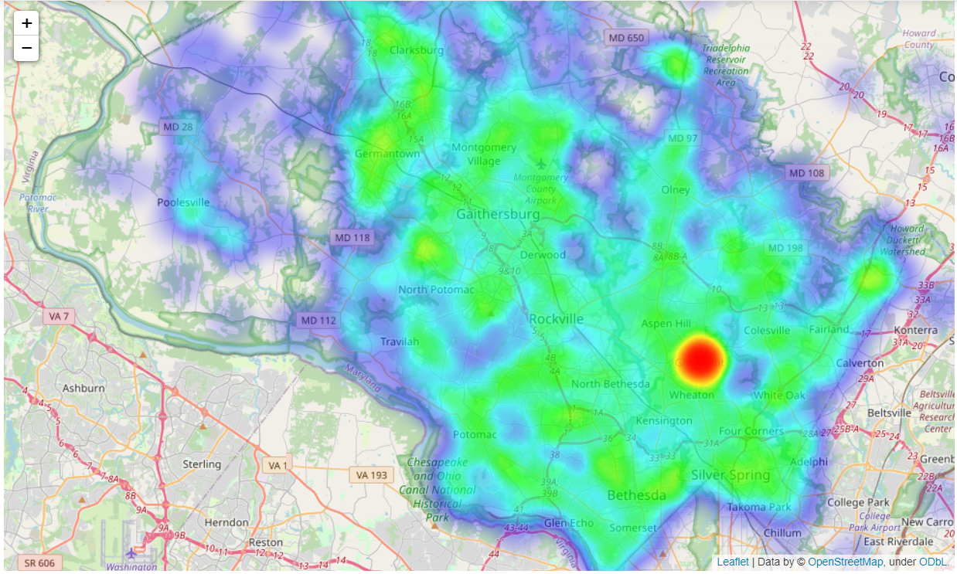

Slide 7
3
Racial Bias in Traffic Police?
Is there any racial bias in traffic control police who give out the violations?:
In order to help the public and improve the police department, we want to see if there is any racial bias when recording traffic violations.
We will compare the violations from technology detection such as cameras to human detection such as patrol cops.
Hypothesis: The technology detected violations will have a 1:1 ratio between non-white and white violators.
57.8% of the population in Maryland state were White in 2018.
We will use a double bar graph in order to compare the violations recorded by technology and humans for white violators and minorities.
Source: https://www.census.gov/quickfacts/MD

Slide 8
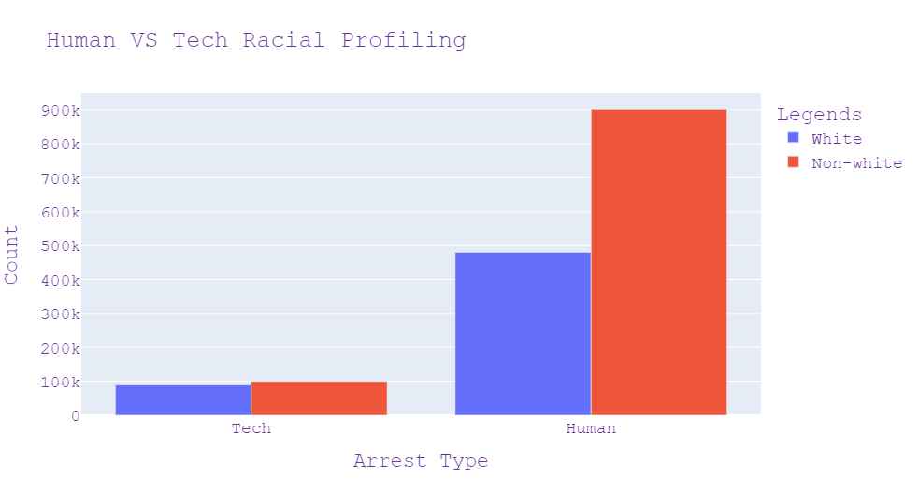

Slide 9
4
Predicting Accidents
Predict if a driver/vehicle combination can cause accident or not!
Using Machine learning, we can predict a dependent variable depending on some independent variables.
We chose Random forest Classifier as it uses voting as a mechanism to come up with the best results.
We split the data into 70:30 ratio as training and testing sets and test our predictions on the testing sets to calculate the accuracy.
Seeing 97% accuracy in our prediction the police department can look at the different car models and see which ones are likely to cause most accidents.

Slide 10
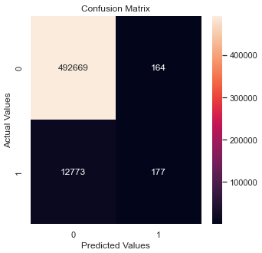
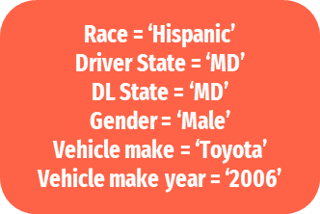
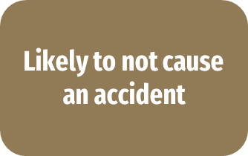
Predicting Accidents
INPUT
OUTPUT

Slide 11
Conclusion
5
1) We were able to see which location had the most accidents being made and hence the police can be more vigilant and increase the traffic rules in those areas.
2) Racial bias should be decreased and strict measures should be taken on the police officer as well if any such false accusations are made just on the basis of race. This will help the community to also be free and safe.
3) Female warning rate is higher than the male warning rate which shows the disparity between the gender in the warnings given to a reckless driver. So there's a possibility that females take traffic violations leniently and department should look into it.
4) Male Hispanics are causing the most number of accidents in comparison to any other race/gender and hence these matters should be addressed and department should look more into it.
5) The predictions will also help that okay what type of make, model, race and gender will cause an accident in the future or not. This can help us follow a trend that if some particular make or model of car is causing most accidents so then that car has some issue.
6) This analysis will help the community be safe and hopefully help reduce accidents.

Slide 12
THANK YOU!
-Group 10

