Slide 1


Slide 2
Introduction
All financial institutions will need to examine each of their businesses to assess where their competitive advantages lie across and within the three core banking activities of balance sheet, transactions, and distribution. And they will need to do so in a world in which technology and AI will play a more prominent role, and against the backdrop of a shifting macroeconomic environment and heightened geopolitical risks.

Slide 3
Problem Statement
Utilize clustering algorithms to group customers based on their banking behaviors, transaction histories, and demographics.

Slide 4
Variables description
Customer_ID : Represents a unique identification of a person Age : Represents the age of the person Occupation : Represents the occupation of the person Annual_Income : Represents the annual income of the person Monthly_Inhand_Salary : Represents the monthly base salary of a person Delay_from_due_date : Represents the average number of days delayed from the payment date Num_of_Delayed_Payment : Represents the average number of payments delayed by a person Credit_Mix : Represents the classification of the mix of credits Outstanding_Debt : Represents the remaining debt to be paid (in USD) Credit_Utilization_Ratio : Represents the utilization ratio of credit card Credit_History_Age : Represents the age of credit history of the person Payment_of_Min_Amount : whether only the minimum amount was paid by the person Total_EMI_per_month : Represents the monthly EMI payments (in USD) Payment_Behaviour : Represents the payment behavior of the customer (in USD) Monthly_Balance : Represents the monthly balance amount of the customer (in USD) Credit_Score : Represents the bracket of credit score (Poor, Standard, Good)

Slide 5
Variables description
Customer_ID : Represents a unique identification of a person
Age : Represents the age of the person
Occupation : Represents the occupation of the person
Annual_Income : Represents the annual income of the person Monthly_Inhand_Salary : Represents the monthly base salary of a person Delay_from_due_date : Represents the average number of days delayed from the payment date
Num_of_Delayed_Payment : Represents the average number of payments delayed by a person
Credit_Mix : Represents the classification of the mix of credits Outstanding_Debt : Represents the remaining debt to be paid (in USD) Credit_Utilization_Ratio : Represents the utilization ratio of credit card Credit_History_Age : Represents the age of credit history of the person Payment_of_Min_Amount : whether only the minimum amount was paid by the person Total_EMI_per_month : Represents the monthly EMI payments (in USD) Payment_Behaviour : Represents the payment behavior of the customer (in USD) Monthly_Balance : Represents the monthly balance amount of the customer (in USD) Credit_Score : Represents the bracket of credit score (Poor, Standard, Good)

Slide 6
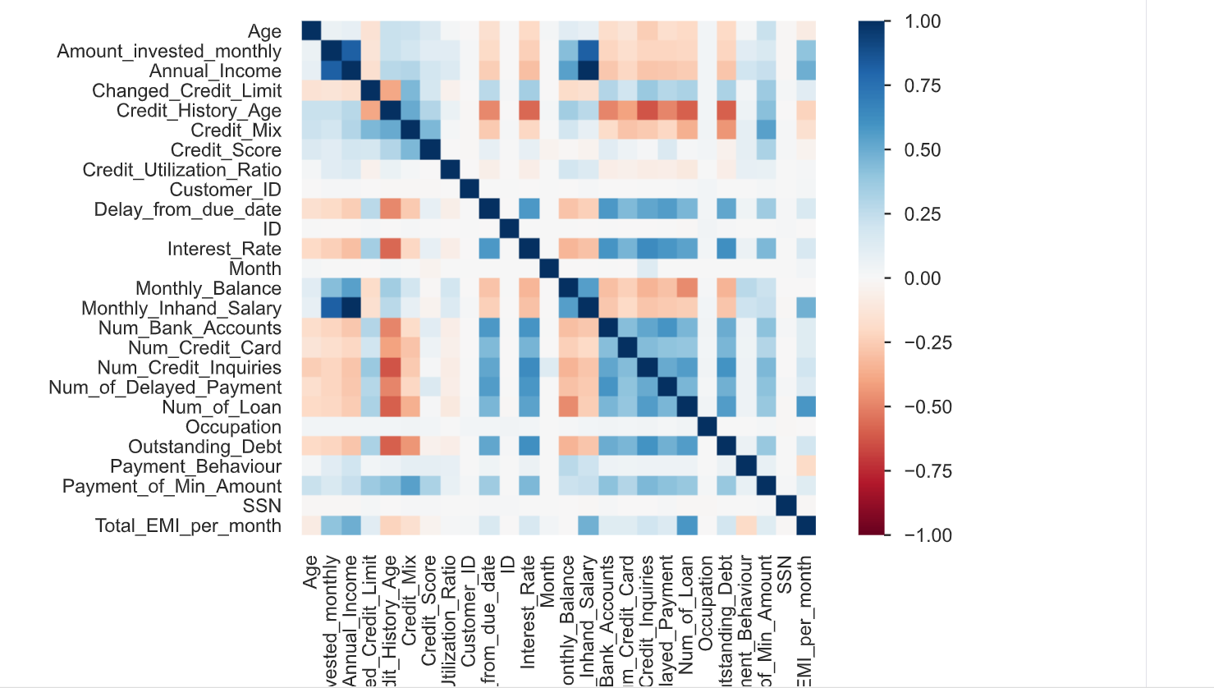
EDA
Correlation Matrix

Slide 7
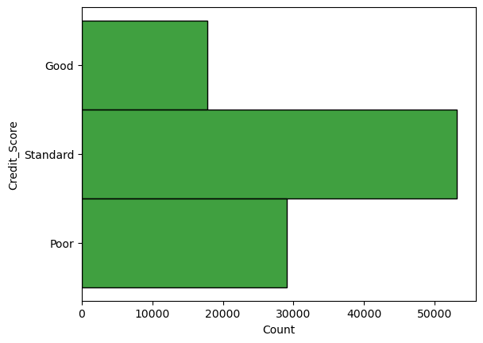
Customer demographics

Slide 8
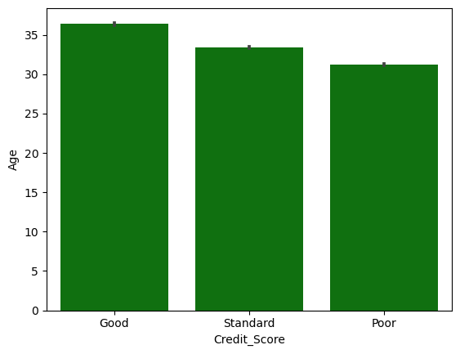
Customer demographics and financial information group by credit scores

Slide 9
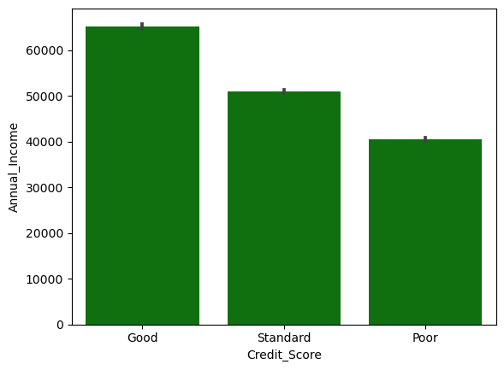
Customer demographics and financial information group by credit scores

Slide 10
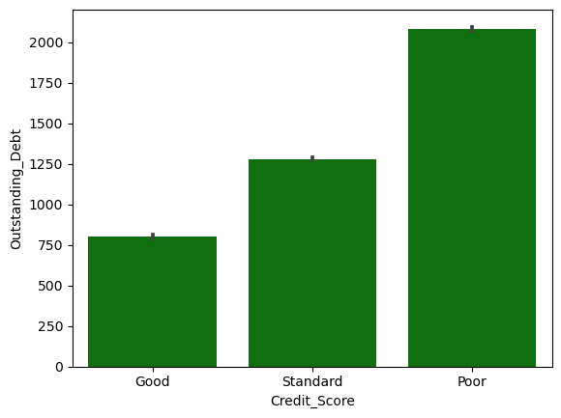
Customer demographics and financial information group by credit scores

Slide 11
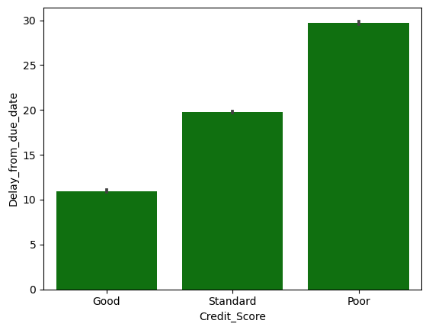
Customer demographics and financial information group by credit scores

Slide 12
Customer demographics and financial information group by credit scores
Good: Average age of around 33 years Average annual income of approximately 55,000 USD Average outstanding debt of about 1,595 USD Average of around 24 days delayed from the payment date.
Poor: Average age of around 35 years Average annual income of approximately 60,000 USD Average outstanding debt of about 960 USD Average of around 17 days delayed from the payment date.
Standard: Average age of around 37 years Average annual income of approximately 61,000 USD Average outstanding debt of about 750 USD Average of around 10 days delayed from the payment date

Slide 13
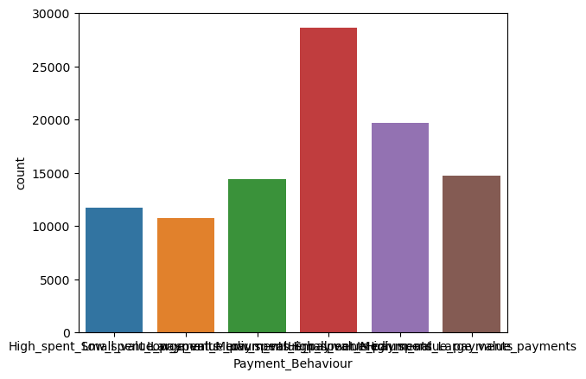
Customer financial information group by payment behavior

Slide 14
Clustering
Customer cluster group distribution
Age and cluster group
Annual income and cluster group
Outstanding debt and cluster group
Number of days delayed from the payment date and cluster group

Slide 15
K-means clustering method
K =3
Cluster 3 : Average age of around 37 years Average annual income of approximately 62,000 USD Average outstanding debt of about 730 USD Average of around 10 days delayed from the payment date.
Cluster 1 : Average age of around 32 years Average annual income of approximately 49,000 USD Average outstanding debt of about 2,450 USD Average of around 35 days delayed from the payment date.
Cluster 2: Average age of around 34 years Average annual income of approximately 59,000 USD Average outstanding debt of about 1,000 USD Average of around 19 days delayed from the payment date.

Slide 16
Thank You

