Slide 1

RAILWAY ACCIDENT IDENTIFICATION AND ALERT SYSTEM USING GSM
Team members :
K Kousalya
M.SREENIVASULU
K.AMULYA BHARGAVI
M.SIVA SAI NADH GOUD
K.MAHESH BABU
Mentor:
Mrs K.SIVA KUMARI MADAM

Slide 2
Railway Accident
Identification and Alert System
An overview of the railway accident identification and alert system using GSM technology.

Slide 3
ABSTRACT
The fastest growth of technology has made our lifestyle Comfort. The technology also increased the traffic risks and the road accidents take place frequently which causes huge loss of life because inadequate of emergency facility our project will help this displacement. The project concludes when a vehicle meets with an accident, the Micro electro mechanical system (MEMS) sensor will analyze the signal and this signal to Arduino. The notification is sent through BT module the location of the accident is gathered with the help of GPS module, to notify police control room or a rescue team. So, the police or rescue team can immediately trace the location through the GPS Module, after receiving the information. Then after confirming the location necessary action will be taken And Video of the accident can be live streamed or can be stored with the help of camera. The aim of this work is to automatically detect an accident and alert the rescue team or control station

Slide 4
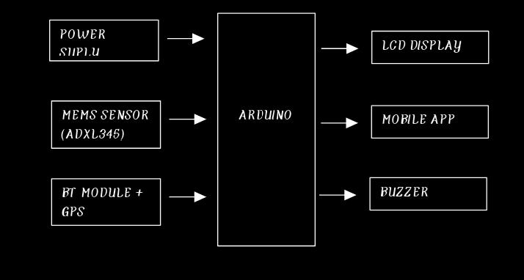
BLOCK DIAGRAM

Slide 5
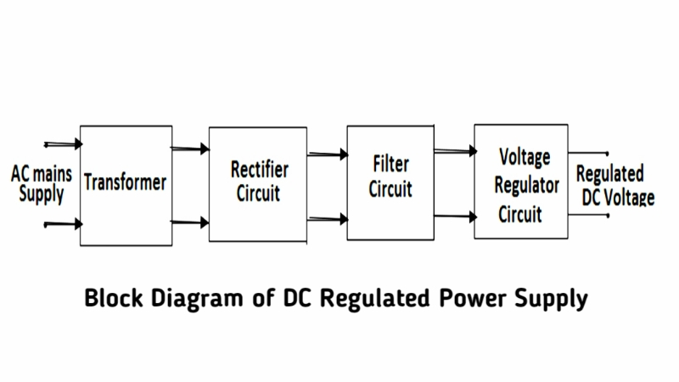
POWER SUPPLY
Adigital circuits require regulated power supply. In this article we are going to learn how to get a regulated positive supply from the mains supply.

Slide 6
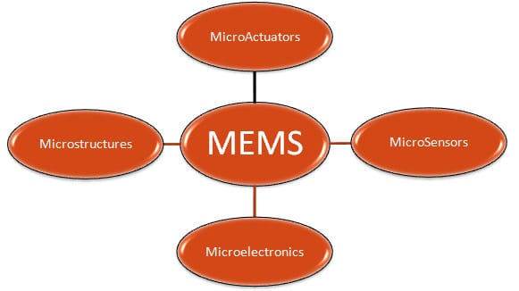
MEMS Sensor
Micro-electromechanical systems (MEMS) are a process technology used to create tiny integrated devices or systems that combine mechanical and electrical components. They are fabricated using integrated circuit (IC) batch processing techniques and can range in size from a few micrometers to millimeters. These devices (or systems) have the ability to sense, control and actuate on the micro scale, and generate effects on the macro scale

Slide 7
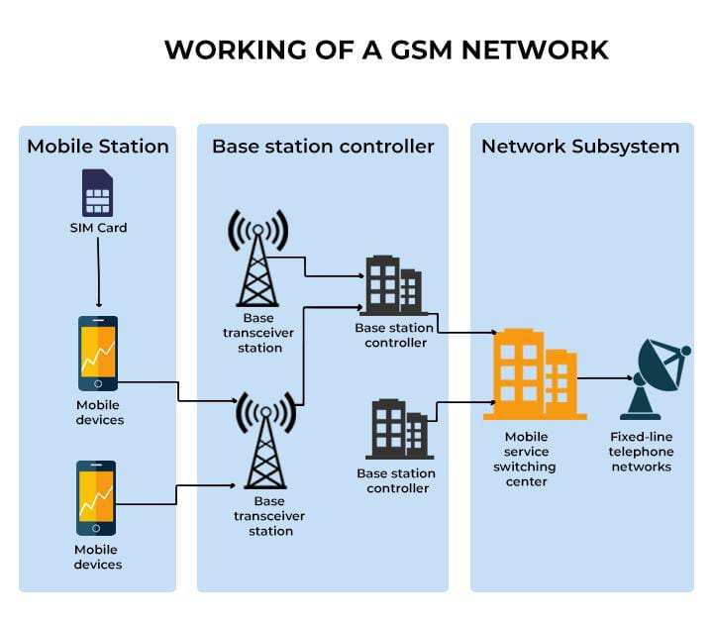
GSM (Global System for Mobile communications)
.
GSM (Global System for Mobile communications) is a cellular network, which means that mobile phones connect to it by searching for cells in the immediate vicinity. GSM networks operate in four different frequency ranges. Most GSM networks operate in the 900 MHz or 1800 MHz bands. Some countries in the Americas use the 850 MHz and 1900 MHz bands because the 900 and 1800 MHz frequency bands were already allocated.

Slide 8
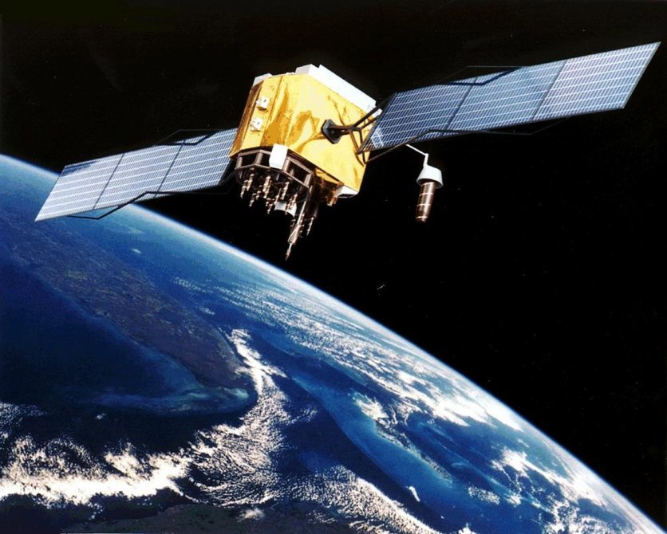
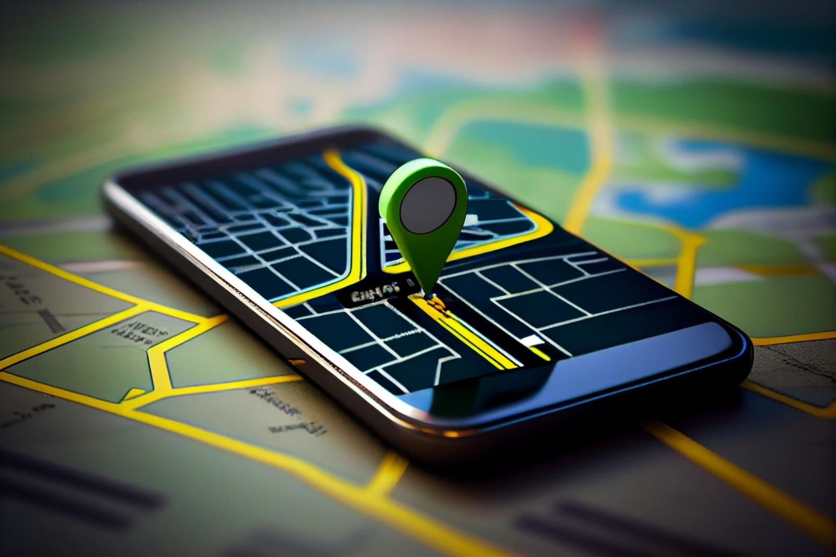
GPS MODULE
Global Positioning System is an earth-orbiting-satellite based system that provides signals available anywhere on or above the earth, twenty-four hours a day, which can be used to determine precise time and the position of a GPS receiver in three dimensions. GPS is increasingly used as an input for Geographic Information Systems particularly for precise positioning of geospatial data and the collection of data in the field.

Slide 9
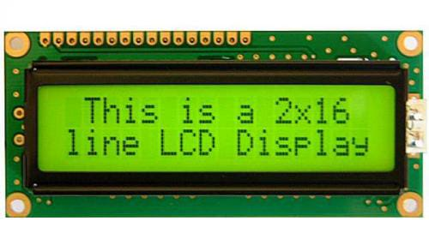
LCD
Aliquid-crystal display (LCD) is a flat-panel display or other electronically modulated optical device that uses the light-modulating properties of liquid crystals combined with polarizers. Liquid crystals do not emit light directly[1] but instead use a backlight or reflector to produce images in color or monochrome.

Slide 10

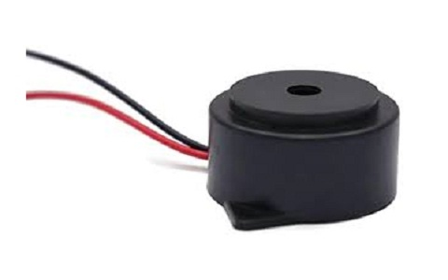
MOBILE APPLICATION
BUZZER A buzzer or beeper is an audio signaling device,which may be mechanical, electromechanical, or piezoelectric (piezo for short). Typical uses of buzzers and beepers include alarm devices, timers, train and confirmation of user input such as a mouse click or keystroke.
A mobile app (or mobile application) is a software application developed specifically for use on small, wireless computing devices, such as smartphones and tablets, rather than desktop or laptop computers.

Slide 11
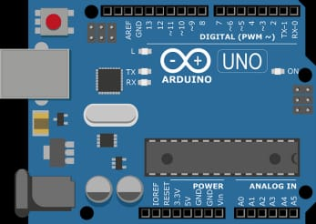
Arduino
Arduino is a computer hardware and software company, project, and user community that designs and manufactures microcontroller kits for building digital devices and interactive objects that can sense and control objects in the physical world. The project's products are distributed as open source hardware and software, which are licensed under the GNU Lesser General Public License (LGPL) or the GNU General Public License (GPL),[1] permitting the manufacture of Arduino boards and software distribution by anyone. Arduino boards are available commercially in preassembled form, or as do-it-yourself kits.

Slide 12
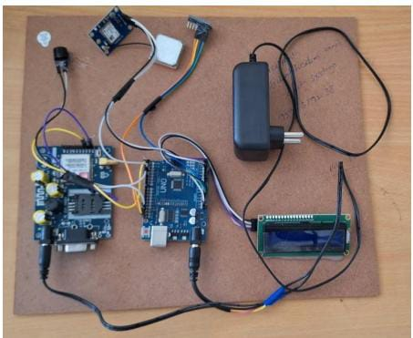
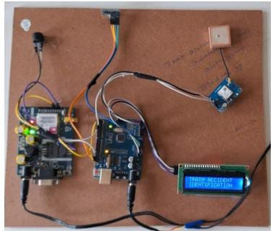
RESULTS
By using this operation, it contains the equipment like this
1. Arduino UNO
2. Regulated power supply(RPS)
3. ATMEGA 168
4. Relay channel board •
And external deviceslike LCD, BUZZER, ANTENA, MEMS and WIRES
The above figure is connecting to the GSM in the system it will be Operated by the Arduino
This technology is working effectively for Railway Accident Identifications
This device is connect to the GSM then the message will be from mobile application then the output will appears
Fig: Kit Image
Fig: Title of the project

Slide 13
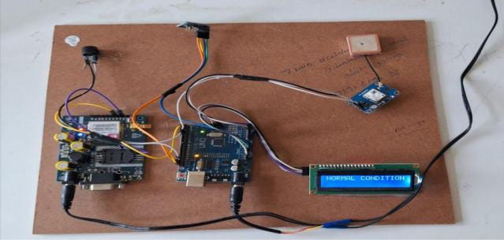
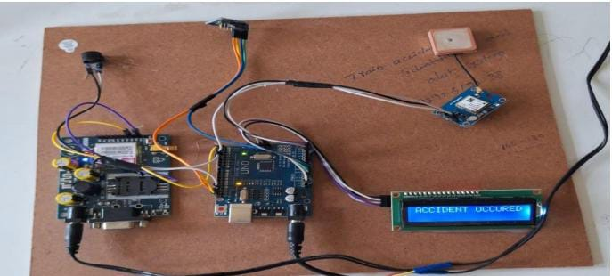
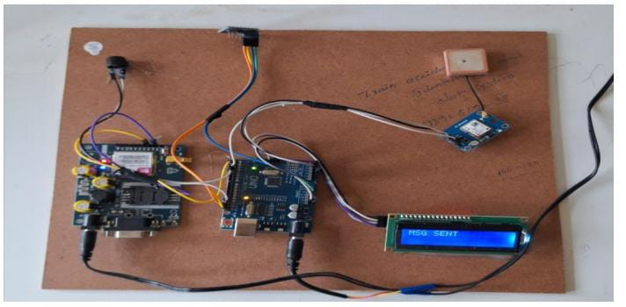
The figure shows the normal condition of the train.
The display shows the train is normal condition. • when the train doesn't meet the accident.
The GSM sent the msg is train is in normal condition.
Fig: Normal Condition
Fig: Accident Occured

Slide 14
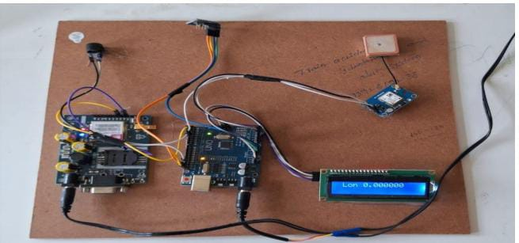
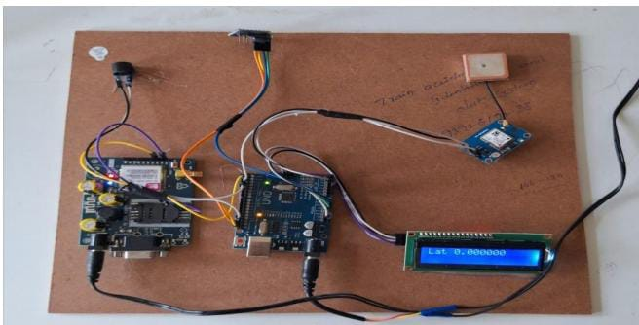
.
when the train meets with an accident the mems sensor fall beside then the GSM sent the message to the control stations the accident is occuredwhen the train meets with an accident the mems sensor fall beside then the GSM sent the message to the control stations the accident is occurred.
when the train meets with an accident the GPS sent the location to the control stations then the longitude and latitude values are shown
Fig: Longitude and Laititude

Slide 15
CONCLUSION
Our idea is used to detect accident and automate emergency assistance services. As a result, system is sending SMS to the nearest Emergency assistance service provider from accident location. The high demand of and automobiles has also increased the traffic hazards and the road accidents. Life of the people is under high risk. This is because of the lack of best emergency facilities available in our country. An automatic alarm device for vehicle accidents. This design is a system which can detect accidents in significantly less time and sends the basic information.
This alert message is sent to the rescue team in a short time, which will help in saving the valuable lives. A Switch is also provided in order to terminate the sending of a message in rare case where there is no casualty, this can save the precious time of the medical rescue team. When the accident occurs the alert message is sent automatically to the rescue team and to the police station and the message is sent through the GSM module.

Slide 16


