Slide 1
Hospital Finder
PIP2001 Capstone Project
Review-0
Batch Number: CBD-10
Roll Number | Student Name
20211CBD0059 | MAHESH REDDY
20211CBD0018 | VADDE VINOD
20211CBD0010 | MAHAMMAD AJAR
20211CBD0051 | MAHAMMAD THOUHEED
Under the Supervision of,
DR. SRINIVAS T R
Assistant Professor
School of Computer Science and Engineering
Presidency University
Name of the Program: B.TECH
Name of the HoD: DR. PRAVINTHRAJA
Name of the Program Project Coordinator: MS. SUMA NG
Name of the School Project Coordinators: Dr. Sampath A K / Dr. Abdul Khadar A / Mr. Md Ziaur Rahman

Slide 2
Content
Problem Statement
Github Link
Analysis of Problem Statement
Timeline of the Project
References

Slide 3
Problem Statement Number: PSCS211
Organization: CDK Global(India) Pvt Ltd
Category (Hardware / Software / Both) :Software
Problem Description:
In the state of mind that a common person is in during a medical emergency, it becomes difficult to take calculated decisions such as which hospital to rush to. This lapse of decision could mean the difference between life or death for a loved one. Additionally, there are several aspects to consider such as availability of the required medical facilities, medicines, blood group and specialists to provide the patient with a maximum chance of survival in those crucial moments. Our app aims to be the solution, giving the user all the necessary information during a medical emergency taking into account their location and requirements and providing the best-suited hospital in that hour of need.
Difficulty Level: Simple

Slide 4
Github Link
The Github link provided should have public access permission.
Github Link
https://github.com/Mahesh-219/hopsitalfinder

Slide 5
Analysis of Problem Statement
Technology Stack Components:
Frontend:
Mobile App: React Native, Flutter, or Android (Kotlin)/iOS (Swift)
Backend:
Server-Side Framework: Node.js (Express), Django, or Flask
Database: MySQL, PostgreSQL, or MongoDB
Api’s :
Google Maps API (for location services)
Hospital information APIs or manually entered data
SMS or email notification services (Twilio, SendGrid)

Slide 6
Analysis of Problem Statement (contd...)
Software Requirements:
Android Studio
HTML & HTML5
CSS
Google Maps API
Node.js

Slide 7
Analysis of Problem Statement (contd...)
Location-Based Challenges
Complexity of Hospital Selection
Medical Facilities
Medicines
Blood Group
Specialists
Storage and Transmission
Performance Overhead
Feature Preservation

Slide 8
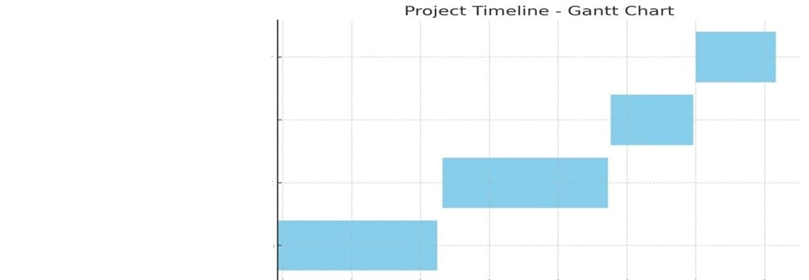
Timeline of the Project (Gantt Chart)
Final Report and Presentation
Testing and Refinement
Development of App(Frontend&Backend)
Research and Analysis

Slide 9
Timeline of the Project (Gantt Chart)
Research and Analysis: September 2024 -October 2024
Development of App(Frontend&Backend): October 2024 - November 2024
Testing and Refinement: November 2024
Final Report and Presentation: December 2024
( it will take around 3 to 4 months)

Slide 10
References (IEEE Paper format)
1 . International Journal of Research Publication and Reviews, Vol 4, no 4, pp 3344-3346, April 2023, https://ijrpr.com/uploads/V4ISSUE4/IJRPR11857.pdf
2. https://www.researchgate.net/publication/333250345_Hospital_Real-Time_Location_System_A_Practical_Approach_in_Healthcare_A_Narrative_Review_Article
3. https://www.academia.edu/36350507/ANDROID_BASED_HOSPITAL_FINDER_APPLICATION_USING_GLOBAL_POSITIONING_SYSTEM_GPS
4. https://srmus.ac.in/view/governance/naac/1.3.4/Supporting%20Documents/MCA/ANISHA%20SHARMA%20%5B20IT103022%5D.pdf

Slide 11


