Slide 1

GatherGenie An Event Management Web Application
Aravind Ogeti
Muhammed Sinan
Mahesh D
Venkata Sai Likhitha Bhogyam
Norah Elizabeth Biju
Iyas Kallan

Slide 2
Problem Statement
In our application, we needed a reliable and automated mechanism to ensure that every code change is validated for both code quality and security before deployment. Without a proper CI pipeline, several challenges were observed:
No automated testing or validation of code changes
Security vulnerabilities in dependencies remained undetected
Manual build and deployment processes led to human errors
Lack of enforced quality gates for code standards
Bugs and issues were detected late in the development lifecycle
These limitations increased the risk of deploying insecure and low-quality code to production, impacting application reliability and security.

Slide 3
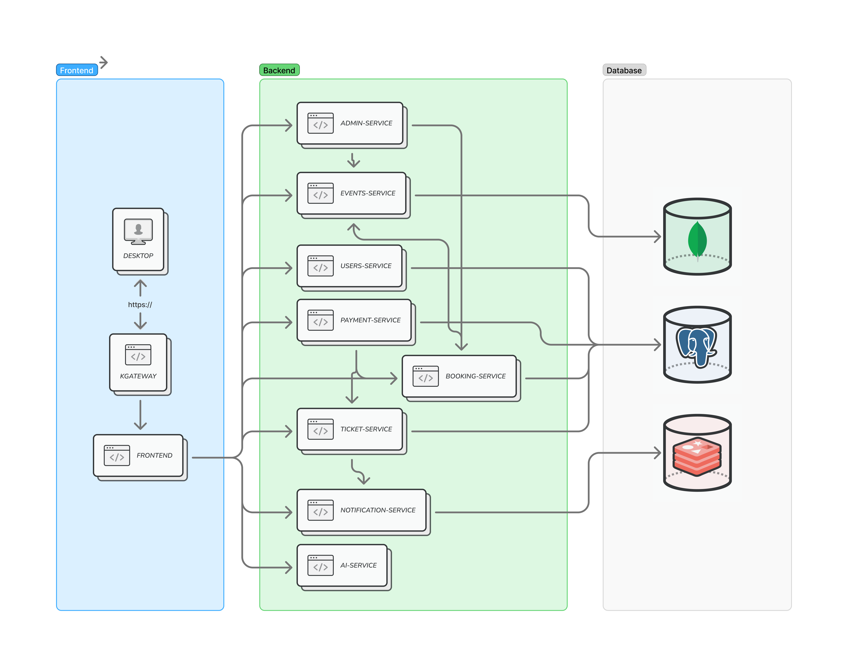
Application Architecture

Slide 4
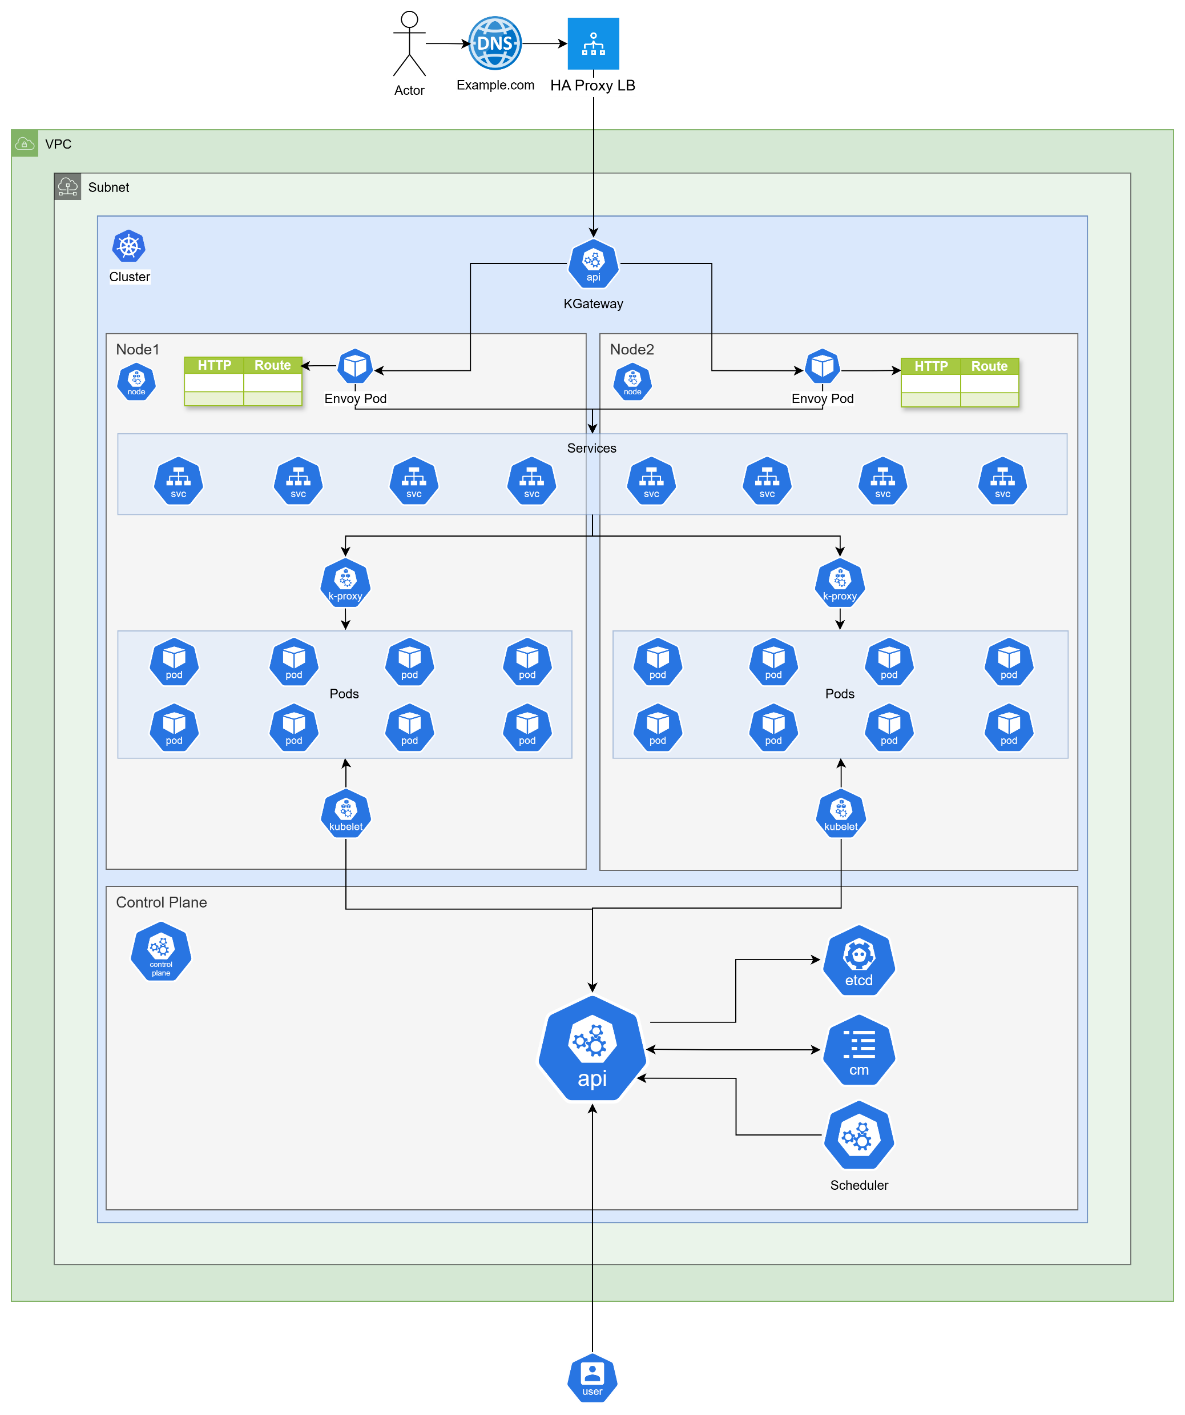
DevOps Architecture

Slide 5
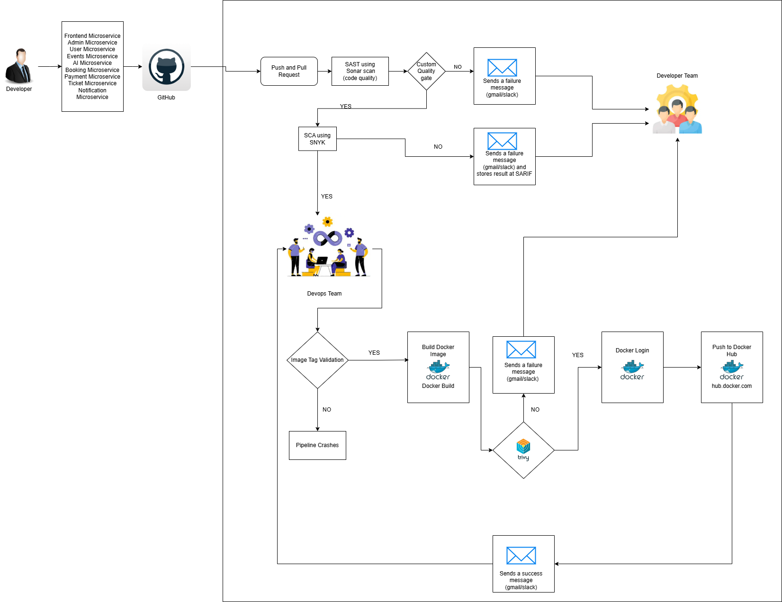
CI Architecture

Slide 6
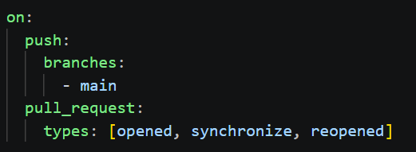
Trigger

Slide 7
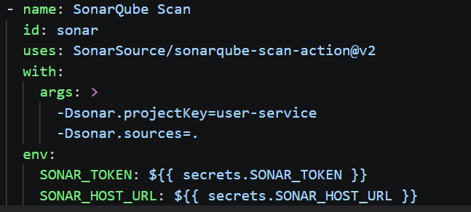
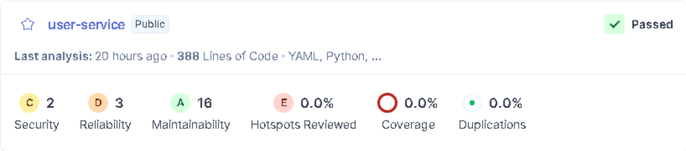
SonaQube Scan

Slide 8
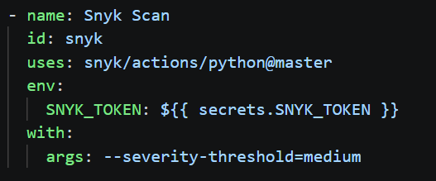
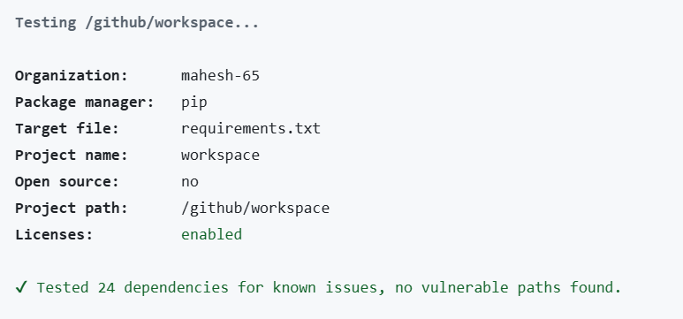
Snyk Scan

Slide 9
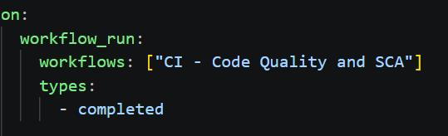
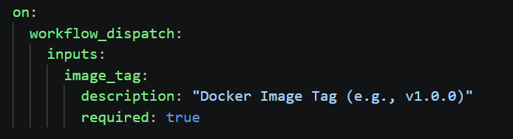
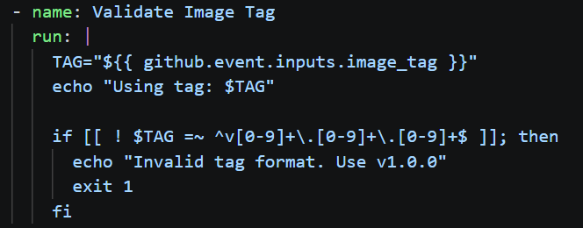
Workflow dispatch

Slide 10
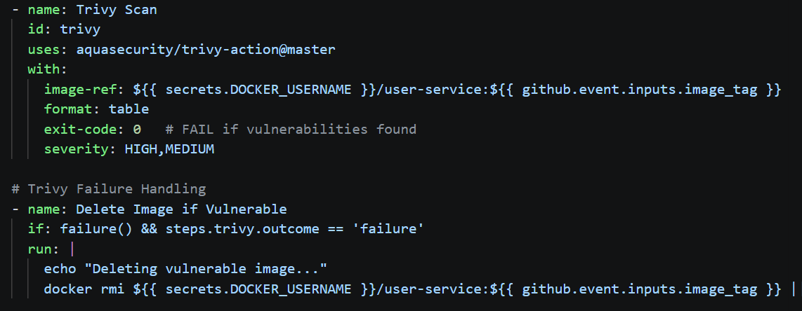
Docker image and Trivy Scan

Slide 11
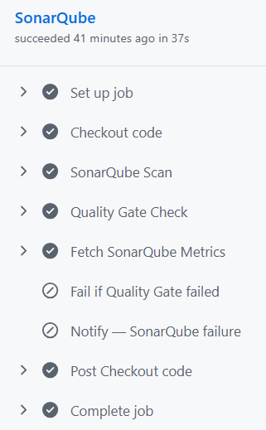
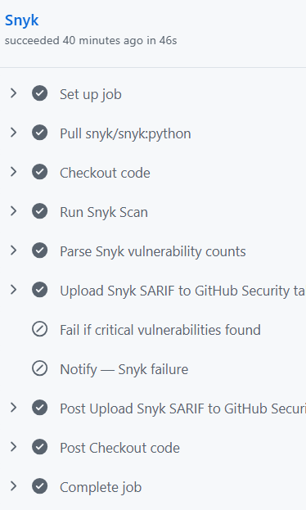
Flow of the Pipeline

Slide 12
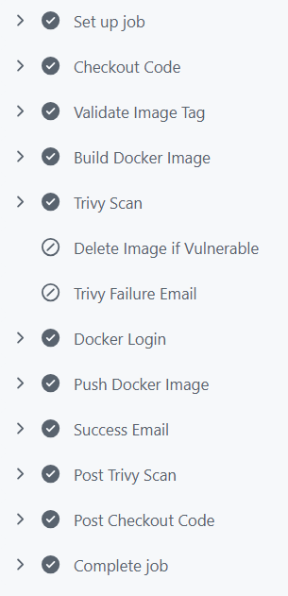
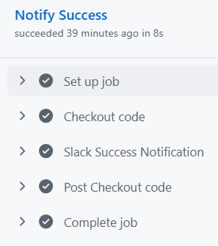
Flow of the Pipeline

Slide 13
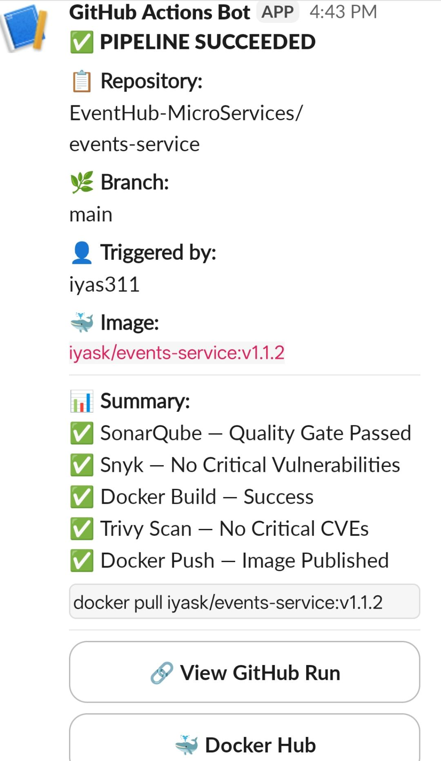
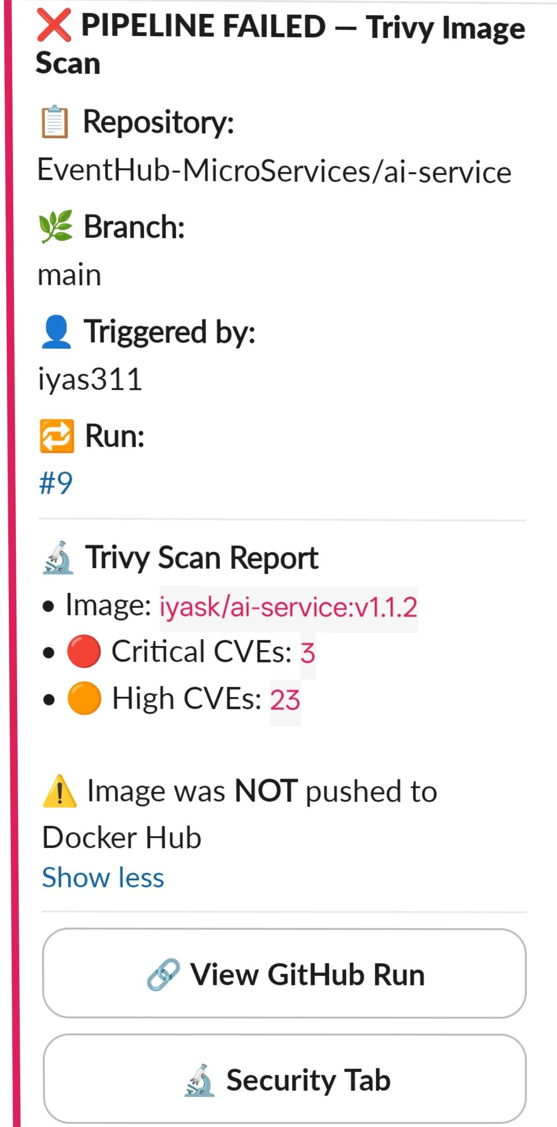
Post Build action

Slide 14
Thank You

