Slide 1
C program

Slide 2
What-why-where
Language? Set of words, sounds/symbols to communicate something
Program language – human machine communication
C programming is a general-purpose, procedural, imperative computer programming language developed in 1972 by Dennis M. Ritchie at the Bell Telephone Laboratories to develop the UNIX operating system. C is the most widely used computer language.
Very fast
Close to hardware
Easy to learn and use
Used in develop OS, software ,embedded products..

Slide 3
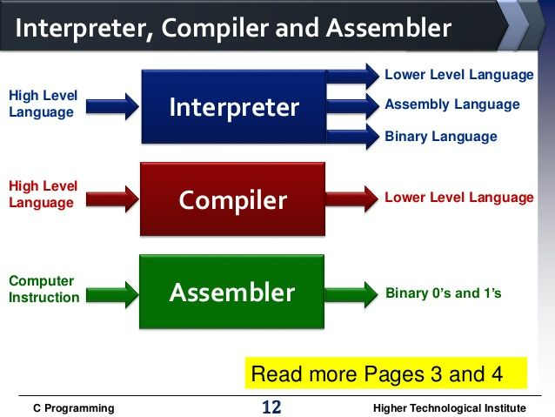
Assembler vs Compiler vs interpreter

Slide 4
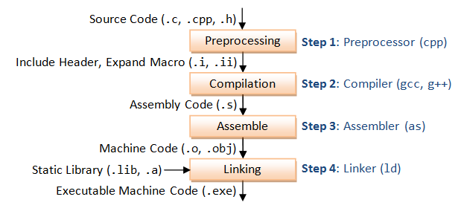
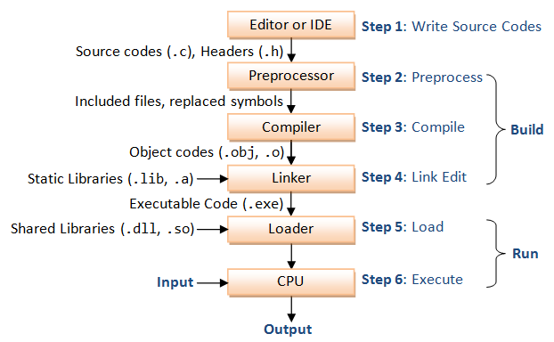
Compilation process

Slide 5
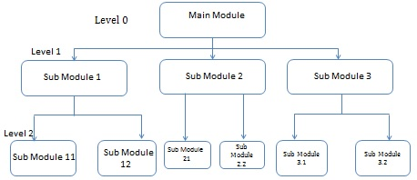
Top down approach

Slide 6
Tokens
Identifier – set of rules to define variables
Keywords – fixed words to do special tasks
Constants/literals –cant change variable value
String – group of characters
Operators – used to do math operations
Special symbols-(),{}

Slide 7
Operator types
Unary ( increment, decrement operator)
Binary (arithmatic,logical,bitwise,relational,assignment operators)
Ternary –conditional operator (?:)
Special operators -&,*,sizeof()

Slide 8
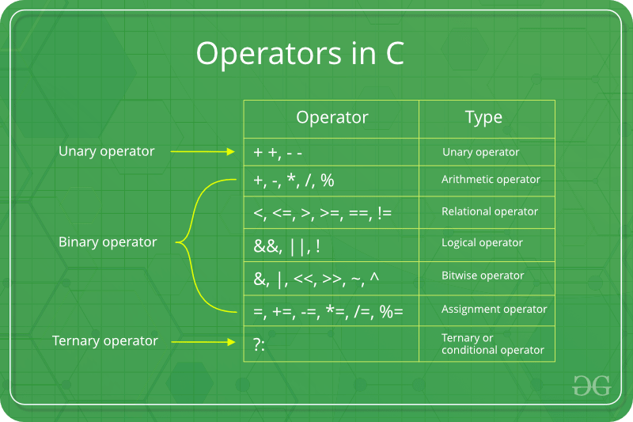
operators

Slide 9
Bitwise operator
Bit set(|)
Bit clear(&)
Bit toggle(^)
Nth bit set
a|=(1<<n)
Nth bit clear
a&=~(1<<n)
Nth bit toggle
a^=(1<<n)

Slide 10
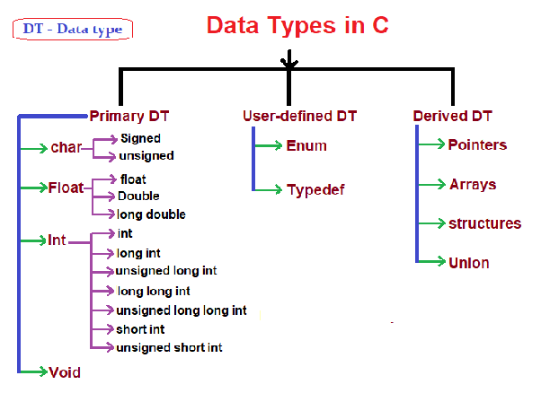
Data types
Primary –int,float,char,void
Derived –array,pointers
User define –structure,union,enumeration,typedef

Slide 11
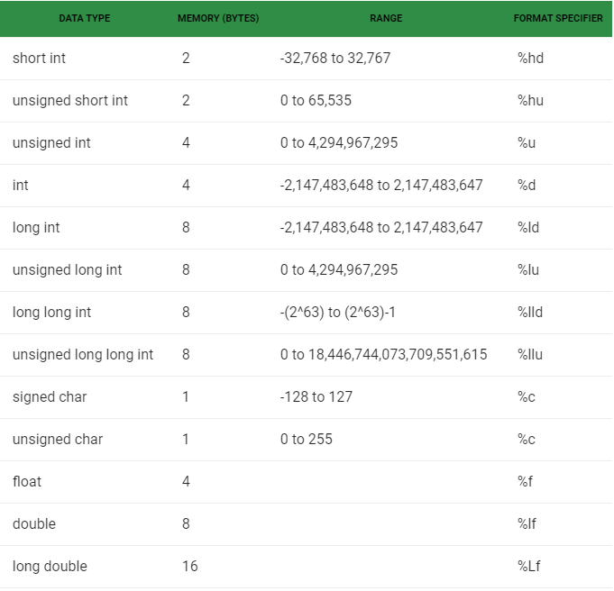
Data types

Slide 12
Qualifiers/modifiers
Signed –signed,unsigned
Sized– short,long,long long

Slide 13
Type conversion/type cast
Implicit type conversion
int a=5;
float b=a;
pf(“%f”,b); //implicit conversion
Explicit type conversion
int a=5;
float b=(float)a; //explicit conversion
pf(“%f”,b);

Slide 14
Basic c program structure
#include <stdio.h>
void main()
{
printf(“hello world”);
}
#include- preprocessor directive for include file
<>- global file include location selection
Stdio –standard input output
.h –header file

Slide 15
Type definition
typedef unsigned char uint8_t;
typedef short intuint16_t;
typedef unsigned int uint32_t;
typedef unsigned long int uint32_t;

Slide 16
Escape sequence
/n –new line
/r – carriage return
/a –beep/alarm
/b-backspace
/t-tab
/v-vertical tab
//-back slace
/’ –single quote
/”-double quote
/?-qus mark
/0-null

Slide 17
Ascii table
Ascii –american standard code for information interchange
A-Z - 65to90
a-z – 97to122
0-9 – 48 to 57

Slide 18
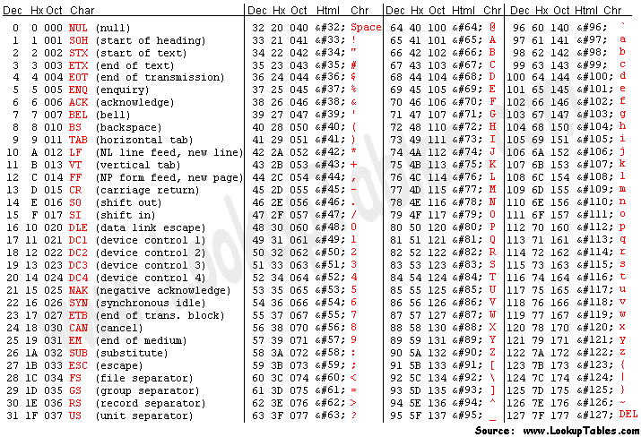
Ascii table

Slide 19
Operator_precedence
Operator Precedence and Associativity
Precedence Associativity
( ) left to right/inside‐out
++ ‐‐ ! + (unary) ‐ (unary) (type) right to left
* / % left to right
+ (addition) ‐ (subtraction) left to right
< <= > >= left to right
== != left to right
&& left to right
|| left to right
= += ‐= *= /= %= right to left
, (comma) right to left

Slide 20
Input and ouput
Scanf()
Printf()

Slide 21
Local vs global variables
Declaration, Definition, initialization
int a; //global
void main()
{
int b; //local ,global for c and d scope
{
int c; //local ,global for d scope
{
int d; //local
}
}
int e; //local
}

Slide 22
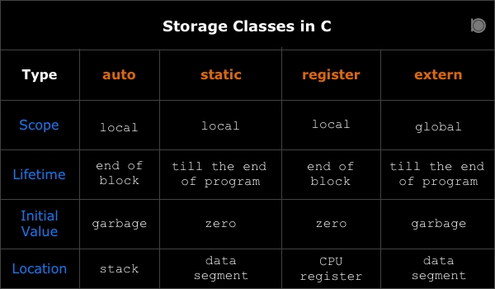
Storage class
Auto -automatic
Static
Extern -external
register

Slide 23
Auto vs static vs extern
//int a ; //global
Void fun()
{
static int a; //vs int a;
a++;
pf(“%d”,a);
}
Void main()
{
Fun();fun();fun();
}

Slide 24
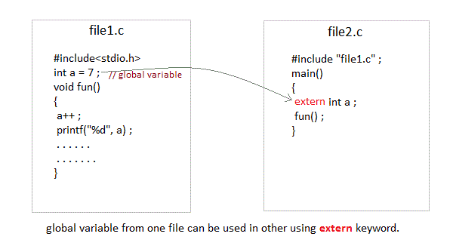
Extern vs static

Slide 25
tasks
Book exercise
Bitwise operators task
Bit set,clear,toggle
Bit set count
Bit set pos check
Bit pos swap
Power of 2
Nibble swap
Bit odd even
Bit reverse
Little endian vs big endian
Number systems

