Slide 1
Control structures

Slide 2
Types
Desion /selection/condition statement-
If, if else ladder,nested if
Looping/iteration/sequence statement-
For,while(entry control),do..while(exit control)
Branch/case/jump/nonconditional statement- goto,break,continue,switch

Slide 3
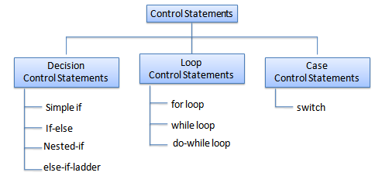
types

Slide 4
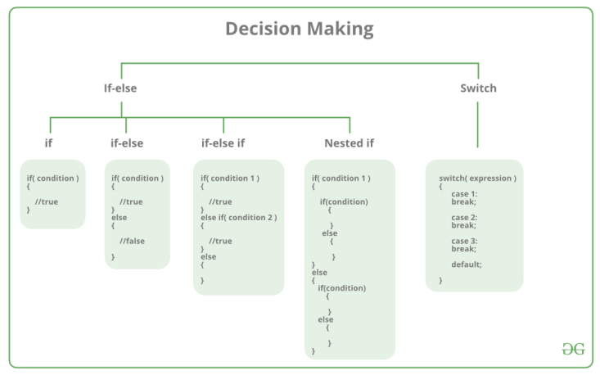
Decision statement

Slide 5
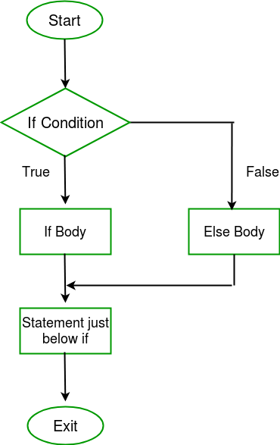
If ..else flow chart

Slide 6
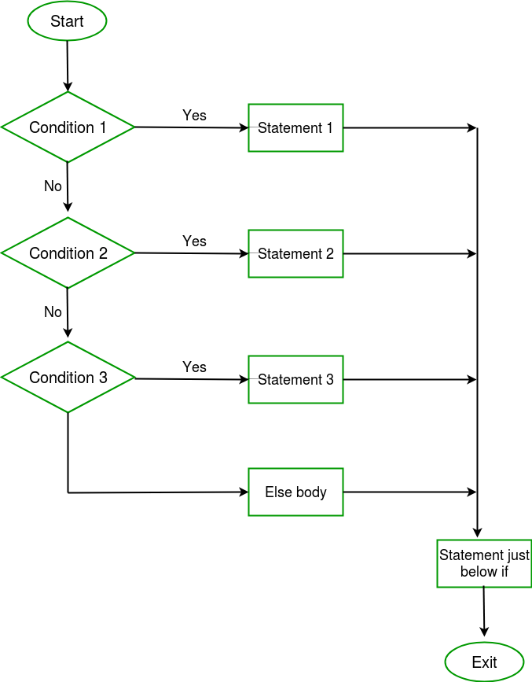
If else ladder

Slide 7
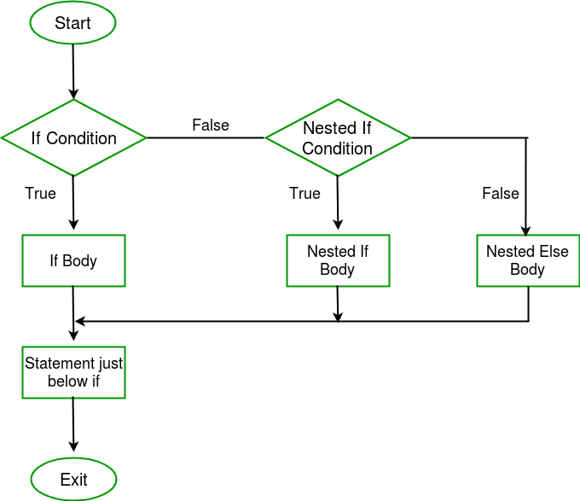
Nested if

Slide 8
If else ladder vs if..if
a=5
if(a==5)
{
pf(5)
a=20
}
else if(a==20) //if here if used 20 will print
{
pf(20)
}
else
{
}

Slide 9
short circuit using logic OR
a=1 b=1 c=1
if(a==b || c++)
{
pf(c not inc due to short ckt);
}
else
{
pf(c inc due to no short ckt);
}

Slide 10
short circuit using logic AND
a=1 b=1 c=1
if(a==b && c++)
{
pf(c inc due to no short ckt);
}
else
{
pf(c not inc due to short ckt);
}

Slide 11
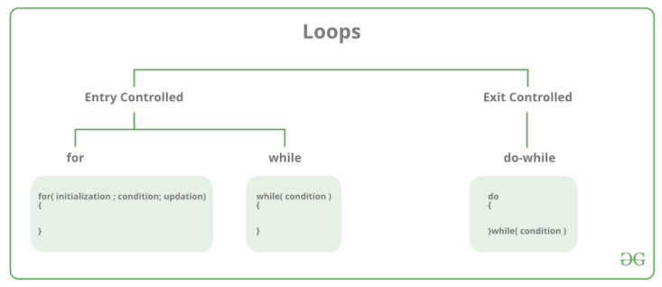
Looping statement

Slide 12
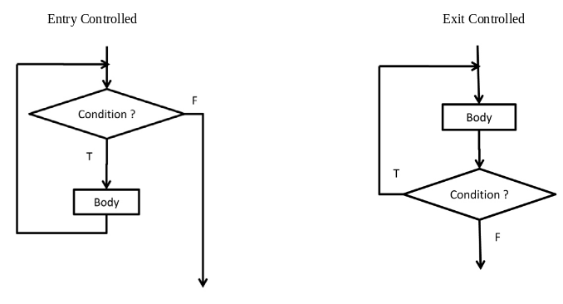
Exit(do.while) and entry(while) control

Slide 13
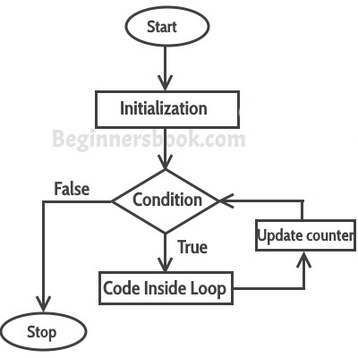
For loop(entry loop)

Slide 14
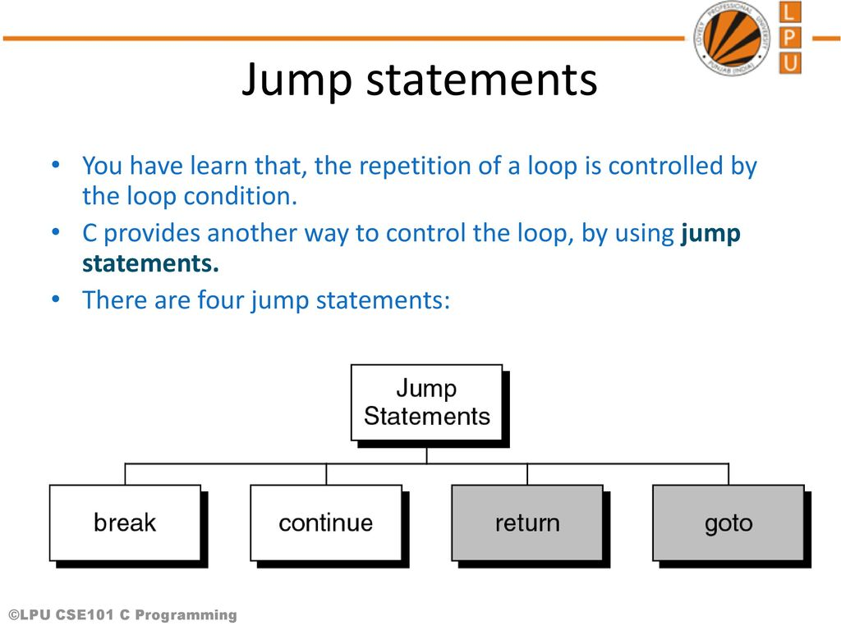
Jumping statements

Slide 15
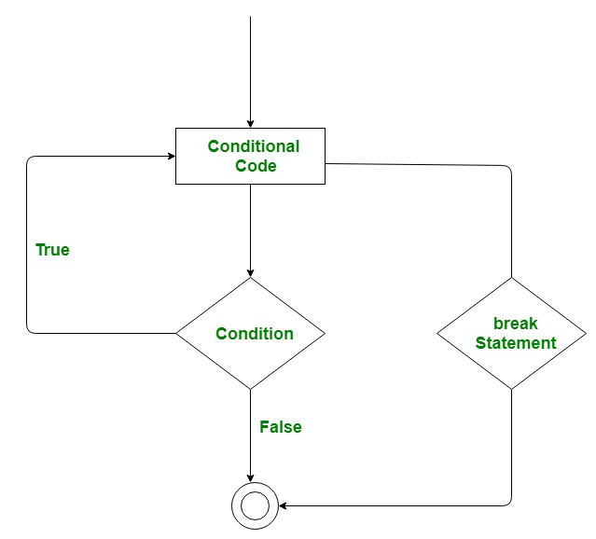
break

Slide 16
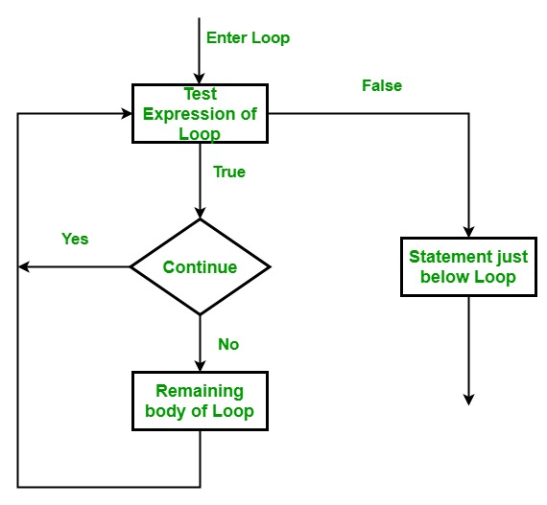
continue

Slide 17
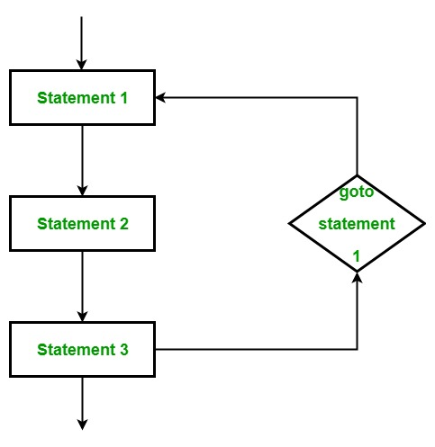
goto

Slide 18
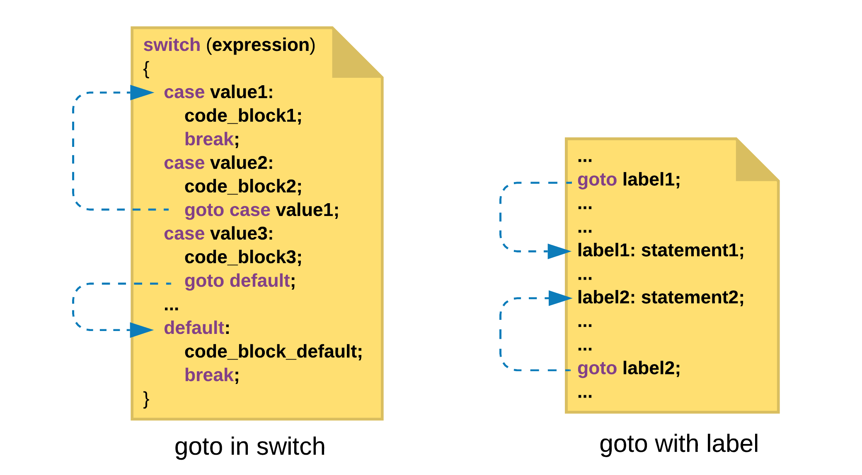
Goto label vs goto switch

Slide 19
tasks
Sum of natural numbers 1 to 100
Fibanaci 0 1 1 2 3 …..
Prime numbers 1 to 100
Arms strong number 1 to 1000
Factorials 3,5,10
Patterns ->number , star
Print multification tables for 1 to 10
Find Largest number
Check palindrom
Find gcd hcf of two number (optional)

