Slide 1
Memory management

Slide 2
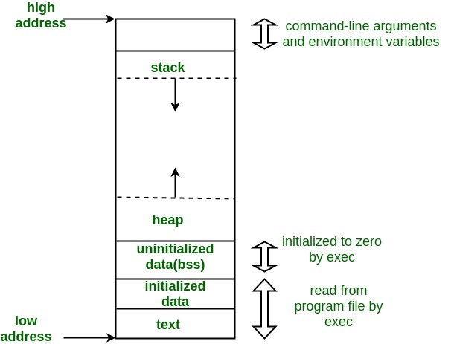
Memory layout

Slide 3
Dynamic memory allocation
To enable use #include<stdlib.h>
It is runtime memory allocation
Memory not static and fixed

Slide 4
Dynamic mem alloc function
Malloc
Calloc
Realloc
free

Slide 5
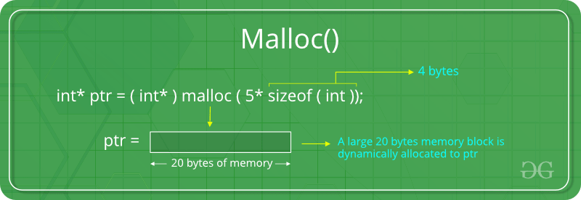
malloc

Slide 6
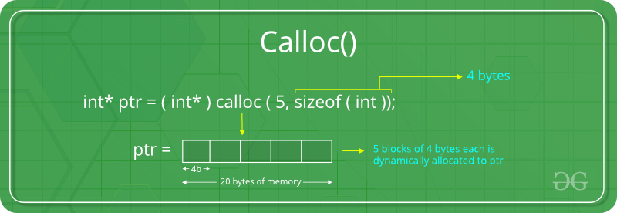
calloc

Slide 7
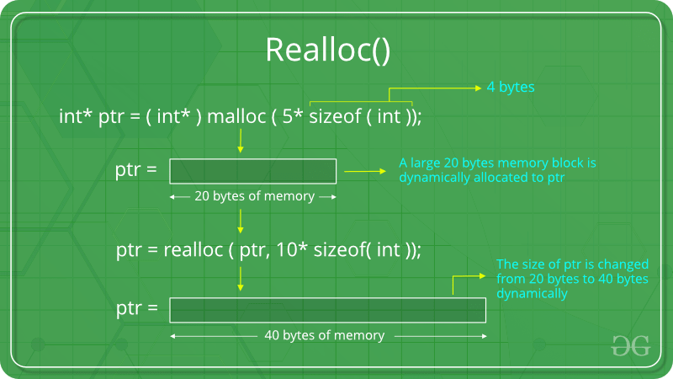
Realloc

Slide 8
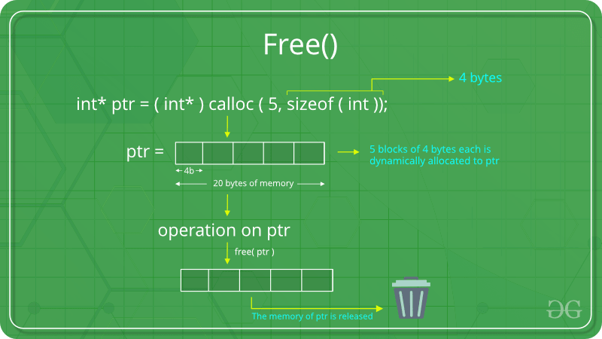
free

Slide 9
Memory leak
char * p =malloc(10);
p=“hello”;
Printf(“%s”,p); //without free mem cause mem leak

